Slide 1
Week 9
miniprep to isolate plasmid DNA

Slide 2
overnight cultures

Slide 3
37º C incubator, shaking 281 rpm

Slide 4
control tubes

Slide 5
lac X1 – X3

Slide 6
ompC X1 – X3

Slide 7
ospA X1 – X3

Slide 8
tet X1 – X3

Slide 9
Synergy plate reader
96-well plates: RFP, GFP, absorbance 600

Slide 10
one of the plates with triplicates (200 µL each)

Slide 11
closeup of some wells

Slide 12
Minipreps

Slide 13
600 µL of culture
X1
X2
X3

Slide 14
100 µL lysis buffer

Slide 15
mix until clear (and blue)

Slide 16
350 µL neutralization buffer

Slide 17
mix until uniformly yellow

Slide 18
centrifuge to pellet cell wall, proteins & lipids

Slide 19
transfer supernatant to spin column

Slide 20
centrifuge: where is plasmid now?
Notes:
Plasmid is bound to positively charged resin in the column.

Slide 21
discard flow-through (from right tube) add 200 µL wash buffer (left tube)

Slide 22
200 µL wash solution 1

Slide 23
centrifuge, discard flow-through

Slide 24
400 µL wash buffer 2 (left) centrifuge through (right)

Slide 25
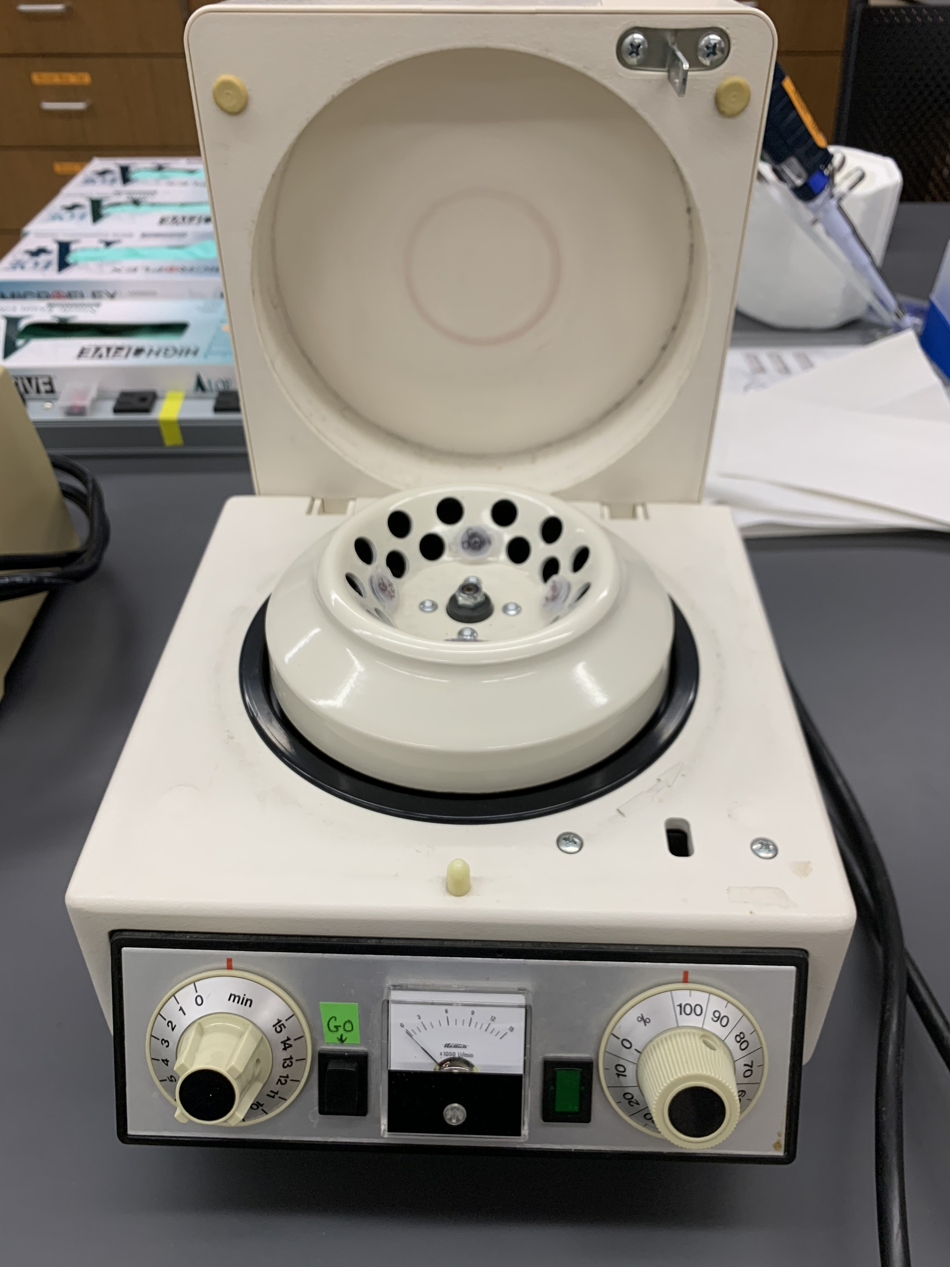
microcentrifuge

Slide 26
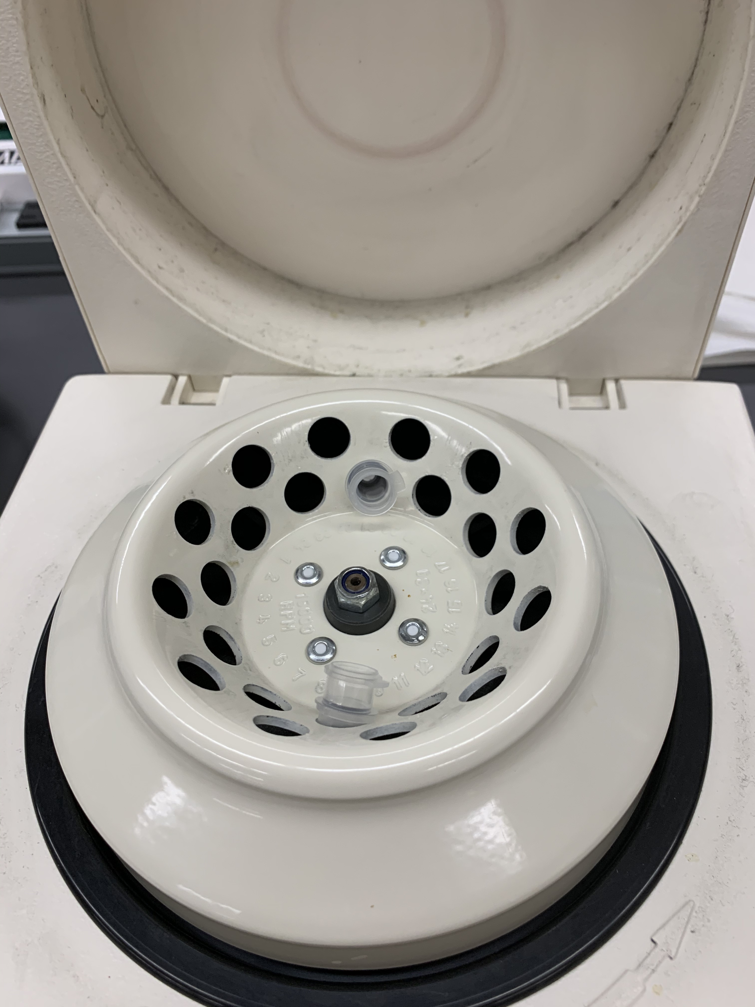
always balance tubes

