Slide 1
Citrate Cycle
Karen Hasty
kahasty@davidson.edu

Slide 2
Citrate Cycle
Series of enzyme catalyzed reactions
Glycolysis - citrate cycle – oxidative phosphorylation
Sugar -> energy

Slide 3
Citrate Cycle

Slide 4
Questions
Which citrate cycle enzymes are present?
Are these genes conserved in all ten species?
If not, which species do not have which enzymes?
Are the genes that are ‘missing’ from our genome actually present?
Based on the above analysis, is the citrate cycle important to our species and related species?

Slide 5
Methods
Which citrate cycle enzymes are present?
KEGG map on the SEED viewer.
JGI KEGG map

Slide 6
RAST KEGG map

Slide 7
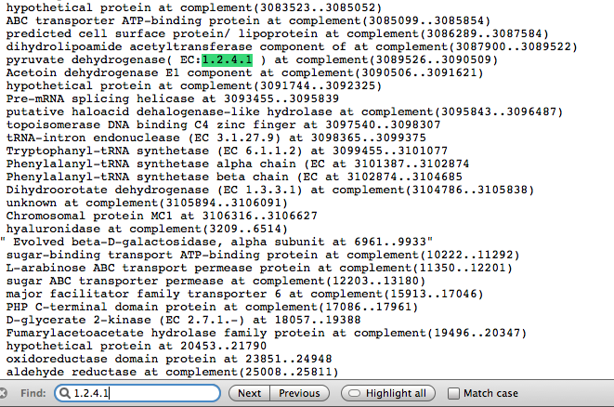
Methods
Are these genes conserved in all ten species?
If not, which species do not have which enzymes?
Find function
with conserved list
Find function with
individual conserved lists

Slide 8
Comparison with other species

Slide 9
Methods
Are the genes that are ‘missing’ from our genome actually present?
NCBI to obtain sequences for missing enzymes
BLASTx of sequence against proteome of mukohataei
Sort results based on e value
TBLASTx sequences of top hits to find any appropriate matches
BLASTn to search for missing proteins

Slide 10
1.1.1.41
RAST
NCBI
Isocitrate dehydrogenase (NAD)
Different, but overlapping locations
NCBI seems to be the only website with EC 1.1.1.41
BLASTn produced no significant results

Slide 11
1.1.1.37
Malate dehydrogenase
Called L-lactate dehydrogenase (EC 1.1.1.27) in RAST
End truncated by ~50bp in RAST
Much confusion with this gene
NCBI??
2 versions in JGI
Which EC is correct?

Slide 12
Citrate Cycle - JGI

Slide 13
1.1.1.37

Slide 14
1.1.1.37

Slide 15
Other 8 missing proteins
No meaningful matches in the proteome
RAST may not have called the protein

Slide 16
1.3.5.1
Nucleotide blast revealed one more missing protein
Succinate dehydrogenase (ubiquinone)
Not called in RAST
Called in JGI with correct EC

Slide 18
Citrate Cycle - JGI

Slide 19
6.4.1.1

Slide 20
Missing genes
Is it possible to do the TCA cycle without these genes?
KEGG:
“According to the genome sequence data, many organisms seem to lack genes for the full cycle, but contain genes for specific segments.”

Slide 21
Conclusions
Based on the above analysis, is the citrate cycle important to our species and related species?
Yes. Highly conserved machinery
Missing proteins may not be necessary
Or just not yet found

