Slide 1
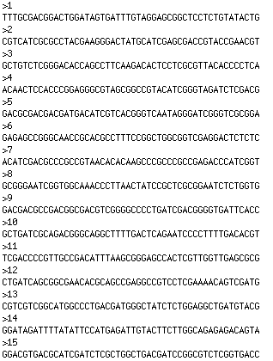
50 bp upstream of JGI/Manatee/Rast genes

Slide 2
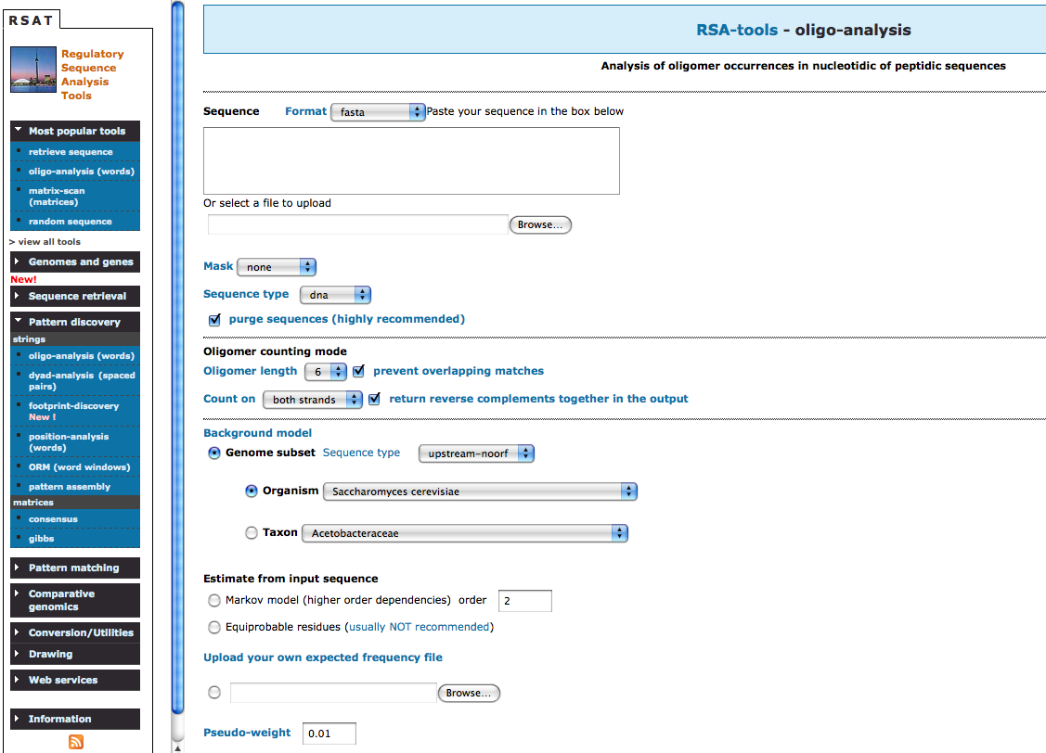
Finding Sequence Pattern
http://rsat.ccb.sickkids.ca/

Slide 3
JGI
Manatee
Rast

Slide 4
T T TGCGACGGACTGGATAGTGATTTGTAGGAGCGGCTCCTCTGTATACTG
GGAGGTG
0 0 01000 => score= 1
T T TGCGACGGACTGGATAGTGATTTGTAGGAGCGGCTCCTCTGTATACTG
GGAGGTG
0 0 00100 => score= 1
T T TGCGACGGACTGGATAGTGATTTGTAGGAGCGGCTCCTCTGTATACTG
GGAGGTG
01 0 1001 => score= 3
T T TGCGACGGACTGGATAGTGATTTGTAGGAGCGGCTCCTCTG T A T A C T G
GG AG G T G
0 0 0 0 011 => score= 2

Slide 5
Minimum score= 6
JGI 25 bp upstream: 270
Manatee 25 bp upstream: 284
Rast 25 bp upstream: 238
Mean distance from the gene
JGI : 7.1
Manatee:7.44
Rast:7.34

Slide 6
http://weblogo.berkeley.edu/logo.cgi

