Slide 1
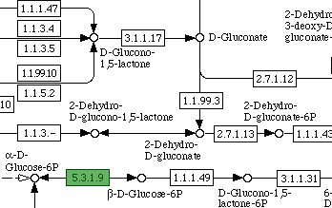
The Case of the Missing Enzymes

Slide 2
The Pentose Phosphate Pathway
Primary Functions:
To generate NADPH for use in reductive biosynthetic reactions
To produce ribose-5-phosphate (R5P) for nucleotide and nucleic acids synthesis
Can metabolize dietary pentose sugars resulting from nucleic acid digestion
Can rearrange dietary carbohydrates into glycolytic/gluconeogenic intermediates.
Two Stages:
Oxidative formation of NADPH
Non-oxidative synthesis of 5-carbon sugars
(http://themedicalbiochemistrypage.org/pentose-phosphate-pathway.html)

Slide 3
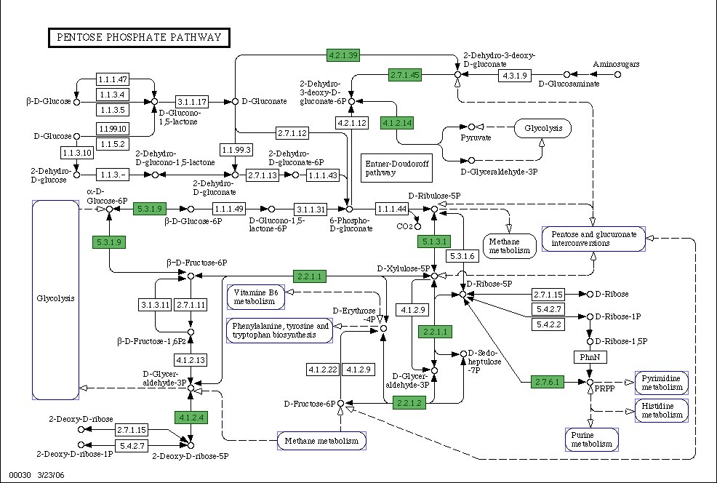
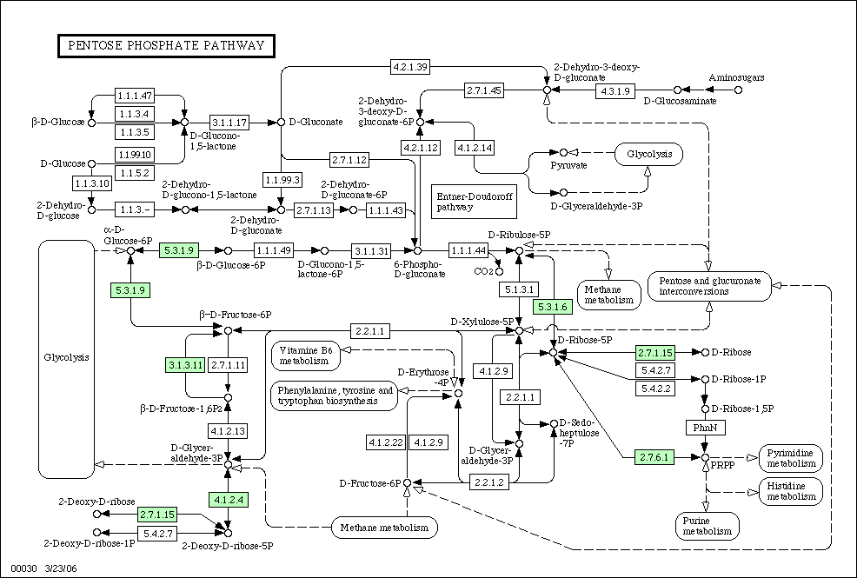
The Pathway

Slide 4
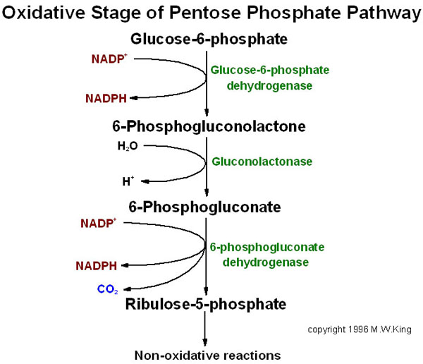
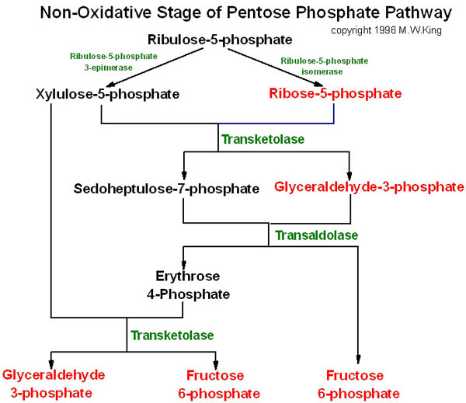
The Pathway
Glucose-6-phosphate dehydrogenase
phosphogluconate dehydrogenase
6-phosphogluconolactonase
ribose-5-phosphate isomerase
(http://themedicalbiochemistrypage.org/pentose-phosphate-pathway.html)

Slide 5
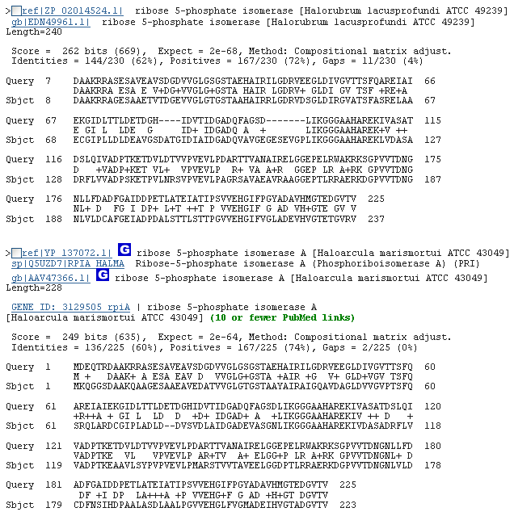
5.3.1.6 (ribose 5-phosphate isomerase)

Slide 6
The Other Enzymes
1.1.1.49 (glucose 6-phosphate dehydrogenase), 3.1.1.31 (6-phosphogluconolactonase), 1.1.1.44 (phosphogluconate dehydrogenase)
EC number search and text-based search returned nothing
Halobacterium salinarium does not contain these enzymes

Slide 7
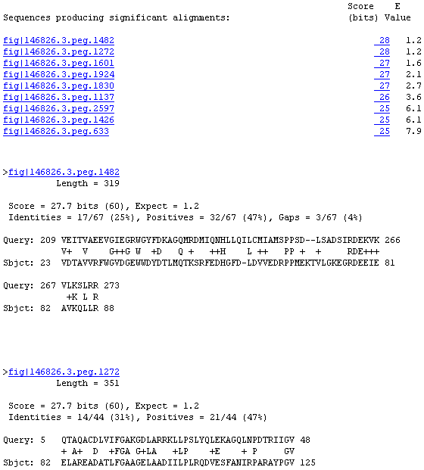
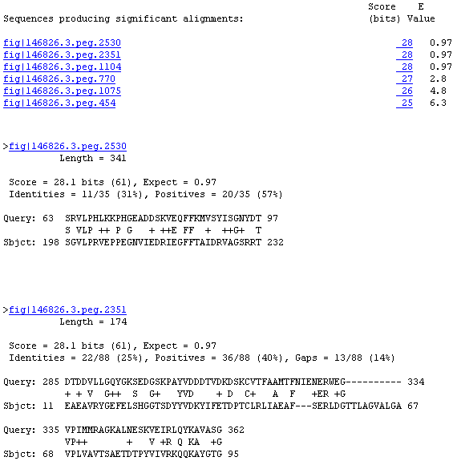
1.1.1.49
Glucose-6-phosphate 1-dehydrogenase from Escherichia coli (strain K12)
Glucose-6-phosphate 1-dehydrogenase from Saccharomyces cerevisiae (yeast)

Slide 8
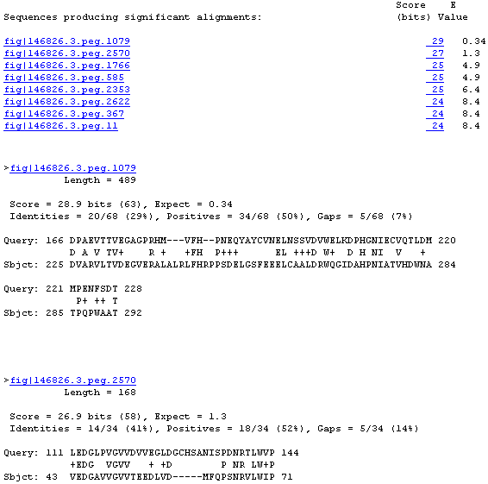
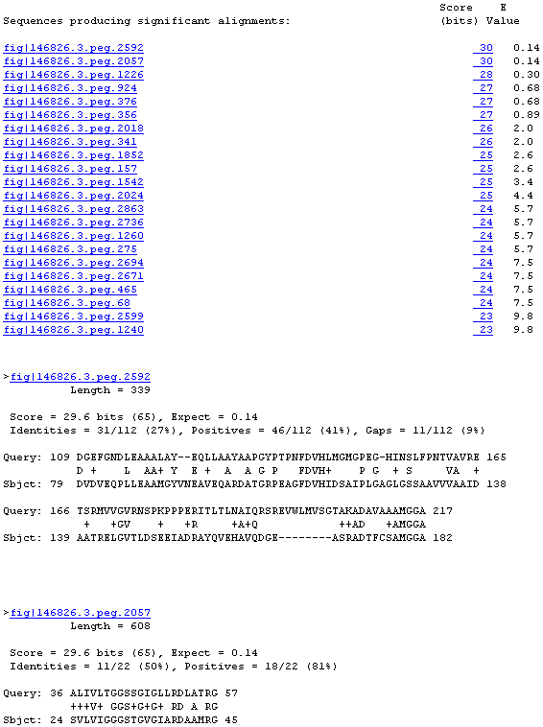
3.1.1.31
6-phosphogluconolactonase from Escherichia coli O1:K1 / APEC
6-phosphogluconolactonase from Mycobacterium leprae

Slide 9
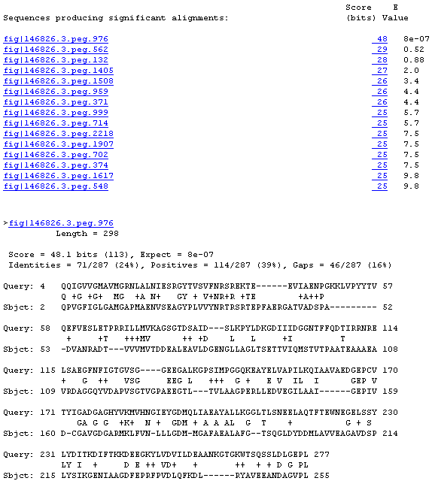
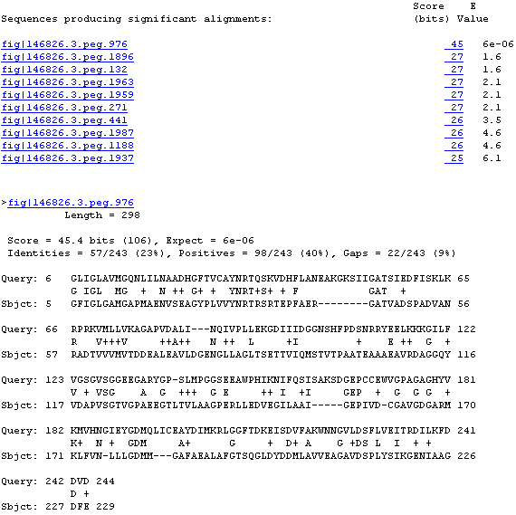
1.1.1.44
6-phosphogluconate dehydrogenase, decarboxylating from Escherichia coli
6-phosphogluconate dehydrogenase, decarboxylating Saccharomyces cerevisiae (yeast)

Slide 10
Literature
“the oxidative PP pathway seems not to exist, because enzyme genes for this pathway are absent in archaeal genomes.”
“However, haloarchaea show glucose 6-phosphate dehydrogenase activity (EC 1.1.1.49) in spite of lacking the respective enzyme gene (Aitken and Brown 1969)”
“encode orthologs of 6-phosphogluconate dehydrogenase (EC 1.1.1.44)”
“an operative, albeit modified oxidative PP pathway is indicated for haloarchaea” (Falb et al. 2008).

Slide 11
Literature
Entner-Doudoroff pathway in aerobic archae
“modified versions of the ED [Entner-Doudoroff] pathway that is generally referred to as the semi-phosphorylative ED pathway”
“has been shown to operate in… the halophilic archaea Halobacterium saccharovorum and Halobacterium halobium (Ahmed et al. 2005)

Slide 12
Conclusions
Pathway missing at least 2 enzymes (1.1.1.49 and 3.1.1.31)
Organism has ribose 5-phosphate isomerase (5.3.1.6 ) and probably also 6-phosphogluconate dehydrogenase (1.1.1.44)
Alternative pathways?
Variation of Entner-Doudoroff pathway

Slide 13
References
Falb M, Müller K, Königsmaier L, Oberwinkler T, Horn P, von Gronau S, Gonzalez O, Pfeiffer F, Bornberg-Bauer F, & Oesterhelt D. “Metabolism of halophilic archaea.” Extremophiles. 2008 March; 12(2): 177–196.
Ahmed H, Ettema TJG, Tjaden B, Geerling ACM, van der Oost J, & Siebers B. “The semi-phosphorylative Entner–Doudoroff pathway in hyperthermophilic archaea: a re-evaluation.” Biochemistry. 2005 September 1; 390(Pt 2): 529–540.
Need to investigate:
Aitken DM & Brown AD. “Citrate and glyoxylate cycles in the halophil, Halobacterium salinarium.” Biochim Biophys Acta 1969; 177:351-4.

