Slide 1
Detection of DNA mut-iGEM-s through the use of a 2-color fluorescent system
GCAT
GCAT
An inter-consortium collaboration
Hampden-Sydney College
Longwood University
University of Mary Washington

Slide 2
VirGEMia Is For Lovers

Slide 3
Collaboration
Geographically nearby
Pool our resources
Shoestring budgets
Overwhelmed during the academic year
Duplication of results for independent validation
Fertile ground for new questions and student projects
Help each other learn synthetic biology
Achieve our academic goals

Slide 4
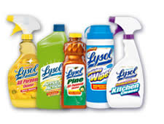
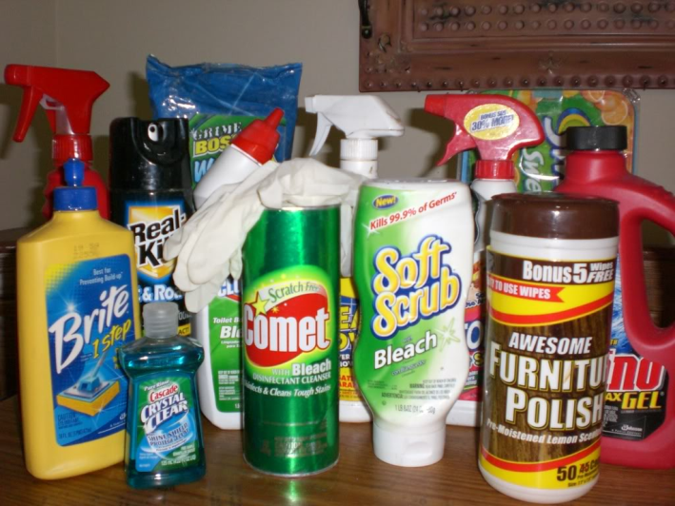
A wide array of common compounds can cause DNA mutation
Household cleaners
Furniture polish

Slide 5
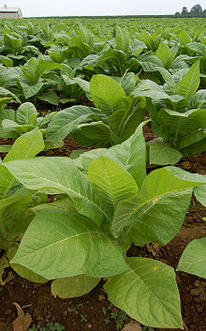
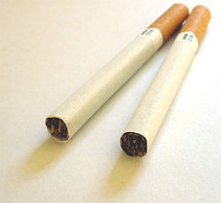
A wide array of common compounds can cause DNA mutation
Formaldehyde-based compounds
Preservative, an embalming agent, and a disinfectant

Slide 6
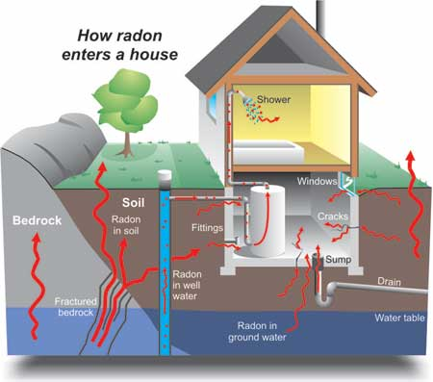
A wide array of common compounds can cause DNA mutation
Radioactive compounds (radon)

Slide 7
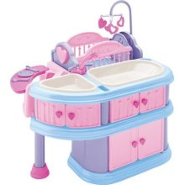
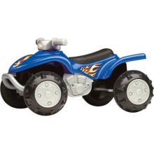
A wide array of common compounds can cause DNA mutation
Phthalates or “plasticizers”
A group of industrial chemicals used to make plastics like polyvinyl chloride (PVC) more flexible or resilient and also as solvents
Phthalates are found
Toys

Slide 8
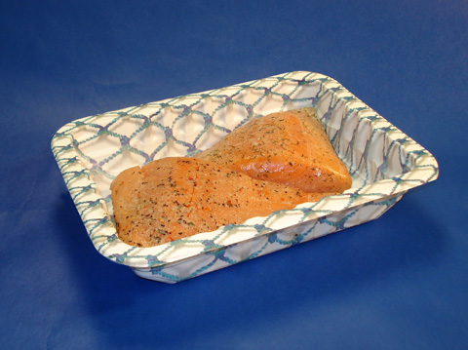
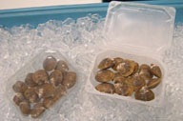
A wide array of common compounds can cause DNA mutation
Phthalates or “plasticizers”
A group of industrial chemicals used to make plastics like polyvinyl chloride (PVC) more flexible or resilient and also as solvents
Phthalates are found
Food packaging

Slide 9
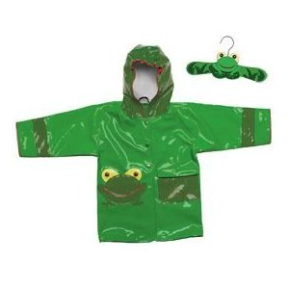
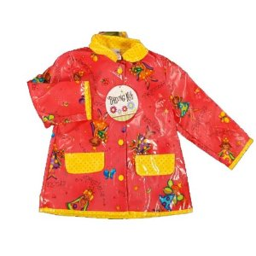
A wide array of common compounds can cause DNA mutation
Phthalates or “plasticizers”
A group of industrial chemicals used to make plastics like polyvinyl chloride (PVC) more flexible or resilient and also as solvents
Phthalates are found
Raincoats

Slide 10
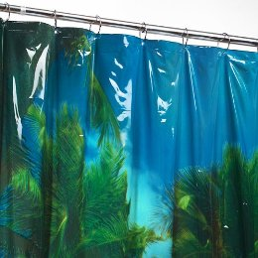
A wide array of common compounds can cause DNA mutation
Phthalates or “plasticizers”
A group of industrial chemicals used to make plastics like polyvinyl chloride (PVC) more flexible or resilient and also as solvents
Phthalates are found
Shower curtains

Slide 11
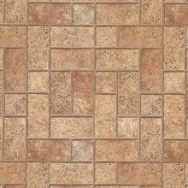
A wide array of common compounds can cause DNA mutation
Phthalates or “plasticizers”
A group of industrial chemicals used to make plastics like polyvinyl chloride (PVC) more flexible or resilient and also as solvents
Phthalates are found
Vinyl flooring

Slide 12
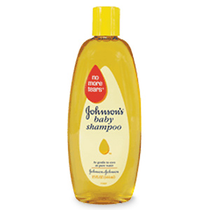
A wide array of common compounds can cause DNA mutation
Phthalates or “plasticizers”
A group of industrial chemicals used to make plastics like polyvinyl chloride (PVC) more flexible or resilient and also as solvents
Phthalates are found
Shampoo

Slide 13
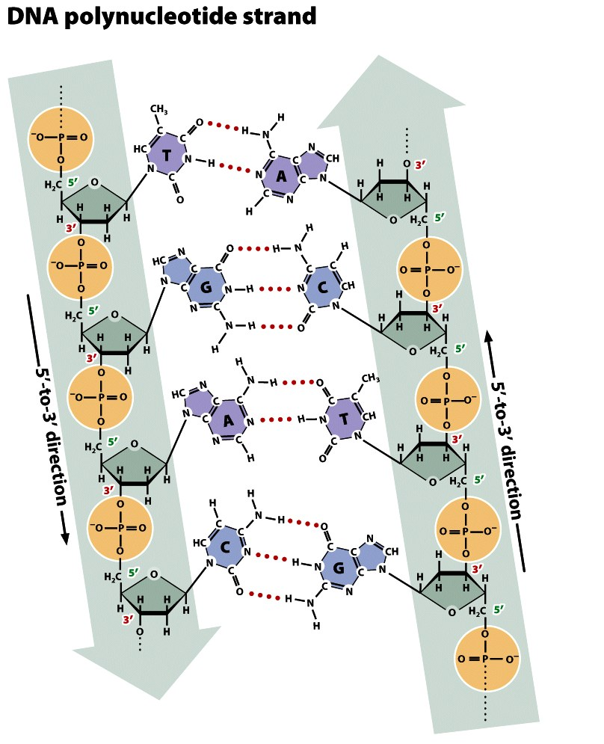
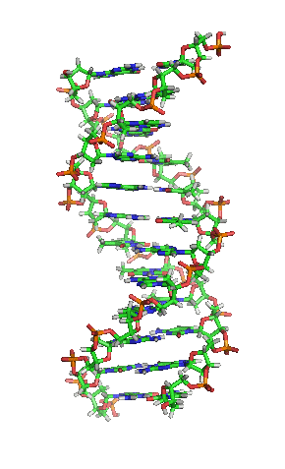
Fig. 10.13

Slide 14
Mutagenic compounds cause changes in the DNA via:
Base analog substitutions
Intercalation
High energy -> chemical bond change
Ionization
Deamination
Bromation
Alkylation

Slide 15
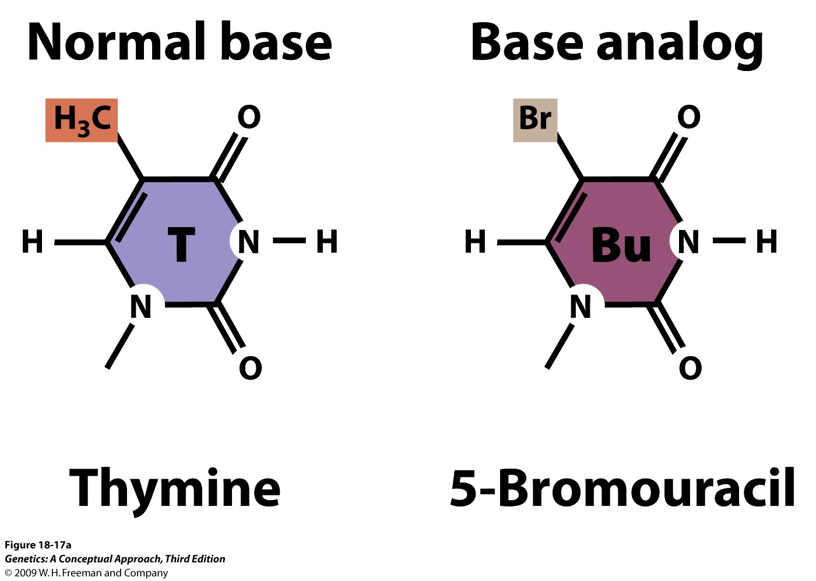
Base analog
ex. 5BU can mispair with Guanine, leading to mutation
Fig. 18.17
Notes:
5-BU sometimes used in chemotherapy
Figure 18.17b 5-Bromouracil (a base analog) resembles thymine, except that it has a bromine atom in place of a methyl group on the 5-carbon atom. Because of the similarity in their structures, 5-bromouracil may be incorporated into DNA in place of thymine. Like thymine, 5-bromouracil normally pairs with adenine but, when ionized, it may pair with guanine through wobble.

Slide 16
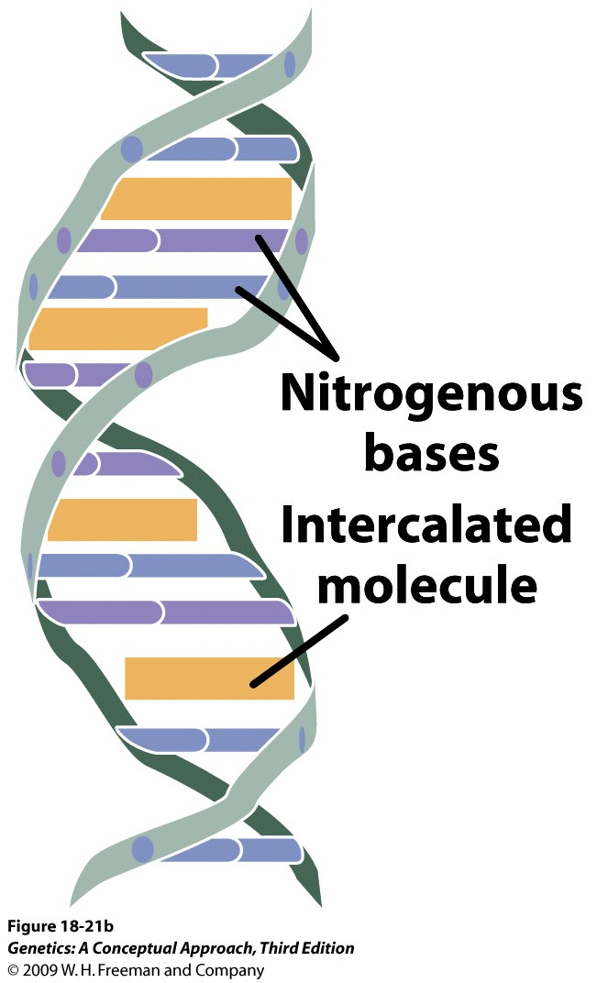
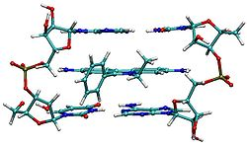
Intercalating agent
Distort DNA leading to insertions and deletions
Notes:
point out rippling
stick - wikipedia
Figure 18.21b Intercalating agents such as proflavin and acridine orange insert themselves between adjacent bases in DNA, distorting the three-dimensional structure of the helix and causing single-nucleotide insertions and deletions in replication.

Slide 17
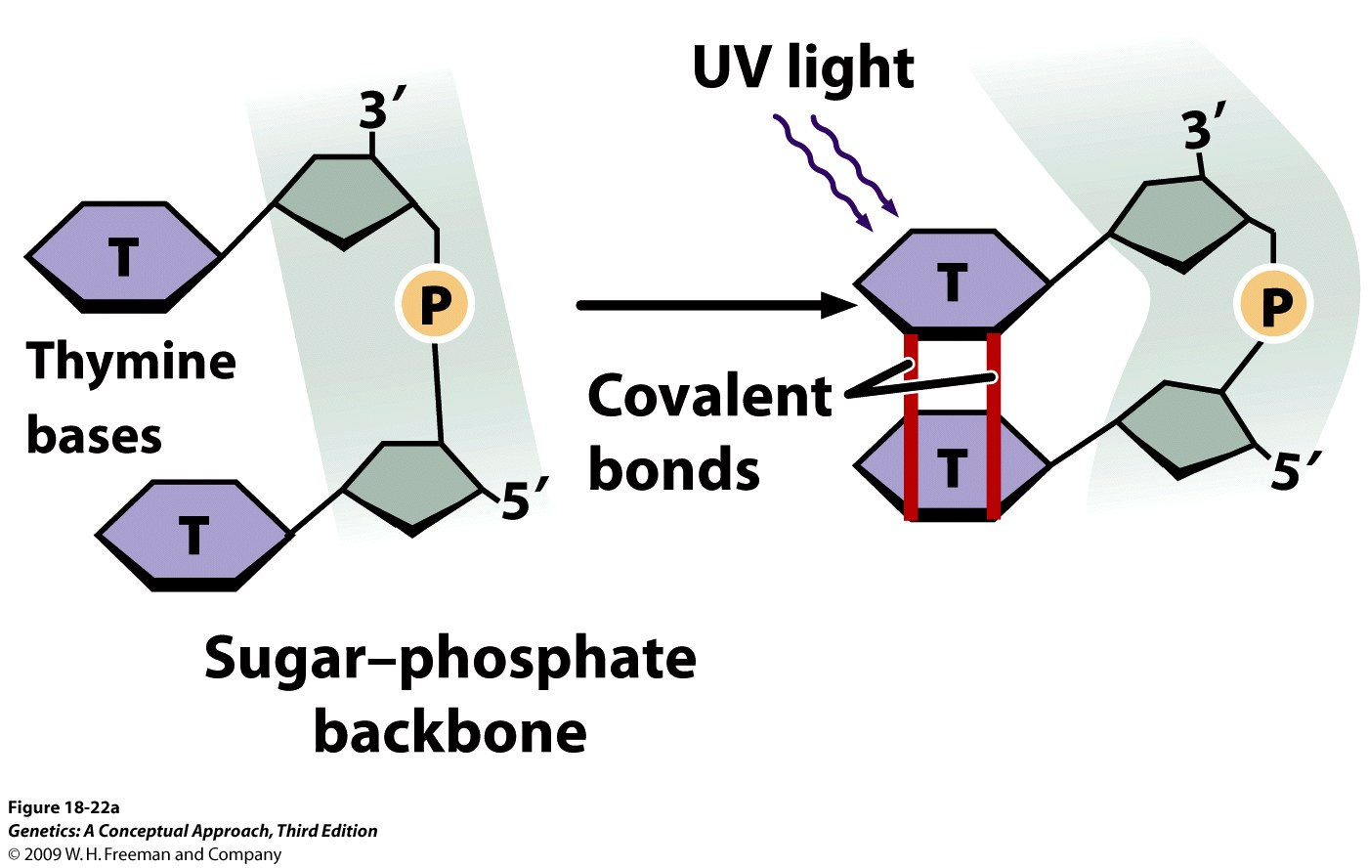
Ultraviolet light
Usually effects base(s) on one strand
Causes pyrimidine dimer: two thymine bases fused, blocking replication.
Fig. 18.22

Slide 18
Three projects
1.) Detection of the presence of dangerous levels of mutagen using E. coli
2.) Does mutation at one locus influence the chance of a mutation at another locus in the same molecule? (E. coli)
3.) Exploration of DNA mutation rate throughout the S. cerevisae genome (yeast)
WT
MUT
WT
MUT

Slide 19
1.) Detection of the presence of dangerous levels of mutagen using E. coli
Mutagen detection based on color change
Constitutively-expressed RFP and GFP stable state is “yellow”.
RBS
Reporter
T
T
Reporter
RBS
T
T
Detectable Yellow
Phenotype
Promoter
Promoter

Slide 20
Mutagens introduce random mutations and may cause RFP and GFP to not function (turn off).
Low levels of mutation may randomly impact one fluorescent gene or the other.
Color could change to red or green
= mutation loci
OR/AND
OR/AND
RBS
Reporter
T
T
Reporter
Detectable Green
Phenotype
RBS
T
T
Promoter
Promoter
OR/AND
OR/AND
RBS
Reporter
T
T
Reporter
RBS
T
T
Detectable Red
Phenotype
Promoter
Promoter

Slide 21
Higher levels of mutation may increase the chance of both fluorescent genes being mutated.
Color would dim or disappear.
OR/AND
OR/AND
OR/AND
OR/AND
RBS
Reporter
T
T
Reporter
RBS
T
T
Detectable Noncolor
Phenotype
Promoter
Promoter

Slide 22
RBS
Reporter
T
T
Reporter
RBS
T
T
Detectable Yellow
Phenotype
Promoter
Promoter
= mutation loci
OR/AND
OR/AND
RBS
Reporter
T
T
Reporter
Detectable Green
Phenotype
RBS
T
T
Promoter
Promoter
OR/AND
OR/AND
RBS
Reporter
T
T
Reporter
RBS
T
T
Detectable Red
Phenotype
Promoter
Promoter
OR/AND
OR/AND
OR/AND
OR/AND
RBS
Reporter
T
T
Reporter
RBS
T
T
Detectable Noncolor
Phenotype
Promoter
Promoter

Slide 23
Logical extension of mutagen detection experiments
Original exp’t: 1 plasmid copy/cell
-limited number of color possibilities.
-mathematical analysis of results.
Scaled-up exp’t: multicopy plasmid (variable plasmid copies/cell)
-infinite number of color possibilities.
-opportunity to explore via construction of mathematical models.

Slide 24
2.) Does mutation at one locus influence the chance of a mutation at another locus in the same molecule? (E. coli)
RBS
Reporter
T
T
Reporter
RBS
T
T
Detectable Yellow
Phenotype
Promoter
Promoter
= mutation loci

Slide 25
RBS
Reporter
T
T
Reporter
RBS
T
T
Detectable Yellow
Phenotype
Promoter
Promoter
300 bp
100 bp
1000 bp
3000 bp

Slide 26
Original Part
Derived Part
Notes:
The chance of a mutation at one location can be determined.
If a mutation occurs at one location, does it affect the chance of a mutation occurring at another location in the same piece of DNA?

Slide 27
Original Part 30 bp
Derived Part 300 bp
Derived Part 3000 bp
Notes:
-Example: a DNA intercalator could kink the DNA and transmit force that leads to additional mutations nearby.
100 bp vs. 300 bp vs. 1000 bp vs 3000 bp apart.

Slide 28
Mathematical Probability
30 bp
300 bp
3000 bp
Biological Reality
?
?

Slide 29
If 30 bp
300 bp
3000 bp
Why?
Hypotheses:
If distant condition observed to mutate more often:
Location of one mutation attracts DNA damage machinery, decreasing the likelihood of a nearby mutation.
If close condition observed to mutate more often:
DNA damage alters the DNA fine structure, opening a nearby site to a mutatgen. (possible to model/simulate)
?
?

Slide 30
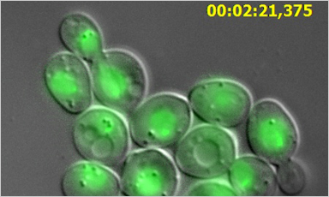
3.) Exploration of DNA mutation rate throughout the S. cerevisae genome (yeast)
-Yeast provides an outstanding simple
eukaryotic model system with significant
homology to mammals.
-The principles used in E. coli for this
mutagen analysis may be easily applied to a
yeast model.
-In a eukaryotic genome, does mutation at one locus influence the chance of a mutation at
another locus?
-same vs. different chromosomes.
-telomere vs. centromere vs. other chromosomal locales.
-Are there readily-detectable mutation “hotspots” that may be uncovered by a random
mutagenic analysis of the yeast genome?
http://www.zeiss.com/C12567BE00472A5C/GraphikTitelIntern/Yeast-TimelapsePopUp/$File/Yeast-TimelapsePopUp.jpg

Slide 31
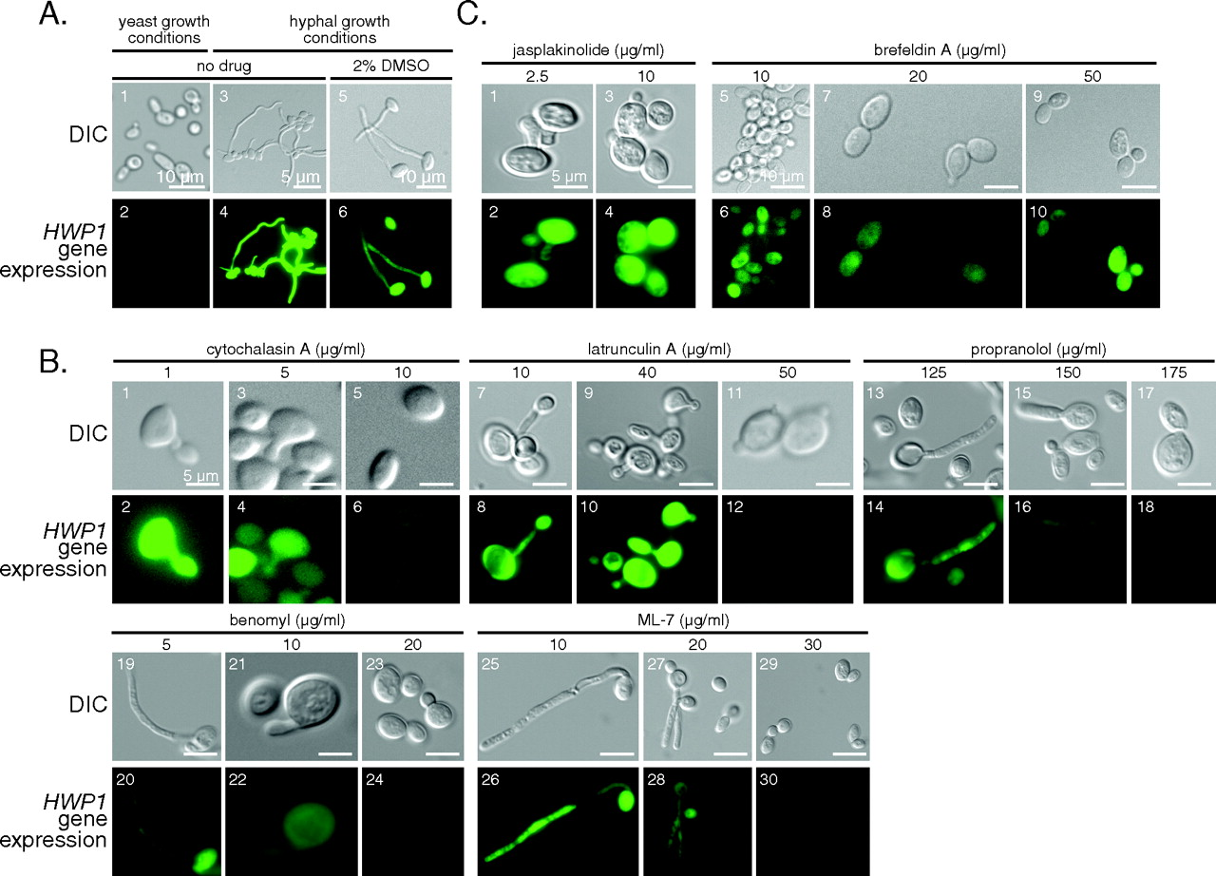
Use of GFP as a marker of promoter function in the
fungus Candida albicans
GFP expression
regulated by
the promoter of
the HWP1 gene
http://ec.asm.org/content/vol6/issue10/images/large/zek0100729830001.jpeg

Slide 32
BioBricks necessary for yeast project
-Bacterial GFP, RFP sequences useable in yeast
-One fluorescent BioBrick (GFP) is integrated into the genome.
GAL promoter
GFP
BBa_J63006-
constitutive when
cells grown on
galactose

Slide 33
BioBricks necessary for yeast project
-to be built: a second fluorescent BioBrick (RFP) that is flanked by the Tn7 transposable element.
-A yeast genomic library in E. coli is randomly disrupted with
the transposable element.
Tn7
GAL promoter
RFP
URA3
Tn7
Yeast genome section
+
=
-yeast genome sections integrated into yeast genome by homologous recombination.
-mutagen exposure, fluorescence evaluation performed as before.
-cells can be counted, characterized by fluorescence microscopy.

Slide 34
Mathematical Modeling
Translation
Steps
- Observe
- Construct
- Test
- Revise

Slide 35
How to Construct Models?
Known Models
Interpolation
Principles

Slide 36
And all our mut-iGEM-s keep spreading information to VA and other states ☺

Slide 37
Short-Term Workshop Goals
Everyone will learn as much as possible. We will all have fun, and the participants will begin a new phase in their teacher-scholar career.
Participants will learn some vocabulary and a new perspective that makes synthetic biology distinct from genetics and molecular biology.
Interdisciplinary teams will explore an area of common interest and investigate feasible projects for undergraduate research and possible course development.
Participants will develop a strategy to recruit and support undergraduates for research in synthetic biology.
Faculty from different departments will collaborate to find common ground, mutual understandings from different perspectives, and a shared vision of how to start a new research adventure.

Slide 38
Long-Term Workshop Goals
Participants will apply what they learn to develop an undergraduate research program in synthetic biology.
Participants will assemble multidisciplinary teams consisting of at least two faculty and two or more students from at least two different majors.
Faculty from outside biology will utilize the methods they learned to help design, construct, and test DNA-based devices as part of a synthetic biology research project.
Biology faculty will learn the language and tools of the trade from their partner’s discipline to a level of proficiency that they can help design, construct, and test a model of the device as part of a synthetic biology research project.

Slide 39
origin
E
X
Original Part
Part A
S
Part B
P
X
S
P

