Slide 1
Cation Efflux System Protein
(My Favorite Gene)

Slide 2
Original Annotations
 | JGI | RAST | Manatee
Length | 303 amino acids | 315 amino acids | 315 amino acids
Description | cation diffusion facilitator family transporter | Cobalt/zinc/cadmium resistance protein | cation efflux system protein

Slide 3
JGI

Slide 4
RAST

Slide 5
Manatee

Slide 6
My Prediction and Evidence
Ran each sequence through BLASTp
BLAST calls | JGI | RAST | Manatee
# of “cation efflux system” | 67 | 66 | 66
# of “Co/Zn/Cd resistance” | 5 | 4 | 4
Best Hits | cation efflux sys | cation efflux sys | cation efflux sys
Evidence → Cation efflux system protein

Slide 7
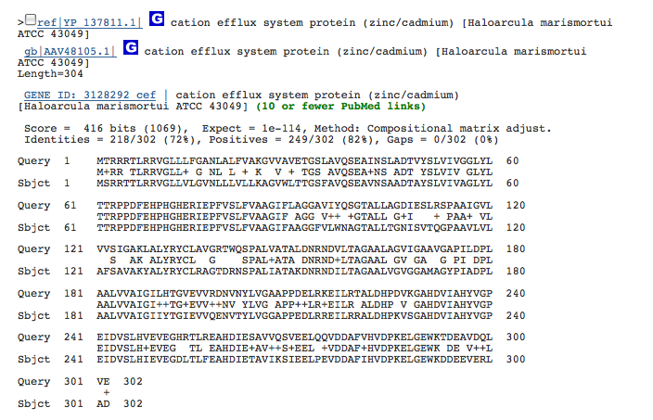
Conclusion: cation efflux system protein

