Slide 1
Gel Electrophoresis Data from v1 PCR
tet X1
tet X2
tet X3
neg. control
2% agarose gel
Midori green DNA dye
ospA X1
ospA X2
ospA X3
neg. control

Slide 2
Gel Electrophoresis Data from v1 PCR
neg. control
ompC X1
ompC X2
2% agarose gel
Midori green DNA dye
ompC X3
neg. control
lac X1
lac X2
lac X3

Slide 3
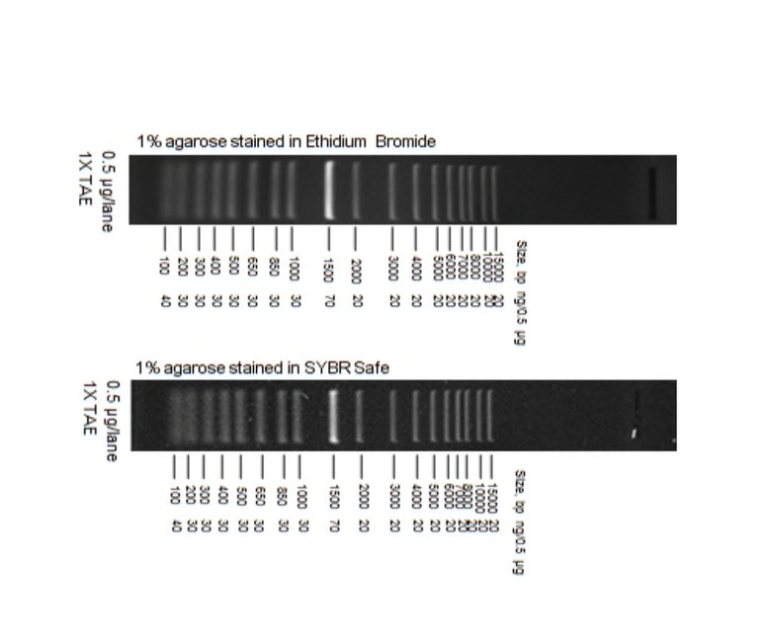
wells

