Slide 1
Integrating Concepts in Biology
Chapter 10: Evolution of Ecological Systems
Section 10.1: How have species evolved as a consequence of their interactions with other species?
by
A. Malcolm Campbell, Laurie J. Heyer, and Chris Paradise

Slide 2
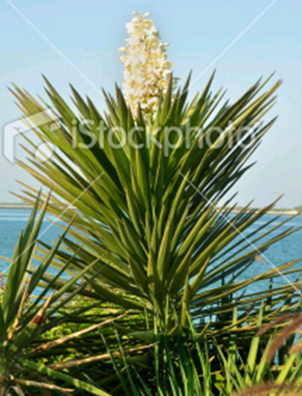
Yucca plant, Yucca filamentosa
Note large central stalk containing the flowers
Figure 10.1
Notes:
Figure 10.1 Yucca plant, Yucca filamentosa. Note the large central stalk containing the flowers.
Talking Points: .

Slide 3
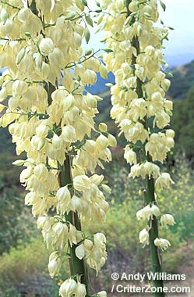
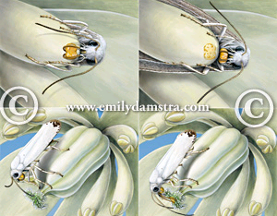
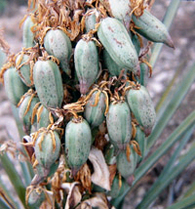
3. Moth collects pollen
4. Moth grasps pollen; prepares to fly to another Yucca flower
2. Moth uses pollen from 1st flower to pollinate where she laid eggs
1. Moth deposits eggs into ovary of another flower
Yucca moth gathering pollen and pollinating Yucca flower
http://www.statesymbolsusa.org/New_Mexico/flower_yucca.html
http://www.emilydamstra.com/portfolio2.php?illid=930
Notes:
Figure is not in text, but shows cycle of pollen collection and egg deposition. There is a description in text that goes along with this figure.

Slide 4
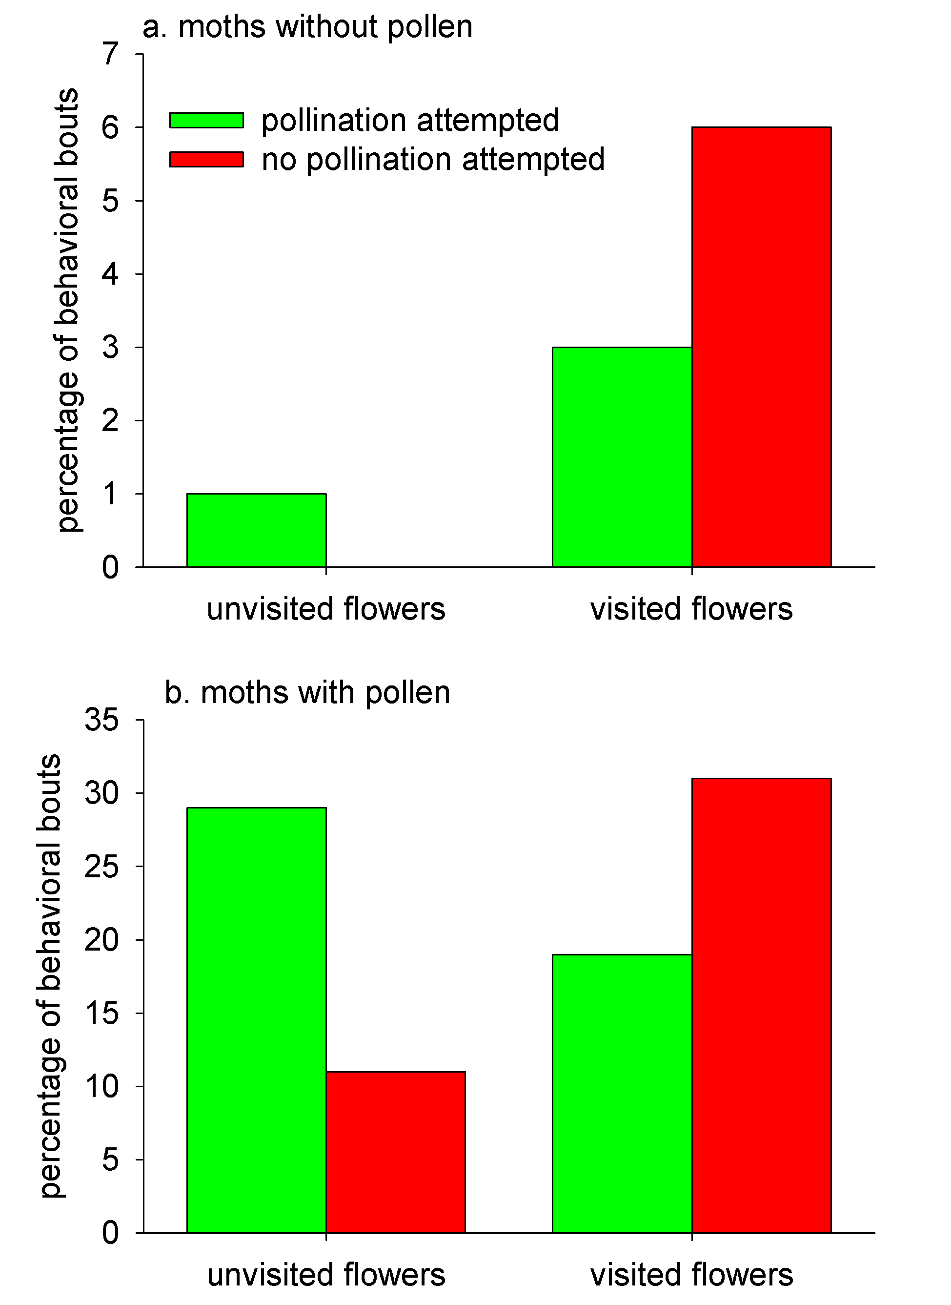
Observed proportion of flower visits for yucca moths
grouped by:
whether pollination was attempted
whether moths possessed pollen
whether flowers had been visited previously
Figure 10.2
Notes:
Figure 10.2 The observed proportion of flower visits for two varieties of yucca moth grouped by whether pollination was attempted, whether moths possessed pollen, and whether flowers had been visited previously.
Talking Points: .

Slide 5
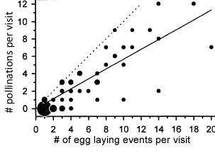
# of pollination events vs. # of egg laying events in one flower visit
Figure 10.3
Notes:
Figure 10.3 The number of pollination events vs. the number of egg laying events in one flower visit. The size of each point is proportional to the number of visits with a given number of pollination and egg laying events. The dotted line has a slope of 1.0, where the number of pollinations equals the number of ovipositions. The solid line is the best fit line for the data.
Talking Points: .

Slide 6
# of pollination events vs. # of egg laying events in one flower visit
Slope of 1.0
Best fit line for the data
Figure 10.3
Notes:
Figure 10.3 The number of pollination events vs. the number of egg laying events in one flower visit. The size of each point is proportional to the number of visits with a given number of pollination and egg laying events. The dotted line has a slope of 1.0, where the number of pollinations equals the number of ovipositions. The solid line is the best fit line for the data.
Talking Points: .

Slide 7
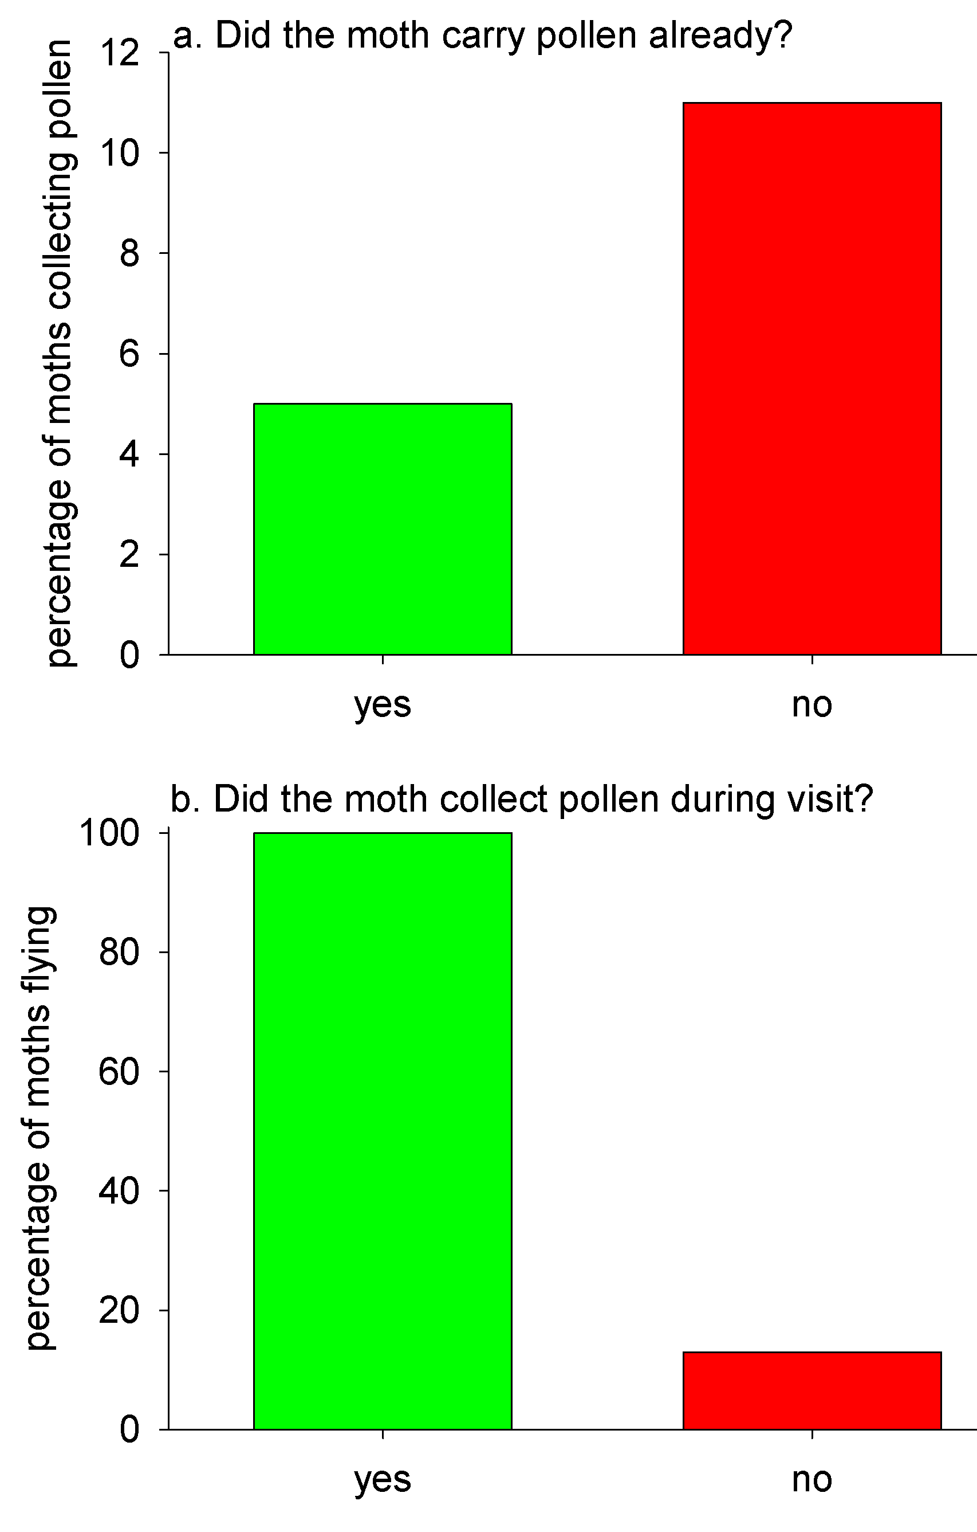
Female yucca moth pollen-collecting and leaving behaviors
Proportion that collected pollen dependent upon whether they already had pollen
Proportion that flew from a flower depended upon whether they collected pollen
Figure 10.4
Notes:
Figure 10.4 Female yucca moth behaviors. a. Proportion of moths that collected pollen dependent upon whether they already had pollen. b. Proportion of moths that flew from a flower as a function of whether they collected pollen. Green bars represent moths that had pollen and red bars represent moths that did not have pollen.
Talking Points: .

Slide 8
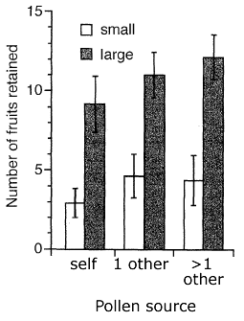
Fruits retained in yucca plants as a function of pollen load and pollen source
Pollen sources:
individual self
1 other yucca
>1 other yucca
Figure 10.5
Notes:
Figure 10.5 Average number of fruits retained in each plant in yucca plants as a function of pollen load and pollen source. White bars = small pollen load and shaded bars = large pollen load. Pollen sources are the individual self, one other yucca, and > one other yucca. Error bars = 1 standard error.
Talking Points: .

Slide 9
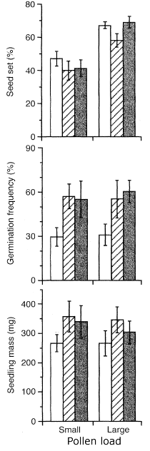
Yucca plant responses as a function of pollen quantity and source
Large pollen loads increase seed set
Pollen from self reduces germination
and seedling mass, when pollen load is low
Figure 10.6
Notes:
Figure 10.6 Average measures of yucca plant response as a function of pollen quantity and source. White bars represent pollen from self, striped bars represent pollen from a single other plant, and shaded bars represent pollen from multiple other plants. Error bars are 1 standard error. a. Percent seed set is the percentage of fertile seeds out of total number of seeds. b. Percentage of germinating seeds out of total selected for planting. c. Biomass of seedlings.
Talking Points: .

Slide 10
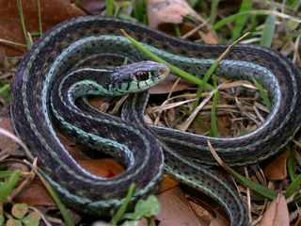
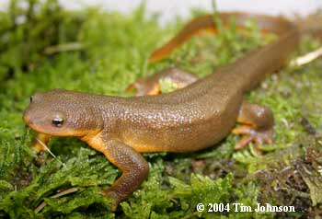
Newt and a garter snake
www.caudata.org/cc/species/Taricha/T_granulosa.shtml
http://www.discoverlife.org/mp/20p?see=I_JDW914

Slide 11
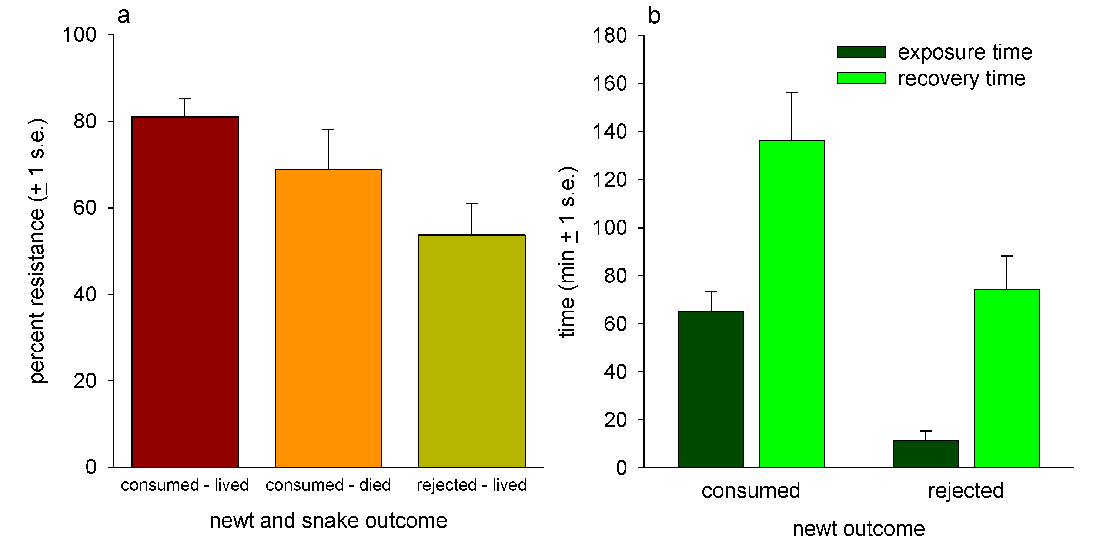
Responses of garter snakes to newts
Exposure time is correlated with recovery time.
Snakes that consumed newts and lived had high resistance to TTX.
Snakes that rejected newts had low resistance.
Figure 10.7
Notes:
Figure 10.7 Responses of garter snakes to newts. a. Percent resistance in garter snakes that consumed rough-skinned newts and lived or died, and in snakes that rejected newts. Resistance measured as percentage of crawling speed before and after snakes were injected with tetrodotoxin, prior to encounter with newts. Newts were either consumed or rejected. Snakes either lived or died. b. Time that snakes were exposed to (held in mouth prior to swallowing or rejecting) and time it took for snakes to recover after encounter with newts.
Talking Points: Snakes that consumed newts and lived had higher innate resistance to tetrodotoxin. Those that rejected newts had low resistance. Exposure time is correlated with recovery time.

Slide 12
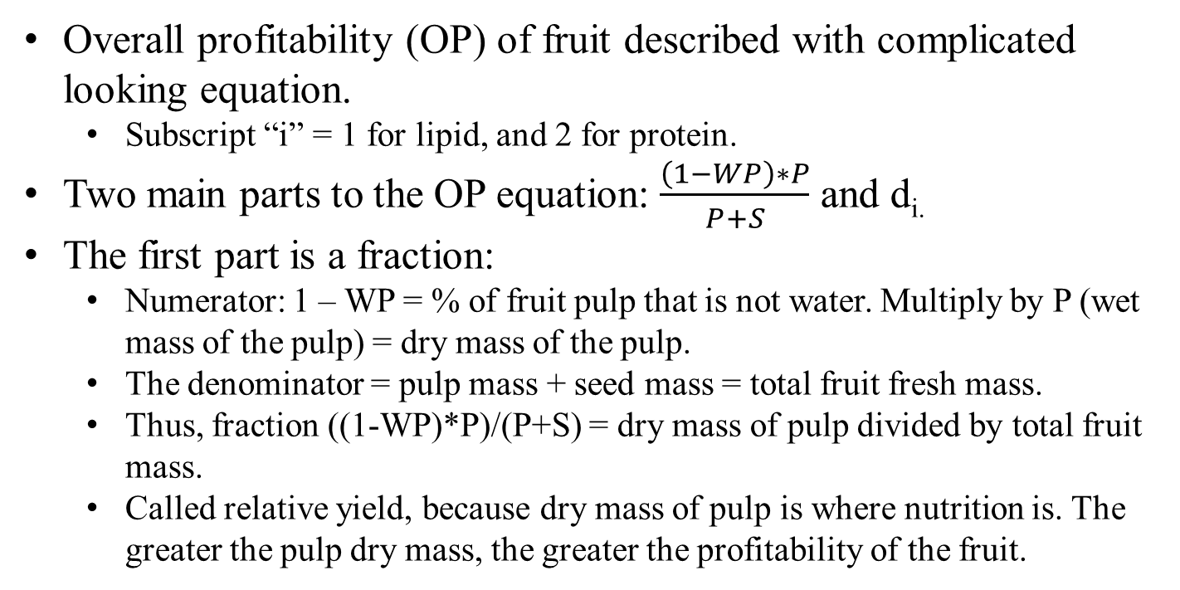
BME 10.1: What does that equation mean? (And is it really necessary?)
Overall profitability (OP) of fruit described with complicated looking equation.
  Subscript “i” = 1 for lipid, and 2 for protein.
Two main parts to the OP equation: $\frac{\left(1−WP\right)∗P}{P+S}$ and d_{i.}
The first part is a fraction:
  Numerator: 1 – WP = % of fruit pulp that is not water. Multiply by P (wet mass of the pulp) = dry mass of the pulp.
  The denominator = pulp mass + seed mass = total fruit fresh mass.
  Thus, fraction ((1-WP)*P)/(P+S) = dry mass of pulp divided by total fruit mass.
  Called relative yield, because dry mass of pulp is where nutrition is. The greater the pulp dry mass, the greater the profitability of the fruit.

Slide 13
Seasonal variation of fruits from Spanish plants whose fruits are dispersed by birds
s.s. = statistically significant among seasons.
variable | OP term | season
 |  | summer | autumn | winter | s.s.?
water (%) | WP | 67.9 + 6.2 | 60.0 + 9.2 | 52.0 + 16.4 | yes
pulp dry mass (mg) | (1-WP)*P | 52.9 + 56.7 | 97.2 + 86.9 | 122.8 + 245.6 | no
fruit wet mass (mg) | P + S | 324.1 + 340.6 | 414.9 + 296.7 | 468.0 + 738.8 | no
relative yield | (1-WP)*P/(P+S) | 16.3 + 6.2 | 20.9 + 7.6 | 23.5 + 8.1 | yes
# of seeds |  | 3.5 + 5.6 | 2.1 + 2.3 | 2.8 + 3.2
lipid (%) | d₁ | 2.5 + 1.2 | 7.4 + 13.7 | 19.7 + 18.7 | yes
protein (%) | d₂ | 4.3 + 1.7 | 4.3 + 1.8 | 5.0 + 1.4 | no
lipid profitability | OP₁ | 0.38 + 0.21 | 1.55 + 2.96 | 4.73 + 4.64 | yes
protein profitability | OP₂ | 0.69 + 0.29 | 0.85 + 0.34 | 1.12 +0.38 | yes
X
X
X
Table 10.1
Notes:
Table 10.1. Seasonal variation of fruits from southern Spanish plants whose fruits are dispersed by birds. Means + 1 standard deviation are shown. The second column contains terms from the overall profitability equation described in text. s.s. = statistically significant among seasons.
Talking Points: Point out that there’s lots of variation in the data, likely due to lumping of all species that all bear fruit in the same season. Even with all that variation, there are still some significant differences, most notably in water availability and profitability for both lipids and proteins.

Slide 14
BME 10.1: What does that equation mean? (And is it really necessary?)
BioMath Exploration Integrating Questions
10.1a: Assuming all other variables are unchanged, does relative yield increase or decrease when WP, the water content of a fruit, increases? decreases
  What about when the mass of the seeds increases? decreases
10.1b: What is the theoretically smallest possible value for relative yield? 0
  What value of WP would lead to this theoretical minimum? 1
  What is the theoretically largest possible value for relative yield? P/(P+S), close to 1 (S can never = 0)
  What values of WP and S would lead to this theoretical maximum? WP = 0, and S = 0 (or small non-zero value)

Slide 15
BME 10.1: What does that equation mean? (And is it really necessary?)
Multiplying the two proportions = overall profitability (OP) of lipid or protein
OP: intuitive measure: the proportion of fruit that is lipid or protein
Herrera most likely used OP equation for convenience
  Terms in equation combined into one quantity
  OP equation provided framework to test for seasonal trends

Slide 16
Integrating Concepts in Biology
PowerPoint Slides for Chapter 10:
Evolution of Ecological Systems
Section 10.2: When and how did plants colonize land?
Section 10.3: How have ecological communities adapted to disturbance?
by
A. Malcolm Campbell, Laurie J. Heyer, and Chris Paradise

Slide 17
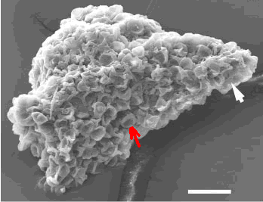
Scanning electron micrograph of 475 million year old fossil plant fragment containing spore-producing part of the plant
Edge of structure that protects spore-producing structures
Spore-producing structure
Figure 10.8
scale bar = 50 µm
Notes:
Figure 10.8 Scanning electron micrograph of 475 million year old fossil plant fragment containing spore-producing part of the plant. Each structure like the one indicated by the red arrow is a spore-producing structure. The white arrow indicates the edge of the structure that protects the spore-producing structures. The scale bar at the bottom right is 50 µm long.
Talking Points: .

Slide 18
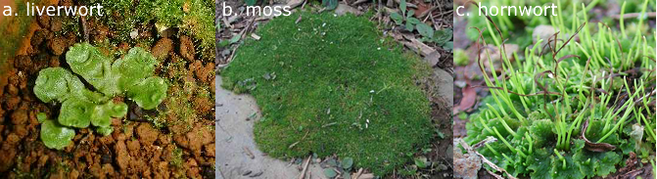
Bryophytes
~ 15 cm
4-5 cm
3-4 cm
Figure 10.9
Notes:
Figure 10.9 Bryophytes. a. The liverwort is approximately 3-4 cm across and 1 cm high. b. The mat of moss is 10-15 cm across and 1-2 cm high. Many individual moss plants make up the mat. c. The hornwort is 4-5 cm across and 2-4 cm high.
Talking Points: Examples of the less derived, possibly ancestral plants that are discussed in this section. These plants do not have vascular systems and are considered ancestral to other terrestrial plants.

Slide 19
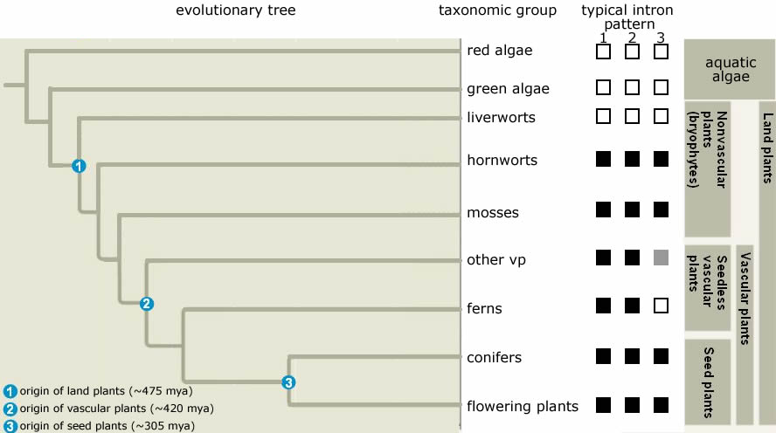
Presence or absence of 3 mitochondrial introns among land plants and two types of algae
Figure 10.10
Notes:
Figure 10.10 Presence or absence of three mitochondrial introns, indicated by closed or open boxes, respectively, among land plants and two types of algae. The evolutionary tree uses a subset of the plants tested by Qui and colleagues based on other DNA sequences. The group to which each species belongs is indicated on the far right. vp = vascular plants, hw = hornworts, ga = green algae, and ra = red algae.
Talking Points: Scientists can piece together a fairly good, if a bit speculative, picture of the attributes of the first terrestrial plant. We know early land plants had evolved at least one trait, sporopollenin, which allowed them to disperse spores on land.
Early plants were not free from living in close proximity to water, were small, and without vascular or support tissue. These traits are similar to bryophytes that exist today.
The evolutionary tree in Figure 10.10 shows that green algae are more closely related to all land plants than are red algae.
Qui and colleagues found that introns studied did not exist in any red algae, green algae or liverworts, and they concluded that the introns evolved after a speciation event that separated the liverwort ancestor from what would become the ancestor of all other land plants.
Mosses and hornworts are more closely related to other land plants than the liverworts. The data from fossils and the evolutionary tree analysis both point to liverworts being most closely related to the ancestors of all land plants.

Slide 20
Integrating Concepts in Biology
Chapter 10: Evolution of Ecological Systems
Section 10.3: How have ecological communities adapted to disturbance?
by
A. Malcolm Campbell, Laurie J. Heyer, and Chris Paradise

Slide 21
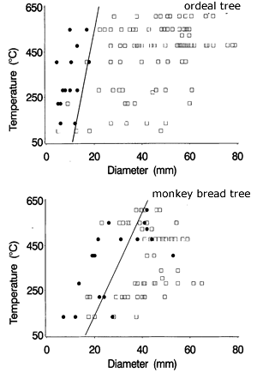
Stems that survived
or died
after exposure to a particular temperature
Regression lines = estimated lethal temp. for any diameter
Estimated lethal temp.s for 30 and 20 mm diameter monkey bread trees
Figure 10.11
Notes:
Figure 10.11 Stems that survived (squares) or died (black circles) after exposure to a particular temperature for both the ordeal tree and the monkey bread tree. The line represents the regression of the estimated lethal temperature for each diameter, defined as the midpoint of the maximum diameter dead point and minimum diameter live point at each temperature.
Talking Points: .

Slide 22
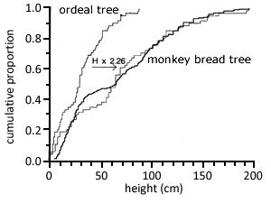
Cumulative frequency distributions of heights of re-sprouting stems of two savanna trees
Figure 10.12
Notes:
Figure 10.12 Cumulative frequency distributions of heights of re-sprouting stems of two species of savanna tree. The thick line is the distribution of monkey bread re-sprouted stems and the thin lines are for ordeal re-sprouted stems. The dashed line is the cumulative frequency distribution of the ordeal stem heights multiplied by 2.26 (see BME 10.2).
Talking Points: .

Slide 23
Cumulative frequency distributions of heights of re-sprouting stems of two savanna trees
Distribution of ordeal tree re-sprouted stems
Distribution of ordeal stem heights multiplied by 2.26
Figure 10.12
Notes:
Figure 10.12 Cumulative frequency distributions of heights of re-sprouting stems of two species of savanna tree. The thick line is the distribution of monkey bread re-sprouted stems and the thin lines are for ordeal re-sprouted stems. The dashed line is the cumulative frequency distribution of the ordeal stem heights multiplied by 2.26 (see BME 10.2).
Talking Points: .

Slide 24
BME 10.2: How fast did the trees grow?
Adaptation to fire: re-sprouting from roots
Do re-sprouted stems of one tree species grow faster than another?
Could not directly measure growth rate of hundreds of re-sprouted stems
  Requires measurement of each stem at intervals
Growth rate measured indirectly using cumulative frequency distributions of re-sprouted stem heights just before a fire
  Distribution is proportion of trees whose height is less than or equal to a given value
BME helps understand how to interpret and use this graph

Slide 25
Cumulative frequency distributions of heights of re-sprouting stems of two savanna trees
Finding the median height
Figure 10.12
Notes:
Figure 10.12 Cumulative frequency distributions of heights of re-sprouting stems of two species of savanna tree. The thick line is the distribution of monkey bread re-sprouted stems and the thin lines are for ordeal re-sprouted stems. The dashed line is the cumulative frequency distribution of the ordeal stem heights multiplied by 2.26 (see BME 10.2).
Talking Points: .

Slide 26
BME 10.2: How fast did the trees grow?
BioMath Exploration IQs
10.2a: Suppose that a sample of 5 trees had grown from sprouts to heights of 22, 28, 30, 35, and 46 cm, respectively, in one year. What is their average height? What is their average growth rate?
32.2 cm; 32.2 cm/yr
10.2b: Given that the heights represented in Figure 10.12 were measured just before a fire, for approximately how long had these re-sprouted stems been growing?
Up to the time since last fire
10.2c: What was the median height of the ordeal trees in this five-plot sample? Of the monkey bread trees?
Between 25 and 30 cm; just over 60 cm
10.2d: What proportion of ordeal trees were less than or equal to 40 cm tall? 50 cm tall? What proportion of ordeal trees were between 40 and 50 cm tall?
~0.7; ~0.8; 0.8 – 0.7 = 0.1, or 10% - see next slide

Slide 27
Cumulative frequency distributions of heights of re-sprouting stems of two savanna trees
Finding the median height
Figure 10.12
Notes:
Figure 10.12 Cumulative frequency distributions of heights of re-sprouting stems of two species of savanna tree. The thick line is the distribution of monkey bread re-sprouted stems and the thin lines are for ordeal re-sprouted stems. The dashed line is the cumulative frequency distribution of the ordeal stem heights multiplied by 2.26 (see BME 10.2).
Talking Points: .

Slide 28
BME 10.2: How fast did the trees grow?
Cumulative distribution contains information on height of all trees
  To estimate average height find proportion whose heights were in each range
  Repeat for all height intervals
  Use this set of heights and corresponding proportions to calculate weighted average (see BME 9.2)
Estimate growth rate by using median in place of average height.
  ~ 25 cm/year for ordeal tree; ~ 60 cm/year for monkey bread
  Monkey bread tree grows about 60/25 = 2.4 times as fast
  Researchers estimated it was 2.26 times as fast
  Multiply all ordeal tree heights by 2.26; resulting distribution gives visual confirmation that estimate was reasonable
  Knowing how much faster monkey bread trees grow than ordeal trees helped characterize adaptations

Slide 29
ELSI 10.1: Should we act to prevent forest fires?
Fire is a disturbance to which species may adapt
Forest management in US has used prevention as main strategy
Is fire suppression the best strategy for ecological systems and human communities?
Plants that have strategies to re-grow quickly after a fire will dominate in fire-prone areas.
In absence of fire, intolerant species may outcompete tolerant species and communities may change
  In high elevation sites in western US, Douglas fir and grand fir have expanded into areas that previously dominated by ponderosa pine
  Ponderosa pine possesses adaptations to frequent fire.
  Fir and other trees that are less fire tolerant lack these adaptations

Slide 30
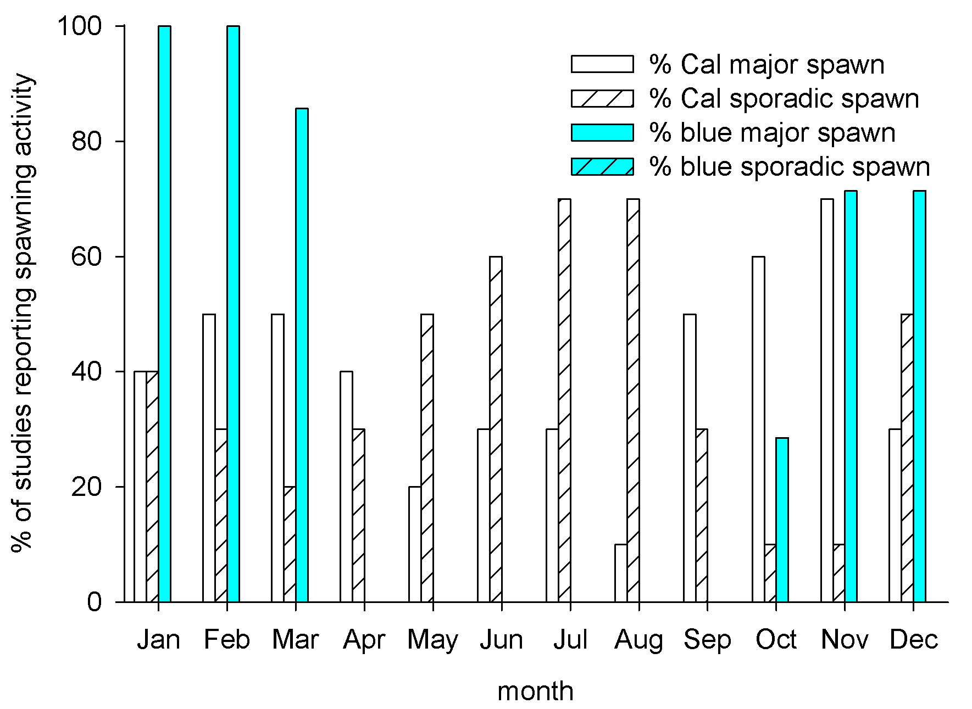
% of studies reporting spawning activity of the California and blue mussel in different months
Figure 10.13
Notes:
Figure 10.13 Percent of studies reporting spawning activity of the California mussel (Cal) and the blue mussel (blue) in different months. N = 10 studies for California and 7 for blue mussel. Sporadic spawning refers to a low level of spawning.
Talking Points: .

Slide 31
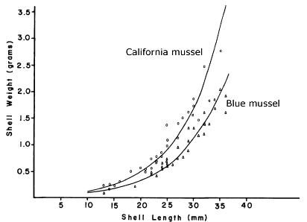
Shell mass vs. length for California and blue mussels of comparable size.
Best fit curves
Figure 10.14
Notes:
Figure 10.14 Shell mass vs. length for California and blue mussels of comparable size.
Talking Points: CA mussel is heavier, or more massive, for any equivalent shell length in the blue mussel.

Slide 32
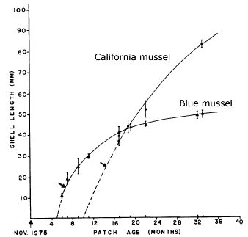
Growth rates of two mussels in a bare rock patch in the low intertidal zone
Shell length of 10 largest individuals found on each date
Dashed lines indicate estimated times of settlement and initial growth in the patch
Figure 10.15
Notes:
Figure 10.15 Growth rates of two mussels in a bare rock patch in the low intertidal zone. Data points represent shell lengths of the ten largest individuals found in the patch on each sampling date. Dashed lines to the abscissa indicate estimated times of settlement and initial growth in the patch.
Talking Points: CA mussel may grow to a larger size than the blue mussel, but blue mussel grows more quickly in open patches. They also colonize patches more quickly. These are adaptations to disturbance and competition with more massive CA mussels.

Slide 33
Integrating Concepts in Biology
Chapter 10: Evolution of Ecological Systems
Section 10.4: How will communities respond to climate change?
by
A. Malcolm Campbell, Laurie J. Heyer, and Chris Paradise

Slide 34
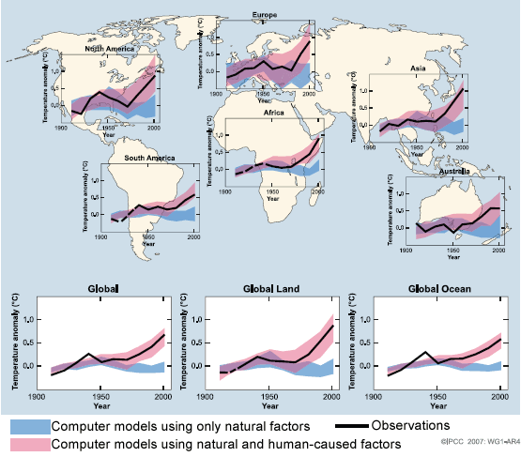
Observed & modeled changes in surface temperatures
Ten-year averages
Pink bands = range of 90% of computer predictions for natural and human-caused factors
Figure 10.16
Notes:
Figure 10.16 Observed continental and global-scale changes in surface temperature with results simulated by climate models using natural and human-caused factors. Ten-year averages are shown in the black line. Lines are dashed where measurements were taken in less than 50% of the area. Pink and blue shaded bands show the range in which 90% of the predictions from computer simulations fell.
Talking Points: average global temperature is rising on every continent and in the oceans; computer models using human-caused factors match up better with the data than models using only natural causes of climate change.

Slide 35
Observed & modeled changes in surface temperatures
Pink bands = range of 90% of computer predictions for natural and human-caused factors
Blue bands = range of 90% of computer predictions for natural factors only
Ten-year averages
Figure 10.16
Notes:
Figure 10.16 Observed continental and global-scale changes in surface temperature with results simulated by climate models using natural and human-caused factors. Ten-year averages are shown in the black line. Lines are dashed where measurements were taken in less than 50% of the area. Pink and blue shaded bands show the range in which 90% of the predictions from computer simulations fell.
Talking Points: average global temperature is rising on every continent and in the oceans; computer models using human-caused factors match up better with the data than models using only natural causes of climate change.

Slide 36
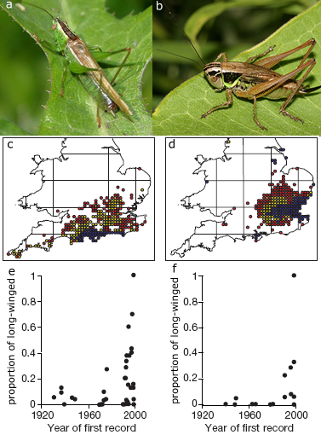
Changing distributions of bush crickets
Long-winged form of Conocephalus discolor
Short-winged form of Metrioptera roeselii.
Figure 10.17
Notes:
Figure 10.17 a. Long-winged form of the bush cricket Conocephalus discolor. b. Short-winged form of Metrioptera roeselii. c. Distribution of C. discolor. Blue circles are locations where the cricket was first recorded between 1961 and 1987, yellow are where it was first recorded between 1988 and 1996, and red are where it was recorded between 1997 and 1999. d. Distribution of M. roeselii; circle colors are as in c. e. Proportion of long-winged C. discolor individuals in populations sampled in 2000, according to year a population was first recorded. f. Same as e, but for M. roeselii.
Talking Points: Two species of bush cricket, types of katydids, that show the long and short-winged forms.

Slide 37
Changing distributions of bush crickets
Distribution of C. discolor
Distribution of M. roeselii
Yellow and red means the species was first spotted in that location after 1988, and as late as 1999 for red dots. Indicates range expansion.
Figure 10.17
Notes:
Figure 10.17 a. Long-winged form of the bush cricket Conocephalus discolor. b. Short-winged form of Metrioptera roeselii. c. Distribution of C. discolor. Blue circles are locations where the cricket was first recorded between 1961 and 1987, yellow are where it was first recorded between 1988 and 1996, and red are where it was recorded between 1997 and 1999. d. Distribution of M. roeselii; circle colors are as in c. e. Proportion of long-winged C. discolor individuals in populations sampled in 2000, according to year a population was first recorded. f. Same as e, but for M. roeselii.
Talking Points: .

Slide 38
Changing distributions of bush crickets
Proportion of long-winged C. discolor in year 2000 vs. year population 1st recorded
Proportion of long-winged M. roeselii in year 2000 vs. year population 1st recorded
Many populations discovered later had high proportions of long-winged individuals
Figure 10.17
Notes:
Figure 10.17 a. Long-winged form of the bush cricket Conocephalus discolor. b. Short-winged form of Metrioptera roeselii. c. Distribution of C. discolor. Blue circles are locations where the cricket was first recorded between 1961 and 1987, yellow are where it was first recorded between 1988 and 1996, and red are where it was recorded between 1997 and 1999. d. Distribution of M. roeselii; circle colors are as in c. e. Proportion of long-winged C. discolor individuals in populations sampled in 2000, according to year a population was first recorded. f. Same as e, but for M. roeselii.
Talking Points: This might be considered abnormal, because density is one factor that triggers high proportions of long-winged individuals, and populations at edge of ranges usually have low densities. Might indicate an evolutionary change.

Slide 39
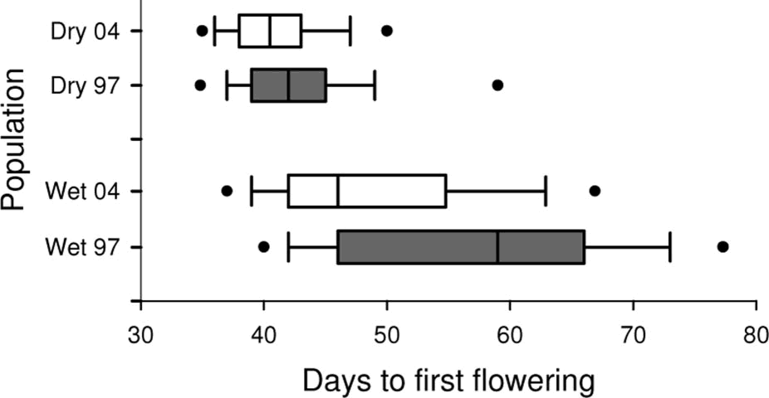
25th percentile
Plots of time to first flowering in wild mustard plants
5th percentile
Median
10th percentile
75th percentile
90th percentile
95th percentile
Figure 10.18
Notes:
Figure 10.18 Box plots of time to first flowering in wild mustard plants from the long season treatment. Wet refers to the high soil moisture site of origin and dry refers to the sandy soil site of origin. 97 refers to plants from the ancestral cross (1997) and 04 refers to plants from the descendant (2004) cross. The center bar is the median, and the boxes, lines, and dots represent the 25th to 75th, 10th to 90th, and 5th to 95th percentiles, respectively.
Talking Points: Shows how to read boxplot.

Slide 40
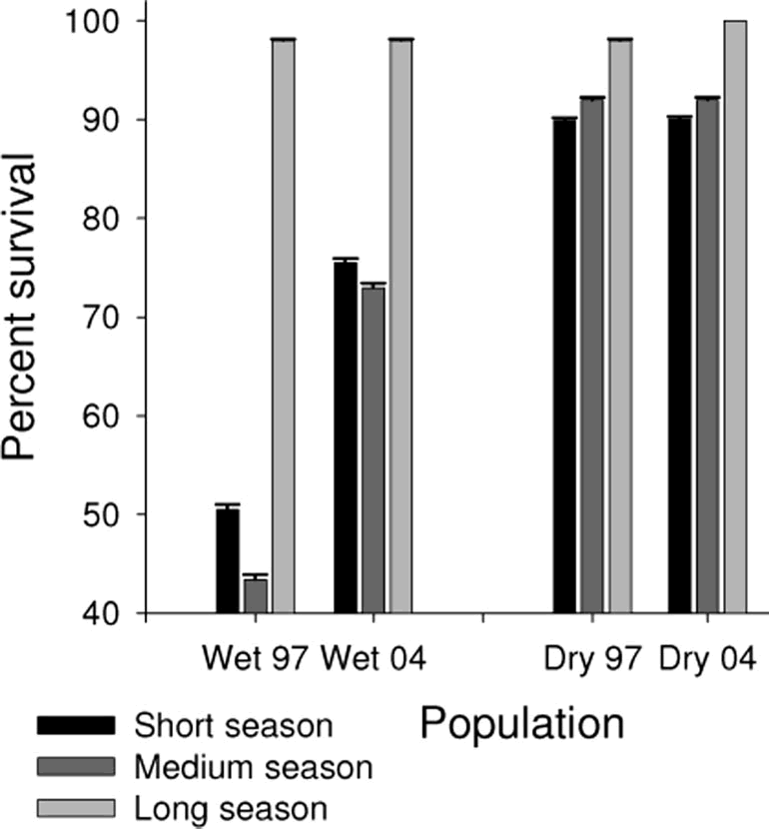
Mean % survival of wild mustard plants
Figure 10.19
Notes:
Figure 10.19 Shown is the mean (+ 1 standard error) percentage of wild mustard plants from each site of origin surviving in the different treatments. Wet refers to the high soil moisture site or origin and dry refers to the sandy soil site of origin. 97 refers to plants from the ancestral cross (1997), H refers to plants from the hybrid ancestral x descendant cross, and 04 refers to plants from the descendant (2004) cross. Length of season refers to the length of time plants received daily watering.
Talking Points: .

Slide 41
Heritability of flowering times in wild mustard plants from two sites of origin: if >0 then some genetic component of variation
Site of origin | Heritability | 95% Confidence interval
Dry site population | 0.29 | 0.03 – 0.55
Wet site population | 0.46 | 0.23 – 0.68
Table 10.2
Notes:
Table 10.2 Heritability of flowering times in wild mustard plants from two sites of origin. From Franks et al. 2008.
Talking Points: .

