Slide 1
Title Page
Integrating Concepts in Biology
PowerPoint Slides for Chapter 11:
Cells at the Molecular Level
11.1 What role does molecular structure play in a cell’s function?
11.2 How do cells respond to fear?
by
A. Malcolm Campbell, Laurie J. Heyer, and Chris Paradise

Slide 2
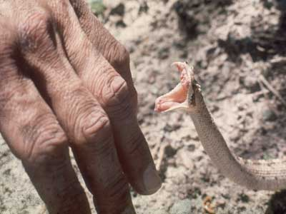
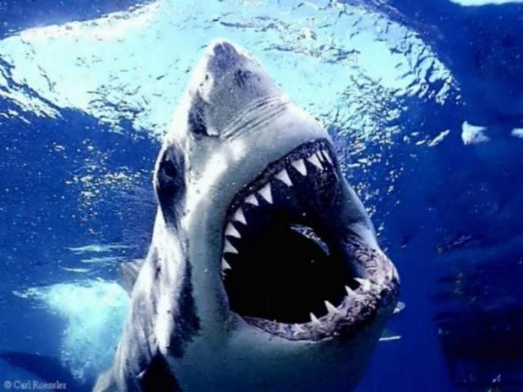
Opening Figure
Cells at the Molecular Level
Notes:
Opening art – Fear stimulates molecular responses in cells.

Slide 3
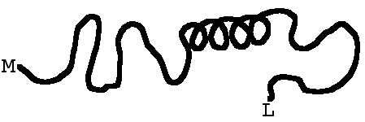

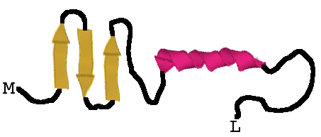
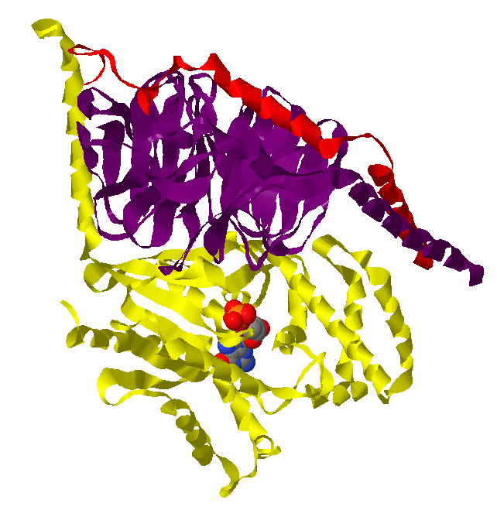
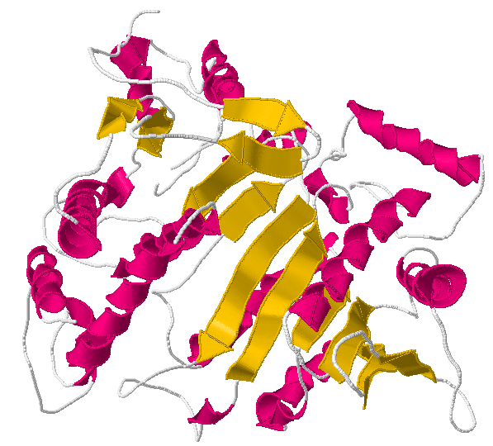
Fig. 11.1
Levels of Protein Structure
Notes:
Figure 11.1 The four layers of structure within proteins. a) Primary structure of amino acid sequence within a protein. b) Amino acids can fold into secondary structures illustrated two ways, as curvy lines or three yellow beta stands and one pink alpha helix. c) Tertiary structure consists of all secondary structures as well as any other shapes adopted by the entire protein. d) Quaternary structure is present only when more than one protein comes together to form a single functional protein complex; three proteins and a ligand shown here.

Slide 4
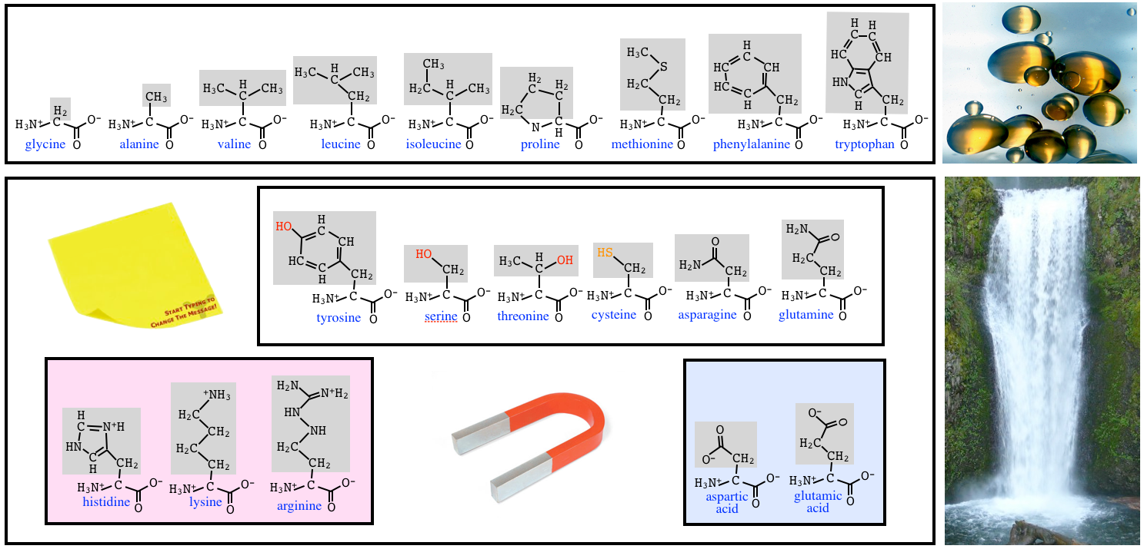
Fig. 11.2
Amino Acids Affect Protein Structure
Notes:
Figure 11.2 Amino acid physical and chemical properties. a) Nine amino acids have side chains that contain only carbon and hydrogen and therefore are hydrophobic like oil mixed with water. b) Eleven amino acids contain either nitrogen, oxygen or sulfur at the extreme ends of their side chains and are hydrophilic. Bases (red) and acids (blue) participate in ionic bonds while the remaining six can participate in hydrogen bonds. See Figure 1.12 for a reminder about the relative strength of bonds.

Slide 5
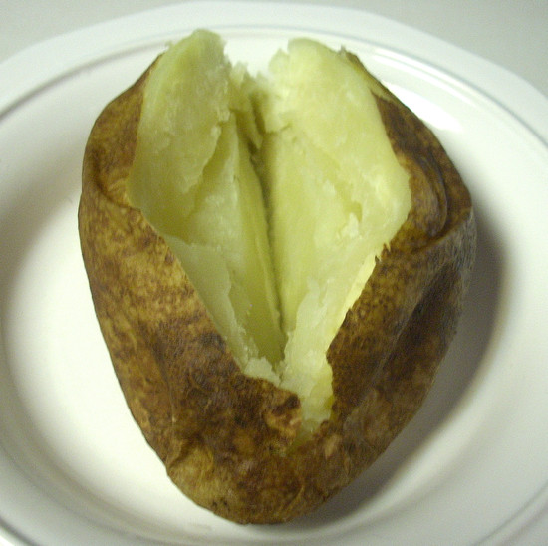
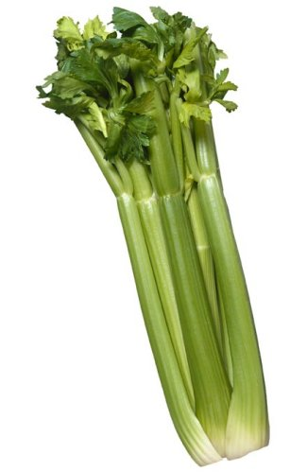
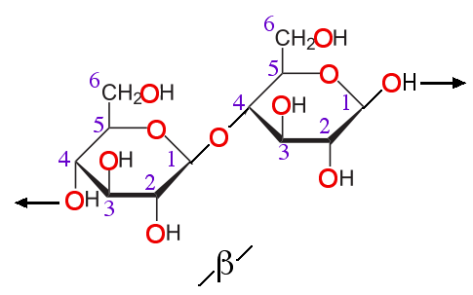
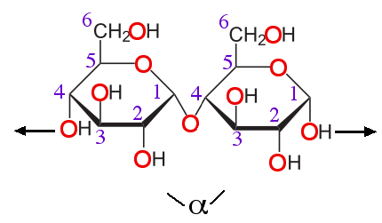
Fig. 11.3
Glucose Polymers Are Not Equivalent
Notes:
Figure 11.3 Differences in glucose polymers. (a) Potatoes rich in starch (b) which is made by connecting glucose molecules via alpha 1-4 covalent bonds. c) Celery is a mixture of water and cellulose (d) in its plant cell walls. Cellulose is a polymer of glucose connected by beta 1-4 covalent bonds. Carbons are located at the vertices and are numbered 1-6 in purple font.

Slide 6
11.2 How do cells respond to fear?

Slide 7
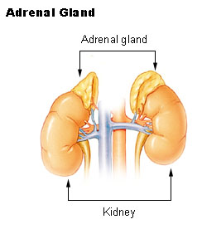
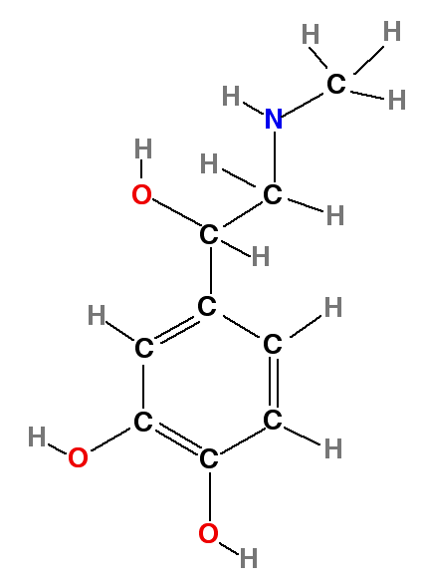
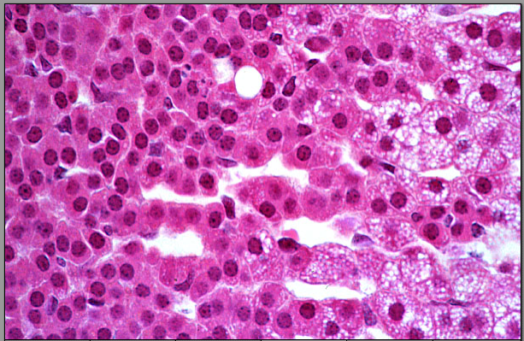
Fig. 11.4
Epinephrine Production
Notes:
Figure 11.4 Adrenal gland anatomy. a) Chemical structure of epinephrine. b) Adrenal glands rest on top of your kidneys. c) Red adrenal cells producing epinephrine contained in clear secretory vesicles, with increased production from top left to bottom right.

Slide 8
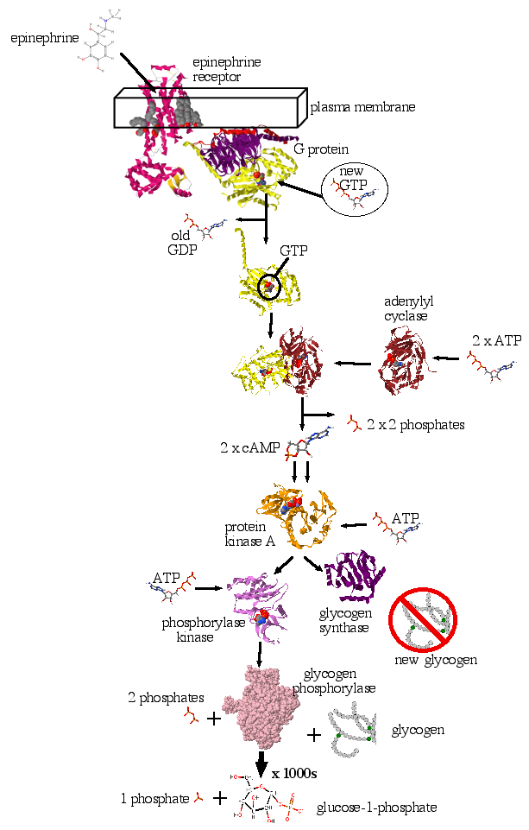
Fig. 11.5
Fear Signal Transduction Pathway
Notes:
Figure 11.5 Fear signal transduction pathway from epinephrine to glucose-1-P. The key proteins involved in this pathway are shown along with other important molecules.

Slide 9
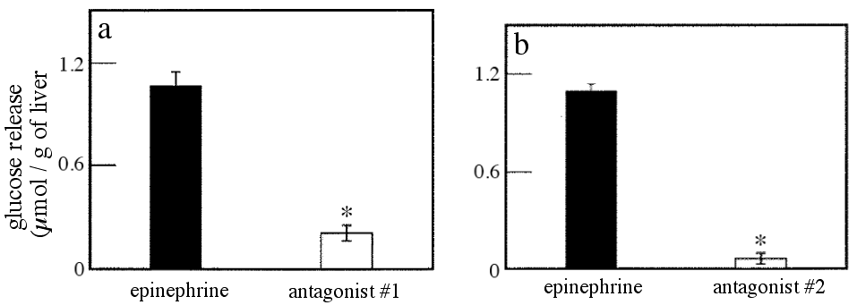
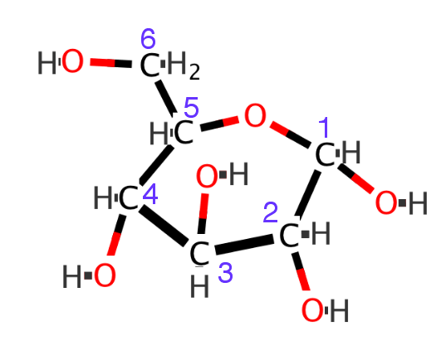
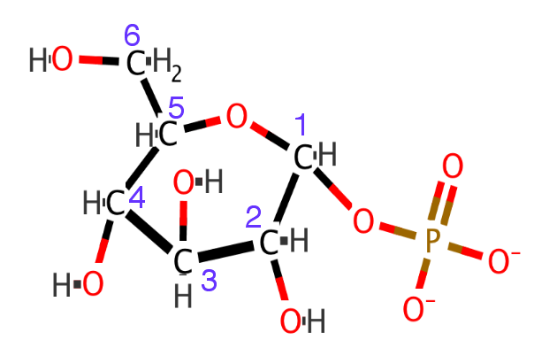
Fig. 11.6
Epinephrine Stimulates Glucose Release
Notes:
Figure 11.6 Testing epinephrine as ligand. (a) and (b) Trout liver was injected with epinephrine, or antagonists followed by epinephrine five minutes later. +/- standard error of the mean. * indicates p < 0.05. (c) Structure of glucose and (d) glucose-1-phosphate inside liver cells. Glucose carbons are numbered in purple font.

Slide 10
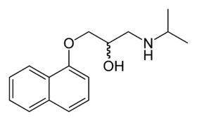
propranolol
Propranolol Structure
propranolol
antagonist #2
epinephrine
Notes:
propranolol structure compared to epinephrine

Slide 11
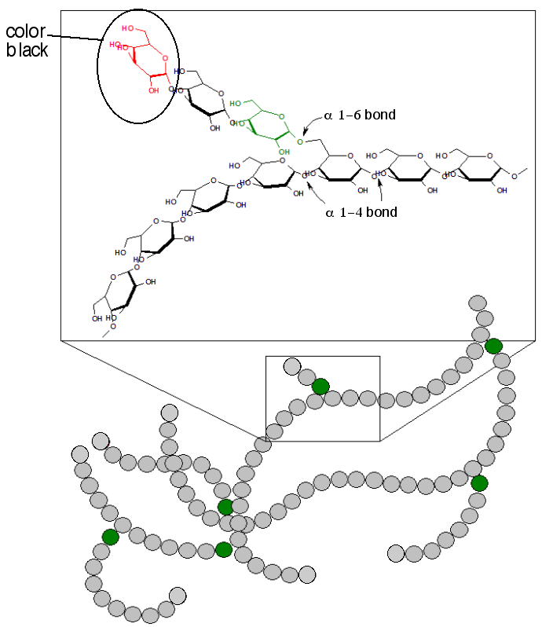
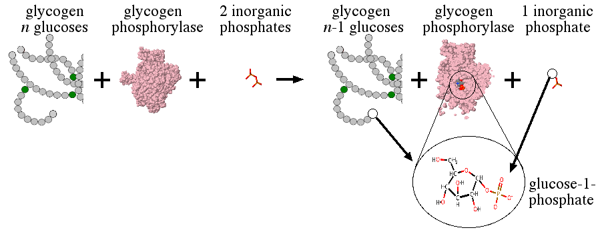
Fig. 11.7
Convert Glycogen to Glucose-1-P
Notes:
Figure 11.7 Glycogen structure and degradation. (a) Glycogen is a polymer composed of glucose monomers connected primarily by alpha 1-4 covalent bonds, and a few alpha 1-6 bonds (green glucose circles). (b) Glycogen is broken into its monomers by glycogen phosphorylase that utilizes free-floating phosphates in the cytoplasm to break alpha 1-4 covalent bonds. Glycogen phosphorylase has been sliced open to reveal the internally located product of glucose-1-phosphate.

Slide 12
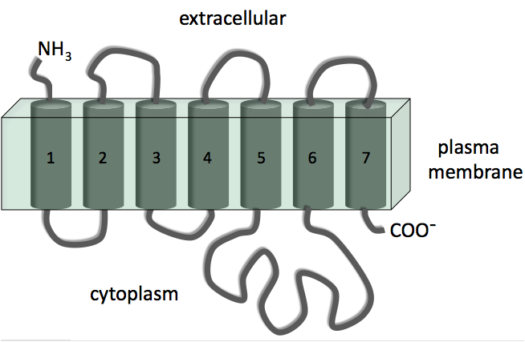
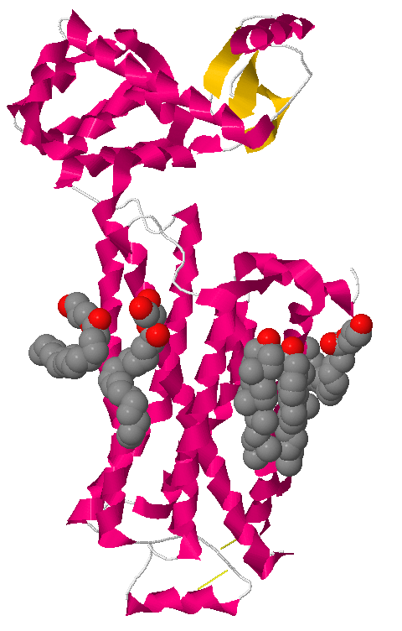
Fig. 11.8
Epinephrine Receptor Structure
Notes:
Figure 11.8 Structure of the epinephrine receptor. a) The primary structure of the epinephrine receptor produces seven transmembrane domains composed of alpha helices. b) Epinephrine binds in a pocket composed of these seven alpha helices. Much of the receptor is intracellular and contains three beta strands.

Slide 13
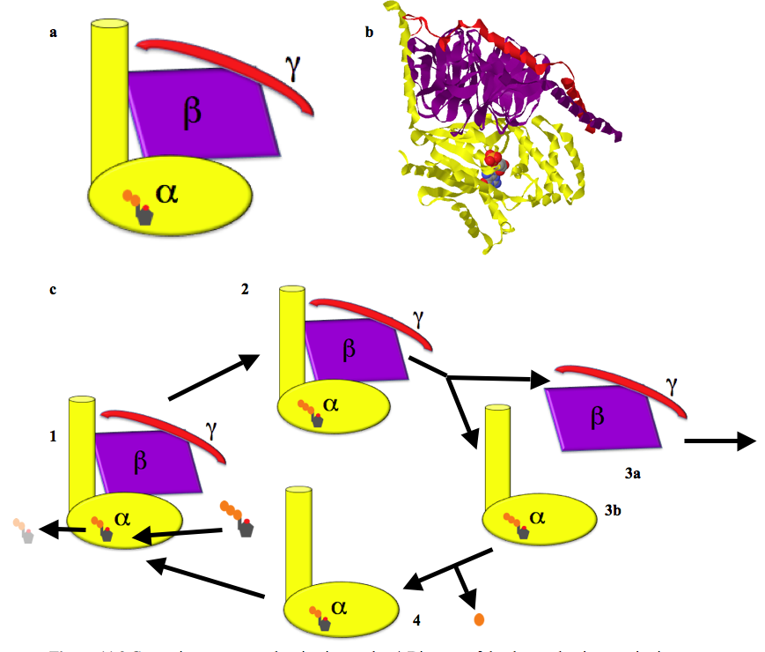
Fig. 11.9
G Protein Cycle
Notes:
Figure 11.9 G protein structure and activation cycle. a) Diagram of the three subunits constituting one G protein complex with GDP bound to the alpha subunit. b) Actual structure of G protein with GDP, colors chosen to highlight the three subunits. c) Four step activation cycle of G protein. See text for details. You can view an G-protein in Jmol structure online.

Slide 14
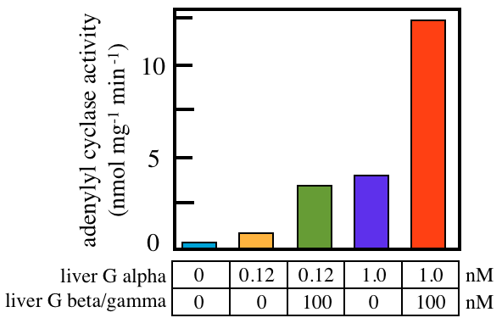
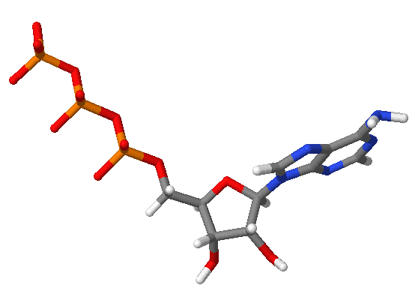
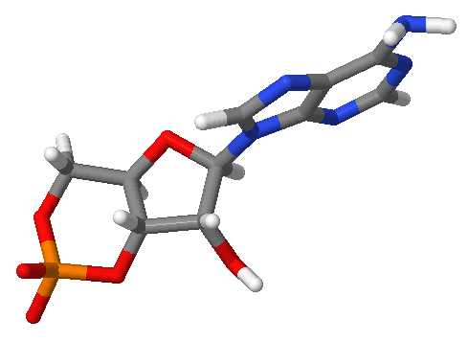
Fig. 11.10
G Protein Stimulates cAMP Production
ATP
cAMP
Notes:
Figure 11.10. Adenylyl cyclase activity as a function of G protein subunits. cAMP production was quantified as a result of adding alpha subunits alone or in combination with beta/gamma subunits. Bars represent average of two experiments.

Slide 15
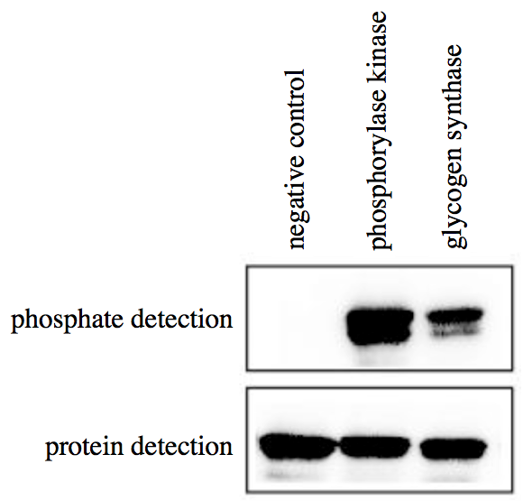
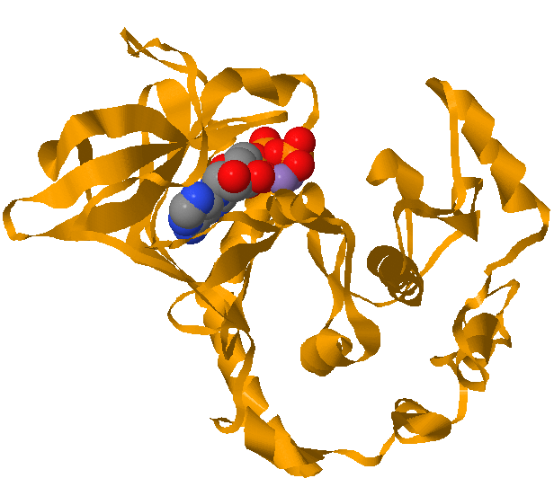
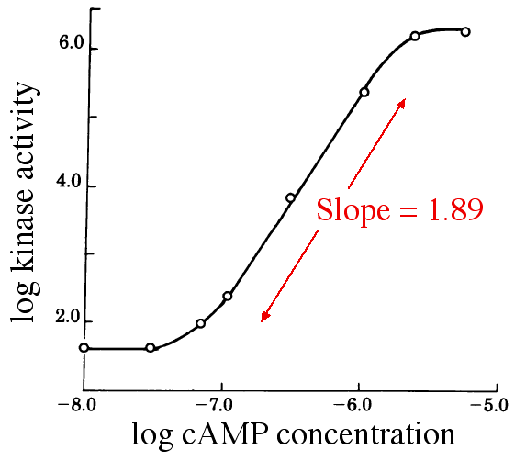
Fig. 11.11
Protein Kinase A Activation
Notes:
Figure 11.11 Protein kinase A activation by cAMP. a) Detection of phosphorylated proteins (top) or an all proteins (bottom) of three protein samples treated with PKA. b) Tertiary structure of protein kinase A with ATP. c) Experimentally determined log₁₀ protein kinase A activity as a function of log₁₀ cAMP concentration, with a slope of nearly two.

Slide 16
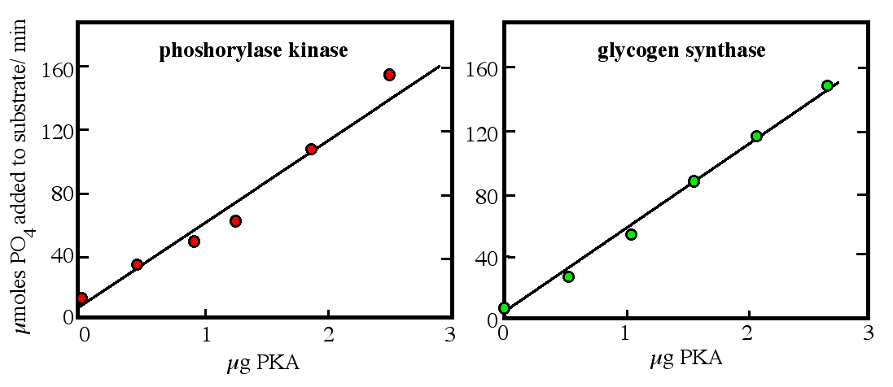
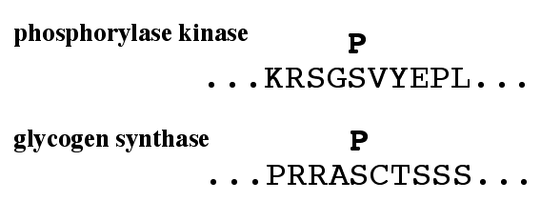
Fig. 11.12
Activation of Glucose Production
Notes:
Figure 11.12 PKA function and structure. a) and b) Activated PKA was incubated with two different substrates to see if PKA could phosphorylate both with equal kinetics. c) Partial amino acid sequences of the two substrates with the location of phosphate shown above the modified amino acids. d) Structure of PKA with ATP bound which is used to phosphorylate its substrates.

Slide 17
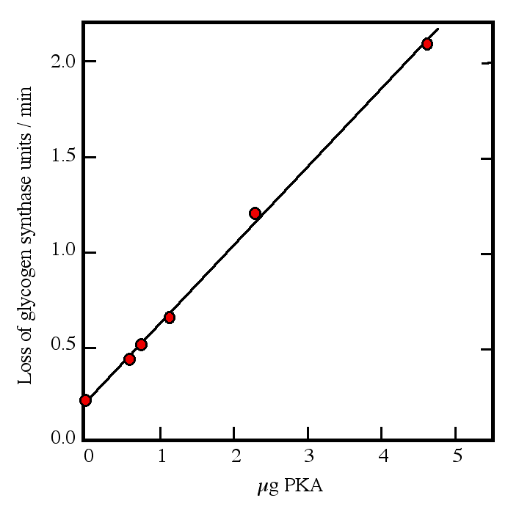
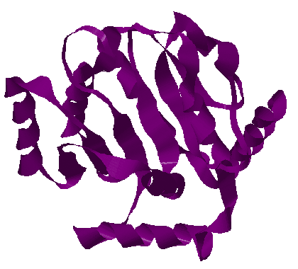
Fig. 11.13
Modulation of Glycogen Synthase
Notes:
Figure 11.13 Inactivation of glycogen synthase. (a) Glycogen production was quantified after incubating glycogen synthase with different amounts of activated PKA. A unit is an arbitrarily defined amount of glucose polymerizing capacity. (b) Tertiary structure of glycogen synthase.

Slide 18
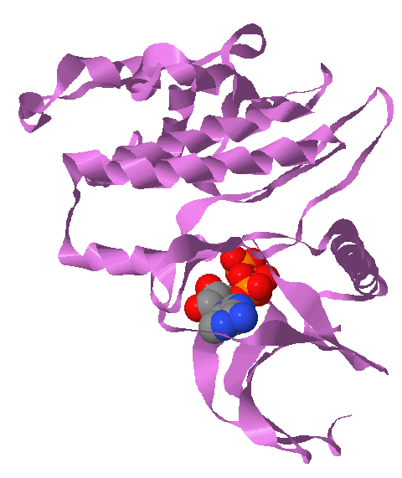
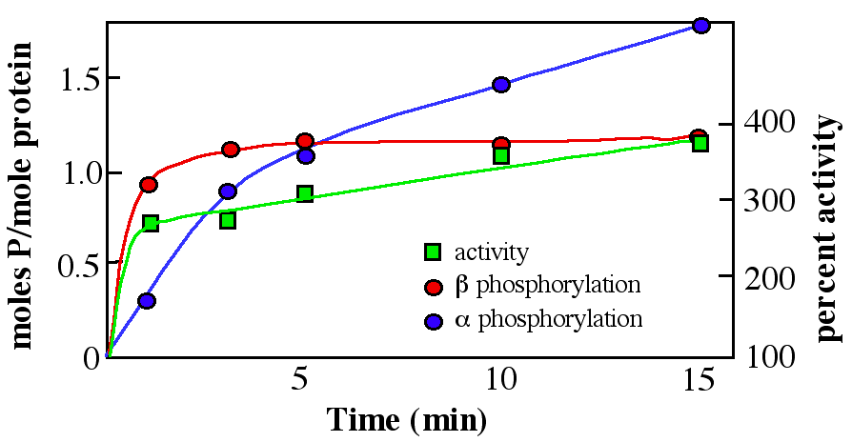
Fig. 11.14
Modulation of Phosphorylase Kinase
Notes:
Figure 11. 14 Activation of phosphorylase kinase. a) Phosphorylase kinase subunits alpha and beta are phosphorylated separately and each has an impact on activation of the gamma subunit. b) Phosphorylase kinase gamma subunit tertiary structure with ATP bound.

Slide 19
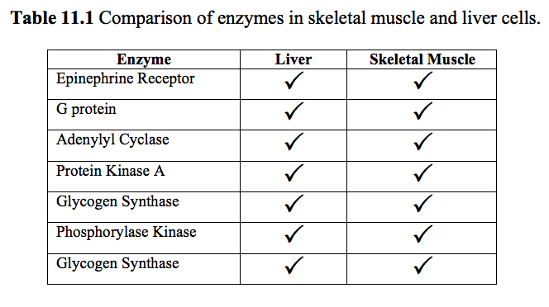
Table 11.1
Muscles First, Liver Second
Notes:
Table 11.1 Comparison of enzymes in skeletal muscle and liver cells.

Slide 20
Signal Transduction Reset
answer here
answer here
answer here
answer here
Notes:
Table 11.1

Slide 21
Signal Transduction Reset
GTP → GDP
cAMP → AMP
phosphatases remove phosphates
ligands wiggle free, stop allosteric activation
Notes:
Table 11.1

Slide 22
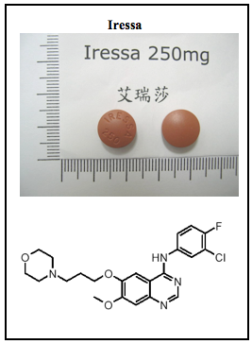
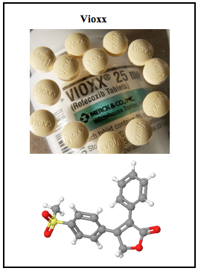
ELSI Fig. 11.1
New Drugs and New Consequences
Notes:
ELSI Figure 11.1 Two examples of new drugs and their chemical structures.

Slide 23
Title Page
Integrating Concepts in Biology
PowerPoint Slides for Chapter 11:
Cells at the Molecular Level
11.3 Why aren’t there giant cells?
11.4 Why are some membranes wavy?
by
A. Malcolm Campbell, Laurie J. Heyer, and Chris Paradise

Slide 24
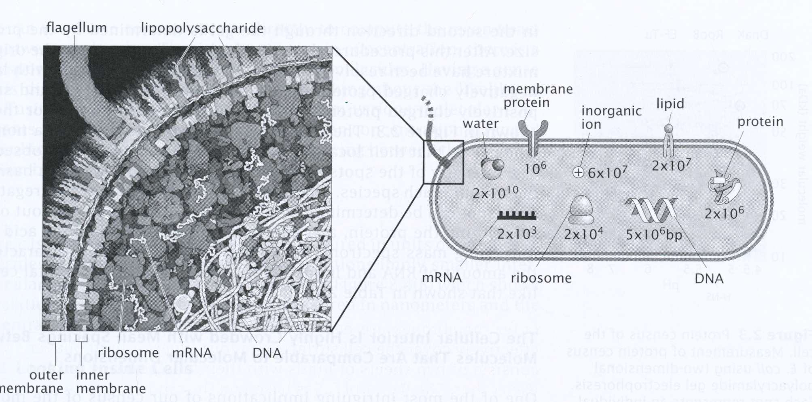
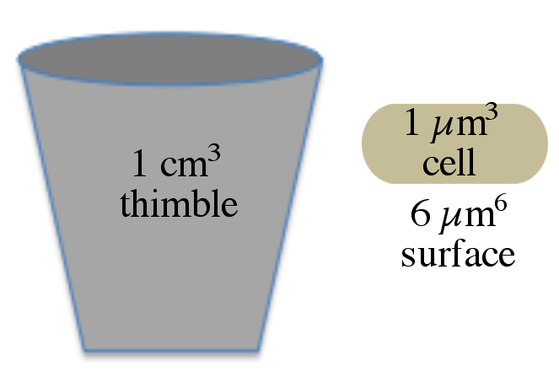
Fig. 11.15
Cytoplasm Is Crowded
Notes:
Figure 11.15 Molecules inside a cell. (a) Artist rendition of a bacterial cell. (b) Diagram showing the number of molecules inside E. coli. (c) Comparison of a thimble and E. coli, not drawn to scale.

Slide 25
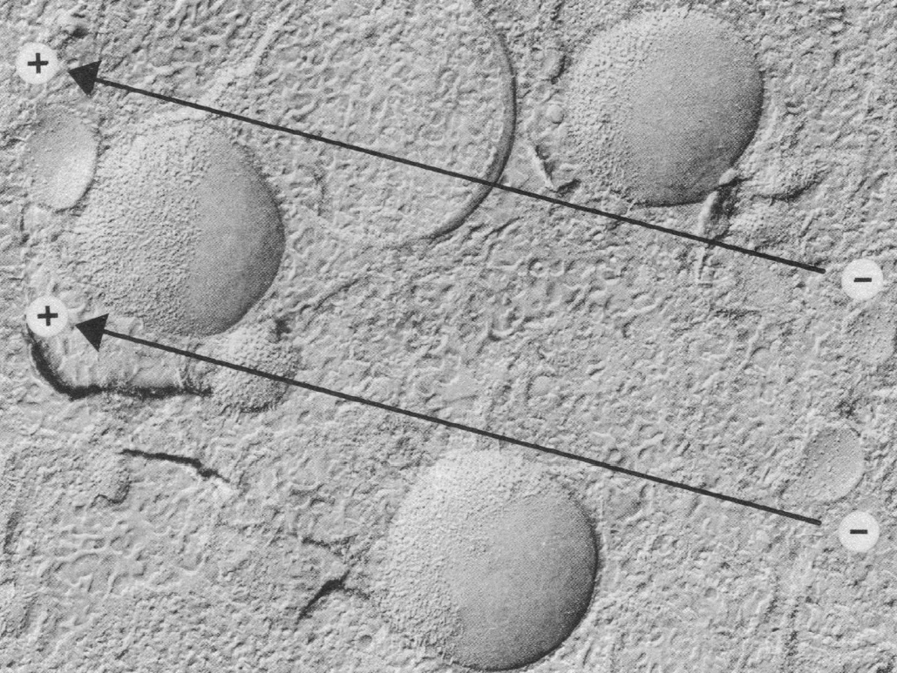
Fig. 11.16
Testing Mobility of Surface Proteins
Notes:
Figure 11.16 Mobility of membrane proteins. Three cells are outlined with red dashed lines. Electrical field is represented by black lines with the indicated polarity. In the top right cell, the movement of proteins is indicated with red arrows, and the edge of the accumulated proteins in a dashed arc.

Slide 26
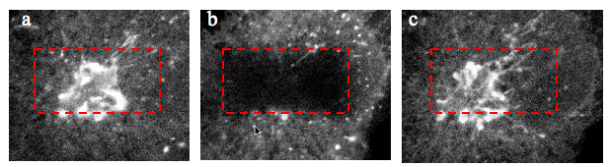
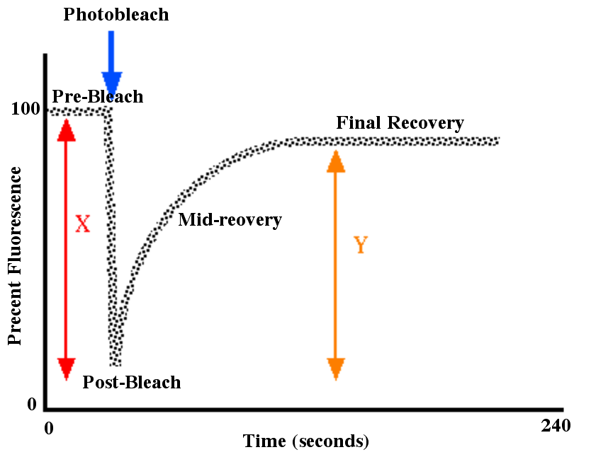
Fig. 11.17
FRAP Measures Protein Movement
Notes:
Figure 11.17 FRAP method. Cell immediately before (a) and after (b) photobleaching inside the boxed area. c) After about 2 minutes, the bleached area has recovered its glowing due to mobile proteins. d) Diagram of FRAP data showing key steps. A FRAP movie of the experiment available online.

Slide 27
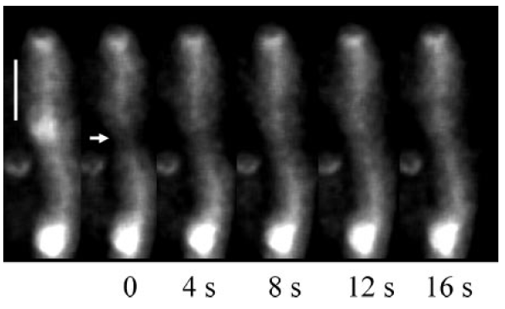
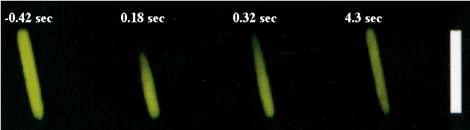
Fig. 11.18
Bacterial FRAP Experiments
Notes:
Figure 11.18 a) FRAP experiment with GFP fused with a normal plasma membrane protein, arrow marks the area photobleached. Times are seconds after bleaching. Bar = 5 µm. b) Imaged E. coli with GFP in cytoplasm of cell at the indicated times in seconds starting 0.42 seconds before photobleaching. Bar = 4 µm.

Slide 28
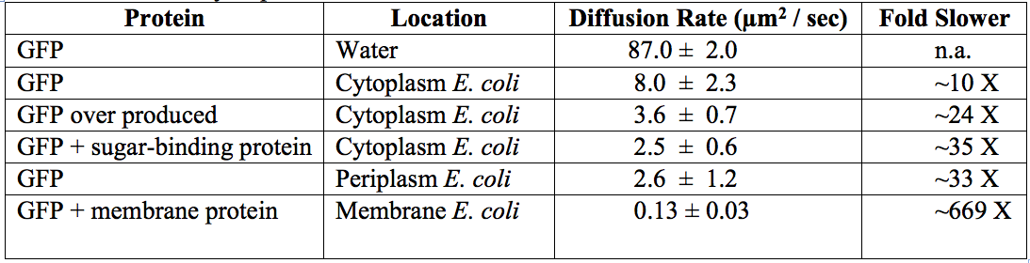
Table 11.2
Table 11.2
Table 11.2 Mobility of proteins in and on E. coli ± 1 standard deviation.
Notes:
Table 11.2 Mobility of proteins in and on E. coli ± 1 standard deviation.

Slide 29
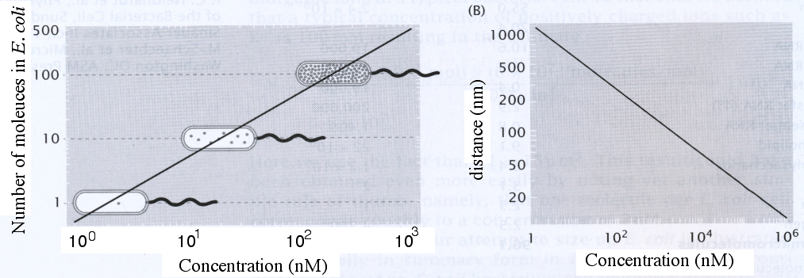
Fig. 11.19
Molecular Density and Distance
Notes:
Figure 11.19 Relationship of concentration and distances inside cells. (a) The number of molecules inside the volume of an E. coli cells converted to concentration. (b) Distance between two molecules given their concentration inside E. coli.

Slide 30
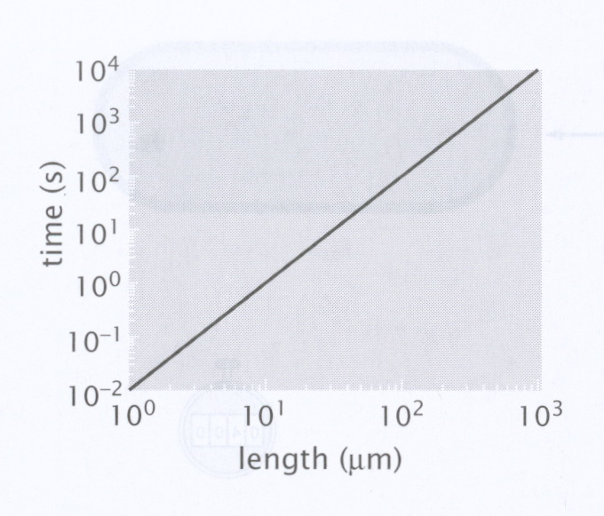
Fig. 11.20
Distance Determines Diffusion
Notes:
Figure 11.20 Effect of distance on diffusion time. The rate of a protein diffusing in water was assumed to be 100 µm² per second to simplify calculations.

Slide 31
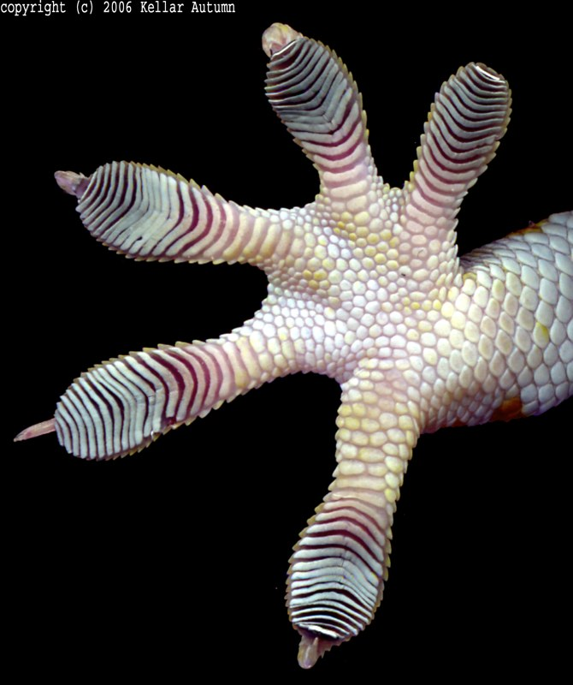

ELSI Fig. 11.2
Basic Research on Gecko Feet
Notes:
ELSI Figure 11.2 Geckos. (a) Gecko foot and (b) lizard walking upside down.

Slide 32
11.4 Why are some membranes wavy?

Slide 33




Fig. 11.21
Form Determines Function
Notes:
Figure 11.21 Cytoskeleton provides internal structure that determines cell shape. a) Fluorescence micrograph of mouse skin cells with microtubules stained green, actin red, and DNA blue. b-d) Electron micrograph of rat intestine cells at three magnifications. Red boxes are magnified area for image below. Red bracket shows actin filaments and arrows point to plasma membranes.

Slide 34



Fig. 11.22
Formation of Membrane Tubes
Notes:
Figure 11.22 Formation of membrane tubes. a) Schematic of experimental method using fabricated vesicles, isolated microtubules and kinesin motor proteins. b) Proposed mechanism for kinesin pulling membrane tubes. c) Time-lapse images of real vesicles being pulled into tubes. Top two images point to one growing tube, as do bottom paired images. Bar = 5 µm. Time span in minutes:seconds. See different movie of ER moving in plant cell.

Slide 35

Fig. 11.23
Vesicle Influences Tube Shape
Notes:
Figure 11.23 Mechanical pulling membrane tubes. Bar = 5 µm. (a) “Normal” membrane vesicle similar to ER membrane pulled by “bead” to form membrane tube. (b) Relaxed vesicle pulled to make tube with larger diameter. (c) Force in picoNewtons needed to pull tube from the vesicle.

Slide 36

Table 11.3
Lipid composition of membranes in eukaryotes.
Notes:
Table 11.3 Lipid composition of membranes in eukaryotes.

Slide 37



Fig. 11.26
Lipid Composition Affects Shape
Notes:
Figure 11. 26 Lipid vesicles spontaneously adopt varied shapes. (a-e) Rigid lipids were labeled blue and more fluid, relaxed lipids were labeled red. All vesicles shown have the same total composition of lipids and were imaged to show equatorial cross sections. Bar = 5 µm.

Slide 38
Title Page
Integrating Concepts in Biology
PowerPoint Slides for Chapter 11:
Cells at the Molecular Level
11.5 How did mitochondria and chloroplasts originate?
by
A. Malcolm Campbell, Laurie J. Heyer, and Chris Paradise

Slide 39


Fig. 11.27
Mitochondria and Chloroplasts
Notes:
Figure 11.27 Electron micrographs of a mitochondrion and a chloroplast. (a) Mouse mitochondrion with clearly resolved membranes. (b) Plant chloroplast with stacks of internal membranes. Large black circles are vacuoles filled with dye from processing the tissue.

Slide 40



Fig. 11.28
Chloroplast Genome
Notes:
Figure 11.28 Chloroplast DNA. a) Electron micrograph of a single cell green alga, Chlamydomonas. CP, chloroplast; M, mitochondria, N, nucleus with grainy DNA; P, pyrinoid body stores starch inside chloroplast; arrow points to chloroplast DNA. b) close up of nuclear and chloroplast DNA. c) Isolated chloroplast circular chromosomes fluoresces with DNA dye. Bar = 10 µm.

Slide 41

Fig. 11.29
Bootstrap Values on DNA Tree
Notes:
Figure 11.29 Deducing the origin of evolved DNA sequences. Original DNA is on the far left side. Bases that changed with each branch are colored red to facilitate detection. Bootstrap values given at each branch point.

Slide 42


Fig. 11.30
Chloroplast & Mitochondrial Origins
Notes:
Figure 11.30 Deducing the origin of chloroplasts and mitochondria. (a) Electron micrographs of two bacterial species and two organelles. (b) Phylogenetic tree for mitochondria from four species, some bacterial genomes, photosynthetic microbe genome, and two different chloroplast genomes. Bootstrap values at branch points.

