Slide 1
Integrating Concepts in Biology
Chapter 13: Cells at the Organismal Level
Section 13.1: How do genetic diseases affect cells and organisms?

Slide 2
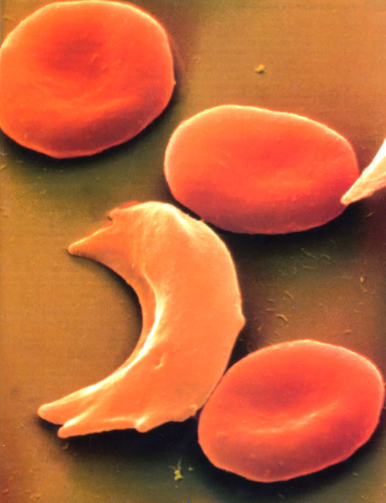
Several normal and one sickled red blood cell
Figure 13.1
Notes:
Figure 13.1 Several normal and one sickled red blood cell.
Talking Points: The shape of red blood cells affect their function and ability to carry oxygen, as you’ll see.

Slide 3
Movement of normal and sickle-cell hemoglobin at different pHs
pH | Normal hemoglobin | Sickle-cell hemoglobin
6 | positive movement | positive movement
6.87 | no movement | positive movement
7 | negative movement | positive movement
7.09 | negative movement | no movement
8 | negative movement | negative movement
No movement at different pHs indicates proteins are different
Table 13.1
Notes:
Table 13.1. Movement of normal and sickle-cell hemoglobin at different pHs.
Talking Points: Hemoglobin from patients with sickle-cell disease is different than that of normal individuals. Evidence is differential movement of the hemoglobins at pH 7.0, where sickle-cell hemoglobin moves as a positive ion and normal hemoglobin moves as a negative ion. This made sickle-cell anemia the first disease in which an abnormality in a protein was known to be at fault.

Slide 4
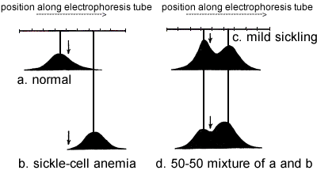
Distribution pattern of hemoglobin represented as scanning diagrams
Peaks = distinct proteins
Figure 13.3
Arrows = line of no movement
Notes:
Figure 13.3 The distribution pattern of hemoglobin represented as scanning diagrams of hemoglobin from (a) normal individuals, (b) individuals with sickle cell anemia, (c) individuals with the mild form of sickling, and (d) an artificial mixture of hemoglobin from normal and sickle-cell anemia individuals at pH 6.9. Each peak represents a distinct band and the arrows in each figure represent the line of no movement.
Talking Points: Normal and sickle-cell disease hemoglobins are homogenous substances (i.e., one protein) because only one peak occurs. In addition, all normal individuals tested had the same hemoglobin, whether they were of Caucasian or African descent.

Slide 5
BME 13.1: What is in the mixture?
13.1a: Describe a trial-and-error experimental procedure for determining the relative proportion of normal and sickle-cell hemoglobin molecules that are in mild sickling.
Repeat electrophoresis and scanning of each and every trial mixture, and comparing the scan to the graph in panel c
Figure 13.4
Notes:
Figure 13.3 The distribution pattern of hemoglobin represented as scanning diagrams of hemoglobin from (a) normal individuals, (b) individuals with sickle cell anemia, (c) individuals with the mild form of sickling, and (d) an artificial mixture of hemoglobin from normal and sickle-cell anemia individuals at pH 6.9. Each peak represents a distinct band and the arrows in each figure represent the line of no movement.
Talking Points: .

Slide 6
BME 13.1: What is in the mixture?
13.1b: Based on the relative heights of the two peaks in panels (c) and (d) of Figure 13.2, do mild sickling individuals have more normal hemoglobin or more sickle-cell hemoglobin? Explain your reasoning.
Left peak is higher than right in mild sickling, whereas right was higher than left in 50-50, suggesting that there was a greater proportion of normal hemoglobin. You would have to try mixtures of 55-45, 60-40, 65-35, etc., to see which one best matched.
Figure 13.4
Notes:
Figure 13.3 The distribution pattern of hemoglobin represented as scanning diagrams of hemoglobin from (a) normal individuals, (b) individuals with sickle cell anemia, (c) individuals with the mild form of sickling, and (d) an artificial mixture of hemoglobin from normal and sickle-cell anemia individuals at pH 6.9. Each peak represents a distinct band and the arrows in each figure represent the line of no movement.
Talking Points: .

Slide 7
BME 13.1: What is in the mixture?
13.1c: Notice that the heights of the two peaks in the 50-50 mixture are not the same. Why not? What measure of the curve in panel (d) would more accurately tell you how much of each molecule was present? (Hint: recall or refer to BME 1.2).
Area under each peak = relative amount of each molecule
In (c), each peak should be at center of corresponding bell-shaped curves from (a) and (b).
Split the two-peaked curve into separate one-peaked curves
Combined curve in (c) is weighted sum of two curves.
In the 50-50 mixture, curves are equally weighted. Figure BME 13.1.1 illustrates.
Figure 13.4
Notes:
Figure 13.3 The distribution pattern of hemoglobin represented as scanning diagrams of hemoglobin from (a) normal individuals, (b) individuals with sickle cell anemia, (c) individuals with the mild form of sickling, and (d) an artificial mixture of hemoglobin from normal and sickle-cell anemia individuals at pH 6.9. Each peak represents a distinct band and the arrows in each figure represent the line of no movement.
Talking Points: .

Slide 8

50-50 mixture broken down into two component curves
Use geometry to estimate relative area under each curve.
Orange curve is taller but narrower than blue curve.
Areas under the curves are roughly equal, reflecting 50-50 mix.
Figure BME 13.1.1
Notes:
Figure BME 13.1.1. 50-50 mixture broken down into two component curves.
Talking Points: One way to estimate the relative areas is to split the two-peaked curve into two separate one-peaked curves so that the combined curve shown in panel (c) is the weighted sum of these two curves. In the 50-50 mixture, the curves are equally weighted, so the combined curve is simply the sum of the two curves. Figure BME 13.1.1 illustrates this process.

Slide 9
Bio-Math Exploration 13.1: What is in the mixture? Hemoglobin_mixture.xlsx
 | Normal | Sickle Cell
Mean | -1.5 | 3
Standard dev | 1.8 | 1.4
Part in mixture | 0.6 | 1.4
Proportion | 0.3 | 0.7
You can control the shape of each individual curve by changing the mean and standard deviation of each distribution.
Change the mixture by changing the proportion of Normal. The remaining values in this box will be calculated automatically.

Slide 10
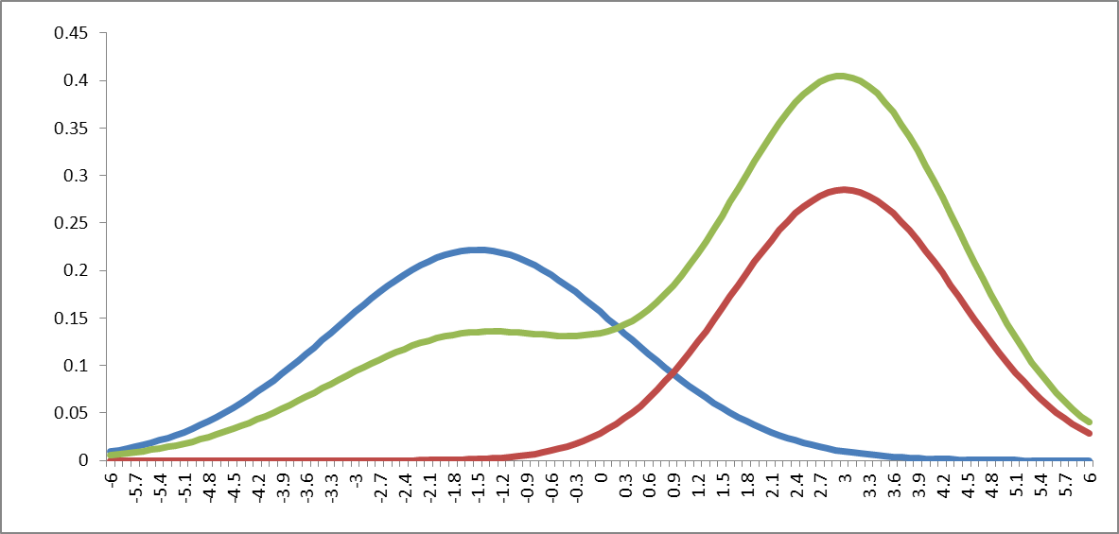
Bio-Math Exploration 13.1: What is in the mixture?
13.1d: Using the default proportion of 0.3 normal hemoglobin, explain why the two peaks are so far below and above, respectively, the original curves.
The combined curve is weighted in favor of the 2nd curve, which makes it higher than the 2nd peak and makes the 1st peak lower than the peak in the 1st curve.
Figure 13.4
Notes:
Figure 13.3 The distribution pattern of hemoglobin represented as scanning diagrams of hemoglobin from (a) normal individuals, (b) individuals with sickle cell anemia, (c) individuals with the mild form of sickling, and (d) an artificial mixture of hemoglobin from normal and sickle-cell anemia individuals at pH 6.9. Each peak represents a distinct band and the arrows in each figure represent the line of no movement.
Talking Points: .

Slide 11
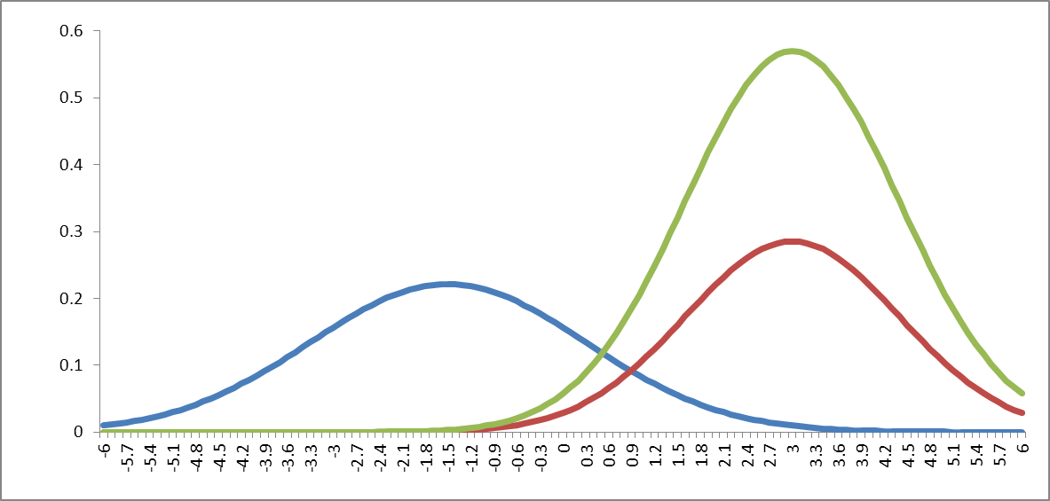
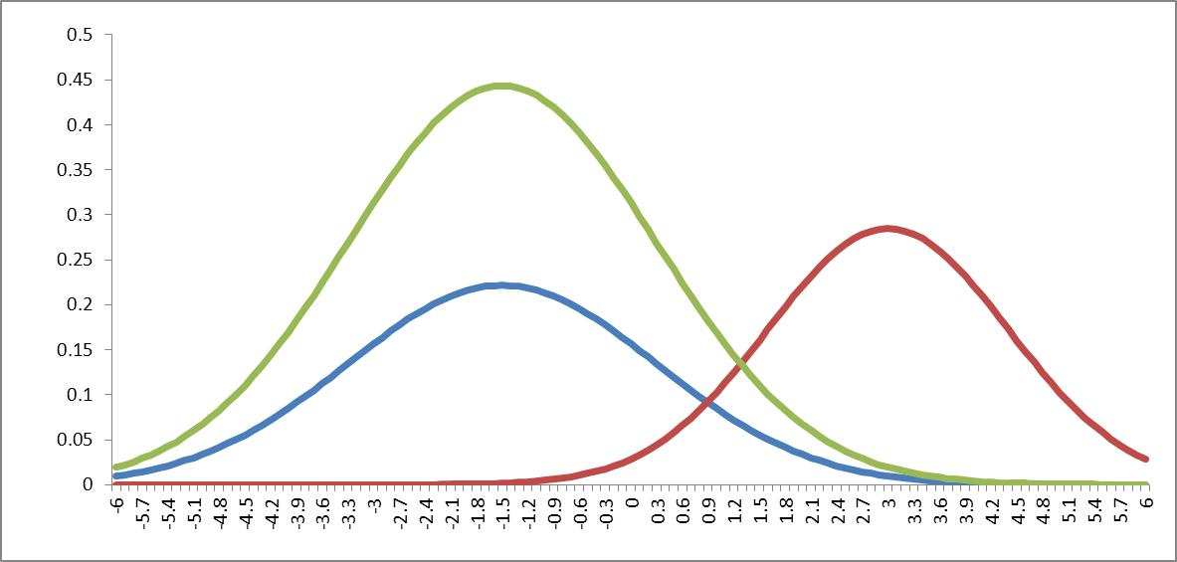
Bio-Math Exploration 13.1: What is in the mixture?
13.1e: Set the proportion of normal hemoglobin (cell B7) to 0 and describe the resulting combined curve. Repeat with the proportion set to 1.
Figure 13.4
Notes:
Figure 13.3 The distribution pattern of hemoglobin represented as scanning diagrams of hemoglobin from (a) normal individuals, (b) individuals with sickle cell anemia, (c) individuals with the mild form of sickling, and (d) an artificial mixture of hemoglobin from normal and sickle-cell anemia individuals at pH 6.9. Each peak represents a distinct band and the arrows in each figure represent the line of no movement.
Talking Points: .

Slide 12
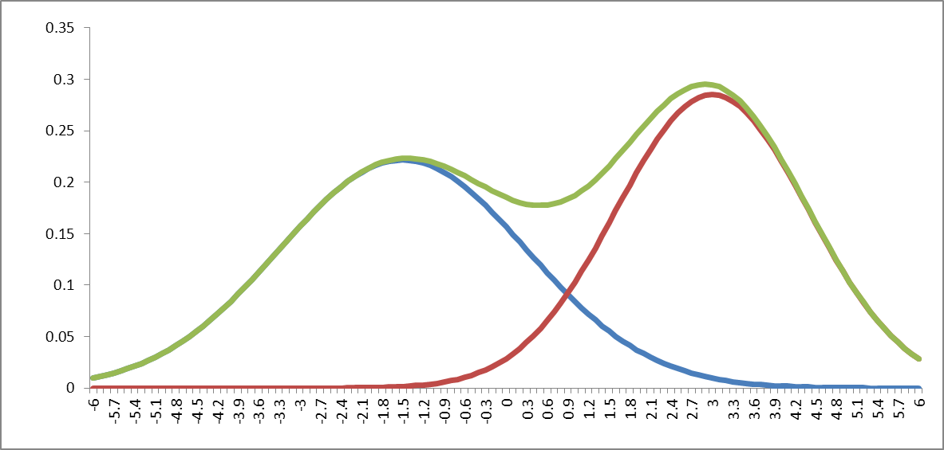
Bio-Math Exploration 13.1: What is in the mixture?
13.1f: Set the proportion of normal hemoglobin to 0.5. Compare the resulting combined curve to that in Figure 13.3(d), and compare the graph of all three curves to Figure BME 13.1.1.
Figure 13.4
Notes:
Figure 13.3 The distribution pattern of hemoglobin represented as scanning diagrams of hemoglobin from (a) normal individuals, (b) individuals with sickle cell anemia, (c) individuals with the mild form of sickling, and (d) an artificial mixture of hemoglobin from normal and sickle-cell anemia individuals at pH 6.9. Each peak represents a distinct band and the arrows in each figure represent the line of no movement.
Talking Points: .

Slide 13
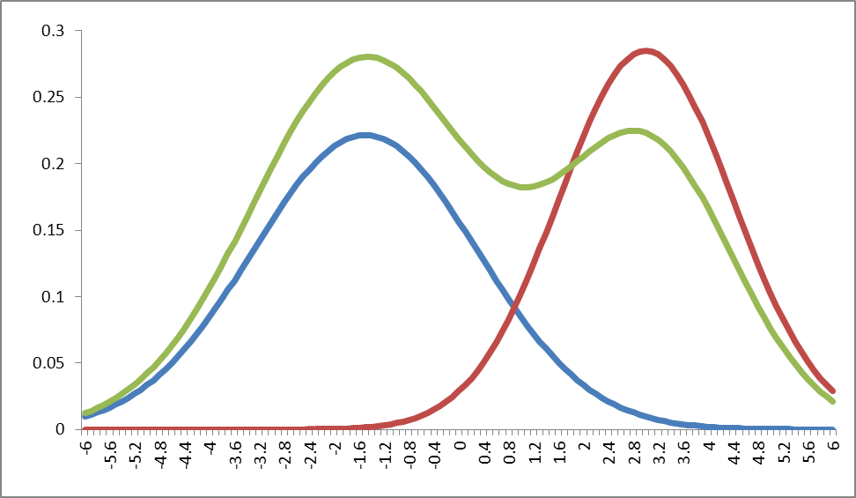
Bio-Math Exploration 13.1: What is in the mixture?
13.1g: Experiment with the proportion of normal hemoglobin to find a value that produces a combined curve that you think most closely matches the one in Figure 13.2(c).
0.63 of normal, 0.37 sickle-cell is shown on top graph.
Figure 13.4
Notes:
Figure 13.3 The distribution pattern of hemoglobin represented as scanning diagrams of hemoglobin from (a) normal individuals, (b) individuals with sickle cell anemia, (c) individuals with the mild form of sickling, and (d) an artificial mixture of hemoglobin from normal and sickle-cell anemia individuals at pH 6.9. Each peak represents a distinct band and the arrows in each figure represent the line of no movement.
Talking Points: .

Slide 14
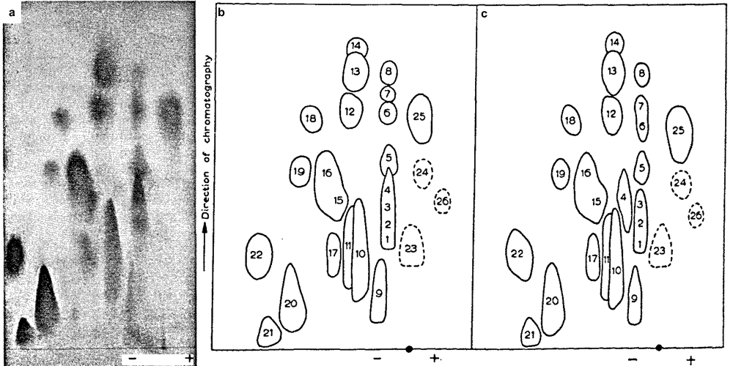
Peptide fingerprint of normal hemoglobin and tracings of normal and sickle-cell hemoglobin fingerprints digested in trypsin
Numbers paired for sickle-cell hemoglobin peptides
Blots are NOT the same!
Figure 13.3
Notes:
Figure 13.3 Peptide fingerprint of normal hemoglobin (a) and tracings of (b) normal and (c) sickle-cell hemoglobin fingerprints digested by trypsin. Peptides are separated by charge horizontally and size vertically. The black dots indicate starting position. Numbers arbitrarily set for normal hemoglobin and then paired for sickle-cell hemoglobin peptides.
Talking Points: .

Slide 15
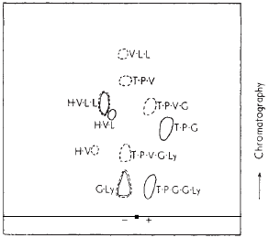
Fingerprint of hemoglobin peptide 4 in Figure 13.4
H = histidine
V = valine
L = leucine
T = threonine
P = proline
G = glutamic acid
Ly = lysine
Figure 13.4
Notes:
Figure 13.4 Fingerprint of hemoglobin peptide 4 from Figure 13.3. The horizontal axis is the electrophoretic axis, with the black square representing the starting position. Normal (solid traces) and sickle-cell (dashed traces) peptide fragments were run separately and superimposed. H = histidine, V = valine, L = leucine, T = threonine, P = proline, E = glutamic acid, K = lysine.
Talking Points: .

Slide 16
Amino acid sequence alignment for peptide hemoglobin chain #4 from Fig. 13.3, reconstructed from peptide fragments in Fig. 13.4
Type of hemoglobin peptide | Sequences
Sickle-cell | H H | V V V | L L | L L | T T T | P P P | V V V | G G G | Ly Ly
Reconstructed sickle-cell peptide | H | V | L | L | T | P | V | G | Ly
Normal | H H | V V | L L | L | T T | P P | G G | G G | Ly Ly
Reconstructed normal peptide | H | V | L | L | T | P | G | G | Ly
Table 13.2
Notes:
Table 13.2 Amino acid sequence alignment for the peptide hemoglobin chain #4 from Figure 13.4, reconstructed from peptide fragments in Figure 13.5. H = histidine, V = valine, L = leucine, T = threonine, P = proline, G = glutamic acid, Ly = lysine.
Talking Points: .

Slide 17
Amino acid sequence alignment for peptide hemoglobin chain #4 from Fig. 13.3, reconstructed from peptide fragments in Fig. 13.4
Type of hemoglobin peptide | Sequences
Sickle-cell | H H | V V V | L L | L L | T T T | P P P | V V V | G G G | Ly Ly
Reconstructed sickle-cell peptide | H | V | L | L | T | P | V | G | Ly
Table 13.2
Notes:
Table 13.2. Amino acid sequence alignment for the peptide hemoglobin chain #4 from Figure 13.4, reconstructed from peptide fragments in Figure 13.5. H = histidine, V = valine, L = leucine, T = threonine, P = proline, G = glutamic acid, Ly = lysine.
Talking Points: .

Slide 18
Amino acid sequence alignment for peptide hemoglobin chain #4 from Fig. 13.3, reconstructed from peptide fragments in Fig. 13.4
Type of hemoglobin peptide | Sequences
Sickle-cell | H H | V V V | L L | L L | T T T | P P P | V V V | G G G | Ly Ly
Reconstructed sickle-cell peptide | H | V | L | L | T | P | V | G | Ly
Table 13.2
Notes:
Table 13.2. Amino acid sequence alignment for the peptide hemoglobin chain #4 from Figure 13.4, reconstructed from peptide fragments in Figure 13.5. H = histidine, V = valine, L = leucine, T = threonine, P = proline, G = glutamic acid, Ly = lysine.
Talking Points: .

Slide 19
Amino acid sequence alignment for peptide hemoglobin chain #4 from Fig. 13.3, reconstructed from peptide fragments in Fig. 13.4
Type of hemoglobin peptide | Sequences
Normal | H H | V V | L L | L | T T | P P | G G | G G | Ly Ly
Reconstructed normal peptide | H | V | L | L | T | P | G | G | Ly
Table 13.2
Notes:
Table 13.2. Amino acid sequence alignment for the peptide hemoglobin chain #4 from Figure 13.4, reconstructed from peptide fragments in Figure 13.5. H = histidine, V = valine, L = leucine, T = threonine, P = proline, G = glutamic acid, Ly = lysine.
Talking Points: .

Slide 20
Amino acid sequence alignment for peptide hemoglobin chain #4 from Fig. 13.3, reconstructed from peptide fragments in Fig. 13.4
Type of hemoglobin peptide | Sequences
Normal | H H | V V | L L | L | T T | P P | G G | G G | Ly Ly
Reconstructed normal peptide | H | V | L | L | T | P | G | G | Ly
Table 13.2
Notes:
Table 13.2. Amino acid sequence alignment for the peptide hemoglobin chain #4 from Figure 13.4, reconstructed from peptide fragments in Figure 13.5. H = histidine, V = valine, L = leucine, T = threonine, P = proline, G = glutamic acid, Ly = lysine.
Talking Points: .

Slide 21
Amino acid sequence alignment for peptide hemoglobin chain #4 from Fig. 13.3, reconstructed from peptide fragments in Fig. 13.4
Type of hemoglobin peptide | Sequences
Normal | H H | V V | L L | L | T T | P P | G G | G G | Ly Ly
Reconstructed normal peptide | H | V | L | L | T | P | G | G | Ly
Table 13.2
Notes:
Table 13.2. Amino acid sequence alignment for the peptide hemoglobin chain #4 from Figure 13.4, reconstructed from peptide fragments in Figure 13.5. H = histidine, V = valine, L = leucine, T = threonine, P = proline, G = glutamic acid, Ly = lysine.
Talking Points: .

Slide 22
Solubility of hemoglobin
 | Normal hemoglobin |  | Sickle-cell hemoglobin
Ionic strength | de-O₂ | O₂ | de-O₂ | O₂
4.5 | no max found | no max found | 0.3 | no max found
5 | 1.6 | 6.3 | 0.08 | 6.3
5.5 | 0.1 | 0.4 | not soluble | 0.4
Table 13.3
Notes:
Table 13.3. Solubility (g/L) of normal and sickle-cell hemoglobin at different pHs. De-O₂ = de-oxygenated, and O₂ = oxygenated forms of hemoglobin.
Talking Points: .

Slide 23
Incidence of malaria parasite in children from a community in Uganda and in adult males dosed with the malaria parasite
a. hemoglobin genotype in children | % with malaria parasite present | % with high parasite density
normal (homozygous normal) | 45.7 | 66.0
mild sickling (heterozygous) | 27.9 | 33.3
b. hemoglobin genotype in adult males | % with malaria parasite present | % with high parasite density
normal (homozygous normal) | 93.3 | 40
mild sickling (heterozygous) | 13.3 | 0
Table 13.4
Notes:
Table 13.4. Incidence of the malaria parasite in blood of normal and sickle-cell children from a small community in Uganda, Africa and adult males dosed with the malaria parasite.
Talking Points: .

Slide 24
The 15 exons of the FUS/TLS protein gene along with the corresponding protein regions and the positions of the mutations
Region rich in arginine-glycine-glycine
Region rich in serine, tyrosine, glutamine, glycine
Figure 13.5
Notes:
Figure 13.5 The 15 exons (bottom) of the gene that encodes the FUS/TLS protein, along with the corresponding protein regions and the positions of the mutations. The amino acids in positions 514 to 526 (exon 15) of the wild type FUS/TLS protein are shown in black letters. The mutations are shown above each position in red. S,Y,Q,G –rich denotes a region rich in serine, tyrosine, glutamine, and glycine; G-rich and RGG-rich regions are enriched in either glycine and arginine-glycine-glycine, respectively.
Talking Points: .

Slide 25
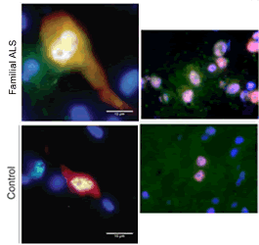
Immunostaining of spinal cord from familial ALS patients vs. control patients
Cells are stained for: nuclei (blue)
a marker protein (red),
and FUS/TLS (green);
bright white = areas that stained for the marker protein, nuclei and FUS/TLS;
large yellow area in the top panel stained for both the marker and FUS/TLS, outside the nucleus.
Figure 13.6
Notes:
Figure 13.6 Staining of spinal cord from a familial ALS (top row) vs. normal individuals (bottom row). In the two left side images, cells are stained for nuclei (blue), a marker protein (red), and FUS/TLS (green); other colors are described in the text. Scale bars, 10 mm. In the two right side images, cells are stained for FUS/TLS (red), ubiquitin (green), and nuclei (blue), and areas with more than one of these are pinkish.
Talking Points: .

Slide 26
Immunostaining of spinal cord from familial ALS patients vs. control patients
Cells are stained for: ubiquitin (green),
FUS/TLS (red)
nuclei (blue),
nuclei with FUS/TLS are pink,
nuclei with ubiquitin and FUS/TLS are whitish-pink.
More nuclei have both FUS/TLS and ubiquitin in familial ALS patients; indicates faulty protein
Figure 13.6
Notes:
Figure 13.6 Staining of spinal cord from a familial ALS (top row) vs. normal individuals (bottom row). In the two left side images, cells are stained for nuclei (blue), a marker protein (red), and FUS/TLS (green); other colors are described in the text. Scale bars, 10 mm. In the two right side images, cells are stained for FUS/TLS (red), ubiquitin (green), and nuclei (blue), and areas with more than one of these are pinkish.
Talking Points: .

Slide 27
ELSI 13.1 What is normal? What would we lose if everyone were perfect?
ELSI Integrating Questions
Do you think that everyone should strive for perfection? In what sense do you mean?
To what lengths do some people go to achieve perfection? Is the quest for perfection in your example normal or abnormal? In what sense?
What would humanity gain or lose if all humans were the same, in any way?

Slide 28
Integrating Concepts in Biology
Chapter 13: Cells at the Organismal Level
Section 13.2 How do pathogens affect cells and organisms?

Slide 29
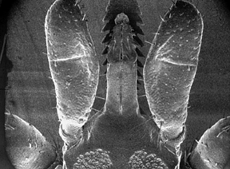
Palps &
Chelicerae protect barbed hypostome. Most hard ticks also secrete a cement from salivary glands.
Hypostome
Dorsal view of mouthparts of hard tick
Notes:
Image is not in text; taken from CP’s entomology notes/slides

Slide 30
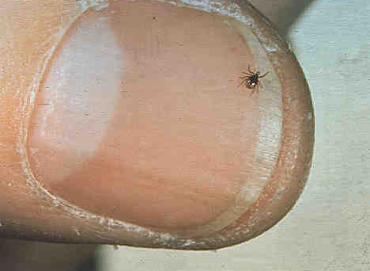
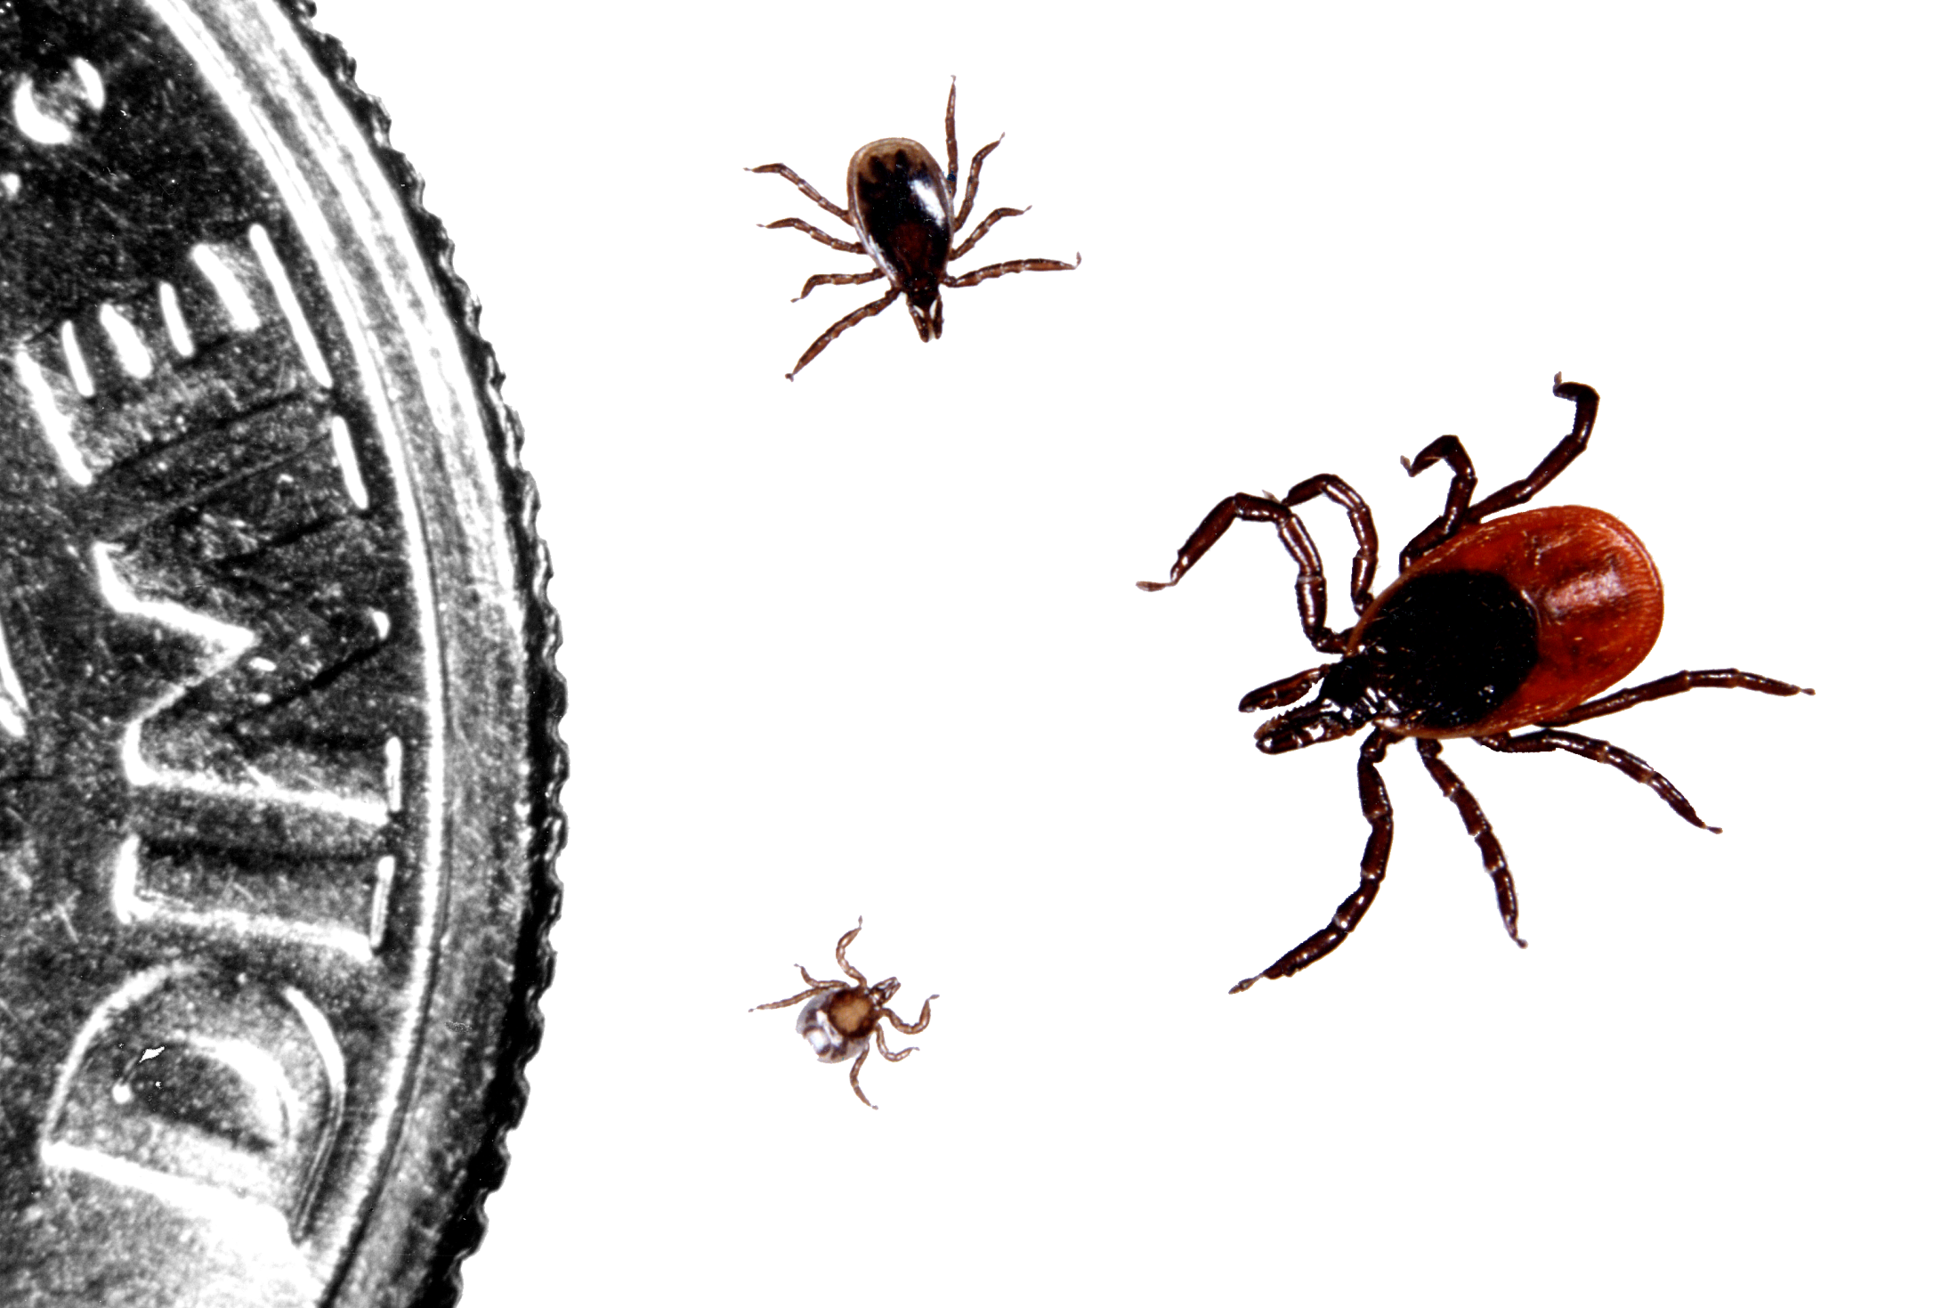
Black-legged ticks (deer ticks)
Nymph
Three life stages
Adult
(female)
Larva
Notes:
Blacklegged ticks live for two years and have three blood meals. The life cycle begins when the female lays eggs. As the eggs mature, they develop into a larva (bottom), then a nymph (left) and finally, adult male or female (adult female shown on right).
Image is not in text; taken from CP’s entomology notes/slides

Slide 31
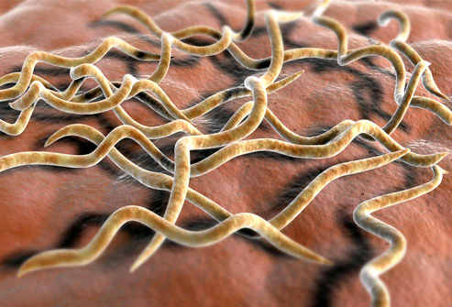
Ticks and Lyme disease
Ticks are ectoparasites and vectors
Spirochete bacterium is the pathogen (Borrelia burgdorferi)
Notes:
Image is not in text; taken from CP’s entomology notes/slides

Slide 32
Numbers of mice and ticks infected with the indicated strain of B. burgdorferi
Strain used to infect mice | Infection route | Antibodies present | B. burgdorferi in mouse tissue | Ticks re-infected
Wild type | Injection | 77.8 | 44.4 | 17.6
 | Tick bite | 83.3 | 83.3 | 92.8
OSP-C negative | Injection | 0 | 0 | 0
 | Tick bite | 0 | 0 | 0
OSP-C re-inserted | Injection | 66.7 | 66.7 | 18.5
 | Tick bite | 75 | 75 | 56.7
Table 13.5
Notes:
Table 13.5 Percentages of mice and ticks infected with the indicated strain of B. burgdorferi. The final column is the percentage of ticks that were re-infected by feeding on mice that had been infected in the experiment.
Talking Points: OSP-C is essential for early mammalian infection. May be required for evasion of immune system during early phase of infection and spread throughout bloodstream.

Slide 33
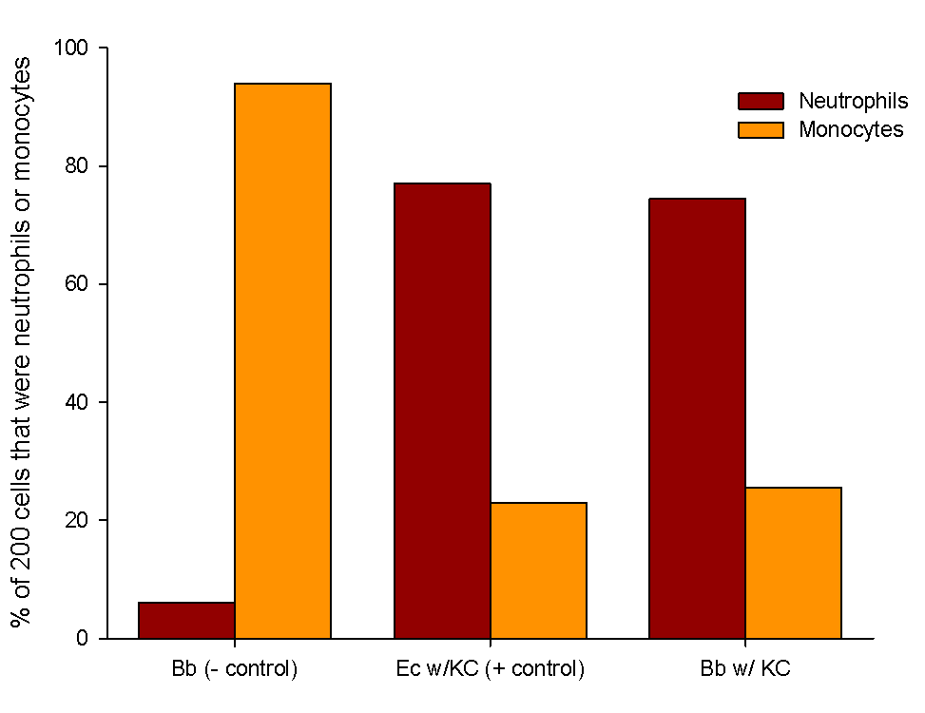
KC activity of cell culture supernatants
overall percentage for all mice sampled
Figure 13.7
Bb = Borrelia burgdorferi, Ec = E. coli, KC = chemokine.
Notes:
Figure 13.7 KC activity of cell culture supernatants. The first 200 leucocytes observed in each sample were identified as either neutrophils or monocytes, and percentage shown is the overall percentage for all mice sampled. Bb = Borrelia burgdorferi, Ec = E. coli, KC = chemokine.
Talking Points: .

Slide 34
% of tissues from mice injected with either non-engineered or genetically engineered B. burgdorferi with active bacterial infections
 | Heart | Joint | Skin
Non-engineered B. burgdorferi | 100 | 100 | 100
KC chemokine B. burgdorferi | 30 | 30 | 60
% of 10 mice injected with either non-engineered or genetically engineered B. burgdorferi w/ infections 30 days after injection
Table 13.6a
Notes:
Table 13.6 a. Percentages of tissues from ten mice injected with either non-engineered or genetically engineered B. burgdorferi that showed active bacterial infections 30 days after injection. b. Percentages of tissues from six mice injected with a particular dose of either non-engineered or genetically engineered B. burgdorferi that showed active bacterial infections 30 days after injection.
Talking Points: .

Slide 35
% of tissues from mice injected with either non-engineered or genetically engineered B. burgdorferi with active bacterial infections
Dose-dependent effect
 | Heart | Joint | Skin
10⁵ non-engineered cells | 100 | 100 | 100
10⁴ non-engineered cells | 100 | 100 | 100
10³ non-engineered cells | 100 | 100 | 100
10² non-engineered cells | 83.3 | 83.3 | 83.3
10¹ non-engineered cells | 0 | 0 | 0
10⁷ KC chemokine cells | 33.3 | 16.7 | 66.7
10⁶ KC chemokine cells | 0 | 0 | 16.7
10⁵ KC chemokine cells | 0 | 0 | 0
10⁴ KC chemokine cells | 0 | 0 | 0
10³ KC chemokine cells | 0 | 0 | 0
Table 13.6b
Notes:
Table 13.6 a. Percentages of tissues from ten mice injected with either non-engineered or genetically engineered B. burgdorferi that showed active bacterial infections 30 days after injection. b. Percentages of tissues from six mice injected with a particular dose of either non-engineered or genetically engineered B. burgdorferi that showed active bacterial infections 30 days after injection.
Talking Points: .

Slide 36
Ethical, Legal, and Social Implications Box 13.2
What are the issues with using animals in research?
Where should we draw the line on range of experiments on animals?
What are your thoughts on this issue?
  What side of the debate do you fall on, and what evidence and arguments are the most compelling for you?
What are some of the legal debates associated with this issue?
Consider laws that apply to product and drug testing, as well as laws that apply to animal rights activists that break into laboratories.
Notes:
Talking Points: .

Slide 37
Response of rice blast infection cells when exposed to concentrated solutions of polyethylene glycol (PEGs) polymers of different mean molecular weights.
PEG molecular weight | Cells with melanin | Cells without melanin
200 (<1 nm pore size) | >90% collapse | >90% burst
400 (1 nm pore size) | >90% collapse | 90% burst
600 (2 nm pore size) | >90% collapse | 90% collapsed
Why does melanin lead to collapse?
What causes collapse in absence of melanin?
Table 13.7
Notes:
Table 13.7 Response of rice blast infection cells when exposed to concentrated solutions of polyethylene glycol (PEGs) polymers of different mean molecular weights.
Talking Points: Cells burst (plasmolyze) when exposed to PEG molecules small enough to enter the pores, because a high concentration outside the cell would cause rapid diffusion of many PEG molecules and bursting of the cell. Cells collapse when exposed to a high concentration of PEG molecules too large to enter the pores, as that would cause water to diffuse out, essentially emptying the cell. This row shows that cells with melanin have smaller pores, whereas cells without melanin have larger pores.

Slide 38
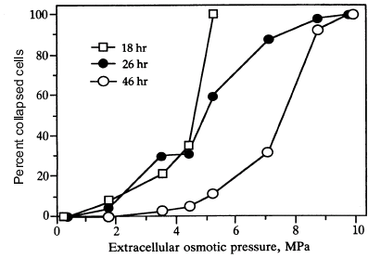
Infection cells grown in water, then placed in a PEG sol’n and then examined for cell collapse
Figure 13.8
Notes:
Figure 13.8 Infection cells were grown in water for either 18, 26, or 46 hours. After that time, the water was replaced with various concentrations of a large molecule PEG, which created a variety of external pressures. After 10 minutes of exposure the cells were examined for cell collapse.
Talking Points: .

Slide 39
Infection cells grown in water, then placed in a PEG sol’n and then examined for cell collapse
Grown in water for 18, 26, or 46 hours
Figure 13.8
Notes:
Figure 13.8 Infection cells were grown in water for either 18, 26, or 46 hours. After that time, the water was replaced with various concentrations of a large molecule PEG, which created a variety of external pressures. After 10 minutes of exposure the cells were examined for cell collapse.
Talking Points: .

Slide 40
Infection cells grown in water, then placed in a PEG sol’n and then examined for cell collapse
Figure 13.8
Notes:
Figure 13.8 Infection cells were grown in water for either 18, 26, or 46 hours. After that time, the water was replaced with various concentrations of a large molecule PEG, which created a variety of external pressures. After 10 minutes of exposure the cells were examined for cell collapse.
Talking Points: .

Slide 41
Penetration as a function of incubation time
Lower numbers are softer substrates
Longer incubation times generally increase percentage penetration, even as hardness of substrates increases
Figure 13.12
Notes:
Figure 13.9 Penetration as a function of (a) incubation time and (b) extracellular osmotic pressure. Numbers 1-6 in both panels indicate the substrate, with lower numbers being softer substrates.
Talking Points: Longer incubation times generally increase percentage penetration, even as hardness of substrates increases: suggests that pressure is building in the infection cells.

Slide 42
Penetration as a function of extracellular osmotic pressure
Lower numbers are softer substrates
Lower extracellular osmotic pressures tend to allow increased penetration, within a hardness level
Figure 13.12
Notes:
Figure 13.9 Penetration as a function of (a) incubation time and (b) extracellular osmotic pressure. Numbers 1-6 in both panels indicate the substrate, with lower numbers being softer substrates.
Talking Points: Lower extracellular osmotic pressures tend to allow increased penetration, within a hardness level: suggests that internal pressure is higher than external, allowing for penetration

Slide 43
Summarizing the Cell as the Big Idea so far
Main themes to integrate throughout the Big Idea
All cells come from preexisting cells (evolution).
Cells maintain internal environments that differ from their external environments (homeostasis).
Cell structure defines cell function (emergent properties, evolution).
Cells communicate with other cells (information).
Summary of 13.2
Pathogens disrupt host cells and allow invasion.
Host cells may not maintain homeostasis and function when invaded.
When cell function is disrupted problems for entire organism occur.

Slide 44
Integrating Concepts in Biology
Chapter 13: Cells at the Organismal Level
Section 13.3 How do muscles respond to exercise?

Slide 45
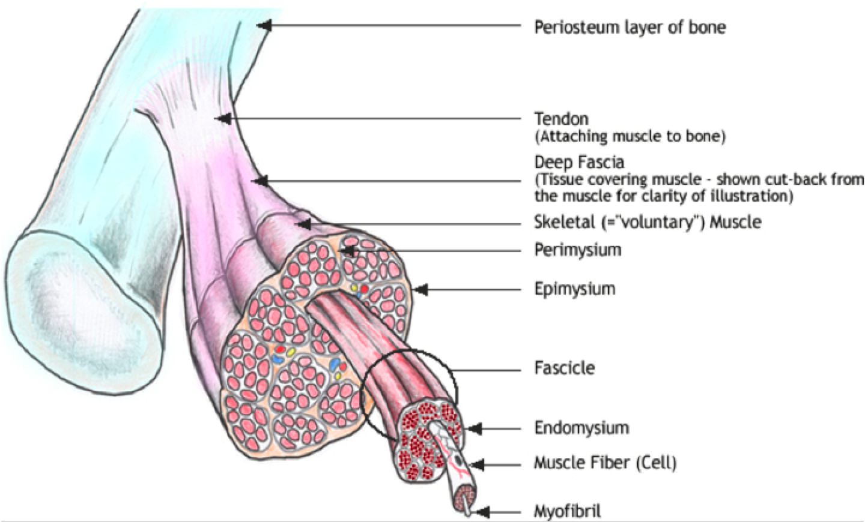
Notes:
Image not in text but shows muscles, scaled up from the cell to the tissue level.

Slide 46
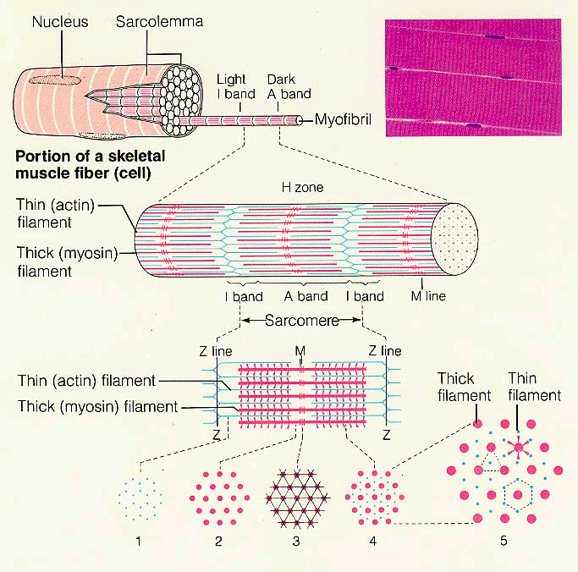
Notes:
Image not in text but shows muscles, across scales. Also shows another image of the functional unit of the muscle cell, the sarcomere

Slide 47
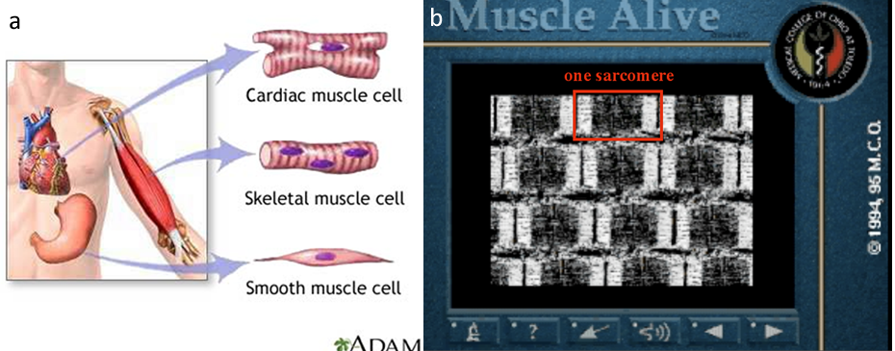
Muscle anatomy and structure
http://www.youtube.com/watch?v=CepeYFvqmk4
http://www.bio.davidson.edu/misc/movies/musclcp.mov
http://www.youtube.com/watch?v=xhgDbjrrmFg
Figure 13.10
Notes:
Figure 13.10 Muscle anatomy and structure. (a) The three types of vertebrate muscle cells, a cardiac muscle cell (top), a skeletal, or striated, muscle cell (middle), and a smooth muscle cell (bottom). Note that the skeletal muscle cell has multiple nuclei, while the other types have only one nucleus per cell. (b) Image from a movie of a skeletal muscle contracting which you can view online at WileyPlus.
Talking Points: .

Slide 48
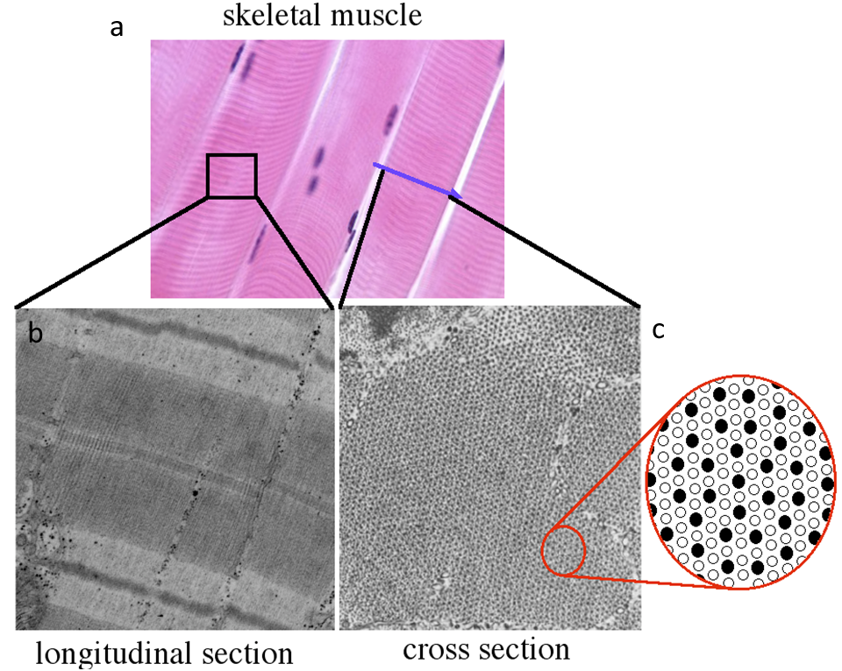
Skeletal muscle viewed from different perspectives
Figure 13.12
Notes:
Figure 13.12 Skeletal muscle viewed from different perspectives. (a) Muscle cells under light microscopy. Blue arrow marks the location of the cross-section in (c). Electron micrographs of (b) longitudinal and (c) cross sections of skeletal muscles.

Slide 49
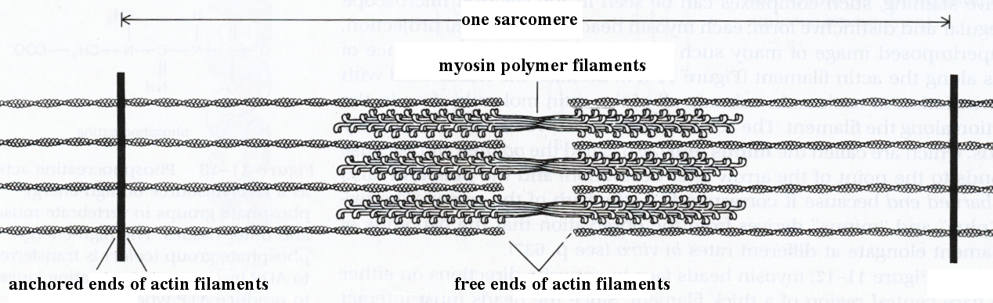
Actin and myosin interactions provide contractile function
Length of contractile unit spans from one actin anchor to the next
Figure 13.13
Notes:
Figure 13.13 Actin and myosin interactions provide contractile function. A sarcomere is the length of a contractile unit that spans from one actin anchor to the next. Squint your eyes to see the light and dark bands of the sarcomere.
Talking Points: .

Slide 50
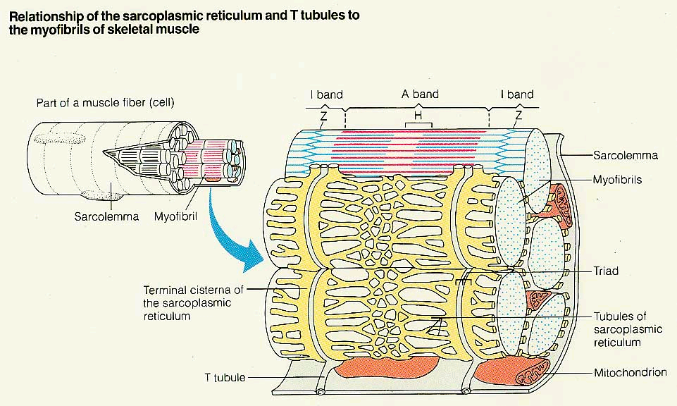
Notes:
Image not in text but shows muscles, across scales. Also shows relationship of sarcoplasmic reticulum and t-tubules to the myofibrils of muscle.

Slide 51
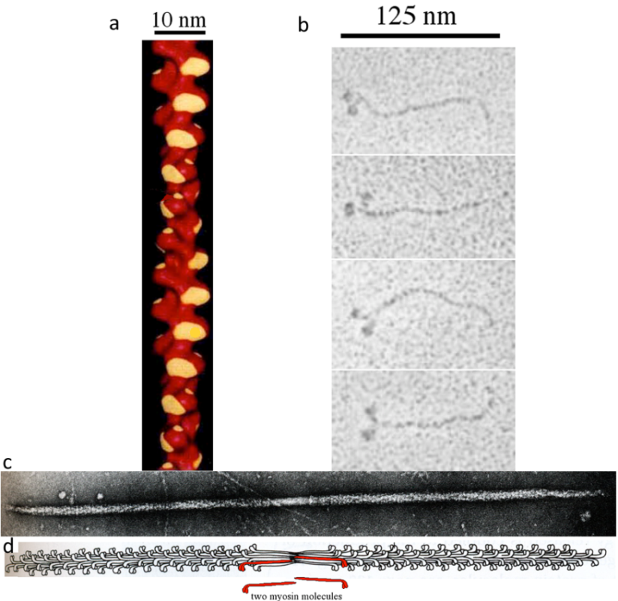
Actin and myosin molecules from skeletal muscle
(a) Actin polymer with myosin binding-site highlighted yellow.
(b) Electron micrographs of four myosin monomers.
(c) Myosin polymer
(d) Line drawing of molecule in panel c; two myosin monomers colored red.
Figure 13.14
Notes:
Figure 13.14 Actin and myosin molecules from skeletal muscle. (a) Molecular model of red actin polymer with myosin binding-site highlighted yellow. (b) Electron micrographs of four myosin monomers. (c) Myosin polymer electron micrograph. (d) Line drawing of molecule in panel c; two myosin monomers colored red.

Slide 52
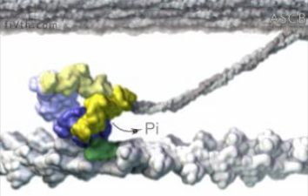
Myosin molecule using ATP to pull an actin filament
http://www.youtube.com/watch?v=VQ4OMSi6qAg
Figure 13.15
Notes:
Figure 13.15 Myosin molecule using ATP to pull an actin filament.

Slide 53
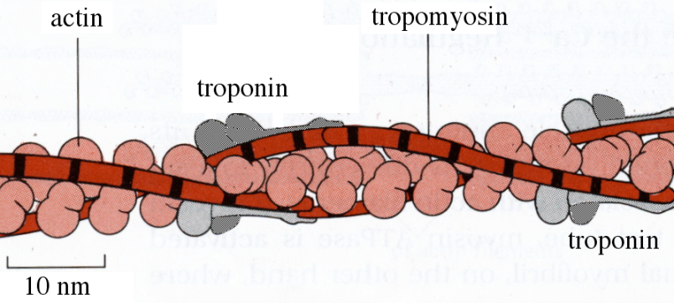
Actin-binding proteins regulate muscle contraction
http://www.bio.davidson.edu/misc/movies/tropotropo.mov
Figure 13.16
Notes:
Figure 13.16 Actin-binding proteins regulate muscle contraction. Actin rods are covered by long tropomyosin fibers and regularly spaced troponin molecules. Troponin binds calcium and tropomyosin blocks myosin binding sites on actin.

Slide 54
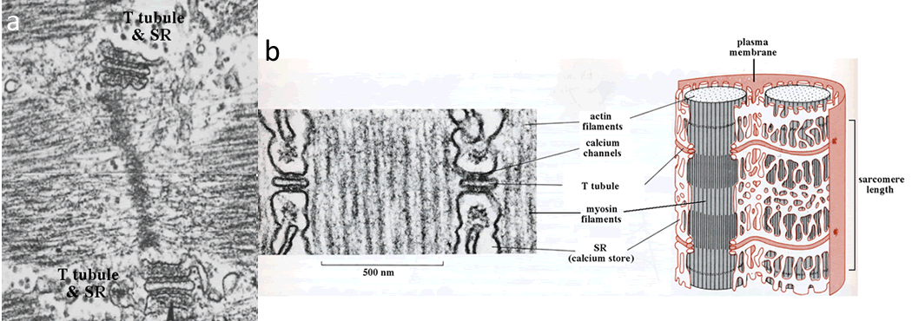
Membrane network surrounding sarcomeres
Figure 13.16
Notes:
Figure 13.17 Membrane network surrounding sarcomeres. (a) Plasma membrane extensions (T-tubules) surround sarcomeres; sarcoplasmic reticulum (SR) abuts T-tubules on both sides. (b) Summary images of sarcomere and membrane network that facilitates stimulation and contraction of muscle cells.

Slide 55
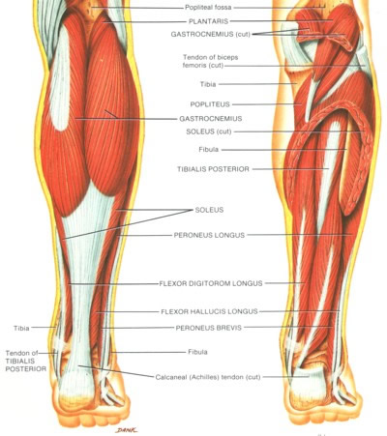
Gastrocnemius and plantaris muscle in humans
Notes:
Image not in text, but shows the muscles examined/experimented on in the case study.

Slide 56
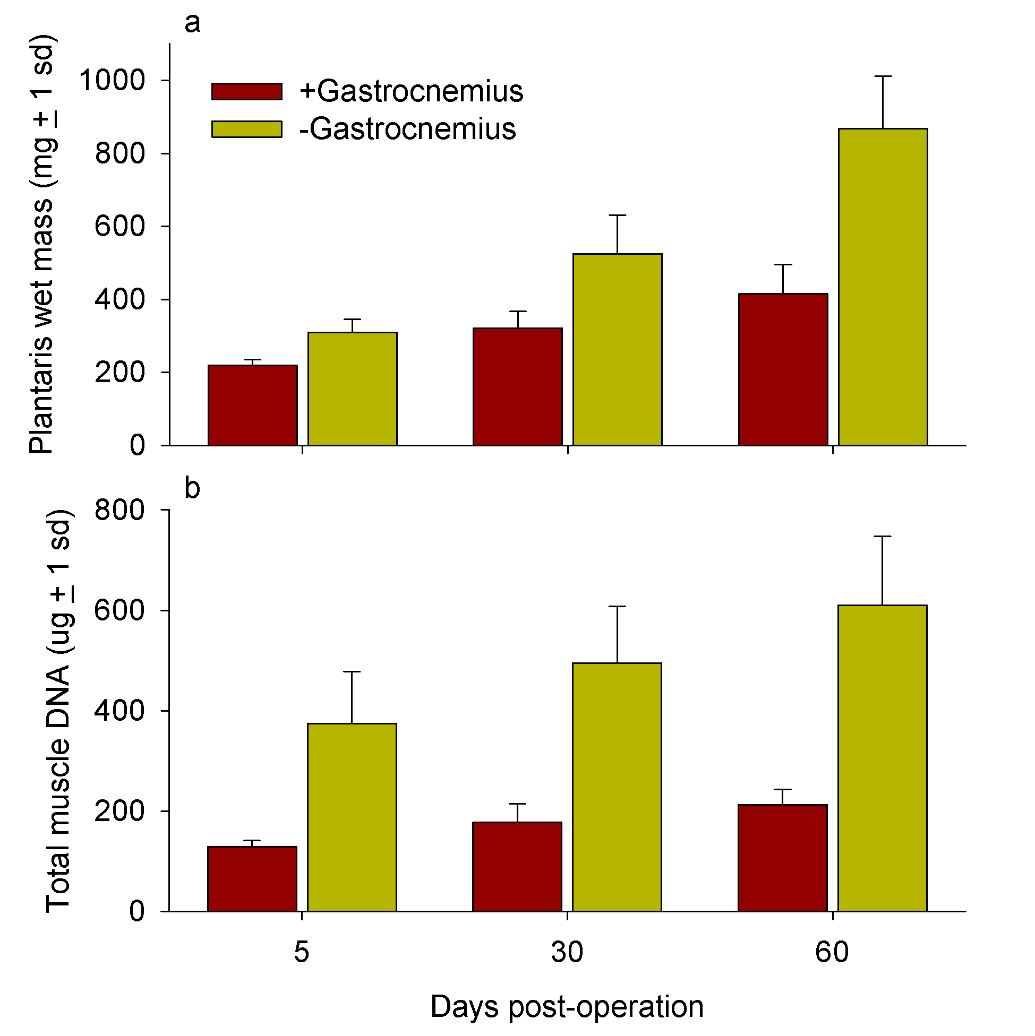
Plantaris wet mass
Effect of removal of the gastrocnemius muscle on the plantaris muscle in rats
Total muscle DNA
Figure 13.18
Notes:
Figure 13.18 Effect of removal of the gastrocnemius muscle on the plantaris muscle in rats. a. Plantaris wet mass. b. Total muscle DNA.
Talking Points: .

Slide 57
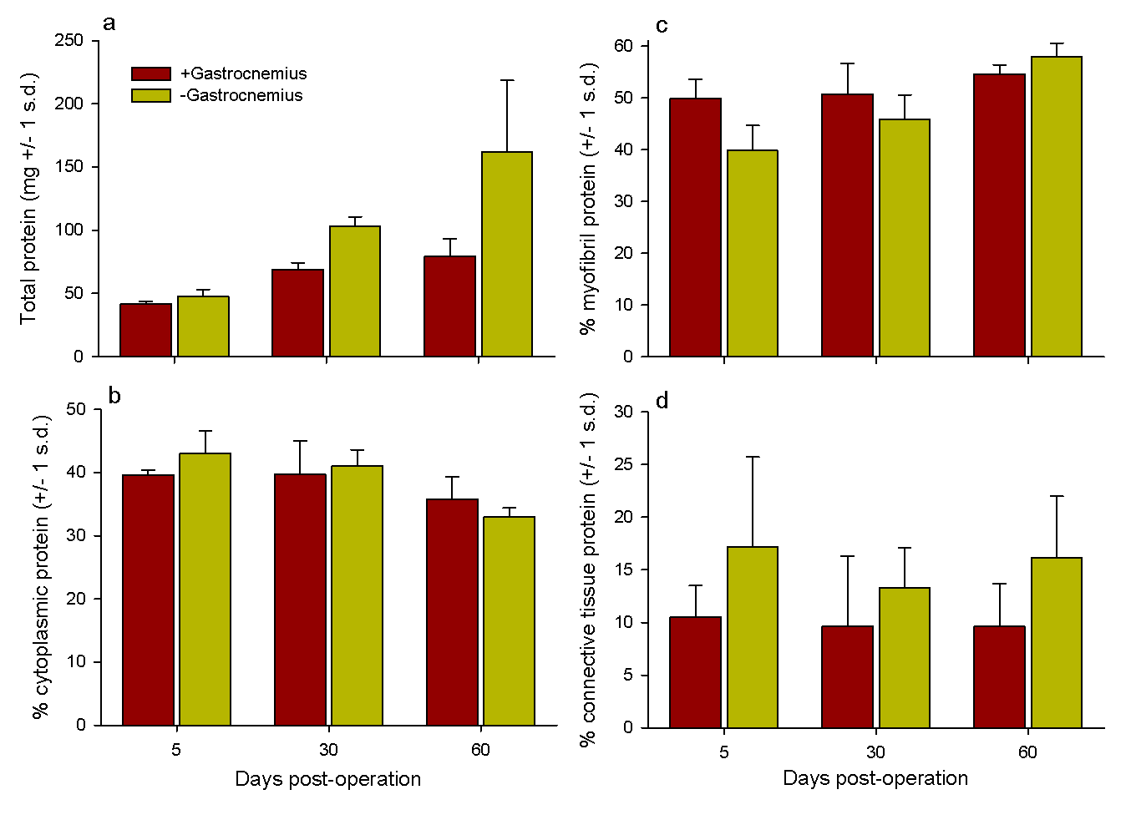
Effect of removal of the gastrocnemius muscle on the plantaris muscle in rats
Total protein mass
% protein found in muscle cell myofibrils
% protein found in muscle cell cytoplasm
% protein found in connective tissues
Figure 13.19
Notes:
Figure 13.19 Effect of removal of the gastrocnemius muscle on the plantaris muscle in rats. a. Total protein mass. b. Percent protein found in muscle cell cytoplasm. c. Percent protein found in muscle cells. d. Percent protein found in connective tissues.
Talking Points: .

Slide 58
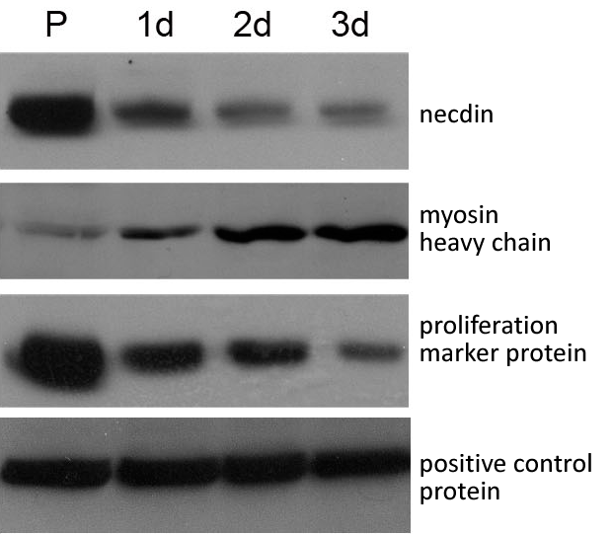
Primary muscle precursor cells maintained in growth medium (P), or allowed to differentiate. Protein expression analyzed using antibodies
Figure 13.20
Notes:
Figure 13.20 Muscle precursor cells were isolated, maintained for 24 h in growth medium (P), or allowed to differentiate for 1, 2, or 3 days. Protein expression was analyzed using antibodies specific to each protein. The myosin heavy chain is a subunit of the myosin protein. A protein expressed in both stages was used as a positive control.
Talking Points: Necdin is present during proliferation but then declines during differentiation. Myosin begins to increase as cells differentiate into muscle cells.

Slide 59
Gastrocnemius and plantaris muscle in humans
Notes:
Image not in text, but shows the relevant muscles for next experiment as well as gastrocnemius as a reference.

Slide 60
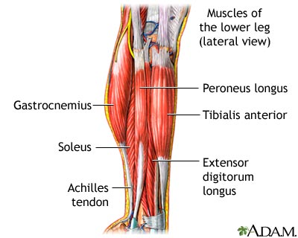
Notes:
Image not in text, but shows the relevant muscles for next experiment.

Slide 61
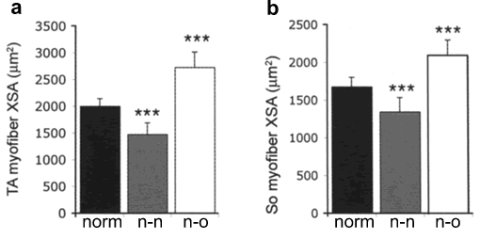
Average myofibril cross-sectional area (XSA) in muscles of normal, no-necdin, and necdin-overexpressing mice of different ages
What is the effect of necdin, based on absence of necdin or overabundance of necdin?
Figure 13.21
Notes:
Figure 13.21 Average myofibril cross-sectional area (XSA) for normal (norm), no-necdin (n-n), and necdin-overexpressing (n-o) mice of tibialis anterior (TA) (a) and soleus (So) (b) muscle in 60 day old mice. * = average significantly different from normal (P < 0.05), and *** = average highly significantly different from normal (P < 0.001).
Talking Points: .

Slide 62
Summarizing the Cell as the Big Idea so far
Main themes to integrate throughout the Big Idea
All cells come from preexisting cells (evolution).
Cells maintain internal environments that differ from their external environments (homeostasis).
Cell structure defines cell function (emergent properties, evolution).
Cells communicate with other cells (information).
Themes evident in 13.3
Muscle cells have many structural adaptations
Structure is related to function
Other cells communicate to cause proliferation and differentiation
Internal environment is important in muscle cell contraction
When many myofibrils are bundled together into a muscle, simultaneous contraction allows the muscle to perform work.

Slide 63
Ethical, Legal, and Social Implications Box 13.3: What are the consequences of performance-enhancing drugs?
Explain how the use of PEDs by some athletes creates an arms race among athletes of a particular sport.
Do you agree that using PEDs is akin to cheating in sports? Why or why not?
Using PEDs such as caffeine and other stimulants is common in schools and universities. Do you agree or disagree that the use of these drugs is analogous to the use of steroids in sports?
Notes:
Talking Points: .

Slide 64
Integrating Concepts in Biology
Chapter 13: Cells at the Organismal Level
Section 13.4 How does a Venus flytrap catch its prey?

Slide 65
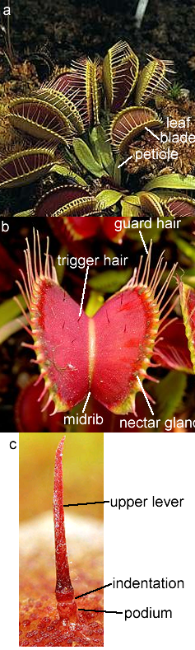
The Venus flytrap (Dionaea muscipula)
multiple leaf traps
close up of one leaf
close up of trigger hair
Figure 13.22
Notes:
Figure 13.22 The Venus flytrap (Dionaea muscipula) with multiple leaf traps (a) and close up of one leaf (b).
Talking Points: .

Slide 66
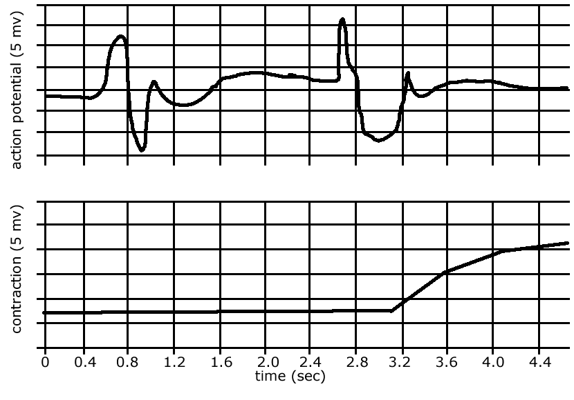
Action potentials and contraction of a Venus flytrap leaf in response to trigger hair deflection
Contraction after second action potential
Figure 13.23
Notes:
Figure 13.23 This graph shows the action potentials and contraction of a Venus flytrap leaf in response to deflection of trigger hairs. The top trace is the action potential measured on an oscilloscope, and the bottom is the contraction measured with a force transducer. The heavy lines on the y-axis are 5 millivolt intervals and the heavy lines on the x-axis are 0.2 second intervals.
Talking Points: .

Slide 67
Amplitude and duration of the first ineffective and second effective action potentials after stimulation of trigger hairs on Venus flytraps
first (ineffective) action potential |  |  |  | second (effective) action potential
depolarization |  | post-depolarization |  | depolarization |  | post-depolarization
Amp. | Dur. | Amp. | Dur. | Amp. | Dur. | Amp. | Dur.
11.2 (0.8) | 0.24 (0.1) | 10.4 (0.8) | 0.76 (0.1) | 14.6 (0.7) | 0.13 (0.02) | 8.4 (0.9) | 0.65 (0.07)
Averages for 31 leaves, with standard errors in parentheses. Amplitude is in millivolts (mv) and duration is in milliseconds (msec).
Table 13.6
Notes:
Table 13.6 Amplitude and duration of the first ineffective and second effective action potentials after stimulation of trigger hairs on Venus flytraps. Averages are for 31 separate leaves, and standard errors are in parentheses. Amplitude is in millivolts (mv) and duration is in milliseconds (msec).
Talking Points: .

Slide 68
Dependence of the distance between rims of lobes on injected charge using two electrodes located in a midrib (+) and in one of the lobes (−)
3 μC charge
injected to the same plant every 7 s. Capacitor was charged 1 s from 1.5 V battery.
Figure 13.24
Notes:
Figure 13.24 Dependence of the distance between rims of lobes on injected charge using two Ag/AgCl electrodes located in a midrib (+) and in one of the lobes (−) and 3 μC charge was injected to the same plant every 7 s. Capacitor was charged 1 s from 1.5 V battery.
Talking Points: .

Slide 69
Effect of various treatments on rate of trap closure in Venus flytraps after stimulation of trigger hairs
treatment | rate of closure
dark pre-treatment for 20 hours, then…
darkness | 39 + 19
light | 129 + 37
held in the following atmospheres in darkness for 30 minutes
air (0.03% CO₂, 20.5% O₂) | 20 + 2
100% CO₂ | 2 + 0
100% O₂ | 82 + 30
Rate of closure is in degrees per second. Numbers are averages for 20 traps + 1 standard deviation.
Table 13.9
Notes:
Table 13.9 Effect of various treatments on rate of trap closure in Venus flytraps after stimulation of trigger hairs. Rate of closure is in degrees per second. Numbers are averages for 20 traps + 1 standard deviation.
Talking Points: .

