Slide 1
Title Page
Integrating Concepts in Biology
PowerPoint Slides for Chapter 2:
Information at the Cellular Level
2.1 How does DNA communicate information to the cell?
by
A. Malcolm Campbell, Laurie J. Heyer, and Chris Paradise

Slide 2
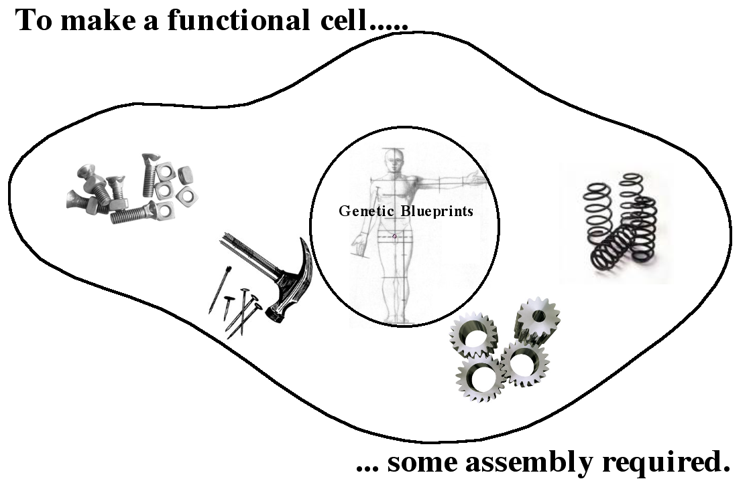
Opening Figure
Cells Are Assemble Molecules
Notes:
Opening Art: DNA contains instructions but each cell must construct its own components to perform a function.

Slide 3
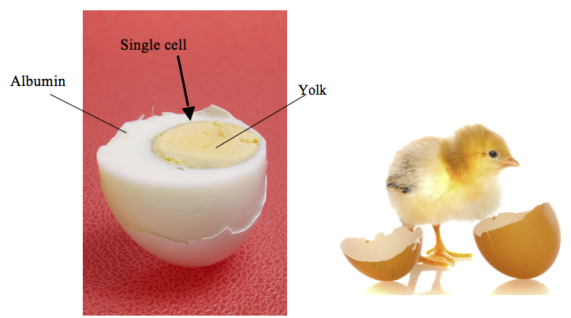
Fig. 2.1
Building Complexity from Simplicity
Notes:
Figure 2.1 Converting an egg to a chicken. Eggs are primarily made of lipids in the yolk and proteins in the albumin. The DNA inside the microscopic cell determines how to assemble these components into a living chick.

Slide 4
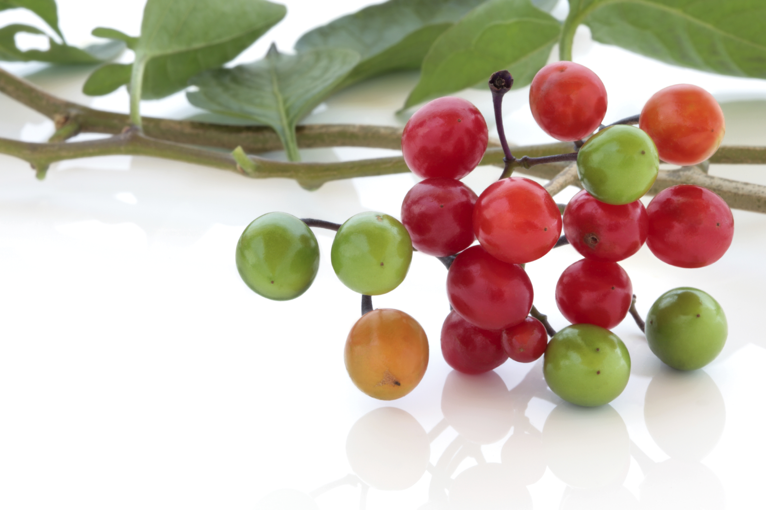
ELSI Fig. 2.1
Choose your words carefully
Notes:
ELSI Figure 2.1 Woody nightshade berries. Word choice can save your life since you can eat these berries but that does not make them edible.

Slide 5
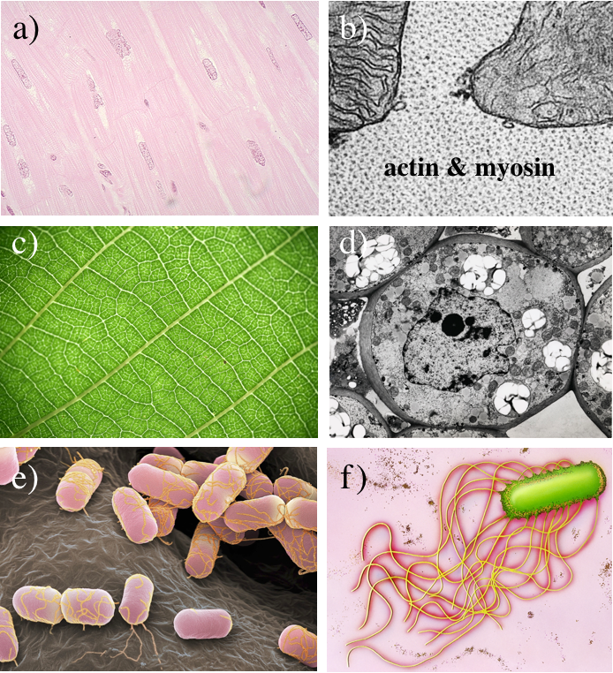
Fig. 2.2
Diversity of Cell Shape and Function
Notes:
Figure 2.2 Light microscope and electron microscope images of muscle cells, plant cells, and bacteria. (a) Cardiac, or heart, muscle cells with pill shaped nuclei; (b) electron micrograph of cardiac cell with mitochondria and actin/myosin fibers. (c) Photograph of plant leaf cells and (d) electron micrograph of a single plant cell. (e) Bacterial cells, colored pink with yellow flagella, adhering to a wavy surface and (f) electron micrograph of one bacterium (colored green) with its flagella used for swimming.

Slide 6
Fig. 2.2
Diversity of Cell Shape and Function
Notes:
Figure 2.2 Light microscope and electron microscope images of muscle cells, plant cells, and bacteria. (a) Cardiac, or heart, muscle cells with pill shaped nuclei; (b) electron micrograph of cardiac cell with mitochondria and actin/myosin fibers. (c) Photograph of plant leaf cells and (d) electron micrograph of a single plant cell. (e) Bacterial cells, colored pink with yellow flagella, adhering to a wavy surface and (f) electron micrograph of one bacterium (colored green) with its flagella used for swimming.

Slide 7
Fig. 2.2
Diversity of Cell Shape and Function
Notes:
Figure 2.2 Light microscope and electron microscope images of muscle cells, plant cells, and bacteria. (a) Cardiac, or heart, muscle cells with pill shaped nuclei; (b) electron micrograph of cardiac cell with mitochondria and actin/myosin fibers. (c) Photograph of plant leaf cells and (d) electron micrograph of a single plant cell. (e) Bacterial cells, colored pink with yellow flagella, adhering to a wavy surface and (f) electron micrograph of one bacterium (colored green) with its flagella used for swimming.

Slide 8
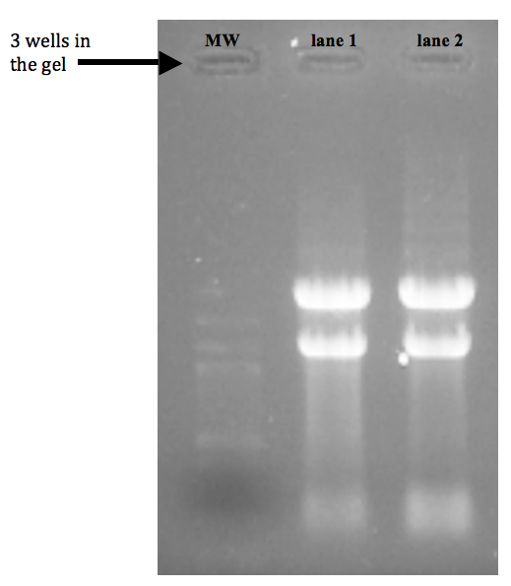
Fig. 2.3
Yeast RNA Separated by Size
Notes:
Figure 2.3 Photo of gel electrophoresis for two RNA samples. Molecular weight (MW) markers are DNA molecules of known sizes for use as a molecular ruler. RNA samples came from yeast with ample glucose for food (lane 1) and yeast with very little glucose (lane 2).

Slide 9
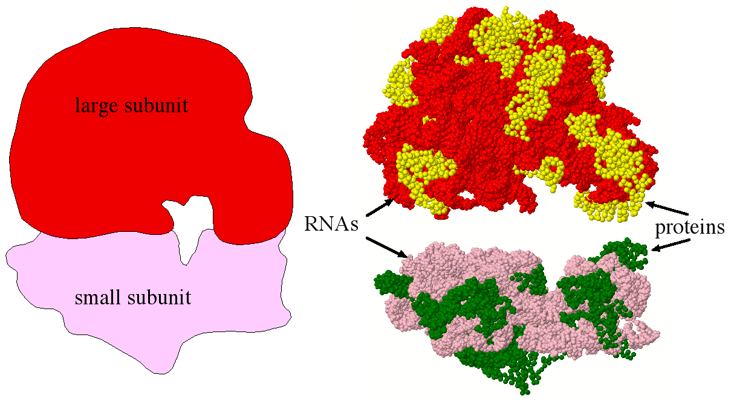
Fig. 2.4
Ribosome Structure
Notes:
Figure 2.4 Ribosome structure. (a) Diagram of a ribosome composed of two subunits. (b) Molecular model of both ribosome subunits, each composed of RNA molecules and proteins.

Slide 10
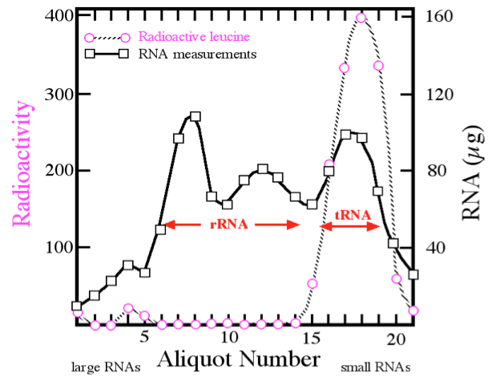
Fig. 2.5a
Notes:
Figure 2.5 Structure and function of tRNA. (a) RNA molecules interact with radioactive leucine. Total RNA from peas was extracted and incubated with radioactive leucine in the presence of cytoplasm from the peas. RNA molecules were separated by size. Radioactive leucine and RNA were detected separately as shown.

Slide 11
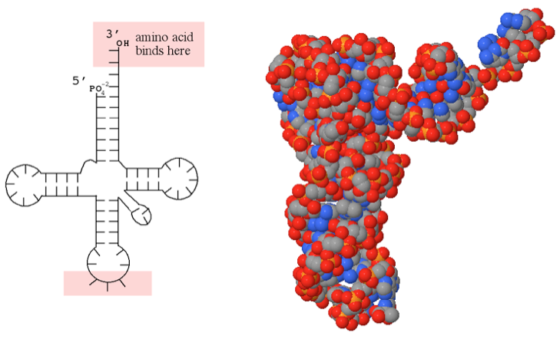
Fig. 2.5b & c
Notes:
Figure 2.5 Structure and function of tRNA. (a) RNA molecules interact with radioactive leucine. Total RNA from peas was extracted and incubated with radioactive leucine in the presence of cytoplasm from the peas. RNA molecules were separated by size. Radioactive leucine and RNA were detected separately as shown. (b) Two-dimensional representation of tRNA as determined by base paring within the molecule. (c) Space filling three-dimensional image of tRNA; red oxygen; blue nitrogen; orange phosphorous; and gray carbon. Interactive Jmol views of tRNA available online.

Slide 12
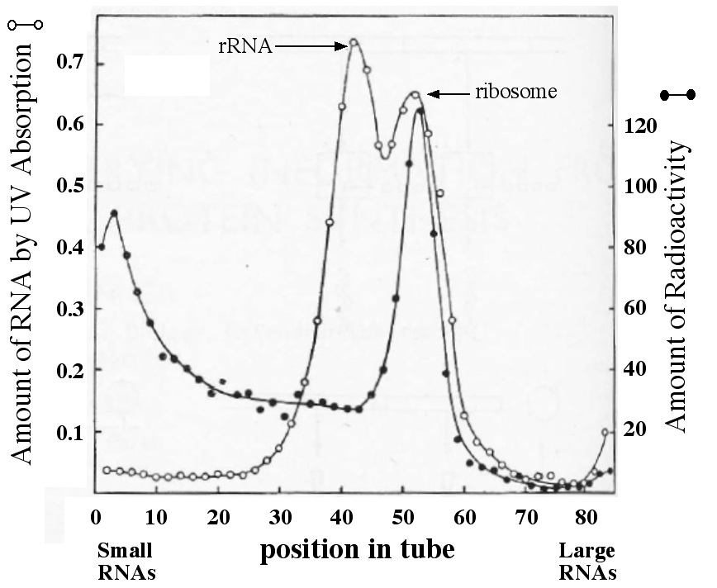
Fig. 2.7
Fractionation of RNA
Notes:
Figure 2.7 Centrifugation of RNA isolated from virally infected cells. RNA treated to protect ribosome stability, separated by density, measured by UV absorption (open circles) and by radioactivity (closed circles). After centrifugation, aliquots of liquid were removed from the indicated vertical positions in the tube (X-axis) and measured for RNA.

Slide 13
Title Page
Integrating Concepts in Biology
PowerPoint Slides for Chapter 2:
Information at the Cellular Level
2.2 How is gene transcription regulated?
by
A. Malcolm Campbell, Laurie J. Heyer, and Chris Paradise

Slide 14
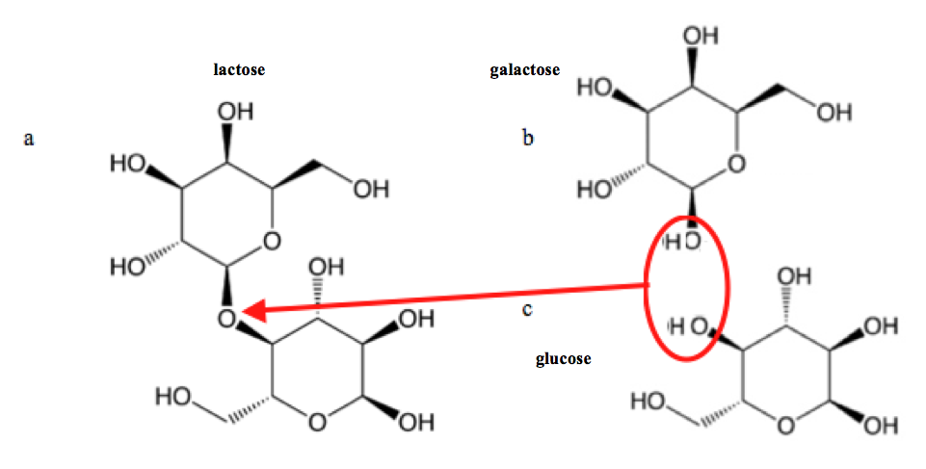
Fig. 2.8
Lactose Structure
Notes:
Figure 2.8 Molecular structure of lactose. (a) Lactose is a disaccharide, meaning it is made of two monosaccharides of (b) galactose and (c) glucose, which are connected by a beta (b) chemical bond (red arrow) connecting the circled atoms. Thick lines show atoms protruding towards the viewer and dashed lines indicate atoms jutting away from the viewer.

Slide 15
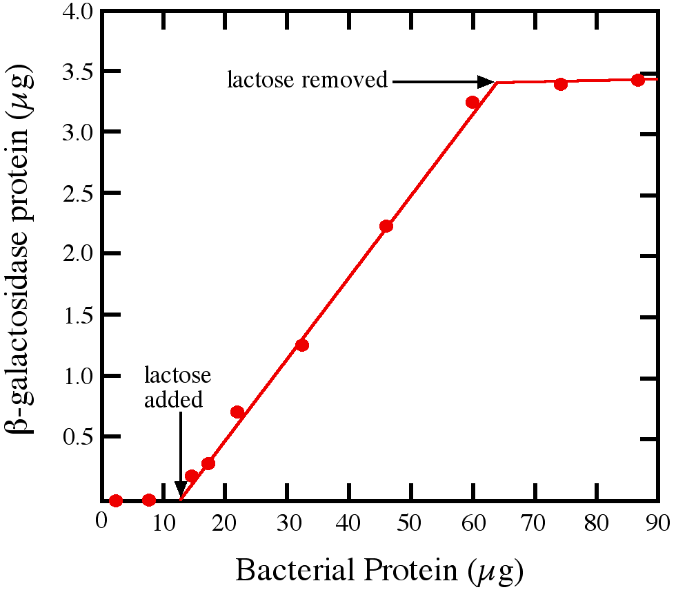
Fig. 2.9
β-galactosidase Induction
Notes:
Figure 2.9 Induction of b-galactosidase after exposure to lactose. Lactose was added to growing E. coli cells, and later removed. Aliquots of cells were isolated over time and tested for the amount of b-galactosidase. The X-axis shows cell growth by increasing total protein mass as an indirect measure of time.

Slide 16
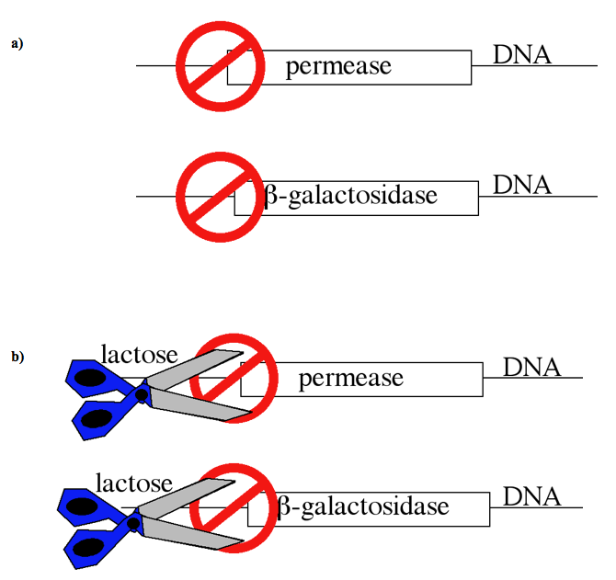
Fig. 2.10
Possible Induction Mechanism
Notes:
Figure 2.10 Proposed mechanism for activation of lactose-responsive genes. Jacob and Monod deduced that the two genes were (a) repressed by some common molecule (red “not” shape) and (b) activated by lactose. The red circle/slash represents a repressor protein.

Slide 17

Fig. 2.11
Genetic Map of Lactose Digestion
Notes:
Figure 2.11 Genetic map of DNA involved in lactose metabolism. The sizes of the boxes do not imply sizes of genes or the operator.

Slide 18
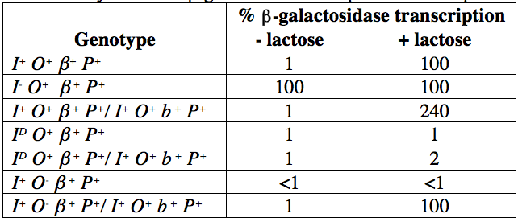
Table 2.1
Table 2.1
Table 2.1 Synthesis of β-galactosidase in diploid and haploid E. coli.
Notes:
Table 2.1. Synthesis of b-galactosidase and permease in diploid and haploid E. coli.

Slide 19
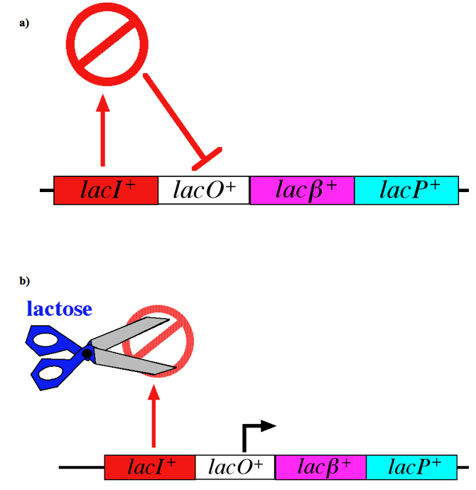
Fig. 2.12a & b
Regulation of Lac Genes
Notes:
Figure 2.12 Schematic diagrams of lac gene regulation. (a) lacI⁺ encodes an inhibitor that binds to lacO⁺ and blocks transcription. (b) In the presence of lactose, LacI⁺ protein is unable to inhibit lacO⁺ and transcription of lacb and lacP genes.

Slide 20
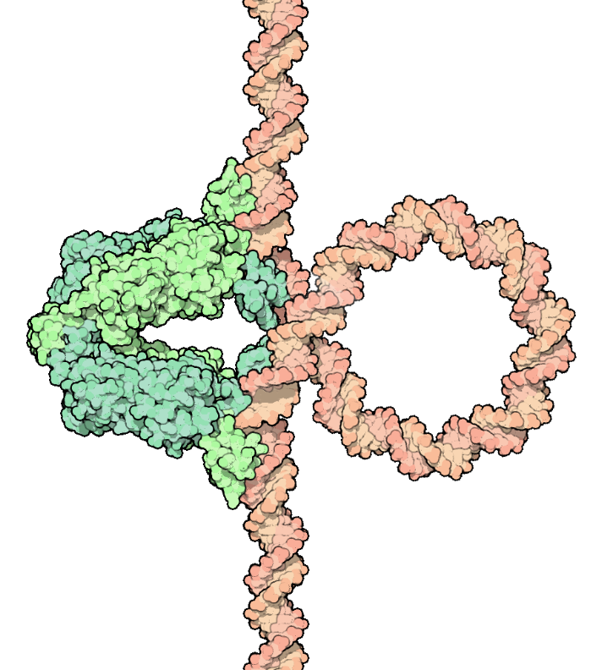
Figure 2.12c
LacI⁺ Bound to lacO⁺
Notes:
Figure 2.12c Schematic diagrams of lac gene regulation. c) Molecular structure of LacI⁺ bound to lacO⁺. Four molecules of LacI⁺ protein (green) coordinate their shapes to bind to two specific DNA sites within lacO⁺ (orange DNA).

Slide 21
Fig. 2.13
T7 Promoter and mRNA
Notes:
Figure 2.13 Partial sequences of a T7 promoter and encoded mRNA. Both strands of the protected T7 DNA segment after DNase treatment are in red. The mRNA sequence of the T7 gene used for the experiment is highlighted blue; black bases highlight the start codon. Underlined portions highlight sequence similarity.

Slide 22
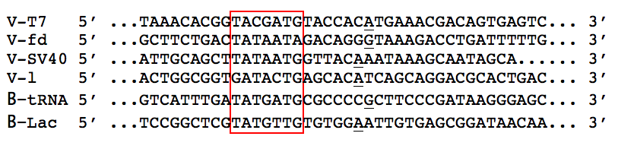
Fig. 2.14
Bacterial Promoter Alignments
Notes:
Figure 2.14 Alignment of DNA sequences containing promoters. Sequences from viral (V) and bacterial (B) genes are aligned so that the strands within the boxed region are stacked on top of each other and the first transcribed bases (underlined) are near each other.

Slide 23
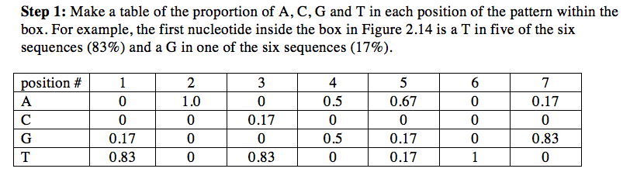
BME 2.2 Position Weight Matrix

Slide 24
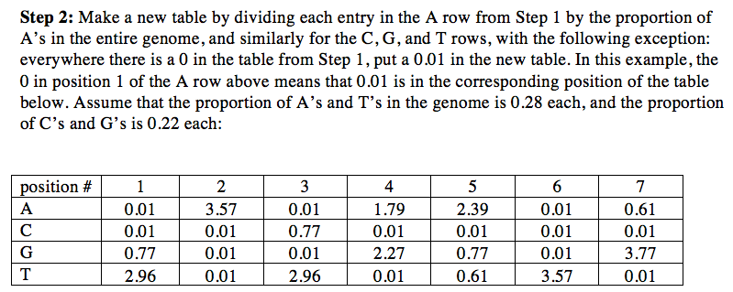
BME 2.2 Position Weight Matrix

Slide 25
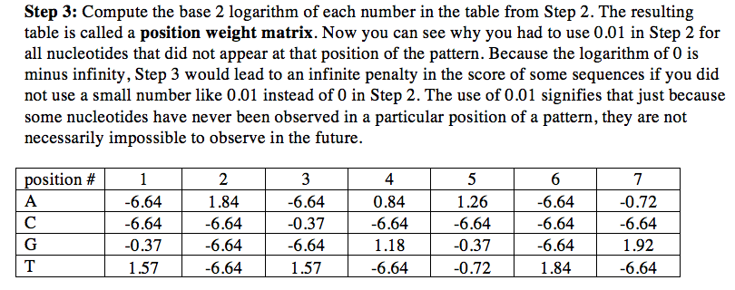
BME 2.2 Position Weight Matrix

Slide 26
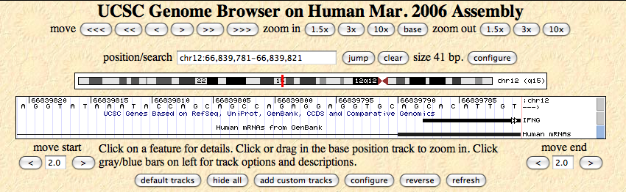
Unmarked Figure 2.2
Used with IQ 21
Notes:
Unmarked Figure 2.2 to go with Integrating Question 19.

Slide 27
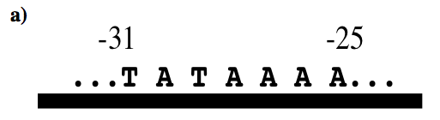
Fig. 2.15a
ssDNA Promoter Sequence
Notes:
Figure 2.15 Testing sequence specificity of promoters. (a) ssDNA sequence from a chicken blood protein promoter. The negative numbers indicate the number of bases between that site and the beginning of transcription. (b) Electrophoresis results from mRNA (open arrowheads) produced using three variations of promoters with wild-type (wt) sequence shown in panel a. Increased darkness indicates the presence of more mRNA. The promoter sequences are listed at the top of the lanes; even lanes contained RNA polymerase and odd lanes did not.

Slide 28
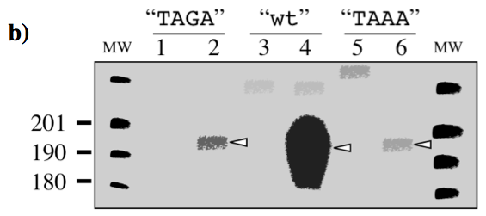
Fig. 2.15b
ssDNA Promoter Sequence
Notes:
Figure 2.15 Testing sequence specificity of promoters. (a) ssDNA sequence from a chicken blood protein promoter. The negative numbers indicate the number of bases between that site and the beginning of transcription. (b) Electrophoresis results from mRNA (open arrowheads) produced using three variations of promoters with wild-type (wt) sequence shown in panel a. Increased darkness indicates the presence of more mRNA. The promoter sequences are listed at the top of the lanes; even lanes contained RNA polymerase and odd lanes did not.

Slide 29
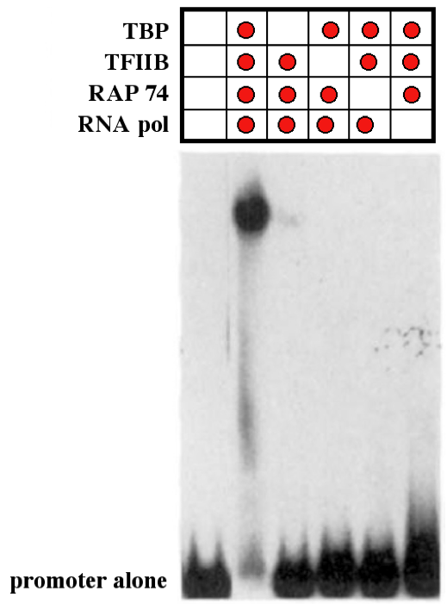
Fig. 2.16
Band Shift Analysis of Promoter
Notes:
Figure 2.16 X-ray film shows the results of a promoter-binding experiment. A radioactive DNA promoter sequence was incubated under six different conditions; combinations contained three transcription factors and RNA polymerase. Samples were loaded on the gel and separated by electrophoresis; promoter alone was loaded in the far left lane as a negative control. Red dots above indicate which components were added to the radioactive promoter.

Slide 30
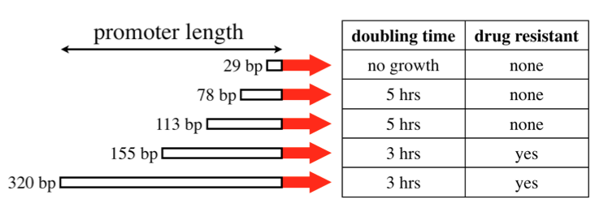
Fig. 2.17
Mapping Parts of a Promoter
Notes:
Figure 2.17 Mapping a promoter. Four experimental versions of a 320 base pair promoter placed upstream of an essential gene (red arrow). Cells containing a construct were measure for growth rate and resistance to a drug that could stop cell growth with low transcription.

Slide 31
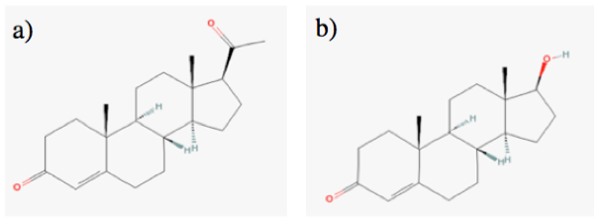
Fig. 2.18
Steroid Hormones
Notes:
Figure 2.18 Steroid hormones. (a) Progesterone and (b) testosterone can stimulate transcripts of particular genes. Carbons are present at vertices and the ends of line segments if no other letter is present. Panels b and c are the steroid hormones.

Slide 32
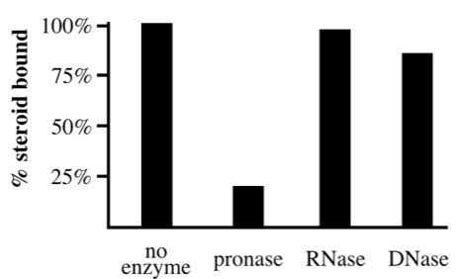
Fig. 2.19
Characterizing Steroid Receptor
Notes:
Figure 2.19 Amount of steroid bound by its receptor. Nuclei containing the injected steroid were incubated for 30 minutes with pronase, RNase, or DNase, or no enzyme for a negative control. The amount of steroid bound to its receptor r was quantified for each enzyme treatment, as well as the negative control.

Slide 33
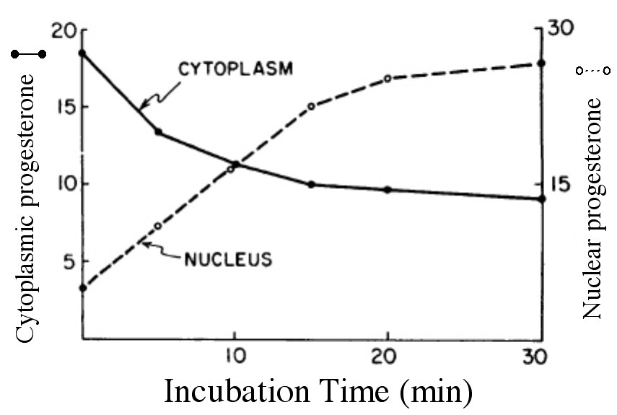
Fig. 2.20
Localization of Steroid Receptor
Notes:
Figure 2.20 Tracing progesterone location over time. Hen tissue incubated with radioactive progesterone at 37° C for the indicated time when cells were disrupted. Cytoplasmic and nuclear progesterone-receptor complexes were quantified (µg/mL) at each time point.

Slide 34
Title Page
Integrating Concepts in Biology
PowerPoint Slides for Chapter 2:
Information at the Cellular Level
2.3 How do cells make proteins?
2.4 Can cells pick and choose information?
by
A. Malcolm Campbell, Laurie J. Heyer, and Chris Paradise

Slide 35
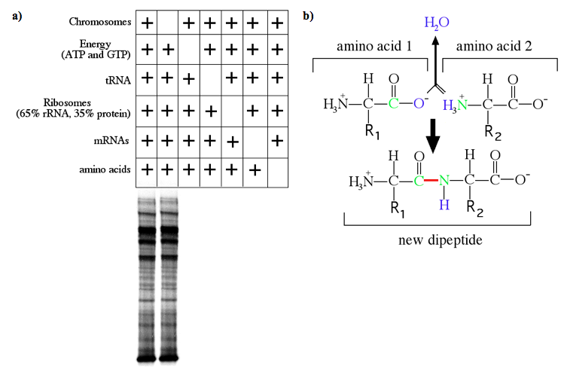
Figure 2.21
Proteins from Amino Acids
Notes:
Figure 2.21 Translation produces a polymer of amino acids to form a protein. (a) A peptide bond (shown as a red line) forms when two amino acids are covalently connected with water as a waste product. Colors are for illustration purposes; R₁ and R₂ represent additional atoms. (b) In vitro translation with each column a different experiment with + indicating presence of an ingredient. Blank boxes show which ingredient was omitted. Below the table are protein gel electrophoresis results from the inputs above.

Slide 36
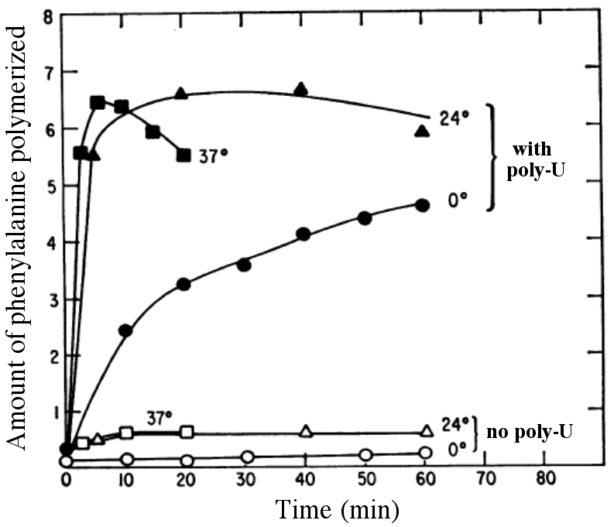
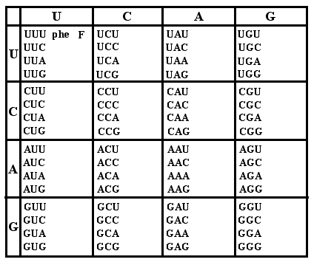
Fig. 2.22
Decoding the First Codon
Notes:
Figure 2.22 Deciphering the first codon. (a) Poly-U mRNA was added to in vitro translation mixture conducted at three temperatures. Negative controls lacked the poly-U RNA. (b) The first codon decoded was for the amino acid phenylalanine (phe or F).

Slide 37
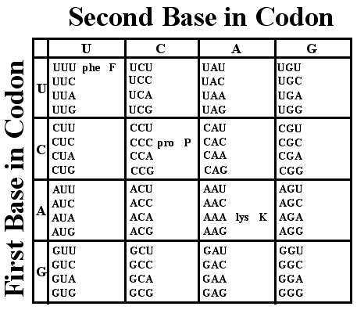
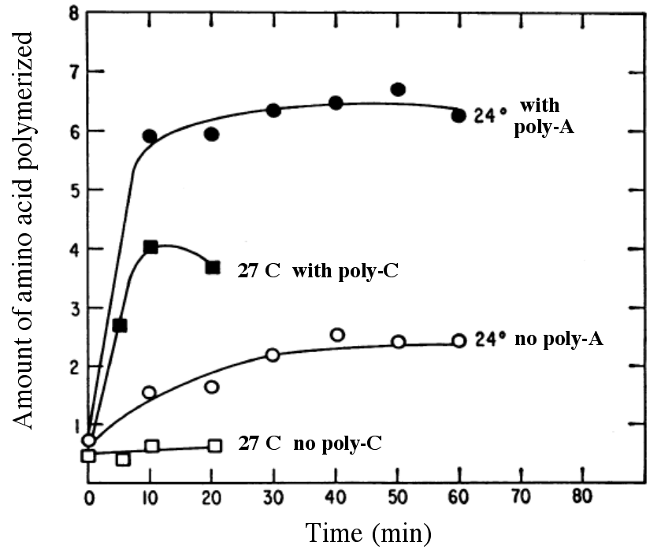
Fig. 2.23
Decoding the Two More Codons
Notes:
Figure 2.23 Deciphering AAA and CCC codons. (a) Poly-A and poly-C mRNAs were tested at two different temperatures. (b) Genetic code determined for two additional codons at noted in table.

Slide 38
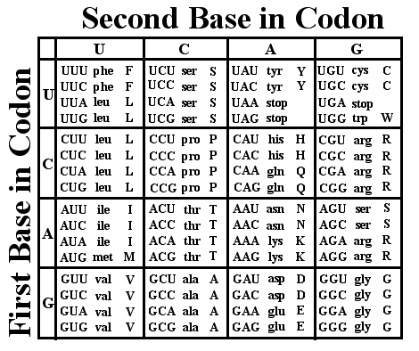
Fig. 2.24
The Genetic Code
Notes:
Figure 2.24 Full genetic code used by plants, animals, bacteria and archaea. Detailed descriptions of each amino acid are available at this interactive web page (www.bio.davidson.edu/courses/genomics/jmol/aatable.html).

Slide 39
2.4 Can cells pick and choose information?
Notes:
Figure 2.24 Full genetic code used by plants, animals, bacteria and archaea. Detailed descriptions of each amino acid are available at this interactive web page (www.bio.davidson.edu/courses/genomics/jmol/aatable.html).

Slide 40

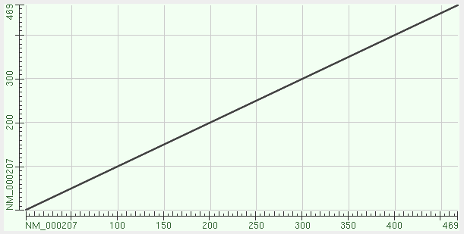
Fig. 2.25
NCBI Biological Information Database
Notes:
Figure 2.25 NCBI web site and databases. (a) Screen shot of the NCBI home page with some links to other resources. (b) Screen shot for Integrating Question 34 showing a dot plot of the human insulin mRNA compared to itself.

Slide 41
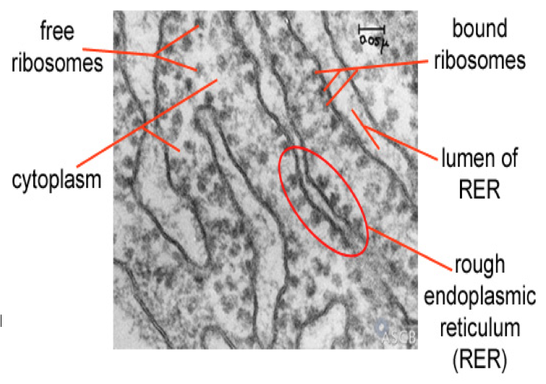
Fig. 2.26
Rough ER
Notes:
Figure 2.26 Electron micrograph of ribosomes. Ribosomes produce proteins either in the cytoplasm or into the rough endoplasmic reticulum. Ennist DL. Free and Bound Ribosomes. ASCB Image & Video Library. 2007; EDU-5.

Slide 42
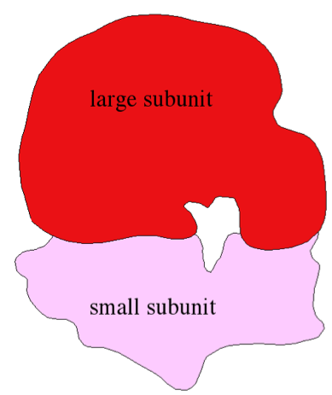
Fig. 2.29b
Rough ER
sm
lg
lumen of ER
Notes:
igure 2.29 Electron micrograph of ribosomes. Ribosomes produce proteins either in the cytoplasm or into the rough endoplasmic reticulum. Ennist DL. Free and Bound Ribosomes. ASCB Image & Video Library. 2007; EDU-5.

