Slide 1
Title Page
Integrating Concepts in Biology
PowerPoint Slides for Chapter 3:
Information at the Organismal Level
3.1 How do prokaryotes communicate their identity to the next generation?
3.2 Do eukaryotes produce new cells the same way as bacteria?
by
A. Malcolm Campbell, Laurie J. Heyer, and Chris Paradise

Slide 2
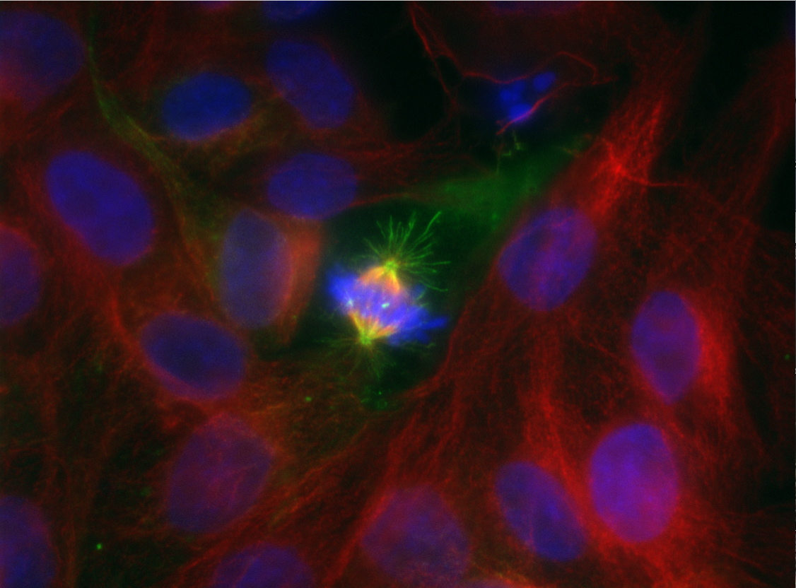
Opening Figure
Cells Make More Cells
Notes:
Opening Art: Front art piece UN 3.1 Mitotic cell with blue DNA, green spindle, and red cytoskeleton.

Slide 3
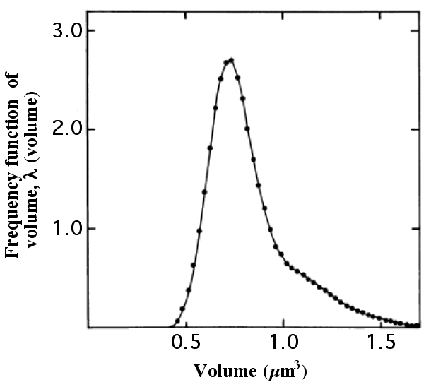
Fig. 3.1
E. coli Cell Volumes
Frequency Function of Volume
Notes:
Figure 3.1 Distribution of E. coli volumes. The volumes of many individual cells were determined by measuring electron micrographs of cells.

Slide 4
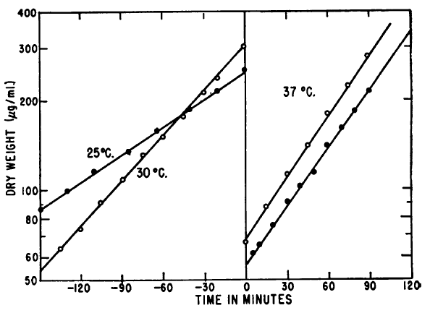
Fig. 3.2
Temperature Affects Cell Growth
Notes:
Figure 3.2 Factors that affect bacterial growth rate. One strain of E. coli was grown in two flasks at the two indicated temperatures (left), and at time 0 they were rapidly diluted and warmed to 37º C (right). Dry weight indicates the mass of cells after they were completely dehydrated. Open circles indicate cells initially grown at 30º C and closed circles indicate cells initially grown at 25º C.

Slide 5
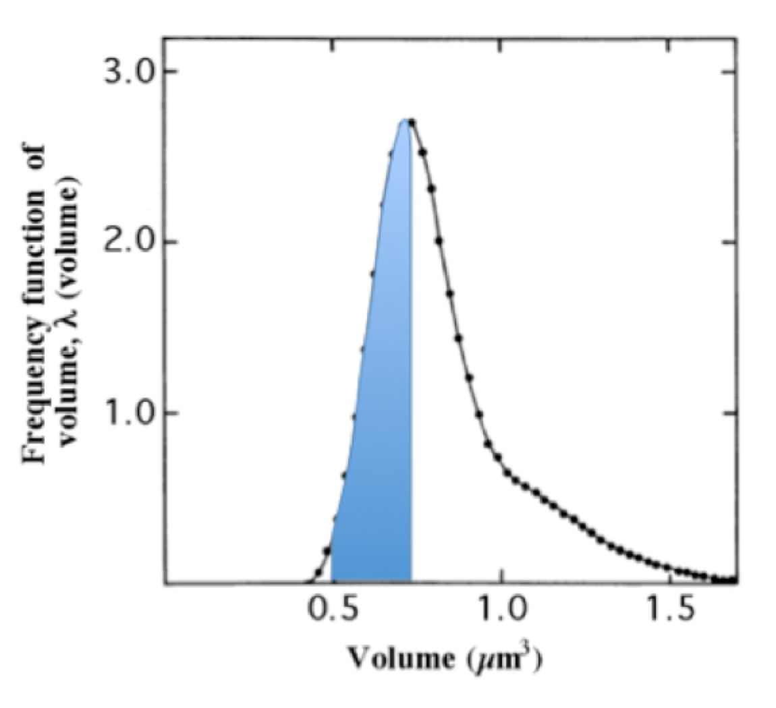
BME Fig. 3.1
Not All Cells Are the Same Size
Notes:
Figure BME 3.1.1 The shaded area is the proportion of cells with volumes between 0.5 and 0.7 µm³.

Slide 6
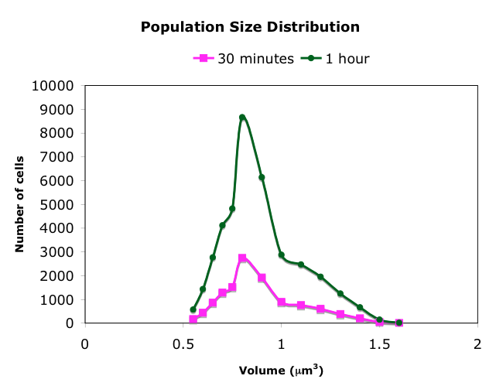
BME Questions
Figure From cell_division.xls

Slide 7
BME Questions
Time Influence Population Sizes
this prediction matches Figure 3.2, so the model allowed you to test differential growth rates
Notes:
BME Figure 3.1: Cell volume distribution when growth rate increases dramatically for volumes between 1.0 and 1.3 μm³. The two graphs show the results after 30 minutes or 60 minutes of growth.

Slide 8
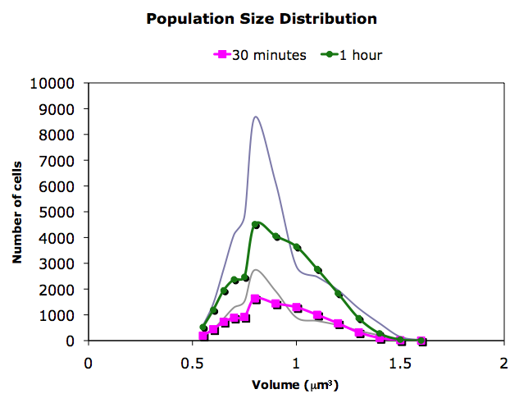
BME Questions
Integrating Question Answer
change all generation
times to 0.03
Notes:
BME Figure 3.1: Cell volume distribution when growth rate increases dramatically for volumes between 1.0 and 1.3 μm³. The two graphs show the results after 30 minutes or 60 minutes of growth.

Slide 9
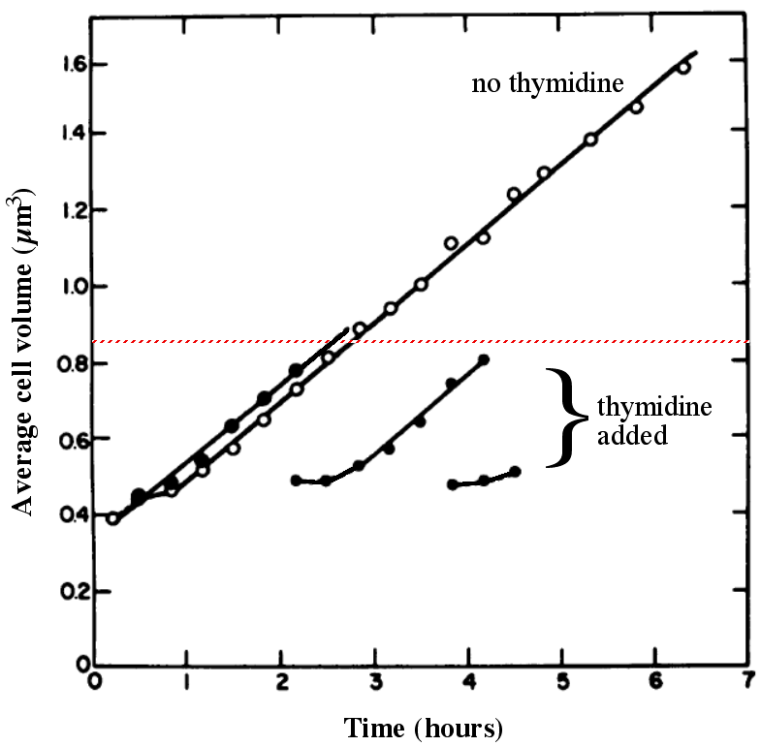
Fig. 3.3
DNA Replication Affects Cell Size
Notes:
Figure 3.3 Effect of DNA replication on cell size. Average cell volume mutant E. coli cells that required the addition of thymidine to produce DNA. Cells were grown either with (closed circles) or without (open circles) thymidine. The red, dashed horizontal line represents the average E. coli volume from Figure 3.1.

Slide 10
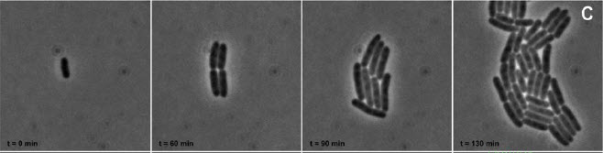
Fig. 3.4
E. coli Cells Dividing
T = 0 min
T = 60 min
T = 90 min
T = 130 min
Notes:
Figure 3.4 Movie of E. coli cells reproducing. Cells were filmed for 130 minutes as they grew to reveal how bacteria divided into two daughter cells, each with its own DNA. These images are modern but similar to the pioneering 1965 time-lapse movies. You can see the modern movie Ecoli_dividing.mov online.

Slide 11
Title Page
3.2 Do eukaryotes produce new cells the same way that prokaryotes do?

Slide 12
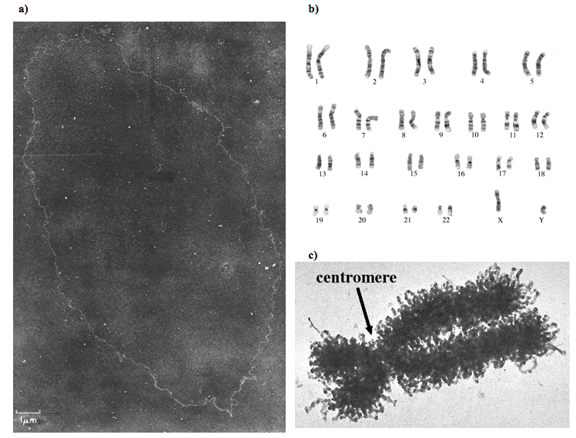
Fig. 3.5
Chromosomal DNA Structures
Notes:
Figure 3.5 Comparison of prokaryote chromosome and human chromosomes. (a) The only chromosome carried by E. coli, photographed with an electron microscope. (b) A human male’s set of chromosomes with each pair numbered, plus the lone X and Y chromosomes that determined his gender. (c) One highly-magnified human chromosome number 12 after DNA replication.

Slide 13
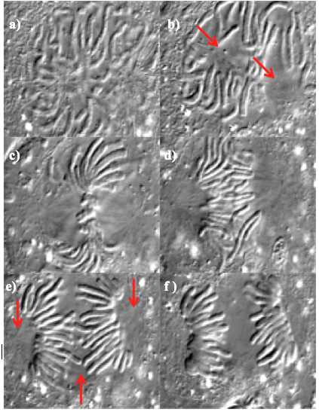
Fig. 3.6
Nuclear Division
Notes:
Figure 3.6 Still frames from a movie made using a light microscope of a newt cell undergoing nuclear division after DNA replication. (a) Initially, the chromosomes are not well defined because they are less condensed. (b) Chromosomes are more condensed and two clear zones appear, as denoted by the arrows. (c-d) Clear zones move to the periphery of the nucleus and chromosomes move to an equatorial position between the two poles. (e) The chromosomes are pulled apart and move to the closer pole; poles and midline equator are highlighted with red arrows. (f) Chromosomes continue to be pulled towards their poles and the clear areas. See the original movie Newt_Mitosis.mov available online.

Slide 14
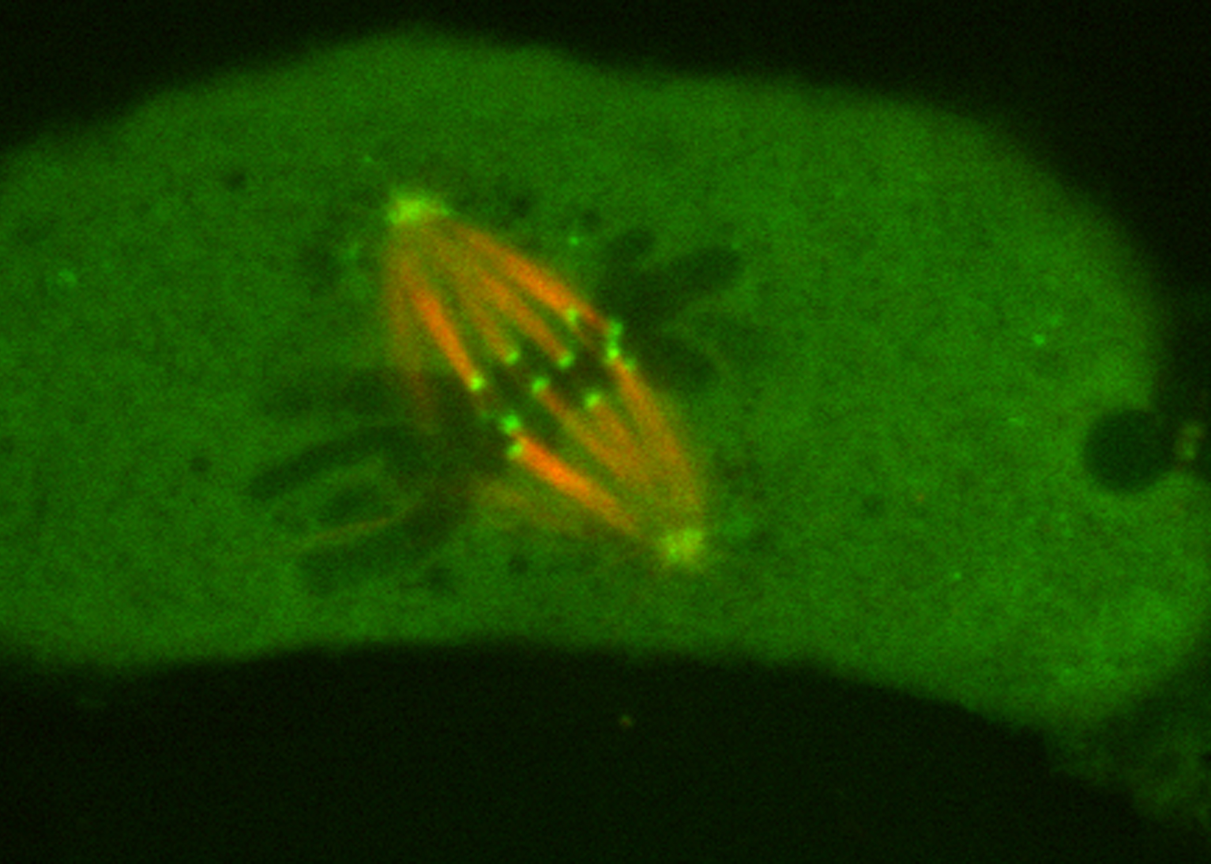
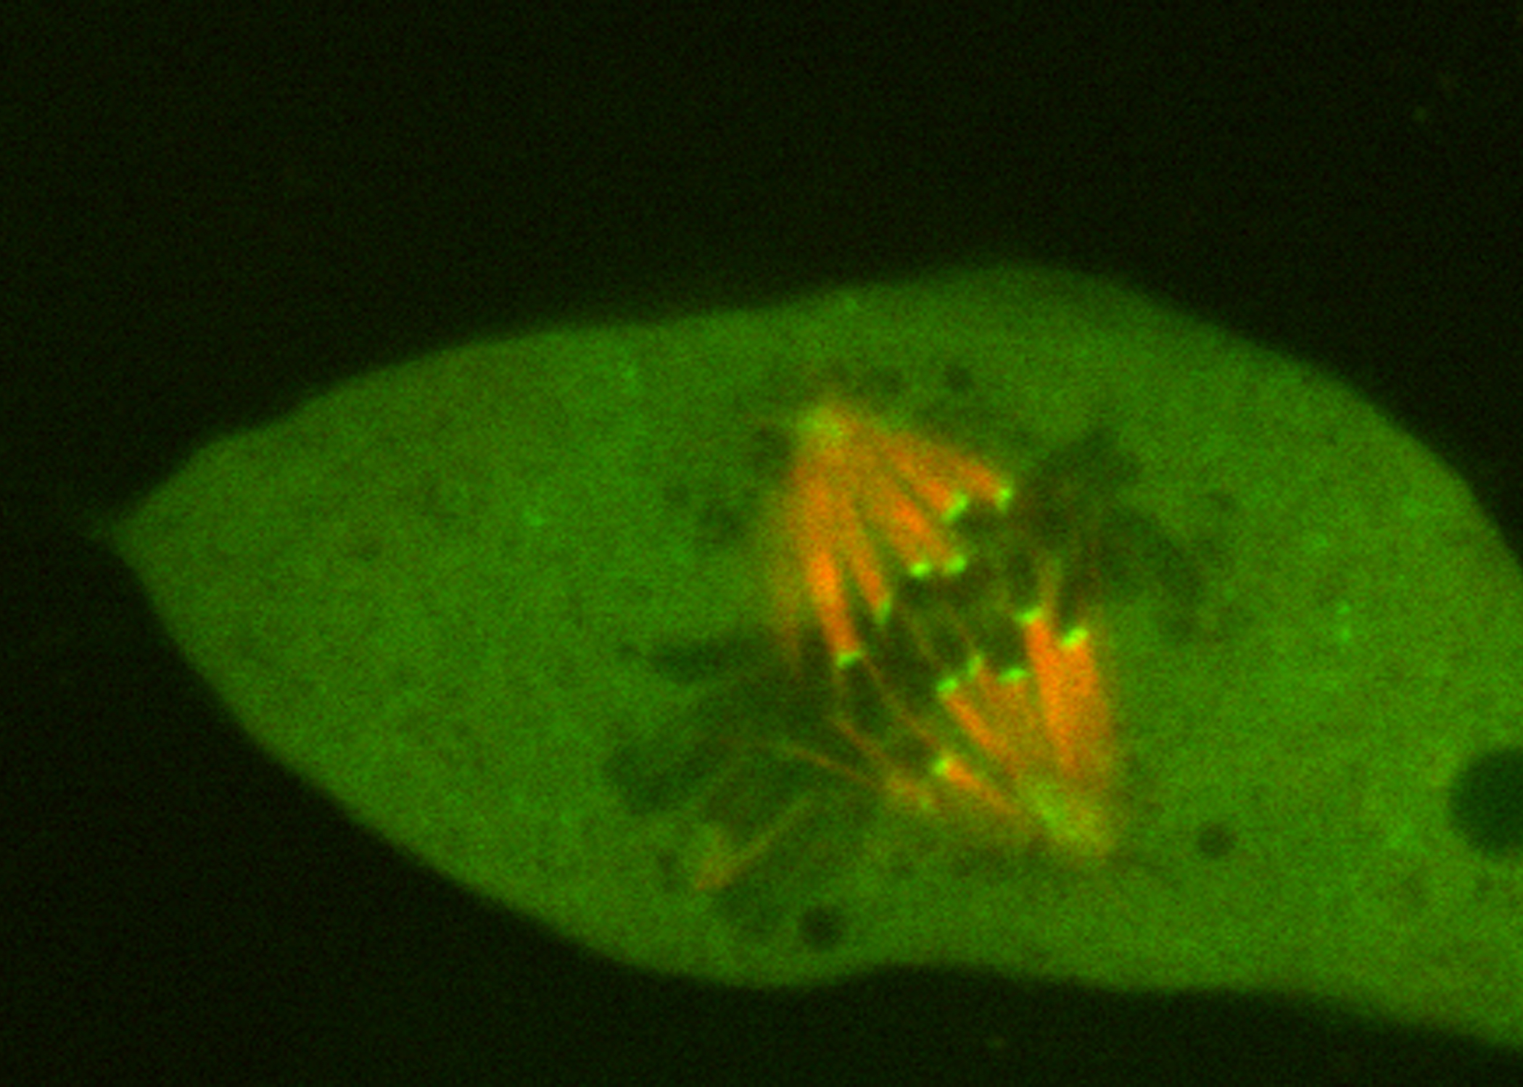
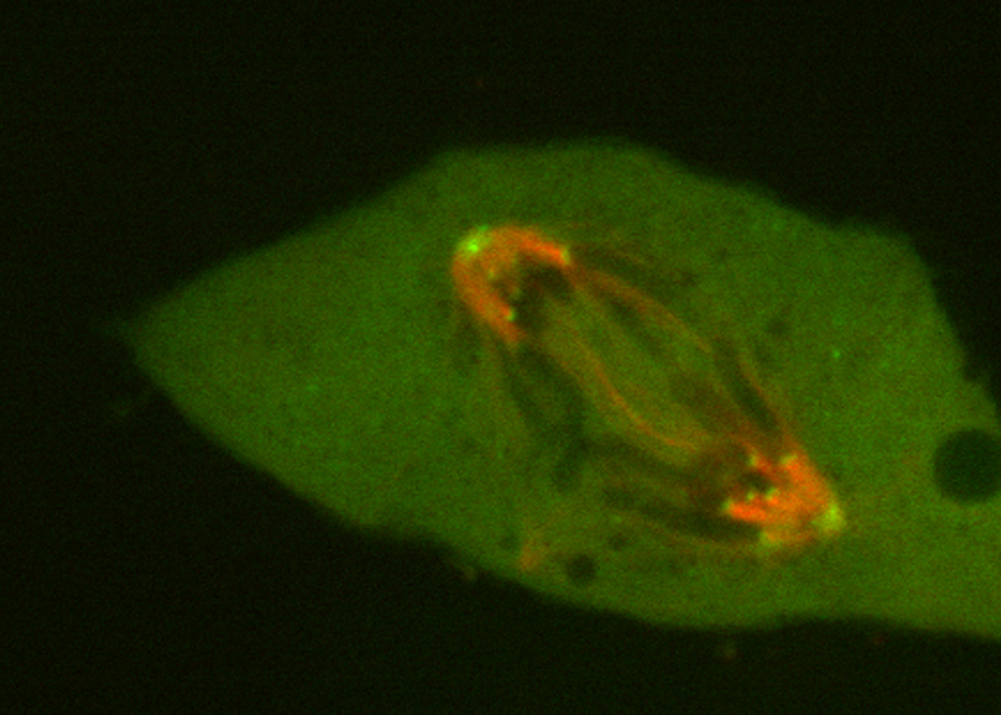
Fig. 3.7
Mitosis Mechanism
a)
b)
c)
Notes:
Figure 3.7 Female kangaroo rat cells undergoing mitosis with the microtubules stained orange and the two poles of the microtubules stained bright green. (a) Chromosomes collected at the midline. (b) Chromatids begin to separate and move to opposite poles. (c) Chromosomes complete their migration. See the movies metaphase_wt.mov, meta-ana_wt.mov, and anaphase_wt.mov online.

Slide 15
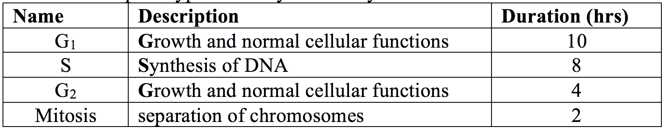
Table 3.1
Table 3.1
Table 3.1 Steps in typical eukaryotic cell cycle.
Notes:
Table 3.1 Steps in typical eukaryotic cell cycle.

Slide 16
Title Page
Integrating Concepts in Biology
PowerPoint Slides for Chapter 3:
Information at the Organismal Level
3.3 How can two parents produce non-identical offspring?
3.4 How can traits disappear and reappear later?
by
A. Malcolm Campbell, Laurie J. Heyer, and Chris Paradise

Slide 17
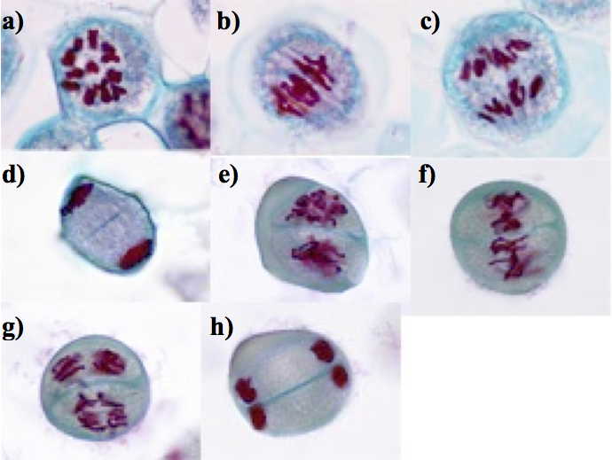
Fig. 3.8
Diploid to Haploid Nuclei
Notes:
Figure 3.8 Egg formation in a lily plant with DNA stained red. (a) Parental diploid cell has undergone DNA replication. (b) Chromosomes condense and pair up with their matching chromosome. Each pair becomes closely intertwined, and then moves to the equator. (c) Paired chromosomes separate and migrate to opposite poles. (d) Cytokinesis separates the haploid nuclei. (e-f) In each cell, chromosomes are repositioned and then align on their respective equators. (g) Attached chromatids are separated and migrate to different poles. (h) Chromosomes coalesce inside nuclei and cytokinesis will produce four haploid cells.

Slide 18
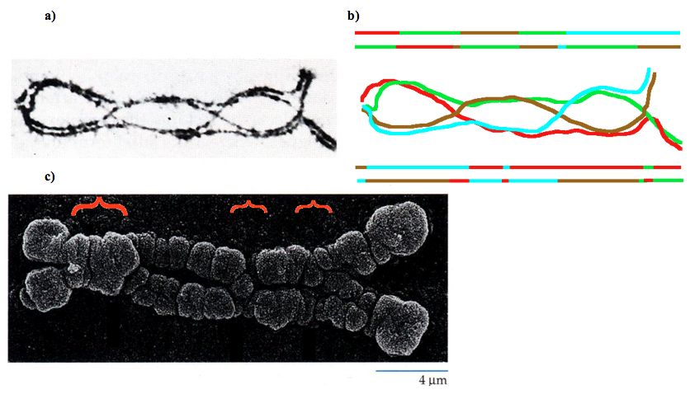
Figure 3.9
Chromatid Recombination
Notes:
Figure 3.9 Chromatids recombine during prophase I. (a) Light micrographs of four homologous chromatids crossing over, or recombining. (b) Line drawing of a) with the four resulting chromatids pulled apart as in anaphase I. (c) Electron micrograph of a different pair of homologous chromosomes recombining in three places (red brackets).

Slide 19
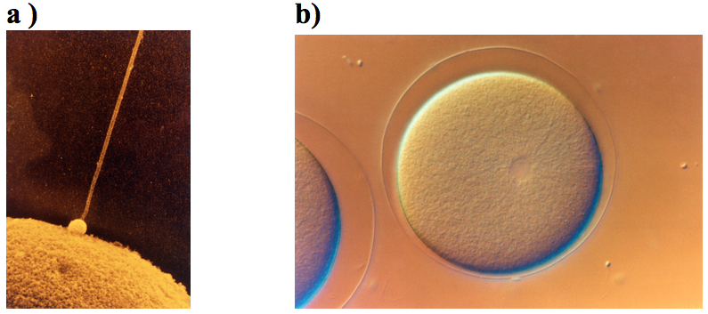
Fig. 3.10
Sea Urchin Fertilization
Notes:
Figure 3.10 Sea urchin fertilization. (a) One sperm, the small bump with long tail, swam to the egg to begin fertilization. (b) Fertilized eggs have a clear membrane shield to block the entry of other sperm. You can watch a real movie online: http://www.youtube.com/watch?v=T6BtSMerBmw

Slide 20
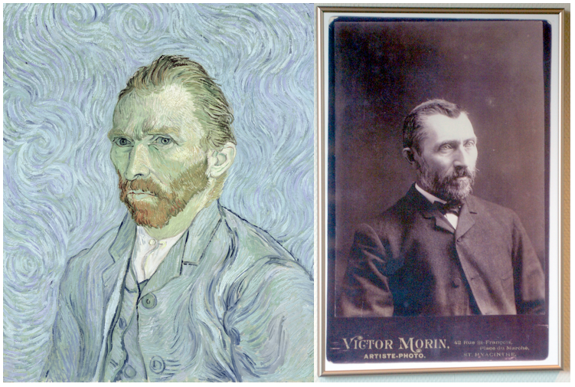
ELSI Fig. 3.1
Impressionist Van Gogh
Notes:
ELSI Figure 3.1 Impressionist painter Vincent Van Gogh. His famous way of seeing the world (in the self-portrait on the left) may have been the consequence of genetic imperfections. Photo of the artist (right) taken about 1886.

Slide 21
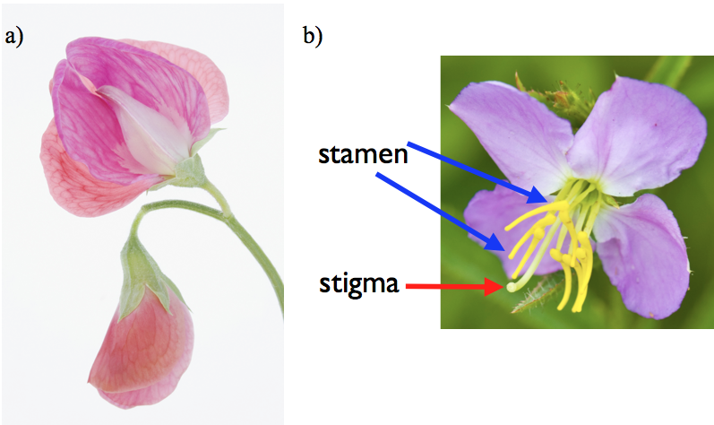
Fig. 3.11
Pea Flower Anatomy
Notes:
Figure 3.11 Flower parts. (a) Pink pea flower with reproductive parts hidden inside. (b) Open flower (not a pea species) with reproductive parts exposed and labeled.

Slide 22
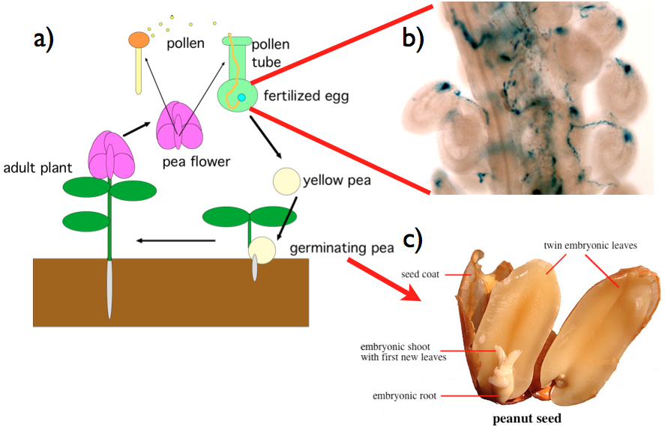
Fig. 3.12
Pea Plant Life Cycle
Notes:
Figure 3.12 Pea plant life cycle and parts of a seed. (a) Diagram of pea life cycle including self-fertilization. (b) Photomicrograph of thin, blue-stained pollen tubes fertilizing eggs (larger blue circles). (c) Like peas, peanuts contain paired embryonic leaves and a root inside.

Slide 23
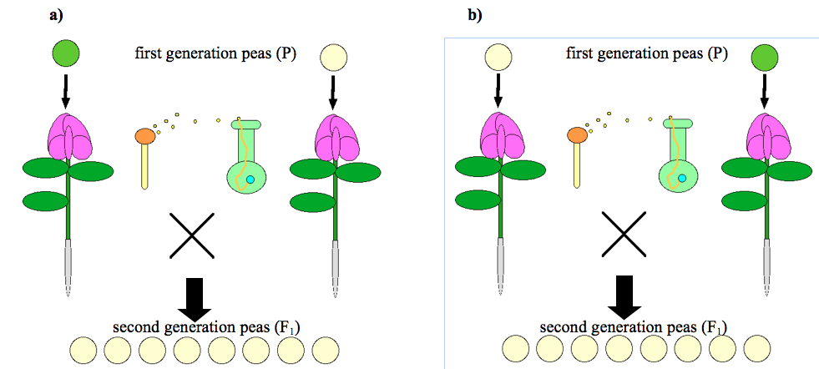
Fig. 3.13
Mendel’s First Experiments
Notes:
Figure 3.13 Mendel’s first breeding results. (a) Pollen from true-breeding green pea plants and eggs from true-breeding yellow pea plants produced only yellow seeds. (b) The reciprocal cross also produced only yellow seeds.

Slide 24
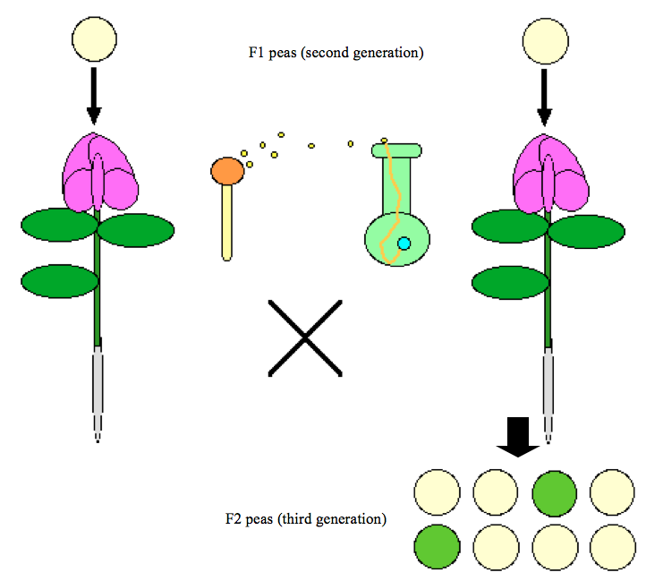
Fig. 3.14
Second Pea Mating Experiments
Notes:
Figure 3.14 Mendel’s second experiments started with F₁ seeds (second generation) from Figure 3.13. Plants derived from yellow F₁ seeds were self-crossed and the F₂ seeds were quantified for pea color.

Slide 25
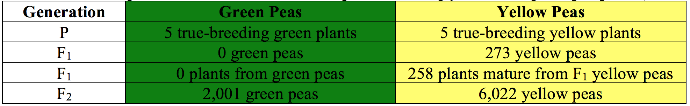
Table 3.2
Table 3.2
Table 3.2 Multi-generational results from mating true-breeding yellow and green pea plants.
Notes:
Table 3.2 Multi-generational results from mating true-breeding yellow and green pea plants.

Slide 26
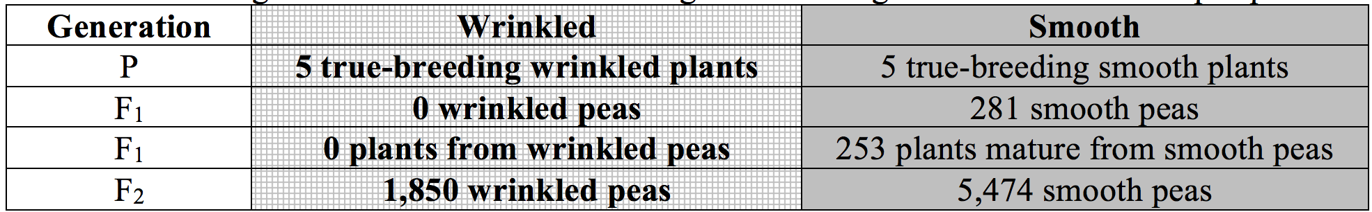
Table 3.3
Table 3.3
Table 3.3 Multi-generational results from mating true-breeding smooth and wrinkled pea plants.
Notes:
Table 3.3 Multi-generational results from mating true-breeding smooth and wrinkled pea plants.

Slide 27
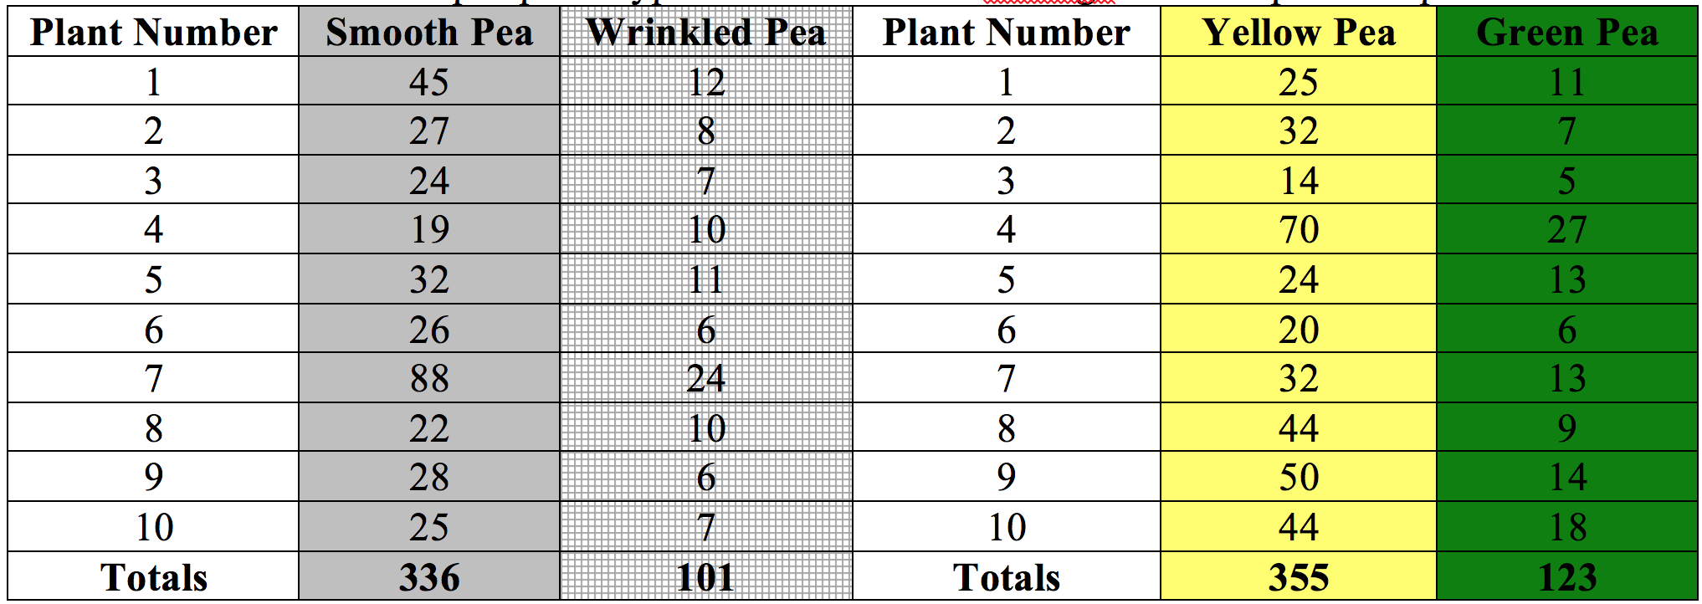
Table 3.4
Table 3.4
Table 3.4 Variation in F₂ pea phenotypes from individual matings in two separate experiments.
Notes:
Table 3.4 Variation in F₂ pea phenotypes from individual matings in two separate experiments.

Slide 28
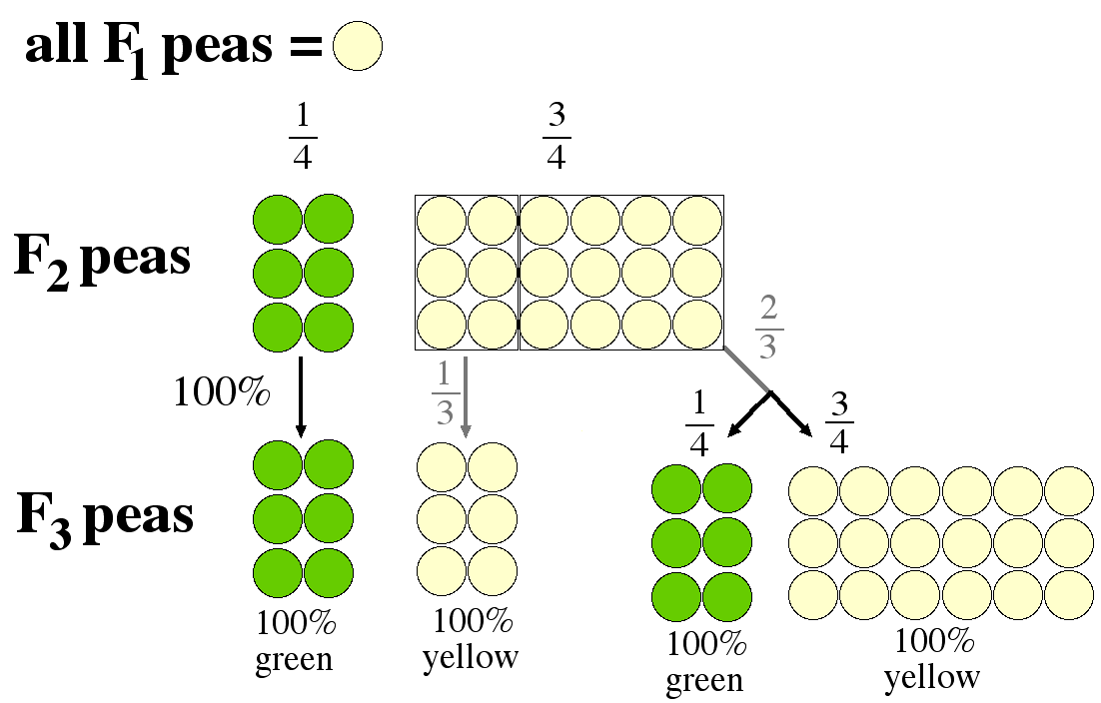
Fig. 3.15
Third Pea Mating Experiments
Notes:
Figure 3.15 Mendel’s F₃ results from F₂ pea plants. For illustration purposes, 24 peas were produced in each generation. Results from self-pollinating F₂ plants are shown as F₃ peas.

Slide 29
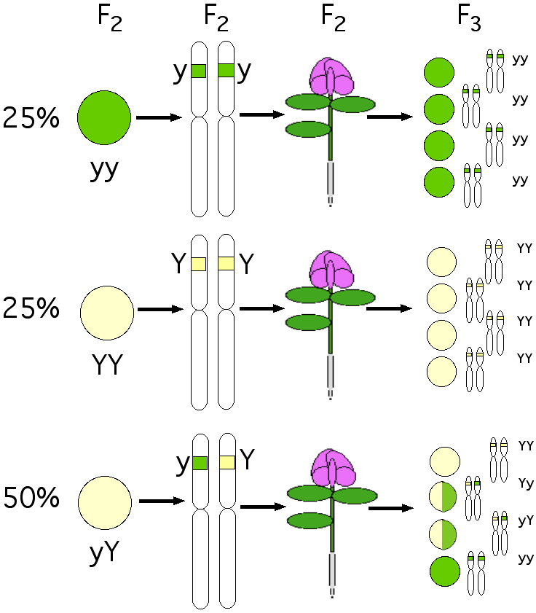
Fig. 3.16
Understanding F₃ Results
Notes:
Figure 3.16 Combining Mendel’s observations with DNA information. From left to right: F₂ seeds and their genotypes shown as homologous chromosomes with colored alleles. The resulting F₂ plants and the F₃ progeny from F₂ self-pollination. F₃ heterozygotes are shaded half yellow and half green for illustration purposes and actually appear fully yellow.

Slide 30
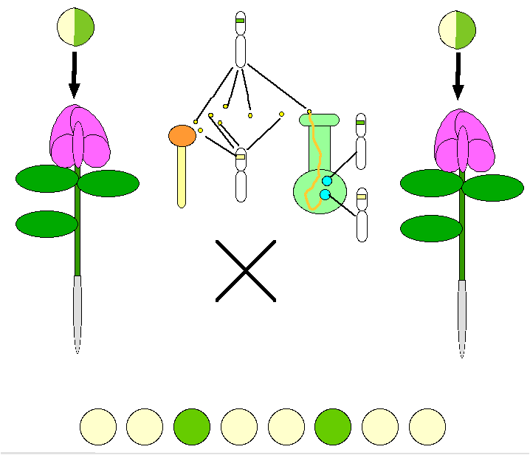
Fig. 3.17
Randomness Causes Deviation
Notes:
Figure 3.17 Chance events cause variations from the expected ratios in Table 3.3. Whether a particular pollen grain will land on the stigma is random, as is the particular egg to be fertilized. Parental heterozygous peas are shaded half yellow and half green for illustration purposes but actually appear fully yellow.

Slide 31
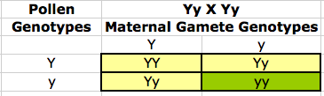
Fig. 3.18
Punnett Square
Notes:
Figure 3.18 A Punnett square. Genotype and phenotype outcome for mating two heterozygotes. Gamete genotypes are placed outside the boxes and pea genotypes placed inside the boxes. Phenotypes are represented by the yellow or green colored squares.

Slide 32
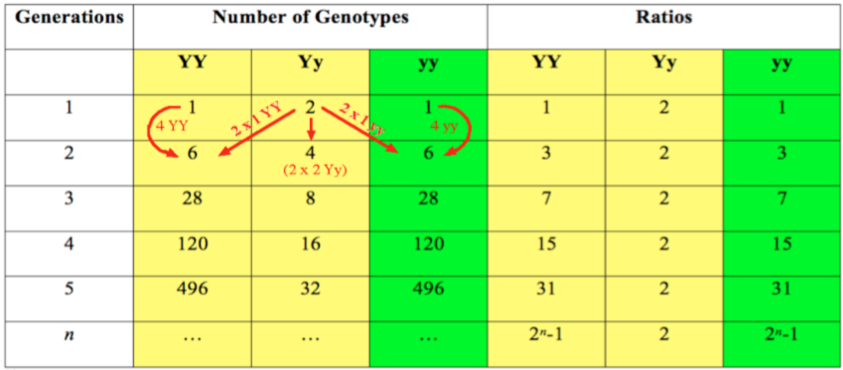
Table 3.5
Table 3.5
Table 3.5 Ratio of pea genotypes for n future generations.
Notes:
Table 3.5 Ratio of pea genotypes for n future generations.

Slide 33
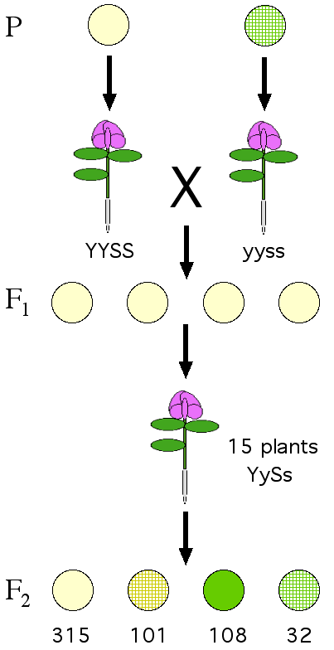
Fig. 3.19
Two Generations Two Loci
Notes:
Figure 3.19 Two generations after mating YYSS x yyss plants. Wrinkled is depicted as gridded peas. Numbers under the F₂ peas are Mendel’s published results. Y is dominant yellow; S is dominant smooth.

Slide 34
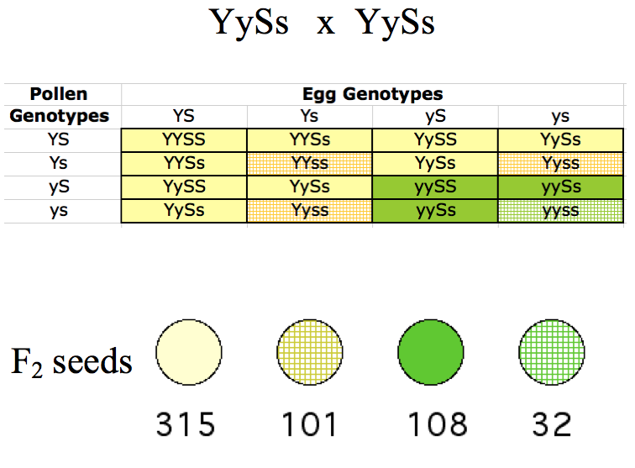
Fig. 3.20
Two Loci Punnett Square
Notes:
Figure 3.20 Punnett square for F₂ peas in Figure 3.19. Genotypes for gametes and the Punnett square make it simple to predict the ratios of genotypes and phenotypes from a dihybrid cross of YySs x YySs.

Slide 35
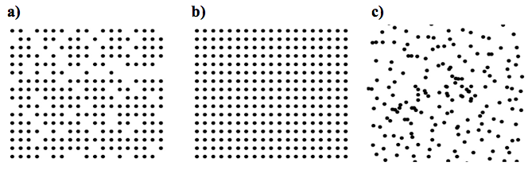
ELSI Figure 3.2
Which is random?
Notes:
ELSI Figure 3.2 Which pattern of dots best represents randomness?

Slide 36
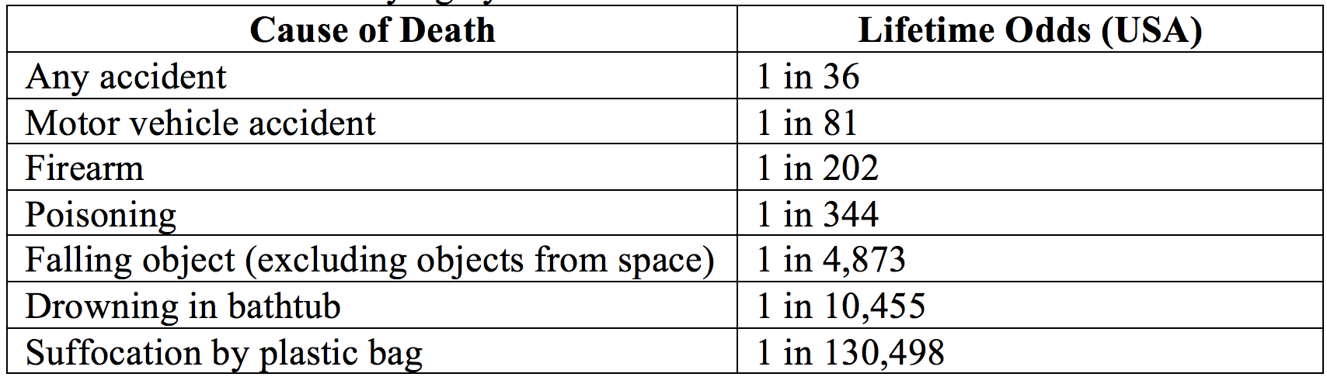
Table ELSI 3.2.1
Table ELSI 3.2.1
Table ELSI 3.2.1: Odds of dying by different causes.
Notes:
Table ELSI 3.2.1: Odds of dying by different causes.

Slide 37
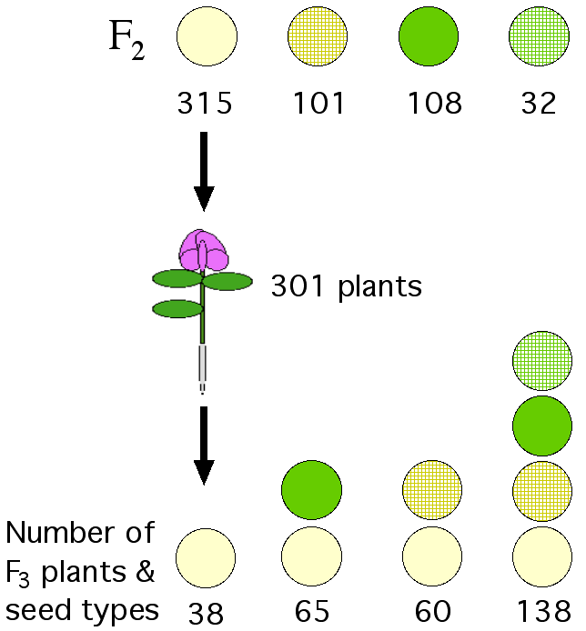
Fig. 3.21
Frequency of F₃ Progeny
Notes:
Figure 3.21 F₃ progeny from smooth, yellow F₂ peas. Smooth, yellow F₂ peas from Figure 3.19 were germinated and self-pollinated. Mendel’s F₃ results are tabulated at the bottom.

Slide 38
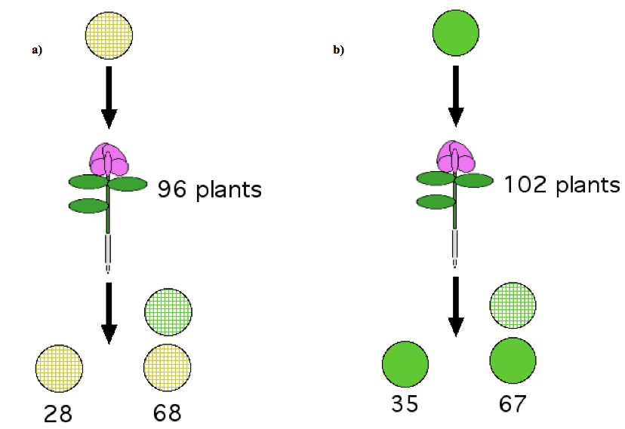
Fig. 3.22
Frequency of F₃ Progeny
Notes:
Figure 3.22 F₃ progeny from self-pollenated F₂ peas. (a) Wrinkled, yellow F₂ peas from Figure 3.19 were germinated and self-pollinated. Mendel’s F₃ results are tabulated at the bottom. (b) Similar experiment using smooth, green F₂ peas.

Slide 39
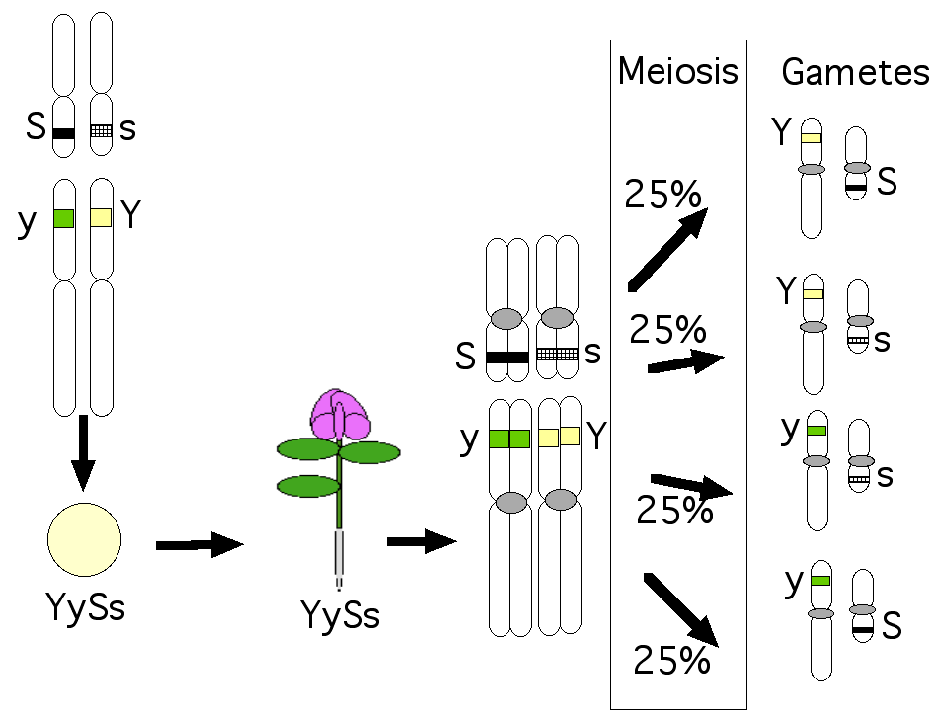
Fig. 3.23
Meiosis Contributes Randomness
Notes:
Figure 3.23 Meiosis produces every possible gamete genotype. The laws of independent assortment and segregation ensure that every possible combination of chromosomes is produced. Centromeres are enlarged for emphasis.

Slide 40
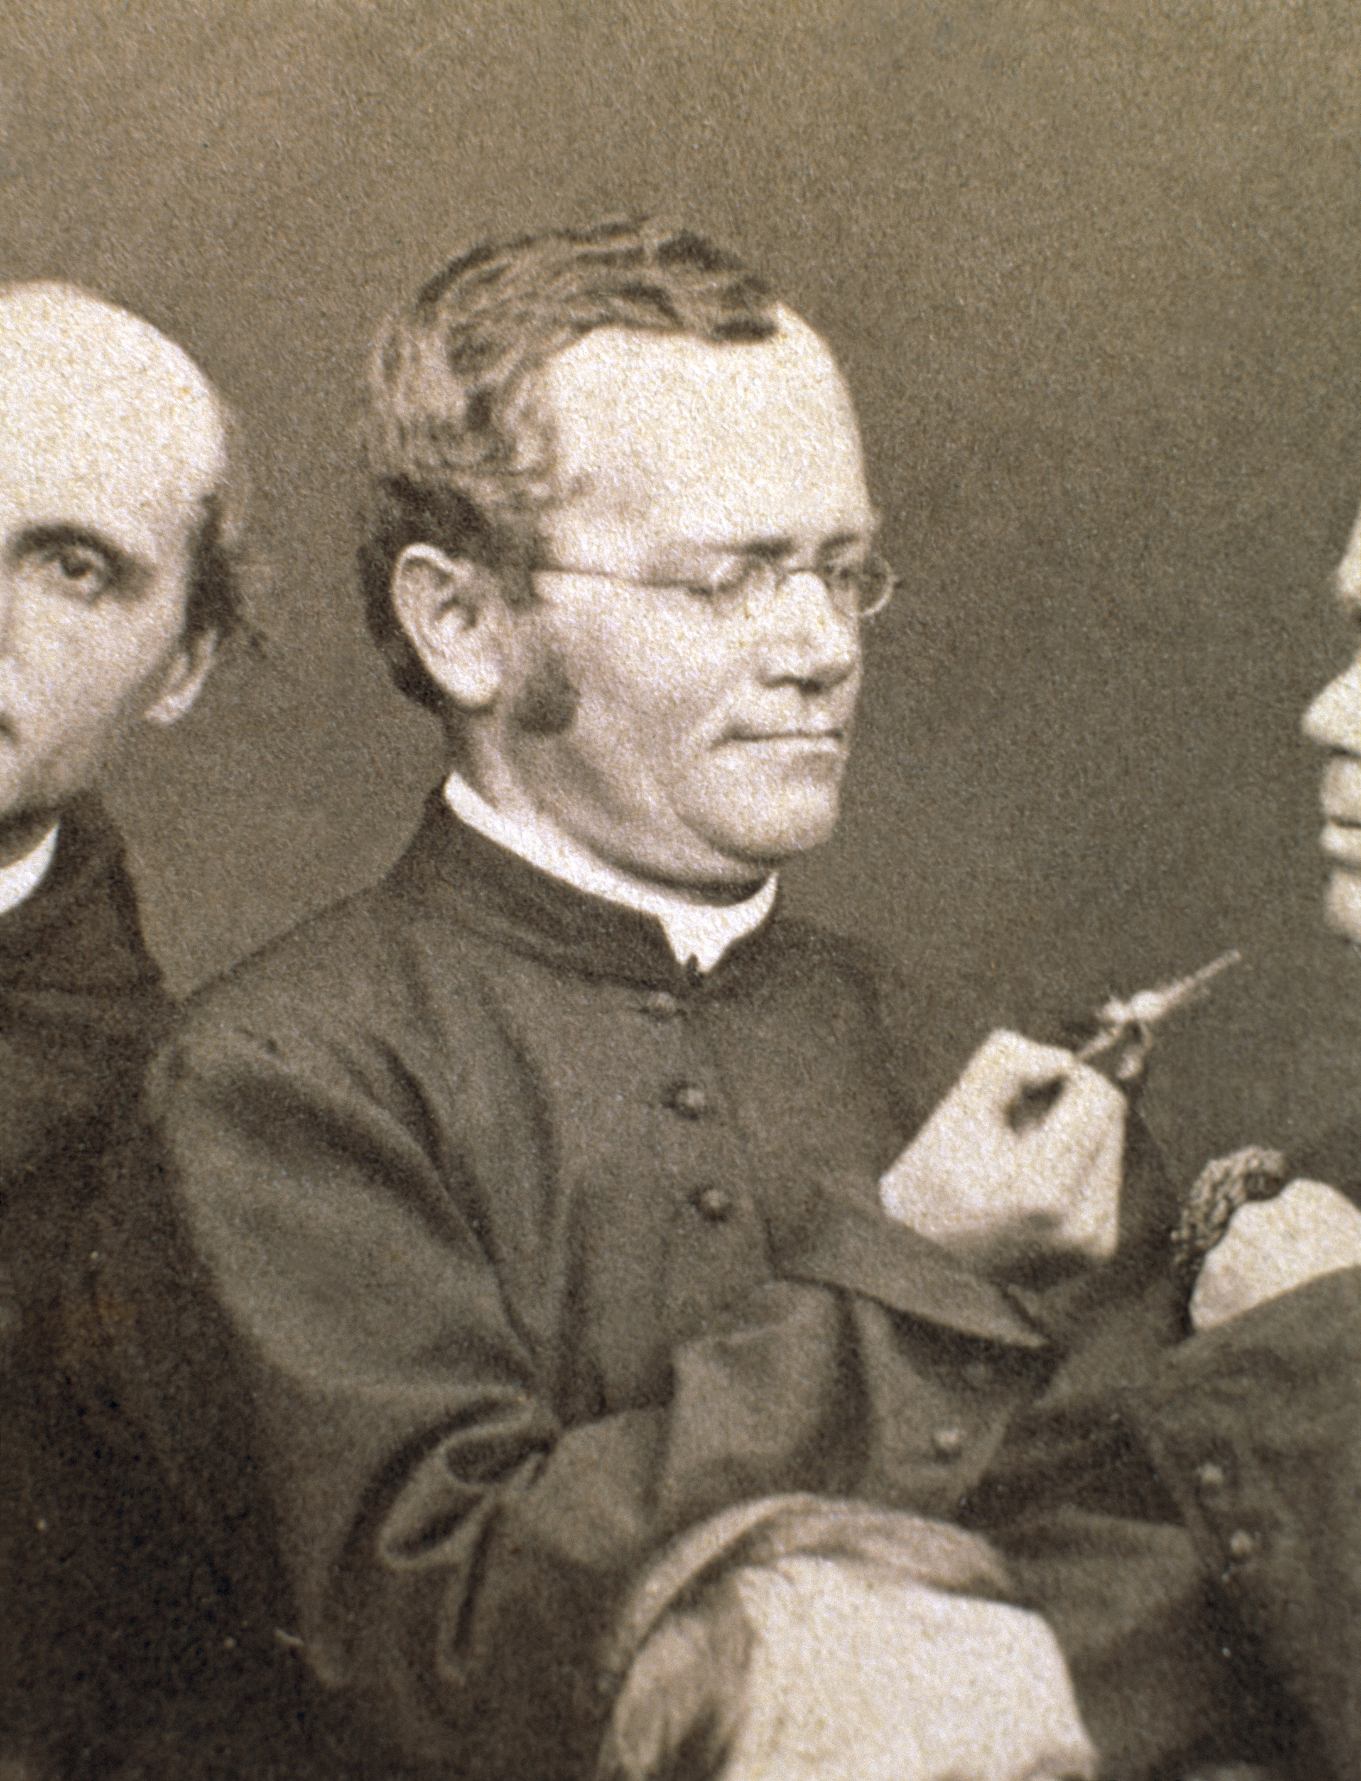
Fig. 3.24
Mendel in the Abbey
Notes:
Figure 3.24 The botanist monk Gregor Mendel. Group photograph of the Augustinian friars at the Abbey of St. Thomas in about 1862. Mendel is holding a Fuchsia clipping, his favorite plant. From: http://www.fieldmuseum.org/mendel/gallery.asp

Slide 41
Title Page
Integrating Concepts in Biology
PowerPoint Slides for Chapter 3:
Information at the Organismal Level
3.5 Non-Mendelian genetics: Why do we need annual flu vaccines?
by
A. Malcolm Campbell, Laurie J. Heyer, and Chris Paradise

Slide 42
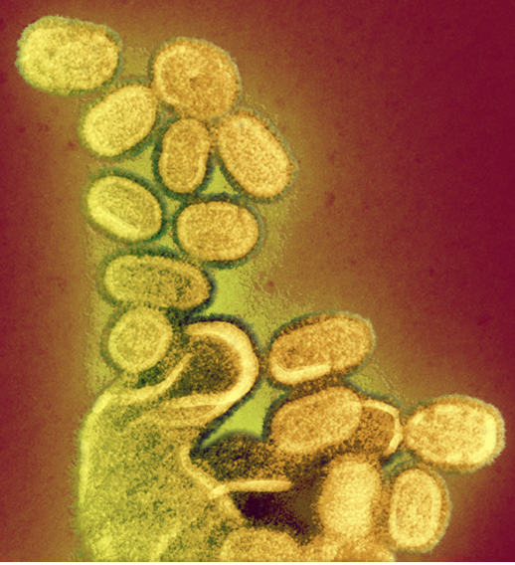
Fig. 3.25
Influenza A Virus
Notes:
Figure 3.25 Electron micrograph of influenza A virus. Pill-shaped viruses reveal their membrane wrappers studded with small spikes of viral proteins. Colors do not reflect biological appearance.

Slide 43
Extra Figure
Recombination of Genomes
new virus buds with novel combination of ssRNA chromosomes
host cell
Notes:
Figure 3.25h Schematic diagram of double virus infection and genomic recombination.

Slide 44
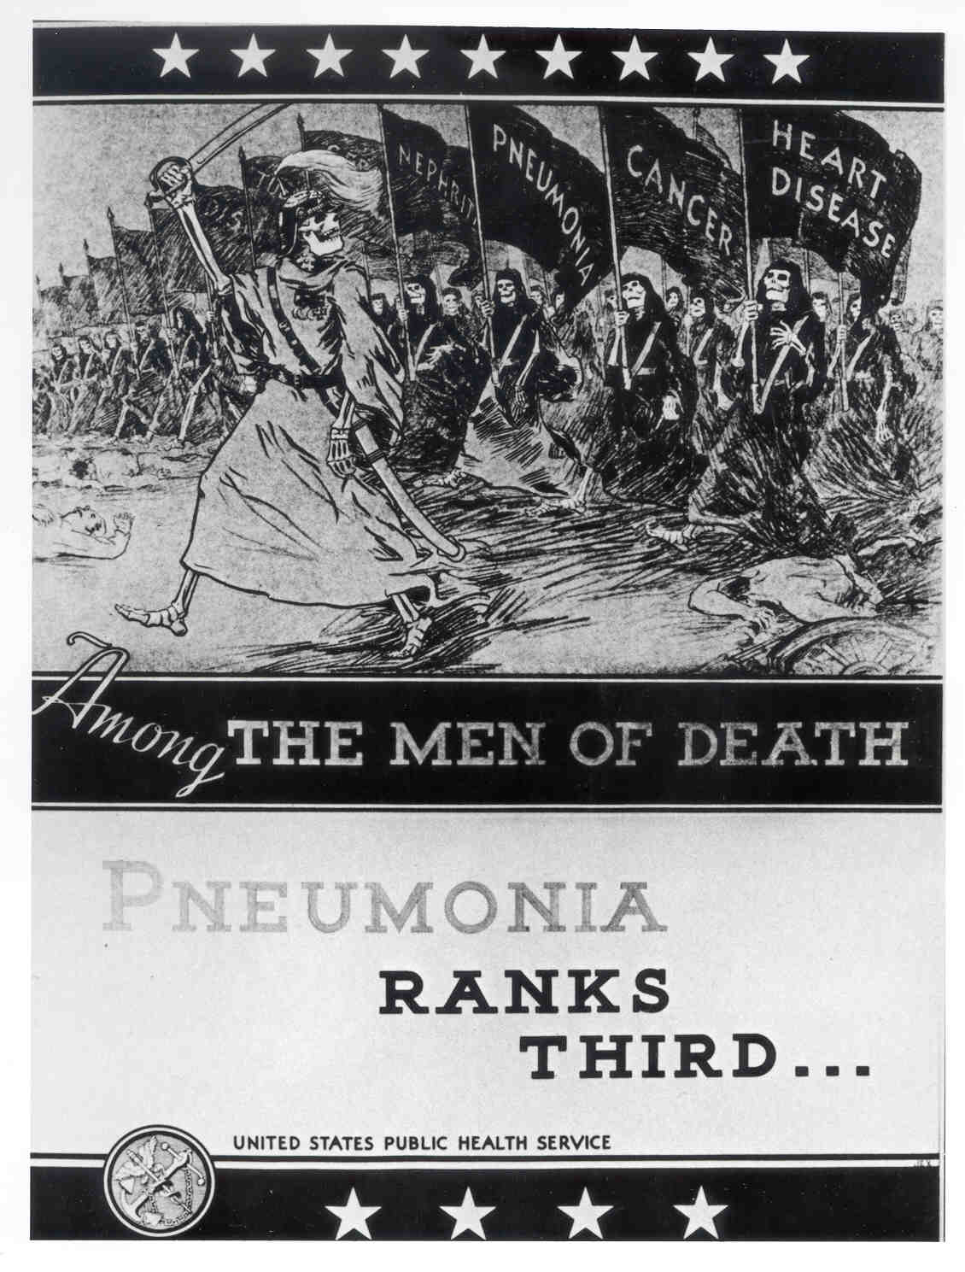
Fig. 3.26
Flu During WWI
Notes:
Figure 3.26 Public health poster circa 1920. Influenza was more lethal than World War I, as indicated by the soldier leading the death march.

Slide 45
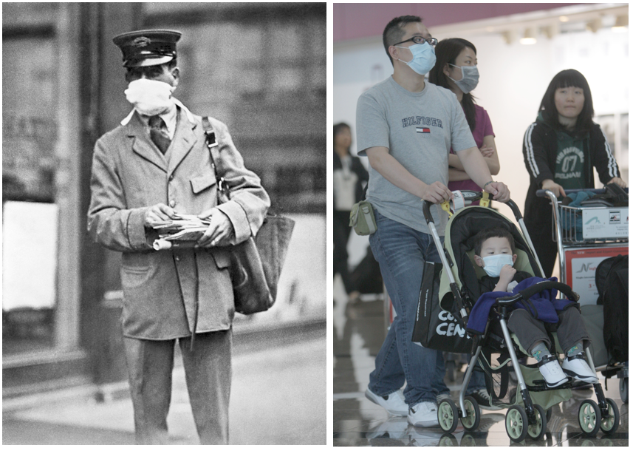
Fig. 3.27
History Repeats Itself
a)
b)
Notes:
Figure 3.27 False sense of security. (a) People in 1918 wore masks to prevent flu but it still infected 1/3 of the global population. (b) Fear of swine flu in 2009-10 caused many travelers to wear masks even though hand washing is the most effective way to prevent infection.

