Slide 1
Integrating Concepts in Biology
Chapter 4: Information at the Population Level
Sections 4.1 & 4.2
by
A. Malcolm Campbell, Laurie J. Heyer, and Chris Paradise

Slide 2
Connections and main ideas of Information
Heritable information provides for continuity of life.
Imperfect information transfer produces variation.
Information can be expressed and regulated without loss of content.
Non-heritable information is transmitted within and between biological systems.
Humans communicate with each other
You don’t know a language when you’re born
You inherit the ability to learn a language
These words represent non-heritable information transmitted from me to you
If you understand me, there has been no loss of content
If you misunderstand me, there has been imperfect information transfer

Slide 3
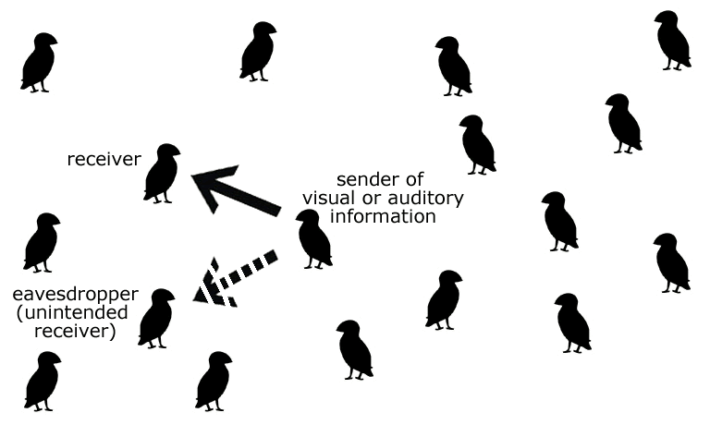
A population of birds and information transfer between individuals
Figure 4.1
Notes:
Figure 4.1 A population of birds and information transfer between two individuals with one other individual also receiving the information.
Talking Points: Demonstrates the concept of the population, and information transfer between individuals, including the idea of unintended recipients or eavesdropping.

Slide 4
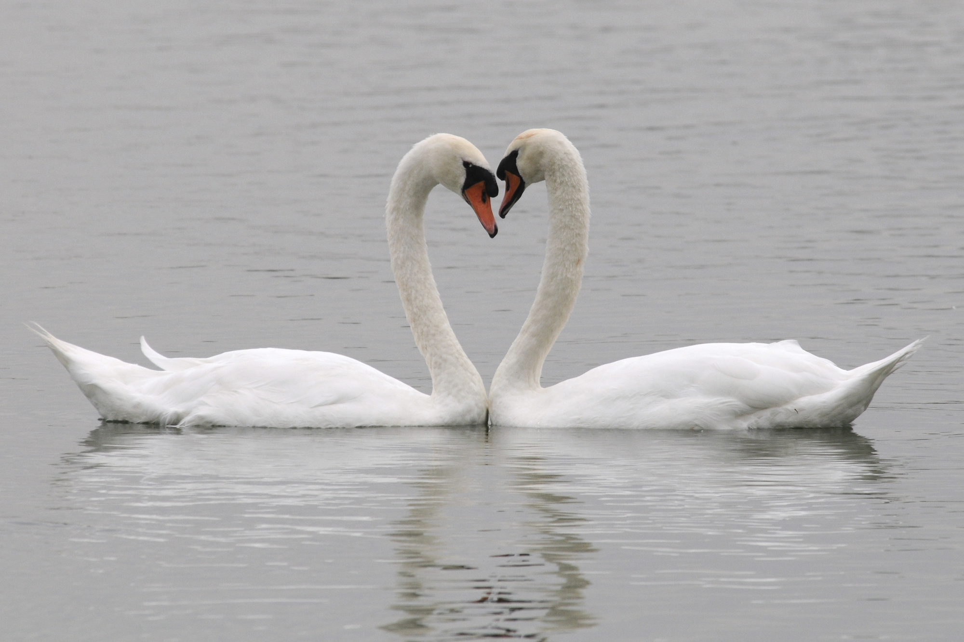
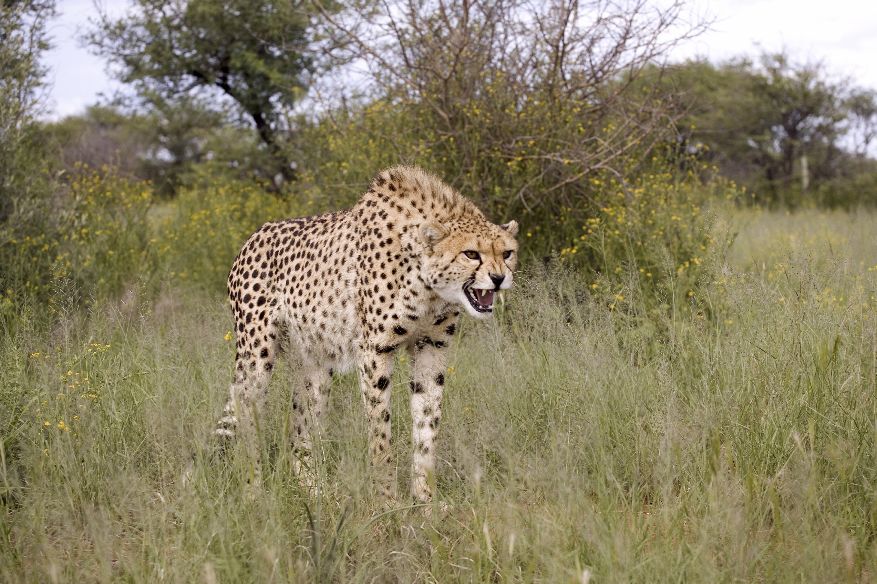
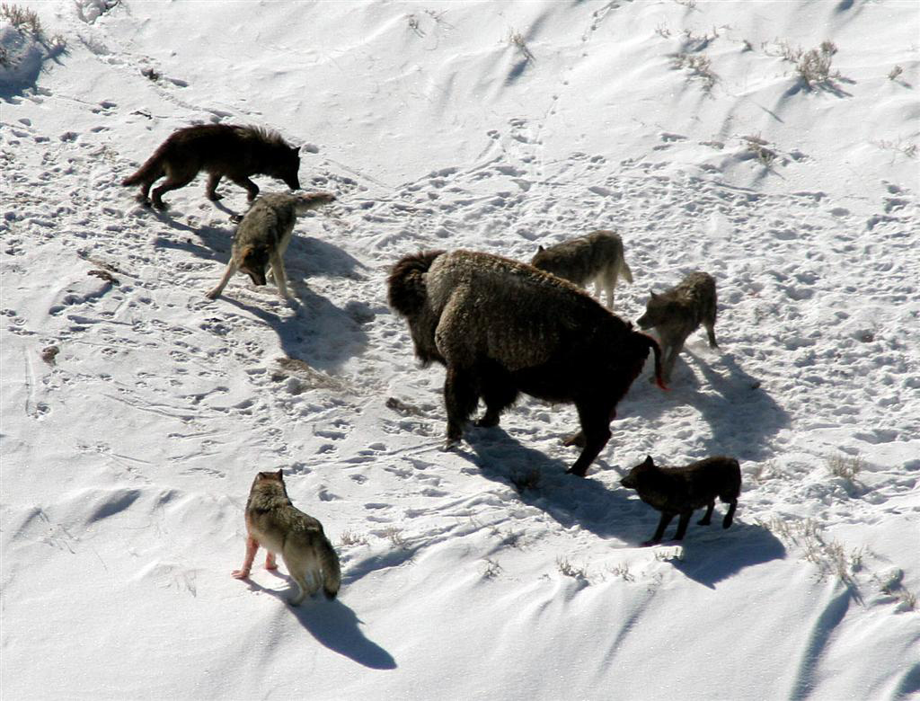
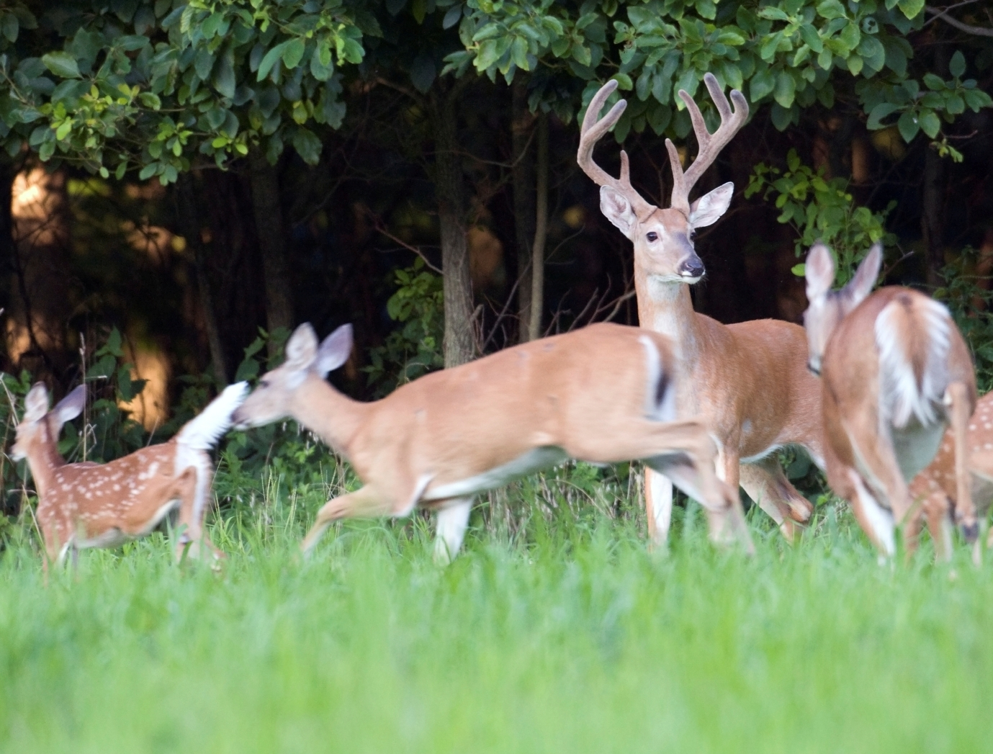
Behaviors associated with information transfer
Figure 4.2
Notes:
Figure 4.2 Some behaviors associated with information transfer in animals.
Talking Points:

Slide 5
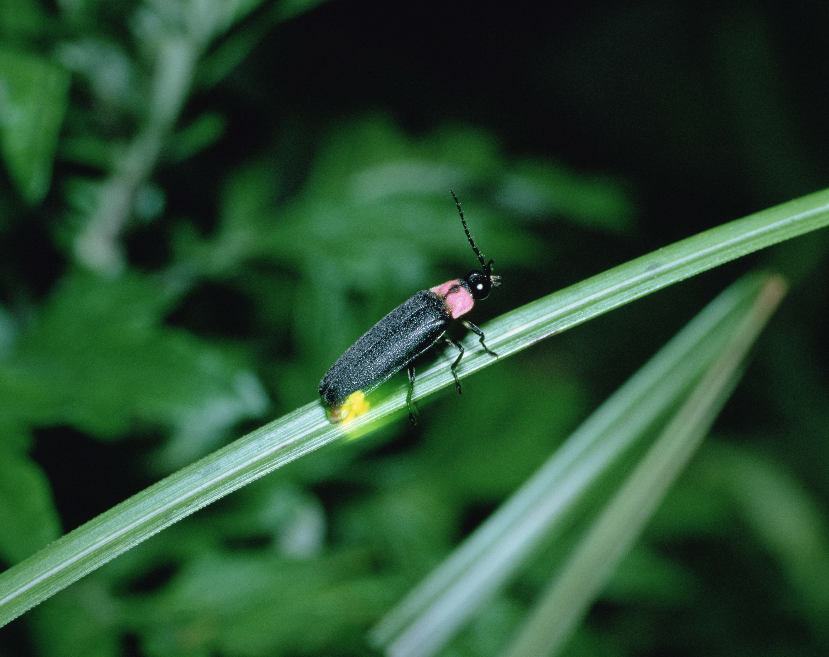
A firefly of the Photinus genus
Identifying feature: thorax
bioluminescent abdomen
Figure 4.3
Notes:
Figure 4.3 A firefly of the Photinus genus. Note the head at the top, the dark wings on its back, and the glowing segments of its abdomen produced by a biochemical reaction that consumes energy.
Talking Points: Fireflies transfer information using bioluminescent signals. They often have a prothoracic shield that covers their head.

Slide 6
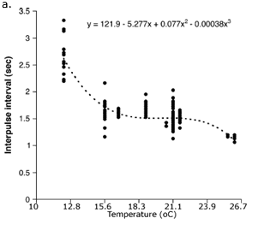
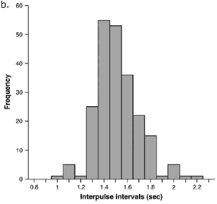
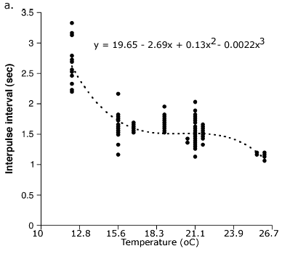
Variation in firefly interpulse intervals
Figure 4.4
Notes:
Figure 4.4 Variation in firefly interpulse intervals. (a) Intervals of time between pulses of light in the courtship signal of male P. greeni, measured at different ambient air temperatures in June. A polynomial regression equation (shown at the top of the graph) was fitted to the data. (b) Frequency distribution of time intervals between pulses for male P. greeni adjusted to 21.1ºC.
Talking Points: Part of the variation in signaling is due to temperature.
The rate of male signaling is partly dependent upon body temperature, which affects the rate of chemical reactions inside an individual.
Low temperatures slow down male firefly signaling, and high temperatures shorten the interpulse interval.
There is a range of temperatures where IPI does not seem to be affected by temperature, although there is variation among males.
Variation in IPI represents imperfect information transfer.

Slide 7
Table BME 4.1.1: Computing adjusted IPI
Variable | Description of variable | example 1 value (seconds) | example 2 value (seconds)
A | actual IPI at 26.1 ºC | 1.165 | 1.066
B | value of regression curve at 26.1 ºC | 1.102 | 1.102
C | value of regression curve at 21.1 ºC | 1.516 | 1.516
 | adjusted IPI = A - B + C | 1.579 | 1.480
Notes:
Table BME 4.1.1: Computing adjusted IPI
Talking Points: The regression curve adjusts each IPI to what it would have been if it had been measured at 21.1 ºC. The IPI is adjusted to be as far above or below the curve at 21.1 ºC as the actual IPI is above or below the curve at the corresponding temperature. Adjusted IPI is equal to actual IPI measured at another temperature minus the value of the regression curve at that temperature plus the value of the regression curve at 21.1 ºC.

Slide 8
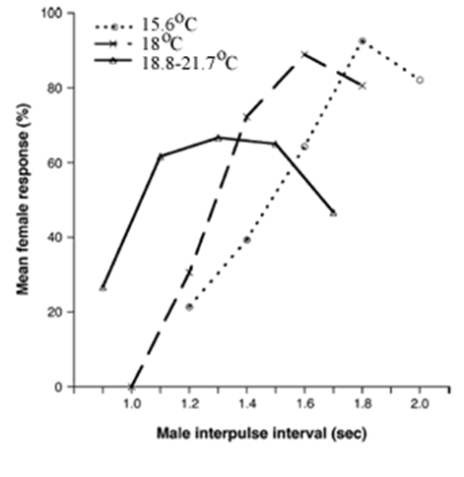
Response of female P. greeni fireflies to simulated male signals at different temperatures
Explain variation caused by temperature and variation caused by IPI
Figure 4.5
Notes:
Figure 4.5 Tests to determine the response of female P. greeni fireflies to simulated male signals at different temperatures. Male signals were double pulses of light of equal duration separated by varying interpulse intervals. There were five intervals tested at each temperature, with the middle level centered on the mean intervals of males at that temperature.
Talking Points: Just as there is variation in the IPI of male signaling, there is variation in female response to different IPIs. Greater percentages of females respond at or near the average IPI for a particular temperature. Different temperatures cause maximum female responses to occur at different IPIs.

Slide 9
Female P. greeni tested for responsiveness to varying IPI
Figure 4.6
Notes:
Figure 4.6 Female P. greeni were tested for their responsiveness to pulse intervals of varying duration that were known to be found in males of three different species (sample size = 1-3 for each IPI tested). The range of pulse intervals for males of each species is indicated by the three different brackets.
Talking Points: Photinus greeni females did not respond to signals that simulated flash patterns of males from other species. Flash patterns verify that receiver and sender are members of the same species – females do not reply if the proper signal is not sent. Female responses allow signaling males to locate receptive females.

Slide 10
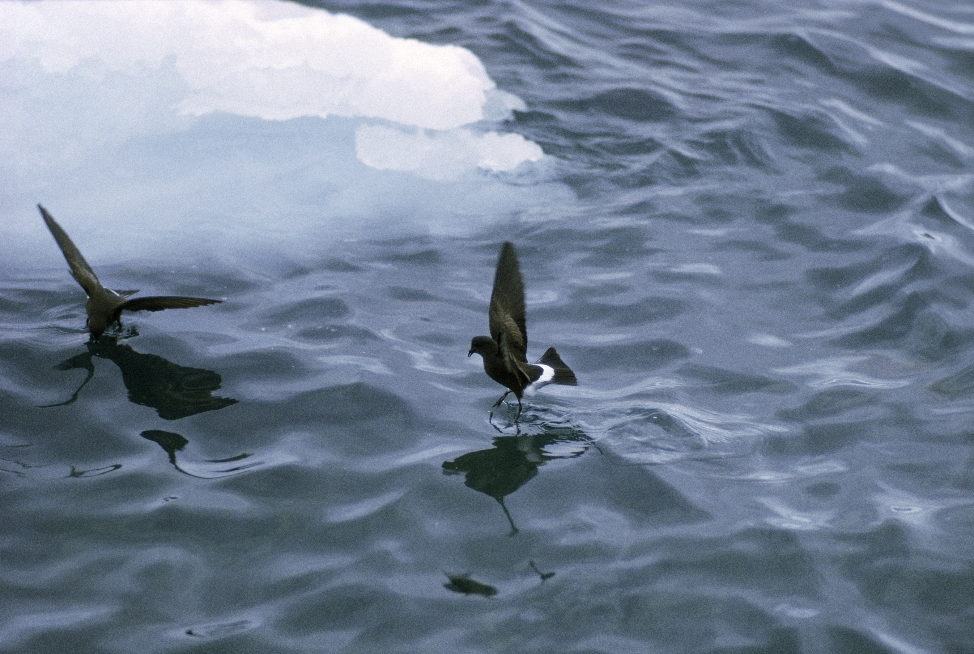
Wilson’s storm petrel (Oceanites oceanicus)
Figure 4.7
Notes:
Figure 4.7 Wilson’s storm petrels (Oceanites oceanicus) appear to walk on water as they skim for food.
Talking Points: These birds live almost their entire lives over the ocean.

Slide 11
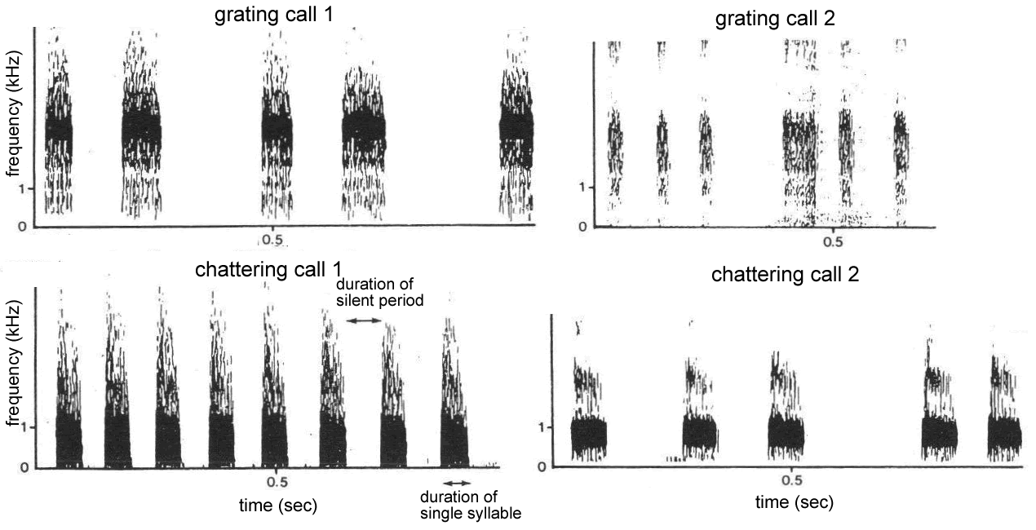
Sonograms of Wilson’s storm petrel
Figure 4.8
Notes:
Figure 4.8 Sonograms of Wilson’s storm petrel acoustic signals on the Kerguelen Islands, in the southern Indian Ocean. Syllables are periods of sound, separated by silence (blank spaces).
Talking Points: Calls vary by their frequency, duration, number of syllables, and duration of silences.

Slide 12
When male Wilson’s storm petrels make particular calls
(a)
situation of the bird | call uttered
 | Chattering | Chattering and grating | Grating
bird alone (n = 96) | 38 | 35 | 23
flown over by another bird (n = 69) | 33 | 18 | 18
facing another bird (n = 95) | 9 | 16 | 70
What major differences in frequencies do you observe?
Table 4.1
Notes:
Table 4.1 Comparison of when male Wilson’s storm petrels make particular calls. (a) Frequency of calls in different situations and (b) chi-squared (χ²) comparison of frequencies (see BME 4.2).
Talking Points: Approximately equal frequencies of chattering when in first two situations, but a very high frequency of grating when one bird faces another bird.

Slide 13
Observed and expected call numbers in two different situations, from data in Table 4.1.
situation of the bird | call uttered |  |  |  |  |  | total
 | chattering |  | chattering and grating |  | grating
 | Obs | Exp | Obs | Exp | Obs | Exp
bird alone | 38 | 41.31 | 35 | 30.84 | 23 | 23.85 | 96
flown over | 33 | 29.69 | 18 | 22.16 | 18 | 17.15 | 69
total | 71 |  | 53 |  | 41 |  | 165
http://people.richland.edu/james/lecture/m170/tbl-chi.html
Table BME 4.2.1
Notes:
Table BME 4.2.1 Observed and expected call numbers in two different situations.

Slide 14
What is the difference between male-male and male-female interactions?
 | male-male interactions (n = 45) |  | χ² | p-value
 | grating call 1 | grating call 2
frequency | 29 | 16 | 3.76 | 0.053
percentage | 64% | 36%
 | male-female interactions (n = 37) |  | χ² | p-value
 | grating call 1 | grating call 2
frequency | 4 | 33 | 26.57 | 2.5 x 10⁻⁷
percentage | 11% | 89%
Table 4.2
Notes:
Table 4.2 Frequencies of types of grating calls made by males when involved either in male-male or in male-female interactions.
Talking Points: Students should be able to evaluate the differences in frequencies and interpret the p-values.

Slide 15
Wilson’s storm petrels responding to signals during a playback experiment
Figure 4.9
Notes:
Figure 4.9 Mean number of Wilson’s storm petrels responding to different acoustic signals during a playback experiment. Brackets set in the middle of the columns represent the standard error (s.e.) of the mean.
Talking Points: The “no call” treatment was a control used to determine behaviors exhibited in absence of a calling petrel. Compared to the control, petrels seem to respond most to the chattering call by circling overhead.

Slide 16
Frequency of responses by males and females to different calls during playback experiment
Playback call | Male response |  |  |  | Female response
 | Chattering | Chattering and Grating | Grating | No call | Grating | No call
Chattering | 0 | 0 | 15 | 8 | 6 | 10
Male grating | 0 | 0 | 12 | 7 | 4 | 16
Female grating | 0 | 0 | 0 | 16 | 4 | 14
Variation among male and female storm petrels responses
Table 4.3
Notes:
Table 4.3 Frequency of responses by males and females to different calls during a playback experiment.
Talking Points: Male Wilson’s storm petrels make a chattering call but females do not, and the male grating call is different from grating calls made by females.
Storm petrels use a gender-specific grating call to advertise sexual identity and to respond to males.

Slide 17
ELSI Box 4.1: What causes love at first sight, and are there ethical and social consequences?
ELSI IQ 4.1a: If two people fall in love at first sight and want to pursue a relationship, despite social pressures from family and friends who want to deny the relationship, can the lovers argue that their love is beyond their control?
ELSI IQ 4.1b: If you fall in love at first sight with someone and later find out that they are in a committed relationship already, what should you do? Can you blame the situation on your biology – on your genes and pheromones? Are you helpless to regulate your feelings since they are regulated by hormones?

Slide 18
Integrating Concepts in Biology
Chapter 4: Information at the Population Level
Section 4.3
by
A. Malcolm Campbell, Laurie J. Heyer, and Chris Paradise

Slide 19
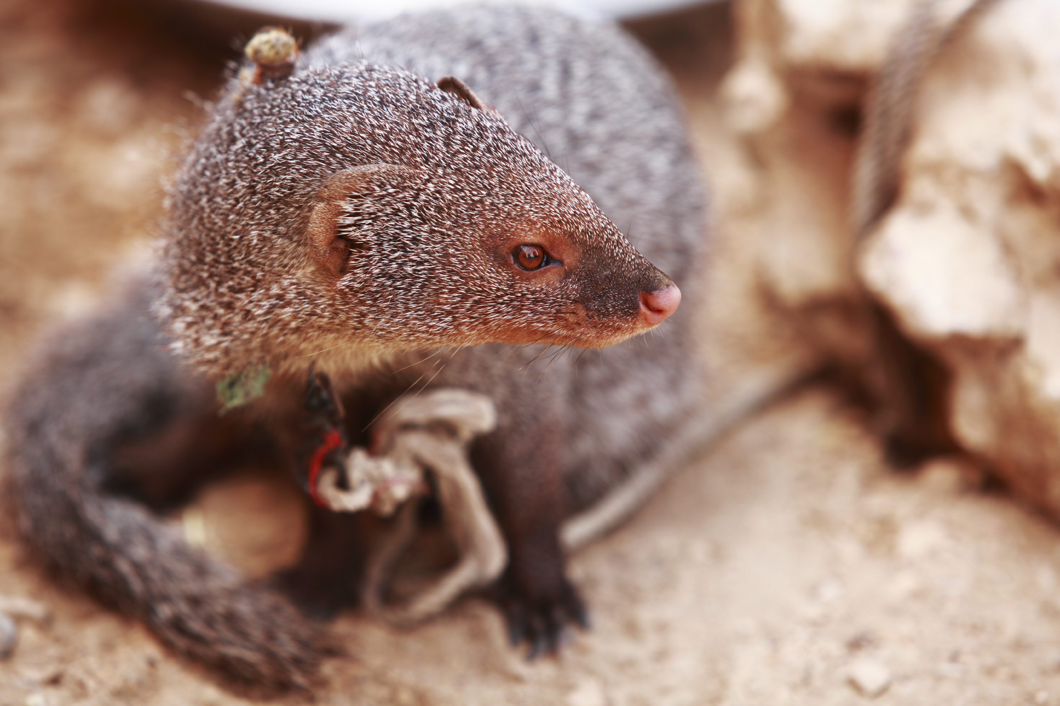
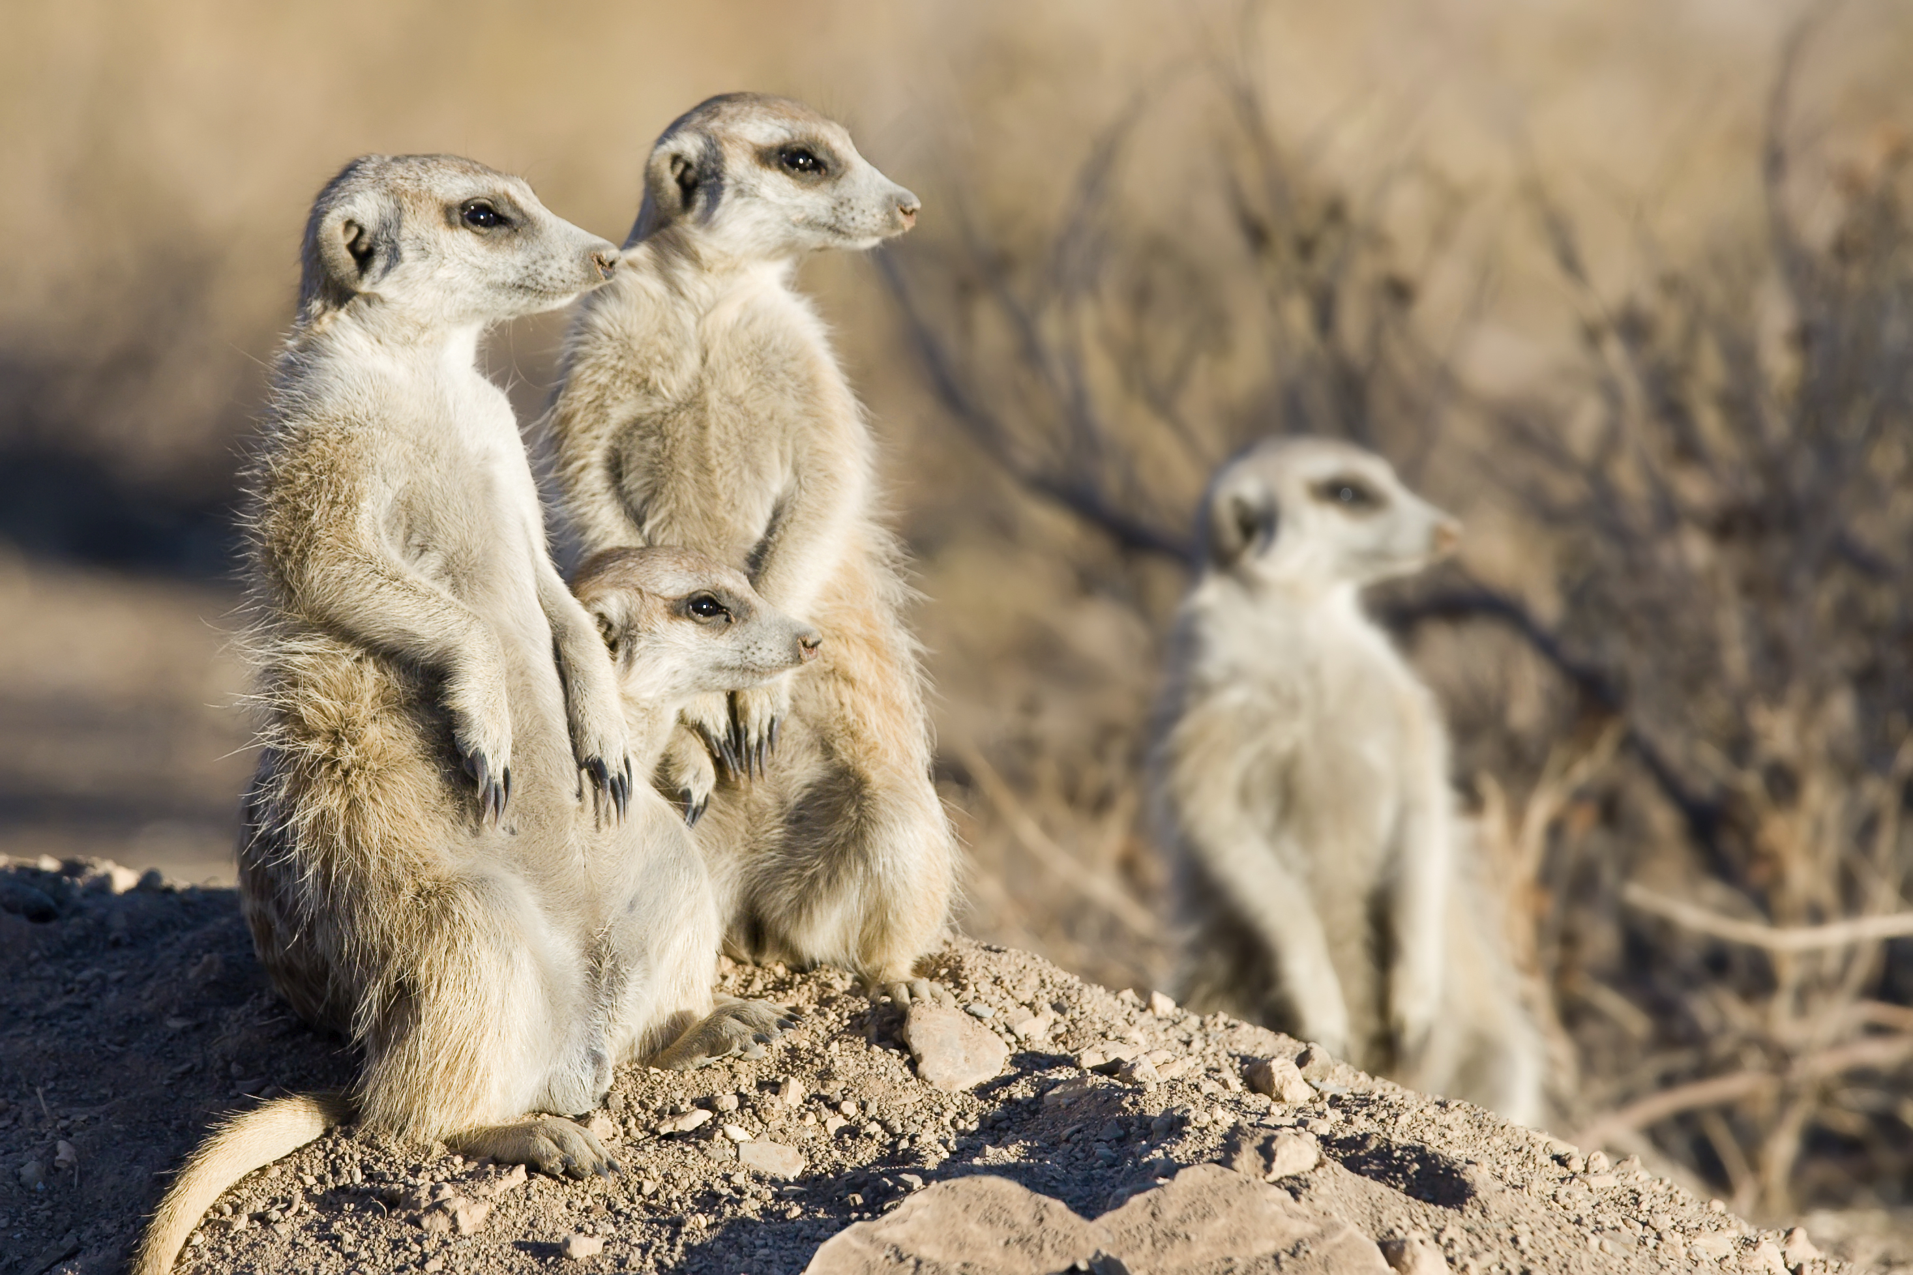
Two species of mongoose, The Cape grey mongoose (Galerella pulverulenta) and the meerkat (Suricata suricata)
Figure 4.10
Notes:
Figure 4.10 Two species of mongoose. (a) Cape grey mongoose lives alone or with only 1 or 2 other individuals. (b) A clan (social group) of social meerkats in savannah habitat.
Talking points: Figure shown again. The Cape grey mongoose lives mostly alone, while meerkats are social and live in small family clans.

Slide 20
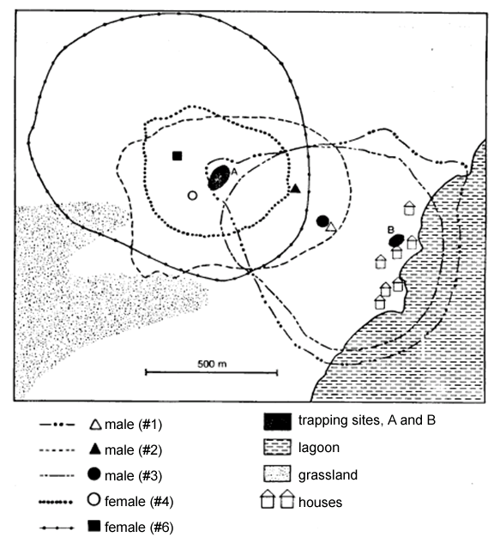
Home ranges of five Cape Gray mongooses
Figure 4.11
Notes:
Figure 4.11 Home ranges of five Cape Gray mongooses in West Coast National Park, South Africa.
Talking points: In one study, Cape gray mongooses were trapped and fitted with radio-collars. The location of each mongoose was then determined multiple times to determine their home ranges. Home range boundary lines were drawn around the area where each mongoose spent most of its time.
95.3% of sightings, mongooses were alone, even though there is extensive overlap in home ranges.

Slide 21
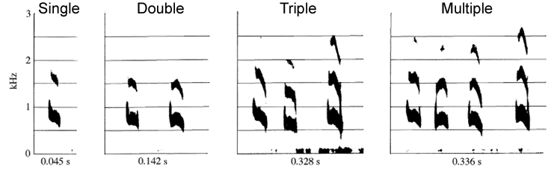
Sonograms of the four most common meerkat sentinel calls
Figure 4.12
Notes:
Figure 4.12 Sonograms of the four most common meerkat sentinel calls.
Talking points: Meerkat sentinels vocalized about 80% of the time they were on duty, and when no predator or threat was visible sentinels used 1 of 6 different calls, the four most common of which are shown here.

Slide 22
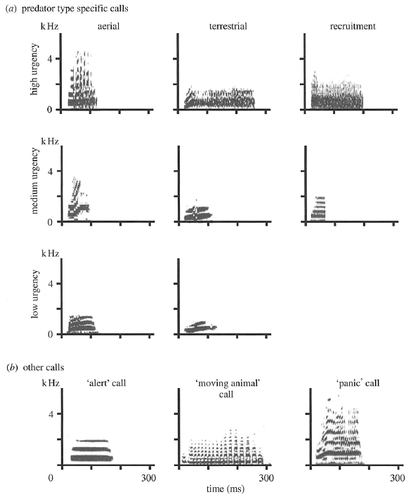
Sonograms of meerkat alarm calls
Figure 4.13
Notes:
Figure 4.13 Sonograms of meerkat alarm calls. (a) Aerial refers to calls given when an aerial predator was sighted, and terrestrial refers to calls given when a terrestrial predator was sighted. Recruitment calls prompted feeding meerkats to mob together. (b) Generic alarm calls. Functions determined by M. Manser.
Talking points: The researcher noted the presence and type of any predator, and the approximate distance from the caller to the predator when a caller made one of the following calls. Calls were categorized by the level of urgency by evaluating the responses of the signaler and receivers and by the geographical proximity of the danger.
Generic panic and alert calls are shown on the bottom row and were not tied to any specific type of threat.

Slide 23
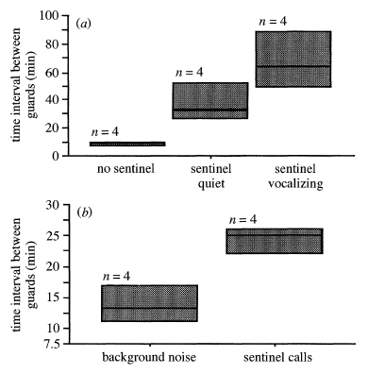
Time interval between new meerkat sentinels assuming guard duty under different conditions
Figure 4.14
Notes:
Figure 4.14 The time interval between new meerkat sentinels assuming guard duty under different conditions. The graphs illustrate the time intervals between the time it took for a meerkat to become a sentinel under three observed conditions (a), and during playback experiments (b) when no actual sentinel was on duty. n = sample size.
Talking points: To help determine the function of the sentinel calls, Manser recorded the time it took for a meerkat to go on duty under different conditions.
A playback experiment was also used to determine function of sentinel calls. New sentinels came on duty more quickly when there was no sentinel, the sentinel was quite, or background noise only was played back.
Boxplots convey information about the distribution of data. The horizontal line inside each box represents the median. The bottom and top of the boxes represent the 25th and 75th percentiles, respectively. The percentiles help describe how variable the response is.

Slide 24
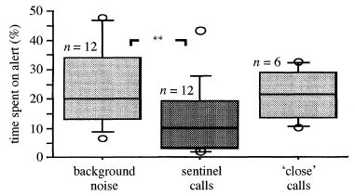
Sentinel call playback experiment
Figure 4.15
Notes:
Figure 4.15 Sentinel call playback experiment. The graph shows the percent of time foraging meerkats spent on alert when exposed to recordings of background noise or sentinel calls. n = sample size.
Talking points: Testing the percent of time foraging meerkats spent being on alert instead of digging in the sand for prey. Less time is spent on alert when sentinels are providing sentinel call. This allows foragers to spend more time feeding.
More on boxplots: Some boxplots have “whiskers” extending above and below the boxes. The ends of these bars represent more extreme values in the dataset. Here, they denote the 10th and 90th percentiles. The open circles above and below the boxes in this figure represent the maximum and minimum responses.
The asterisks indicate that the first two conditions are significantly different from one another.

Slide 25
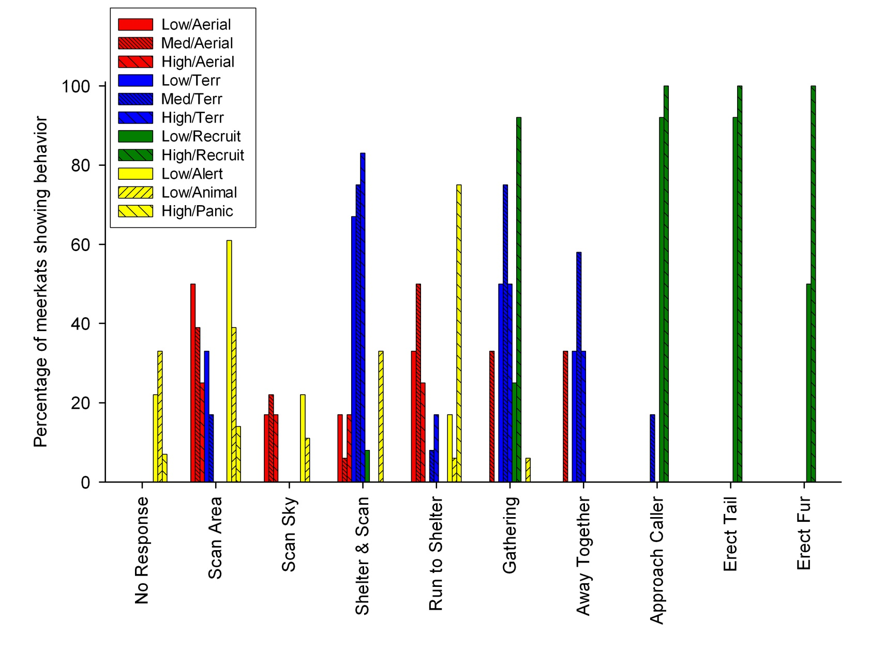
Percentages of meerkats displaying a behavior in response to recorded vocalizations
Figure 4.16
Notes:
Figure 4.16 The percentages of meerkats displaying one of nine behaviors in response to recorded vocalizations when no predator or other animal was within sight. Percentages in a vocalization category may add up to more than 100% because meerkats may exhibit multiple behaviors after one call.
Talking points: Results of playback experiments.
It was determined that no actual predators were in the area before starting the playback.
Meerkats performed different behaviors upon hearing certain calls.

Slide 26
Take-home message for information transmission in populations of animals?
What information themes are evident?
Themes:
Imperfect information transfer produces variation.
Information can be expressed without loss of content.
Ability to transfer information is heritable, but information transmitted between individuals is non-heritable
Populations can adapt and evolve new mechanisms of information transfer, or communication. That heritable information provides for continuity of life.
Notes:
Themes:
Imperfect information transfer produces variation
Information can be expressed and regulated without loss of content.
Ability to transfer information is heritable, but information transmitted between individuals is non-heritable
Populations can adapt and evolve new mechanisms of information transfer, or communication. That heritable information provides for continuity of life.

Slide 27
Integrating Concepts in Biology
PowerPoint Slides for Chapter 4:
Information at the Population Level
Section 4.4 How do plants of the same species recognize one another?
by
A. Malcolm Campbell, Laurie J. Heyer, and Chris Paradise
Notes:
Themes:
Imperfect information transfer produces variation
Information can be expressed and regulated without loss of content.
Ability to transfer information is heritable, but information transmitted between individuals is non-heritable
Populations can adapt and evolve new mechanisms of information transfer, or communication. That heritable information provides for continuity of life.

Slide 28
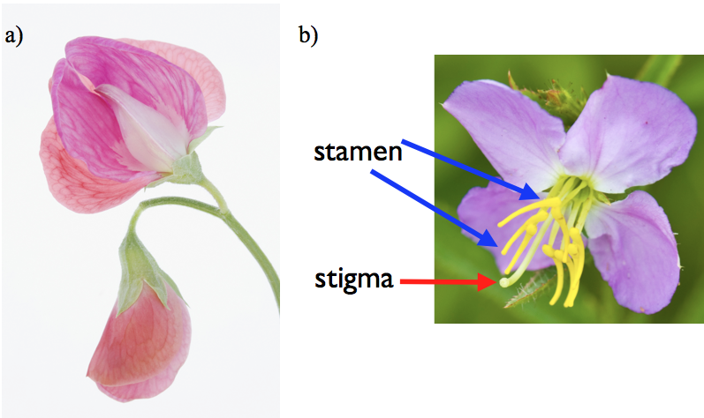
Fig. 3.11
Pea Flower Anatomy
Notes:
Figure 3.11 Pea flower parts. (a) Pink pea flower with reproductive parts hidden inside. (b) Open flower (not a pea species) with reproductive parts exposed as labeled.

Slide 29
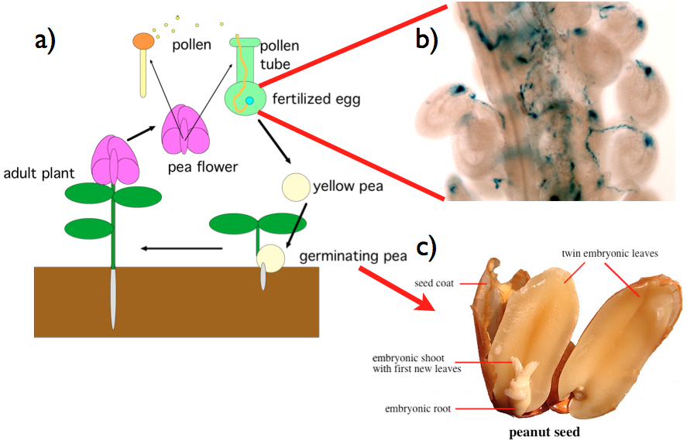
Fig. 3.12
Pea Plant Life Cycle
Notes:
Figure 3.12 Pea plant life cycle and parts of a seed. (a) Diagram of pea life cycle including self-fertilization. (b) Photomicrograph of thin, blue-stained pollen tubes fertilizing eggs (larger blue circles). You can see movies of this online http://www.biomedcentral.com/1471-2229/6/7/additional/ .(c) Similar to peas, peanuts contain paired embryonic leaves and root inside.

Slide 30
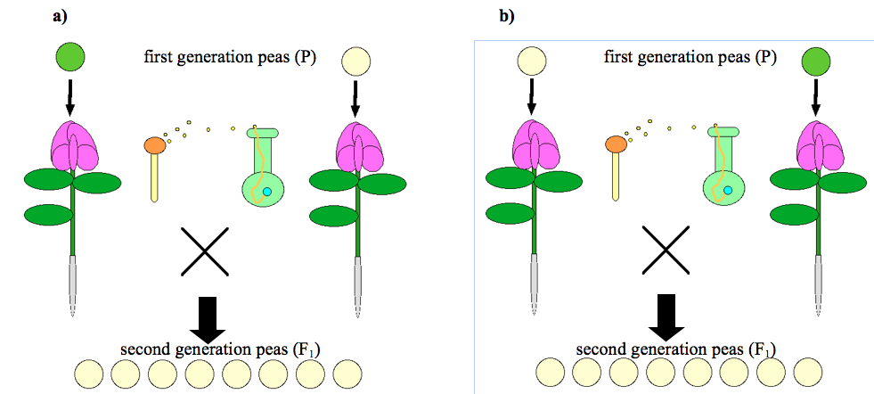
Fig. 3.13
Mendel’s First Experiments
Notes:
Figure 3.13 Mendel’s first breeding results. (a) Pollen from true-breeding green pea plants and eggs from true-breeding yellow pea plants produced only yellow seeds. (b) The reciprocal cross also produced only yellow seeds.

Slide 31
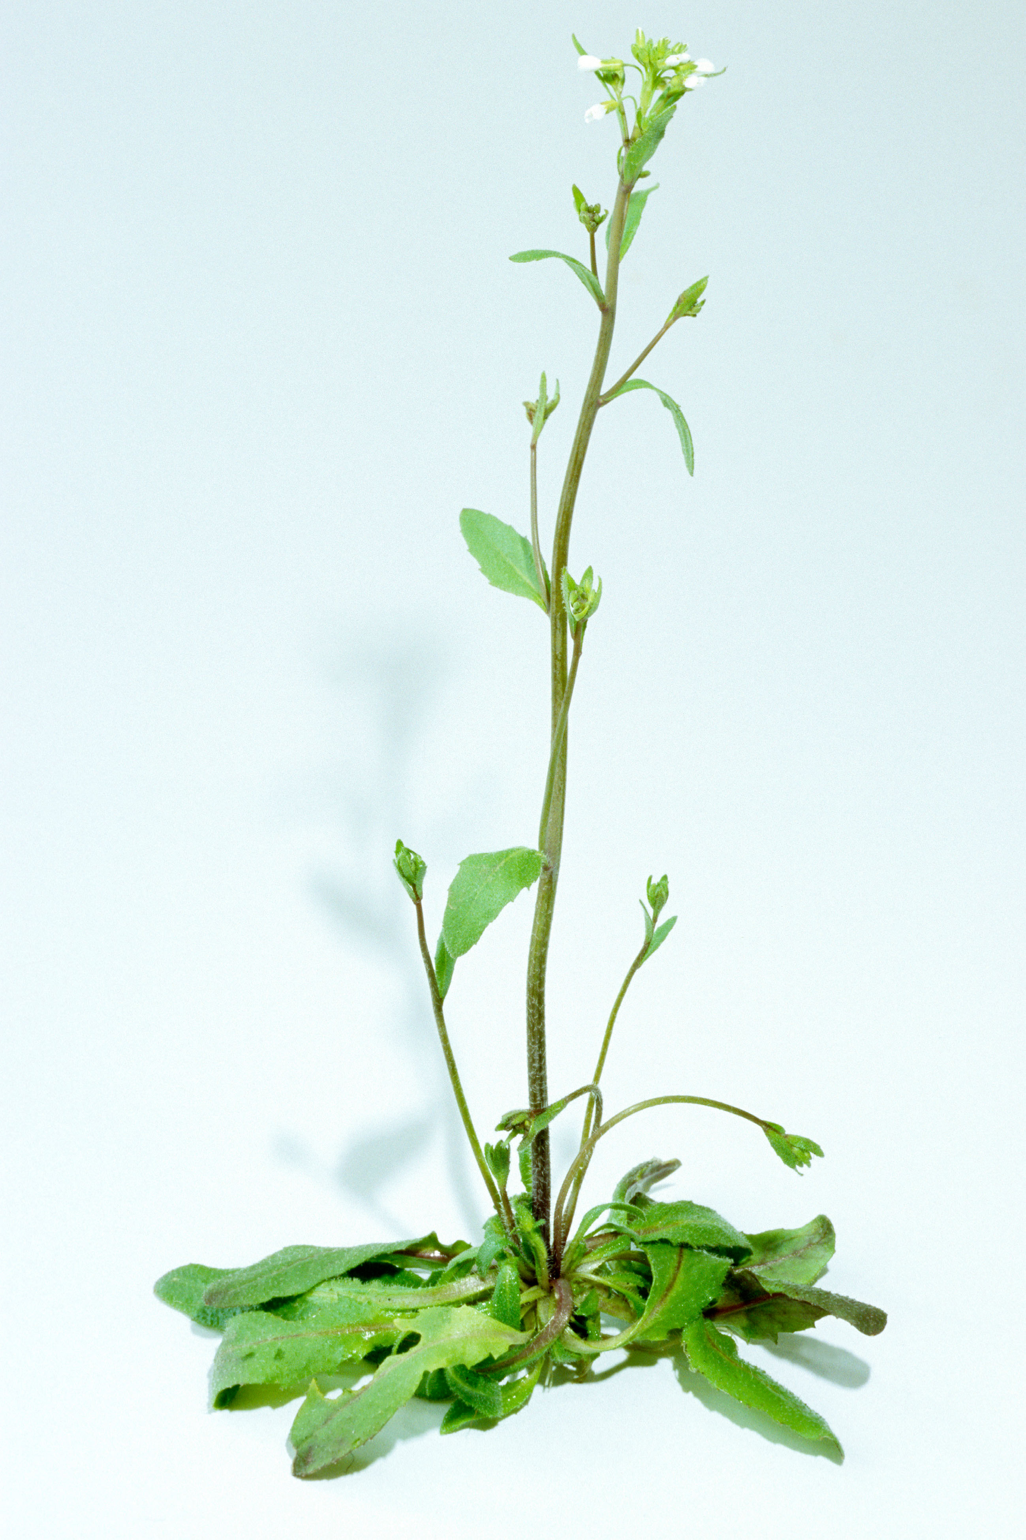
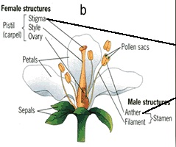
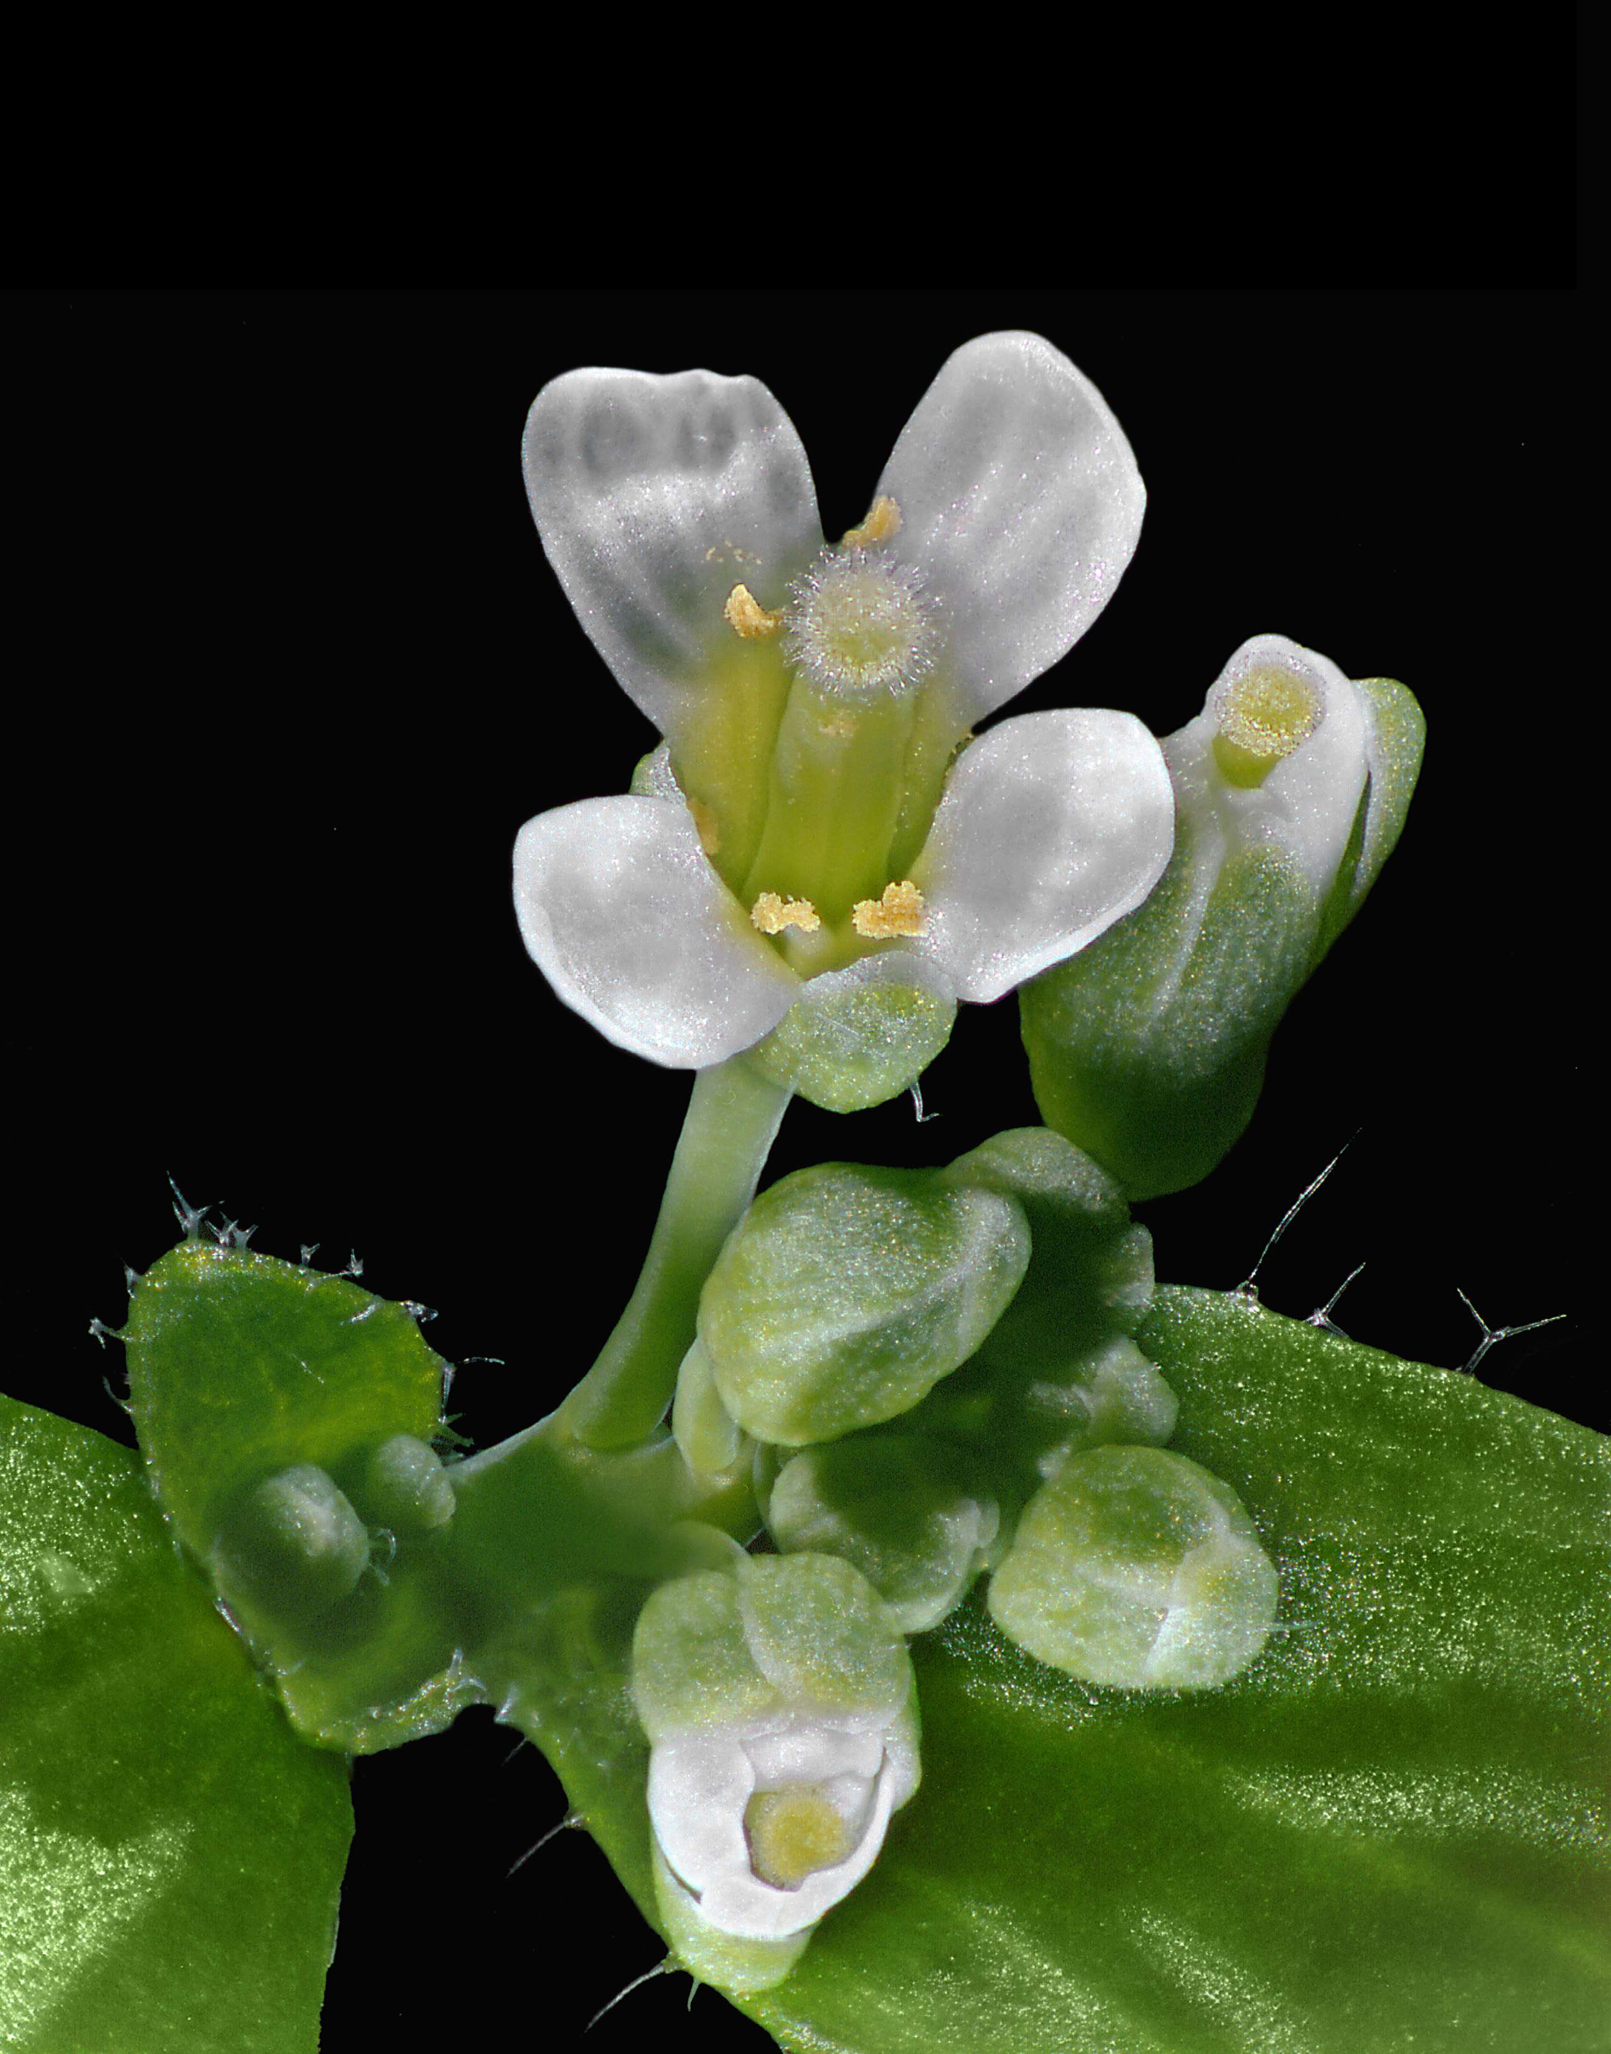
Arabidopsis thaliana
Yellow arrow indicates direction of pollen movement
Figure 4.17
Notes:
Figure 4.17 Arabidopsis thaliana. (a) The flowering stalk grows about 15-30 centimeters and arises from a set of low-lying leaves. (b) Arabidopsis flower anatomy. Pollen is released from the anthers and travels to the stigma. (c) Close up of flower.
Talking points: Specific flower anatomy is shown, can be generalized to flowers of other species. Match the parts shown in the schematic with those in part “c.” The yellow arrow shows the direction of pollen movement, from the anther to the stigma on the pistil.

Slide 32
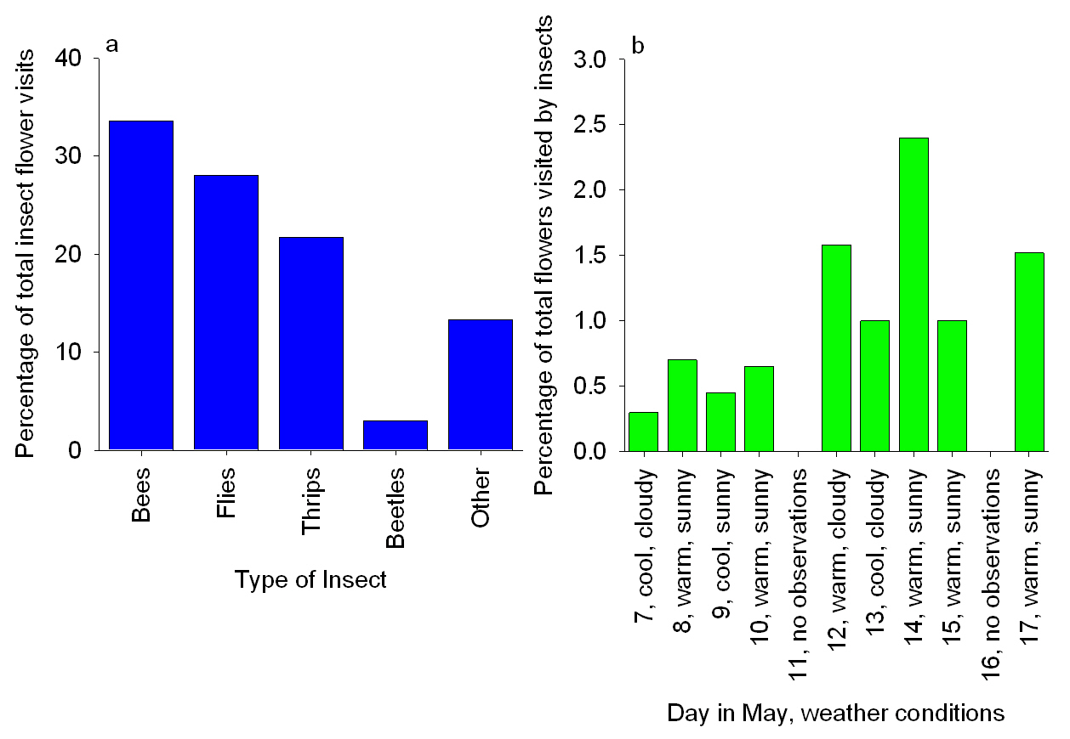
Insect pollination of Arabidopsis
Figure 4.18
Notes:
Figure 4.18 Insect pollination of Arabidopsis. (a) The percentage of types of insects that visited Arabidopsis flowers, of the total number of insects caught or observed. (b) The percentage of flowers that were visited by insects.
Talking points: Bees, flies, and tiny insects called thrips may be a source of pollination in Arabidopsis. Insects visited Arabidopsis flowers mostly on warm, sunny days. General absence of animal pollinators suggests that Arabidopsis flowers self-pollinate.
Advantage to self-pollination is that pollen is not dependent upon animals or wind. A disadvantage is that inbreeding may result.
Advantage to insect pollination is that pollen may travel fairly long distances. A disadvantage is that pollen from other species may be transferred and plants are dependent upon good weather for insect activity.

Slide 33
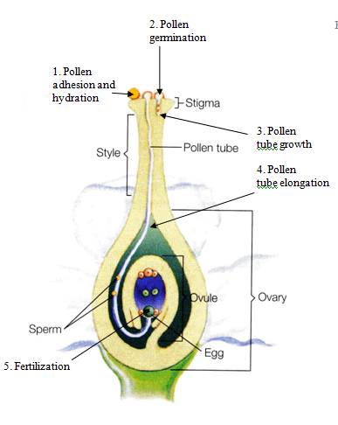
The plant flower pistil, with steps involved in pollination and fertilization
Follow steps using purple arrows. Red arrows point to where steps occur.
http://www.bio.davidson.edu/people/macampbell/111/ISB_Book/497_2007_64_MOESM1_ESM.mov
Figure 4.19
Notes:
Figure 4.19 The plant flower pistil, with the steps involved in pollination and ultimately fertilization (union of sperm and egg). Pollen and pollen tubes are shown in gold, while green and blue tissues represent the pistil.
Talking points: This schematic shows the five stages of pollen germination and growth.
Information is exchanged between the pistil and the pollen.
Start the sequence at the green circle. Follow steps using purple arrows. Red arrows point to where steps occur.

Slide 34
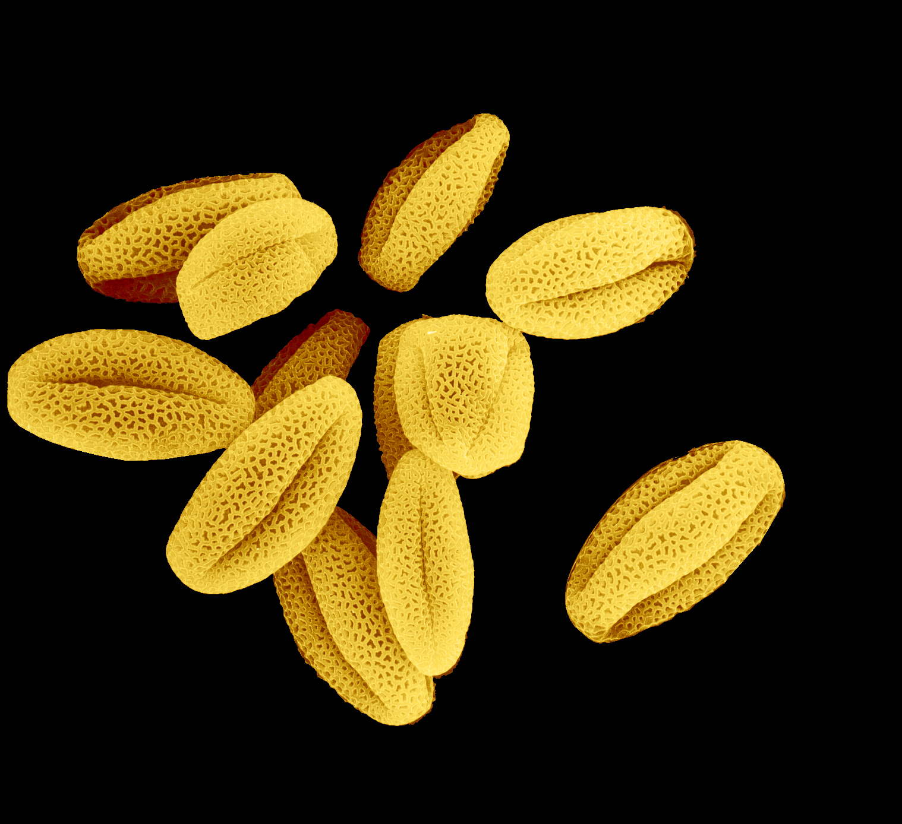
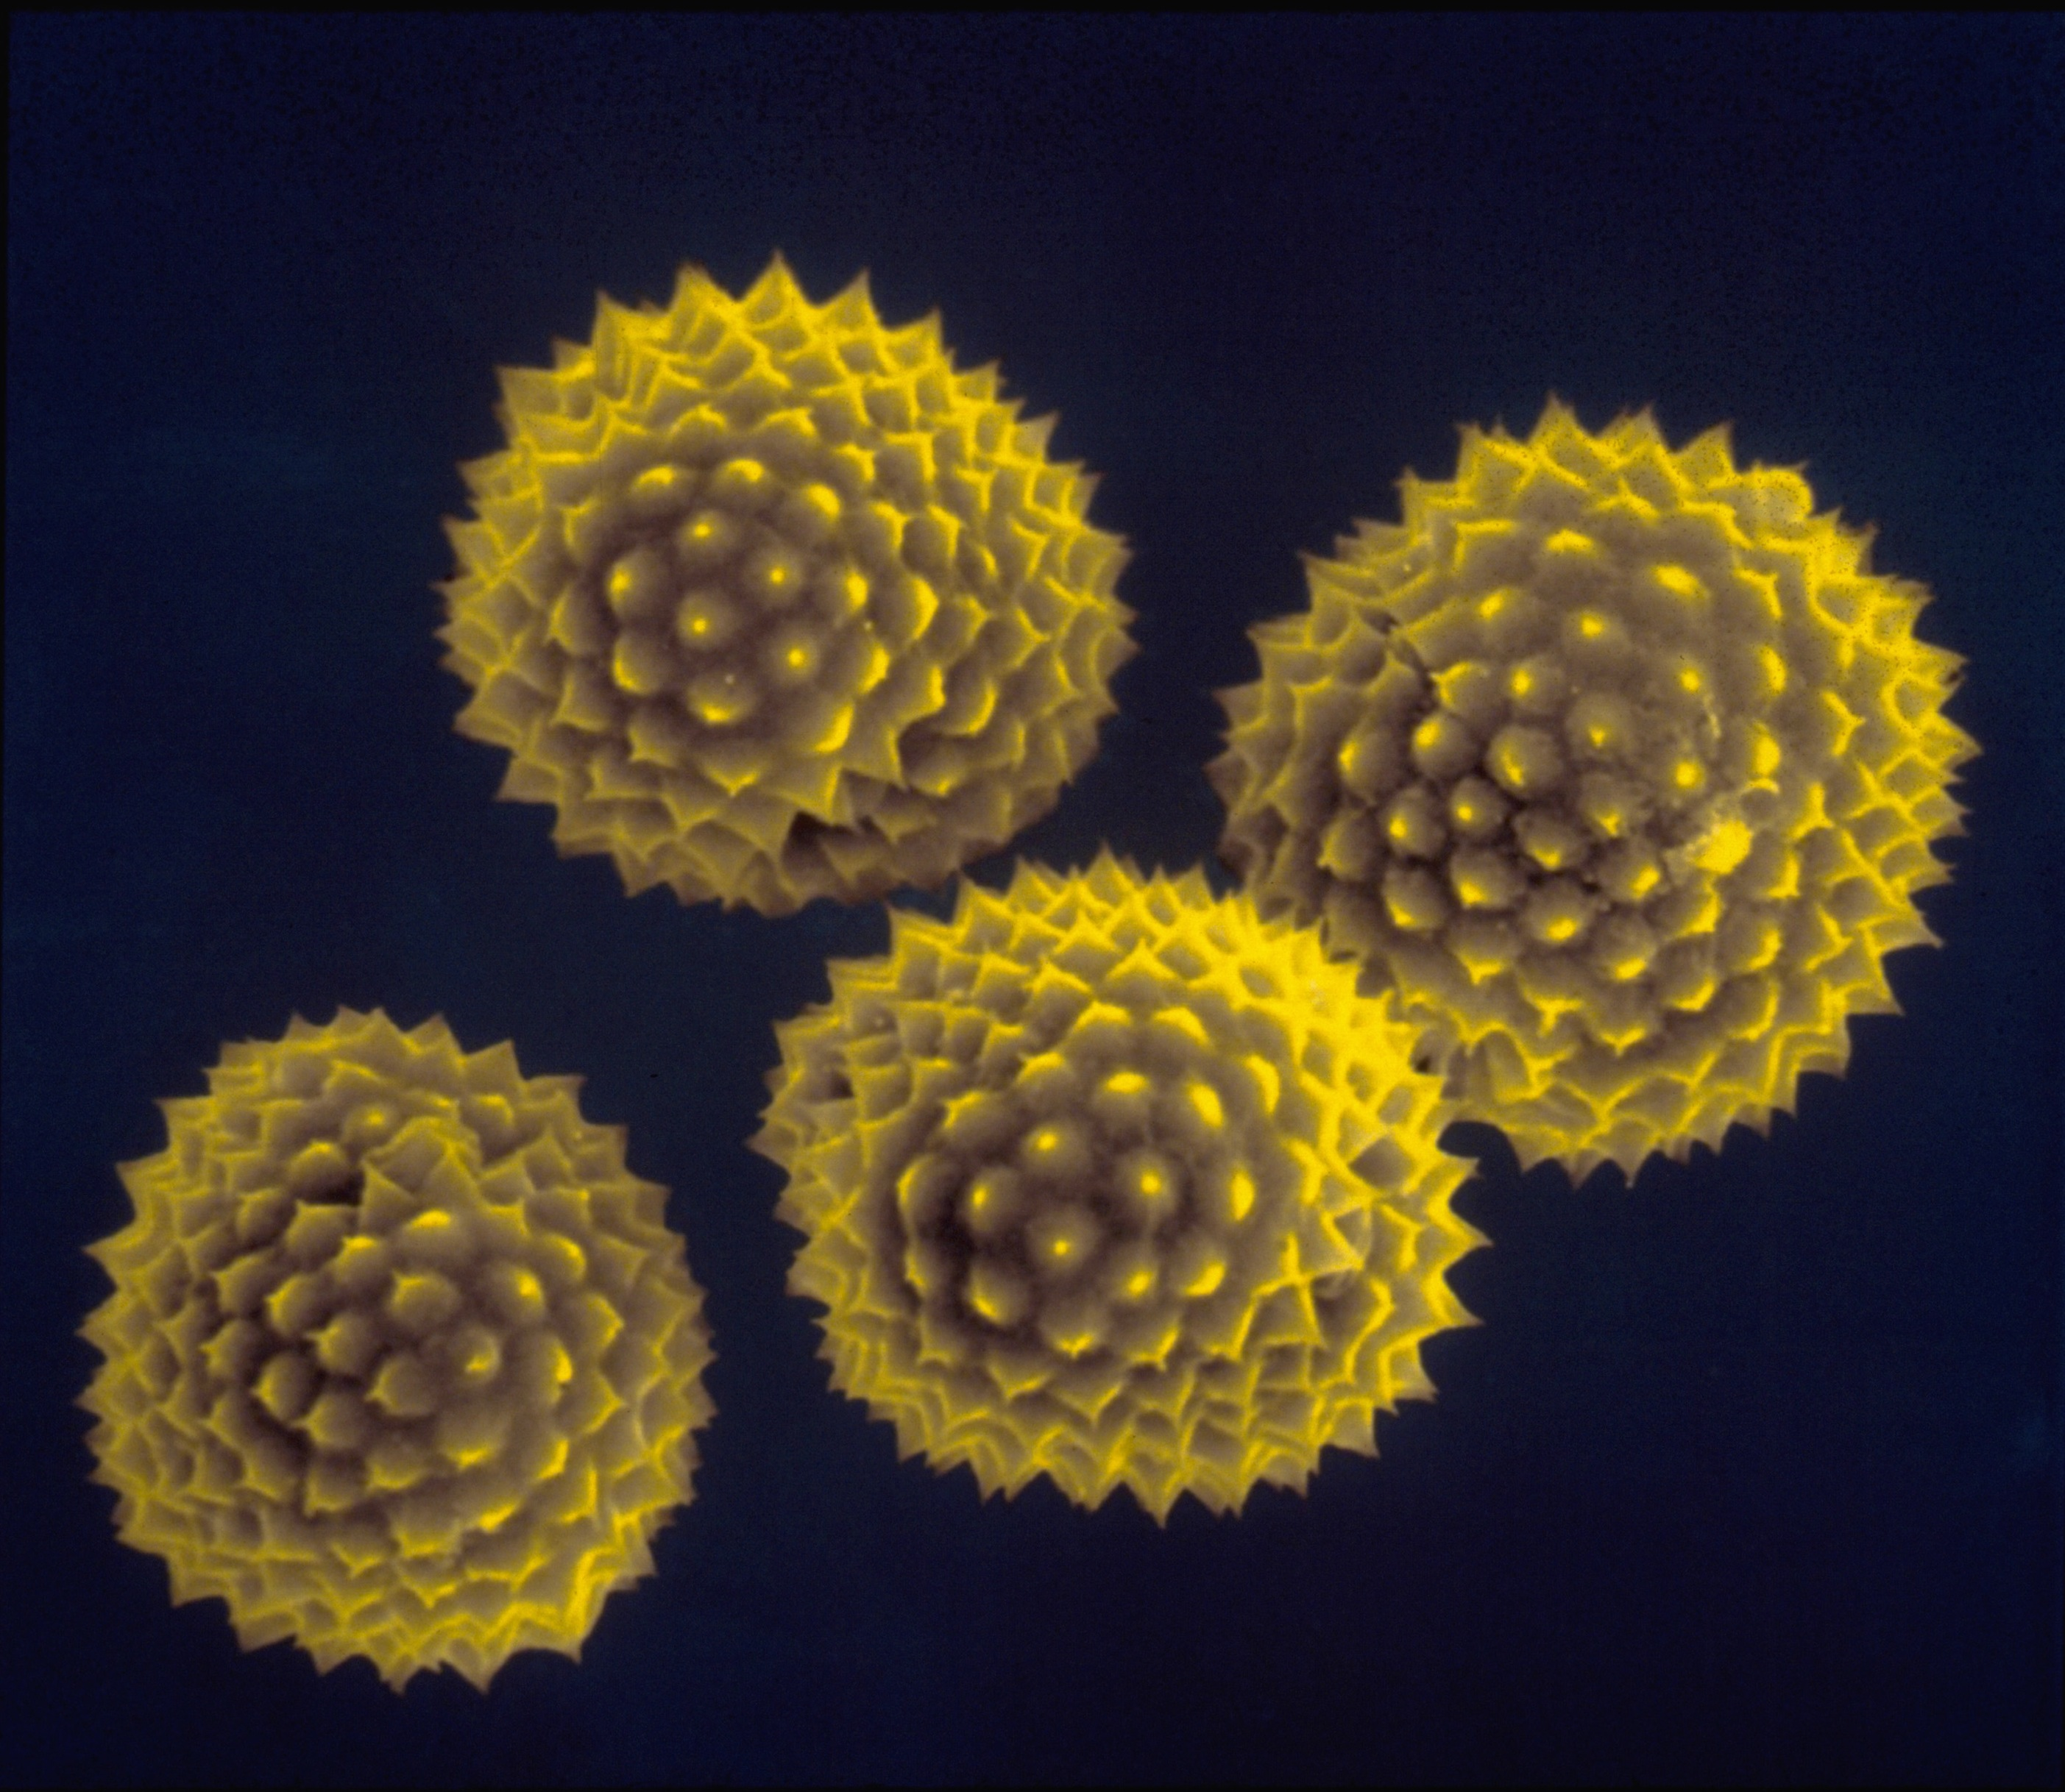
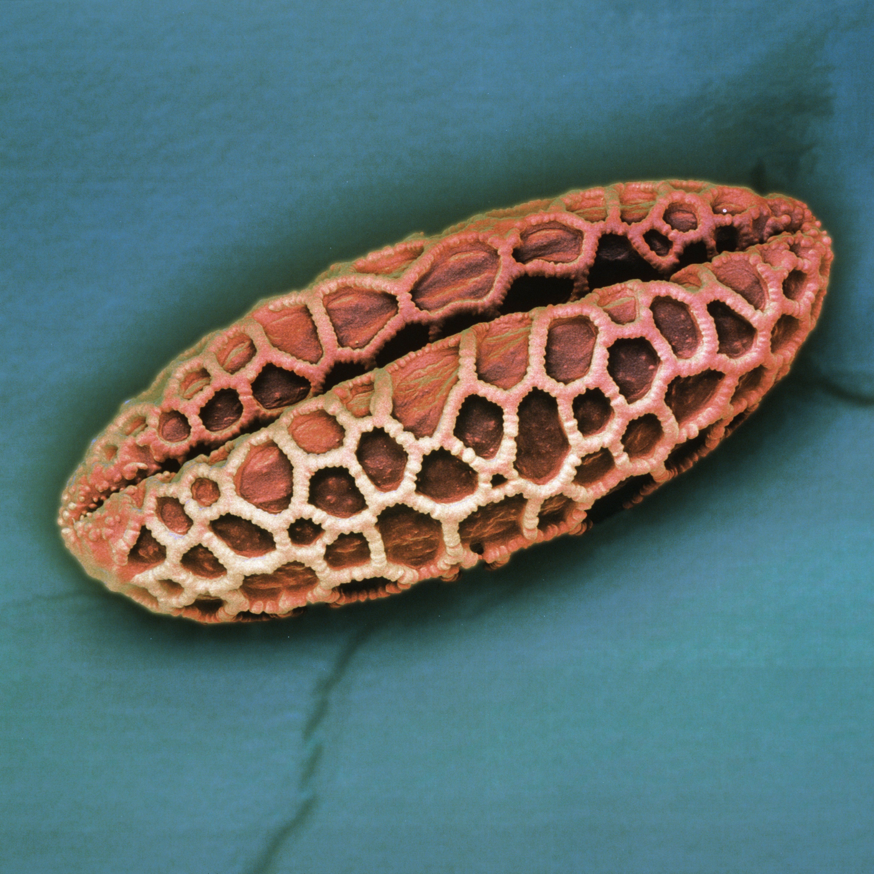
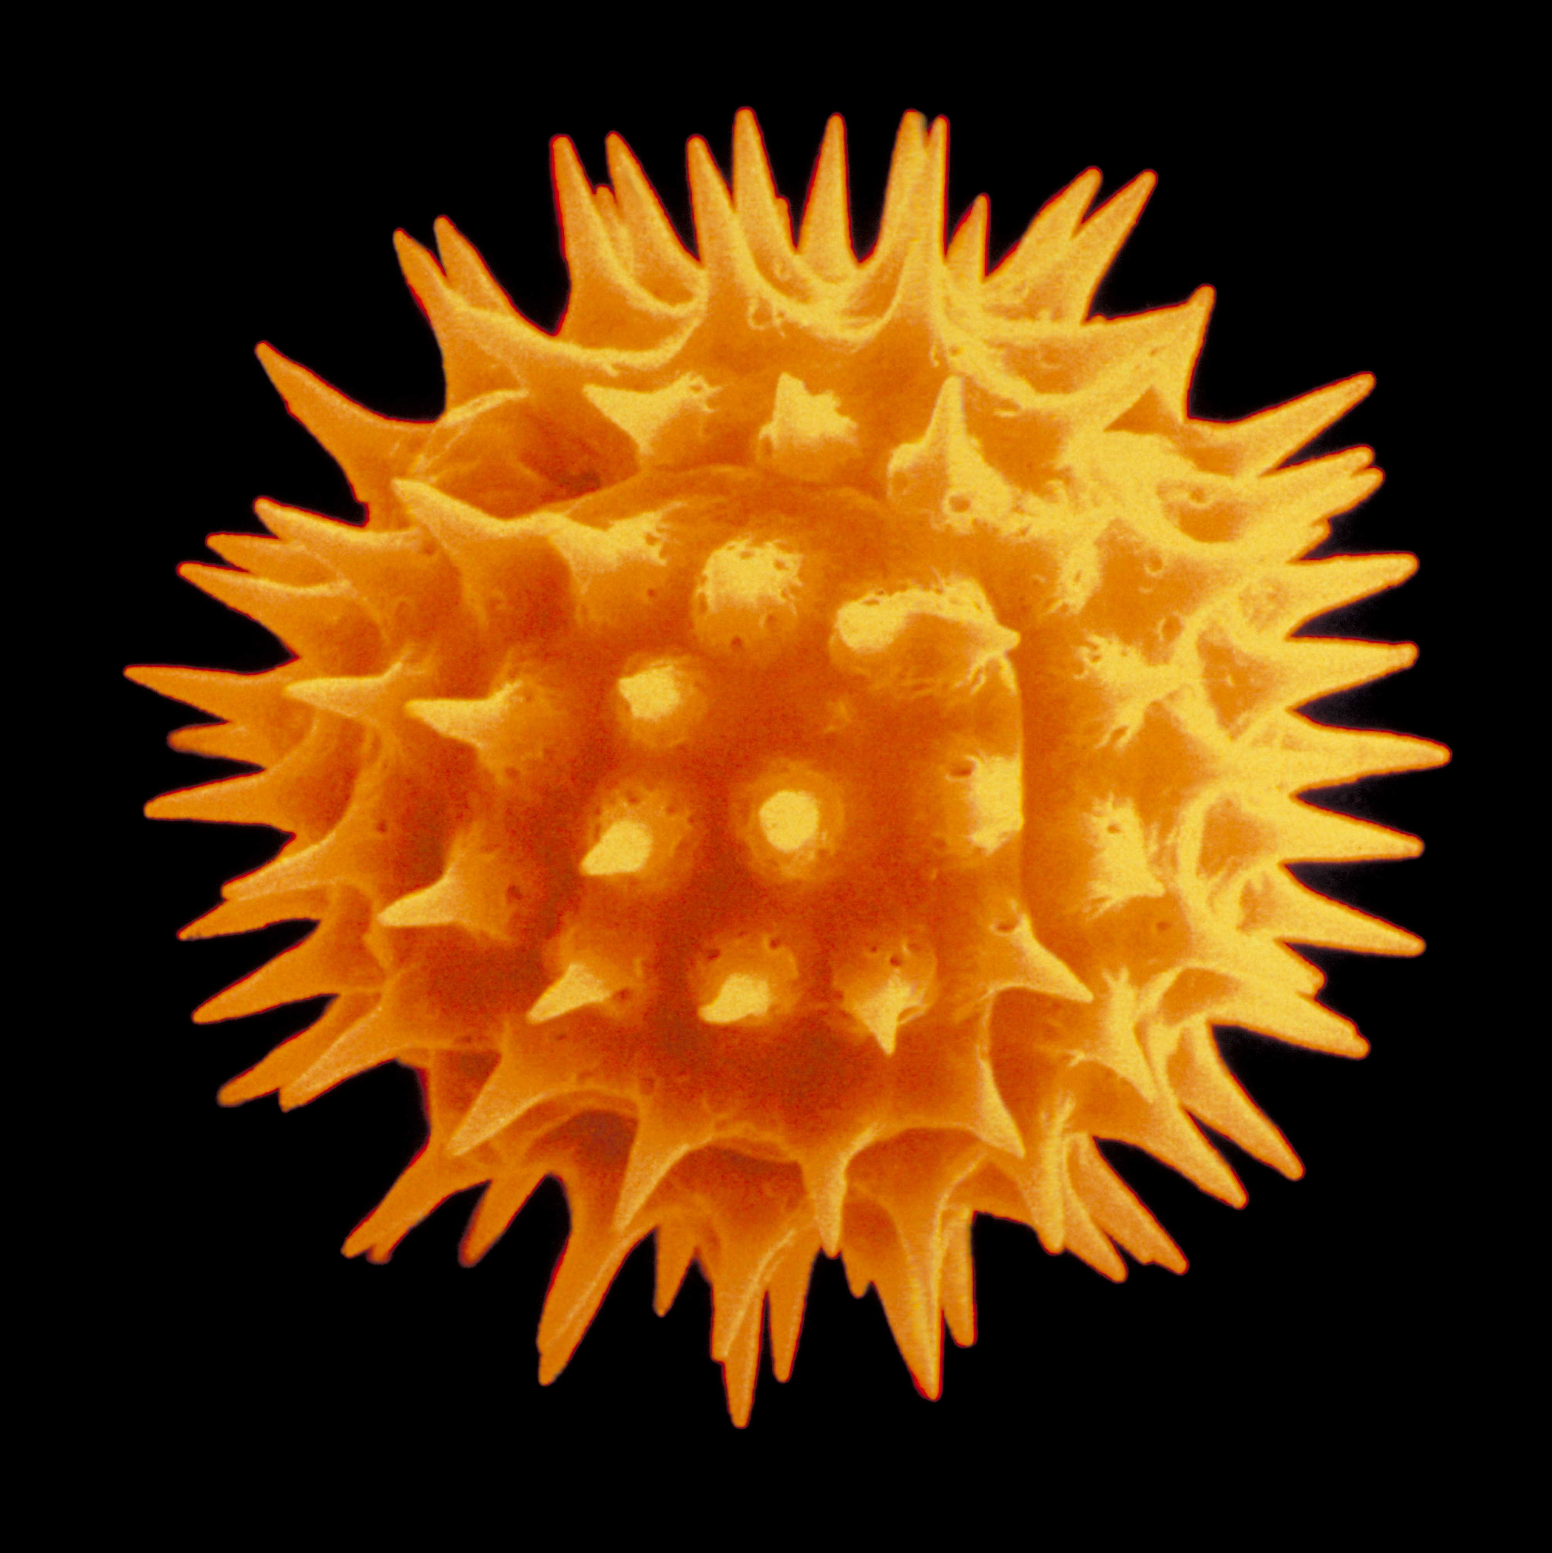
Pollen grains of different plant species
Compare and contrast pollen
Figure 4.20
Notes:
Figure 4.20 Information is contained in the shape and protein composition of pollen grains.
Talking points: Pollen grains are made up of only a few cells yet are complex structures, and each species is unique. This figure shows four representative species, including Arapidopsis. The important point is to compare the structures of these different pollen grains.

Slide 35
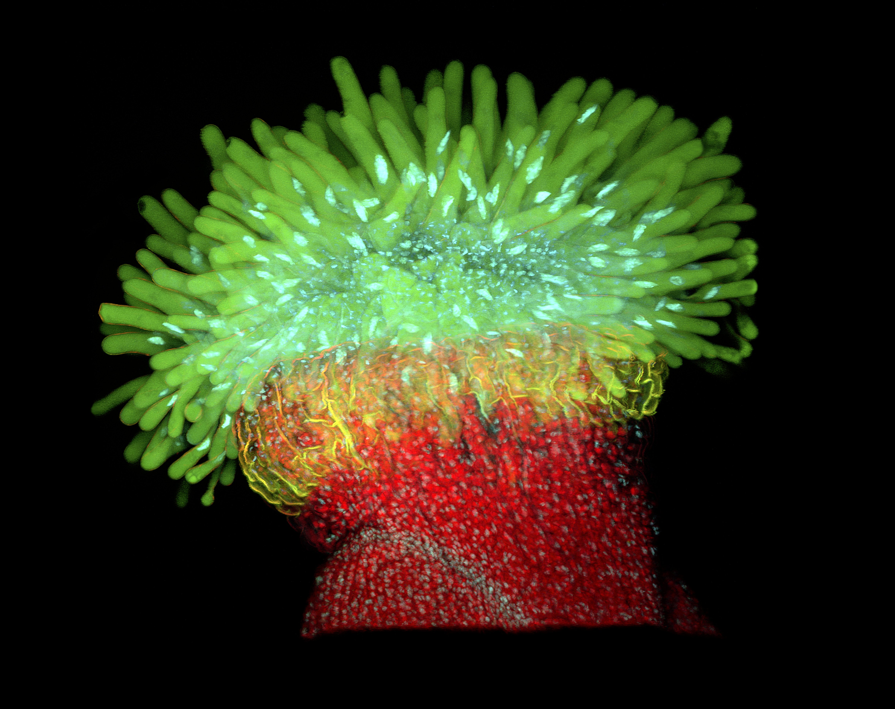
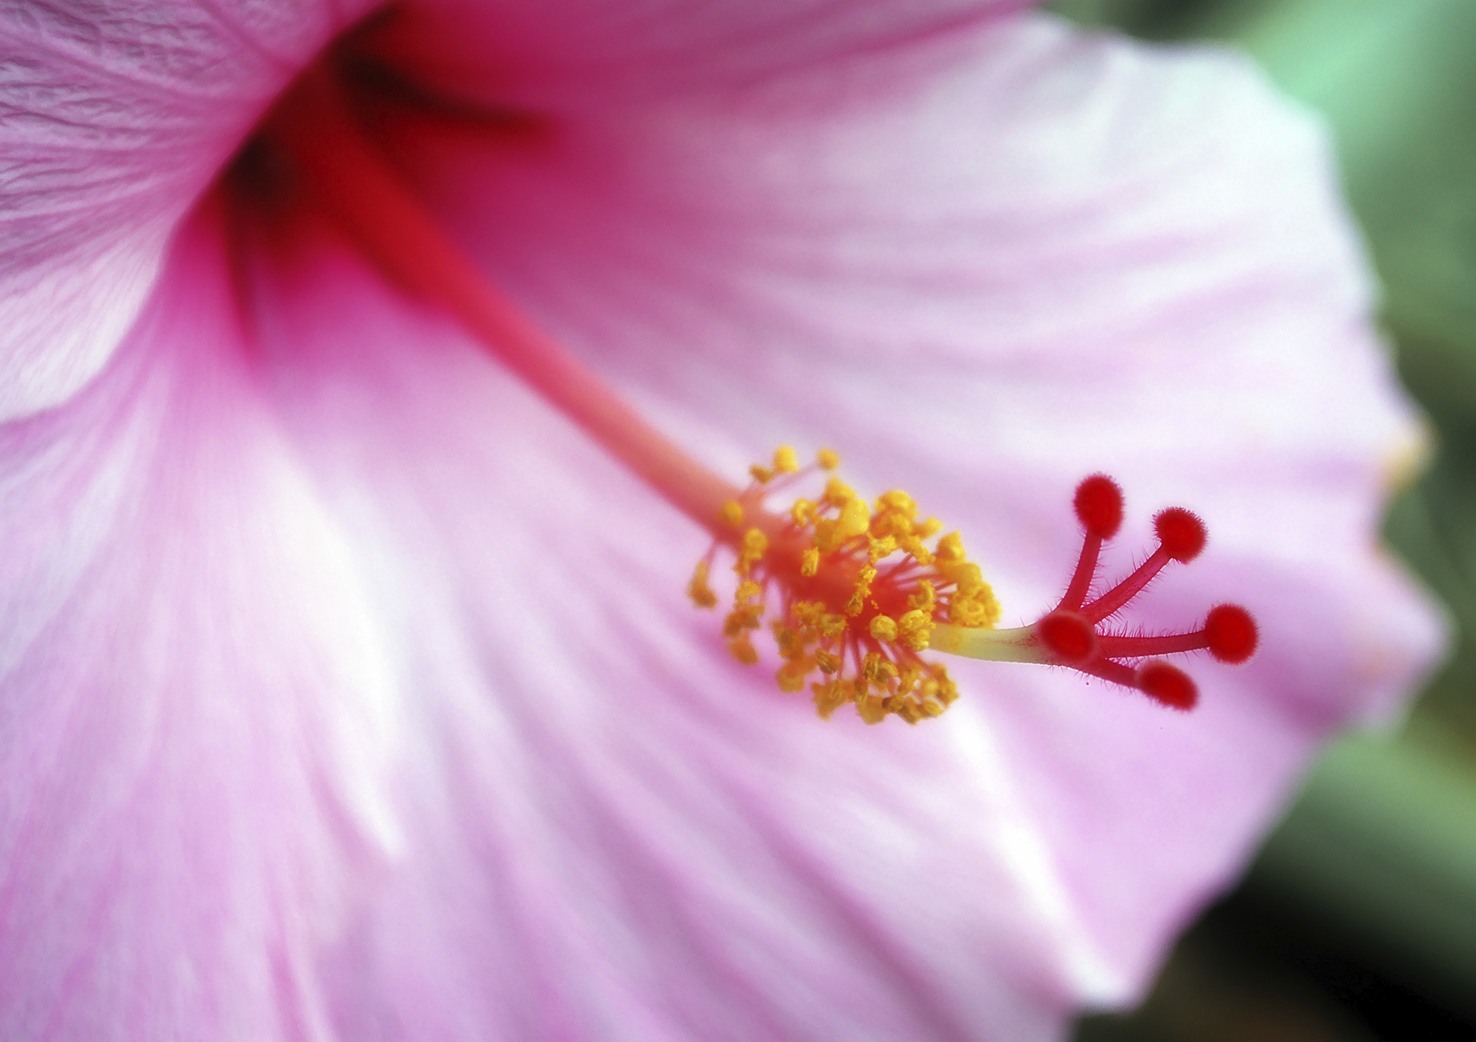
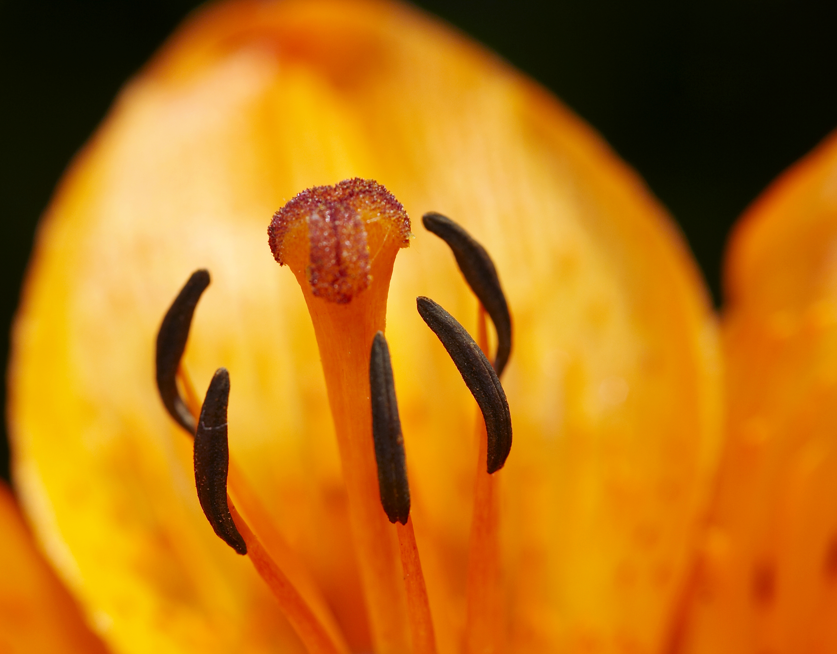
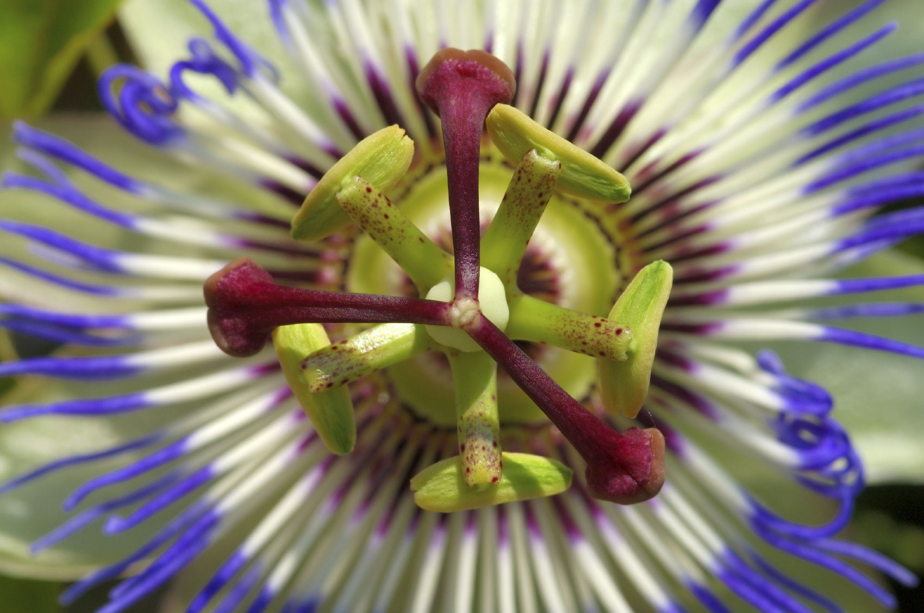
Diversity in plant stigmas
Compare and contrast stigmas
Figure 4.21
Notes:
Figure 4.21 Micrographs showing diversity in plant stigmas.
Talking points: Stigmas are also complex, with features that are exclusive to each species. The point is to examine and compare the structures of these different stigmas. In the preceding pictures, you can also see unique aspects of flowers.

Slide 36
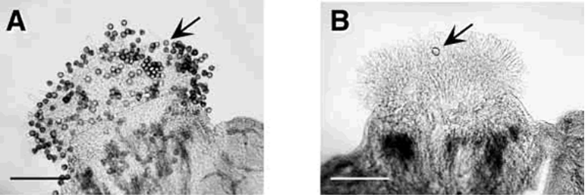
Pollen adhesion to Arabidopsis stigmas
Arabidopsis pollen adhering to Arabidopsis stigma
A petunia pollen grain on Arabidopsis stigma after washing
0.5 mm
Figure 4.22a and b
Notes:
Figure 4.22 Assessment of pollen adhesion to Arabidopsis stigmas. (a) Arabidopsis pollen adhering to Arabidopsis stigma. (b) One lone petunia pollen grain remaining on an Arabidopsis stigma after washing. Bar at lower left = 0.5 mm.
Talking points: Unpollinated Arabidopsis pistils were covered with pollen grains of test species. Pistils were then washed in buffer solutions, and pollen grains still bound to stigmas were counted.

Slide 37
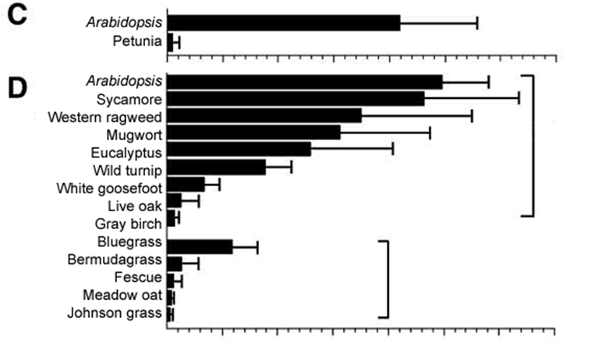

Adhesion of various species of pollen to Arabidopsis stigmas
Pollen grains adhering to stigmas after washing with buffer
Figure 4.22c and d
Notes:
Figure 4.22 Assessment of pollen adhesion to Arabidopsis stigmas. (c) Mean number of pollen grains bound per stigma for Arabidopsis pollen (n = 38) and petunia pollen (n = 33). (d) Other species of pollen assayed on Arabidopsis stigmas (minimum of 10 assays per pollen type). Error bars in all graphs are one standard deviation.
Talking points: Unpollinated Arabidopsis pistils were covered with pollen grains of test species. Pistils were then washed in a buffer solution, and pollen grains still bound to stigmas were counted.
Species with pollen that adheres tightly to Arabidopsis are often closely related to Arabidopsis (upper bracket in “d”) indicating shared traits in pollen-stigma interactions/communication. The pattern is not entirely consistent with evolutionary relationship.
Arabidopsis pollen and stigmas transfer information to recognize each other.

Slide 38
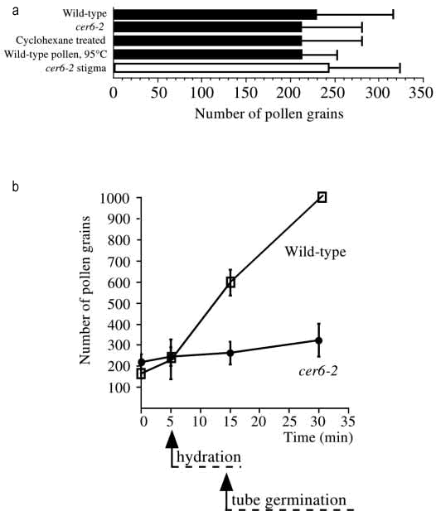
Adhesion assays on Arabidopsis
Figure 4.23
Notes:
Figure 4.23 Adhesion assays on Arabidopsis. (a) Early adhesion assays for different pollen treatments on Arabidopsis stigmas. Normal pollen was also applied to cer6-2 stigmas, shown on the white bar (sample size > 10 in each test). (b) Adhesion assay monitoring the number of pollen grains bound per stigma (n=5 stigmas per data point; error bars = 1 standard deviation) over time. Onset (arrows) and duration (dashed lines) of hydration and germination are indicated.
Talking points: a. Are pollen protein coat lipids and proteins critical for adhesion? Remove them from the outer layer of the pollen grain to find out. Normal pollen (wild-type – top bar) is the control. One mutant strain (cer6-2) of Arabidopsis produced pollen with no lipids and only a few proteins. Cyclohexane eliminated lipids and proteins from normal Arabidopsis pollen. Heating normal pollen to 95ºC degrades proteins and lipids from surface. In addition, they tested normal pollen on cer6-2 stigmas. There were no differences in pollen binding among these treatments.
b. A set of stigmas were pollinated with wild-type or mutant pollen. At 5, 15, and 30 minutes after pollination, a subset of the stigmas exposed to each type of pollen were analyzed to determine number of pollen grains bound to stigmas. Over time the number of pollen grains adhering to wild-type pollen continues to increase, but not for mutant pollen, indicating that pollen grains are adhering in a secondary process initiated during or after hydration and that lipids and/or proteins may be important in that process.

Slide 39
Are ovules important in signaling and guiding pollen tube growth? IQ 46
Observed values | Ovule with associated pollen tube after 20 hours | Ovule without associated pollen tube after 20 hours
Normal ovule | 124 | 60
Abnormal ovule | 0 | 189
Expected values | Ovule with associated pollen tube after 20 hours | Ovule without associated pollen tube after 20 hours
Normal ovule | 124/373*184 = 61.2 | 249/373*184 = 122.8
Abnormal ovule | 124/373*189 = 62.8 | 249/373*189 = 126.2
χ² = 190.8, p < 0.001
Table 4.4
Notes:
Table 4.4 Mutant Arabidopsis flowers were used to determine if ovules were important in signaling and guiding pollen tube growth.
Talking points: Are pollen tubes are guided by signals from the ovule or egg and are signals are species specific?
Use mutant Arabidopsis with normal tissue in the pistil, but with half of the ovules failing to produce eggs during meiosis.
Mutant stigmas dusted with wild-type pollen, and incubated for 20 hours. Ovaries then stained for callose, a polysaccharide produced by pollen tubes. The staining shows pollen tubes that grew and entered an ovule.
All ovules with successful pollen tube entry were normal. All abnormal ovules lacked pollen tubes.
The pollen tubes that reached normal ovules within mutant successfully transferred information between two individuals of the same species. Pollen tube guidance by an ovule requires a signal from that ovule.

Slide 40
Integrating Concepts in Biology
PowerPoint Slides for Chapter 4:
Information at the Population Level
Section 4.5 How does a squid use bacterial communication to glow in the dark?
by
A. Malcolm Campbell, Laurie J. Heyer, and Chris Paradise

Slide 41
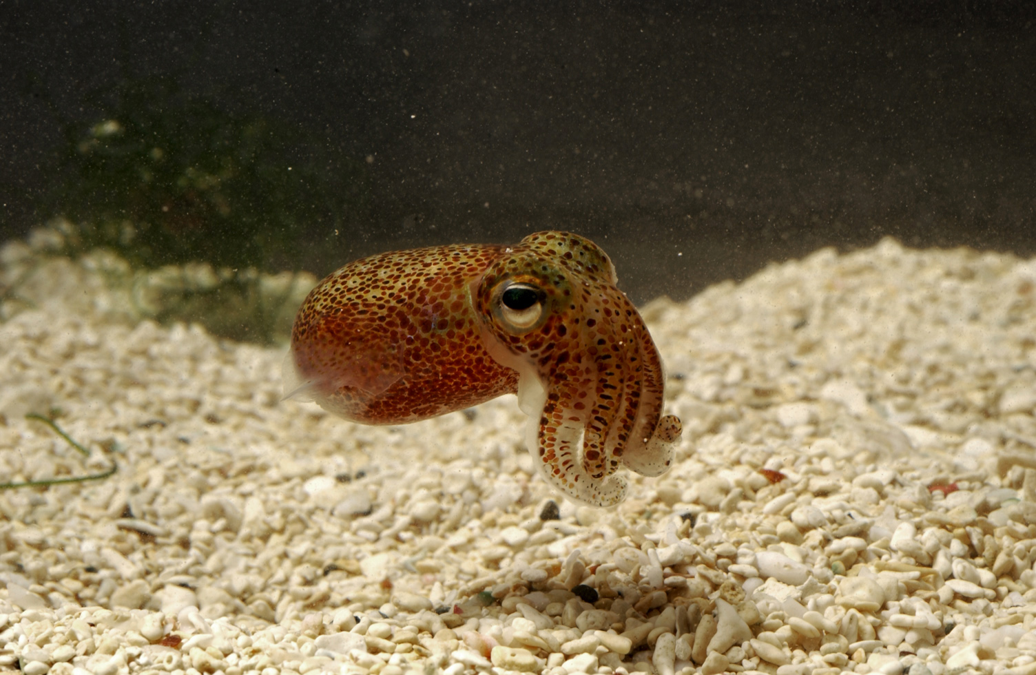
The Hawaiian bobtail squid
Water enters through gills and leads to large body cavity
Water exits out funnel
http://www.physorg.com/news/2010-11-symbiosis-bobtail-squid-bacteria-buddies.html
Figure 4.24
Notes:
Figure 4.24 An adult Hawaiian bobtail squid measuring about 25 cm.
Talking points: The Hawaiian bobtail squid, Euprymna scolopes, uses bacteria to emit light. The squid are nocturnal, spending their days buried in the sand, and coming out at night to feed in the open water. Vibrio fischeri is bioluminescent and can live inside some marine animals, including squid, in a symbiotic relationship. Over 25 species have been found to house Vibrio.
Squid take in seawater to obtain oxygen. The water circulates in the large body cavity (the mantle cavity), which has an opening behind their eyes, as can be seen in figure.

Slide 42
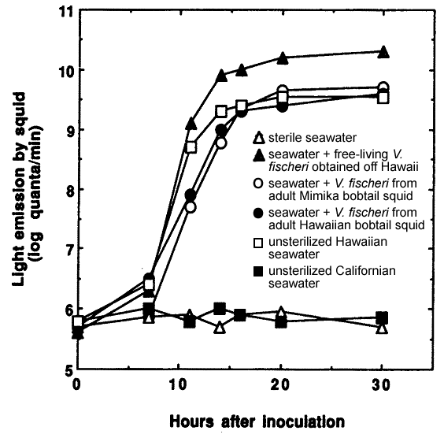
Bioluminescence of baby Hawaiian bobtail squid exposed to different seawater treatments
What treatments are most effective, and what do you conclude from this experiment?
Figure 4.25
Notes:
Figure 4.25 Bioluminescence of baby Hawaiian bobtail squid exposed to different seawater treatments.
Talking points: Baby squid were inoculated with multiple types of seawater, some sterilized, some with V. fischeri, and some unsterilized. Graph shows readings of light emission by squid taken at regular intervals.
Graph shows that squid are not born with the bacteria needed to bioluminescence.
V. fischeri obtained from Hawai’i or from Hawaiian squid were able to successfully grow in squid.
Sterile seawater and unsterilized Californian seawater did not lead to emission of light.

Slide 43
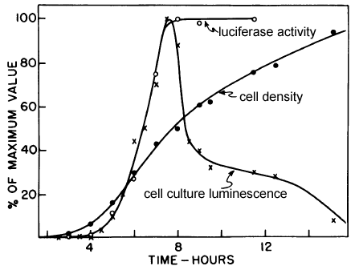
Time course of growth and luminescence of V. fischeri cells
Figure 4.26
Notes:
Figure 4.26 Time course of growth and luminescence of V. fischeri cells. Note that the y-axis scale is a percentage of the maximum value obtained for each variable.
Talking points: Vibrio fischeri cultured to understand bioluminescent properties. Researchers estimated density of cells and bioluminescence at different points. Bioluminescence was estimated by measuring light emitted from a culture using a light detector and by measuring luciferase concentration and activity.
Bioluminescence only occurs when bacteria have achieved a sufficiently high density, a phenomenon called quorum sensing; when a culture reaches a certain number of bacteria then signal is strong enough to be received by all members of the culture. Bacteria are packed in a squid much like high density cultures in the laboratory, where they reach the quorum density.
Luciferase stays high in more dense cultures, but something causes decline in culture luminescence. Possibly loss of substrate or energy required for reaction.

Slide 44
Testing for presence of chemical signal in two strains of V. fischeri
Treatment | Hypothesized to be present in medium when cells are added to culture |  | Optical density at point of luminescence after inoculation with …
 | Strain 1 signal | Strain 2 signal | Strain 1 | Strain 2
Control | No | No | 0.3-0.4 | 0.1-0.15
Strain 1 fluid | Yes | No | Immediate | 0.03-0.05
Strain 1 fluid, filtered twice | Yes | No | Immediate
Strain 1 fluid, boiled | Yes | No | 0.03-0.05
Strain 2 fluid | No | Yes | 0.03-0.06 | Immediate
Strain 2 fluid, filtered twice | No | Yes |  | Immediate
Strain 2 fluid, boiled | No | Yes |  | Immediate
Table 4.5
Notes:
Table 4.5 Results of an experiment testing for the presence of chemical signal in two strains of V. fischeri.
Talking points: One experiment tested for a chemical signal that induces luciferase production and for species-specific signals.
Two strains of V. fischeri were grown to high density. The chemical signal was isolated through centrifugation and filtration. The fluid was then unmanipulated, boiled or passed through successive filters with increasingly smaller pores.
Fluid was added to one of two centrifuged cultures. High optical density means a culture had to grow before it became luminescent. “Immediate” means the culture was luminescent as soon as cells were exposed to supernatant.
Not all treatments were tested with both strains. The negative control never had any cells so it lacked any quorum signaling capacity.
Immediate response when strain 1 cells were added to the supernatant of strain 1 unmanipulated and filtered meant that the signal was present in the fluid. Boiling had differential effects – the signal of strain 1 was destroyed by heating, while the signal of strain 2 was not. The two chemicals are different.

Slide 45
V. fischeri Quorum Sensing
Activated LuxR is a transcription activator binding to luxP operon
➔ transcription of inducer and luciferase genes
More VAI = more light
LuxR
LuxI
LuxR
Luciferase Genes

