Slide 1
Integrating Concepts in Biology
Chapter 5: Information in Ecological Systems
Section 5.1: Have organisms evolved to exploit communication between individuals of other species?
by
A. Malcolm Campbell, Laurie J. Heyer, and Chris Paradise

Slide 2
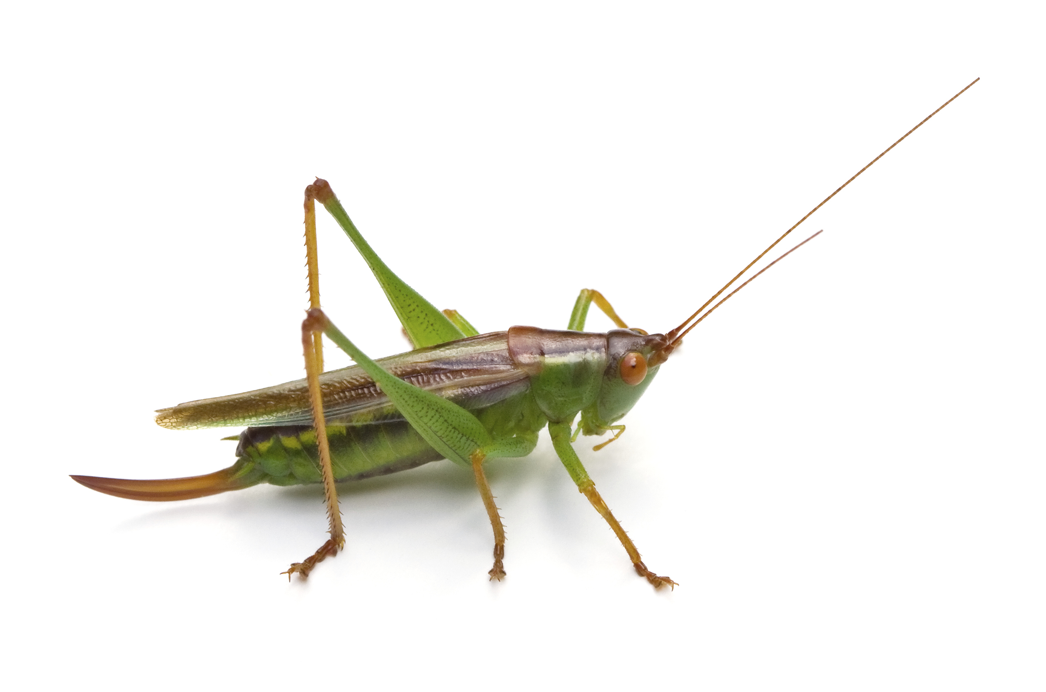
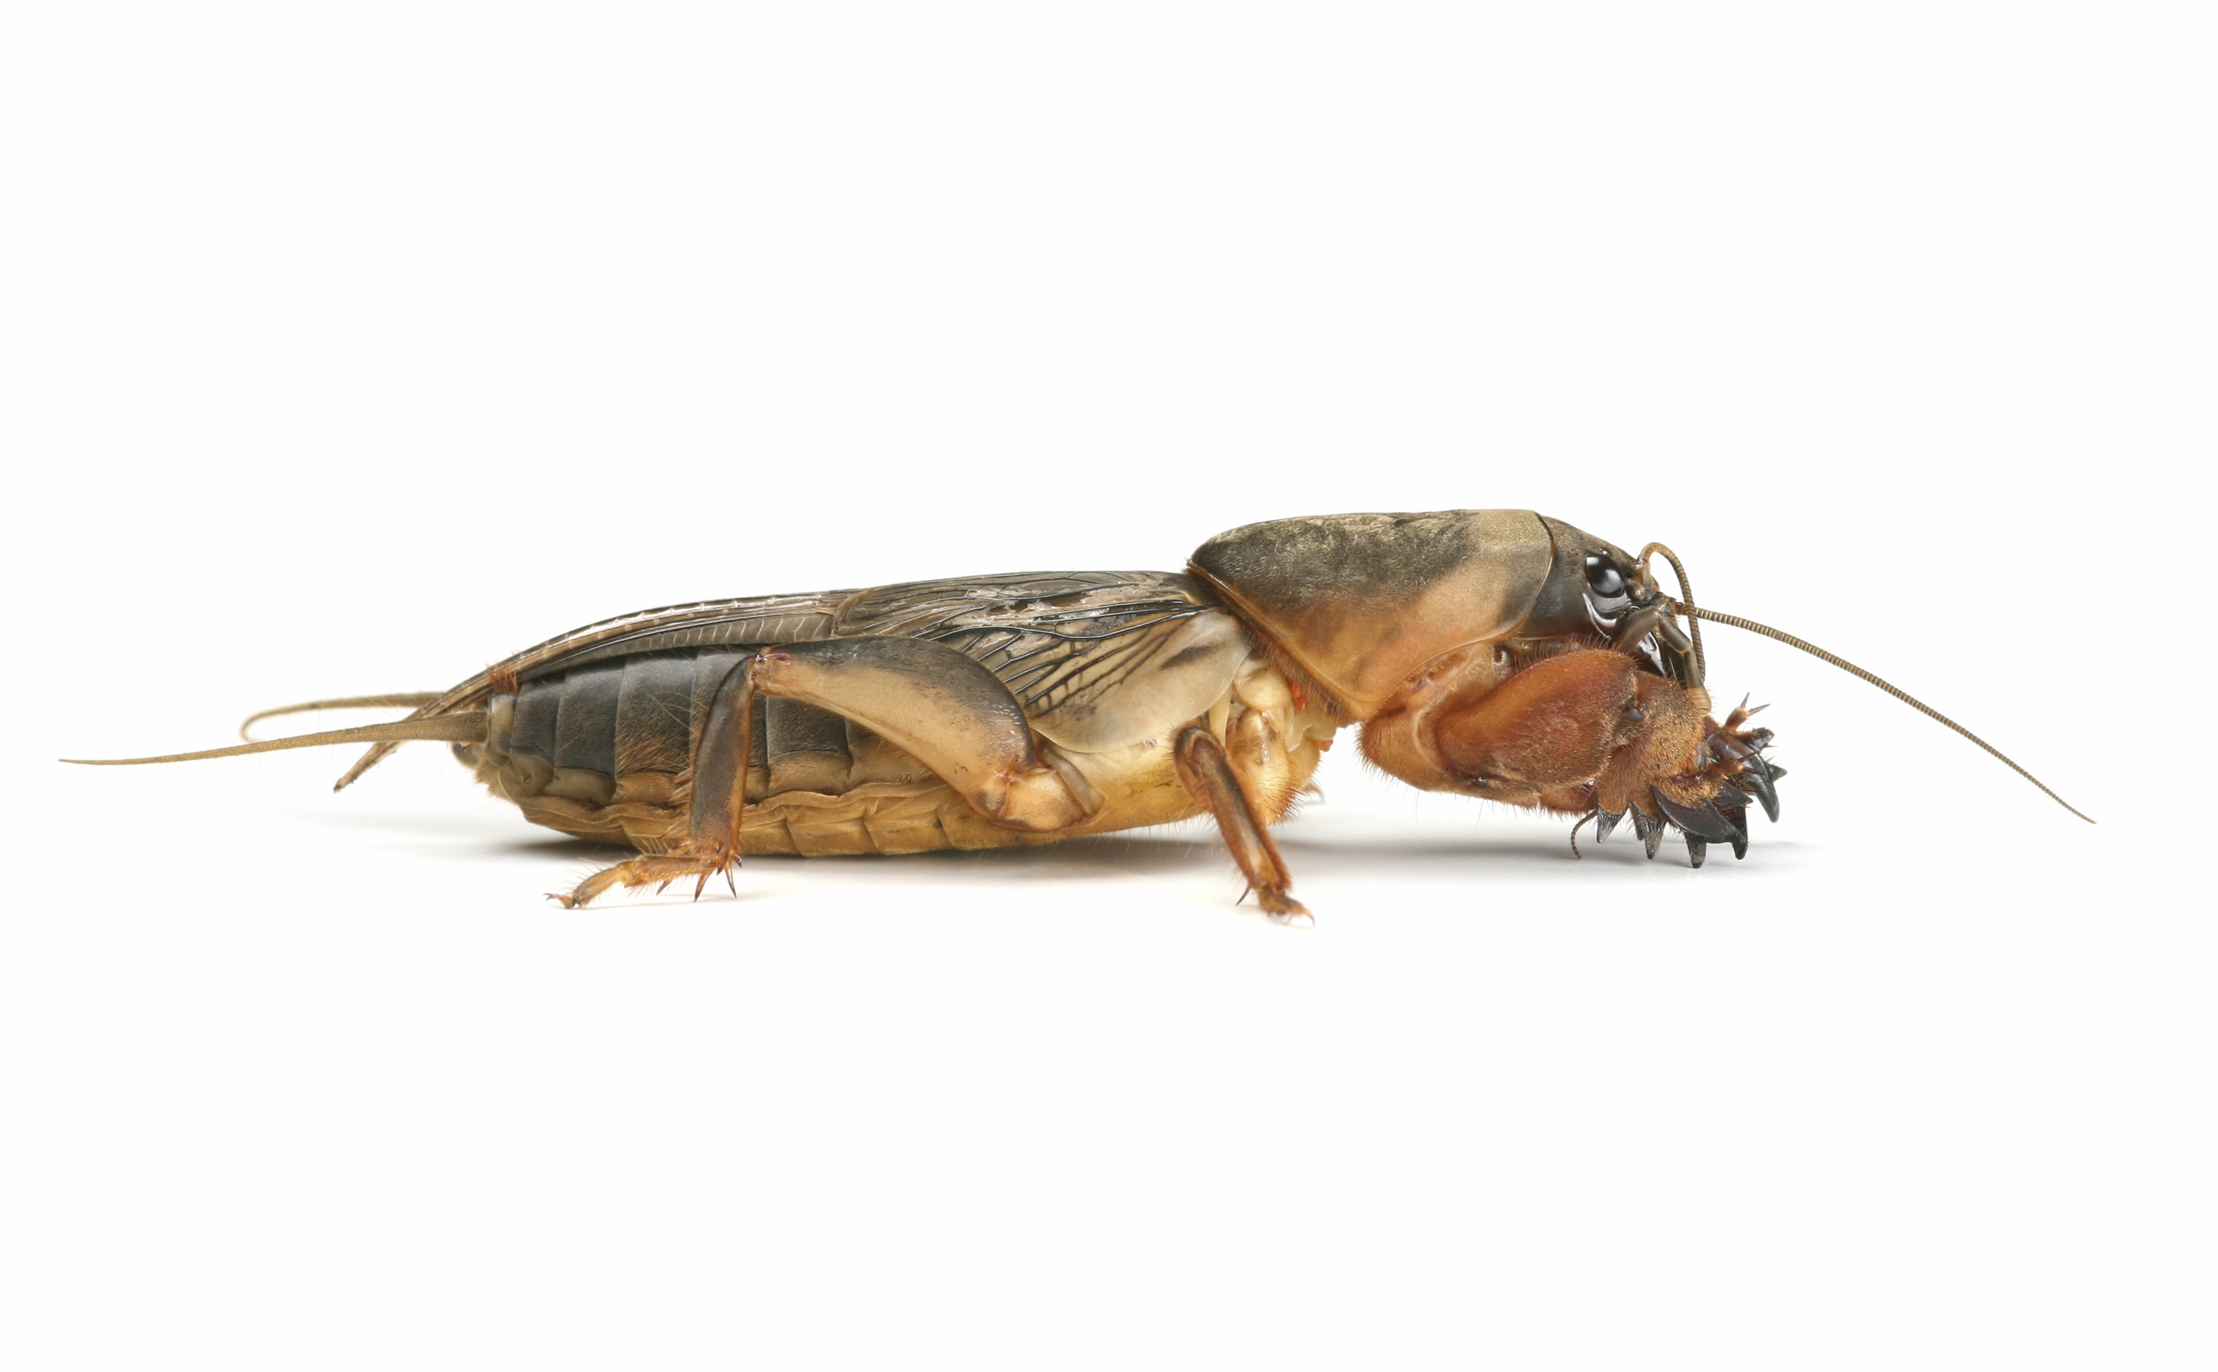
A grasshopper (katydid) and a mole cricket
Figure 5.1
Notes:
Figure 5.1 A grasshopper (katydid), and a mole cricket. Note the variation in the legs of these two species.
Talking Points: Two related insects, each with specific leg adaptations. The katydid, like most grasshoppers have enlarged hind femurs and are well adapted for jumping long distances. The mole cricket has modified front legs for digging.

Slide 3
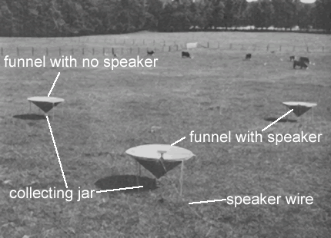
Testing mole cricket responses to vocalizations
Describe experiment of Ulagaraj and Walker
Figure 5.2
Notes:
Figure 5.2 Experimental design for testing mole cricket response to vocalizations. One funnel contains a speaker playing southern mole cricket songs, and another funnel contains a speaker playing tawny mole cricket songs. The third funnel contains no speaker.
Talking Points: The scientists recorded male vocalizations of these two cricket species, and broadcast each song through a different speaker in a playback experiment. Each speaker was mounted in the center of a large funnel and faced skyward. A third funnel had no speaker. At the base of each funnel was a jar, where adults that flew into the funnel were collected. The flight activity of mole crickets tends to occur just after sunset and end about an hour later, which is when Ulagaraj and Walker performed their nightly playback experiments. Adults collected from each funnel were brought back to the laboratory, indentified, and their sex was determined.

Slide 4
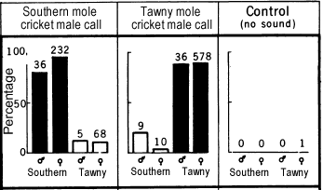
Responses of mole crickets to recordings of male calls
Figure 5.3
Notes:
Figure 5.3 Responses of flying southern and tawny mole crickets to broadcast recordings of male calls. Black bars indicate crickets captured in traps broadcasting male calls of the same species; white bars indicate crickets captured in traps broadcasting male calls of the other species. Numbers above bars indicate numbers of individuals trapped. Bar height indicates percentage in each trap, by gender and species.
Talking Points: Make a note that the numbers above the bars indicate sample sizes and percentages are based on total numbers of each sex/species combination caught. 36 + 9 male southern mole crickets = 45 total, 80% at southern mole cricket calling stations and 20% at tawny mole cricket calling stations. Fewer males than females of either species were caught.

Slide 5
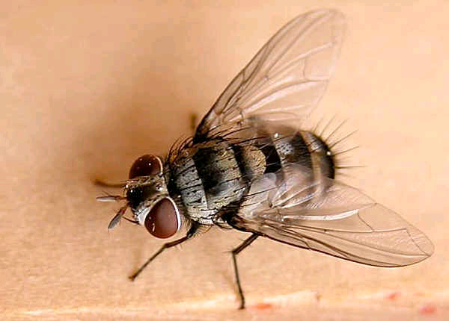
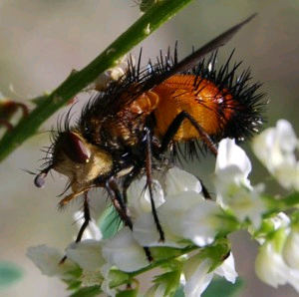
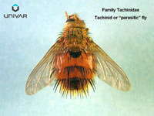
Tachinid, or parasitic flies
Tachinid vs. caterpillar:
http://www.youtube.com/watch?v=gxKoK4rnBbw
http://buginfo.com/article.cfm?id=81
http://www.oocities.org/brisbane_flies/TACHINIDAE.htm
http://www.whatsthatbug.com/2010/08/10/tachinid-fly-9/
Notes:
Images of tachinid flies not found in text.

Slide 6
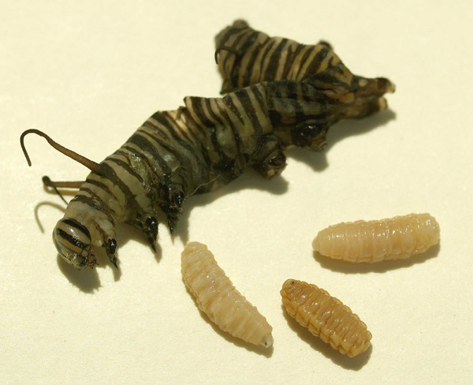
Tachinid larvae that were living in a caterpillar
Notes:
Image of parasitized caterpillar, not found in text.

Slide 7
Captures of parasitic flies at speakers playing male calls of three mole crickets
What do these data tell you about the life cycles of the parasitic fly and the mole crickets?
Figure 5.4
Notes:
Figure 5.4 Monthly captures of female parasitic flies at speakers playing the male calls of three species of mole cricket, the tawny, southern, and imitator.
Talking Points: A playback experiment determined the extent that one species of parasitic fly (Ormia depleta) was attracted to vocalizations of southern and tawny mole crickets, along with the imitator mole cricket (S. imitatus). The particular species of flies that lay eggs on mole crickets have evolved such that adults are active at the same time of year that male mole crickets are vocalizing to attract females. Another requirement for success is to lay eggs quickly and fly away before the mole cricket has an opportunity to defend itself or escape from the fly underground. Once the fly recognizes an appropriate host by its call, it makes the decision to land and lay eggs, which it does very quickly.

Slide 8
Tachinid flies captured at traps playing vocalizations from 1 of 5 mole cricket species
mole cricket call | # of tachinid flies
southern | 24
tawny | 51
imitator | 33
changa | 0
northern | 0
Table 5.1
Notes:
Table 5.1. Numbers of tachinid flies captured at traps playing vocalizations from one of five species of mole cricket.
Talking Points: Vocalizations of five species of mole cricket were played during peak activity of the parasitic fly. Two more species were added. The parasitic fly was not attracted to vocalizations of the two additional mole cricket species. All five species of mole cricket may be found in Florida, but the three to which the flies are attracted arrived in Florida from South America.

Slide 9
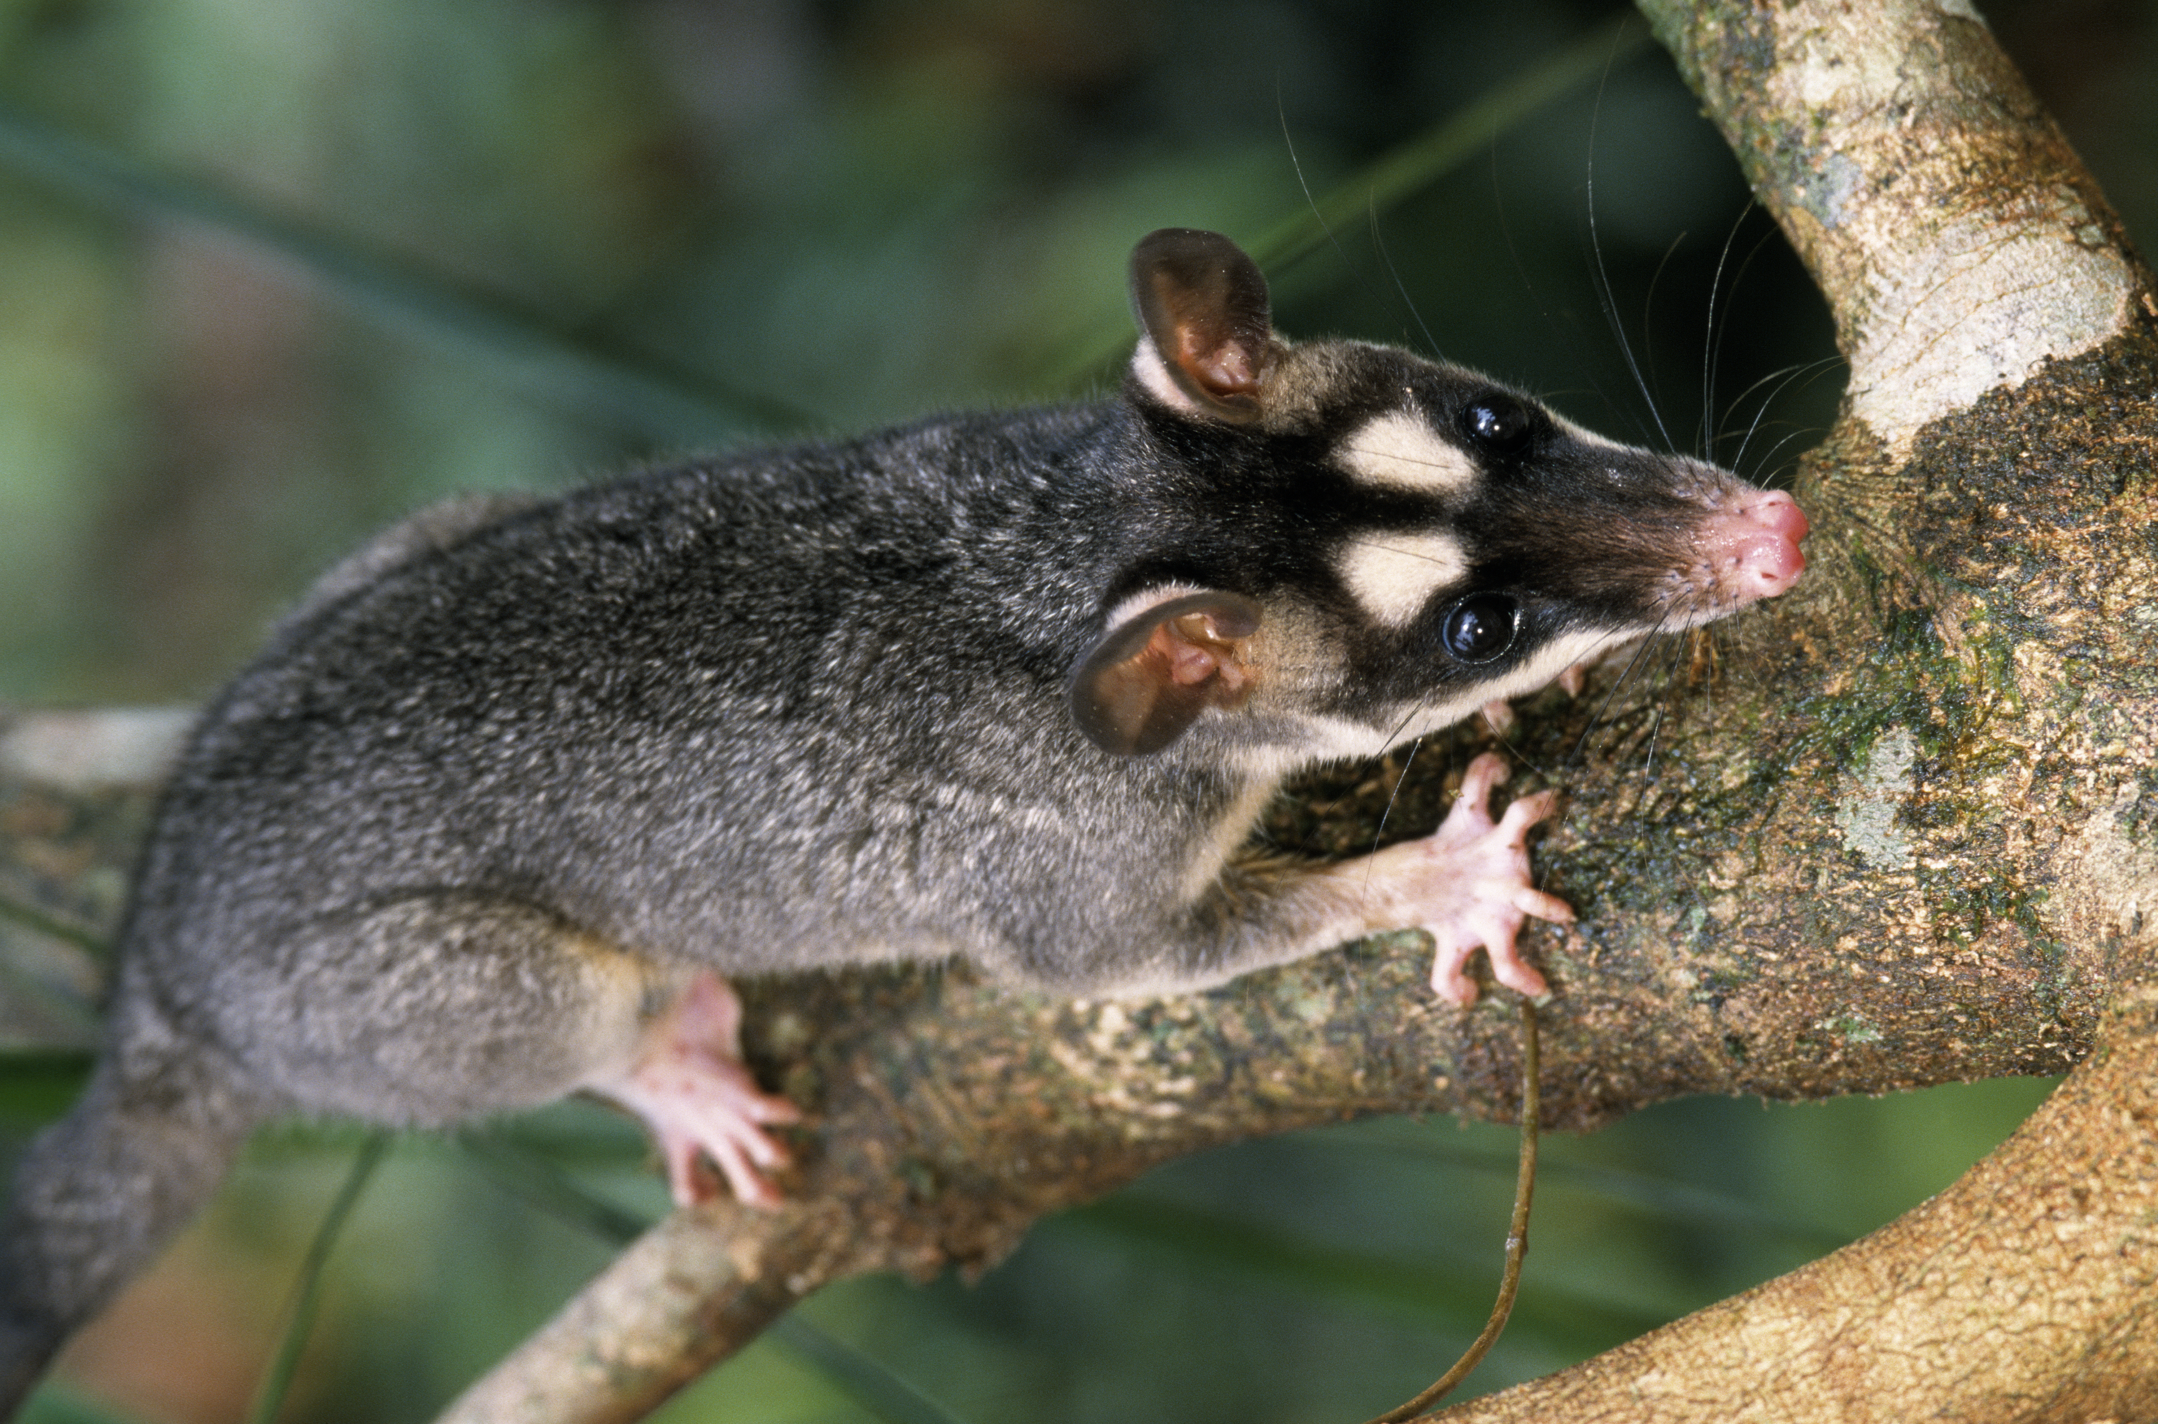
The philander opossum, a predator of frogs
20 – 33 cm
Figure 5.5
Notes:
Figure 5.5 The predator, philander opossum, and prey, Tungara frog. The Tungara frog pictured is a vocalizing male.
Talking Points: The philander opossum is a predator of a community of frogs that congregate around ponds in South America, including the Tungara frog. The opossum is about 20-33 cm long, excluding the tail. Researchers performed a playback experiment, where they played recordings of the Tungara frog vocalizations from a speaker. The recordings were played only when an opossum was nearby but facing away from the speaker and no frogs were vocalizing. In five out of five trials, the opossum turned toward the speaker and performed head tilting and ear rotating behaviors. The opossum then approached the speaker, and in three instances, pounced on the speaker.

Slide 10
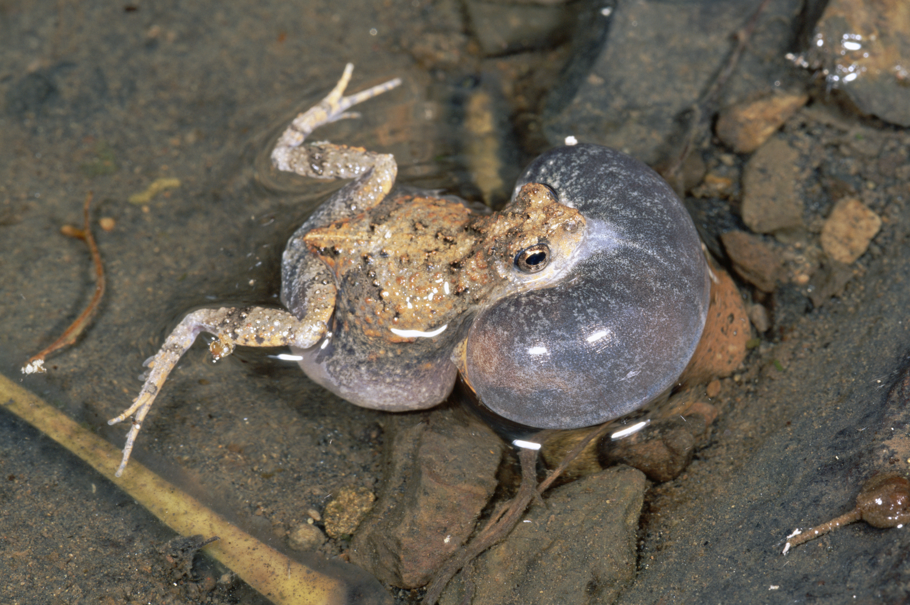
The Tungara frog
Vocalizing male
http://www.youtube.com/watch?feature=endscreen&v=5S-RAgudnww&NR=1
Figure 5.5
Notes:
Figure 5.5 The predator, philander opossum, and prey, Tungara frog. The Tungara frog pictured is a vocalizing male.
Talking Points: The philander opossum is a predator of a community of frogs that congregate around ponds in South America, including the Tungara frog. Shown here is a vocalizing male.

Slide 11
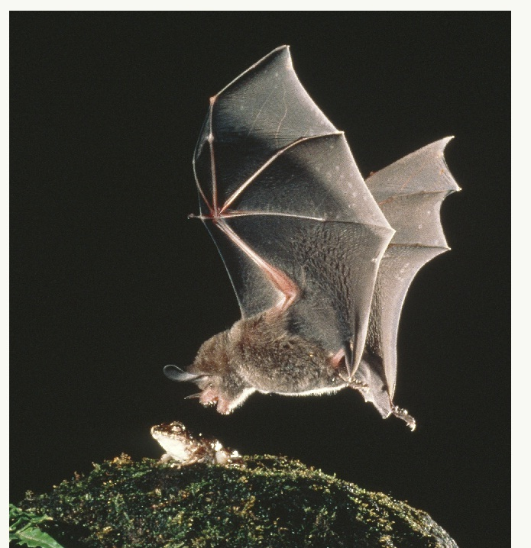
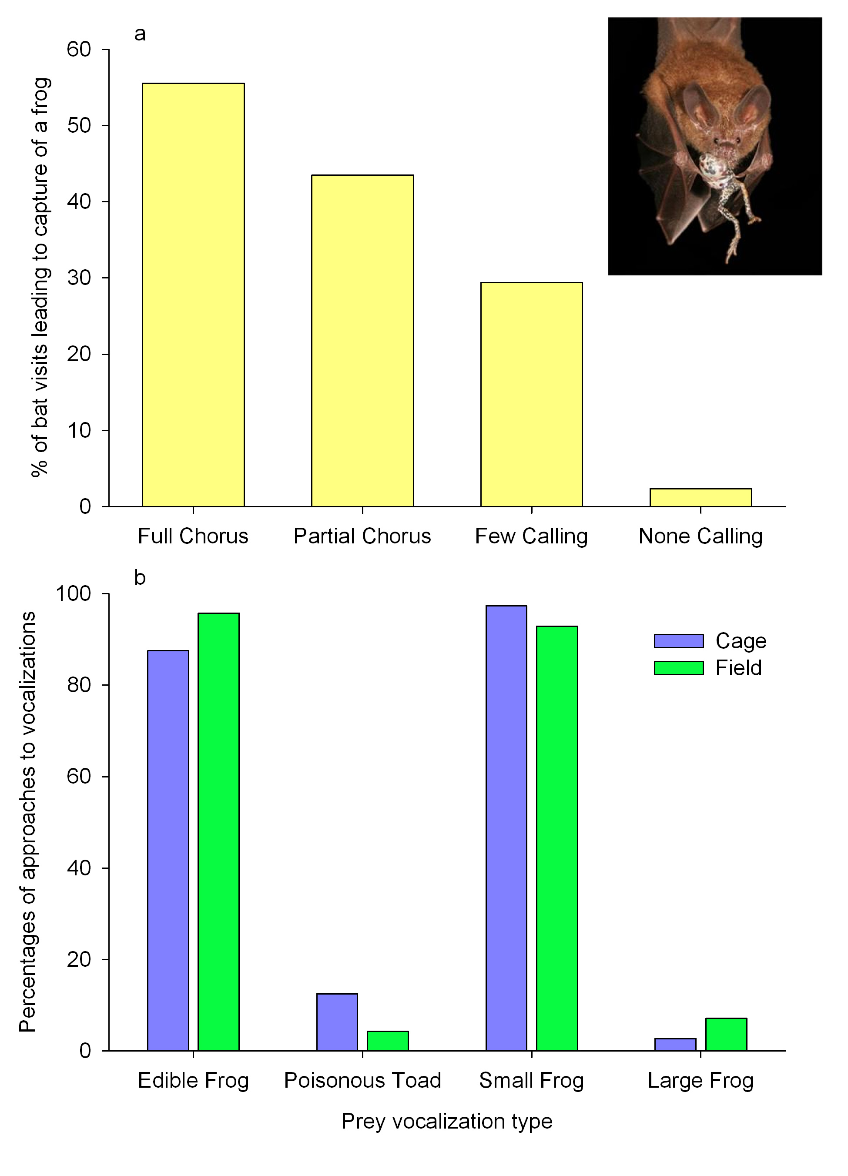
A fringe-lipped bat capturing and then eating a frog
http://www.youtube.com/watch?v=6095qsR8tt0
Figure 5.6
Notes:
Figure 5.6 Results of experiments on fringe-lipped bats preying on frogs. (a) Percentage of bat visits resulting in a frog capture for four categories of Tungara frog vocalization frequency. Inset: A fringe-lipped bat consuming a frog. (b) Responses of frog-eating bats to vocalizations of edible vs. poisonous, or small vs. large frog or toad prey.
Talking Points: The fringe-lipped bat is another predator on the same community of frogs.

Slide 12
Results of experiments on fringe-lipped bats preying on frogs
Rate of success:
% of bat visits leading to capture of a frog
Compare responses within boxes
Figure 5.6
Notes:
Figure 5.6 Results of experiments on fringe-lipped bats preying on frogs. (a) Percentage of bat visits resulting in a frog capture for four categories of Tungara frog vocalization frequency. Inset: A fringe-lipped bat consuming a frog. (b) Responses of frog-eating bats to vocalizations of edible vs. poisonous, or small vs. large frog or toad prey.
Talking Points: The fringe-lipped bat is another predator on the same community of frogs.
Researchers categorized observational times by the amount of vocalizations coming from the male frogs. The categories included a full chorus (many males vocalizing), a partial chorus (several males vocalizing), only a few vocalizing, and no males vocalizing. The researchers determined the number of bat visits per frog capture. A predator that preys on frogs cues in on the sound, which is exploitation of information transfer. The exploiter uses the information to locate potential prey. Bats were less successful during visits to ponds when no frogs were vocalizing – the percentage of visits leading to one prey capture was much lower than when even just a few frogs were vocalizing. The rate of success was very low when frogs were not vocalizing – about 2.3% (1 frog in 42.7 visits). The success rate was much higher whenever frogs were vocalizing – between 29.4 and 55.5% (1 frog in 3.4 to 1.8 visits).
Captive and wild frog-eating bats were exposed to vocalizations of an edible vs. a poisonous frog, or a frog small enough to eat vs. one too large for a bat to capture (b). Data were recorded for captive bats in cages and free (wild) bats in the field. Fringe-lipped bats could discriminate between vocalizations and knew the vocalizations of their preferred prey. There were strong preferences for edible frog vocalization over the vocalization of poisonous toad. When given a choice of frogs of different sizes, bats preferred the vocalizations of frogs that were not too large, presumably because very large frogs would be hard for a relatively small bat to carry.
There is a cost to vertebrates that advertise their presence to attract mates; they may be more susceptible to predation. But large and poisonous frogs incur little cost in making themselves conspicuous. The other frogs and toads do not make themselves very conspicuous, hiding in the bushes and ceasing their vocalizations when they detect a nearby threat.

Slide 13
Trials needed for fringe-lipped bats to learn to associate cane toad vocalization with palatable prey
treatment | mean number of trials | standard error | sample size
inexperienced bat with experienced bat | 5.3 | 1.7 | 10
two inexperienced bats | 96.8 | 3.2 | 5
one inexperienced bat | 96.2 | 3.8 | 5
Table 5.2
Notes:
Table 5.2. Number of trials needed for fringe-lipped bats to learn to associate the cane toad vocalization with palatable prey.
Talking Points: Bats were trained to fly to and land on a speaker broadcasting cane toad vocalization to receive a reward of raw fish. Experienced bats were paired with bats that had never experienced these vocalizations. In each pair, the inexperienced bat was allowed to observe the experienced bat. The researchers also presented cane toad vocalizations to pairs of two inexperienced bats and to single inexperienced bats with no other bats present.
This study showed that fringe-lipped bats, which live and forage in social groups of four to 50 individuals, can learn from their neighbors, and they can associate a new frog vocalization with edible prey by watching what their experienced neighbors eat. Rates of learning were significantly faster for inexperienced bats when they were paired up with an experienced bat that had previously learned that cane toad vocalizations were associated with palatable prey.

Slide 14
Integrating Concepts in Biology
PowerPoint Slides for Chapter 5:
Information in Ecological Systems
Section 5.2: How do organisms assess their environment when searching for resources?
by
A. Malcolm Campbell, Laurie J. Heyer, and Chris Paradise

Slide 15
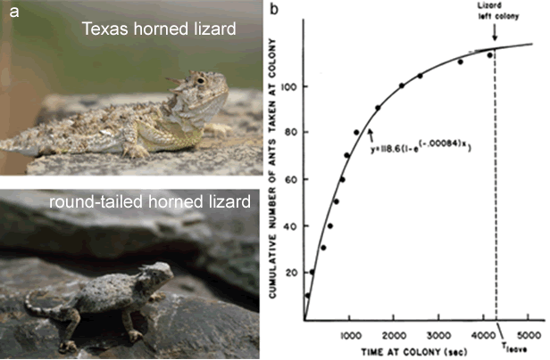
Horned lizards as optimal foragers
Figure 5.7
Notes:
Figure 5.7 Horned lizards as optimal foragers. (a) Horned lizards. (b) Example of feeding curve of a horned lizard at an ant nest. The dots represent every 10th ant consumed. Over 130 ants were consumed by this one lizard at this nest. The lizard remained at the nest for over 4,000 seconds (over 1 hour).
Talking Points: A scientist recorded all feeding activity of horned lizards, shown, at ant nests, including every ant eaten, how quickly they were eaten, and how long the lizard remained at a nest. These are two species of horned lizards.

Slide 16
BME 5.1: Continuous vs. discrete models
Cumulative # ants caught
Time (seconds)
Notes:
BME 5.1. Comparing output from continuous and discrete models.
Talking Points: The spreadsheet ants.xls illustrates the exponential model using numbers corresponding to the equation in Figure 5.7b. BME 5.1 compares the continuous model there with a discrete model.
The difference between the two models is very small, about half an ant over the entire time at the nest. The spreadsheet model (like your by-hand calculation in the BME IQs) is discrete, meaning the percentages were removed in chunks, once every 60 seconds. The exponential equation is continuous, meaning that the ants are removed continuously through time.
Discrete is analogous to dipping water out of a bucket by the cupful
Continuous is like slowly pouring water out of a bucket.
Once you have this model for the foraging process, you can make predictions of when the lizard should leave the nest to optimize its resources (see BME 5.2).

Slide 17
BME 5.1: Continuous vs. discrete models
Cumulative # ants caught
Time (seconds)
Notes:
BME 5.1. Comparing output from continuous and discrete models.
Talking Points: The spreadsheet ants.xls illustrates the exponential model using numbers corresponding to the equation in Figure 5.7b. BME 5.1 compares the continuous model there with a discrete model.
The difference between the two models is very small, about half an ant over the entire time at the nest. The spreadsheet model (like your by-hand calculation in the BME IQs) is discrete, meaning the percentages were removed in chunks, once every 60 seconds. The exponential equation is continuous, meaning that the ants are removed continuously through time.
Discrete is analogous to dipping water out of a bucket by the cupful
Continuous is like slowly pouring water out of a bucket.
Once you have this model for the foraging process, you can make predictions of when the lizard should leave the nest to optimize its resources (see BME 5.2).

Slide 18
BME 5.1: Continuous vs. discrete models
A slight difference in the models at the end
Cumulative # ants caught
Time (seconds)
Notes:
BME 5.1. Comparing output from continuous and discrete models.
Talking Points: The spreadsheet ants.xls illustrates the exponential model using numbers corresponding to the equation in Figure 5.7b. BME 5.1 compares the continuous model there with a discrete model.
The difference between the two models is very small, about half an ant over the entire time at the nest. The spreadsheet model (like your by-hand calculation in the BME IQs) is discrete, meaning the percentages were removed in chunks, once every 60 seconds. The exponential equation is continuous, meaning that the ants are removed continuously through time.
Discrete is analogous to dipping water out of a bucket by the cupful
Continuous is like slowly pouring water out of a bucket.
Once you have this model for the foraging process, you can make predictions of when the lizard should leave the nest to optimize its resources (see BME 5.2).

Slide 19
BME 5.2: The Marginal Value Theorem
Notes:
BME 5.2. Predicting foraging behavior using the marginal value theorem.
Talking Points: The marginal value theorem says that the optimal time for a lizard to leave a nest is precisely when the rate of capture at that nest slows down to the overall average rate of capture in the habitat for all nests.
The optimal behavior is to do all foraging at an above average rate.
Travel time reduces the overall average intake rate.
Forager has to catch enough prey so the overall average stays as high as possible.
Marginal value theorem says that to keep overall average as high as possible, forager should stay at each nest until current capture rate decreases to the overall average rate for that patch type, but no longer.
MVT predicts the optimal time for a forager to leave a patch based on its rate of feeding in a patch and its expectation of whether it could find more food by moving to another patch.
Expectation of doing better elsewhere is based on information collected over time.
The quality of a patch affects the optimal leaving time.
Here, if the forager had a capture rate at all time points equal to its capture rate at t = 960, the curve would look like the blue straight line. It could represent the overall average intake rate; if so, it could be used to predict leaving time and ants caught in the present patch.

Slide 20
BME 5.2: The Marginal Value Theorem
y = 2.737x + b
65.65 = 2.737*16 + b
b = 21.86
y = 2.737x + 21.86
Notes:
BME 5.2. Predicting foraging behavior using the marginal value theorem.
Talking Points: The marginal value theorem says that the optimal time for a lizard to leave a nest is precisely when the rate of capture at that nest slows down to the overall average rate of capture in the habitat for all nests.
The optimal behavior is to do all foraging at an above average rate.
Travel time reduces the overall average intake rate.
Forager has to catch enough prey so the overall average stays as high as possible.
Marginal value theorem says that to keep overall average as high as possible, forager should stay at each nest until current capture rate decreases to the overall average rate for that patch type, but no longer.
MVT predicts the optimal time for a forager to leave a patch based on its rate of feeding in a patch and its expectation of whether it could find more food by moving to another patch.
Expectation of doing better elsewhere is based on information collected over time.
The quality of a patch affects the optimal leaving time.
Here, if the forager had a capture rate at all time points equal to its capture rate at t = 960, the curve would look like the blue straight line. It could represent the overall average intake rate; if so, it could be used to predict leaving time and ants caught in the present patch. Leaving time would be 960 seconds, when instantaneous intake rate equals the overall average intake rate.

Slide 21
BME 5.2: The Marginal Value Theorem
Notes:
BME 5.2. Predicting foraging behavior and patch residence time using the marginal value theorem.
Talking Points: The marginal value theorem says that the optimal time for a lizard to leave a nest is precisely when the rate of capture at that nest slows down to the overall average rate of capture in the habitat for all nests.
Travel time reduces the overall average intake rate.
Forager has to catch enough prey so the overall average stays as high as possible.
Marginal value theorem says that to keep overall average as high as possible, forager should stay at each nest until current capture rate decreases to the overall average rate for that patch type, but no longer.
MVT predicts the optimal time for a forager to leave a patch based on its rate of feeding in a patch and its expectation of whether it could find more food by moving to another patch.
The quality of a patch affects the optimal leaving time.
Here, if the forager had travelled 2000 seconds to get to the patch, and had a capture rate as shown here, the best it could do, in terms of overall average for this patch type would be equal to a tangent line drawn from (-2000, 0). Any other line that crossed the cumulative gain curve from that point would yield an average overall intake rate lower than the tangent line would yield (if it left sooner or stayed longer, it’s overall average would be lower).

Slide 22
BME 5.2: The Marginal Value Theorem
Predicting patch residence time based on travel time
Notes:
BME 5.2. Predicting foraging behavior and patch residence time using the marginal value theorem.
Talking Points: The marginal value theorem says that the optimal time for a lizard to leave a nest is precisely when the rate of capture at that nest slows down to the overall average rate of capture in the habitat for all nests.
Travel time reduces the overall average intake rate.
Forager has to catch enough prey so the overall average stays as high as possible.
Marginal value theorem says that to keep overall average as high as possible, forager should stay at each nest until current capture rate decreases to the overall average rate for that patch type, but no longer.
MVT predicts the optimal time for a forager to leave a patch based on its rate of feeding in a patch and its expectation of whether it could find more food by moving to another patch.
The quality of a patch affects the optimal leaving time.
Here, if the forager had travelled 2000 seconds to get to the patch, and had a capture rate as shown here, the best it could do, in terms of overall average for this patch type would be equal to a tangent line drawn from (-2000, 0). Any other line that crossed the cumulative gain curve from that point would yield an average overall intake rate lower than the tangent line would yield (if it left sooner or stayed longer, it’s overall average would be lower).

Slide 23
BME 5.2: The Marginal Value Theorem
If forager left earlier or later, intake rate would be lower
Predicting patch residence time based on travel time
Notes:
BME 5.2. Predicting foraging behavior and patch residence time using the marginal value theorem.
Talking Points: The marginal value theorem says that the optimal time for a lizard to leave a nest is precisely when the rate of capture at that nest slows down to the overall average rate of capture in the habitat for all nests.
Travel time reduces the overall average intake rate.
Forager has to catch enough prey so the overall average stays as high as possible.
Marginal value theorem says that to keep overall average as high as possible, forager should stay at each nest until current capture rate decreases to the overall average rate for that patch type, but no longer.
MVT predicts the optimal time for a forager to leave a patch based on its rate of feeding in a patch and its expectation of whether it could find more food by moving to another patch.
The quality of a patch affects the optimal leaving time.
Here, if the forager had travelled 2000 seconds to get to the patch, and had a capture rate as shown here, the best it could do, in terms of overall average for this patch type would be equal to a tangent line drawn from (-2000, 0). Any other line that crossed the cumulative gain curve from that point would yield an average overall intake rate lower than the tangent line would yield (if it left sooner or stayed longer, it’s overall average would be lower).

Slide 24
BME 5.2: The Marginal Value Theorem
Compare environments with patches that have different densities of ants
Notes:
BME 5.2. Predicting foraging behavior and patch residence time using the marginal value theorem.
Talking Points: Compare environments that have patches with different ant densities. If patches have dense aggregations of ants, should a lizard leave earlier or stay later?
Travel time reduces the overall average intake rate.
Marginal value theorem says that to keep overall average as high as possible, forager should stay at each nest until current capture rate decreases to the overall average rate for that patch type, but no longer.
MVT predicts the optimal time for a forager to leave a patch based on its rate of feeding in a patch and its expectation of whether it could find more food by moving to another patch.
The quality of a patch affects the optimal leaving time.
If all patches were high quality, dense patches, lizards would do better by leaving each patch earlier than in an environment with less dense patches. In environments where ants are sparse, lizards should stay longer in each patch.

Slide 25
BME 5.2: The Marginal Value Theorem
Notes:
BME 5.2. Predicting foraging behavior and patch residence time using the marginal value theorem.
Talking Points: Compare environments that have patches with different ant densities. If patches have dense aggregations of ants, should a lizard leave earlier or stay later?
Travel time reduces the overall average intake rate.
Marginal value theorem says that to keep overall average as high as possible, forager should stay at each nest until current capture rate decreases to the overall average rate for that patch type, but no longer.
MVT predicts the optimal time for a forager to leave a patch based on its rate of feeding in a patch and its expectation of whether it could find more food by moving to another patch.
The quality of a patch affects the optimal leaving time.
If all patches were high quality, dense patches, lizards would do better by leaving each patch earlier than in an environment with less dense patches. In environments where ants are sparse, lizards should stay longer in each patch.

Slide 26
BME 5.2: The Marginal Value Theorem
Notes:
BME 5.2. Predicting foraging behavior and patch residence time using the marginal value theorem.
Talking Points: Compare environments that have patches with different ant densities. If patches have dense aggregations of ants, should a lizard leave earlier or stay later?
Travel time reduces the overall average intake rate.
Marginal value theorem says that to keep overall average as high as possible, forager should stay at each nest until current capture rate decreases to the overall average rate for that patch type, but no longer.
MVT predicts the optimal time for a forager to leave a patch based on its rate of feeding in a patch and its expectation of whether it could find more food by moving to another patch.
The quality of a patch affects the optimal leaving time.
If all patches were high quality, dense patches, lizards would do better by leaving each patch earlier than in an environment with less dense patches. In environments where ants are sparse, lizards should stay longer in each patch.

Slide 27
BME 5.2: The Marginal Value Theorem
Notes:
BME 5.2. Predicting foraging behavior and patch residence time using the marginal value theorem. This shows maximum feeding rates with a travel time of 2000 seconds.
Talking Points: Compare environments that have patches with different ant densities. If patches have dense aggregations of ants, should a lizard leave earlier or stay later?
Travel time reduces the overall average intake rate.
Marginal value theorem says that to keep overall average as high as possible, forager should stay at each nest until current capture rate decreases to the overall average rate for that patch type, but no longer.
MVT predicts the optimal time for a forager to leave a patch based on its rate of feeding in a patch and its expectation of whether it could find more food by moving to another patch.
The quality of a patch affects the optimal leaving time.
If all patches were high quality, dense patches, lizards would do better by leaving each patch earlier than in an environment with less dense patches. In environments where ants are sparse, lizards should stay longer in each patch.
Note the overall average intake rate in dense patches is much steeper than the original or sparse patch environments. Once the instantaneous rate hits that average, the forager should leave the patch.

Slide 28
BME 5.2: The Marginal Value Theorem
Predicted patch residence time, depending upon density in patches
Notes:
BME 5.2. Predicting foraging behavior and patch residence time using the marginal value theorem. This shows maximum feeding rates with a travel time of 2000 seconds. Patch residence times are predicted for each situation as the point where the accumulation curve and maximum feeding rate curve touch.
Talking Points: Compare environments that have patches with different ant densities. If patches have dense aggregations of ants, should a lizard leave earlier or stay later?
Travel time reduces the overall average intake rate.
Marginal value theorem says that to keep overall average as high as possible, forager should stay at each nest until current capture rate decreases to the overall average rate for that patch type, but no longer.
MVT predicts the optimal time for a forager to leave a patch based on its rate of feeding in a patch and its expectation of whether it could find more food by moving to another patch.
The quality of a patch affects the optimal leaving time.
If all patches were high quality, dense patches, lizards would do better by leaving each patch earlier than in an environment with less dense patches. In environments where ants are sparse, lizards should stay longer in each patch.
Note the overall average intake rate in dense patches is much steeper than the original or sparse patch environments. Once the instantaneous rate hits that average, the forager should leave the patch.

Slide 29
BME 5.2: The Marginal Value Theorem
Overall average rate of intake varies, depending upon density in patches
Notes:
BME 5.2. Predicting foraging behavior and patch residence time using the marginal value theorem. This shows maximum feeding rates with a travel time of 2000 seconds.
Talking Points: Compare environments that have patches with different ant densities. If patches have dense aggregations of ants, should a lizard leave earlier or stay later?
Travel time reduces the overall average intake rate.
Marginal value theorem says that to keep overall average as high as possible, forager should stay at each nest until current capture rate decreases to the overall average rate for that patch type, but no longer.
MVT predicts the optimal time for a forager to leave a patch based on its rate of feeding in a patch and its expectation of whether it could find more food by moving to another patch.
The quality of a patch affects the optimal leaving time.
If all patches were high quality, dense patches, lizards would do better by leaving each patch earlier than in an environment with less dense patches. In environments where ants are sparse, lizards should stay longer in each patch.
Note the overall average intake rate in dense patches is much steeper than the original or sparse patch environments. Once the instantaneous rate hits that average, the forager should leave the patch.

Slide 30
BME 5.2: The Marginal Value Theorem
Predicted patch residence time, depending upon density in patches
Notes:
BME 5.2. Predicting foraging behavior and patch residence time using the marginal value theorem. This shows maximum feeding rates with a travel time of 2000 seconds. Patch residence times are predicted for each situation as the point where the accumulation curve and maximum feeding rate curve touch.
Talking Points: Compare environments that have patches with different ant densities. If patches have dense aggregations of ants, should a lizard leave earlier or stay later?
Travel time reduces the overall average intake rate.
Marginal value theorem says that to keep overall average as high as possible, forager should stay at each nest until current capture rate decreases to the overall average rate for that patch type, but no longer.
MVT predicts the optimal time for a forager to leave a patch based on its rate of feeding in a patch and its expectation of whether it could find more food by moving to another patch.
The quality of a patch affects the optimal leaving time.
If all patches were high quality, dense patches, lizards would do better by leaving each patch earlier than in an environment with less dense patches. In environments where ants are sparse, lizards should stay longer in each patch.
Note the overall average intake rate in dense patches is much steeper than the original or sparse patch environments. Once the instantaneous rate hits that average, the forager should leave the patch.

Slide 31
Think about it
How does a shorter average travel time affect patch residence time? Draw a graph supporting your answer.
Which would yield the shortest patch residence time?
A patch with high prey density & long inter-patch distance
A patch with medium prey density & short inter-patch distance
A patch with low prey density & short inter-patch distance
A patch with high prey density & short inter-patch distance
A patch with medium prey density & long inter-patch distance
Notes:
BME 5.2. Predicting foraging behavior and patch residence time using the marginal value theorem.
Talking Points: Compare environments that have patches with different ant densities. If patches have dense aggregations of ants, should a lizard leave earlier or stay later?
Travel time reduces the overall average intake rate.
Marginal value theorem says that to keep overall average as high as possible, forager should stay at each nest until current capture rate decreases to the overall average rate for that patch type, but no longer.
MVT predicts the optimal time for a forager to leave a patch based on its rate of feeding in a patch and its expectation of whether it could find more food by moving to another patch.
The quality of a patch affects the optimal leaving time.
If all patches were high quality, dense patches, lizards would do better by leaving each patch earlier than in an environment with less dense patches. In environments where ants are sparse, lizards should stay longer in each patch.

Slide 32
How does a shorter average travel time affect patch residence time? Draw a graph supporting your answer.
Notes:
BME 5.2. Predicting foraging behavior and patch residence time using the marginal value theorem.
Talking Points: The marginal value theorem says that the optimal time for a lizard to leave a nest is precisely when the rate of capture at that nest slows down to the overall average rate of capture in the habitat for all nests.
Travel time reduces the overall average intake rate.
Forager has to catch enough prey so the overall average stays as high as possible.
Marginal value theorem says that to keep overall average as high as possible, forager should stay at each nest until current capture rate decreases to the overall average rate for that patch type, but no longer.
MVT predicts the optimal time for a forager to leave a patch based on its rate of feeding in a patch and its expectation of whether it could find more food by moving to another patch.
The quality of a patch affects the optimal leaving time.
Here, if the forager had travelled 2000 seconds to get to the patch, and had a capture rate as shown here, the best it could do, in terms of overall average for this patch type would be equal to a tangent line drawn from (-2000, 0). Any other line that crossed the cumulative gain curve from that point would yield an average overall intake rate lower than the tangent line would yield (if it left sooner or stayed longer, it’s overall average would be lower).

Slide 33
BME 5.2: The Marginal Value Theorem
Notes:
BME 5.2. Predicting foraging behavior and patch residence time using the marginal value theorem. This shows maximum feeding rates with a travel time of 2000 seconds. Patch residence times are predicted for each situation as the point where the accumulation curve and maximum feeding rate curve touch.
Talking Points: Compare environments that have patches with different ant densities. If patches have dense aggregations of ants, should a lizard leave earlier or stay later?
Travel time reduces the overall average intake rate.
Marginal value theorem says that to keep overall average as high as possible, forager should stay at each nest until current capture rate decreases to the overall average rate for that patch type, but no longer.
MVT predicts the optimal time for a forager to leave a patch based on its rate of feeding in a patch and its expectation of whether it could find more food by moving to another patch.
The quality of a patch affects the optimal leaving time.
If all patches were high quality, dense patches, lizards would do better by leaving each patch earlier than in an environment with less dense patches. In environments where ants are sparse, lizards should stay longer in each patch.
Note the overall average intake rate in dense patches is much steeper than the original or sparse patch environments. Once the instantaneous rate hits that average, the forager should leave the patch.

Slide 34
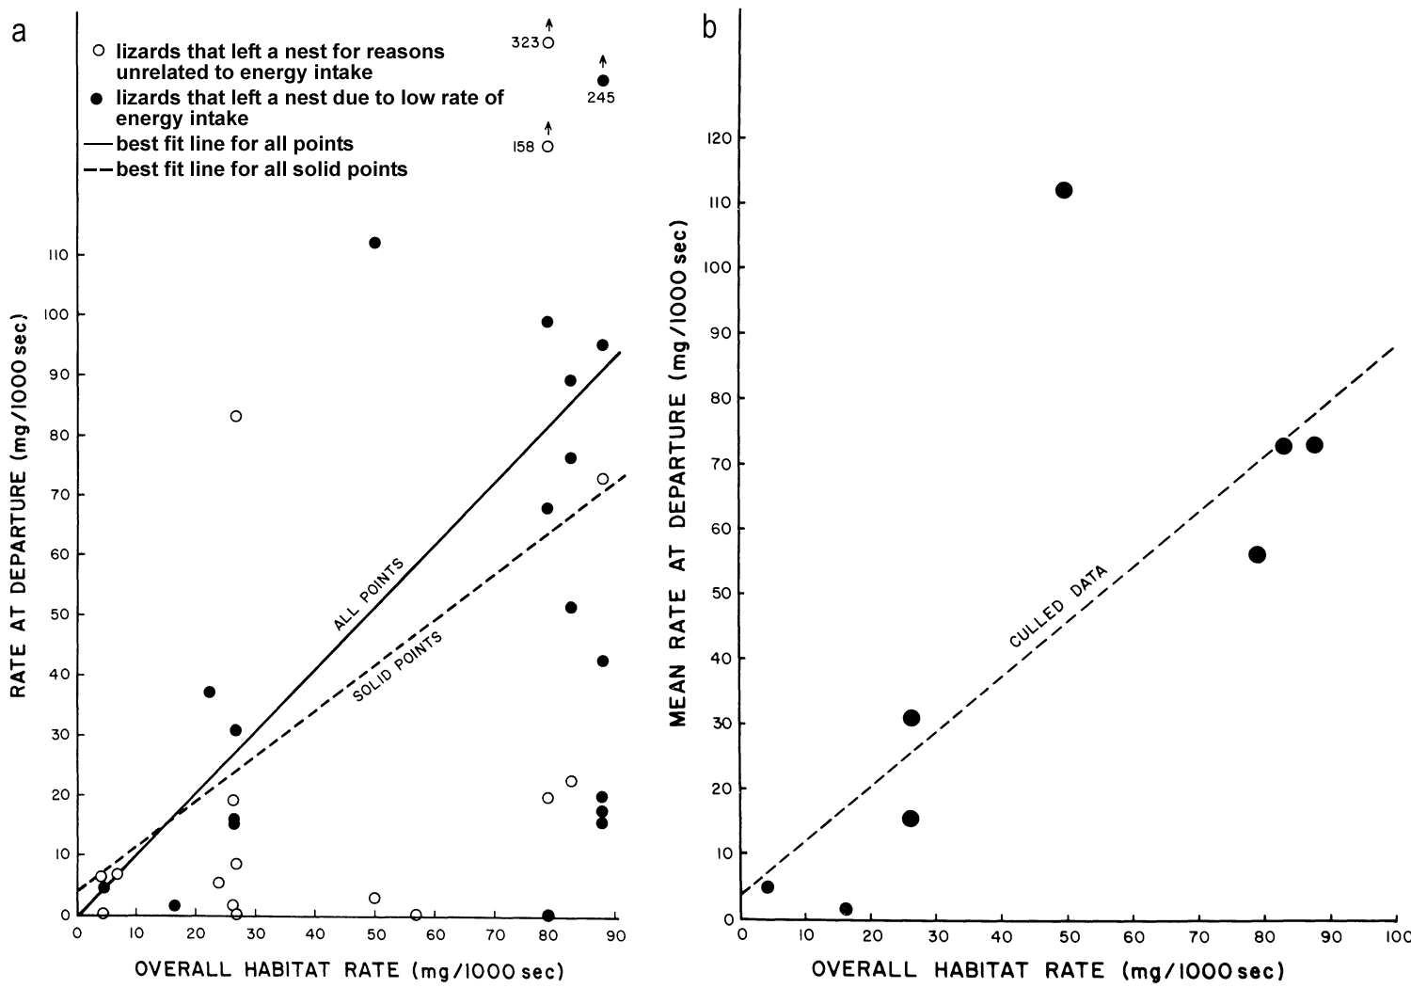
Rate of departure for horned lizards leaving ant nests
Why is the slope for all ant nest visits higher than the slope for visits in which foragers did not leave early?
Does this fit the expectations of the marginal value theorem?
All visits by one lizard fall in a vertical line
Figure 5.8
Notes:
Figure 5.8 Rate of departure for horned lizards leaving ant nests. (a) The capture rate at the time of leaving a nest is compared to the average capture rate during foraging for each lizard. (b) The individual capture rates at departure in “a” are averaged for each lizard and again plotted against the average capture rate.
Talking Points: For each forager, calculate overall habitat rate of energy intake as the mean mass of food consumed per 1,000 seconds. Plot on left shows consumption rate at departure for each lizard at each nest against that lizard’s overall habitat rate.
Some lizards left a nest for reasons unrelated to maximization of energy intake (open symbols).
Marginal value theorem predicts slope of line for rate at departure vs. overall habitat rate should be 1.
Best fit line when considering all ant nest visits had a slope of 1.04. The higher slope for the full data set is explained by the fact that individual visits that were interrupted were included. A lizard forced to leave early would likely have a high foraging rate upon departure, which would shift values up on the y-axis and therefore increase the slope of the line.
For visits in which the lizard did not leave early due to heat or other factors, best fit line had a slope of 0.76. This slope was not statistically different from 1. If travel time had been included in calculation, it would have shifted values on the x-axis to the left, which would have raised the slope of the best fit line. Also, variation in the data caused by experimental error
Capture rate at time of departure for each lizard at each ant nest was approximately = overall average capture rate for that lizard, supporting MVT.

Slide 35
Rate of departure for horned lizards leaving ant nests
What do these data show?
Figure 5.8
Notes:
Figure 5.8 Rate of departure for horned lizards leaving ant nests. (a) The capture rate at the time of leaving a nest is compared to the average capture rate during foraging for each lizard. (b) The individual capture rates at departure in “a” are averaged for each lizard and again plotted against the average capture rate.
Talking Points: For each forager, calculate overall habitat rate of energy intake as the mean mass of food consumed per 1,000 seconds.
Figure on right shows average consumption rate at the time of departure for all ant nest visits for each lizard in which the lizard did not leave the nest early for reasons unrelated to energy maximization vs. the overall habitat rate of consumption for each lizard.
The best fit line for those eight lizards had a slope of 0.84. also not different from slope of 1.
Capture rate at time of departure for each lizard at each ant nest was approximately = overall average capture rate for that lizard, supporting MVT.

Slide 36
Rate of departure for horned lizards leaving ant nests
Average feeding rate for a lizard at all nests when it did not leave early
Open circles: left early
Figure 5.8
Notes:
Figure 5.8 Rate of departure for horned lizards leaving ant nests. (a) The capture rate at the time of leaving a nest is compared to the average capture rate during foraging for each lizard. (b) The individual capture rates at departure in “a” are averaged for each lizard and again plotted against the average capture rate.
Talking Points: For each forager, calculate overall habitat rate of energy intake as the mean mass of food consumed per 1,000 seconds. Plot on left shows consumption rate at departure for each lizard at each nest against that lizard’s overall habitat rate.
Some lizards left a nest for reasons unrelated to maximization of energy intake (open symbols).
Marginal value theorem predicts slope of line for rate at departure vs. overall habitat rate should be 1.
Best fit line when considering all ant nest visits had a slope of 1.04. The higher slope for the full data set is explained by the fact that individual visits that were interrupted were included. A lizard forced to leave early would likely have a high foraging rate upon departure, which would shift values up on the y-axis and therefore increase the slope of the line.
For visits in which the lizard did not leave early due to heat or other factors, best fit line had a slope of 0.76. This slope was not statistically different from 1. If travel time had been included in calculation, it would have shifted values on the x-axis to the left, which would have raised the slope of the best fit line. Also, variation in the data caused by experimental error
Figure on right shows average consumption rate at the time of departure for all ant nest visits for each lizard in which the lizard did not leave the nest early for reasons unrelated to energy maximization vs. the overall habitat rate of consumption for each lizard. Provides average response for population of lizards without artificially increasing sample size.
The best fit line for those eight lizards had a slope of 0.84. also not different from slope of 1.
Capture rate at time of departure for each lizard at each ant nest was approximately = overall average capture rate for that lizard, supporting MVT.

Slide 37
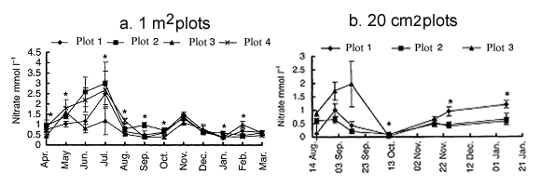
Measurements of soil nutrients over space and time
Figure 5.9
Notes:
Figure 5.9 Measurements of soil nitrate over space and time. Mean nitrate concentrations in the four 1 m² plots (a) and mean nitrate in three 20 cm² plots (b). Error bars indicate + 1 standard error within each plot. An asterisk indicates months where there were statistically significant differences among the plots.
Talking Points: Soil cores from four 1 square meter plots 2 meters apart were sampled monthly for a year. Ammonium (NH₄⁺), nitrate (NO₃⁻), and phosphate (PO₄³⁻) were analyzed (a, b, c).
Smaller 20 cm² plots were analyzed for a shorter period of time (d and e).
Nutrients such as nitrogen and phosphorus can enter soil with the rain, when an animal urinates or defecates, or when an organism dies and decays.
A decaying carcass causes soil nutrient variation in one spot over time. Two meters away, there may be no carcass; patches of high nutrients may result.
Variation in nutrients exists over time and space.

Slide 38
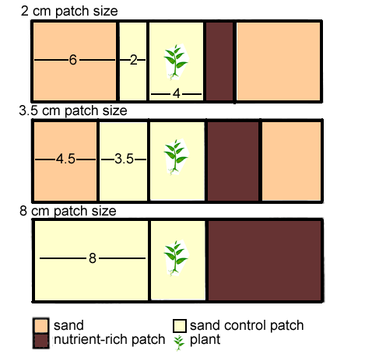
Pots used to test responses of roots to patches of nutrient rich soil
test plant
Figure 5.10
Notes:
Figure 5.10 Drawings of rectangular pots used to test responses of roots to patches of nutrient rich soil. Lengths of patches are shown in centimeters.
Talking Points: Offspring of seven plant species transplanted to center section of pots (20 cm x 5 cm x 4 cm).
Pots were subdivided by netting to establish patches; allowed roots to grow through, but no soil mixing.
Each pot had a nutrient-enriched treatment patch on one side of center section (brown shading) and non-enriched control patch.
Small (2 cm), medium (3.5 cm), and large (8 cm) nutrient-enriched patches were tested.
Non-enriched areas and areas outside the testing zone (beige and tan areas) filled with sand.
Nutrient-enriched areas were filled with: 100% soil or 50% soil/50% sand.
Concentrations of ammonium, nitrate, and phosphorus determined (Table 5.3).

Slide 39
Nutrient levels in the three soil treatments
Patch | Ammonium (NH₄⁺) | Nitrate (NO₃⁻) | Phosphorus (P)
Sand (control) | 0.07 | 0.05 | 0.01
50% soil | 0.38 | 0.19 | 0.17
100% soil | 0.69 | 0.34 | 0.47
* Values are expressed in μmol/g of dry soil.
Notes:
Table 5.3. Nutrient levels in the three soil treatments.
Talking Points: Levels of the three nutrients vary quite a bit between control and two treatments.
As expected, they are very low in sand, and then each is about half in the 50% soil treatment as it is in the 100% soil treatment.

Slide 40
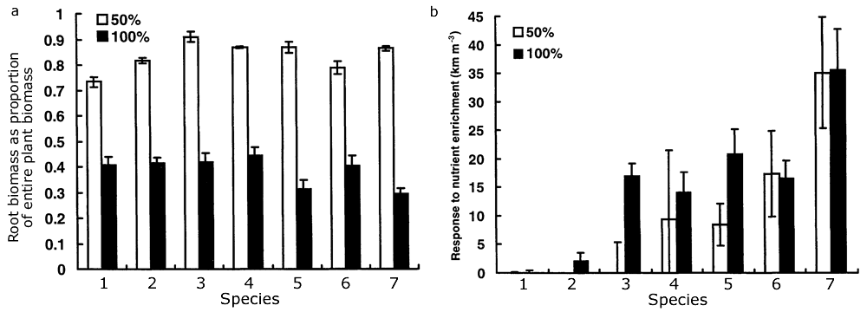
Root responses of seven plant species to two nutrient enrichment treatments
Figure 5.11
Notes:
Figure 5.11 Root responses of seven plant species to two nutrient enrichment treatments. (a) Mean proportion of biomass made up of roots for plants subjected to the low (50%) and high (100%) enriched soil treatments relative to the control. (b) Mean responses to nutrient-enrichment levels, expressed as the difference in root density (km * m⁻³) between enriched and control patches. Error bars represent + 1 standard error.
Talking Points: Each value is average over 12 plants (four pots in each of three different patch sizes). 7 species tested.
Root biomass relative to total plant biomass was determined.
Total root length in each section was analyzed, and was divided by volume of the section to find root length density.
Response of plant is difference between root length density in treatment patch and density in control (non-enriched) patch.
a. Plants respond to [low nutrient] by growing a higher fraction of total biomass as roots; to maximize nutrient acquisition. In high nutrient soils, plants do not have to allocate as much growth to roots; nutrients are easy to capture.
b. Species 2-5 had an increased response to higher nutrient concentrations. Even if there is a lower proportion of biomass as roots in the high nutrient soil, as indicated by 5.11a, the roots are denser for most species in nutrient-enriched patches, relative to controls (see also 5.12a). Response to enrichment is not the same for every species of plant. Some plants responded more to high nutrient-enriched soil, others responded equally to enrichment relative to control.

Slide 41
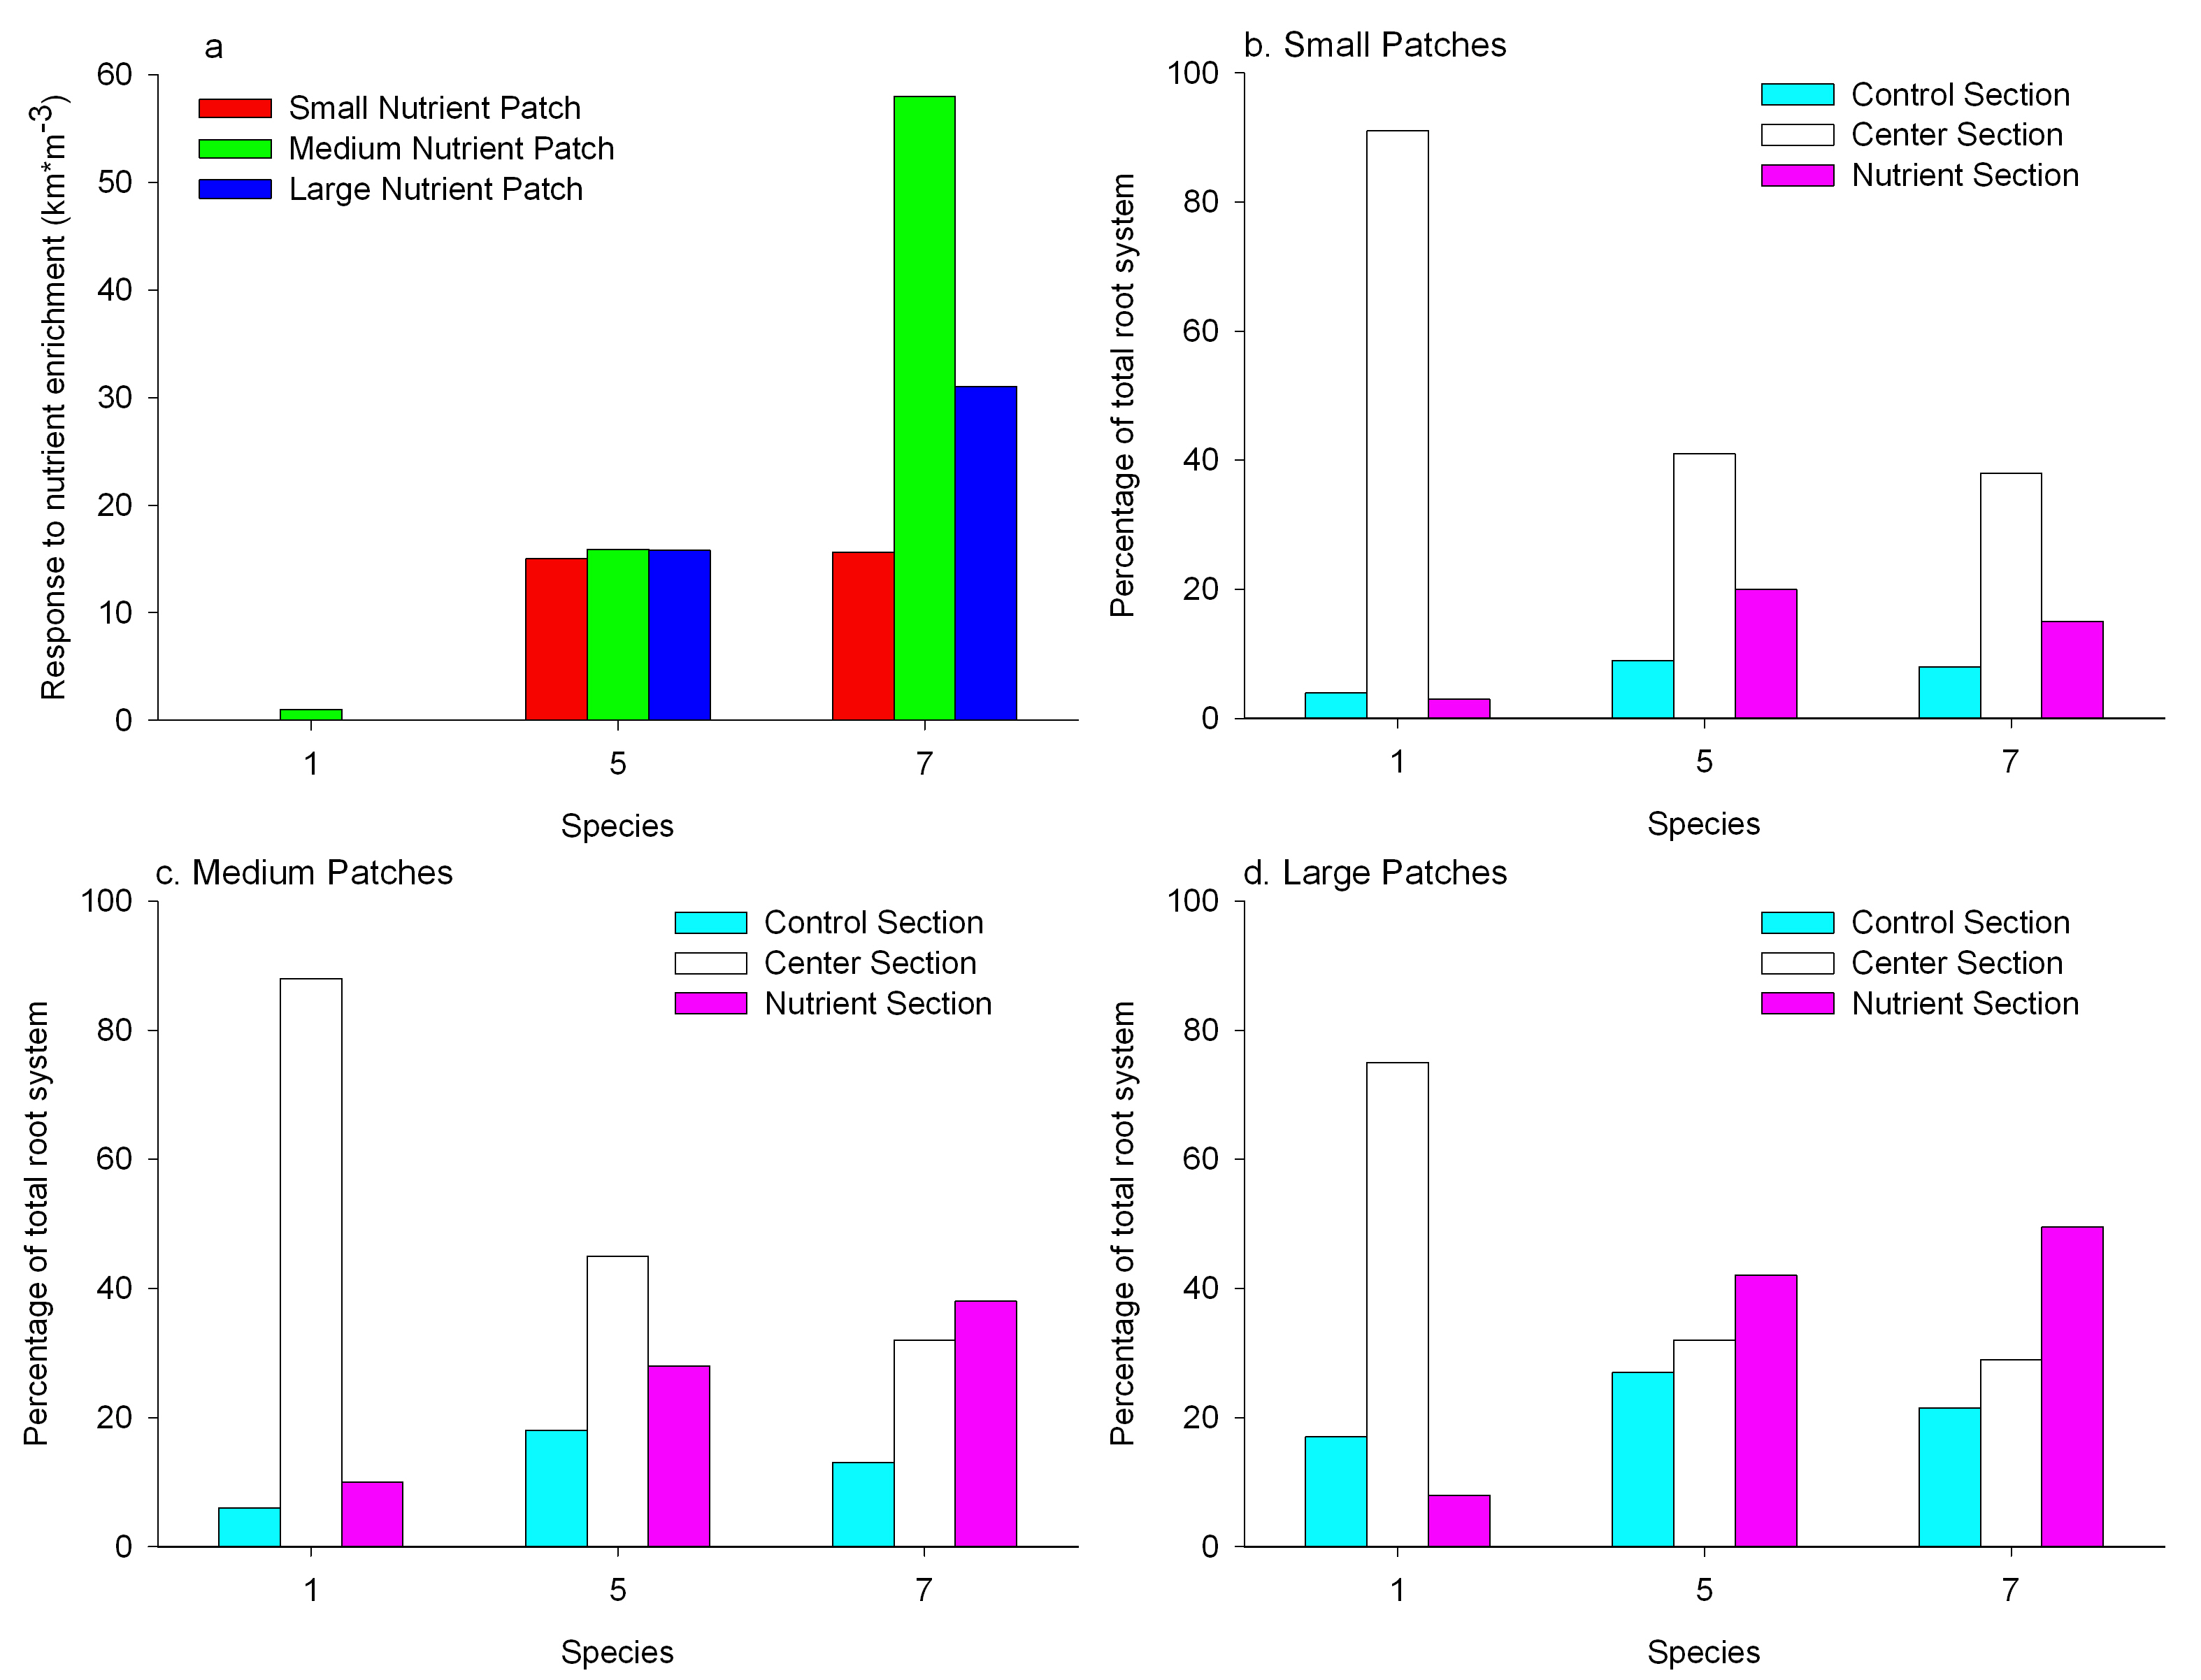
Root responses to size of nutrient-enriched patches
Figure 5.12
Notes:
Figure 5.12 Root responses to size of nutrient-enriched patches for 3 plant species. (a) Mean response, averaged over two nutrient-enrichment treatments. The proportions of root systems of seven plant species in different patches of (b) small patch size pots, (c) medium patch size pots, and (d) large patch size pots.
Talking Points:
Panel a: response of 0 means no difference between root length density in treatment and density in control (non-enriched). Roots denser for most species in nutrient-enriched patches, relative to the control patches.
Panels b-d show average proportion of root system in each patch for each species.
In most cases, plants allocate more root biomass to nutrient-enriched sections relative to control.
In b and c total proportions do not always add up to 100% if roots had grown beyond either side of experimental sections.
The response to soil enrichment is not the same for every species of plant – some have a more sensitive and immediate response than others.
Species 1 and 2 have most of their root biomass in the center section only. For other species, as patch size increases, a greater proportion of root biomass is found in the nutrient-enriched patch relative to the center section and the control.

Slide 42
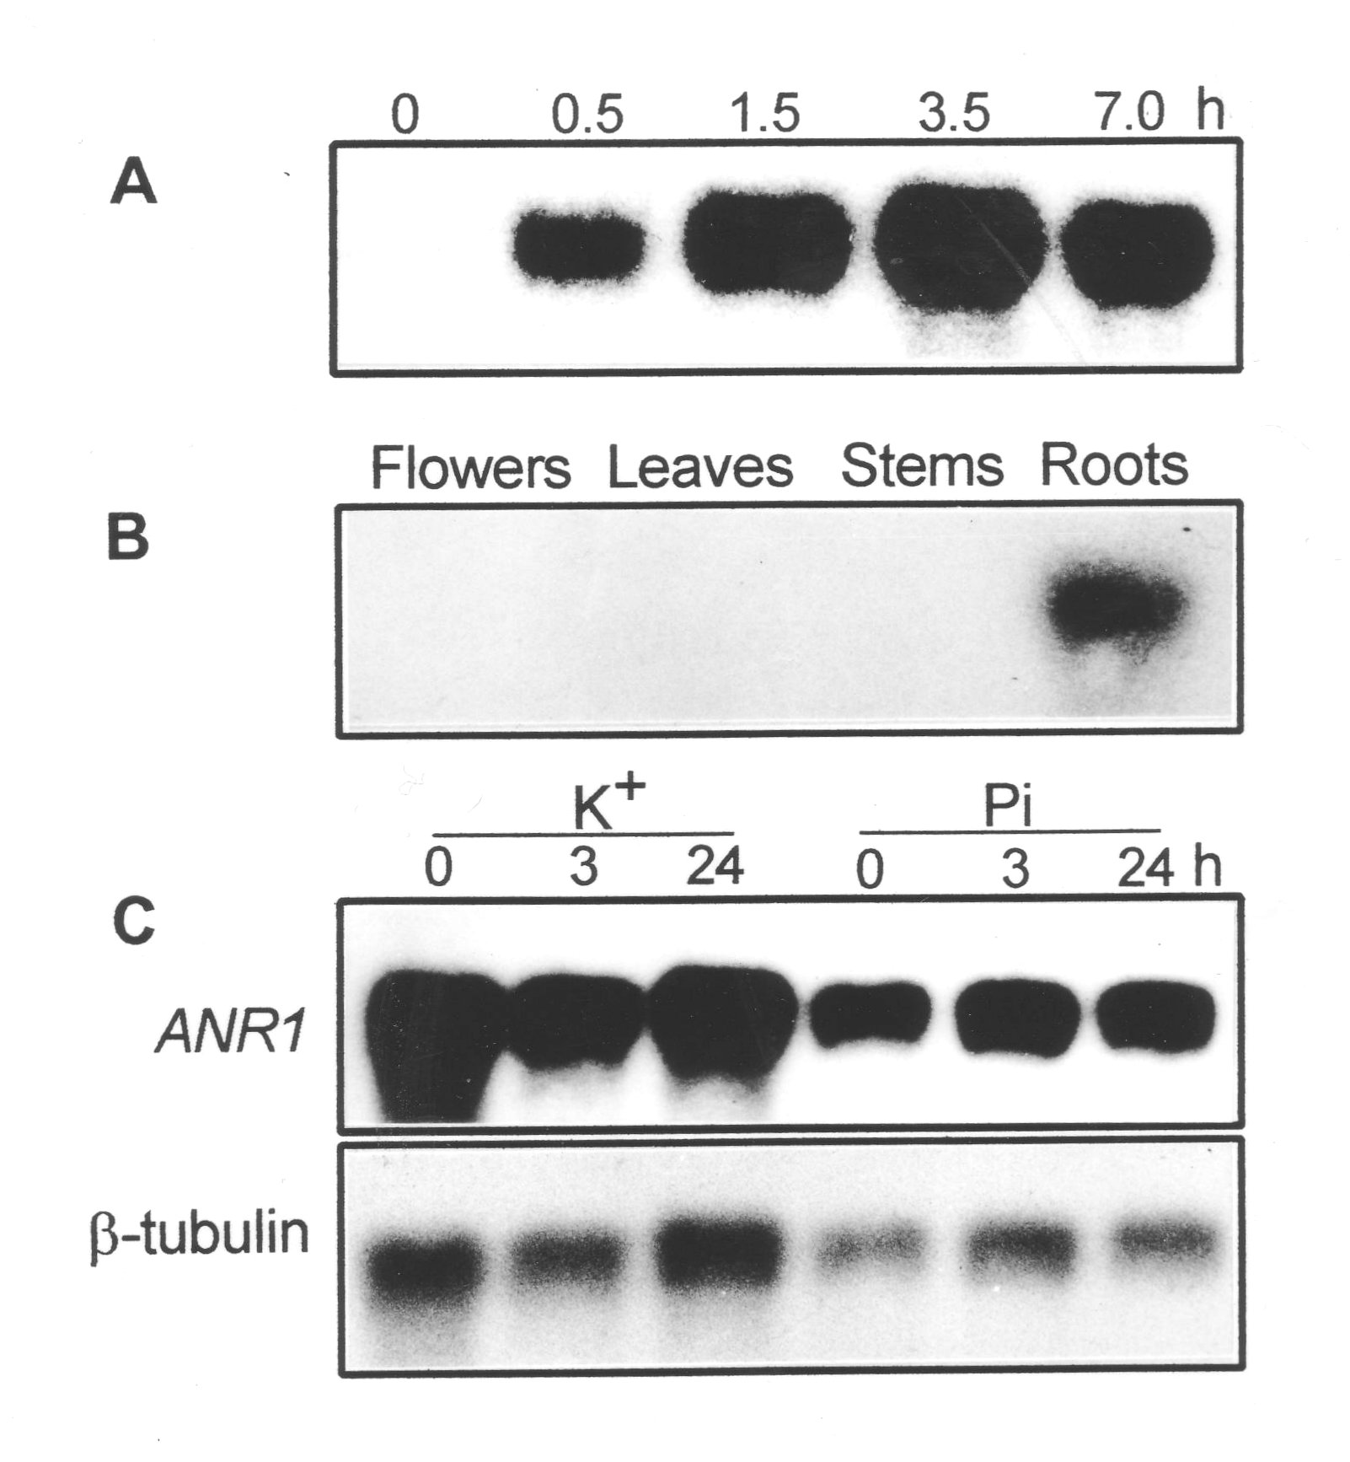
Northern blots to measure ANR1 expression
Explain time course.
Explain tissue-specific expression.
Explain response to starvation, then resupply of nutrients.
Figure 5.13
Notes:
Figure 5.13 Northern blots to measure ANR1 expression. The expression of ANR1 (a) when roots are exposed to nitrate (NO₃⁻), (b) in different tissue types, and (c) when roots are exposed to potassium (K+) or phosphate (PO₄³⁻).
Talking Points: Gene induction is studied to determine its role and transcription of mRNA in response to nutrient exposure. Scientists looked for messenger RNA (mRNA) of ANR1, a gene hypothesized to be important for root growth in Arabidopsis thaliana.
Plants exposed to nitrate showed that ANR1 was expressed rapidly upon exposure to nitrate. (5.13a).
mRNA extracted from different tissues showed that ANR1 expression occurred only in roots (5.13b).
ANR1 transcription remained high when exposed to nitrate but starved of potassium or phosphorus.
ANR1 is sensitive to presence of nitrate, but not to other nutrients.
Results support hypothesis that ANR1 plays a role in root growth, specifically in response to nitrate.
Tubulin (a gene expressed at roughly equal levels in all cells) mRNA is a loading control to confirm that mRNA loading is the same across the gel (expression levels of loading control should not vary).

Slide 43
Integrating Concepts in Biology
PowerPoint Slides for Chapter 5:
Information in Ecological Systems
Section 5.3: Is chemical communication used to block competition or defend self?
by
A. Malcolm Campbell, Laurie J. Heyer, and Chris Paradise

Slide 44
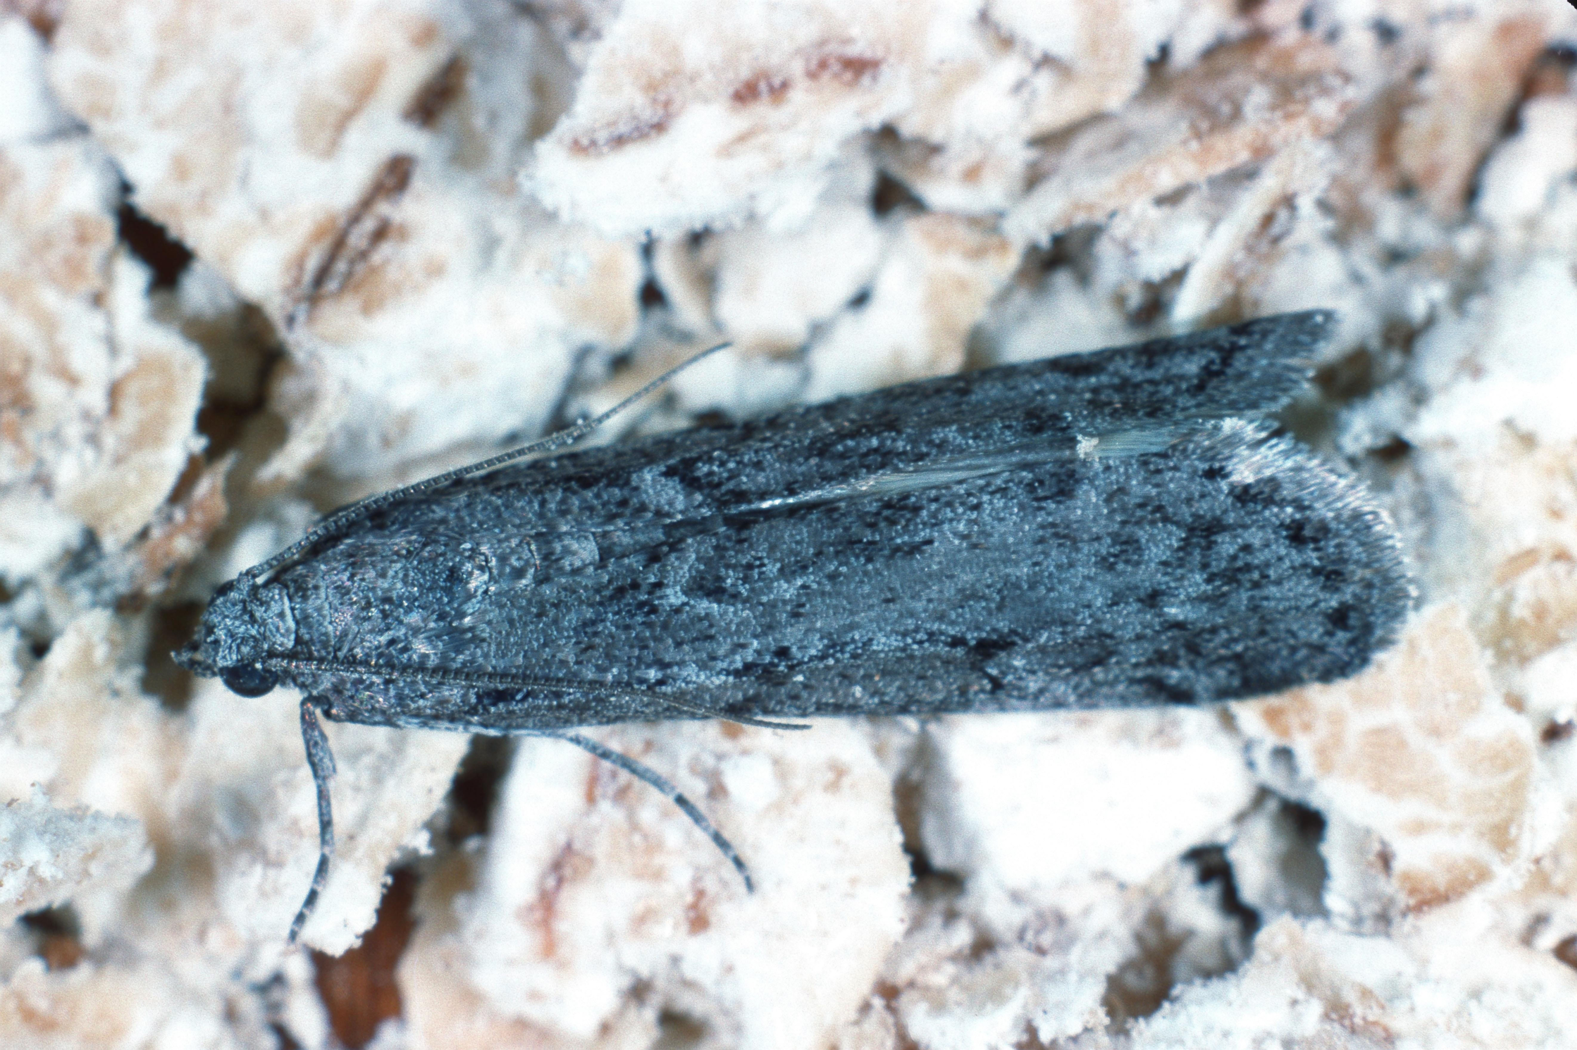
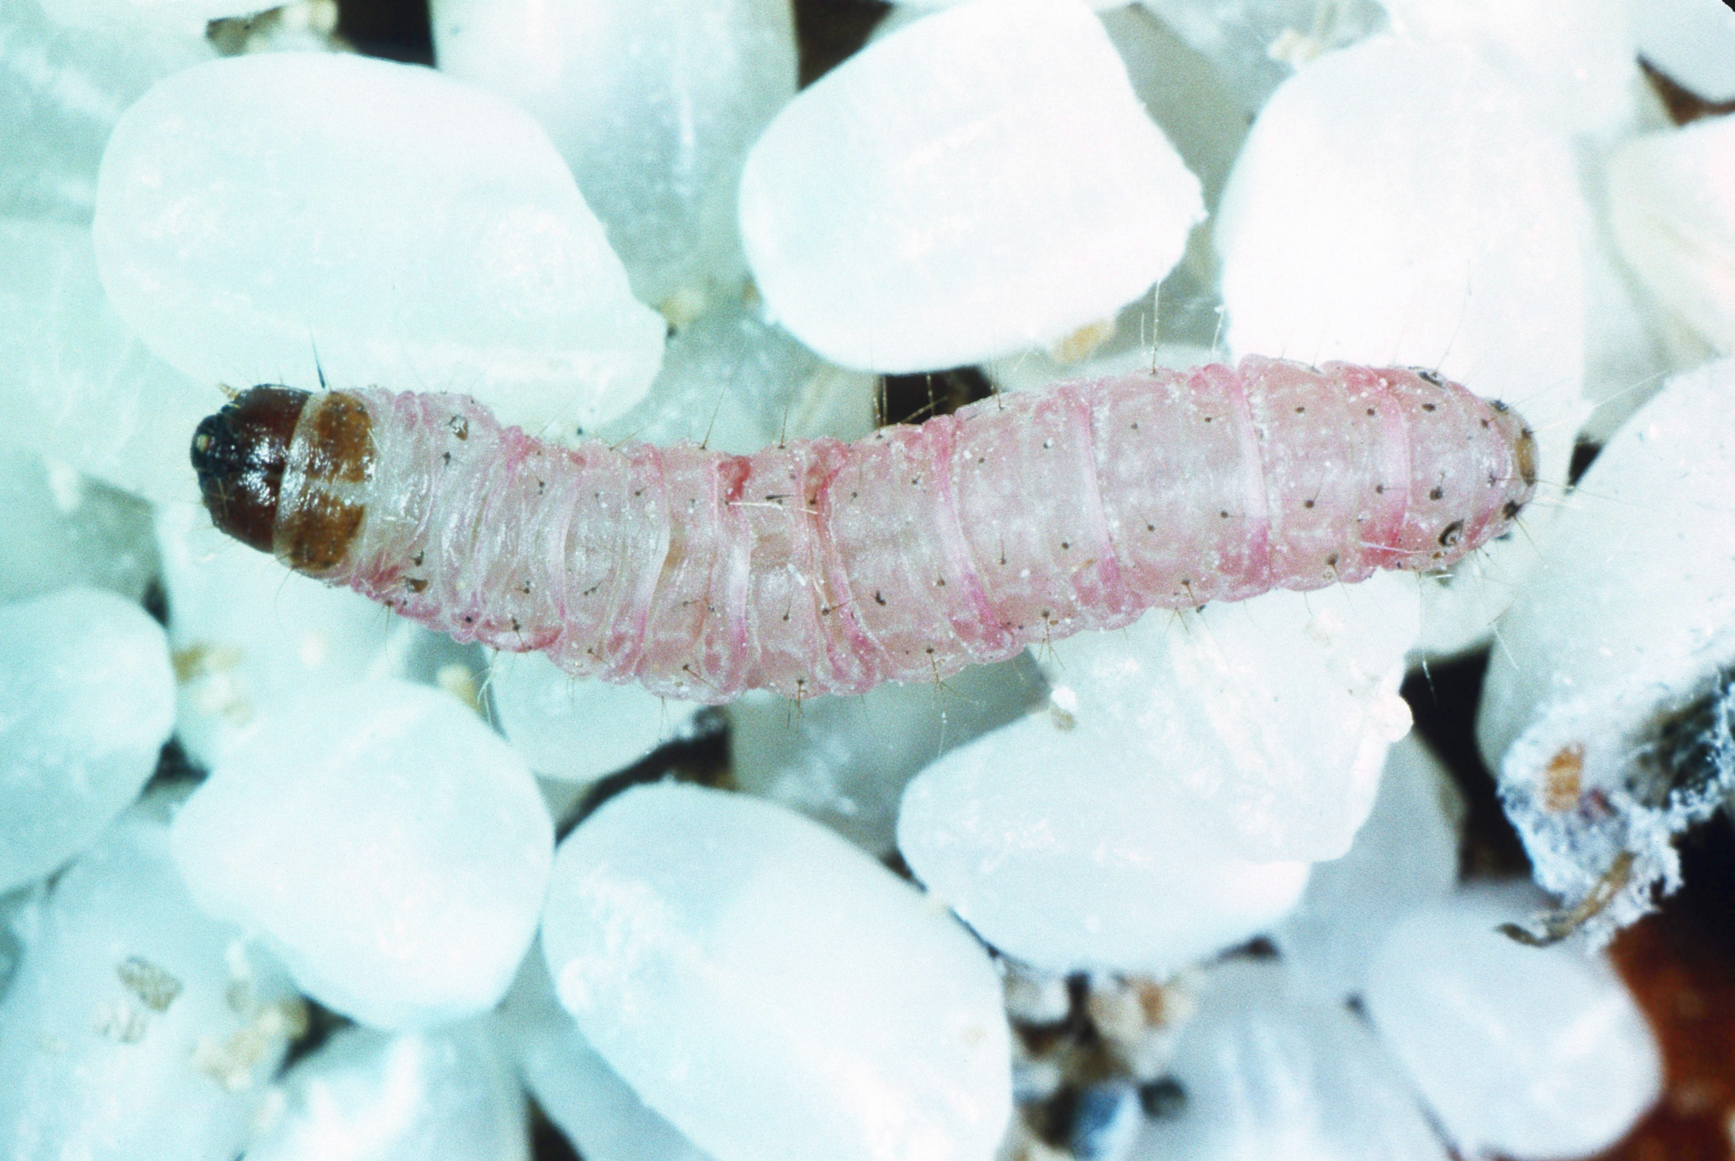
The Mediterranean flour moth, Ephestia kuehniella
Figure 5.14
Notes:
Figure 5.14 The Mediterranean flour moth, Ephestia kuehniella. (l) Adult and (r) larva.
Talking Points: To better understand the communication of chemical information, Sarah Corbet studied larvae of the Mediterranean flour moth, Ephestia kuehniella

Slide 45
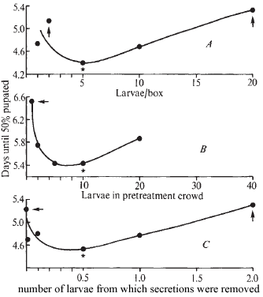
Effects of larvae and gland secretions on developmental time of Mediterranean flour moth larvae
Within an experiment, orange circled points significantly different from green circle points.
Do larvae or mandibular gland secretions affect pupation time ?
Figure 5.15
Notes:
Figure 5.15 Effects of larvae and gland secretions on the developmental time of larvae of the Mediterranean flour moth. Points that have an asterisk were significantly different than points marked with arrows. Pupation response to (a) larval density, (b) prior presence of various numbers of larvae, and (c) extracted mandibular gland secretions.
Talking Points: Larvae of Mediterranean flour moth secrete droplets of a liquid from glands near their mouths. Graphs show time for 50% of a test population to pupate when exposed to different conditions.
In first test, larvae were placed in boxes to simulate various population densities.
In second, variable #s of larvae were placed in boxes for a period of time, and removed before test larvae added.
In third, secretions from mandibular glands were spread on a coverslip, and test larvae were exposed to the extract. Secretions from glands of larva led to responses by other larvae of the same species.
Glandular secretions reduce competition – the presence of high densities of larvae inhibits pupation.
Intermediate densities reduce pupation time, which may indicate that presence of some larvae is information that a patch is a potentially good resource for offspring.

Slide 46
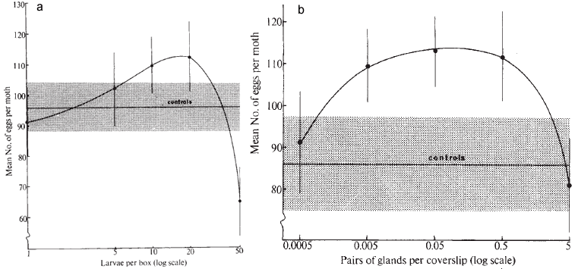
Effects of larvae or gland secretions on eggs laid by adult Mediterranean flour moths
Mean + 1 s.e. in number of eggs laid by females in boxes with no larvae or glandular secretions.
Do larvae or mandibular gland secretions affect number of eggs laid?
What are best and worst levels for number of eggs laid?
Figure 5.16
Notes:
Figure 5.16 Effects of (a) larvae or (b) gland secretions on the number of eggs laid by adult Mediterranean flour moths. The horizontal line and the gray shaded area represent the mean and the extent of + 1 standard error, respectively, in the number of eggs laid by females in boxes with no other larvae or glandular secretions.
Talking Points: Larvae of Med. flour moth secrete droplets from glands near their mouths.
In related experiment, # of eggs laid by females in presence of larvae or secretions was determined.
Secretions from glands of an individual larva led to responses by egg-laying females.
Mediterranean flour moth uses glandular secretions of larvae to help reduce competition – the presence of high densities of larvae inhibits egg-laying.
Intermediate densities actually increase egg-laying, which may indicate that the presence of some larvae is information that a patch is a potentially good resource for offspring.

Slide 47
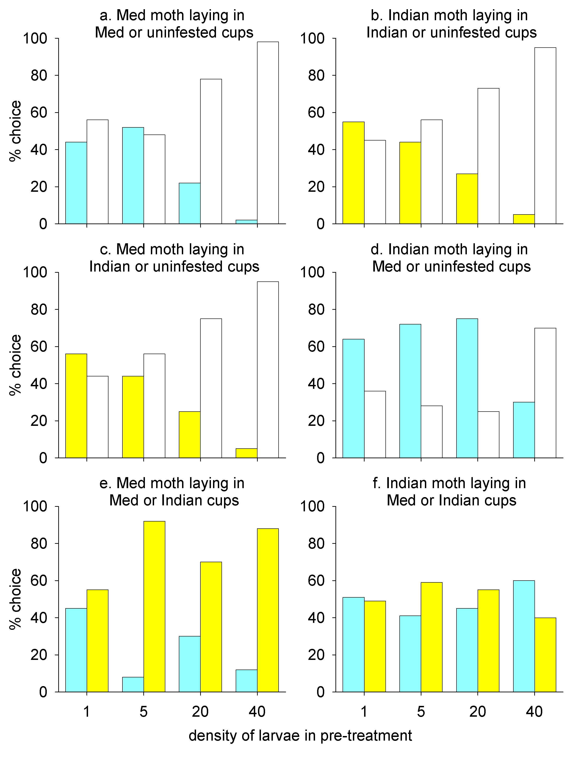

Choice experiments by female Mediterranean flour and Indian meal moths
-Cups with Med flour moth
-Cups with Indian meal moth
-Uninfested cups
Figure 5.17
Notes:
Figure 5.17 Results of choice experiments by female Mediterranean flour and Indian meal moths. Females chose between cups that had contained larvae of the same species or were uninfested (a and b), between cups that had contained larvae of the other species or were uninfested (c and d), and between cups that had contained larvae of either species (e and f). Med = Mediterranean.
Talking Points: A mated female of either species was released into a small screened cage containing two cups with wheat germ mixture (patches of resources), into which she could choose to lay eggs.
Cups filled with 0, 1, 5, 20, or 40 larvae of 1 of 2 species for 24 hours prior to test, then removed.
In a and b, one cup contained larvae of the same species, and the other cup was uninfested.
In c and d, one cup contained larvae of the other species, and the other cup was uninfested.
Two bars for any density treatment in a-d represent a choice between a cup that had contained the indicated density and a cup that had contained no larvae.
In e and f, one cup had contained larvae of same species, and other had contained larvae of other species.
When given a choice between an uninfested cup and a cup that previously held one larva (no matter the species), Med. flour moth females did not exhibit a clear preference (a and c).
Med. flour moth females avoid cups that previously held high densities of either species when an uninfested cup was available.
When given a choice to lay eggs in cups that held larvae of their species vs. the other species, Med. flour moth females prefer to lay eggs in cups that had previously held larvae of the other species (e).
The Med. flour moth can distinguish between the two signals.
Indian meal moth females showed some avoidance of Med flour moth larvae when cups held 40 larvae; they could detect presence of other species. Slight preference for densities below 20 larvae of either species.
Low amounts of secretion could indicate to female that a patch is suitable for her offspring; signal is not strong enough to indicate that competition would result.

Slide 48
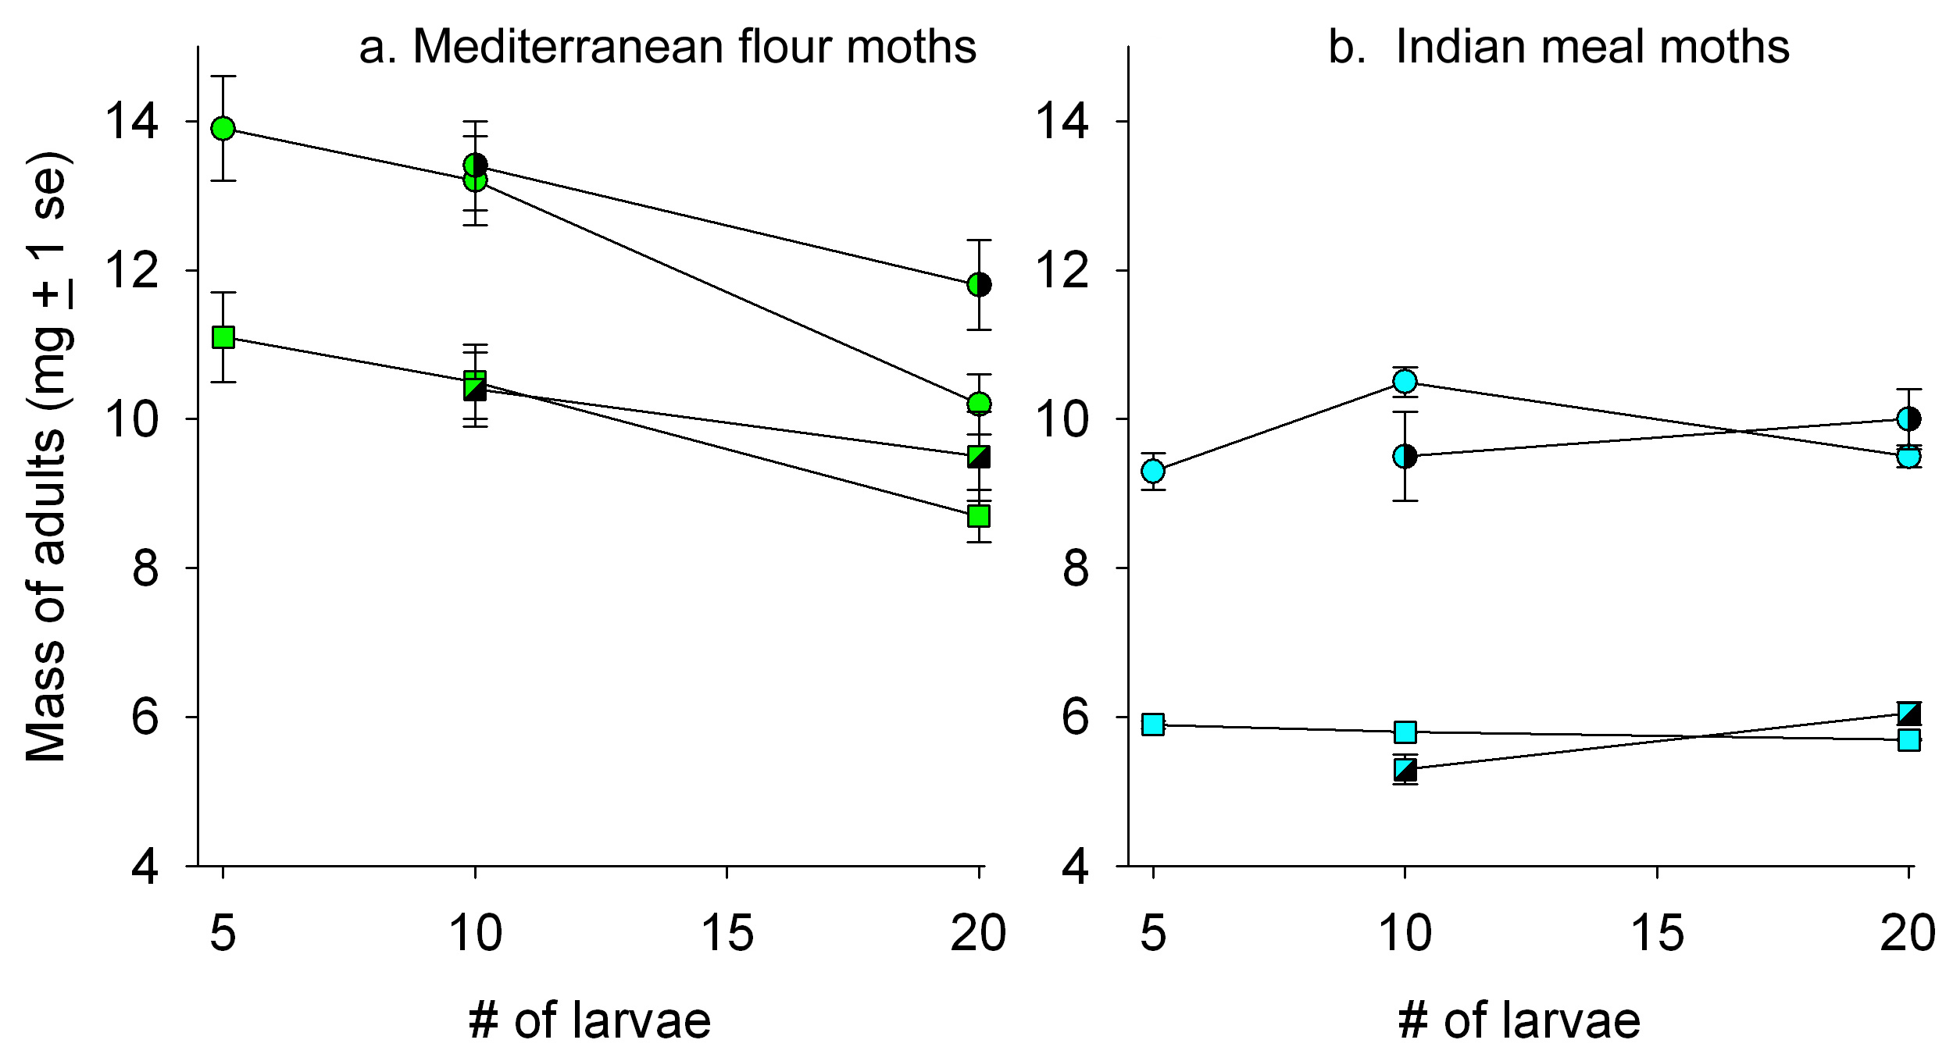
Growth of Mediterranean flour moths larvae at various larval densities
Females in mixed population
Females with larvae of same species
Males with larvae of same species
Males in mixed population
Figure 5.18
Notes:
Figure 5.18 Growth of moth larvae at various larval densities. (a) Mean weight of female and male Mediterranean flour moths and (b) Indian meal moths when grown at different densities of larvae. Circles represent females and squares are males. Solid symbols represent mass when grown with the larvae of the same species, and symbols that are shaded half black represent mass when grown in a mixed population (half one species and half the other species). Error bars represent + 1 standard error.
Talking Points: High larval densities cause a decrease in mean weight for the Med. flour moth (a). Decrease more pronounced when with high densities of same species compared to high densities of both species.
Med. flour moth competes well for resources against Indian meal moth larvae but less well against other Med. moth larvae. Med. moths sensitive to signal of their own species because of this competition.
The Indian meal moth typically develops faster and does not get as large.
Its final size does not seem to be affected by varying densities of either species (b).

Slide 49
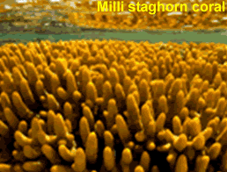
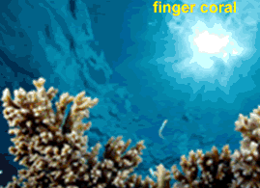
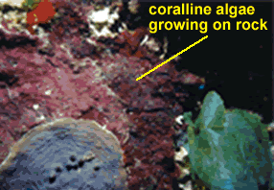
Three coral reef species
Figure 5.19
Notes:
Figure 5.19 Three coral reef species.
Talking Points: Katharina Fabricius and her Australian colleagues studied two species of coral that are common on the Great Barrier Reef, Acropora millepora, sometimes called milli staghorn coral, and A. tenuis, known as the finger coral. The rightmost panel shows coralline algae growing on a rock.

Slide 50
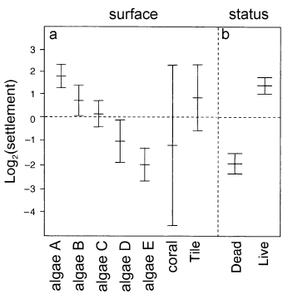
Settlement densities of Acropora coral larvae
Figure 5.20
Notes:
Figure 5.20 Settlement densities of coral larvae. (a) Effects of various surfaces (five species of coralline algae (mean of live and dead pieces), coral pieces, and clay tile). (b) Settlement densities on horizontal vs. vertical surfaces. (c) Settlement densities on live vs. dead coralline algae. Error bars represent 1 standard error.
Talking Points: One of each type of surface (5 coralline algae species, both dead and alive (2), in both horizontal and vertical orientation (2), plus two abiotic surfaces (= 5 x 2 x 2 + 2 = 22 treatments)) into 5 tanks.
8,000 finger coral larvae added to each tank, numbers of settled corals on each type of surface counted.
Plotted on log₂ scale (see BME 1.3); an increase by one unit corresponds to a doubling of densities.
To find ratio between any two treatments, raise 2 to the power of the difference between their values on the log₂ scale. Settlement on live algae is 3.2 units = 2^{3.2} ≈ 9.2 times greater than on dead algae).
Coral settlement greater on live coralline algae than dead
Coral settlement greater on horizontal than on vertical orientation.
Physical aspects of surface play some role in settlement success.
Coral larvae may either be attracted to live algae or inhibited by dead algae.
Species of coralline algae have different properties that increase or decrease their suitability as surfaces for coral larvae. Species A had about 15 times more settlement than species E.
Coral settlement on coralline algae species D and E is also lower than settlement on the tile surface, these two species may be inhibiting coral settlement.

Slide 51
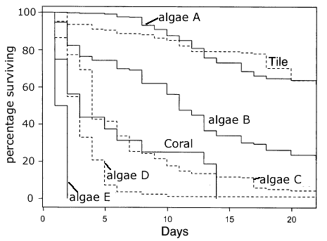
Survival of finger coral larvae over 22 days
Describe the effects of the various substrates on survival of finger coral larvae.
Figure 5.21
Notes:
Figure 5.21 Survival of finger coral larvae over 22 days, showing the effects of various surfaces on daily survival.
Talking Points: Fragments transferred to another tank where coral larvae observed for 22 days
Proportion of coral surviving at the end of each day was determined.
e.g., for algae species E, survival was 100% after 1 day, 50% died after 2, and all were dead by day 3.
Finger coral have survival patterns that vary with the type of surface on which they settled.
Coralline algae species A and B induced the most settlement in corals and were the ones on which corals had high growth and survival.

Slide 52
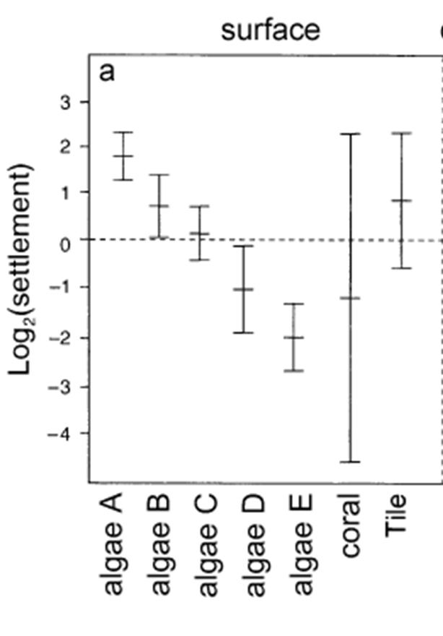
Survival of finger coral larvae; compare settlement with survival
Figure 5.20a and 21
Notes:
Figure 5.21 Survival of finger coral larvae over 22 days, showing the effects of various surfaces on daily survival.
Talking Points: Fragments transferred to another tank where coral larvae observed for 22 days
Proportion of coral surviving at the end of each day was determined.
e.g., for algae species E, survival was 100% after 1 day, 50% died after 2, and all were dead by day 3.
Finger coral have survival patterns that vary with the type of surface on which they settled as is evident here.
Coralline algae species A and B induced the most settlement in corals and were the ones on which corals had high growth and survival.
Settlement and survival of corals were lowest on algal species D and E.
Settled coral larvae also died when algae shed their outer layers or overgrew the larvae.
Coral larvae may choose surfaces on which to settle based on information they gather from the environment.
Releasing chemicals may deter settlement of corals, but corals have evolved to recognize algae based on the chemical information they emit. They use that information to accept or reject a settlement location.

Slide 53
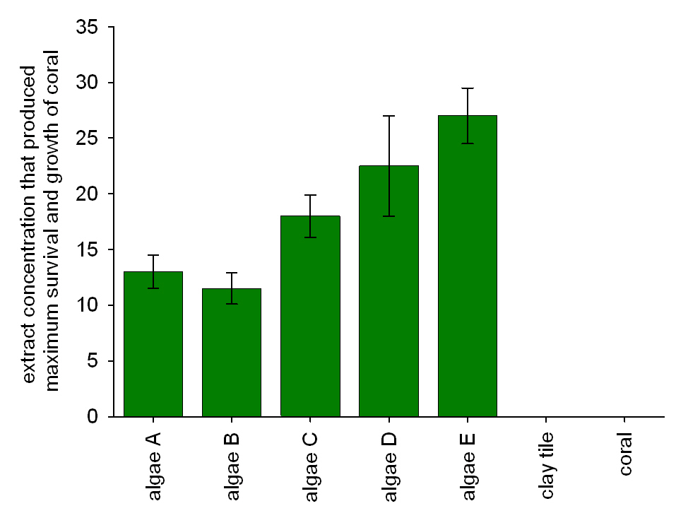
Extract concentrations that produced maximum survival and growth of settled coral larvae in laboratory experiments
To which coralline algae extract are the finger coral most sensitive, in terms of their survival and growth? To which are they least sensitive?
Figure 5.22
Notes:
Figure 5.22 Extract concentrations that produced maximum survival and growth of settled coral larvae in laboratory experiments (with 95% confidence intervals). Concentrations that were both lower and higher than indicated produced less coral growth and maturation.
Talking Points: The low maximum concentrations of extracts from species A and B meant that coral larvae were more sensitive to chemicals from those species than to other coralline algae.
Algal species D and E, on which settlement and survival of corals were lowest, still produced chemicals that affected growth, but not to as high a degree as other species.
High survival was related to high sensitivity to the corresponding chemical extract.
Coral larvae may choose surfaces on which to settle based on information they gather from environment.
Releasing chemicals may deter settlement of corals, but corals have evolved to recognize algae based on the chemical information they emit. They use that information to accept or reject a settlement location.

Slide 54
Survival of finger coral larvae; compare settlement with survival
Figure 5.21a and 22
Notes:
Figure 5.22 Survival of finger coral larvae over 22 days, showing the effects of various surfaces on daily survival.
Talking Points:
Coralline algae species A and B induced the most settlement in corals and were the ones on which corals had high growth and survival.
The low maximum concentrations of extracts from species A and B meant that coral larvae were more sensitive to chemicals from those species than to other coralline algae.
Algal species D and E, on which settlement and survival of corals were lowest, still produced chemicals that affected growth, but not to as high a degree as other species.
Coral larvae may be choosing surfaces on which to settle based on information they gather from the environment.
Releasing chemicals may deter settlement of corals, but corals have evolved to recognize algae based on the chemical information they emit. They use that information to accept or reject a settlement location.

Slide 55
Integrating Concepts in Biology
PowerPoint Slides for Chapter 5:
Information in Ecological Systems
Section 5.4: How does change in number of species affect information content of an ecological system?
by
A. Malcolm Campbell, Laurie J. Heyer, and Chris Paradise

Slide 56
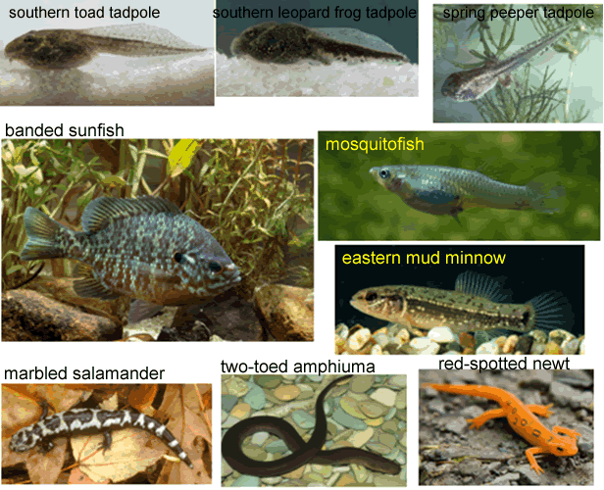
Tadpoles (top row) and their predators
Figure 5.23
Notes:
Figure 5.23 Tadpoles (top row) and their predators.
Talking Points: A study on the interactions and biodiversity of ponds in eastern North America was performed by David Chalcraft and William Resetarits, who were interested in how interactions between species were affected in pond ecological systems with different predators.

Slide 57
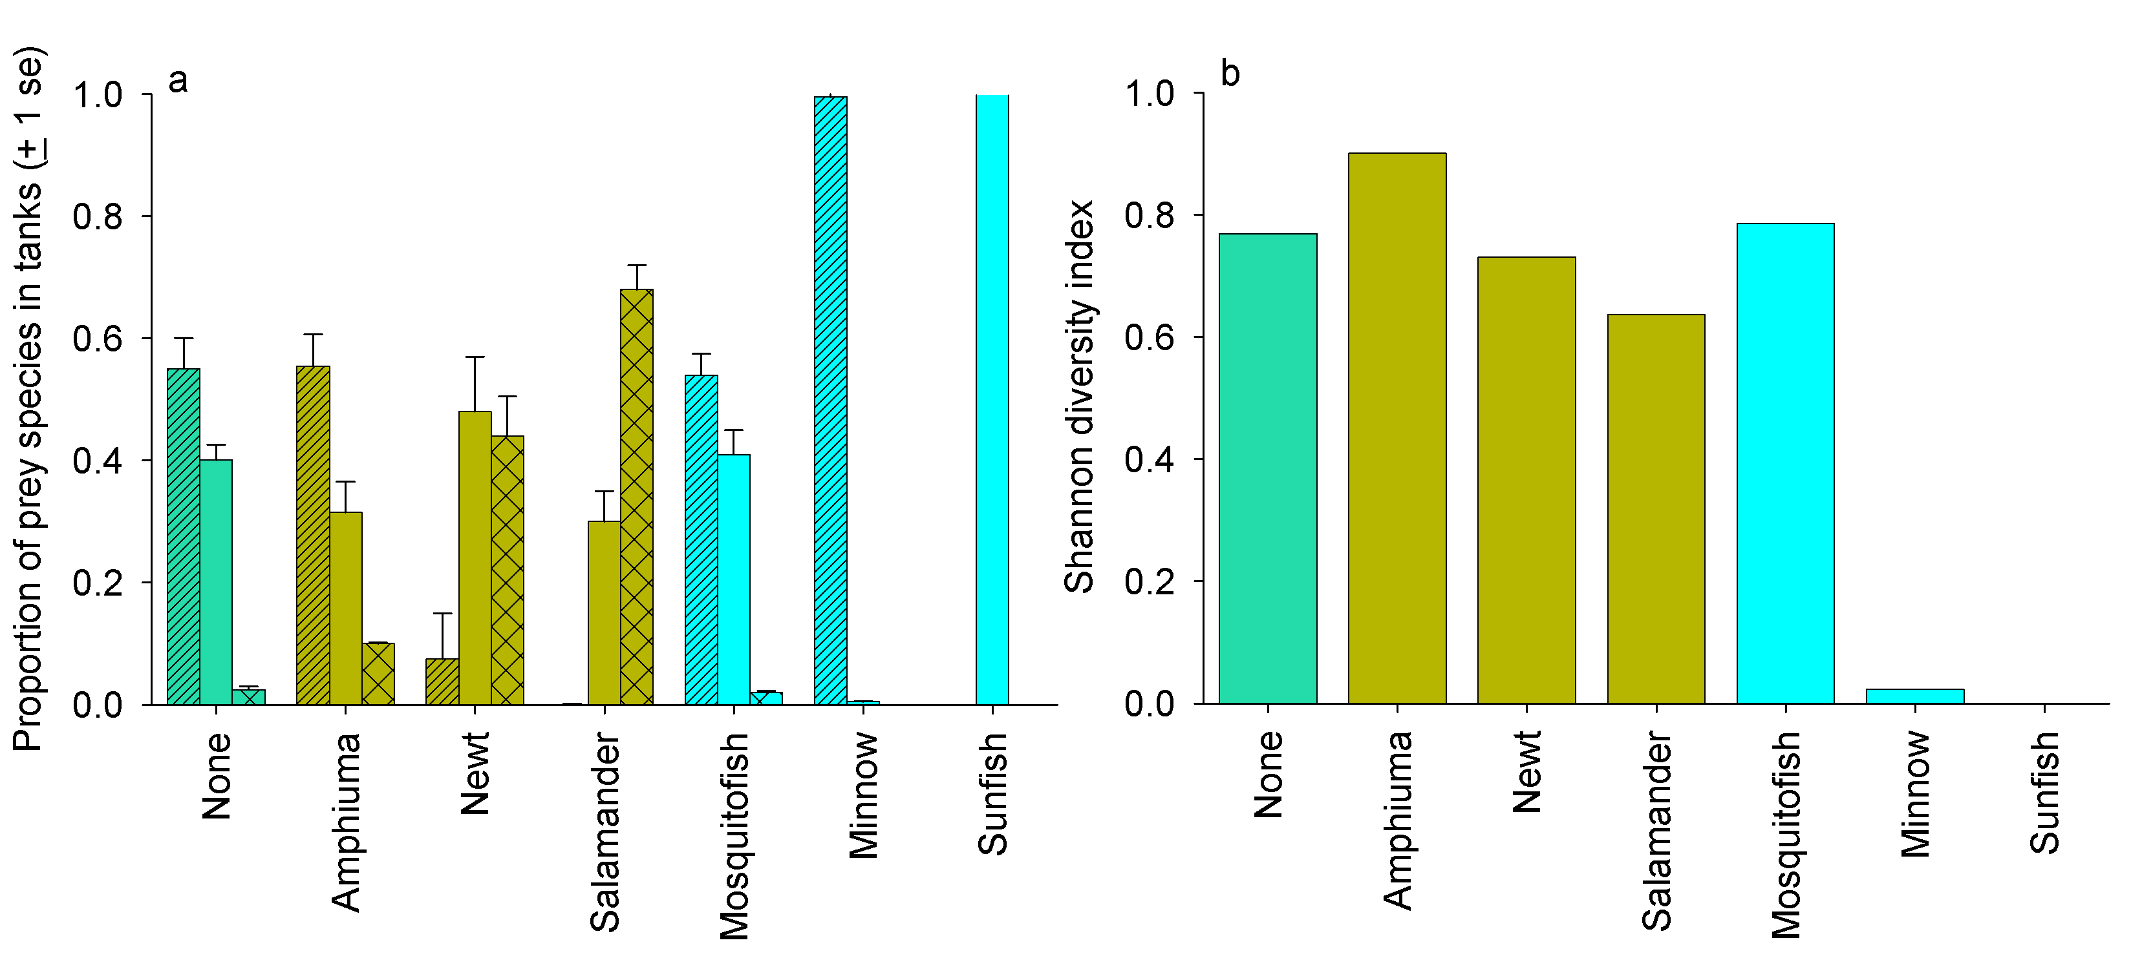
Effect of predation on tadpole communities
southern toad
southern leopard frog
spring peeper
Salamander predators
Fish
predators
Salamander predators
Fish
predators
Figure 5.24
Notes:
Figure 5.24 Effect of predation on tadpole communities. (a) Proportion of tadpoles in each predator treatment. Tanks with no predators are green, tanks with salamanders are gold, and tanks with fish are blue. Southern toad proportions have diagonal hatching, southern leopard frog proportions have no hatching, and spring peeper proportions have double hatching. (b) The Shannon diversity index (see BME 5.3) for prey exposed to different predators. The color scheme is the same as in (a).
Talking Points: 6 tanks (one for each predator) and a control were set up, with each replicated four times. Each tank contained pond water, leaves, and 175 tadpoles of each prey species.
Two individuals of each predator added to one tank; tanks monitored for 60 days.
Predators affected both number of prey species and their proportions differently.
Salamanders reduced one of the three tadpoles to zero or nearly zero.
Minnows and sunfish reduced diversity to nearly zero, by eliminating or nearly eliminating 2 prey species. Predators able to locate only certain prey, or prey able to detect the presence of only certain predators.
Southern leopard frog only eliminated by one predator, the minnow.
Spring peepers eliminated through competition with no predators present, or certain types of predator.
Predator and prey species collect and assess information in their environment.

Slide 58
BME 5.3: Computing the Shannon diversity index for Figure 5.24a, no predators
To compute the Shannon diversity index, find the relative proportion of each species.
The second step is to find the natural logarithm of each of these proportions
No Predator | Proportion | LN (proportion) | Proportion * LN(proportion
Southern toad | 0.575 | -0.5534 | -0.3182
Leopard frog | 0.4 | -0.9163 | -0.3665
Spring peeper | 0.025 | -3.6889 | -0.0922
Shannon biodiversity index |  |  | 0.7769
Next, multiply each proportion by its natural log, such as 0.575 * -0.5534.
Finally, add these three products and negate the answer.
Notes:
BME 5.3. Computing the Shannon diversity index.
Talking Points: To compute the Shannon diversity index, first find the relative proportion of each species.
W/ no predator, 0.575 were southern toads, 0.4 were southern leopard frogs, and 0.025 were spring peepers.
Next, calculate the natural logarithm of each of proportion. The natural log of x is log_{e}x, the power to which e must be raised to get x.
The natural logs of the proportions are as follows: ln(0.575) ≈ -0.553, ln(0.4) ≈ -0.916, and ln(0.025) ≈ -3.689.
Next, multiply each proportion by its natural log, such as 0.575 * -0.553.
Finally, add these three products, and negate the answer to obtain the Shannon biodiversity index.
Also illustrated in the spreadsheet “tadpole.xls.”

Slide 59
ELSI Box 5.1: Do we have an obligation to preserve biodiversity?
Summarize the three arguments for and against the preservation of biodiversity. Which argument is most compelling to you, and why?
What are the benefits of biodiversity for the argument you find the most compelling? What are the consequences of lost biodiversity?
What are the consequences when a species is lost? Does the biological information of an ecological system affect the survival of the human species?

