Slide 1
Title Page
Integrating Concepts in Biology
PowerPoint Slides for Chapter 6:
Evolution at the Molecular Level
6.1 What is evolution?
6.2 Could abiotic molecules produce the first cells?
by
A. Malcolm Campbell, Laurie J. Heyer, and Chris Paradise

Slide 2
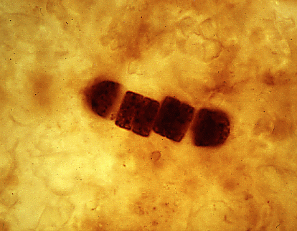
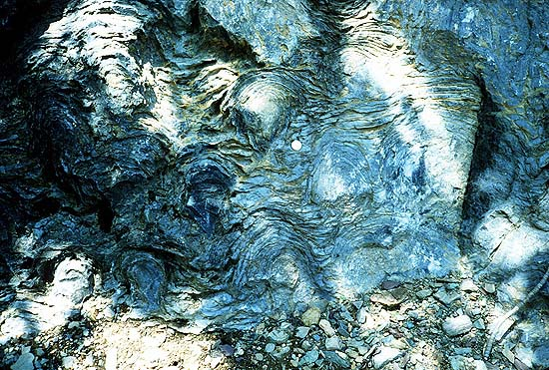
Opening Figure
Fossil Evidence of Early Life
Notes:
Opening Art: Left - 1 billion year old microbe fossil. Right - 2.7 billion year old colonial microbe layered in wavy sheets.

Slide 3
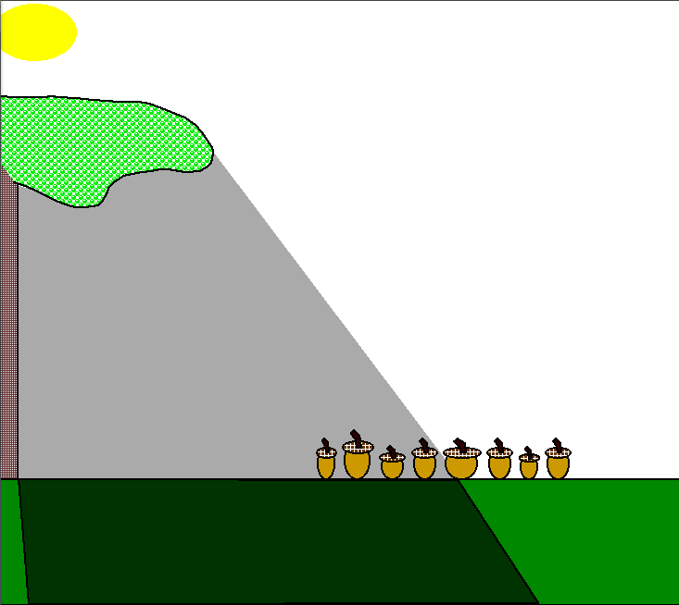
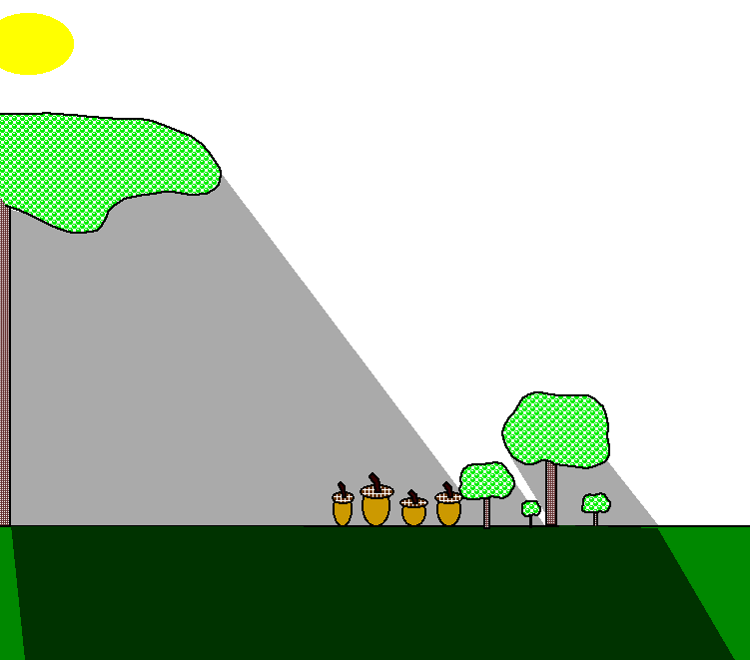
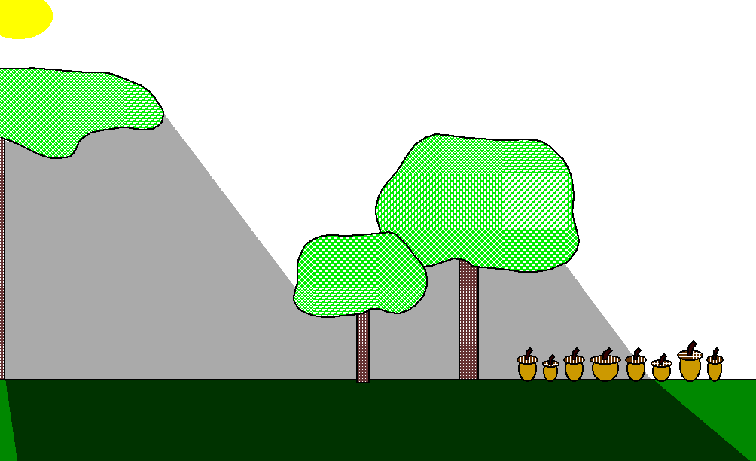
Fig. 6.1
Natural Selection Example
Notes:
Figure 6.1 Example of natural selection. a) Over production of acorns with variation leads to a competition for the limited resource of light. b) F₁ Acorns that are faster to germinate grow first and shade out their competition. c) Those with the selective advantage survive, reproduce and propagate the trait of fast germination in F₃ progeny.

Slide 4
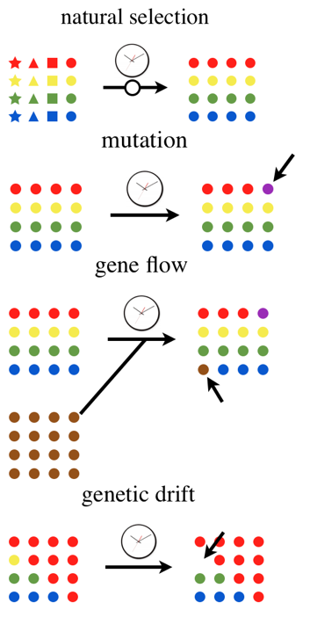
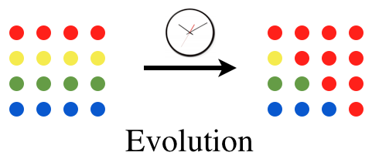
Fig. 6.2
Four Mechanisms of Evolution
b)
a)
c)
d)
e)
Notes:
Figure 6.2 Evolution and the four mechanisms of evolution. a) Depiction of evolution where circles represent individuals in a population with different alleles (colors). The frequency of alleles changes over time. b) Natural selection favors circles which are allowed to reproduce. c) Mutation is the appearance of a new allele through DNA change. d) Gene flow is the arrival of a new allele from a different population. e) Genetic drift is the arbitrary loss of an allele e) through a process not related to natural selection.

Slide 5
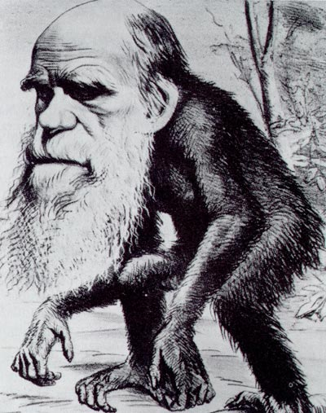
ELSI Figure 6.1
Political Satire of Darwin
Notes:
ELSI Figure 6.1 Nineteenth century political cartoon of Charles Darwin. The concept of descent from a common ancestor was not fully understood by Victorian England so Darwin was ridiculed as being a buffoon.

Slide 6
6.2 Could abiotic molecules produce the first cells?

Slide 7
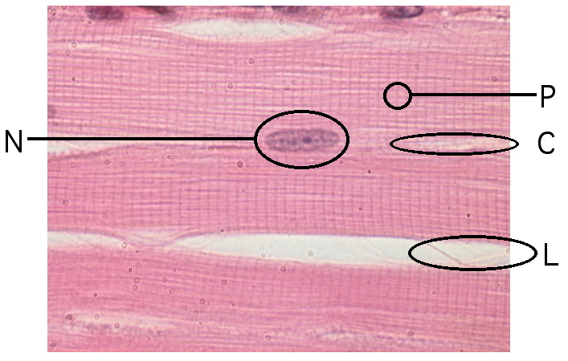
Fig. 6.3
Skeletal Muscle Cell
Notes:
Figure 6.3 Building blocks of a muscle cell. Portions of several skeletal muscle cells are shown with proteins (P) forming the actin and myosin fibers, nucleic acids (N) inside the nucleus, carbohydrates (C) in the cytoplasm, and lipids (L) forming the plasma membranes.

Slide 8
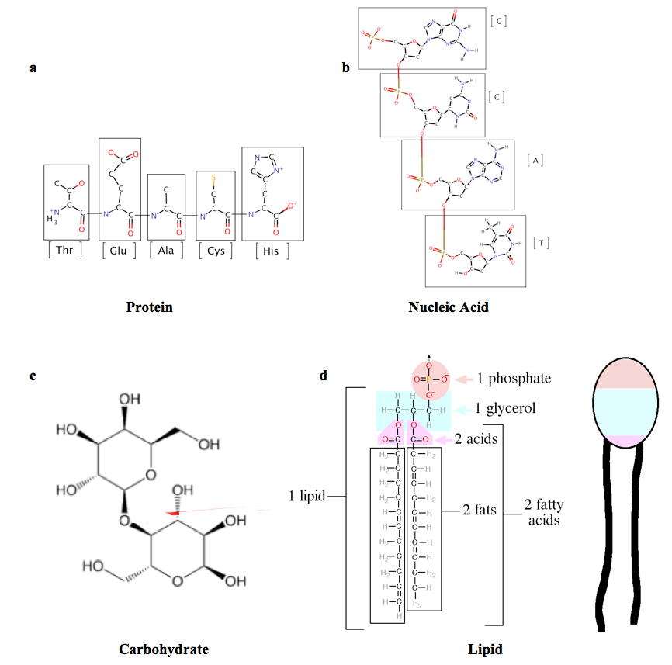
Fig. 6.4
Biological Building Blocks
Notes:
Figure 6.4 Complex biological molecules that form the building blocks of life. a) Five amino acids connected by peptide bonds. b) Four nucleotides connected by phosphodiester bonds. c) The disaccharide lactose. d) A generic phospholipid drawn in chemical detail and as simplified icon.

Slide 9
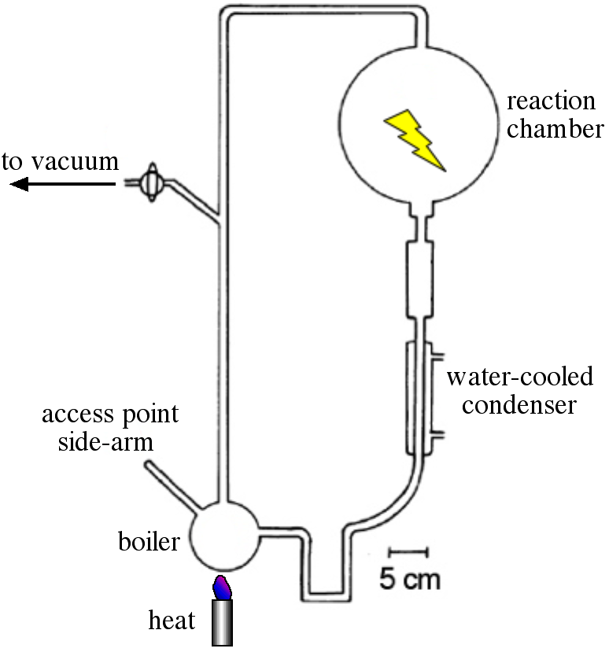
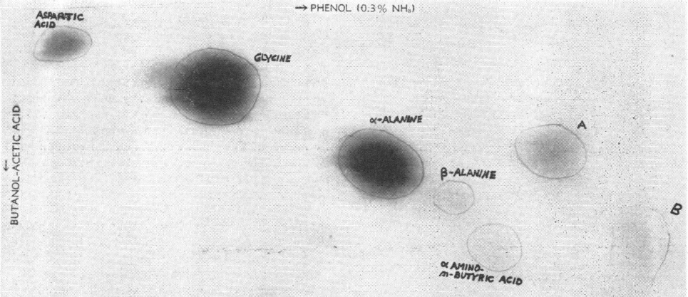
Fig. 6.5
Miller’s Primitive Earth Experiment
Notes:
Figure 6.5 Miller’s experiment to simulate primitive Earth. (a) Modified drawing from Miller showing the parts of his ancient world device. (b) Thin layer chromatography results after running the primitive earth experiment for 1 week. Hand-written labels and circles by Miller.

Slide 10
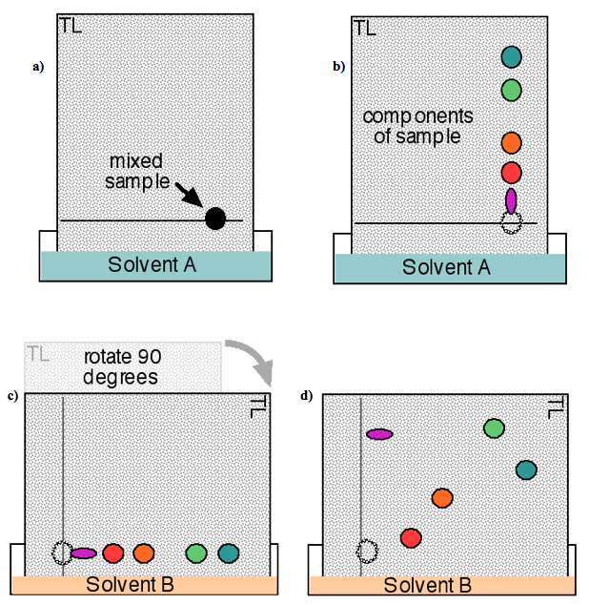
Fig. 1.19
Thin Layer Chromatography
Notes:
Figure 1.19 Thin layer chromatography method. (a) Complex mixture of a sample is spotted on the line and then the entire sheet is dipped in solvent A. (b) Sample components migrate at different rates depending on their chemical structures. (c) The sheet is then rotated and dipped into a second solvent where (d) the components again migrate according to their chemical properties. TL marks the top left corner in panel (a) to help with orientation in panels c-d.
Talking Points: Introduction to thin layer chromatography (TLC) method.

Slide 11
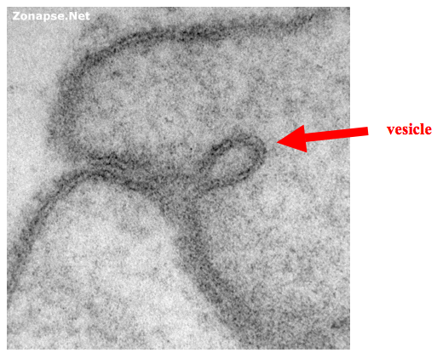
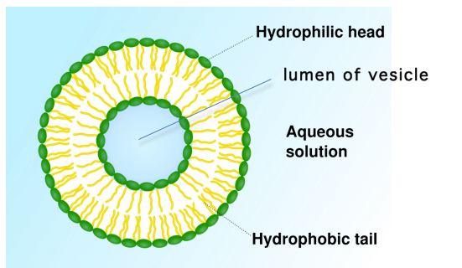
Fig. 6.6
Lipid Vesicles
Notes:
Figure 6.6 Vesicles made of lipids similar to NASA’s experiments. Electron micrograph (a) and line drawing (b) of vesicles. Vesicles are spheres made of two lipid layers or bilayers; The center cavity of a vesicle is called its lumen.

Slide 12
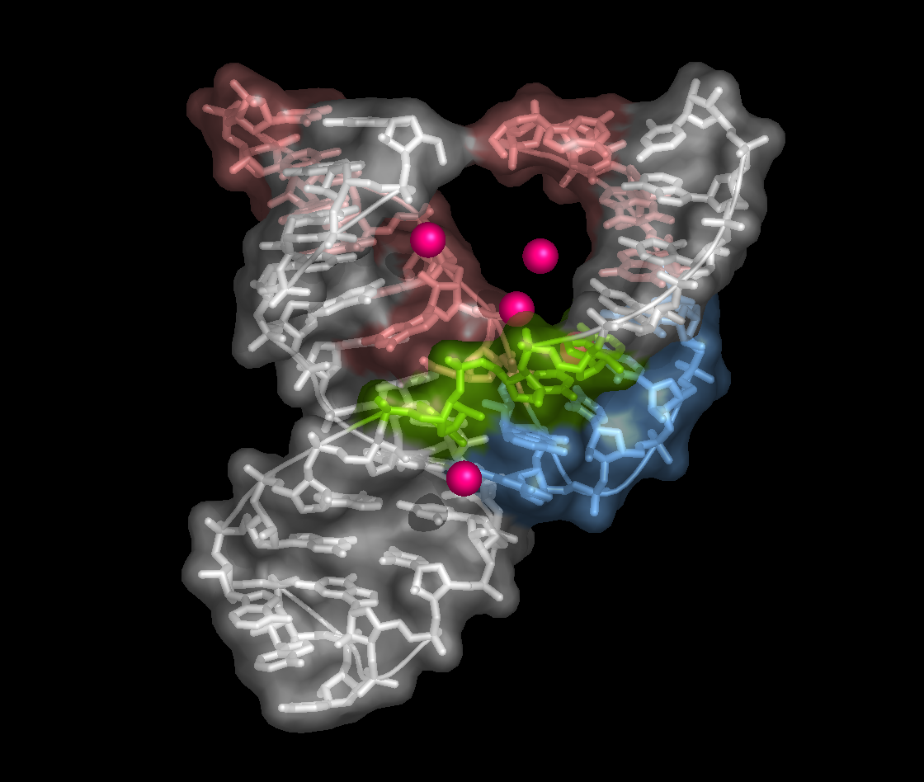
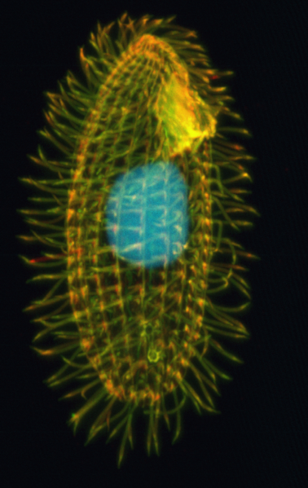
Fig. 6.7
Ribozyme from Tetrahymena
Notes:
Figure 6.7 Ribozyme and Tetrahymena. a) Ribozymes fold into 3D shapes that facilitate their enzymatic functions. b) Tetrahymena is a ciliated eukaryote, meaning it has many tiny hair-like cilia (yellow) covering its single-celled body and its genetic material is contained in its nucleus (light blue).

Slide 13
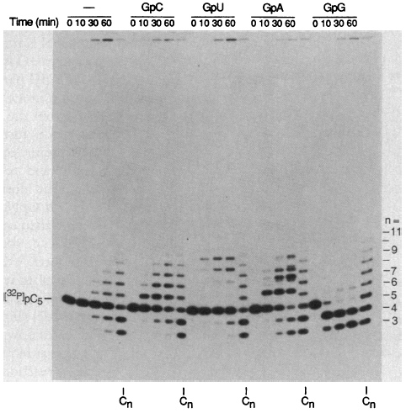
Fig. 6.8
Functional Ribozyme
Notes:
Figure 6.8 RNA self-replication. Results from gel electrophoresis of RNA molecules separated by size. RNA molecular size is indicated on the right side by number of bases and the original pC₅ molecule marked on the left. Negative control and 4 experimental dinucleotides are grouped by the incubation times indicated at the top. Columns labeled C_{n} are molecular weight markers 3 to 9 bases.

Slide 14
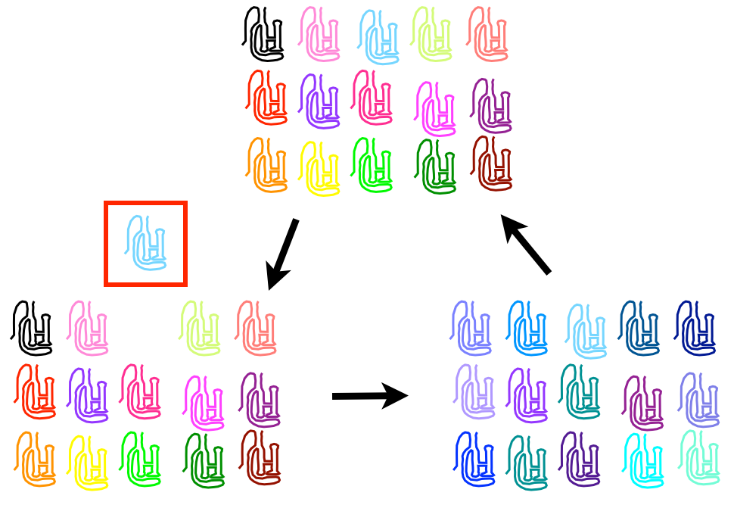
Fig. 6.9
Directed Evolution of Ribozyme
Notes:
Figure. 6.9 One 3-step cycle of directed evolution starting at the top with ribozyme variants. In reality, each molecule would be present many more times than shown here. The diagram emphasizes critical steps and removes non-essential components for clarity.

Slide 15
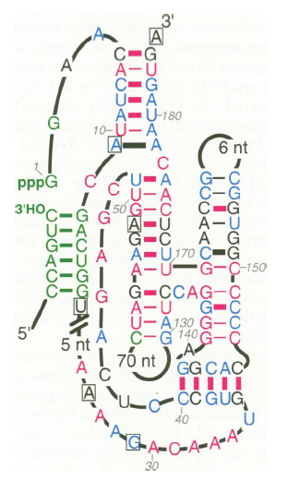
Fig. 6.10
Self-splicing Ribozyme
Notes:
Figure 6.10 Two dimensional diagram of self-splicing ribozymes. Base pairs are denoted by dashes between complementary bases. Thick dashes indicate covariation evidence for pairing. Diagonal lines between base 19 (U) and base 25 (A) indicate where bases were removed to shorten the molecule.

Slide 16
Title Page
Integrating Concepts in Biology
PowerPoint Slides for Chapter 6:
Evolution at the Molecular Level
6.3 Can non-living objects compete and grow?
by
A. Malcolm Campbell, Laurie J. Heyer, and Chris Paradise

Slide 17
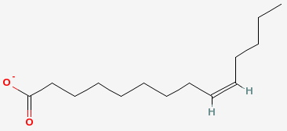
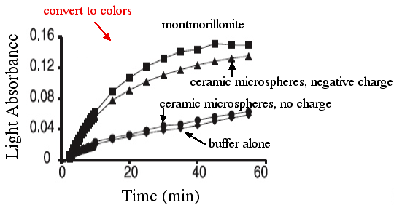
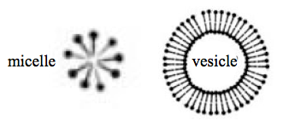
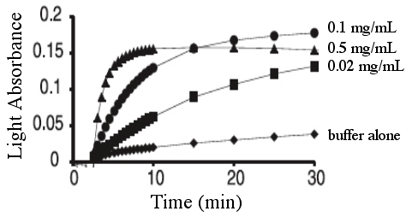
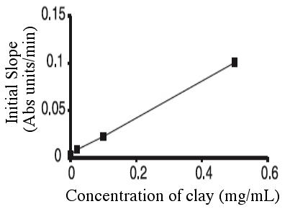
Fig. 6.11
Abiotic Vesicle Formation
Notes:
Figure 6.11 Fatty acid structures and vesicle formation rates. a) Myristoleate chemical structure. b) Fatty acid monolayer forming a micelle and a bilayer forming a membrane vesicle. c) Effects of different solid surfaces for vesicle formation. d) Effects of different concentrations of clay on vesicle formation. e) Initial rates of vesicle formation based on clay concentrations.

Slide 18
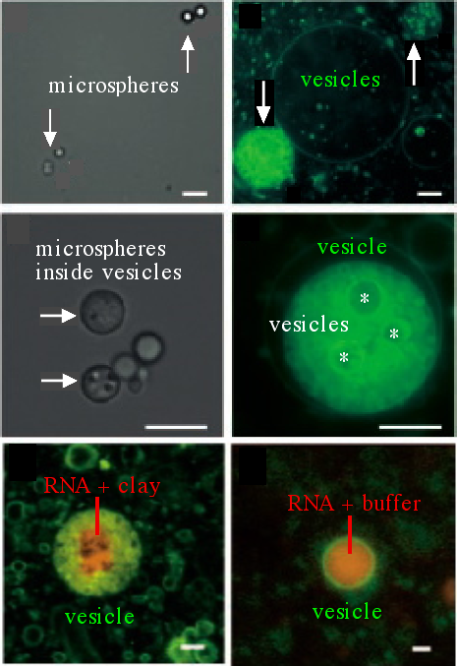
Fig. 6.12
Are Abiotic Vesicles Empty?
Notes:
Figure 6.12 Microscopy of spontaneous vesicles with cargo. Green-stained fatty acids mixed with negatively charged ceramic microspheres. White light in panels (a) and (c) to emphasize the microspheres. Green fluorescence in panels (b) and (d) to highlight the vesicles. Red-stained RNA attached to clay (e) or in solution (f) trapped inside vesicles. Size bars are 5 µm in a-d, and 1 µm in e and f.

Slide 19
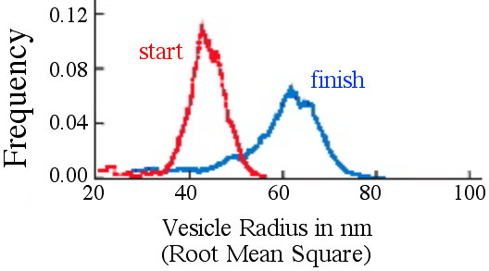
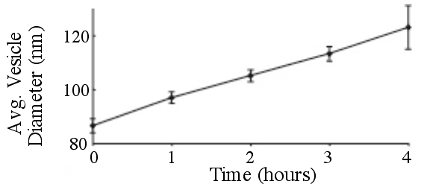
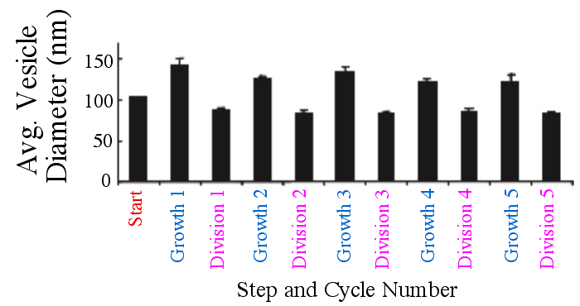
Fig. 6.13
Dynamic Vesicle Sizes
Notes:
Figure 6.13 Changes in vesicle sizes. a) Small starting vesicles grew larger after the addition of micelles. b) A similar experiment with periodic sampling. c) Mean diameter + standard deviation of four measurements demonstrates reproducibility of vesicle growth.

Slide 20
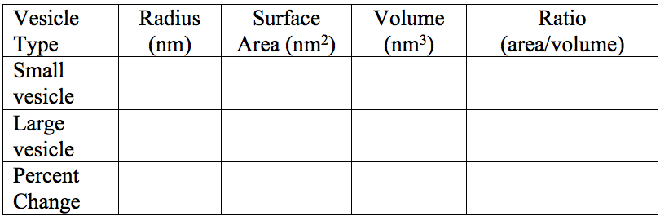
IQ #13
Dynamic Vesicle Sizes
Notes:
IQ #13 As a vesicle grows in size, its volume and surface area change at different rates. Calculate the volumes and surface areas for the two major size classes of vesicles in Figure 6.13a. Use the highest point in the two graphs to estimate the radii for the two populations of vesicles. The formula for the surface area of a sphere is 4π r² and the formula for the volume of a sphere is 4/3 π r³. Calculate the percent change in vesicle radius, surface area and volume.

Slide 21
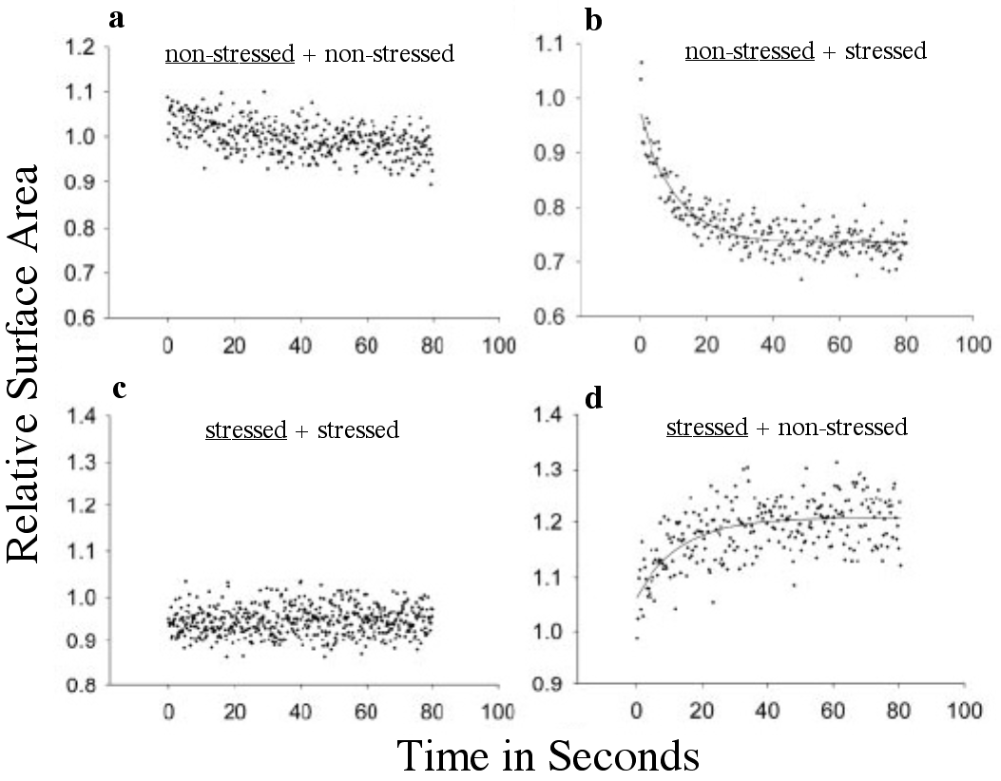
Fig. 6.14
Abiotic Competition for Lipids
Notes:
Figure 6.14 Surface areas of competing vesicles. Relaxed vesicles were measured after adding relaxed (a) or osmotically stressed (b) vesicles. Osmotically stressed vesicles were measured after adding equally stressed (c) or relaxed (d) vesicles. Solid lines indicate exponential curves with best fit to the data.

Slide 22
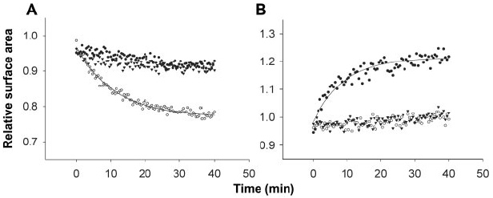
Fig. 6.15
RNA Induces Vesicle Growth
Notes:
Figure 6.15 Vesicle competition using tRNA to stress vesicles. Non-stressed (a) or stressed (b) vesicles were measured after mixing with stressed vesicles containing tRNA (open circles), non-stressed vesicles (solid circles), or buffer only (triangles).

Slide 23
BME 6.4
BME 6.2
y = ae^{-kt} + b
Notes:
BioMath Exploration 6.4. Exponential change.

Slide 24
BME 6.2
BME 6.2
y = ae^{-kt} + b
a = 0 is flat; = 1 is fast drop
b = 0 shifts down; = 1 shifts up
k = 0 is flat; = 5 is fast drop
k is rate of change in vesicle size
Notes:
BioMath Exploration 6.4. Exponential change.

Slide 25
Title Page
Integrating Concepts in Biology
PowerPoint Slides for Chapter 6:
Evolution at the Molecular Level
6.4 Can non-living objects harvest and store energy?
6.5 How did the first nucleus come into being?
by
A. Malcolm Campbell, Laurie J. Heyer, and Chris Paradise

Slide 26
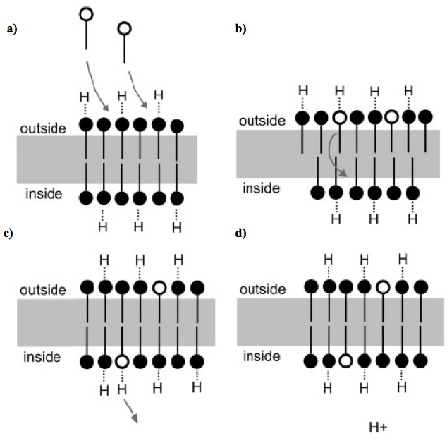
Fig. 6.16
Model of pH Gradient Production
Notes:
Figure 6.16 Mechanism for accumulation of pH gradient inside the vesicle lumen. The process proceeds from (a) through (d) over time to gradually accumulate H⁺ ions inside vesicles which lowers internal pH.

Slide 27
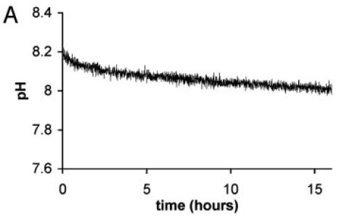
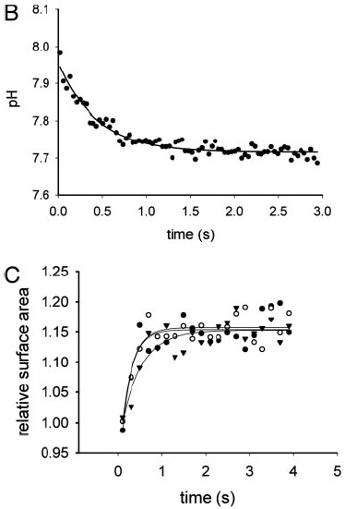
Fig. 6.17
Vesicle Accumulates H⁺ Ions
a)
b)
c)
Notes:
Figure 6.17 Vesicle pH after adding micelles. (a) pH changes quickly at first, and then slowly. (b) Change in pH immediately after adding micelles. (c) Change of surface area for vesicles in panel b. Three trials are shown with each line representing an exponential curve fit.

Slide 28
6.5 How did the first nucleus come into being?

Slide 29
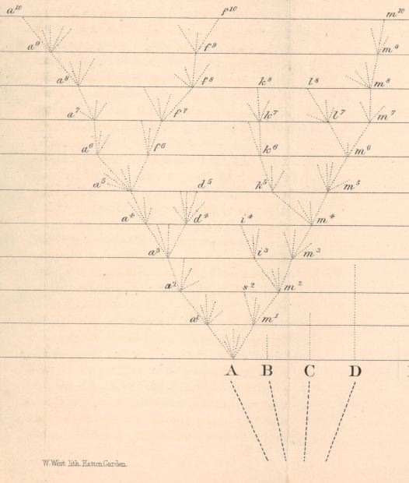
Fig. 6.18
Darwin’s Original Tree of Life
Notes:
Figure 6.18 Tree of life from Darwin’s On the Origin of Species. Species B, C and D went extinct, while species A continued to evolve over time (vertical axis) to give rise to three species listed at the top.

Slide 30
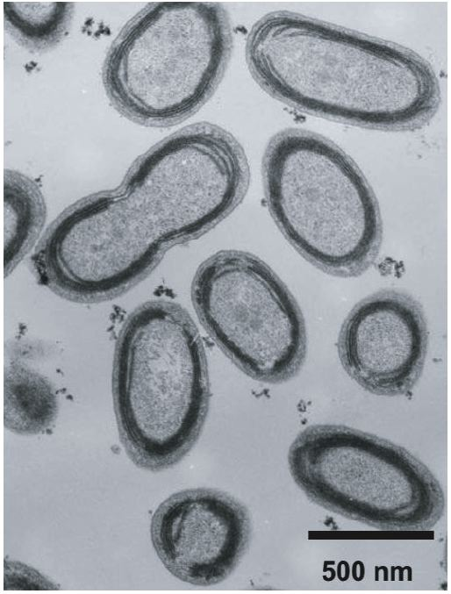
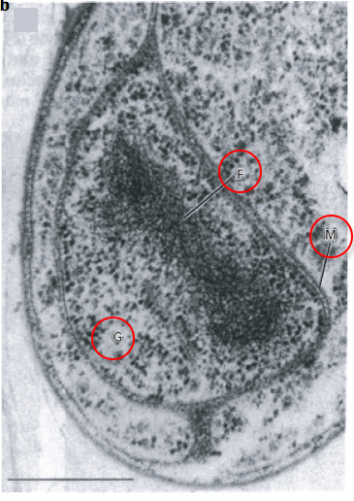
Fig. 6.19
Prokaryotic Internal Membranes
Notes:
Figure 6.19 Electron micrographs of two prokaryotes that contain internal membranes. a) Photosynthetic bacteria contain internal membranes in think peripheral bands. b) The larger bacterium Gemmata obscuriglobus contains internal membranes similar to a nuclear envelop. Bar = 0.5 µm.

Slide 31
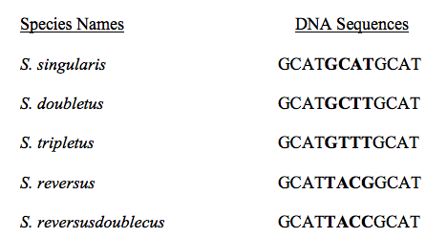
hypothetical sequences
DNA Sequences
Notes:
Hypothetical DNA sequences to accompany Figure 6.20.

Slide 32
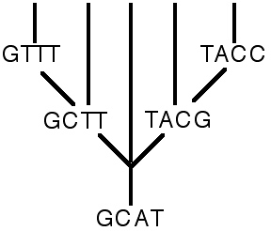
Fig. 6.20
Simplistic Evolutionary Tree
Notes:
Figure 6.20 Evolutionary tree showing the changes in DNA over time, the vertical axis. The original species at the base is represented by the sequence GCAT. Only the four central bases are shown for clarity.

Slide 33
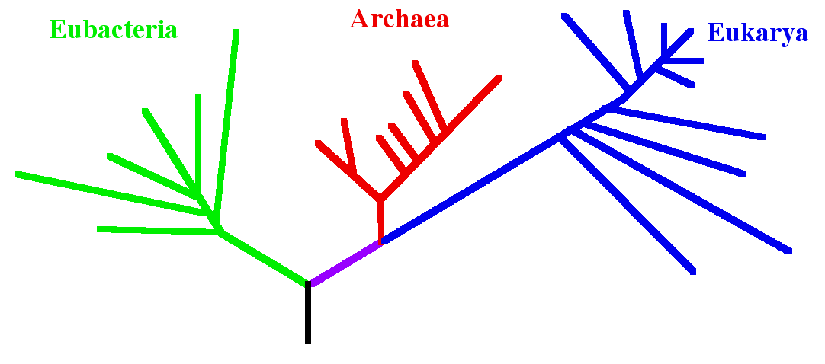
Fig. 6.21
Domain Level Evolutionary Tree
Notes:
Figure 6.21 Evolutionary tree based only on one ribosomal gene from many species. Each domain is color coded, with Archaea and Eukarya sharing a common ancestor.

Slide 34
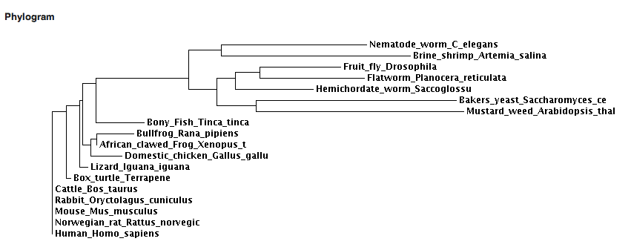
IQ 22
Integrating Question #22
Notes:
IQ 22. Evolutionary tree based only on one ribosomal gene from many species. Each domain is indicated, with Archaea and Eukarya sharing a common ancestor.

Slide 35
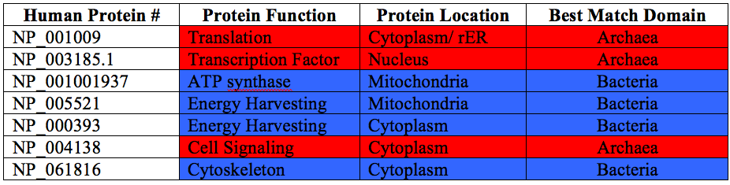
Fig. UN 6.2
BLASTp Results
Notes:
UN 6.2 Summary results from BLASTing human protein sequences against microbial sequences.

Slide 36
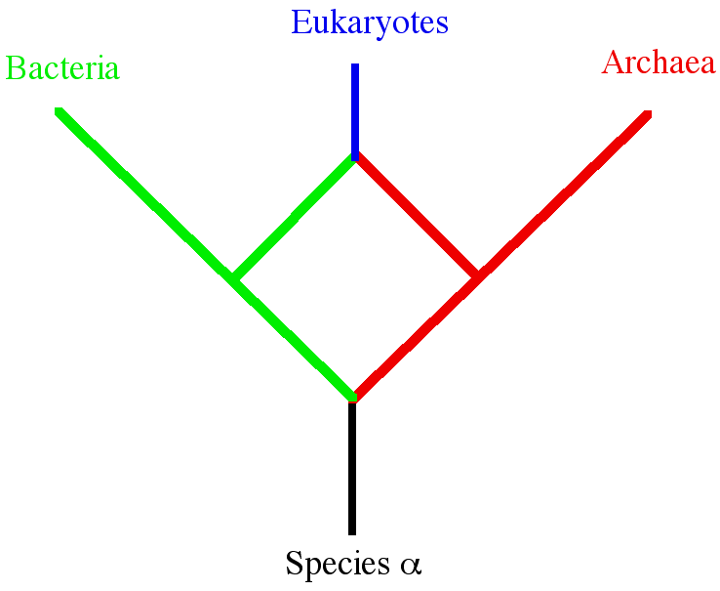
Fig. 6.22
Fuse Genomes Model
Notes:
Figure 6.22 Non-tree based evolutionary relationships. Diagram illustrates how a primitive species a could diverge into two branches which merged genomes later to produce a third branch. Note the atypical branching structure with a diamond in the middle.

Slide 37
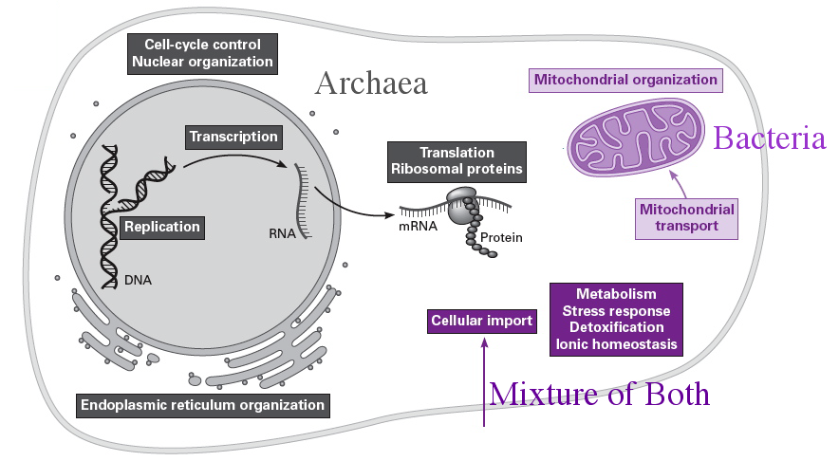
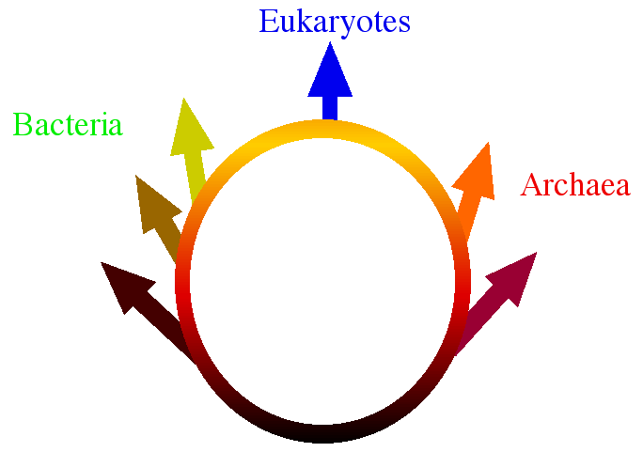
Fig. 6.23
Eukaryote Composite Genome
Notes:
Figure 6.23 Origins of eukaryotes. (a) Diagram showing the evolutionary origins of genes that originated in Archaea, Eubacteria , or a mixture of both. (b) Ring of life diagram showing the intimate relationships between Archaea and Bacteria that fused genomes to produce Eukaryotes.

