Slide 1
Title Page
Integrating Concepts in Biology
PowerPoint Slides for Chapter 7:
Evolution at the Cellular Level
7.1: How are new species formed?
by
A. Malcolm Campbell, Laurie J. Heyer, and Chris Paradise

Slide 2
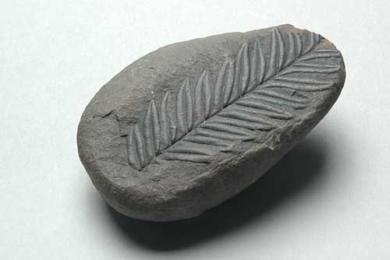
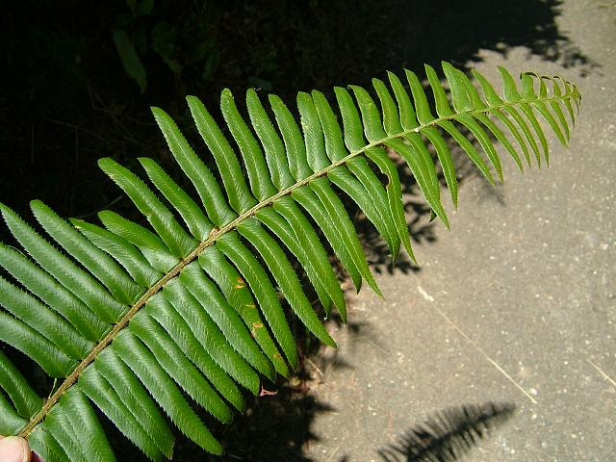
Opening Figure
Life is Ancient
Notes:
UN 7.1 Plant fossil and modern fern, Polystichum munitum.

Slide 3
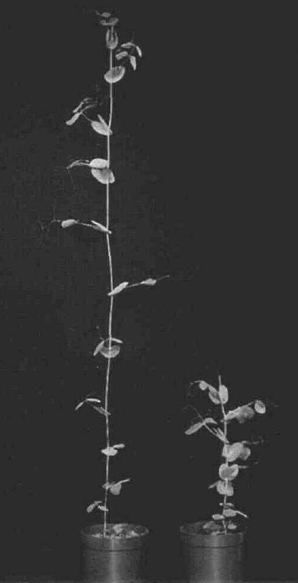
Fig. 7.1
Mendel’s Short Pea Plant
Notes:
Figure 7.1 Two adult pea plants showing Mendel’s wild-type and short phenotypes.

Slide 4
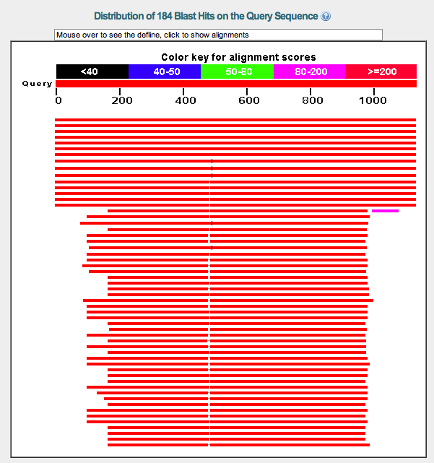
IQ #1
IQ #1
Le BLAST
results
Notes:
IQ #1 BLASTing Le.

Slide 5
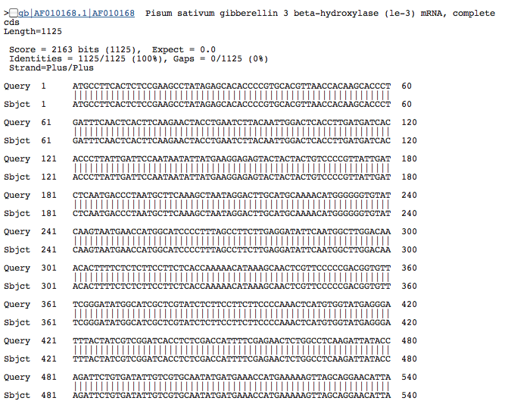
IQ #1
IQ #1
Le BLAST match
Notes:
IQ #1 BLASTing Le.

Slide 6
IQ #1
IQ #1
all bases
match
Notes:
IQ #1 BLASTing Le.

Slide 7
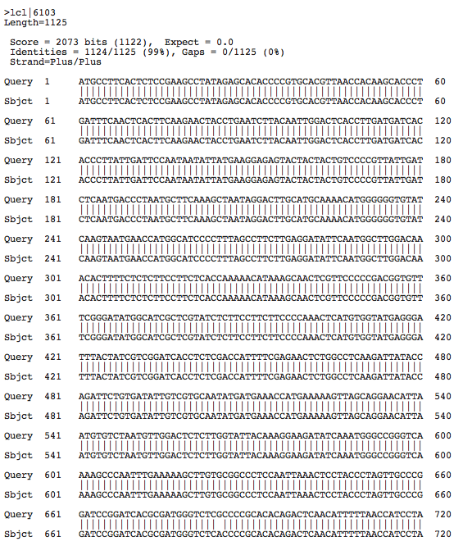
IQ #2
IQ #2
Le vs. short
BLAST2
DNA sequences
Notes:
IQ #1 BLASTing Le.

Slide 8
IQ #2
IQ #2
single base
change
G → A
Ala → Thr
Notes:
IQ #2 BLASTing Le.

Slide 9
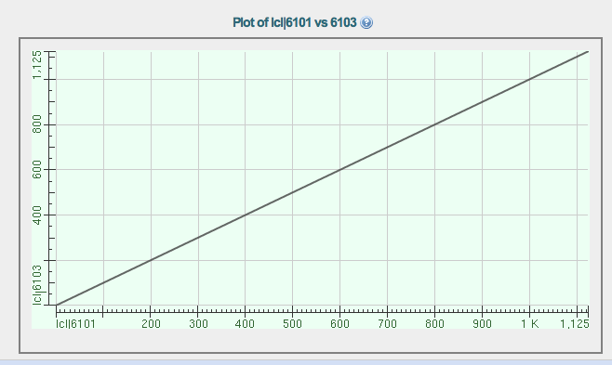
IQ #2
IQ #2
dot plot does not show mutation
G → A
Notes:
IQ #2 BLAST2 alignment with Le and short mutant allele.

Slide 10
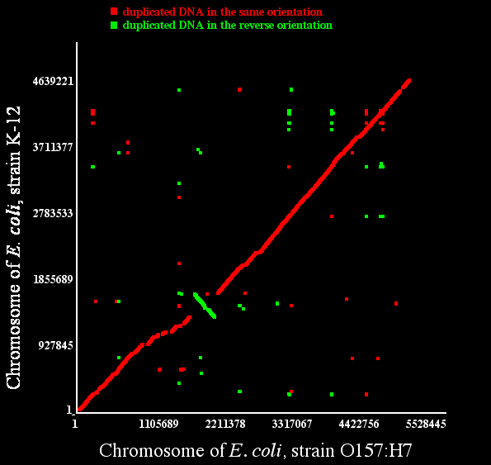
Fig. 7.2
E. coli Genomes Compared
Notes:
Figure 7.2 Dot plot comparing the chromosome of E. coli strain K-12 on the vertical axis with E. coli O157:H7 on the horizontal axis. Green dots indicate similar DNA sequences are inverted and red dots indicate similar DNA sequences that are not inverted.

Slide 11
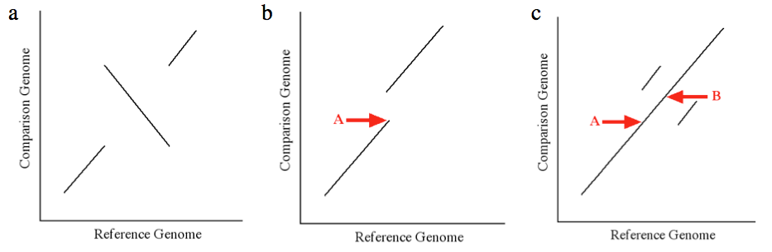
IQ #2
IQ #4
Notes:
IQ #2 BLAST2 alignment with Le and short mutant allele.

Slide 12
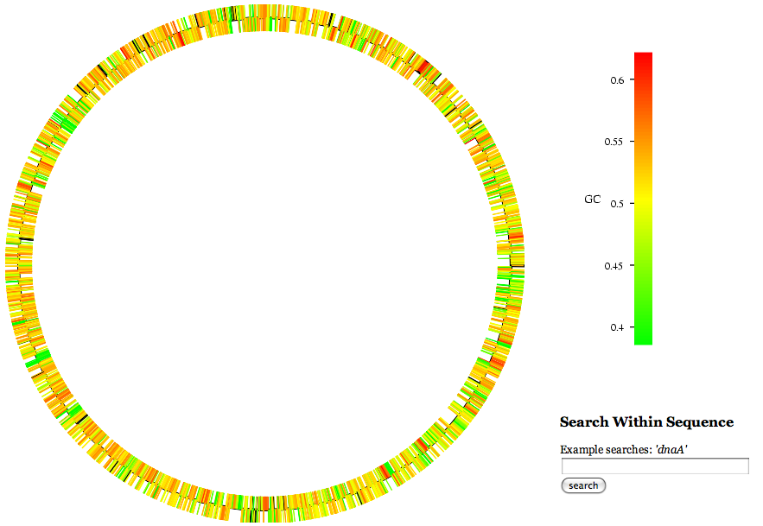
Fig. 7.3
E. coli O157:H7 Genome
Notes:
Figure 7.3 E. coli O157:H7 EDL933 circular chromosome with colors indicating average GC content for each gene. Both strands of DNA are depicted separately with each gene an individual block of color.

Slide 13
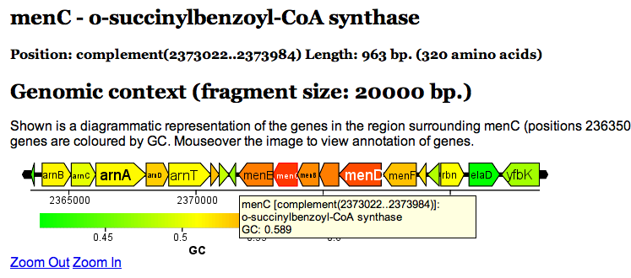
IQ #6
IQ #6
Notes:
IQ #6 Go to the E. coli genome web site at Xbase centered on the gene menC and its surrounding 20,000 bp. What is the GC content of menC? What two pieces of evidence support the conclusion that menC might have arrived in E. coli by horizontal gene transfer?

Slide 14
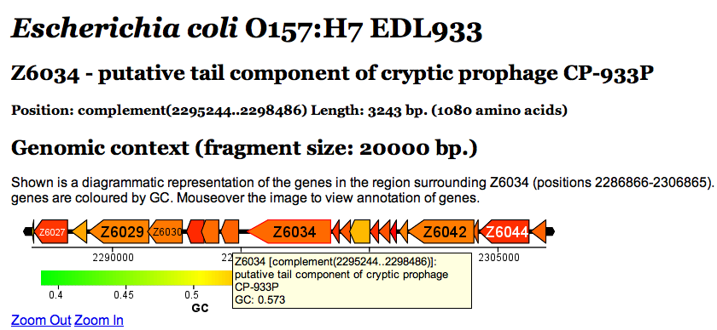
IQ #7
IQ #7
Notes:
IQ #7 Now view the E. coli gene Z6034. Does Z6034 have atypical GC content? What do Z6034 and its neighboring genes have in common that might indicate they arrived in the E. coli genome by horizontal gene transfer?

Slide 15
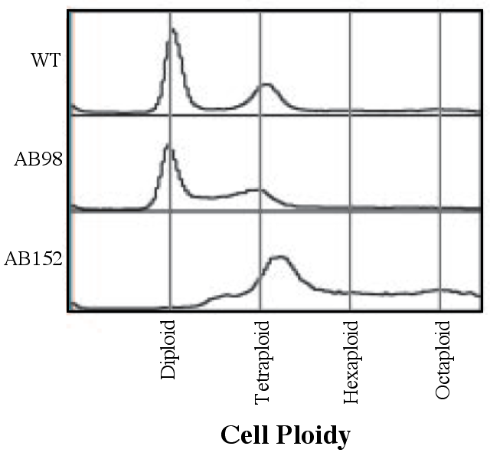
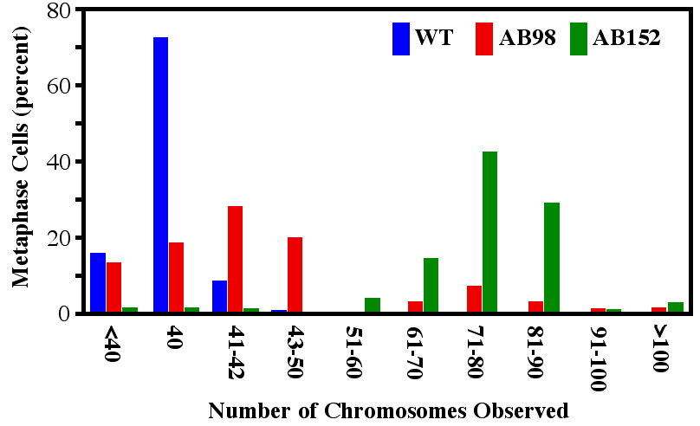
Fig. 7.4
Genome Ploidy in Cancer Cells
Notes:
Figure 7.4 Ploidy number from wild-type mouse cells and two cancer cell lines. This mouse species normally has 40 chromosomes in diploid cells. Equal numbers of cells were counted for all three sources. (a) Automated quantification of total DNA based on fluorescence of a DNA-binding dye. (b) Manual chromosome counts using a microscope.

Slide 16
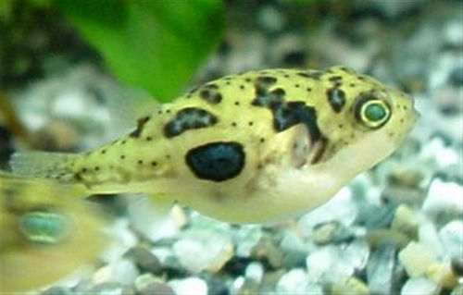
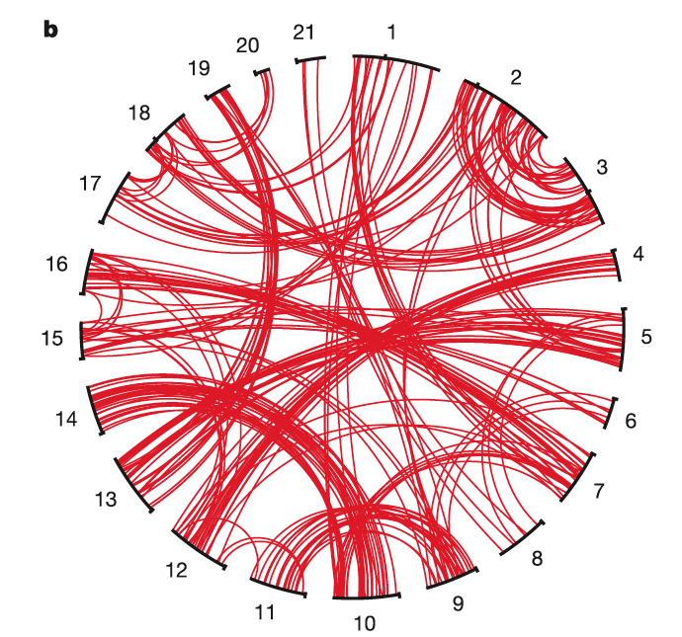
Fig. 7.5
Puffer Fish as Model Vertebrate
Notes:
Figure 7.5 Puffer fish genome analysis. (a) Photo of a freshwater puffer fish. (b) Chromosome comparison of puffer fish paralogs. Red lines connect paralogs on numbered chromosomes.

Slide 17
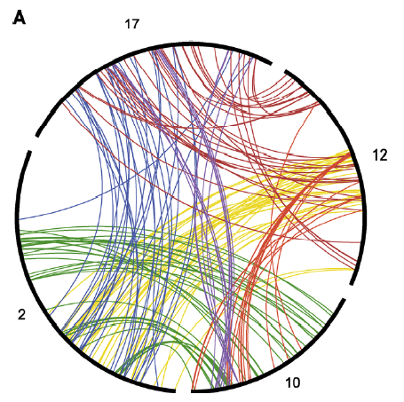
Fig. 7.6
Human Data of Genome Duplication
Notes:
Figure 7.6 Gene mapping on four randomly chosen human chromosomes. Duplicate genes on different chromosomes are connected by colored lines connecting the numbered chromosomes.

Slide 18
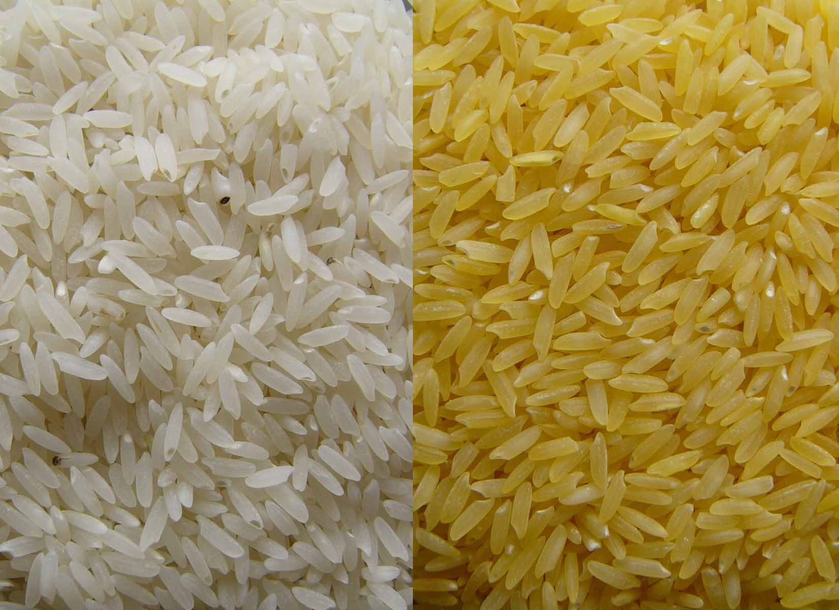
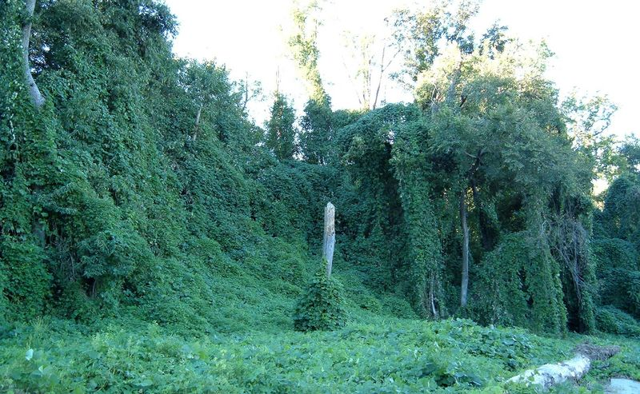
Fig. ELSI 7.1
Are GMOs Good?
Notes:
Figure ELSI 7.1 Non-native species. (a) Regular white rice and (b) genetically modified golden rice, rich in beta-carotene. c) Kudzu was introduced from Japan to the Southeast US and has become an invasive species.

Slide 19
Title Page
Integrating Concepts in Biology
PowerPoint Slides for Chapter 7:
Evolution at the Cellular Level
7.2 Why do my allergies get worse over time?
7.3 Why are corals dying around the world?
by
A. Malcolm Campbell, Laurie J. Heyer, and Chris Paradise

Slide 20
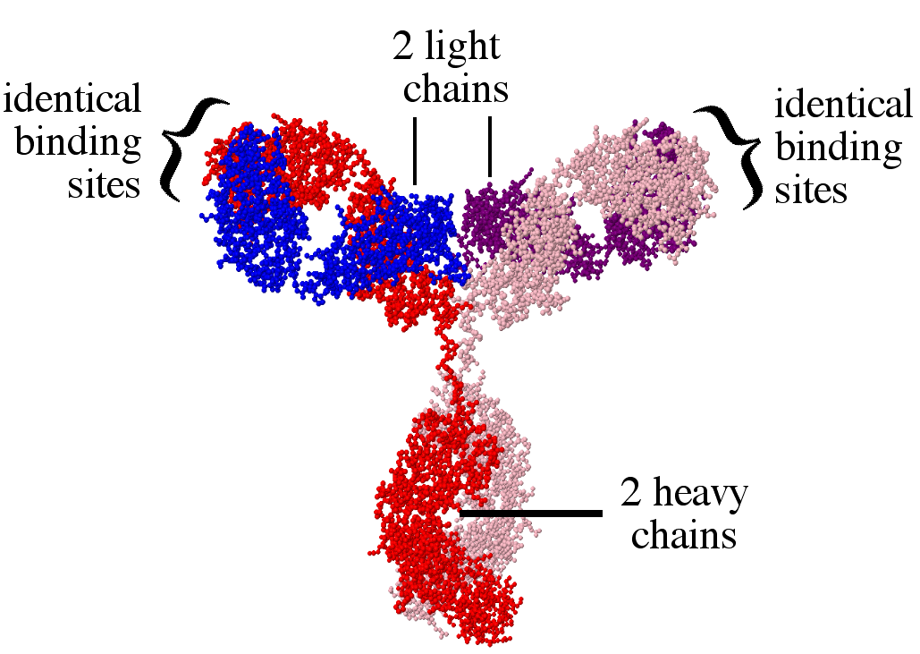
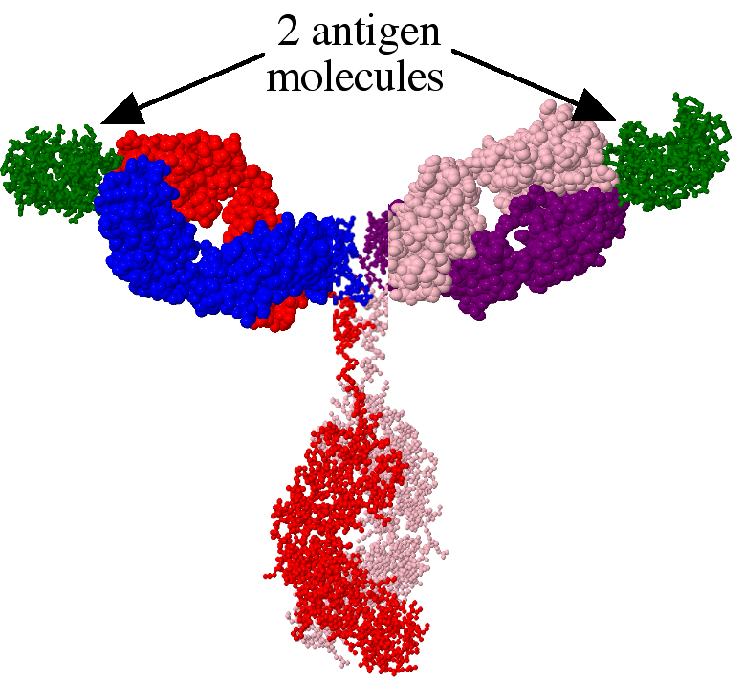
Fig. 7.7
Antibody Structure
Notes:
Figure 7.7 Antibody structure and function. (a) Antibody composed of two heavy chains (red and pink) and two light chains (blue and purple). (b) The same antibody with two identical antigen molecules bound. The arms of the antibody have been filled in to highlight their mass.

Slide 21
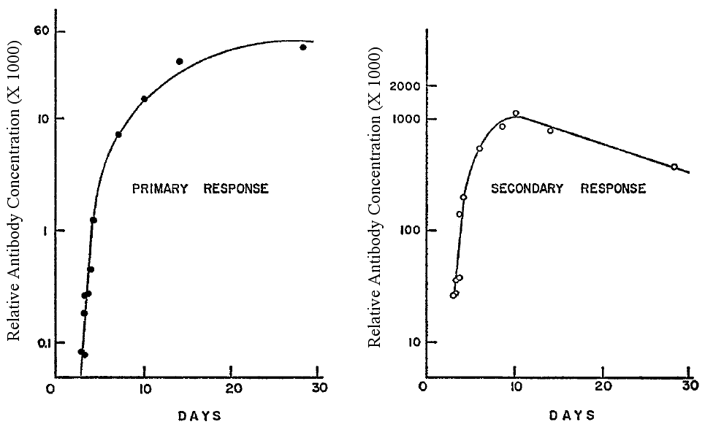
Fig. 7.8
Primary and Secondary Responses
Notes:
Figure 7.8 Primary and secondary antibody responses to the same protein. Investigators quantified guinea pig blood levels of antibodies specific to the injected protein (a) the first time and (b) again three weeks later. Different individual animals were used for panels a and b. Note the units and logarithmic Y-axis.

Slide 22
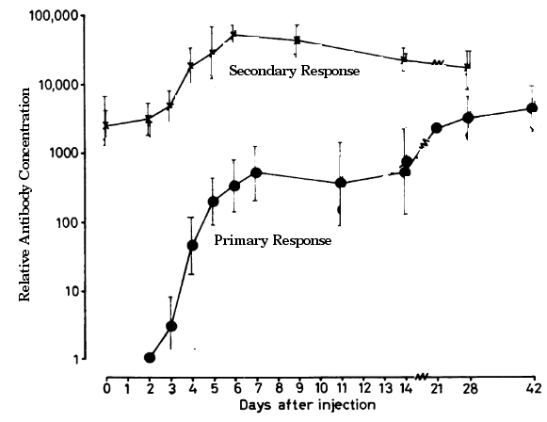
Fig. 7.9
Immune Responses Independent
Notes:
Figure 7.9 Primary and secondary responses in the same rat injected with two different antigens. Rats were injected with an antigen once and again six weeks later. The rats were injected with a new protein the same day as the second injection of the first antigen.

Slide 23
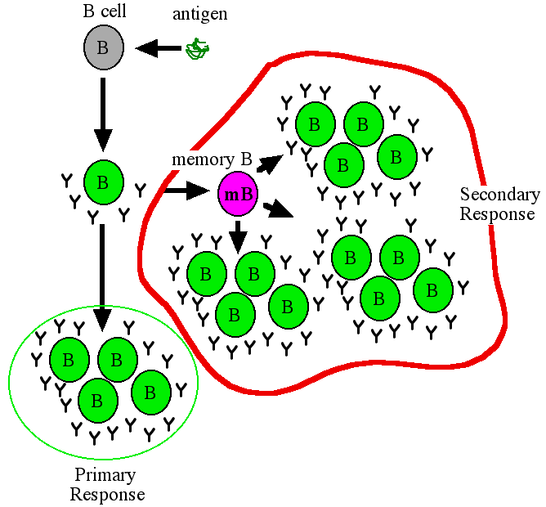
Fig. 7.10
Cell Lineage of Immune Responses
Notes:
Figure 7.10 Primary and secondary response. The primary response produces B cells (green ovals) making antibodies as well as memory B (pink oval) cells. The memory B cells produce many more B cells in the secondary response (red outline). Length of arrows indicate passage of time.

Slide 24
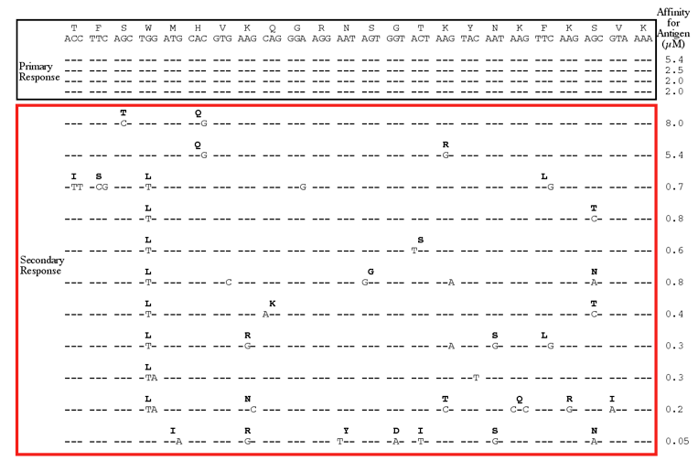
Fig. 7.11
Evolution of Antibody Sequences
Notes:
Figure 7.11 DNA and amino acid sequences from the heavy chain gene in primary and secondary B cells from one animal. Top lines show the amino acids on above the DNA codons. Dashes indicate no change in DNA. Binding affinity for antibodies for each B cell is in the right column with smaller numbers indicating higher affinities.

Slide 25
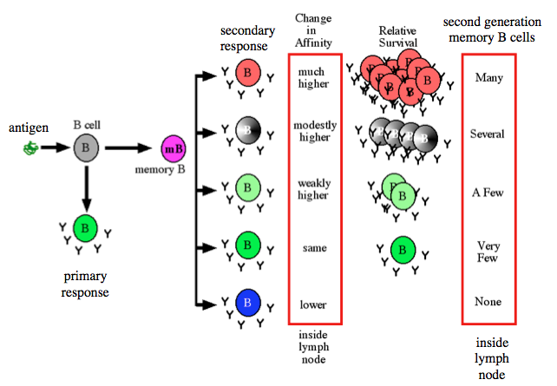
Fig. 7.12
Natural Selection in B Cells
Notes:
Figure 7.12 Summary of long-term B cell responses. Antigen stimulates B cells to make antibody and memory B cells. Second generation B cells undergo somatic hypermutation which may alter antibody binding affinity. B cells with the highest affinity receive the most survival signal, produce the most B cells and memory B cells.

Slide 26
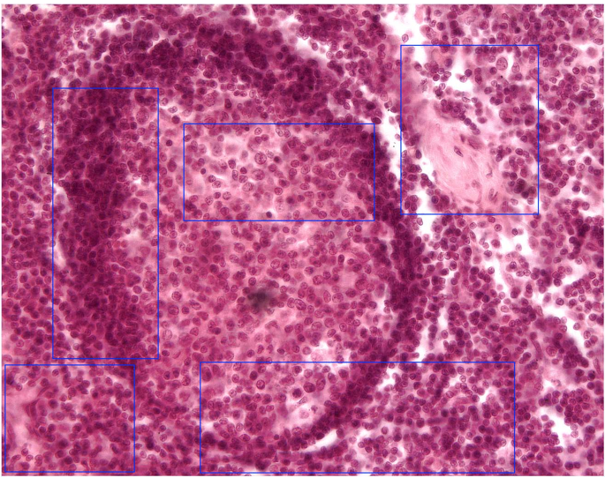
IQ # 18
Lymph Node Histology
lymph nodes swell when
B cells proliferate
Notes:
IQ #18: Use the data in Figure 7.11 to demonstrate natural selection in B cells that became more prevalent due to increased binding affinity and survival signal. Explain why your lymph nodes swell during an exposure to antigen. You can go to this web site to view the interactive histology of a lymph node.

Slide 27
IQ # 18
Lymph Node Histology
germinal center where somatic hypermutation
happens in B cells
Notes:
IQ #18: Use the data in Figure 7.11 to demonstrate natural selection in B cells that became more prevalent due to increased binding affinity and survival signal. Explain why your lymph nodes swell during an exposure to antigen. You can go to this web site to view the interactive histology of a lymph node.

Slide 28
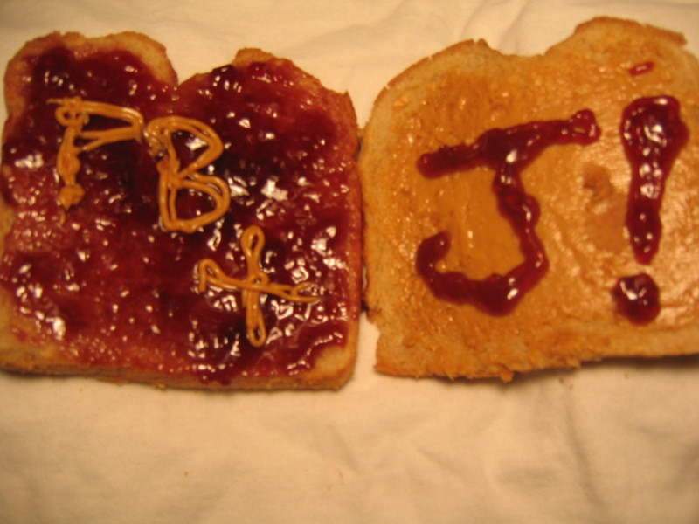
Fig. ELSI 7.2
Peanut Allergies vs. PB&J
Notes:
Figure ELSI 7.2 Photo of peanut butter and jelly sandwich.

Slide 29
7.3 Why are corals dying around the world?

Slide 30
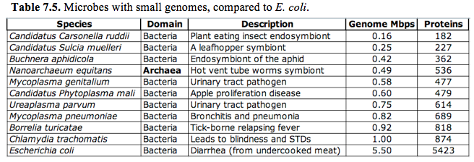
Table 7.1
Table 7.1
Table 7.1 Microbes with small genomes, compared to E. coli.
Notes:
Table 7.1 Microbes with small genomes, compared to E. coli.

Slide 31
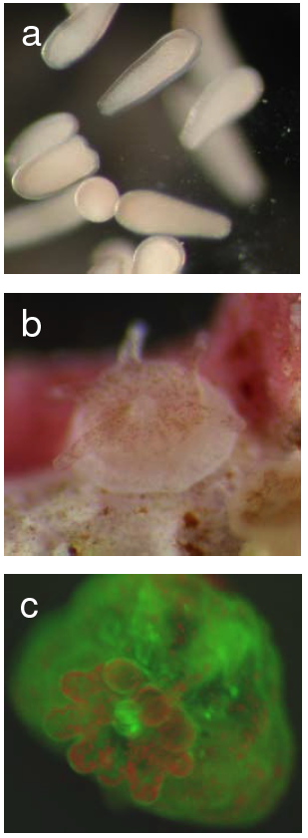
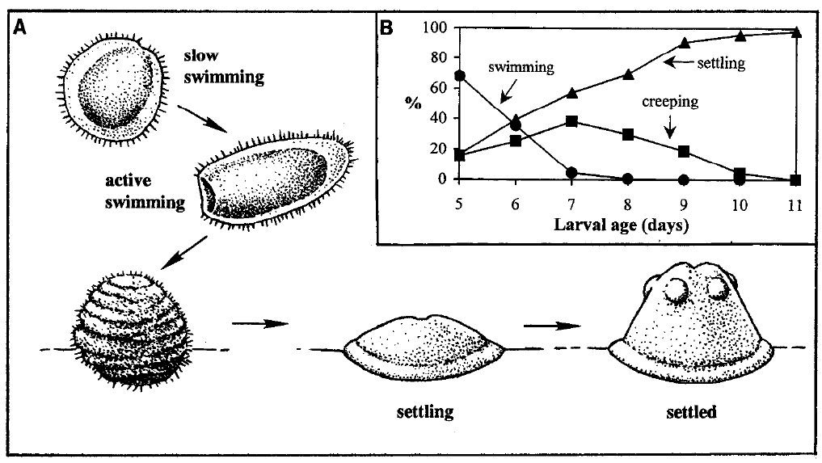
Fig. 7.13
Coral Life Cycle
Notes:
Figure 7.13 Coral Life cycle. a) Photograph of larvae lacking symbiotic algae. b) After fertilization, larvae swim, settle and grow. c) Young coral with six tentacles around a central mouth. Brown spots are mutualistic algae. d) Under UV light, the coral appears green and the algae fluoresce red due to pigments used in photosynthesis.

Slide 32
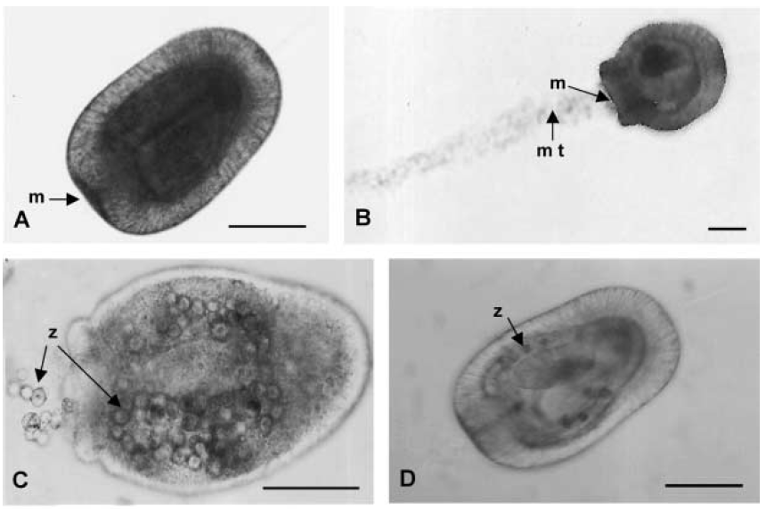
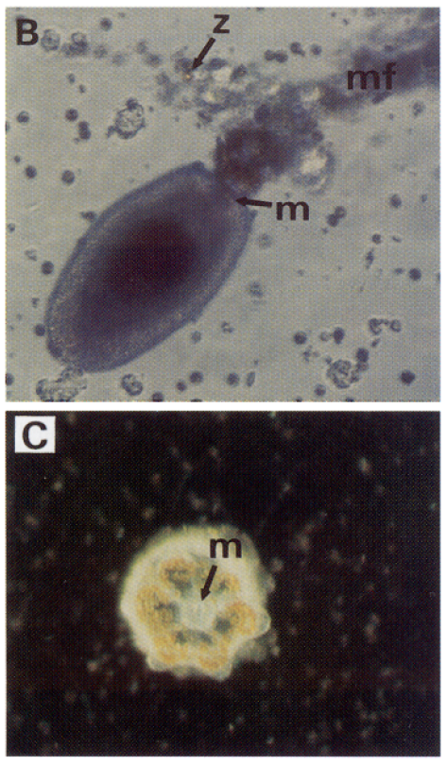
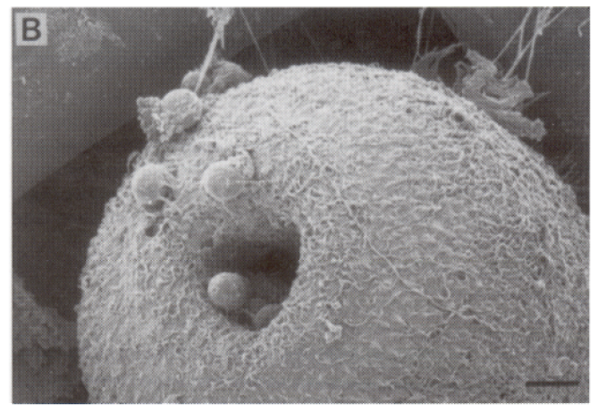
Fig. 7.14
Larval Acquisition of Algae
Notes:
Figure 7.14 Coral acquisition of mutualistic algae. (a) Three day old larva (m = mouth). (b) Feeding larva with mucus trail (mt) used to capture algae. (c) Larva with algae (arrows) near mouth and inside body. (d) Algae inside larval cells. (e) Scanning electron micrograph of larva eating algae. (f) Newly settled coral with central mouth (m) and golden algae inside the coral. Scale bar in a-e 10 µm.

Slide 33
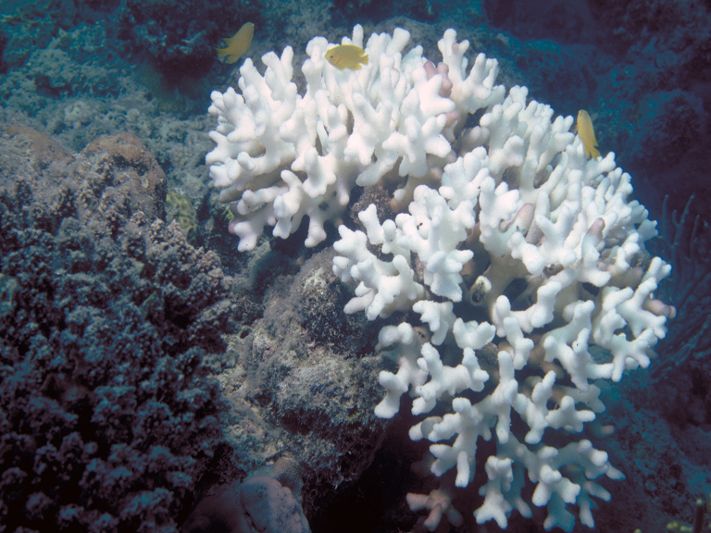
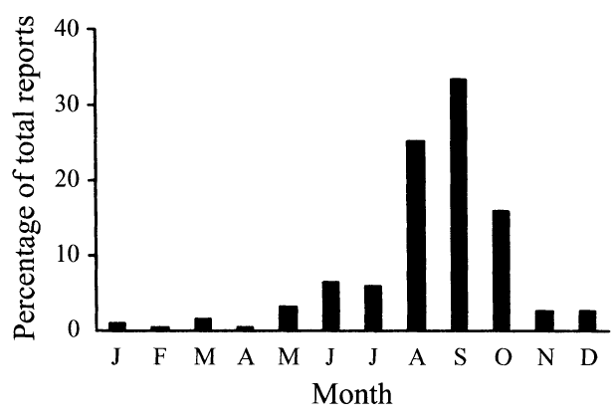
Fig. 7.15
Seasonal Coral Bleaching
Notes:
Figure 7.15 Coral bleaching in the Caribbean. (a) Photograph of bleached coral and fish that use the coral for protection. (b) Monthly distribution of reported coral bleaching from 1983 – 2000.

Slide 34
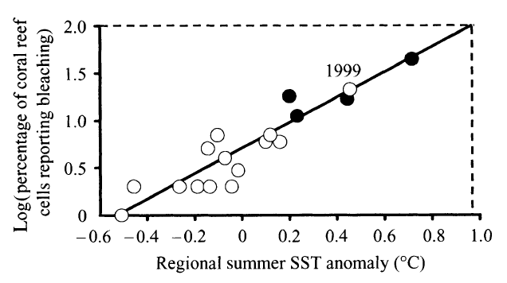
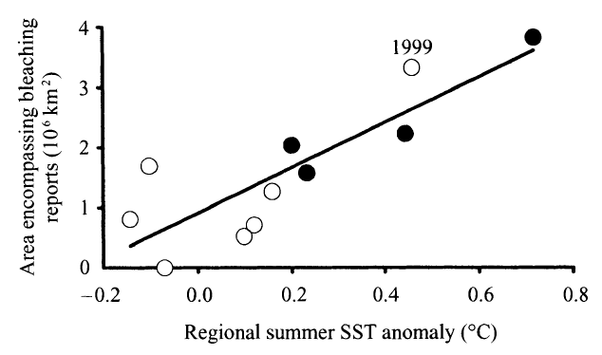
Fig. 7.16
Bleaching and Temperature
Notes:
Figure 7.16 Impact of sea surface temperatures (SST) variations from 30-year average (degrees Celsius;1983 – 2000). Black circles mark years qualified as “massive” and white circles indicate other years. (a) Percent ocean area (map grid cells) reporting at least one occurrence of coral bleaching, as a function of SST variation. (b) Total area of bleached reef as a function of SST variation.

Slide 35
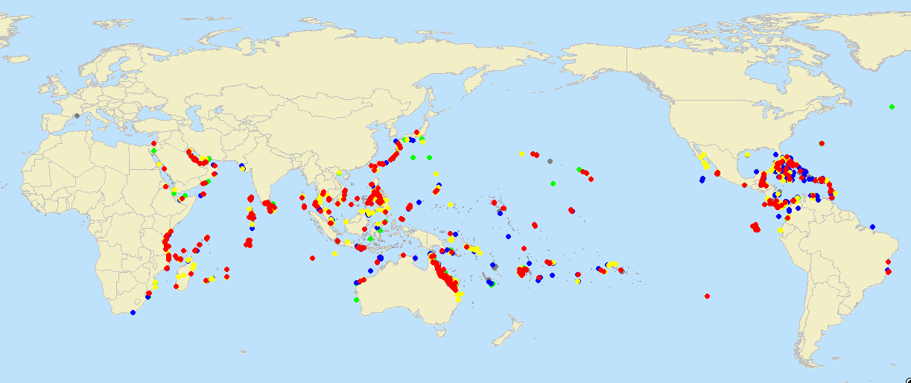
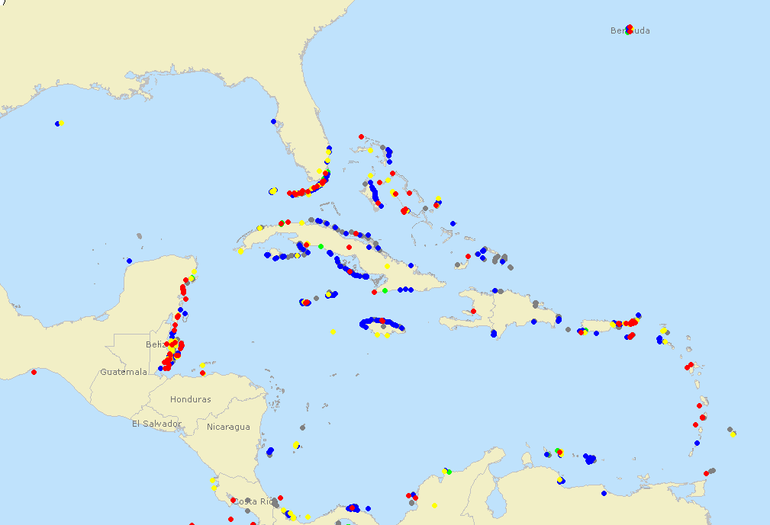

Fig. 7.17
Global Distribution of Bleaching
Notes:
Figure 7.17 Global coral bleaching. (a) Qualitative data from around the world showing the degree of coral bleaching in 2007. (b) Zoomed in view of Caribbean and Bermuda data.

Slide 36
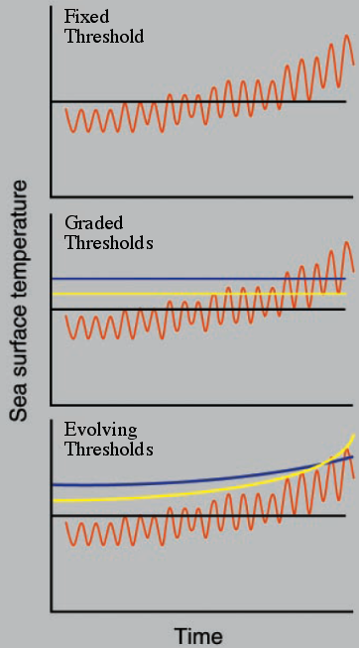
Fig. 7.18
Predictive Models of Coral Bleaching
Notes:
Figure 7.18 Three models for outcome of global warming and coral evolution. Orange line represents fluctuating, yet gradually rising, sea surface temperatures. Green, yellow and blue lines represent sea surface temperatures tolerated by different species of coral.

Slide 37
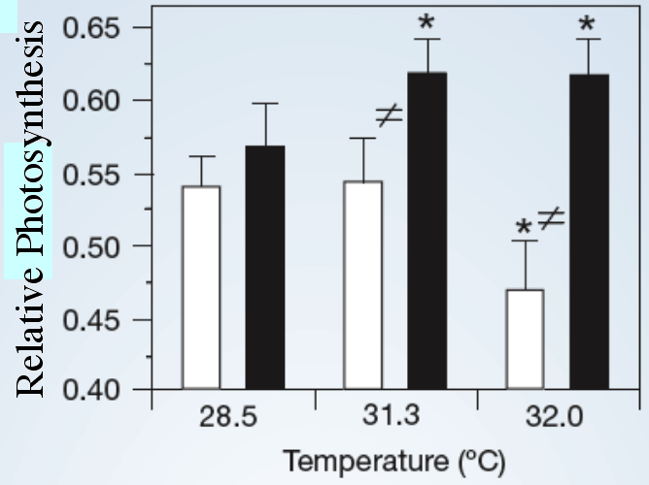
Fig. 7.19
Species-specific Thermal Responses
Notes:
Figure 7.19 Comparison of two species of algae and their capacity to photosynthesize. Asterisks indicate significant differences (p < 0.05) between the elevated and baseline temperatures for a given species; ≠ indicate significant differences (p < 0.05) between species at a given temperature.

Slide 38
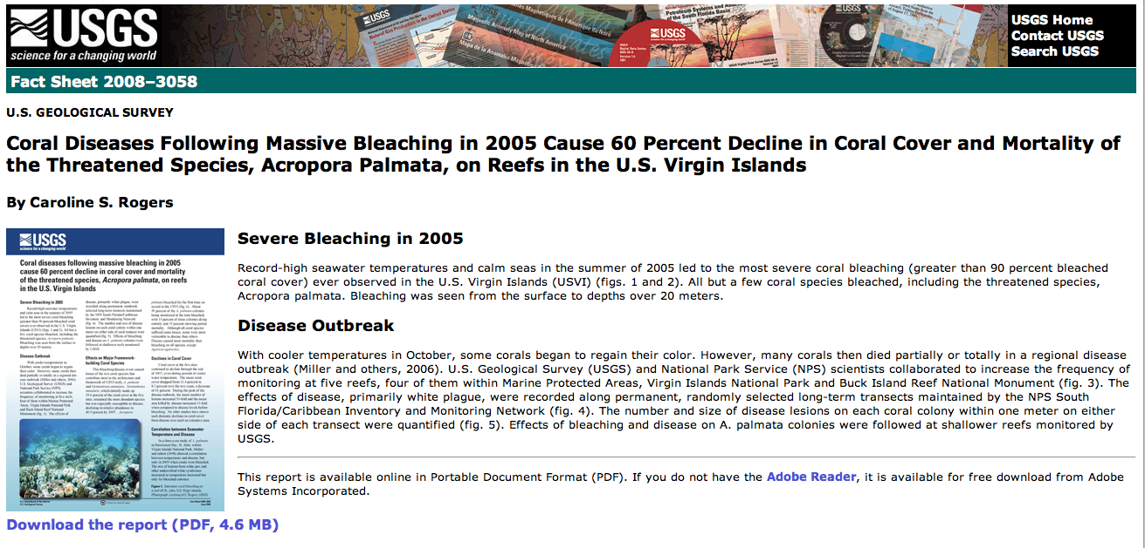
IQ # 24
IQ # 24
Notes:
IQ #24 Consult this US government publication and determine if 1998 was the worst bleaching year to date. Keep in mind that warm waters spawn hurricanes and 2005 was the year Katrina hit the US Gulf coast.

Slide 39
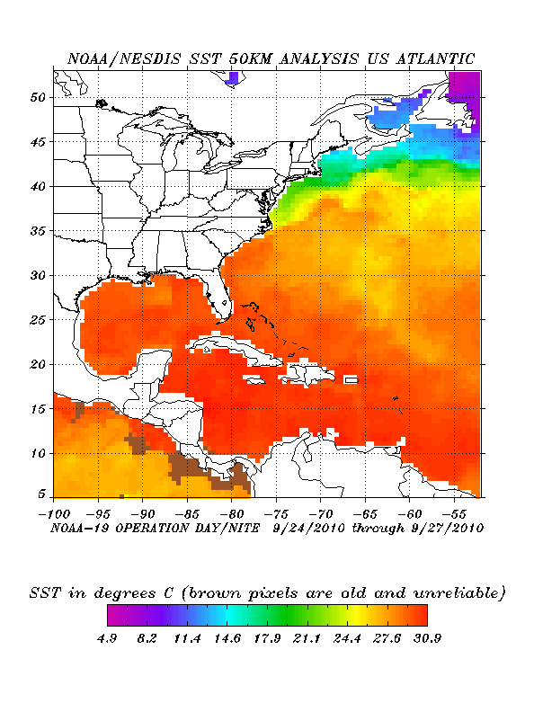
IQ # 26
IQ # 26
Notes:
IQ #26 Go to the NOAA satellite image to see “colored field” maps of the world’s ocean temperatures. Click on a map of your choosing and study the data. As the oceans gradually warm, predict how this map will change over time. Currently, coral reefs are located where the water is 28 – 32º C. View the global “filled contour” map to see where coral reefs live now. What would you expect to happen to the locations for coral reefs as oceans continue to warm. How could coral’s life cycle (see Figure 7.13) contribute to its potential to survive?

