Slide 1
Integrating Concepts in Biology
Chapter 9:
Evolution of Populations
Section 9.1: When are two isolated populations not isolated?
by
A. Malcolm Campbell, Laurie J. Heyer, and Chris Paradise

Slide 2
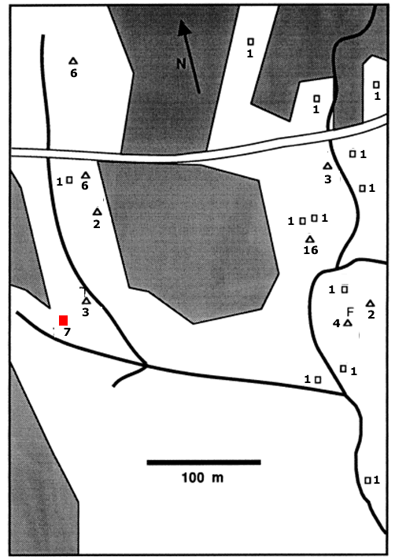
Spatial structure of a fungus population in a forest
non-forested areas
downed logs
streams
Figure 9.1
Notes:
Figure 9.1 Spatial structure of a fungus population in a forest, showing downed logs (squares and triangles), and the number of distinct genetic types of fungus at each log. Solid lines indicate locations of streams, while shading indicates non-forested areas. The red square is log R, which is shown in detail in Figure 9.2.
Talking Points: Location of each log that had sprouting mushrooms was determined; position of clusters of mushrooms on each log were recorded, and samples collected.
Between 1 and 16 distinct individuals were found on each of 21 logs, for a total of 53 individual fungi.
The researchers mapped the location of rotting logs and noted the number of individual fungi on each log
Genetic similarity of individual fungi and their distribution relative to related individuals was determined.
Related oyster fungi more likely to be found near each other, usually on the same log.
Fungi also occupy logs nowhere near other logs, indicating ability to disperse beyond one log. A small percentage of spores are carried long distance by wind, water, or animals.

Slide 3
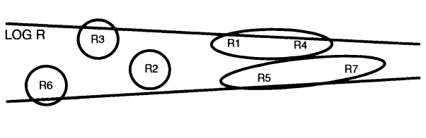
Figure 9.2 Distribution of genetic types in a fungus inhabiting a rotting log (R in Figure 9.1)
Groups of genetically similar individuals are circled.
Figure 9.2
Notes:
Figure 9.2 Distribution of genetic types in a fungus inhabiting a rotting log whose location is indicated by the red square in Figure 9.1. Groups of genetically similar individuals are circled.
Talking Points: Genetic similarity of individual fungi and their distribution relative to related individuals was determined.
Groups of genetically similar individuals are circled.
Movement and genetic relatedness of individuals within populations determine population structure and evolution.
Related oyster fungi more likely to be found near each other, usually on the same log.
Unrelated individuals also can inhabit the same log.
On a single log there are often multiple individual fungi of the same genotype, indicating localized dispersal.
Fungi also occupy logs nowhere near other logs, indicating ability to disperse beyond one log. A small percentage of spores are carried long distance by wind, water, or animals.

Slide 4
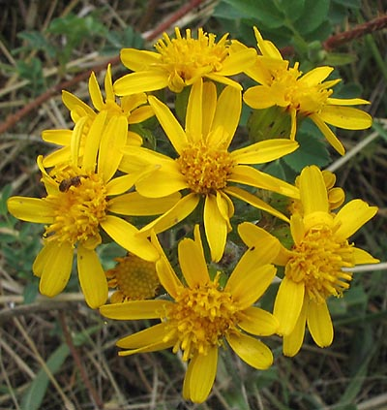
Groundsel (Senecio integerrimus), found in the Colorado Rockies.
Note the bee on the flower.
Figure 9.3
Notes:
Figure 9.3 Groundsel (Senecio integerrimus), found in the Colorado Rockies. Note the bee on the flower at the 9 o’clock position.
Talking Points: Johanna Schmitt examined neighborhoods and their sizes in three species of sunflower-like plants, relative to pollination by bees and butterflies.

Slide 5
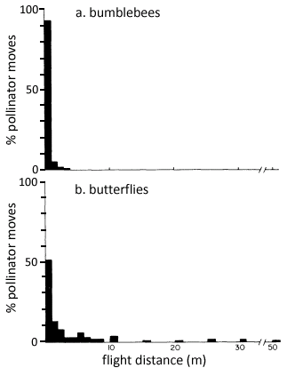
Bio-Math Exploration 9.1: What information is in a relative frequency distribution?
9.1a: What percent of bumblebee flights are greater than 1 m? Of butterfly flights? (Hint: first find the % of flights < 1 m.)
Figure 9.4
Notes:
Figure 9.4 Frequency histogram of juvenile starling dispersal distances. Note that the x-axis has a discontinuous scale.
Talking Points: Bees typically visit many flowers in rapid succession. Butterflies feed on nectar and are also often looking for mates while flying and foraging. Butterflies often pass by flowers next to one at which they just fed.
When plants are pollinated by several species, population structure can be affected by different pollinator types. Isolation could occur if individuals disperse only short distances and mate only with individuals within a small geographic range.
Dispersal ability for this plant is determined by the pollinator.
About 95% of bumblebee flights were less than 1 meter in length; thus <5% were greater than 1 meter.

Slide 6
Bio-Math Exploration 9.1: What information is in a relative frequency distribution?
Bumblebees
Lower bound of interval | Upper bound of interval | Average of interval | Proportion in interval | Value times Proportion
0 | 1 | 0.5 | 0.92 | 0.46
1 | 2 | 1.5 | 0.05 | 0.075
2 | 3 | 2.5 | 0.02 | 0.05
3 | 4 | 3.5 | 0.01 | 0.035
 |  |  | 1 | 0.62
Compare to median of 0.54
Notes:
Talking Points: To estimate mean flight distance from a relative frequency distribution, use a process much like that used to compute average grade in a class.
For example, compute course grade with the following percentages: 3 tests (15% each), lab reports (25%) and a final exam (30%). To find average, multiply each score by corresponding percentage, and add the results. This is the weighted average.
Determine percentage of flights in each 1 m interval along the x-axis (analogous to % that each score counts toward grade).
Skip this step by using the spreadsheet “flight_distances.xls;” can do this as a group in class to be sure students understand how to get these percentages.
The spreadsheet shows the remaining steps in estimating the mean (see next slide):
(1) represent each interval by the average number in the interval,
(2) multiply the average number in each interval by the proportion in that interval, and
(3) add these numbers.
Note that these averages are not exactly what was reported (see Figure 9.4), because she had all the original flight distances from which exact average could be computed.

Slide 7
Bio-Math Exploration 9.1: What information is in a relative frequency distribution?
Butterflies
Lower bound of interval | Upper bound of interval | Average of interval | Proportion in interval | Value times Proportion
0 | 1 | 0.5 | 0.52 | 0.26
1 | 2 | 1.5 | 0.14 | 0.21
2 | 3 | 2.5 | 0.08 | 0.2
3 | 4 | 3.5 | 0.02 | 0.07
4 | 5 | 4.5 | 0.02 | 0.09
5 | 6 | 5.5 | 0.05 | 0.275
6 | 7 | 6.5 | 0.02 | 0.13
7 | 8 | 7.5 | 0.02 | 0.15
8 | 9 | 8.5 | 0.02 | 0.17
9 | 10 | 9.5 | 0 | 0
10 | 11 | 10.5 | 0.04 | 0.42
15 | 16 | 15.5 | 0.01 | 0.155
20 | 21 | 20.5 | 0.01 | 0.205
25 | 26 | 25.5 | 0.02 | 0.51
30 | 31 | 30.5 | 0.02 | 0.61
50 | 51 | 50.5 | 0.01 | 0.505
 |  |  | 1 | 3.96
Compare to median of 0.5
Notes:
Talking Points: To estimate mean flight distance from a relative frequency distribution, use a process much like that used to compute average grade in a class.
For example, compute course grade with the following percentages: 3 tests (15% each), lab reports (25%) and a final exam (30%). To find average, multiply each score by corresponding percentage, and add the results. This is the weighted average.
Determine percentage of flights in each 1 m interval along the x-axis (analogous to % that each score counts toward grade).
Skip this step by using the spreadsheet “flight_distances.xls;” can do this as a group in class to be sure students understand how to get these percentages.
The spreadsheet shows the remaining steps in estimating the mean (see next slide):
(1) represent each interval by the average number in the interval,
(2) multiply the average number in each interval by the proportion in that interval, and
(3) add these numbers.
Note that these averages are not exactly what Schmitt reported (see Figure 9.7), because she had all the original flight distances from which she could compute the exact average.

Slide 8
Distribution of flight distances for bumblebees and butterflies visiting flowers
For this frequency distribution median and mean are very different (0.5 vs. 3.96)
Figure 9.4
Notes:
Figure 9.4 Distribution of flight distances for bumblebees and butterflies visiting flowers.
Talking Points: Butterflies feed on nectar and are also often looking for mates while flying and foraging. Butterflies often pass by flowers next to one at which they just fed.
Almost 50% of butterfly flights were greater than 1 meter in length, and ranged up to 50 meters. The median is about 0.5 meters, while the mean is almost 4 meters.
Distributions with long tails and are not symmetrical tend to have median and mean that are not similar.

Slide 9
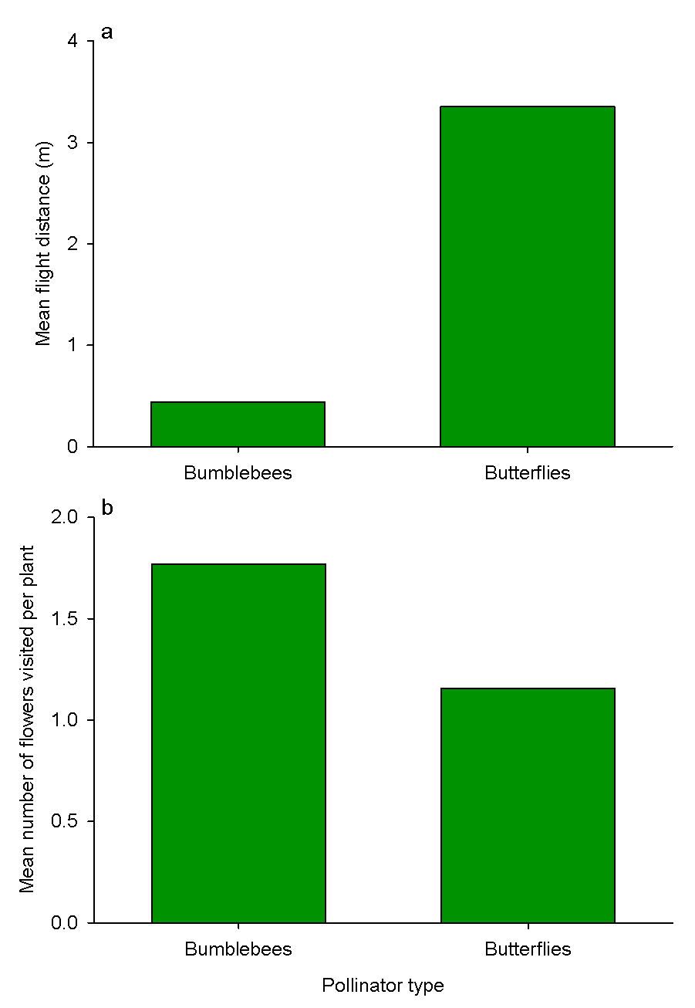
Mean flight distance (a) and number of flowers visited per plant (b) for bumblebees and butterflies.
Figure 9.5
Notes:
Figure 9.5 Mean flight distance (a) and number of flowers visited per plant (b) for bumblebees and butterflies.
Talking Points: Mean flight distances between flowers are much lower for bumblebees than butterflies, while # of flowers visited per plant was higher.
Butterflies sometimes visited flowers close together, but often flew a significant distance before stopping to collect nectar.
In populations where bumblebees are the primary pollinator, neighborhoods may be small, both in numbers of individuals and area occupied.
When butterflies are the pollinator, neighborhoods are predicted to be much bigger and to be connected genetically, as gene flow and mating between widely separated individuals would be much more substantial.
The result of gene flow is to prevent divergence of populations; the flow of genetic material helps maintain genetic similarity among populations. In addition, mutations or adaptations that arose in one population could spread among populations.

Slide 10
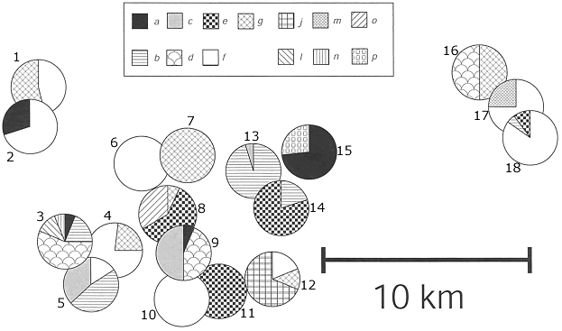
Distribution of 13 mt allele combinations among 18 populations of bladder campion
Each pie chart represents the geographic location and frequency of different mitochondrial allele combinations. Numbers are arbitrarily assigned to each population.
Figure 9.6
Notes:
Figure 9.6 Distribution of 13 mitochondrial allele combinations among 18 populations of bladder campion, with each pie chart representing the geographic location and frequency of different mitochondrial allele combinations. Numbers are arbitrarily assigned to each population.
Talking Points: 18 populations of bladder campion, each > 500 m from any other population, were assessed.
DNA was extracted from plants in each population; 2 mitochondrial DNA genes were chopped up using restriction enzymes, which cut DNA at variable locations, depending upon DNA sequence, resulting in fragments of variable size.
Use variation in mt allele combination patterns as evidence of genetic variation among individuals.
13 different allele combinations of the two genes found among the 18 populations
Some close populations are genetically similar, others are not. Some distant populations are genetically similar.
Populations farther away from each other had lower genetic distances than populations closer together, on average.
Bladder campion can disperse long distances.

Slide 11
BME 9.2: How genetically different are two populations?
Objective: Interpret measures of genetic distance (GD)
Olson and McCauley computed GD between pairs of populations to determine if GD was correlated with geographic distance.
Use “genetic_distance.xls” to explore properties of GD between pairs of populations.
Notes:
Talking Points: Genetic distance between pairs of populations can be calculated. BME 9.2 discusses how to quantify genetic distance, and lets you explore the genetic distances between any two populations in Figure 9.6.
Genetic distance expresses the genetic differences among two populations as a single number.
GD near 0 means that two populations are very similar. GD near 1 means that two populations have diverged genetically.
The allele frequencies for each population are in a table on the far right side of the Excel spreadsheet.
The formula for GD is relatively easy to calculate, even without Excel.
In Excel, column labeled pbar finds a weighted average of the allele frequencies between the two populations
MSP and MSG estimate variability in frequencies, similar to the idea of standard deviation.
Understanding how these formulas model genetic relatedness requires advanced probability and statistics, but now you have a feel for the range of values for genetic distance.

Slide 12
genetic_distance.xlsx
 | Population
 | 1 | 2 | 3 | 4 | 5 | 6 | 7 | 8 | 9 | 10 | 11
Pop Size | 74 | 18 | 250 | 20 | 100 | 33 | 9 | 250 | 30 | 250 | 250
Allele
a |  | 0.3 | 0.05 |  |  |  |  |  | 0.05
b |  |  | 0.2 |  | 0.5
c |  |  |  |  | 0.35 |  |  |  | 0.5
d |  |  | 0.55 |  |  |  |  |  | 0.45
e |  |  |  |  |  |  |  | 0.65 |  |  | 1
f | 0.45 | 0.7 |  | 0.8 | 0.15 | 1 |  |  |  | 1
g | 0.55 |  |  | 0.2 |  |  | 1 | 0.05
j
l |  |  | 0.15
m
n |  |  | 0.05
o |  |  |  |  |  |  |  | 0.3
p
Total | 1 | 1 | 1 | 1 | 1 | 1 | 1 | 1 | 1 | 1 | 1
Notes:
From the excel file, genetic_distance.xls, available on website

Slide 13
BME Integrating Questions
9.2a: By looking at the allele frequencies of the populations 1 - 4, predict which of populations 2, 3, or 4 is genetically closest to population 1, and which is genetically furthest from population 1. Compute the genetic distance between population 1 and 2, 1 and 3, and 1 and 4 to verify your predictions.
Notes:
Talking Points: Genetic distance between pairs of populations can be calculated. BME 9.1 discusses how to quantify genetic distance, and lets you explore the genetic distances between any two populations in Figure 9.6.
BME IQs ask the student to examine a set of the populations from Figure 9.6.
The next few slides will help to answer these questions.

Slide 14
Distribution of 13 mt allele combinations among 18 populations of bladder campion
Figure 9.6
Notes:
Figure 9.6 Distribution of 13 mitochondrial allele combinations among 18 populations of bladder campion, with each pie chart representing the geographic location and frequency of different mitochondrial allele combinations. Numbers are arbitrarily assigned to each population.
Talking Points: The populations from the first IQ are outlined in the green box.
By inspection, students should be able to predict that populations 1 and 4 are closest genetically, as they both have the same two, and only those two, allele combinations.
Population 1 should be farthest genetically from population 3 – there are no allele combinations in common between the two populations.
Some close populations are genetically similar, others are not. Some distant populations are genetically similar, as is the case for the population 1 and 4 comparison.

Slide 15
genetic_distance.xlsx
 | Population
 | 1 | 2 | 3 | 4 | 5 | 6 | 7 | 8 | 9 | 10 | 11
Pop Size | 74 | 18 | 250 | 20 | 100 | 33 | 9 | 250 | 30 | 250 | 250
Allele
a |  | 0.3 | 0.05 |  |  |  |  |  | 0.05
b |  |  | 0.2 |  | 0.5
c |  |  |  |  | 0.35 |  |  |  | 0.5
d |  |  | 0.55 |  |  |  |  |  | 0.45
e |  |  |  |  |  |  |  | 0.65 |  |  | 1
f | 0.45 | 0.7 |  | 0.8 | 0.15 | 1 |  |  |  | 1
g | 0.55 |  |  | 0.2 |  |  | 1 | 0.05
j
l |  |  | 0.15
m
n |  |  | 0.05
o |  |  |  |  |  |  |  | 0.3
p
Total | 1 | 1 | 1 | 1 | 1 | 1 | 1 | 1 | 1 | 1 | 1
Notes:
BME 9.2 and table from the companion excel spreadsheet

Slide 16
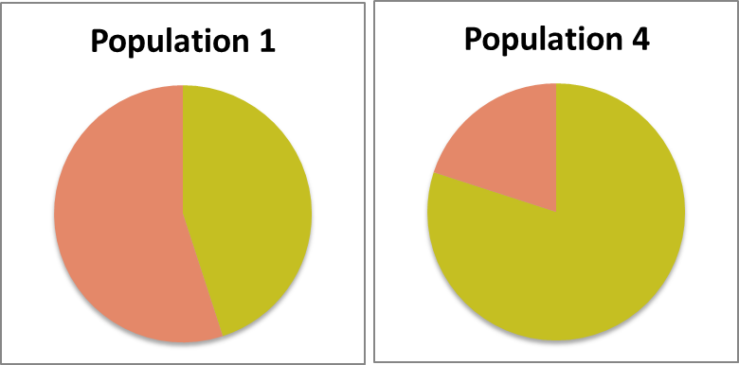
BME 9.2
Populations to Compare: |  |  |  | Genetic Distance:
 | 1 | 4 |  |  | 0.1871
Notes:
Talking Points: Explore the genetic distance between populations 1 and 4 from Figure 9.6 (BME 9.2).
GD near 0 means that two populations are very similar. GD near 1 means that two populations have diverged genetically.
GD between these two populations is 0.19, indicating high similarity.
Even though they both have allele combinations f and g, frequencies of those allele combinations are different, which is why GD is low, but >0.
The formula for GD is relatively easy to calculate, even without Excel.
In Excel, column labeled pbar finds a weighted average of the allele frequencies between the two populations
MSP and MSG estimate variability in frequencies, similar to the idea of standard deviation.

Slide 17
BME 9.2
Populations to Compare: |  |  |  | Genetic Distance:
 | 1 | 4 |  |  | 0.1871
Populations to Compare: |  |  |  | Genetic Distance:
 | 1 | 2 |  |  | 0.3001
Populations to Compare: |  |  |  | Genetic Distance:
 | 1 | 3 |  |  | 0.4176
Notes:
Talking Points: Explore the genetic distance between populations 1 and 3 from Figure 9.6 (BME 9.2).
GD between these two populations is 0.42, indicating low similarity, or at least lower than between 1 and 4.
The two populations have a mutually exclusive set of allele combinations. They do not share any allele combinations.
In Excel, column labeled pbar finds a weighted average of the allele frequencies between the two populations
MSP and MSG estimate variability in frequencies, similar to the idea of standard deviation.
Here the math should support the predictions made by inspecting the figure; that populations 1 and 3 have the highest GD, whereas populations 1 and 4 have the lowest.

Slide 18
BME 9.2
Populations to Compare: |  |  |  | Genetic Distance:
 | 1 | 4 |  |  | 0.1871
Populations to Compare: |  |  |  | Genetic Distance:
 | 1 | 2 |  |  | 0.3001
Populations to Compare: |  |  |  | Genetic Distance:
 | 1 | 3 |  |  | 0.4176
Populations to Compare: |  |  |  | Genetic Distance:
 | 2 | 3 |  |  | 0.4157
Populations to Compare: |  |  |  | Genetic Distance:
 | 2 | 4 |  |  | 0.1133
Populations to Compare: |  |  |  | Genetic Distance:
 | 3 | 4 |  |  | 0.454
Notes:
Talking Points: Explore the genetic distance between populations 1 and 3 from Figure 9.6 (BME 9.2).
GD between these two populations is 0.42, indicating low similarity, or at least lower than between 1 and 4.
The two populations have a mutually exclusive set of allele combinations. They do not share any allele combinations.
In Excel, column labeled pbar finds a weighted average of the allele frequencies between the two populations
MSP and MSG estimate variability in frequencies, similar to the idea of standard deviation.
Here the math should support the predictions made by inspecting the figure; that populations 1 and 3 have the highest GD, whereas populations 1 and 4 have the lowest.

Slide 19
BME Integrating Questions
9.2b: Which two populations do you predict are closest to each other? Compute the genetic distance between these two populations. Explain why you think their distance is less than the distance between populations 1 and 4.
9.2c: Which two populations do you predict are furthest from each other? Compute their genetic distance. Explain why you think their distance is greater than the distance between populations 1 and 3.
Notes:
Talking Points: Genetic distance between pairs of populations can be calculated. BME 9.1 discusses how to quantify genetic distance, and lets you explore the genetic distances between any two populations in Figure 9.6.
BME IQs ask the student to examine a set of the populations from Figure 9.6.
The next few slides will help to answer these questions.

Slide 20
BME 9.1
Populations to Compare: |  |  |  | Genetic Distance:
 | 1 | 4 |  |  | 0.1871
Populations to Compare: |  |  |  | Genetic Distance:
 | 1 | 2 |  |  | 0.3001
Populations to Compare: |  |  |  | Genetic Distance:
 | 1 | 3 |  |  | 0.4176
Populations to Compare: |  |  |  | Genetic Distance:
 | 2 | 3 |  |  | 0.4157
Populations to Compare: |  |  |  | Genetic Distance:
 | 2 | 4 |  |  | 0.1133
Populations to Compare: |  |  |  | Genetic Distance:
 | 3 | 4 |  |  | 0.454
Notes:
Talking Points: Explore the genetic distance between populations 1 and 3 from Figure 9.6 (BME 9.2).
GD between these two populations is 0.42, indicating low similarity, or at least lower than between 1 and 4.
The two populations have a mutually exclusive set of allele combinations. They do not share any allele combinations.
In Excel, column labeled pbar finds a weighted average of the allele frequencies between the two populations
MSP and MSG estimate variability in frequencies, similar to the idea of standard deviation.
Here the math should support the predictions made by inspecting the figure; that populations 1 and 3 have the highest GD, whereas populations 1 and 4 have the lowest.

Slide 21
BME Integrating Questions
9.2c: Use Fig 9.6 and “genetic_distance.xls” to determine genetic and geographic distances between populations 6 vs. 7, 6 vs. 10, 6 vs. 11, 7 vs. 11, 7 vs. 10, and 10 vs. 11. To estimate geographic distance, measure the distance between the centers of two population circles, and then estimate using the scale bar. What conclusions about the relationship between genetic and geographic distance can you draw from just these six pairs of populations? Can you find four other populations that do not support this conclusion?
Notes:
Talking Points: Genetic distance between pairs of populations can be calculated. BME 9.1 discusses how to quantify genetic distance, and lets you explore the genetic distances between any two populations in Figure 9.6.
BME IQs ask the student to examine a set of the populations from Figure 9.6.
The next few slides will help to answer these questions.

Slide 22
BME 9.2 & IQ #7
Notes:
Talking Points: Explore the genetic distance between populations 6 and 10 from Figure 9.6.
GD between these two populations is 0, indicating very high similarity.
Here the math should support the predictions made by inspecting the figure; that two populations with the same allele frequencies have GD of 0.

Slide 23
Distribution of 13 mt allele combinations among 18 populations of bladder campion
Figure 9.6
Notes:
Figure 9.6 Distribution of 13 mitochondrial allele combinations among 18 populations of bladder campion, with each pie chart representing the geographic location and frequency of different mitochondrial allele combinations. Numbers are arbitrarily assigned to each population.
Talking Points: Students can pick out two populations they predict will be closest genetically to answer BME IQ 9.2.
Populations 6 and 10 are an obvious choice because they each have only one allele combination and it is the same one for both population.

Slide 24
Frequency histogram of juvenile starling dispersal distances
12 km: shortest measured dispersal distance
2,623 km: maximum measured dispersal distance (1 bird)
Figure 9.7
Note discontinuous scale
Notes:
Figure 9.7 Frequency histogram of juvenile starling dispersal distances. Note that the x-axis has a discontinuous scale.
Talking Points: European starlings (Sternus vulgaris) have spread across North America
Birds banded while still in the nest; date and location of the nest are recorded.
When collected or caught again, date and location are recorded to determine dispersal distance after leaving the nest.
Juvenile starlings move anywhere from 12 to 2,623 km between the time of leaving the nest and the subsequent season.
Most disperse only a short distance from nest, relative to the maximum dispersal distance of this very mobile species.
In addition, tissue samples from starlings in four states: CA, CO, VT, and VA were used to determine genotypic frequencies of 22 genes. Allele frequencies for each gene were calculated, and GD for each pair of populations determined.
16 of 22 genes contained only one allele in all of the starlings sampled in the four states. All individuals were homozygous for the same allele in those 16 genetic loci.
Of 6 other loci where more than one allele was found, GD = 0 for 5 (all had same % of each allele for those five genes).
Only 1 out of 22 genes had multiple alleles found in different frequencies among populations in different states.

Slide 25
Integrating Concepts in Biology
Chapter 9:
Evolution of Populations
Section 9.2: Do populations evolve in the absence of natural selection?
by
A. Malcolm Campbell, Laurie J. Heyer, and Chris Paradise

Slide 26
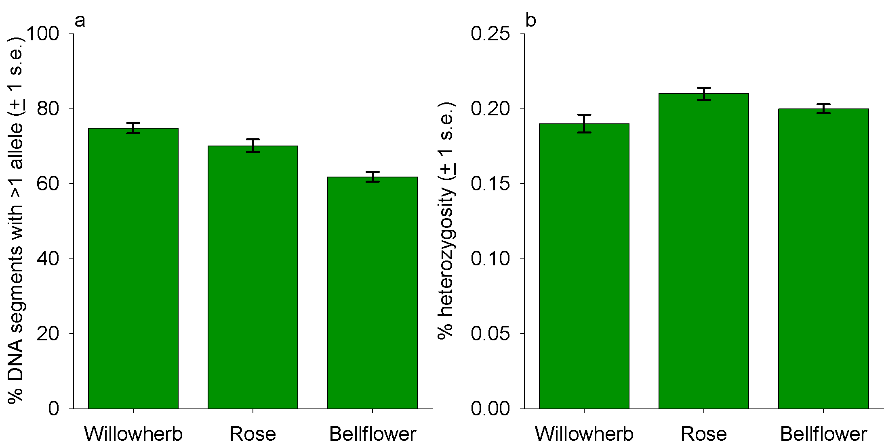
Heterozygosity and multiple alleles in Swiss Alp plant populations
Figure 9.8
Notes:
Figure 9.8 Heterozygosity and multiple alleles in Swiss Alp plant populations. a. The mean percentage of loci within a population that had multiple alleles, averaged over all populations. b. Heterozygosity, the percentage of heterozygous genes within a population, averaged over all genes, individuals and populations.
Talking Points: Consider species that live in mountainous regions, where populations are widely scattered and fragmented.
3 species of plants in the Swiss Alps were studied: alpine willowherb, a species of rose, and yellow bellflower. Populations were separated by 5 to 30 kilometers. These plants are all insect pollinated and seeds are dispersed by the wind.
Genetic structure of each species may be correlated with fragmented and isolated population structure.
Random Amplification of Polymorphic DNA (RAPD) was used. Several primers resulted in multiple fragments of different sizes, run on a gel that separates them based on size. A pattern of bands for each plant results.
Genetic variation measured as number of unique band patterns and their frequencies. There were 47 to 89 polymorphic segments in this study, depending upon the species.
Frequency of particular sized bands allowed determination of homozygosity and heterozygosity for particular segments.
Two measures of diversity were calculated: a measure of heterozygosity and the percentage of genes that were polymorphic.
Heterozygosity varied across the species of plants, when averaged over all populations sampled. H was low, which is predicted for isolated populations. Up to 80% of loci were estimated to be homozygous.
The percentage of polymorphic regions within a population was high, but varied (9.8b), contrary to predictions.
Diversity should decline over time as alleles are eliminated by chance events, or genetic drift. Many alleles were not eliminated, suggesting other evolutionary mechanisms acting on the populations, or short time since isolation.
There was no relationship between the size of populations and the two molecular diversity measures.

Slide 27
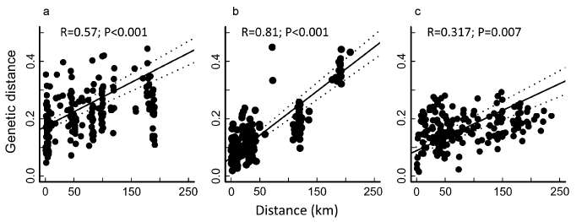
Genetic distances for each pair of populations, with a best fit line and 95% confidence interval
Alpine willowherb Rose-like plant Yellow bellflower
Figure 9.9
Notes:
Figure 9.9 Genetic distances for each pair of populations, with a best fit regression line fit through the data (solid line), with 95% confidence interval for the best fit line (dotted lines). a. Alpine willowherb. b. Rose-like plant. c. Yellow bellflower.
Talking Points: For each pair of populations within a species, genetic and geographic distance were determined and then plotted on a scatterplot.
Genetic distance correlated to geographical distance for all three species. Populations far apart more distant genetically. This effect was most pronounced for the rose (G. reptans).
Fragmented populations are isolated. Far apart populations are less likely to exchange genetic material by gene flow.
The mechanisms for dispersal, insects and wind, are unlikely to lead to long distance dispersal for this species.
There is variation in the plots. Indicates perhaps that just by chance pollen or seeds from one population make it to another.

Slide 28
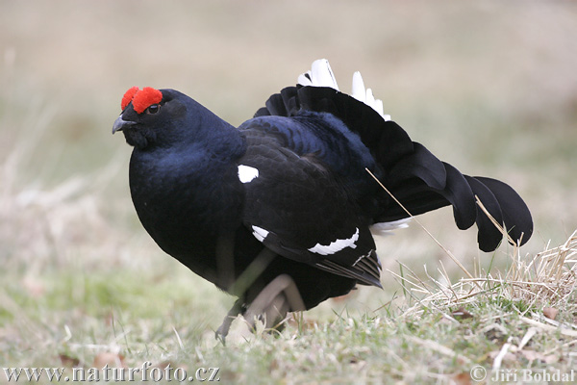
Black grouse
Front art piece UN9.1
Notes:
Front art piece UN9.1 Declines in populations of black grouse in Europe led to loss of genetic diversity.
Talking Points: This will be one of the subjects of Section 9.2.

Slide 29
Change over time in # of displaying black grouse cocks and # of occupied breeding areas
Note scale
Figure 9.10
Notes:
Figure 9.10 Change over time in number of displaying black grouse cocks and the number of occupied breeding areas in the Netherlands from 1940 to 2007.
Talking Points: A sharp decline in an isolated population of grouse living in the Netherlands is shown.
Only 9 to 32 displaying cocks (males) were sighted from mid-1980’s to the mid-2000’s.
Dutch population is >200 kilometers away from populations in Belgium and Germany; dispersal range grouse is no more than 30 kilometers for hens (females).

Slide 30
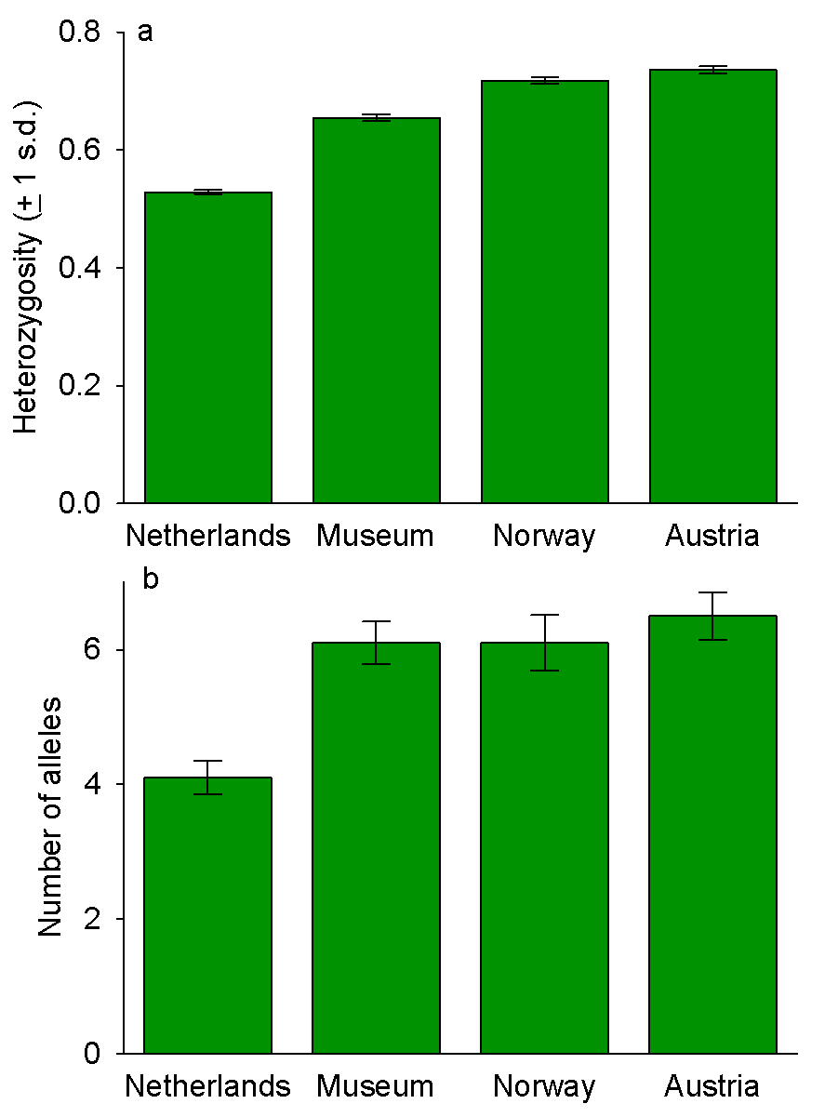
Estimates of heterozygosity and number of alleles in black grouse populations
Figure 9.11
Notes:
Figure 9.11 Estimates of genetic diversity, as measured by heterozygosity and number of alleles, in four black grouse populations. The museum population estimated values for the Dutch population in the past, and the Norway and Austrian populations were current, but larger populations. Values are averages (with standard deviation error bars).
Talking Points: Tissue samples from museum specimens in the Netherlands, and collected feathers and eggshells from living birds in the Dutch population and several other populations were examined.
Norway and Austria populations were much larger than the Netherlands population, and were not isolated by distance.
Molecular techniques were used to extract DNA and determine the genotypes and number of alleles for multiple genes.
Mean number of alleles and the heterozygosity of each population were calculated.
Sudden decrease in population size of black grouse in the Netherlands led to lower heterozygosity and numbers of alleles.
This is expected when a population goes through a bottleneck.
Low population size led to inbreeding as choice of mates is limited to related individuals in a small isolated population.
Comparing one population at two different times was critical in determining how the genetic structure of the population changed as the population structure (size and distribution) changed.
Ancestral population similar to the larger populations in Norway and Austria.

Slide 31
Estimates of genetic distance among four populations of black grouse
 | Dutch museum | Norway | Austria
Dutch present | 0.111 (0.062-0.177) | 0.160 (0.124-0.193) | 0.152 (0.108-0.194)
Dutch museum |  | 0.050 (0.011-0.109) | 0.036 (0.006-0.078)
Norway |  |  | 0.031 (0.013-0.050)
Genetic distance between Dutch museum specimens and Dutch present population
Table 9.1
Notes:
Table 9.1. Estimates of genetic distance among four populations of black grouse in Europe. Numbers in parentheses are the 95% confidence intervals for the estimates.
Talking Points: Tissue samples from museum specimens in the Netherlands, and collected feathers and eggshells from living birds in the Dutch population and several other populations were examined.
Norway and Austria populations were much larger than the Netherlands population, and were not isolated by distance.
Genetic distance among populations was calculated.
Comparing one population at two different times was critical in determining how the genetic structure of the population changed as the population structure (size and distribution) changed.
Ancestral population similar to the larger populations in Norway and Austria.
Each was genetically less similar to the present Dutch population, suggesting the Norwegian and Austrian populations have not changed genetically in the last 50 to 60 years, but that the Dutch population has.

Slide 32
Bio-Math Exploration 9.3: How confident can you be in your observations?
Bio-Math Exploration Integrating Questions:
9.3.a You learned how to compute the genetic distance between two populations in BME 9.2. Because there is a formula for the distance, why can’t you be 100% sure what the true distance is?
9.3.b Would you get a larger confidence interval if you multiplied the s.e. by 1 or by 2? Which one could you be more confident held the true genetic distance?

Slide 33
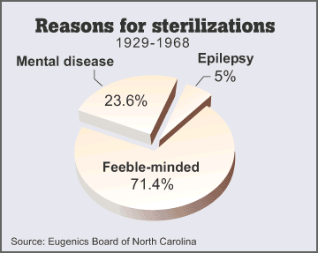
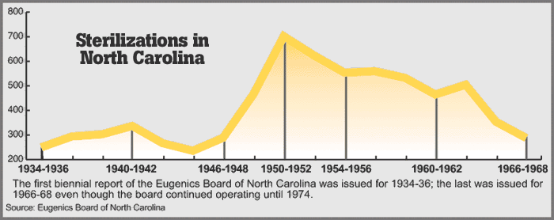
NC: first state moving to compensate victims of forced sterilization, a panel voted Jan. ‘12 to pay victims of a eugenics program that forcibly sterilized more than 7,500 people.
At least 7/33 states that carried out eugenics programs have acknowledged or apologized; NC is the first to propose compensating.
http://latimesblogs.latimes.com/nationnow/2012/01/north-carolina-sterilization-compensation.html
http://againsttheirwill.journalnow.com/

Slide 34
ELSI 9.1 What is prejudice vs. good science? Eugenics yesterday and today
Eugenics: science that deals with improvement of the human race through selective breeding.
Positive eugenics: voluntary breeding programs
Negative eugenics: prevent unfit people from breeding
  “Degeneracy theory” a guiding principle.
  Flawed understanding of heredity and evolution
The downfall of eugenics began at the end of World War II
Recent studies have shown correlations between possession of a certain allele and a particular trait
Notes:
Variation in the human species is apparent.
Distinctly variable humans live side by side, in the same country, city, or neighborhood.
Superficial, physical differences between groups are often at the heart of prejudices.
Prejudice and a sense of superiority may lead to view certain traits as genetically controlled, and that some traits are less desirable and some more beneficial than others.

Slide 35
ELSI 9.1 What is prejudice vs. good science? Eugenics and misconceptions
People with low IQs more likely to exhibit abnormal behavior and be criminals.
Prevention of homozygous recessive individuals from breeding would rapidly reduce the occurrence of the recessive trait.
Complex behavioral traits determined by a single gene.
Notes:
Talking Points: Degeneracy theory was based on a flawed understanding of genes and heredity and on Lamarckian evolution.
Lamarck proposed that the environment could cause heritable changes in organisms – a change in an organism during its lifetime could be passed on to its offspring. This idea is incorrect.
Degeneracy theory predicted that degenerate behavior could be removed within three generations by moving the family to a “good” social environment.
Low IQs were associated with abnormal behavior, poverty, and crime. There was a fear that “feebleminded” people might appear normal and possibly reproduce with intelligent people, mixing bad genes with good genes. There was also widespread acceptance that genes alone explained all these attributes and behaviors and that the traits were recessive.
One misconception was that people with low IQs were more likely to exhibit abnormal behavior and be criminals. This was degeneracy theory in action.
Another was that prevention of homozygous recessive individuals from breeding would rapidly reduce occurrence of recessive traits. Population genetics and the Hardy-Weinberg equilibrium revealed this was not so because of heterozygous carriers.
A misconception of early eugenics was that complex behavioral traits were thought to be determined by a single gene. However, complex, continuous traits are very rarely, if ever, controlled by a single gene, and although complex traits may have a genetic component, there is a substantial environmental component.

Slide 36
Integrating Concepts in Biology
Chapter 9: Evolution of Populations
Section 9.3: Where, when, and from what ancestors did humans evolve?
by
A. Malcolm Campbell, Laurie J. Heyer, and Chris Paradise

Slide 37
Skull of Sahelanthropus tchadensis discovered in Chad
Front view
Side view
View from above and below
Figure 9.12
Notes:
Figure 9.12 Skull of Sahelanthropus tchadensis discovered in Chad. a. View from the front; note that skull has been compressed on one side. b. side view. c. View from above. d. View from below.
Talking Points: New fossils are discovered all the time, and the evidence is strong that humans evolved in Africa. The discovery of fossils dated from 6-7 million years ago have extended the human family tree beyond what scientists thought was possible just several decades ago.
In 2001 and 2002 researchers discovered several fossils in Chad, in central Africa; an almost complete skull, along with several other bone fragments.
Large brow ridge, thought to be a male.
The middle of the face is short and does not jut forward as much as it does in chimpanzees or other ancient hominids.

Slide 38
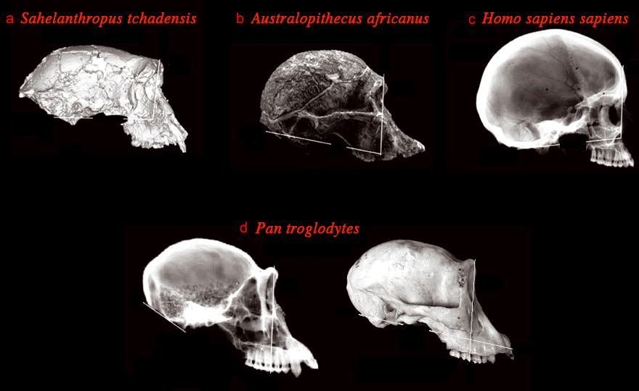
Skulls of several hominids and chimpanzees
Discovered in Chad
Human
Two skulls of chimpanzees
Figure 9.13
Notes:
Figure 9.13 Skulls of several hominids and chimpanzees. a. Sahelanthropus tchadensis discovered in Chad. b. Australopithecus africanus c. Homo sapiens, human. d. Two skulls of chimpanzees, Pan troglodytes.
Talking Points: The middle of the face of the Chad fossil is rather short and does not jut forward as much as it does in chimpanzees or other ancient hominids.
Australopithecus africanus is estimated to be between 2 and 3 million years old.

Slide 39
Skull measurements for unknown hominid fossil and several known species. Ranges are shown, if known. A. = Australopithecus, P. = Paranthropus, Pan troglodytes is the chimpanzee.
 | Upper lip length (mm) | Upper canine thickness (mm) | Lower canine width (mm) | Lower canine thickness (mm) | Brow ridge thickness (mm)
Chad fossil* | 22 | 10.2 | 11.0 | 8.5 | 18.2
A. afarensis | 30 – 33 | 9.3 – 12.5 | 7.5 – 11.7 | 8.8 – 12.4
A. africanus | 21.1 – 30 |  |  |  | 6 – 10
P. boisei | 42.2 | relatively small compared to Australopithecus
Homo habilis | 25 – 31
Homo sapiens | short | 6.5 – 7.7 | 6.5 – 10.4 | 1.8 – 10.1 | 0 - ~5
Pan troglodytes |  | 9.5 – 11.8 | 7.0 – 17.9 | 11.4 | 5.2 – 11.8
Gorilla (gorilla) |  | 11.3 – 16.8 | 8.0 – 20.9 |  | 7.3 – 17.5
Extinct hominids
Humans
Great apes
Notes:
Table 9.2. Skull measurements for unknown hominid fossil and several known species. If the range from multiple specimens is known, that is shown. Empty cells represent missing data. The upper lip length is the distance from the base of the nasal cavity to the base of the upper teeth. Canines are teeth. A. = Australopithecus, P. = Paranthropus, Pan troglodytes is the chimpanzee.
*estimates based on reconstruction of the compressed skull. #canines of Paranthropus described as “relatively small compared to Australopithecus.”
Talking Points: Measurements of skull size and other key features are compared among ancient and modern species. This could help determine whether the Chad fossils were from a previously undiscovered species.
The brow ridge was thicker than even a large male gorilla, yet the face did not extend forward as it does with many great apes and human ancestors.
Smallish canines were human-like and unlike great apes (chimpanzees, gorillas, and orangutans).
Small canines are a derived phenotype of early human ancestors and the possession of these traits suggests that the Chad fossil is an early hominid species in the human family tree.
But small brain size, a primitive trait, suggests a more ape-like species.
Mixture of both primitive and derived traits led researchers to conclude that S. tchadensis is close to the base of the human family tree, possibly being close to the last common ancestor of hominids and apes.

Slide 40
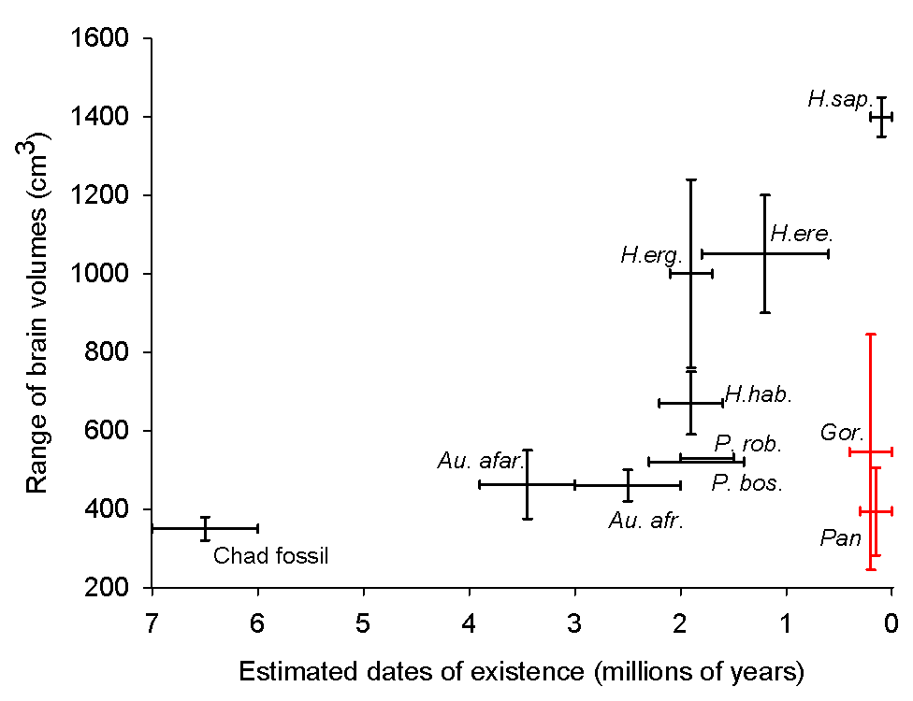
Estimates of brain volume ranges of a variety of hominid species and three living species
Homo sapiens
Homo erectus
Homo ergaster
Paranthropus robustus
Paranthropus boisei
Australopithecus africanus
Homo habilis
gorilla
Australopithecus afarensis
chimpanzee
Figure 9.14
Notes:
Figure 9.14 Estimates of brain volume ranges from fossil evidence of a variety of hominid species and three living species. The fossil from Chad is at the lower left, and extinct hominids are also shown (Australopithecus afarensis (Au. afar.), Australopithecus africanus (Au. afr.), Paranthropus boisei (P. bos.), Paranthropus robustus (P. rob.), Homo habilis (H. hab.), Homo ergaster (H. erg.), Homo erectus (H. ere.)). Modern humans, Homo sapiens (H. sap.), chimpanzees (Pan) and gorillas (Gor.) are shown for comparison.
Talking Points: Brain capacity of the Chad fossil was comparable to that of living chimpanzees and smaller than a gorilla.

Slide 41
Analysis of fossil species near S. tchadensis fossil
>700 mammal fossils from where S. tchadensis skull was found
Rock layers formed from sediments deposited at lake bottom, and from winds and floods during times when area was not under water.
Researchers used relative dating
  Mammal fossils found in one particular layer
  Wave ripples in layers, formed from water flow, running in many different directions. Indicates episodic flooding and draining
  Shallow, semi-aquatic area provides different habitats
Fish fossils known to be present in Africa since about 8 MYA
Terrestrial mammals were diverse
Based on a comparison of sites of known age w/ or w/out the species, the site determined to be 6 to 7 million years old.
S. tchadensis lived in an area w/ aquatic habitats, bounded by forest close to shore with open grassland dominant away from the shore
Notes:
Talking Points: Many fossils found alongside the Chad fossil have descendants alive today. Hyenas, many hooved mammals, and elephants are all common in grasslands, although some may also be found in forests. Otters and amphibious species are found in or near bodies of water.
In addition to using animals as evidence for habitat, it is known that trees often grow close to the edge of water, even in habitats dominated by grasses, so reasonable to conclude that both forest and grassland existed near the lake.
Humans are interested in when and in what habitats adaptations evolved, and in what ancestral species.
The Chad fossil indicates that the human family tree began to evolve 1 to 2 million years before previous estimates.

Slide 42
Known fossil record of hominids, including humans and chimpanzees, grouped by brain and tooth size
Dates of earliest and latest fossil evidence
Figure 9.15
Notes:
Figure 9.15 This figure represents the known fossil record of hominids, including humans (top left) and chimpanzees (top right). The height of a bar represents the dates of the earliest and latest fossil evidence. Species are grouped by brain and tooth size, and posture and locomotion inferred by skeletal evidence. Obligate bipedal organisms must walk on two legs; facultatively bipedal organisms can walk on two legs or using all four limbs, depending on circumstances and need. Species marked with an asterisk were unknown prior to 1990.
Talking Points: The Chad fossil was dated beyond the previously accepted divergence point of the human lineage and the great ape lineage (5 million years ago).
Features uniquely human were evident even back then, including small canines and more vertically oriented face.
Large brain evolved later.
Not all hominids were similar in every way.
Evolutionary tree, based on available fossil evidence, suggests conclusions about evolution from S. tchadensis to H. sapiens.
Brain size, teeth size, and bipedalism all varied, even among species that lived at the same time.
Some evolutionary lineages went extinct.
Some species existed for longer periods of time than others. Evolution from S. tchadensis to H. sapiens was not linear and the evolutionary tree of hominids is more like a bush than a tree.

Slide 43
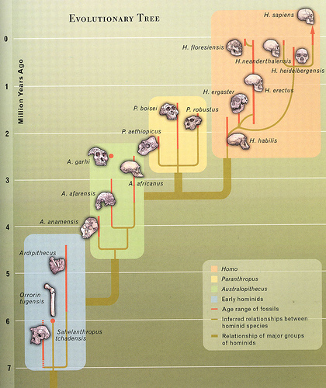
Evolutionary reconstruction of hominids
Age ranges shown by red lines
Tan lines represent inferred relationships
Major groups within colored boxes
Figure 9.16
Notes:
Figure 9.16 Phylogenetic reconstruction of hominids; the human family tree. Note that age ranges of fossils are shown by red lines, and tan lines represent inferred relationships based on fossil evidence. Major groups are contained within colored boxes.
Talking Points: Evolutionary tree, based on available fossil evidence of known hominids, suggests several conclusions about the evolution from S. tchadensis to H. sapiens.
Some lineages went extinct
Some species existed for longer periods of time, at least as evidenced by the fossil record.
Evolution from S. tchadensis to H. sapiens was not linear and evolutionary tree of hominids is more like a bush than a tree.

Slide 44
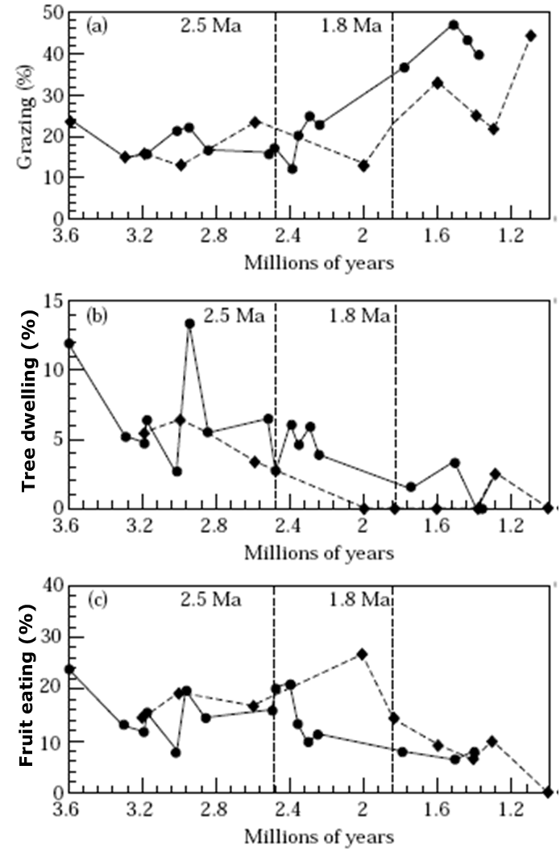
Plot of the percentages of mammals found in hominid fossil localities between 3.6 and 2.5 million years ago
woodland or shrubby habitat with some grasslands
time frame and hominids in existence during time frame
Figure 9.17
Notes:
Figure 9.17 Plot of the percentages of (a) grazing mammals, (b) tree-climbing/dwelling mammals, and (c) fruit eating mammals found in hominid fossil localities over time. The vertical dotted lines represent 2·5 and 1·8 million years ago (Ma = millions of years ago). Diamonds = averages for east Africa locales, and circles represent averages for southern Africa locales.
Talking Points: Fossil evidence of the mammalian communities in eastern and southern Africa was used.
Regions are areas where major fossil finds of many hominids have been found.
The community of mammals changed over time. Percentages of grazing mammals indicates open habitats and grasslands, the percentages of tree-dwelling forest mammals and fruit eaters indicates shrubby or forested habitat.
Australopithecus species, 4.5 and 2.5 MYA, seemed to have lived in woodland or shrubby habitat with some grasslands.
Around 2.5 MYA there was a change to drier, more open habitats, causing selection to occur.

Slide 45
Plot of the percentages of mammals found in hominid fossil localities between 2.5 and 1.8 MYA
woodland decreasing, grasslands increasing
time frame and hominids in existence during time frame
Figure 9.17
Notes:
Figure 9.17 Plot of the percentages of (a) grazing mammals, (b) tree-climbing/dwelling mammals, and (c) fruit eating mammals found in hominid fossil localities over time. The vertical dotted lines represent 2·5 and 1·8 million years ago (Ma = millions of years ago). Diamonds = averages for east Africa locales, and circles represent averages for southern Africa locales.
Talking Points: Fossil evidence of the mammalian communities in eastern and southern Africa was used.
Regions are areas where major fossil finds of many hominids have been found.
The community of mammals changed over time. Percentages of grazing mammals indicates open habitats and grasslands, the percentages of tree-dwelling forest mammals and fruit eaters indicates shrubby or forested habitat.
Around 2.5 MYA there was a change to drier, more open habitats, causing selection to occur.
Tree dwelling or climbing mammals declined sharply at that time, which corresponded to an increase in grazing mammals between 2.3 and 1.8 million years ago. Fruit eating mammals declined between 2.5 and 1.8 million years ago in eastern Africa. Australopithecus species evolved into other species or went extinct at that time.
Habitats of Paranthropus have been classified as shrubby habitat to open woodland regions, with grasslands as a major component of the habitat, but with deltas and floodplains.
Some Homo localities have been classified as arid plains and shrubland with possible river-edge woodland.
The genus Homo arose about 2 million years ago in more open and arid habitats, possibly selecting for upright walking to see far and scan for predators. Available resources changed, forcing them to adapt to new food sources or face extinction.
Brain size increased, the ability to walk upright became obligate, tool use developed, and complex social interactions evolved.

Slide 46
Plot of the percentages of mammals found in hominid fossil localities from 1.8 to 1 MYA
Grasslands come to dominate these areas
time frame and hominids in existence during time frame
Figure 9.17
Notes:
Figure 9.17 Plot of the percentages of (a) grazing mammals, (b) tree-climbing/dwelling mammals, and (c) fruit eating mammals found in hominid fossil localities over time. The vertical dotted lines represent 2·5 and 1·8 million years ago (Ma = millions of years ago). Diamonds = averages for east Africa locales, and circles represent averages for southern Africa locales.
Talking Points: Fossil evidence of the mammalian communities in eastern and southern Africa was used.
Regions are areas where major fossil finds of many hominids have been found.
The community of mammals changed over time. Percentages of grazing mammals indicates open habitats and grasslands, the percentages of tree-dwelling forest mammals and fruit eaters indicates shrubby or forested habitat.
Some Homo localities have been classified as arid plains and shrubland with possible river-edge woodland.
The genus Homo arose about 2 million years ago in more open and arid habitats, possibly selecting for upright walking to see far and scan for predators. Available resources changed, forcing them to adapt to new food sources or face extinction.
Brain size increased, the ability to walk upright became obligate, tool use developed, and complex social interactions evolved.

Slide 47
Plot of the percentages of mammals found in hominid fossil localities over time
Climbing mammals declined, grazers increased between 2.3 and 1.8 MYA
Australopithecus species evolved or went extinct
Paranthropus: shrubby to open woodland regions, with much grassland, but near water
Homo arose about 2 MYA in open and arid habitats
Figure 9.17
Notes:
Figure 9.17 Plot of the percentages of (a) grazing mammals, (b) tree-climbing/dwelling mammals, and (c) fruit eating mammals found in hominid fossil localities over time. The vertical dotted lines represent 2·5 and 1·8 million years ago (Ma = millions of years ago). Diamonds = averages for east Africa locales, and circles represent averages for southern Africa locales.
Talking Points: Fossil evidence of the mammalian communities in eastern and southern Africa was used.
Regions are areas where major fossil finds of many hominids have been found.
The community of mammals changed over time. Percentages of grazing mammals indicates open habitats and grasslands, the percentages of tree-dwelling forest mammals and fruit eaters indicates shrubby or forested habitat.
Australopithecus species, 4.5 and 2.5 MYA, seemed to have lived in woodland or shrubby habitat with some grasslands.
Around 2.5 MYA there was a change to drier, more open habitats, causing selection to occur.
Tree dwelling or climbing mammals declined sharply at that time, which corresponded to an increase in grazing mammals between 2.3 and 1.8 million years ago. Fruit eating mammals declined between 2.5 and 1.8 million years ago in eastern Africa. Australopithecus species evolved into other species or went extinct at that time.
Habitats of Paranthropus have been classified as shrubby habitat to open woodland regions, with grasslands as a major component of the habitat, but with deltas and floodplains.
Some Homo localities have been classified as arid plains and shrubland with possible river-edge woodland.
The genus Homo arose about 2 million years ago in more open and arid habitats, possibly selecting for upright walking to see far and scan for predators. Available resources changed, forcing them to adapt to new food sources or face extinction.
Brain size increased, the ability to walk upright became obligate, tool use developed, and complex social interactions evolved.

Slide 48
ELSI 9.2 Has evolution reached its peak? Are humans still evolving?
Humans considered by many as pinnacle of evolution
Complexity has increased over time
  Does selection always lead to greater complexity?
  Does evolution have a goal?
Certain characteristics of living in social groups contributed to evolution of a large, complex brain
  What if a large brain was not favored by selection?
What would you predict regarding effects of mechanisms of evolution?
  Natural selection?
  Gene flow?
  Genetic drift?
  Mutation?
Notes:
Talking Points:
Evolution is not directed and does not have a goal, so the conclusion that humanity is the endpoint of evolution is a misunderstanding of biological evolution.
The mechanisms of evolution about which you have learned: natural selection, mutation, gene flow, and genetic drift are not goal-directed, and will continue to occur in every species, as long as DNA is replicated.
During the course of hominid evolution, selection could have favored a solitary existence, if human ancestors ate a diet that could be obtained individually and they lived free from major predators.
If so, a large brain, which requires a lot of energy to maintain, may not have been necessary.
The result of a high level of gene flow would be homogenization of the gene pool. Mutations could spread from a source population to other populations, and separate populations would not be likely to diverge.

Slide 49
ELSI 9.2 Has evolution reached its peak? Are humans still evolving? Evidence
In >75% of human pop’ns lactase activity declines by 95% at birth.
  Adult lactase activity in 95% of European-derived pop’ns, but in only about 10% of Asians and Africans.
In malaria-prevalent regions of Africa
  Mutation in glucose-6-phosphate dehydrogenase (G6PD) causes problems in blood, affecting >400 million people
  But improves resistance to malaria
Knowledge of the mechanisms of evolution would lead us to suspect that Homo sapiens is subject to them
Notes:
Talking Points: The rise of lactase persistence seems to coincide with the rise of dairy farming, during the past 10,000 years.

Slide 50
Integrating Concepts in Biology
Chapter 9: Evolution of Populations
Section 9.4: How does the amount of light affect the distribution of photosynthesizing organisms?

Slide 51
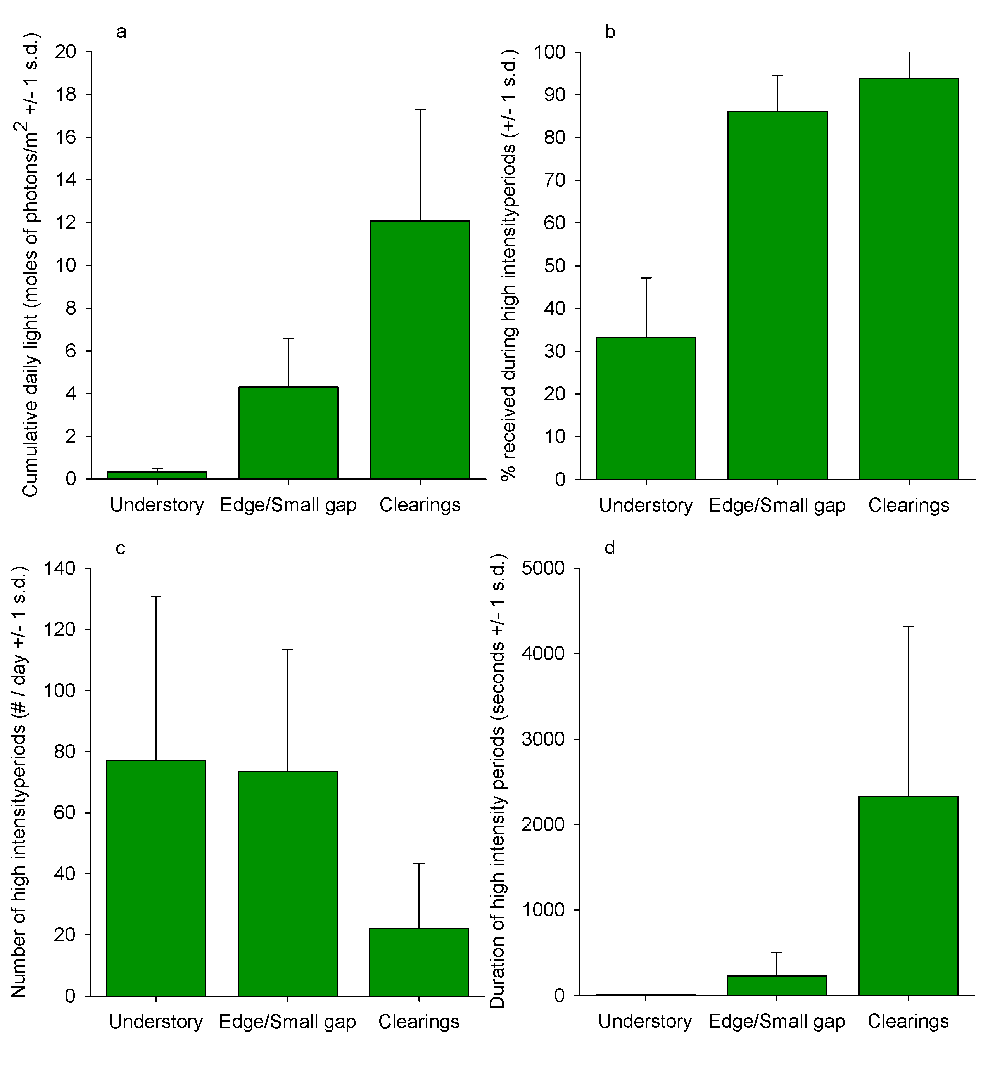
Properties of the light environment in the rainforest understory, near edges or gaps, and in clearings
Average total daily photons, a measure of light intensity
Time periods that receive bright light
A measure of the length of light flashes
% of total light from “a” attributed to light flashes
Figure 9.18
Notes:
Figure 9.18 Some properties of the light environment in the forest understory, near edges or small gaps, and in clearings in a Panama rainforest. a. Average total daily light photons, which is a quantitative measure of light intensity. b. Number of time periods that receive bright light, correlated with number of light flashes. c. Duration of bright light periods, a measure of the length of light flashes. d. Percentage of total light from panel a that was attributed to light flashes.
Talking Points: Photosynthesis was examined in several species of rainforest shrubs under changing light conditions in three places: in the forest understory beneath the tree canopy, along the edges of forests, and in gaps.
Photosensors recorded light intensity at regular intervals; total number of photons of light was a measure of light quantity.
Photons strike the sensor even when it is shaded, but more photons strike it when exposed to full sunlight, even if for only a brief period of time.
Frequency of high light periods and the overall intensity of light varied among the three habitats.
Clearings had the highest total light occurring on a daily basis, more than twice as much as edges, and more than 30 times that of the understory. They also had higher duration of bright light periods.
Understory and Edge had high frequencies of short duration periods of high intensity light.

Slide 52
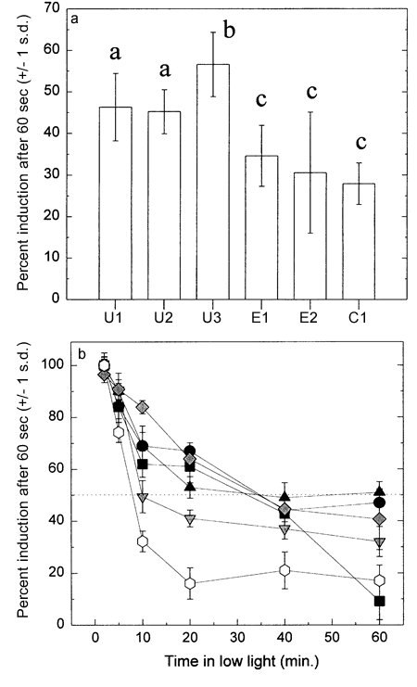
% of maximum induction after 60 sec exposure to bright light
Understory shrubs
Edge species
Open clearing specialist
Leaves were kept in shade for 14 hours
Different letters above two bars indicate significant difference.
Figure 9.19a
Notes:
Figure 9.19 Percentage of maximum induction after 60 second exposure to bright light. a. Leaves were kept in shade for at least 14 hours. Understory shrubs are U1-U3, Edge species are E1 and E2, and the open clearing specialist is C1. The letter above each bar indicates groups that were not significantly different from each other, as determined by statistical test, and different letters above two bars indicate significant difference. b. Leaves were kept in high light, followed by varying exposure times to shade, prior to exposure to bright light. Solid symbols are understory species, grey symbols are edge/gap species, and open symbols are for the clearing species. Values are means + 1 s.d.
Talking Points: 3 species were understory plants, 2 were edge shrubs, and 1 grows in open clearings.
Special chamber used to enclose individual leaves to measure carbon dioxide flux.
During periods of intense photosynthesis, [CO₂] drops, and in low light, CO₂ increases. Changing [CO₂] reflected flow of CO₂.
Maximum net photosynthetic rate was determined; the maximum amount of CO₂ captured by photosynthesis after 1 minute of bright light exposure.
The intensity of light that causes the maximum varies with the species.
To see how fast photosynthesis was induced when a leaf was exposed to flashes of light, the researchers recorded measurements in the shade, and then opened a shutter that let in intense light.
Amount of light and pattern of occurrence of high and low light affect the distribution of plants.
Plants in understory dependent upon short flashes of light, and adapted to take advantage of these short duration flashes.
Shrubs in understory had higher % induction after being kept in shade and then being exposed to bright light. These plants achieved a higher percentage of their maximum photosynthesis rate than other plants.
Good adaptations for plants living mostly in shade exposed to brief, but frequent, bursts of bright light.
These plants and the plants living in the forest edge had somewhat similar responses as the time in low light increased.
Clearing plants did not respond as well to light flashes.

Slide 53
% of maximum induction after 60 sec exposure to bright light
Solid symbols = understory species
Grey symbols = edge/gap species
Open symbols = clearing species
Figure 9.19b
Notes:
Figure 9.19 Percentage of maximum induction after 60 second exposure to bright light. a. Leaves were kept in shade for at least 14 hours. Understory shrubs are U1-U3, Edge species are E1 and E2, and the open clearing specialist is C1. The letter above each bar indicates groups that were not significantly different from each other, as determined by statistical test, and different letters above two bars indicate significant difference. b. Leaves were kept in high light, followed by varying exposure times to shade, prior to exposure to bright light. Solid symbols are understory species, grey symbols are edge/gap species, and open symbols are for the clearing species. Values are means + 1 s.d.
Talking Points: 3 species were understory plants, 2 were edge shrubs, and 1 grows in open clearings.
Special chamber used to enclose individual leaves to measure carbon dioxide flux.
During periods of intense photosynthesis, [CO₂] drops, and in low light, CO₂ increases. Changing [CO₂] reflected flow of CO₂.
Maximum net photosynthetic rate was determined; the maximum amount of CO₂ captured by photosynthesis after 1 minute of bright light exposure.
The intensity of light that causes the maximum varies with the species.
To see how fast photosynthesis was induced when a leaf was exposed to flashes of light, the researchers recorded measurements in the shade, and then opened a shutter that let in intense light.
Plants in understory dependent upon short flashes of light, and adapted to take advantage of these short duration flashes.
Shrubs in understory had higher % induction after being kept in shade and then being exposed to bright light. These plants achieved a higher percentage of their maximum photosynthesis rate than other plants.
Good adaptations for plants living mostly in shade exposed to brief, but frequent, bursts of bright light.
These plants and the plants living in the forest edge had somewhat similar responses as the time in low light increased.
Clearing plants did not respond as well to light flashes.
Plant distributions, or where plants are found, are affected by the amount and pattern of light available.
Amount of light and pattern of occurrence of high and low light affect the distribution of plants.

Slide 54
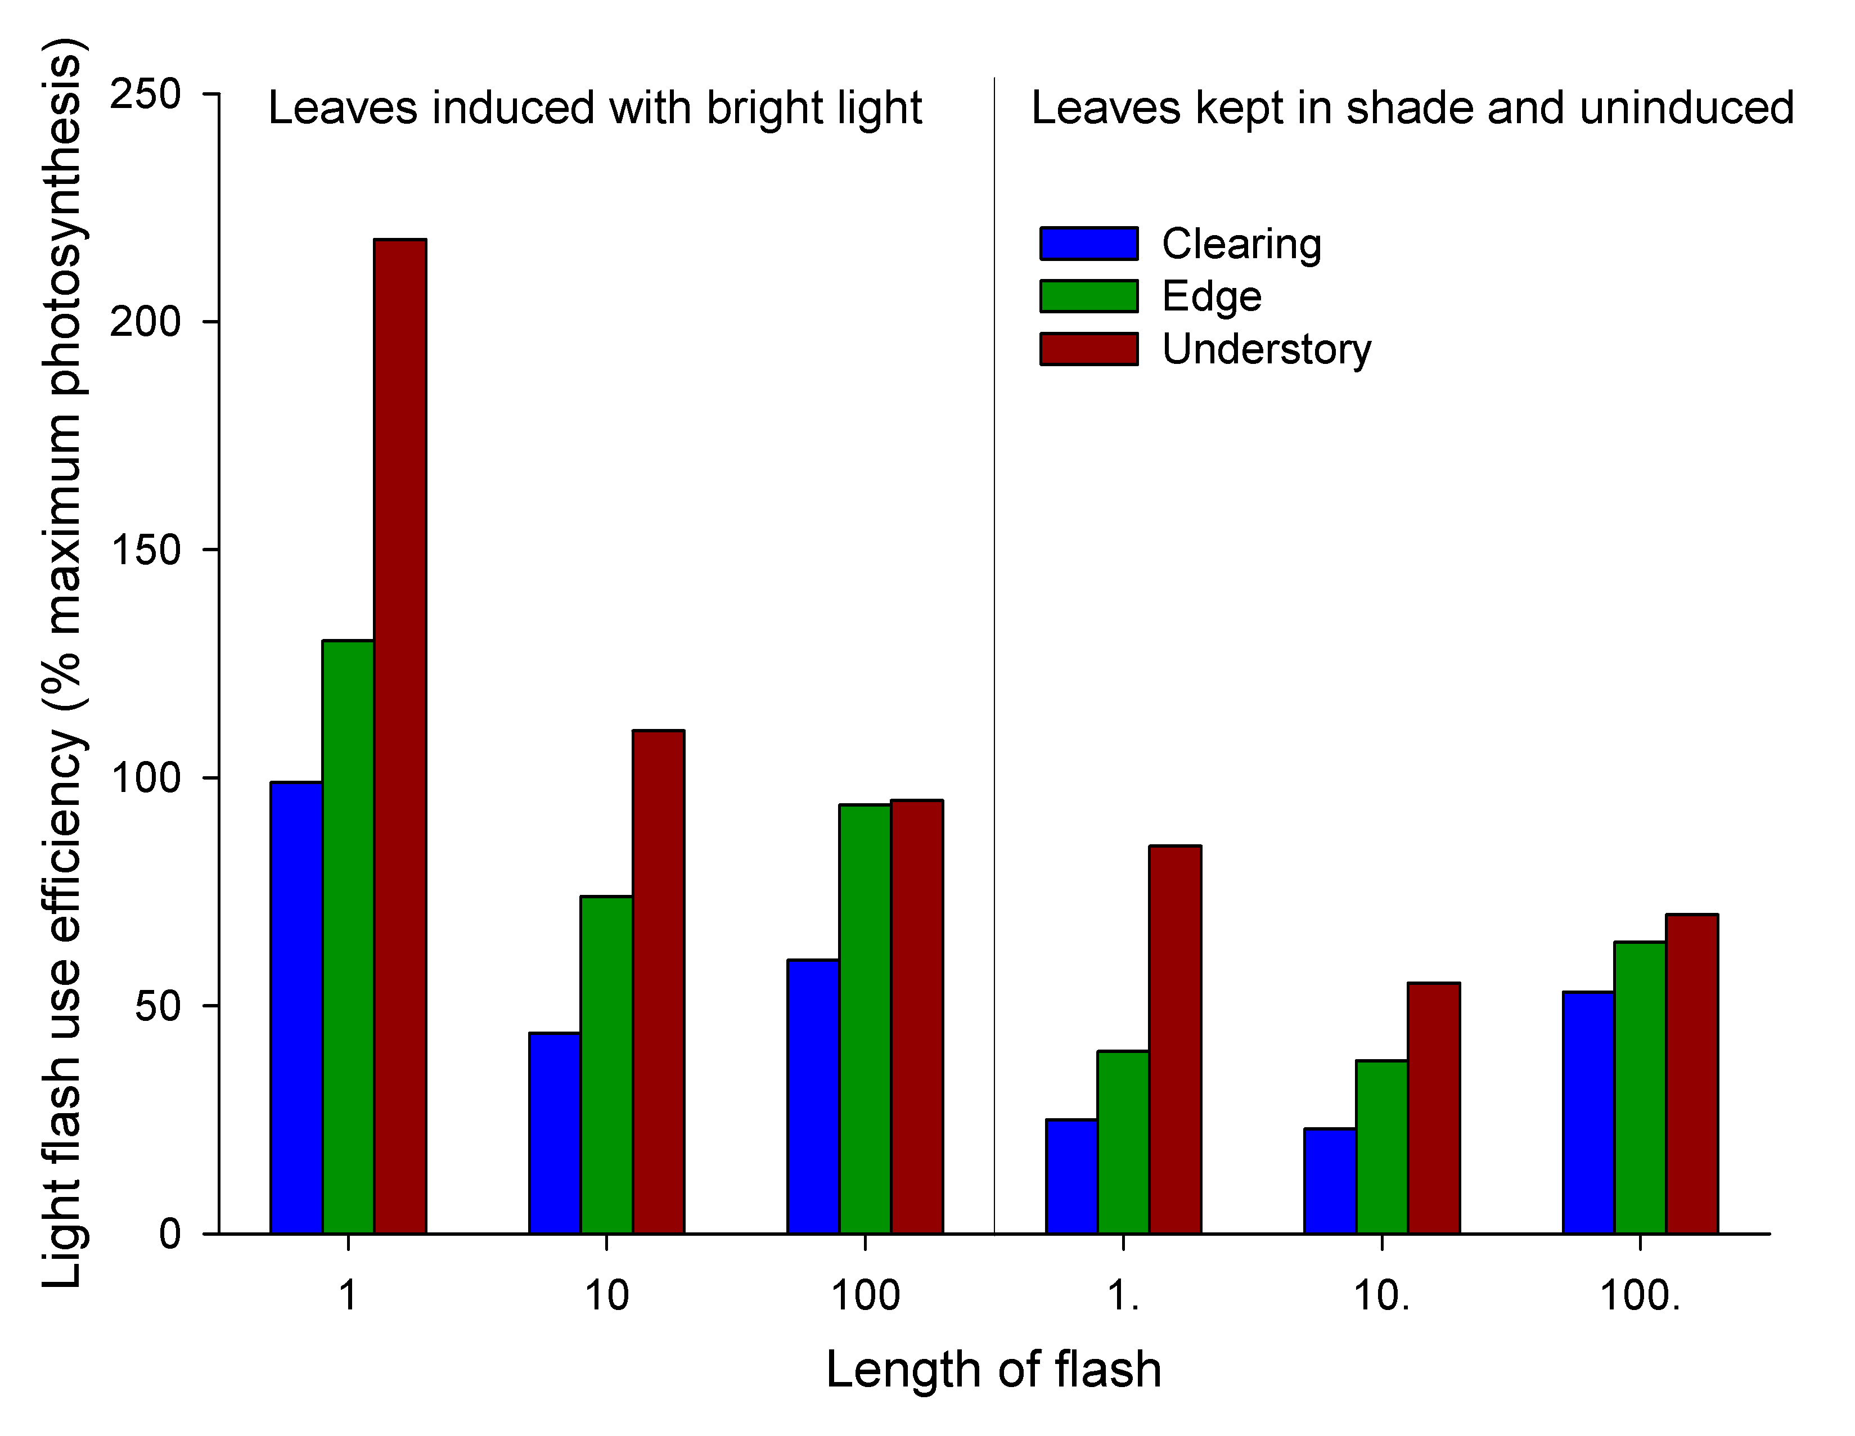
Light-flash use efficiency (LUE) as a function of the duration of light flashes
LUE ratio close to 100% = achievement of max photosynthesis during brief exposure to flash
Figure 9.20
Notes:
Figure 9.20 Lightflash use efficiency (LUE) as a function of the duration of light flashes. a. Values for leaves that had been induced with high light intensity to produce maximum photosynthesis response, followed by a period of time in shade, prior to light flash exposure. b. Values for leaves that had not been induced prior to light flash exposure.
Talking Points: Some leaves exposed to high light, then low light, and then high light again. Lightflash use efficiency (LUE) was measured, where leaves subjected to flashes of light of increasing duration after periods of shade and high intensity light.
LUE calculated as CO₂ fixed by photosynthesis during a lightflash / maximum amount of CO₂ fixed by photosynthesis under constant high intensity light.
LUE ratio close to 100% = achievement of maximum photosynthesis during the brief exposure to light flash.
LUE varied by species and by the length of the lightflash to which a leaf was exposed, and depended upon whether the leaf had been induced by bright light prior to exposure to the lightflash.
Understory shrubs generally had higher LUE across most light flash durations, especially short durations.
Open clearing plant did not have high LUE except when uninduced and duration of flash was long.
Induction led to very high LUE, even for open clearing plant, but especially for understory shrubs.

Slide 55

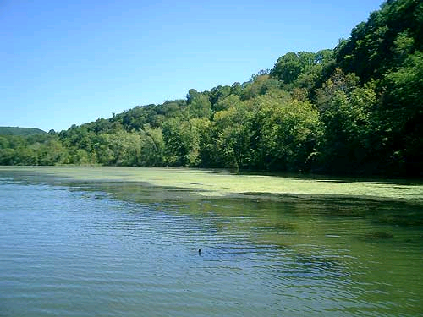
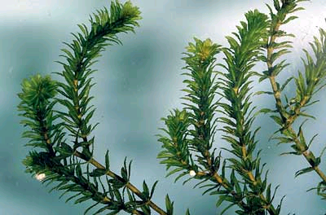
Hydrilla in southeastern US lake
http://www.focl.org/hydrilla.html
Notes:
Figures not found in text

Slide 56
Photosynthetic & respiration characteristics of hydrilla plants grown under several light levels
Light level | Light level where Ps = Resp | Light level of max. Ps | Max Ps rate | Resp rate in darkness
Low | 7 | 150 | 2.6 + 0.3 | 1.2 + 0.9
Med-low | 10 | 200 | 3.3 + 0.4 | 1.4 + 0.2
Med-high | 15 | 350 | 4.3 + 0.2 | 2.0 + 0.3
High | 20 | 600 | 5.4 + 0.6 | 2.5 + 0.2
Table 9.3
Notes:
Table 9.3. Photosynthetic and respiration characteristics of hydrilla plants grown under several light levels. Light levels are µeinsteins/m2/sec, and rates are µmoles of CO2/mg chlorophyll/hour. Values from first two columns are estimates from a best fit curve of carbon dioxide change vs. light level, and values from last two columns are means of 6 plants + 1 s.d.
Talking Points: What are the limits to the growth of an aquatic plant under different light conditions? What are lowest light levels at which hydrilla is predicted to grow and spread?
Hydrilla (Hydrilla verticillata) is a plant species introduced into the southeastern U.S. and is a serious weed problem.
Aquaria with hydrilla were exposed to 16 hours of light each day, but at one four light levels.
Each week dry mass of several plants was measured. Photosynthetic and respiration rates on several plants three weeks into the experiment were measured, using changes in CO₂ levels, relative to amount of chlorophyll, as a proxy.
As light levels increase, photosynthesis will increase until it reaches a maximum rate.
Change in CO₂ is net photosynthesis. When the net change is zero, the two processes are in balance.
Distribution of hydrilla appears to be limited by low light levels, although there is a large degree of physiological compensation that plants can undergo to live in a range of light conditions.
Hydrilla could adjust its physiology to reduce both photosynthetic capacity and respiration when in the dark.
Plants in low light were more responsive to low light.
Hydrilla may have a wider distribution and be a better competitor in lakes because it has great tolerance to low light.

Slide 57
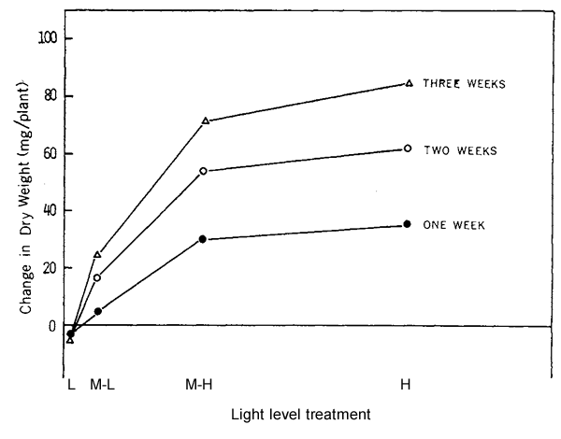
Growth of hydrilla exposed to one of four light levels
Each point = mean of 6 plants harvested at each time
Weekly gains
Weight gain
Weight loss
Figure 9.21
Distance relative to difference in light level
Notes:
Figure 9.21 Growth of hydrilla exposed to one of four light levels, expressed as change in dry mass. L = low, M-L = medium-low, M-H = medium-high, and H = high light. The distance separating each treatment on the x-axis is relative to the difference in the amount of light to which plants were exposed. Each point is the mean of 6 plants harvested at 1 week, 2 weeks, and 3 weeks.
Talking Points: Growth of plants, as measured by changes in dry mass in plants collected each week, were measured and compared among light level treatments.
At the lowest light level tested, plants lost mass, more energy spent in respiration than gained during photosynthesis. True even after 3 weeks.
All other light levels showed gain in mass over the three week test period.
Medium-high and high light levels no that different, but both showed higher gains than medium-low.

