Slide 1
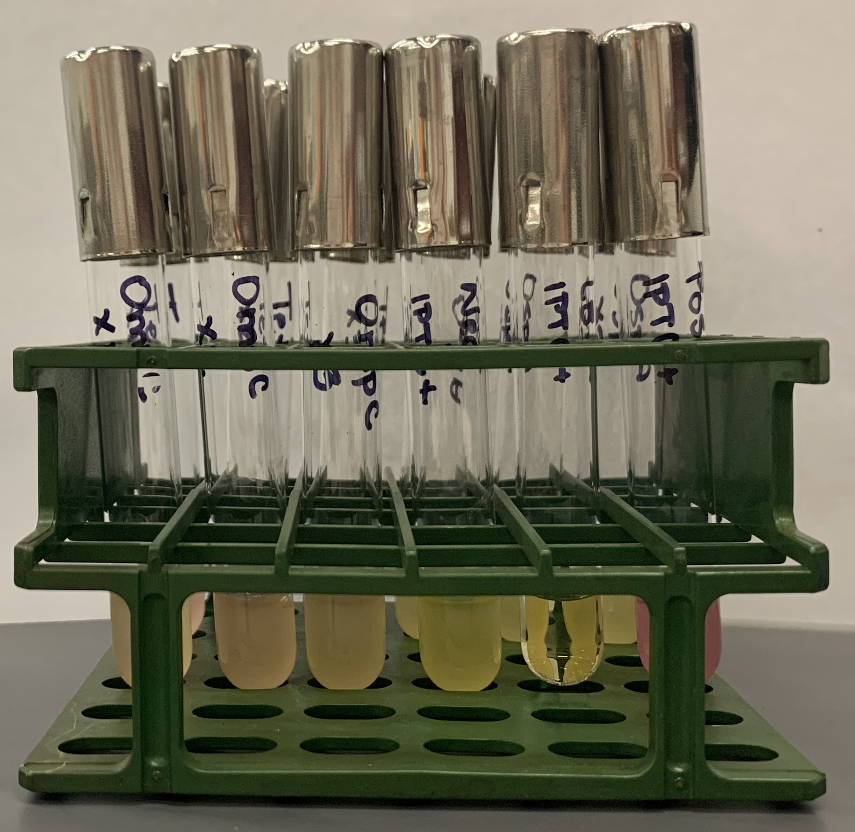
v2 tubes after overnight growth

Slide 2
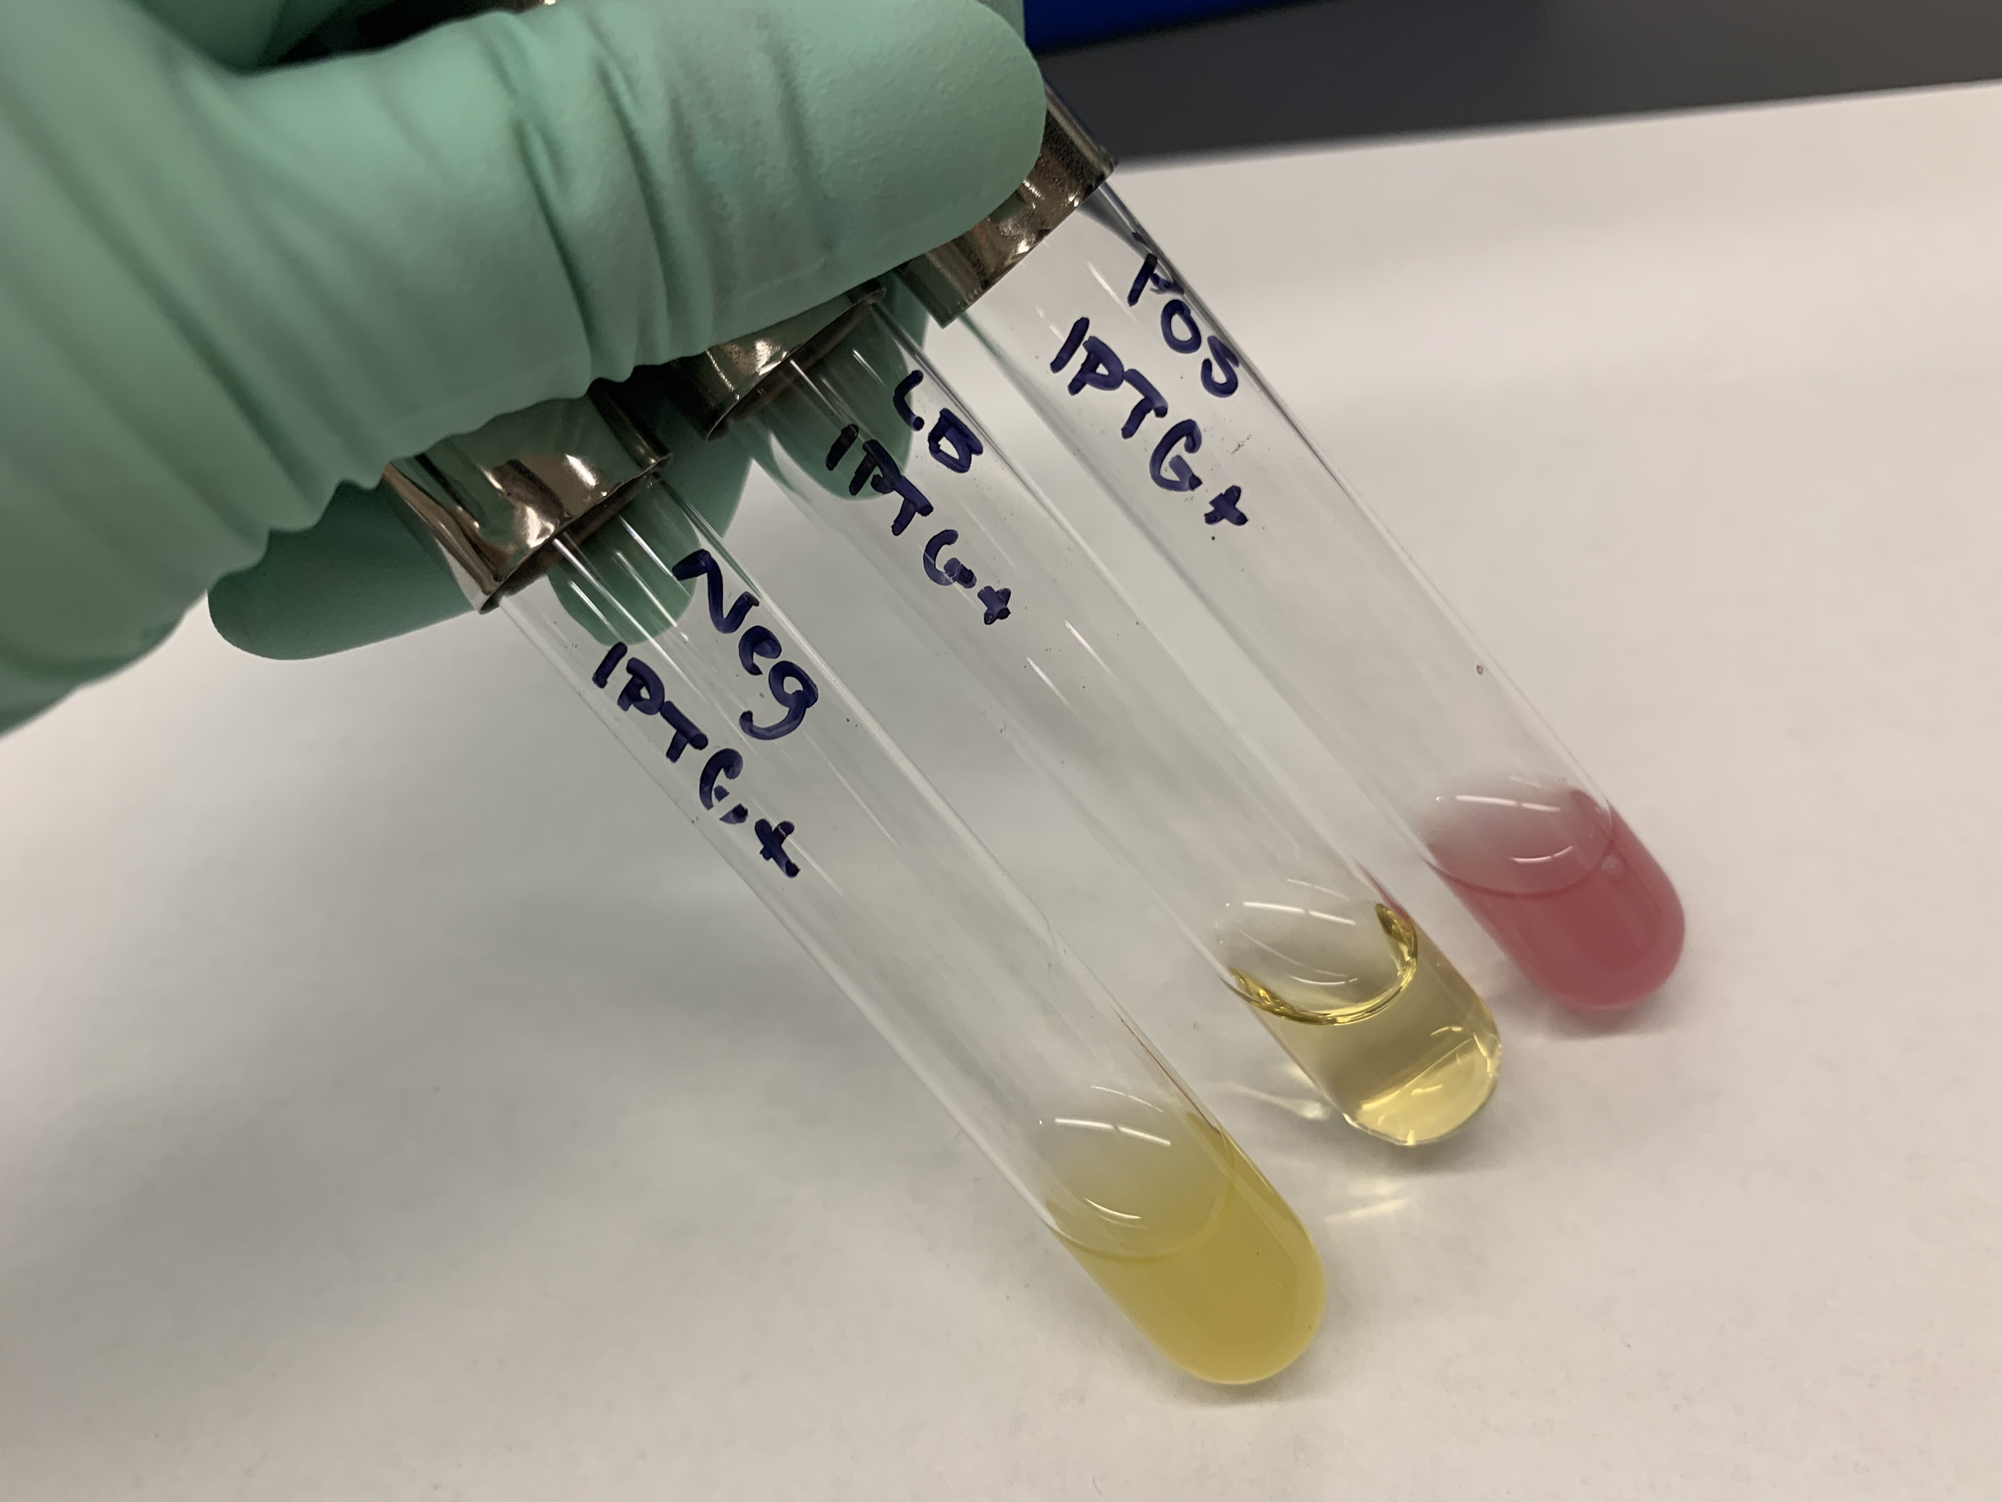
3 control tubes

Slide 3
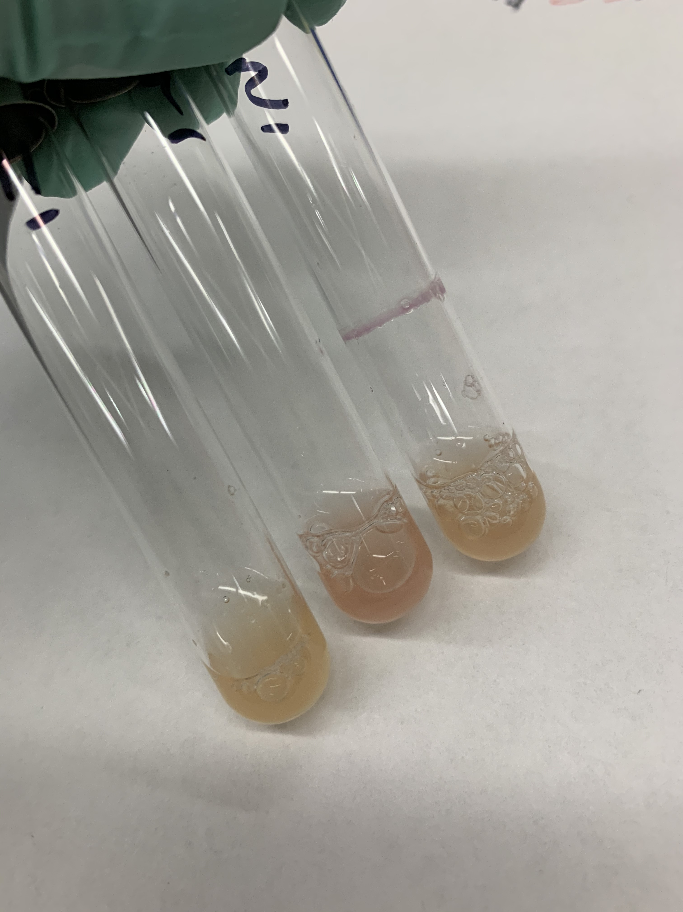
lac tubes
X3
X2
X1

Slide 4
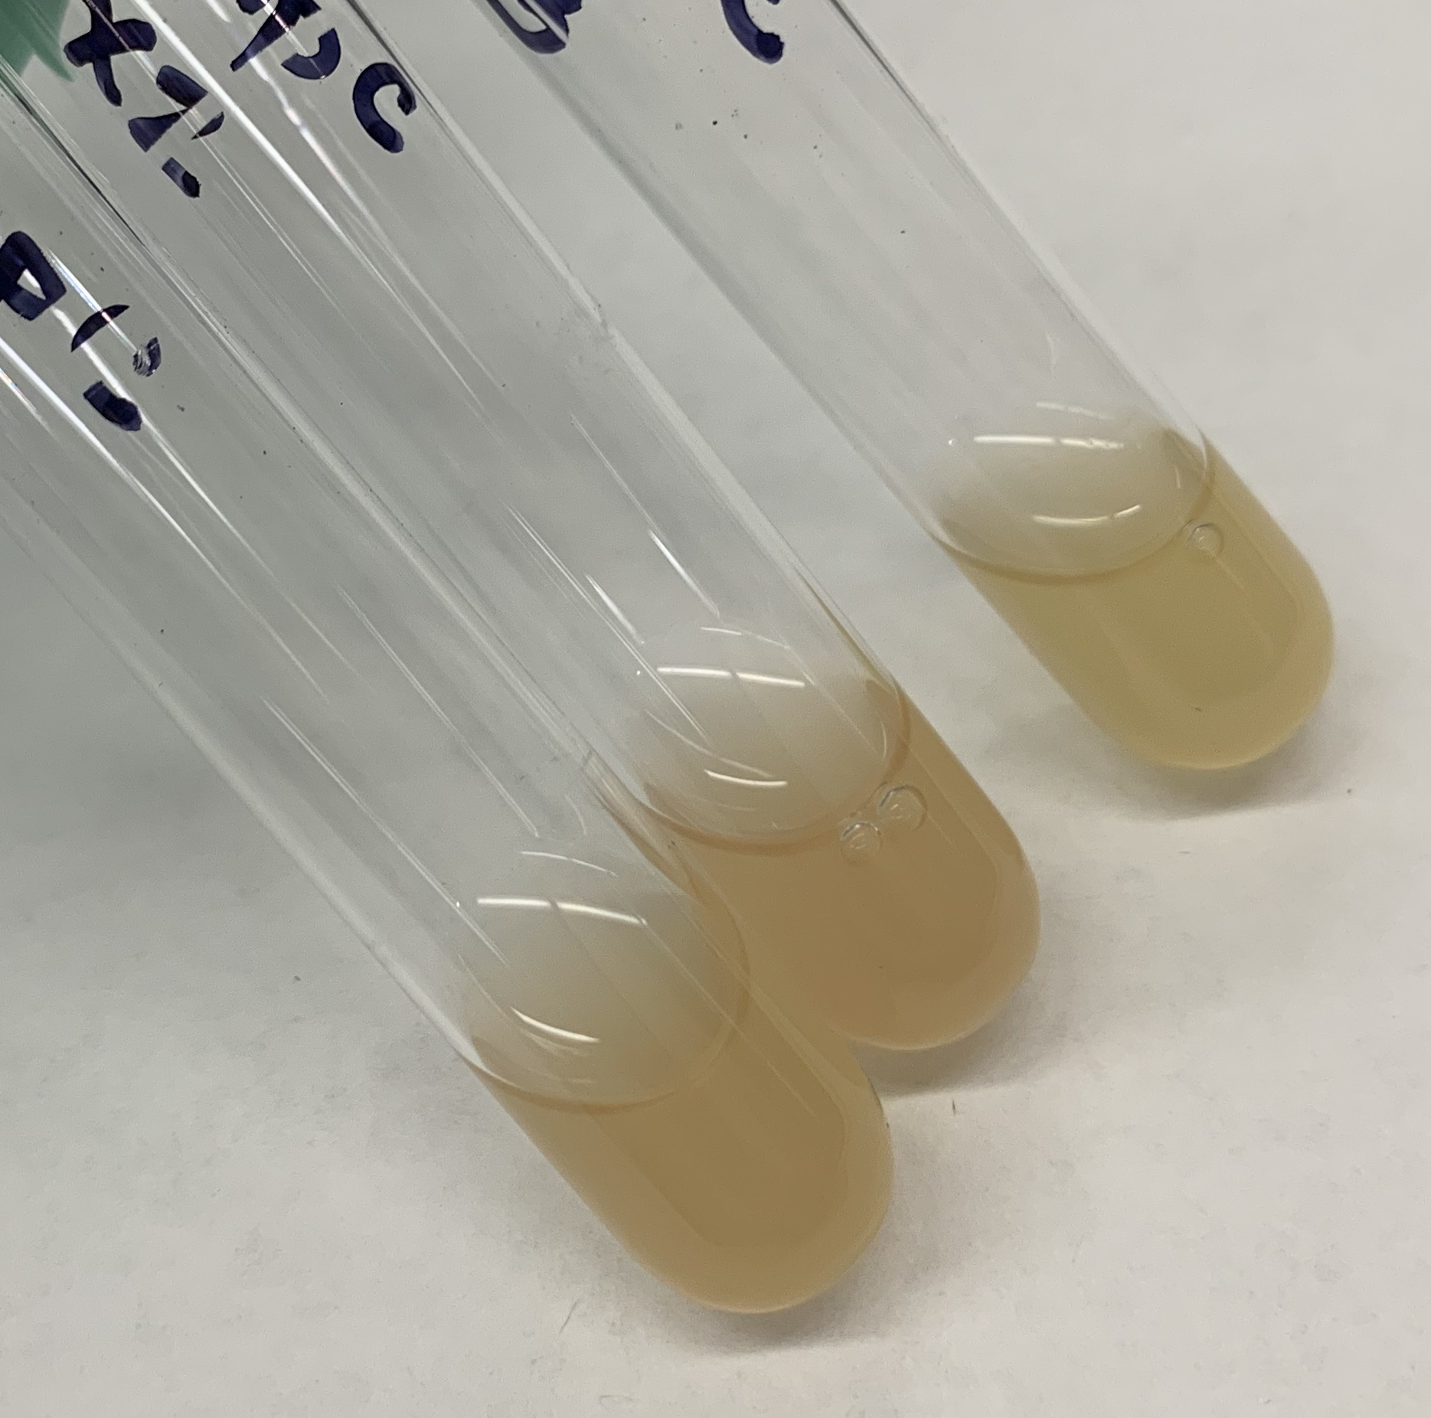
ompC tubes
X3
X2
X1

Slide 5
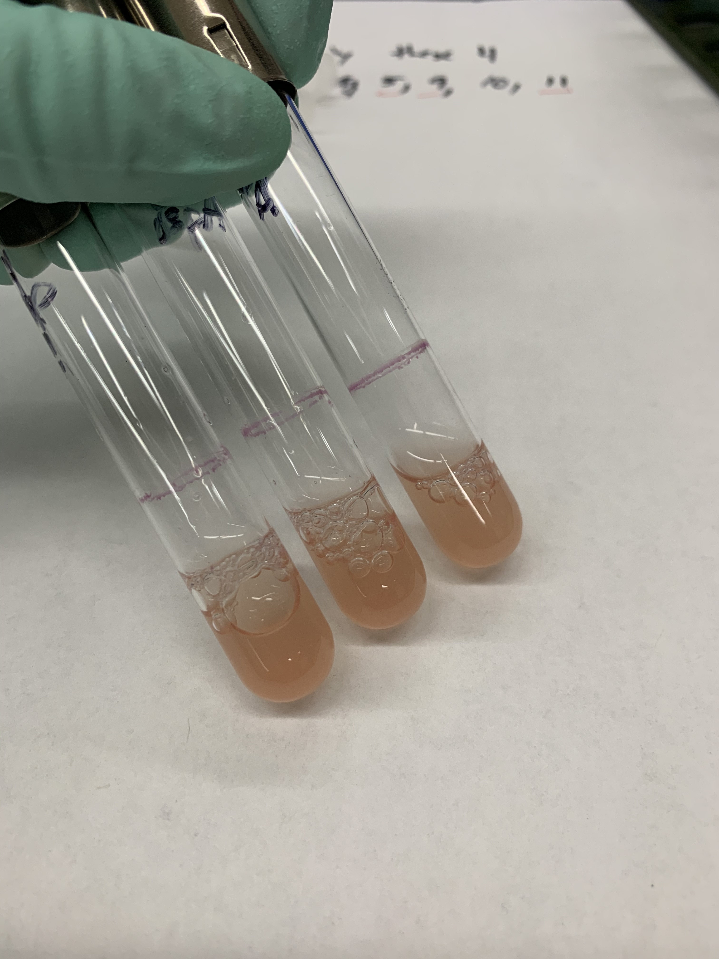
ospA tubes
X3
X2
X1

Slide 6
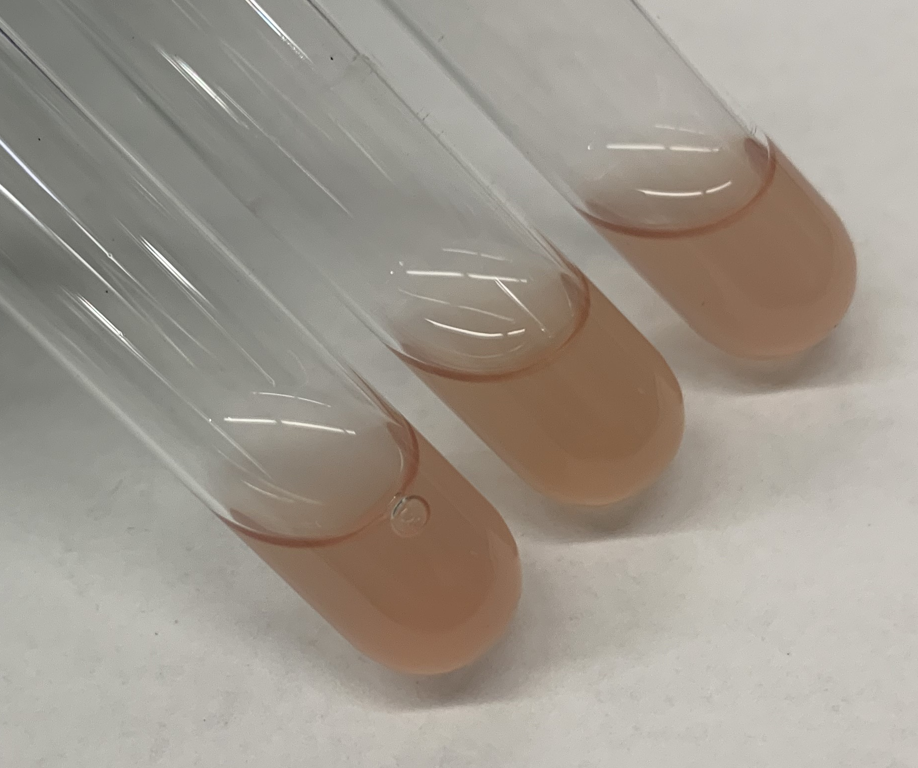
tet tubes
X3
X2
X1

Slide 7
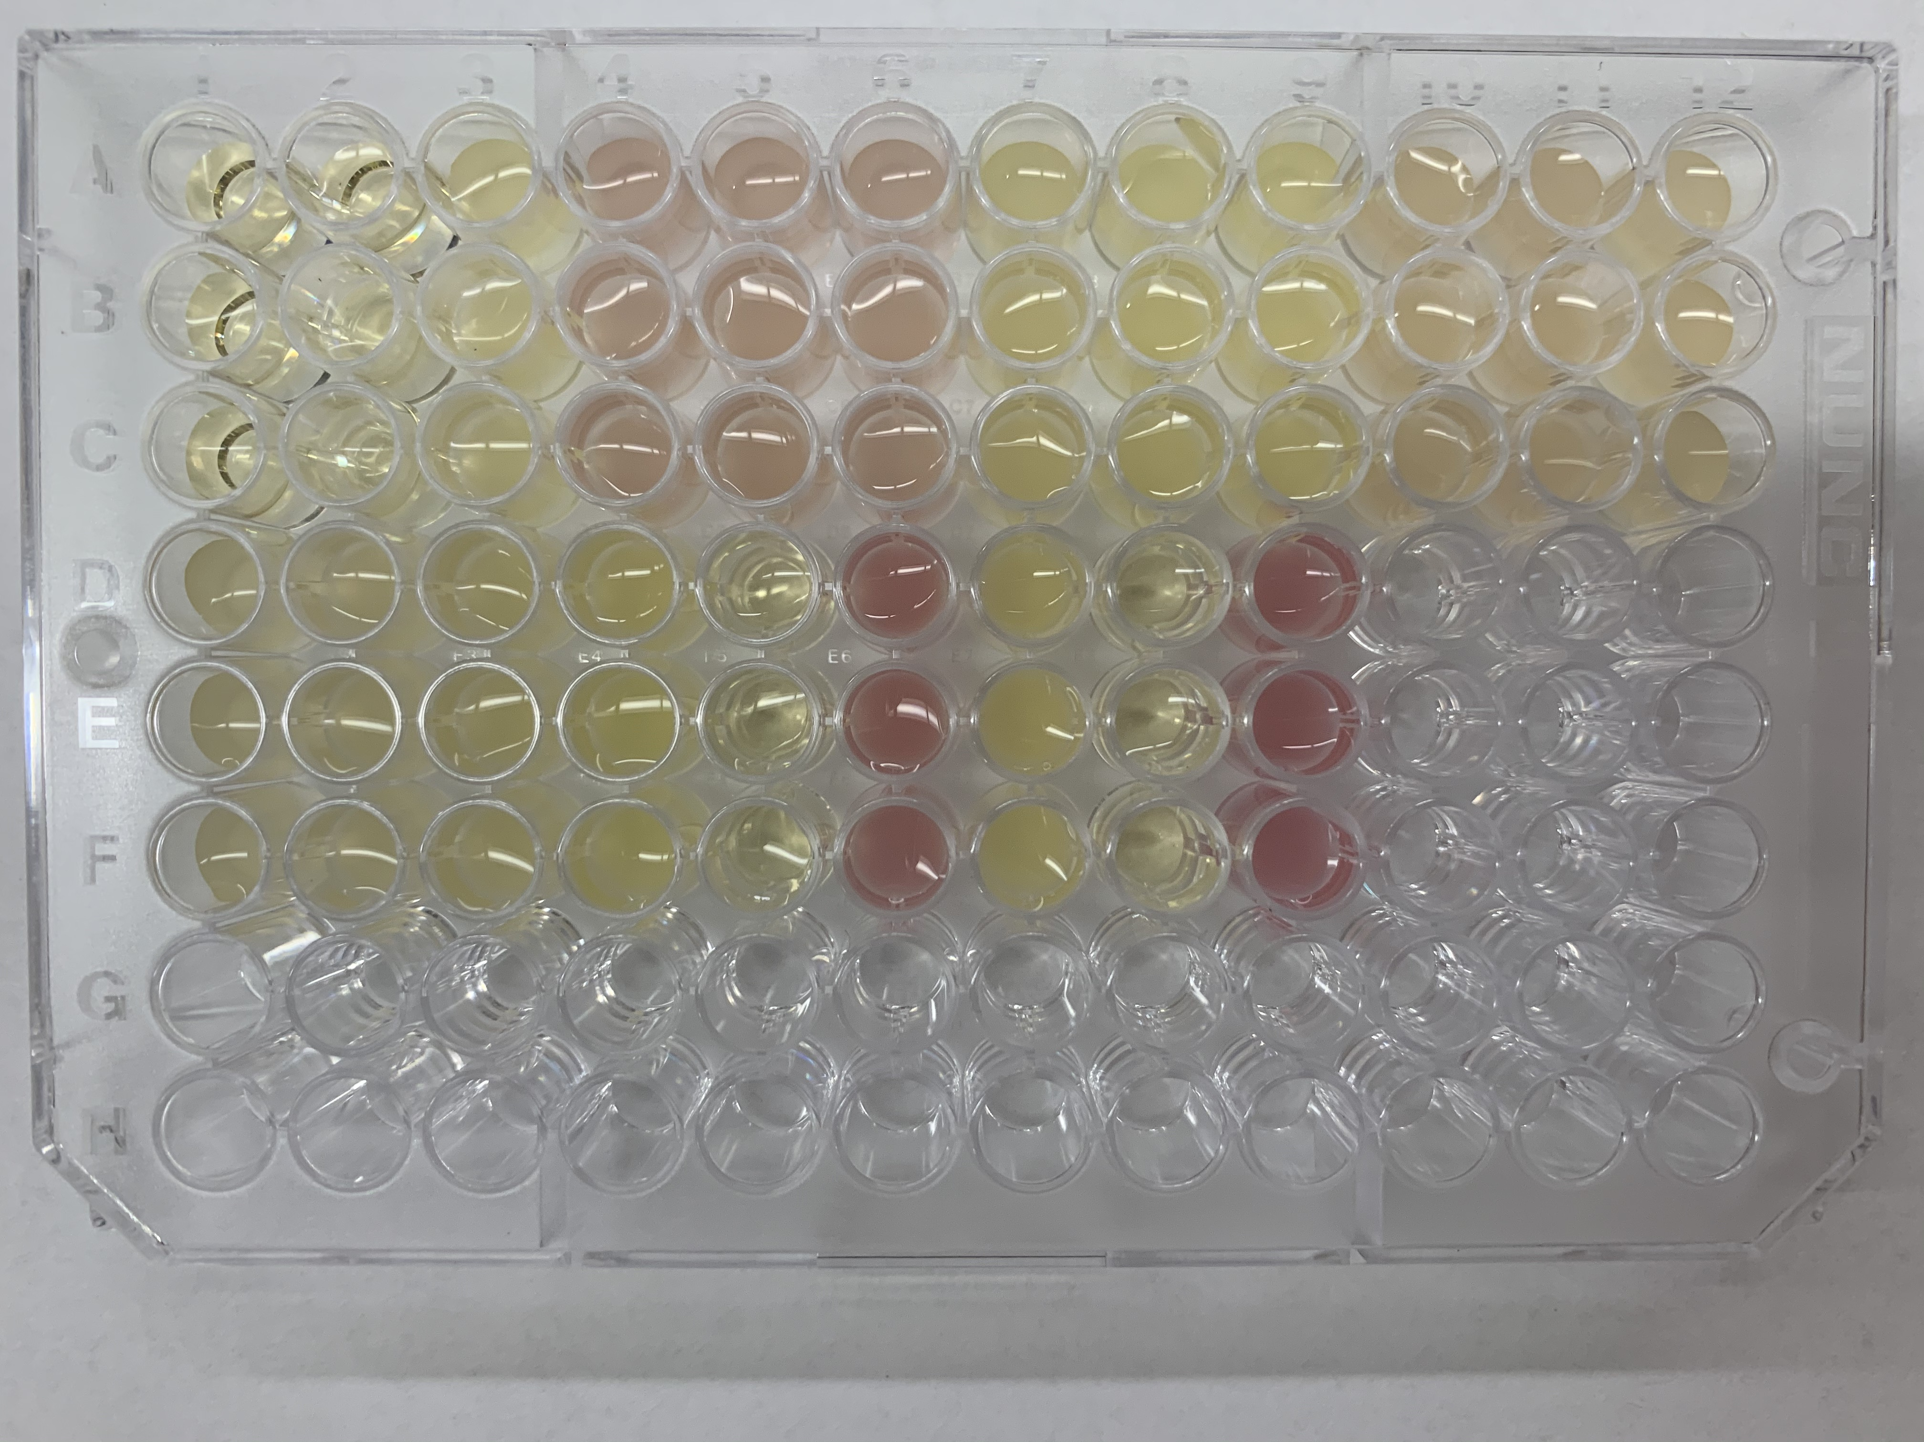
96-well plate, v2 samples (subset)

