Slide 1
This exercise is designed to help you understand how neurons work.
Sort the slides until they are in the correct sequence. Slides 1 – 5 are in the correct order, as is the last one.
The neuron icon at the top shows you where within a neuron the zoomed in portion is located.
Copyright, A. Malcolm Campbell, 2016
Notes:
Do not move this slide.
Copyright, A. Malcolm Campbell, 2016

Slide 2
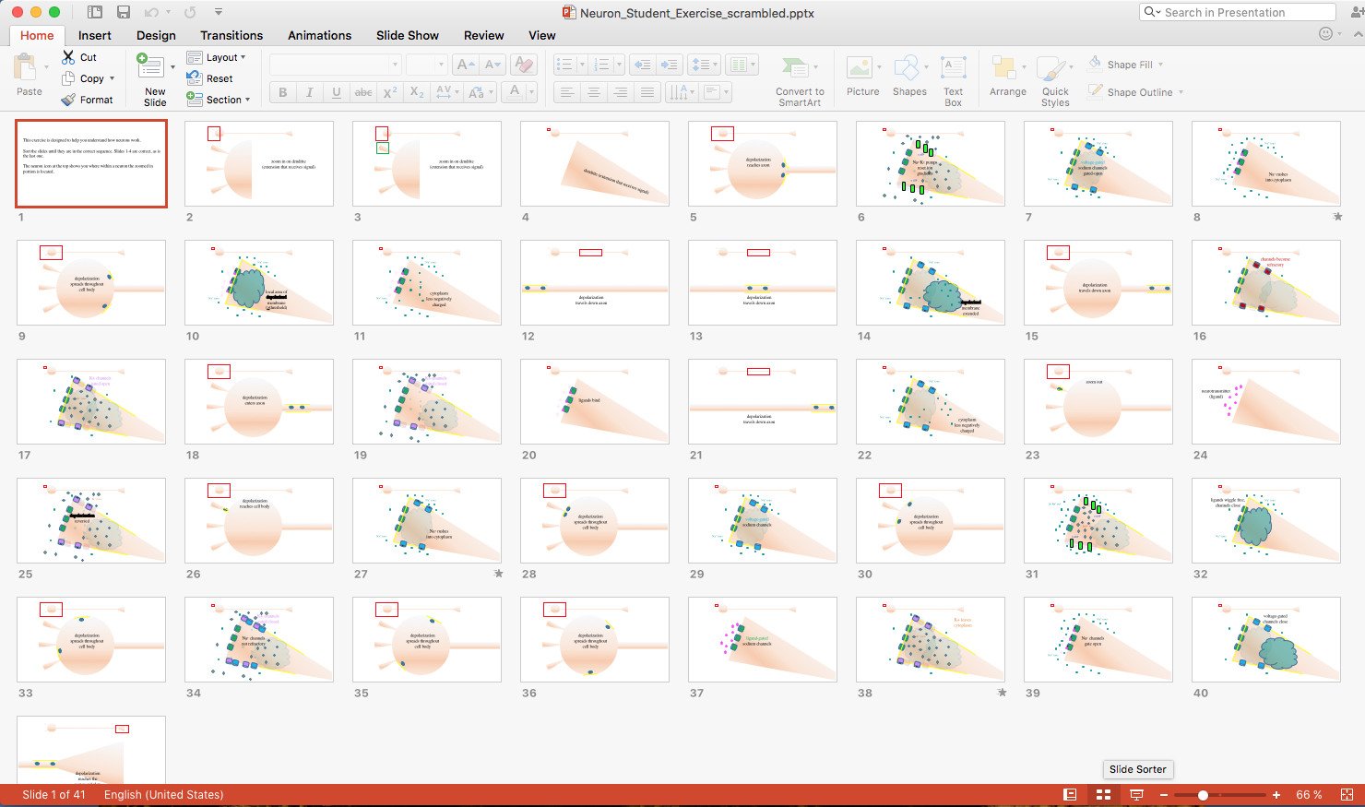
Click on the slide sorter so you can drag the slides into the correct order.
Copyright, A. Malcolm Campbell, 2016
Notes:
Do not move this slide.
Copyright, A. Malcolm Campbell, 2016

Slide 3
zoom in on dendrite
(extension that receives signal)
Copyright, A. Malcolm Campbell, 2016
Notes:
Do not move this slide.
Copyright, A. Malcolm Campbell, 2016

Slide 4
zoom in on dendrite
(extension that receives signal)
Copyright, A. Malcolm Campbell, 2016
Notes:
Do not move this slide.
Copyright, A. Malcolm Campbell, 2016

Slide 5
dendrite (extension that receives signal)
Copyright, A. Malcolm Campbell, 2016
Notes:
Do not move this slide.
Copyright, A. Malcolm Campbell, 2016

Slide 6
Ca²⁺ ions
Na⁺ ions
voltage-gated
Ca²⁺ channels
gated open
K⁺ ions
Na⁺ ions
Ca²⁺ ions
Copyright, A. Malcolm Campbell, 2016
Notes:
Sort this slide to its correct place in the sequence of all 61 slides.
Copyright, A. Malcolm Campbell, 2016

Slide 7
channels become
refractory
Copyright, A. Malcolm Campbell, 2016
Notes:
Sort this slide to its correct place in the sequence of all 42 slides.
Copyright, A. Malcolm Campbell, 2016

Slide 8
depolarization
reaches cell body
Copyright, A. Malcolm Campbell, 2016
Notes:
Sort this slide to its correct place in the sequence of all 42 slides.
Copyright, A. Malcolm Campbell, 2016

Slide 9
Na⁺ ions
voltage-gated
sodium channels
Na⁺ ions
Copyright, A. Malcolm Campbell, 2016
Notes:
Sort this slide to its correct place in the sequence of all 42 slides.
Copyright, A. Malcolm Campbell, 2016

Slide 10
Na⁺ ions
Na⁺/K⁺ pump
returned ions
to original locations
K⁺ ions
K⁺ ions
Na⁺ ions
Copyright, A. Malcolm Campbell, 2016
Notes:
Sort this slide to its correct place in the sequence of all 42 slides.
Copyright, A. Malcolm Campbell, 2016

Slide 11
depolarization
spreads throughout
cell body
Copyright, A. Malcolm Campbell, 2016
Notes:
Sort this slide to its correct place in the sequence of all 42 slides.
Copyright, A. Malcolm Campbell, 2016

Slide 12
K+ channels
gated closed
Copyright, A. Malcolm Campbell, 2016
Notes:
Sort this slide to its correct place in the sequence of all 42 slides.
Copyright, A. Malcolm Campbell, 2016

Slide 13
depolarization
spreads throughout
cell body
Copyright, A. Malcolm Campbell, 2016
Notes:
Sort this slide to its correct place in the sequence of all 42 slides.
Copyright, A. Malcolm Campbell, 2016

Slide 14
Na⁺ ions
K⁺ ions
vesicles bind
to plasma
membrane
Na⁺ ions
Copyright, A. Malcolm Campbell, 2016
Notes:
Sort this slide to its correct place in the sequence of all 42 slides.
Copyright, A. Malcolm Campbell, 2016

Slide 15
Na⁺ ions
Na⁺ rushes
into cytoplasm
Na⁺ ions
Copyright, A. Malcolm Campbell, 2016
Notes:
Sort this slide to its correct place in the sequence of all 42 slides.
Copyright, A. Malcolm Campbell, 2016

Slide 16
depolarization
travels down
axon
Copyright, A. Malcolm Campbell, 2016
Notes:
Sort this slide to its correct place in the sequence of all 42 slides.
Copyright, A. Malcolm Campbell, 2016

Slide 17
K⁺ ions
Na⁺ ions
Ca²⁺ pump
returned ions
to extracellular
space
K⁺ ions
Na⁺ ions
K⁺ ions
Copyright, A. Malcolm Campbell, 2016
Notes:
Sort this slide to its correct place in the sequence of all 42 slides.
Copyright, A. Malcolm Campbell, 2016

Slide 18
zoom out
Copyright, A. Malcolm Campbell, 2016
Notes:
Sort this slide to its correct place in the sequence of all 42 slides.
Copyright, A. Malcolm Campbell, 2016

Slide 19
K⁺ ions
depolarization reversed
Copyright, A. Malcolm Campbell, 2016
Notes:
Sort this slide to its correct place in the sequence of all 42 slides.
Copyright, A. Malcolm Campbell, 2016

Slide 20
depolarization
travels down axon
Copyright, A. Malcolm Campbell, 2016
Notes:
Sort this slide to its correct place in the sequence of all 42 slides.
Copyright, A. Malcolm Campbell, 2016

Slide 21
K+ channels
gated closed
Na⁺ channels
not refractory
Copyright, A. Malcolm Campbell, 2016
Notes:
Sort this slide to its correct place in the sequence of all 42 slides.
Copyright, A. Malcolm Campbell, 2016

Slide 22
depolarization
travels down axon
Copyright, A. Malcolm Campbell, 2016
Notes:
Sort this slide to its correct place in the sequence of all 42 slides.
Copyright, A. Malcolm Campbell, 2016

Slide 23
Na⁺ ions
Na⁺ rushes
into cytoplasm
Na⁺ ions
Copyright, A. Malcolm Campbell, 2016
Notes:
Sort this slide to its correct place in the sequence of all 42 slides.
Copyright, A. Malcolm Campbell, 2016

Slide 24
depolarization
reaches the
motor end plate
Copyright, A. Malcolm Campbell, 2016
Notes:
Sort this slide to its correct place in the sequence of all 42 slides.
Copyright, A. Malcolm Campbell, 2016

Slide 25
Na⁺ ions
voltage-gated
Na⁺ channels opened
Na⁺ ions
Copyright, A. Malcolm Campbell, 2016
Notes:
Sort this slide to its correct place in the sequence of all 42 slides.
Copyright, A. Malcolm Campbell, 2016

Slide 26
Na⁺ ions
cytoplasm
less negatively
charged
Na⁺ ions
Copyright, A. Malcolm Campbell, 2016
Notes:
Sort this slide to its correct place in the sequence of all 42 slides.
Copyright, A. Malcolm Campbell, 2016

Slide 27
Na⁺ ions
voltage-gated
Na⁺ channels closed,
become refractory
Na⁺ ions
Copyright, A. Malcolm Campbell, 2016
Notes:
Sort this slide to its correct place in the sequence of all 42 slides.
Copyright, A. Malcolm Campbell, 2016

Slide 28
Na⁺ ions
voltage-gated
Na⁺ channels
gated opened
Na⁺ ions
Copyright, A. Malcolm Campbell, 2016
Notes:
Sort this slide to its correct place in the sequence of all 42 slides.
Copyright, A. Malcolm Campbell, 2016

Slide 29
K+ leaves
cytoplasm
K⁺ ions
Copyright, A. Malcolm Campbell, 2016
Notes:
Sort this slide to its correct place in the sequence of all 42 slides.
Copyright, A. Malcolm Campbell, 2016

Slide 30
Na⁺ ions
K⁺ ions
voltage-gated
K⁺ channels opened
K⁺ ions
Na⁺ ions
Copyright, A. Malcolm Campbell, 2016
Notes:
Sort this slide to its correct place in the sequence of all 42 slides.
Copyright, A. Malcolm Campbell, 2016

Slide 31
K+ channels
gated open
K⁺ ions
Copyright, A. Malcolm Campbell, 2016
Notes:
Sort this slide to its correct place in the sequence of all 42 slides.
Copyright, A. Malcolm Campbell, 2016

Slide 32
Na⁺ ions
secretory vesicles
(neurotransmitters)
Na⁺/K⁺ pump
helped restore resting
membrane potential
K⁺ ions
Na⁺ ions
Copyright, A. Malcolm Campbell, 2016
Notes:
Sort this slide to its correct place in the sequence of all 42 slides.
Copyright, A. Malcolm Campbell, 2016

Slide 33
voltage-gated
channels close
Copyright, A. Malcolm Campbell, 2016
Notes:
Sort this slide to its correct place in the sequence of all 42 slides.
Copyright, A. Malcolm Campbell, 2016

Slide 34
ligand-gated
sodium channels
Copyright, A. Malcolm Campbell, 2016
Notes:
Sort this slide to its correct place in the sequence of all 42 slides.
Copyright, A. Malcolm Campbell, 2016

Slide 35
Na⁺ ions
secretory vesicles
(neurotransmitters)
depolarization
continued to
the terminus
K⁺ ions
Na⁺ ions
Copyright, A. Malcolm Campbell, 2016
Notes:
Sort this slide to its correct place in the sequence of all 42 slides.
Copyright, A. Malcolm Campbell, 2016

Slide 36
n ATP
Na^{+/}K⁺ pumps
reset ion gradients
n ATP
Copyright, A. Malcolm Campbell, 2016
Notes:
Sort this slide to its correct place in the sequence of all 42 slides.
Copyright, A. Malcolm Campbell, 2016

Slide 37
Na⁺ ions
K⁺ ions
membrane depolarization
reversed
K⁺ ions
Na⁺ ions
Copyright, A. Malcolm Campbell, 2016
Notes:
Sort this slide to its correct place in the sequence of all 42 slides.
Copyright, A. Malcolm Campbell, 2016

Slide 38
depolarization
spreads throughout
cell body
Copyright, A. Malcolm Campbell, 2016
Notes:
Sort this slide to its correct place in the sequence of all 42 slides.
Copyright, A. Malcolm Campbell, 2016

Slide 39
ligands bind
Copyright, A. Malcolm Campbell, 2016
Notes:
Sort this slide to its correct place in the sequence of all 42 slides.
Copyright, A. Malcolm Campbell, 2016

Slide 40
depolarization
spreads throughout
cell body
Copyright, A. Malcolm Campbell, 2016
Notes:
Sort this slide to its correct place in the sequence of all 42 slides.
Copyright, A. Malcolm Campbell, 2016

Slide 41
Ca²⁺ ions
Na⁺ ions
Ca²⁺ floods
cytoplasm
K⁺ ions
Na⁺ ions
Copyright, A. Malcolm Campbell, 2016
Notes:
Sort this slide to its correct place in the sequence of all 42 slides.
Copyright, A. Malcolm Campbell, 2016

Slide 42
Na⁺ ions
Na⁺ ions
cytoplasm
less negatively
charged
Copyright, A. Malcolm Campbell, 2016
Notes:
Sort this slide to its correct place in the sequence of all 42 slides.
Copyright, A. Malcolm Campbell, 2016

Slide 43
Na⁺ ions
local area of
depolarized membrane
(>threshold)
Na⁺ ions
Copyright, A. Malcolm Campbell, 2016
Notes:
Sort this slide to its correct place in the sequence of all 42 slides.
Copyright, A. Malcolm Campbell, 2016

Slide 44
Na⁺ ions
Ca²⁺ ions
K⁺ ions
Ca²⁺ binds to
vesicle membrane protein
Na⁺ ions
Copyright, A. Malcolm Campbell, 2016
Notes:
Sort this slide to its correct place in the sequence of all 42 slides.
Copyright, A. Malcolm Campbell, 2016

Slide 45
Na⁺ and K⁺ ions
return to original
locations
3n Na⁺ out
n ADP
2n K⁺ in
n ADP
Copyright, A. Malcolm Campbell, 2016
Notes:
Sort this slide to its correct place in the sequence of all 42 slides.
Copyright, A. Malcolm Campbell, 2016

Slide 46
depolarization
reaches axon
Copyright, A. Malcolm Campbell, 2016
Notes:
Sort this slide to its correct place in the sequence of all 42 slides.
Copyright, A. Malcolm Campbell, 2016

Slide 47
ligands wiggled free,
channels closed
Na⁺ ions
Na⁺ ions
Copyright, A. Malcolm Campbell, 2016
Notes:
Sort this slide to its correct place in the sequence of all 42 slides.
Copyright, A. Malcolm Campbell, 2016

Slide 48
K⁺ ions
Na⁺ ions
membrane depolarization
reversed
Ca²⁺ channels
closed
K⁺ ions
vesicles bind
to plasma
membrane
Na⁺ ions
K⁺ ions
Copyright, A. Malcolm Campbell, 2016
Notes:
Sort this slide to its correct place in the sequence of all 42 slides.
Copyright, A. Malcolm Campbell, 2016

Slide 49
Na⁺ ions
voltage-gated
sodium channels
gated-open
Na⁺ ions
Copyright, A. Malcolm Campbell, 2016
Notes:
Sort this slide to its correct place in the sequence of all 42 slides.
Copyright, A. Malcolm Campbell, 2016

Slide 50
K⁺ ions
Na⁺ ions
K⁺ ions
membranes
fuse
Na⁺ ions
K⁺ ions
Copyright, A. Malcolm Campbell, 2016
Notes:
Sort this slide to its correct place in the sequence of all 42 slides.
Copyright, A. Malcolm Campbell, 2016

Slide 51
depolarization
spreads throughout
cell body
Copyright, A. Malcolm Campbell, 2016
Notes:
Sort this slide to its correct place in the sequence of all 42 slides.
Copyright, A. Malcolm Campbell, 2016

Slide 52
K⁺ ions
Na⁺ ions
K⁺ ions
neurotransmitter
released into
synapse
Na⁺ ions
K⁺ ions
Copyright, A. Malcolm Campbell, 2016
Notes:
Sort this slide to its correct place in the sequence of all 42 slides.
Copyright, A. Malcolm Campbell, 2016

Slide 53
depolarization
spreads throughout
cell body
Copyright, A. Malcolm Campbell, 2016
Notes:
Sort this slide to its correct place in the sequence of all 42 slides.
Copyright, A. Malcolm Campbell, 2016

Slide 54
depolarization
reaches axon
Copyright, A. Malcolm Campbell, 2016
Notes:
Sort this slide to its correct place in the sequence of all 42 slides.
Copyright, A. Malcolm Campbell, 2016

Slide 55
Na⁺ ions
neuron ready
for next
action potential
K⁺ ions
K⁺ ions
Na⁺ ions
Copyright, A. Malcolm Campbell, 2016
Notes:
Sort this slide to its correct place in the sequence of all 42 slides.
Copyright, A. Malcolm Campbell, 2016

Slide 56
Na⁺ ions
Na⁺ ions
depolarized membrane extended
Copyright, A. Malcolm Campbell, 2016
Notes:
Sort this slide to its correct place in the sequence of all 42 slides.
Copyright, A. Malcolm Campbell, 2016

Slide 57
neurotransmitter
(ligand)
Copyright, A. Malcolm Campbell, 2016
Notes:
Sort this slide to its correct place in the sequence of all 42 slides.
Copyright, A. Malcolm Campbell, 2016

Slide 58
Ca²⁺ ions
Na⁺ ions
secretory vesicles
(neurotransmitters)
voltage-gated
Ca²⁺ channels
K⁺ ions
Na⁺ ions
Ca²⁺ ions
Copyright, A. Malcolm Campbell, 2016
Notes:
Sort this slide to its correct place in the sequence of all 42 slides.
Copyright, A. Malcolm Campbell, 2016

Slide 59
depolarization
travels down axon
Copyright, A. Malcolm Campbell, 2016
Notes:
Sort this slide to its correct place in the sequence of all 42 slides.
Copyright, A. Malcolm Campbell, 2016

Slide 60
Na⁺ ions
Na⁺ channels
gate open
Na⁺ ions
Copyright, A. Malcolm Campbell, 2016
Notes:
Sort this slide to its correct place in the sequence of all 42 slides.
Copyright, A. Malcolm Campbell, 2016

Slide 61
ready to start over again
Copyright, A. Malcolm Campbell, 2016
Notes:
Sort this slide to its correct place in the sequence of all 42 slides.
Copyright, A. Malcolm Campbell, 2016

