Slide 1
This exercise is designed to help you understand how neurons work.
Sort the slides until they are in the correct sequence. Slides 1 – 5 are in the correct order, as is the last one.
The neuron icon at the top shows you where within a neuron the zoomed in portion is located.
Notes:
Do not move this slide.
Copyright, A. Malcolm Campbell, 2016

Slide 2
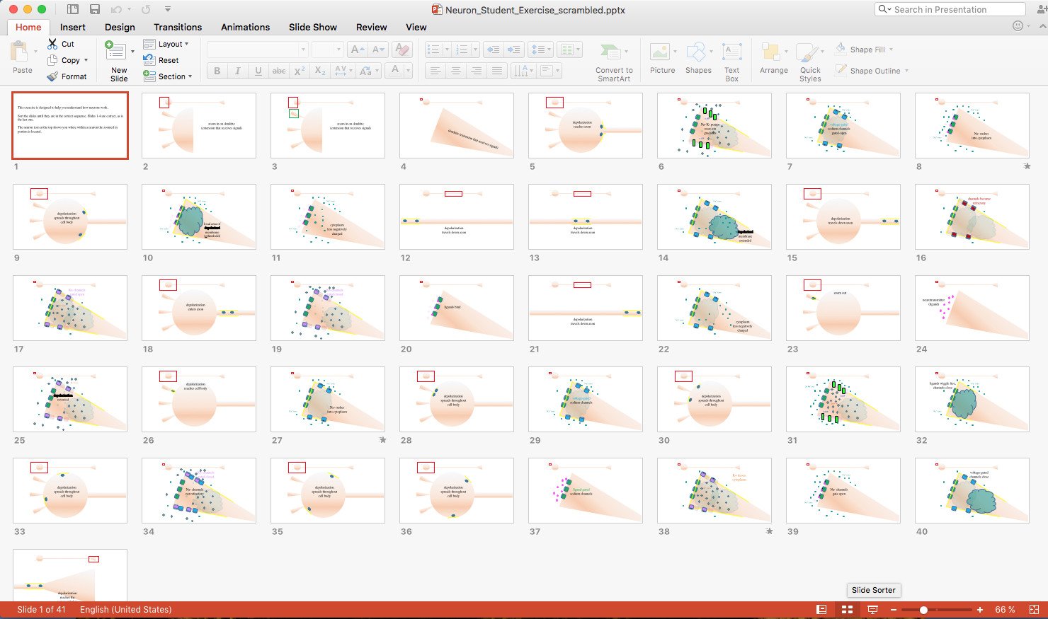
Click on the slide sorter so you can drag the slides into the correct order.
Notes:
Do not move this slide.
Copyright, A. Malcolm Campbell, 2016

Slide 3
zoom in on dendrite
(extension that receives signal)
Notes:
Do not move this slide.
Copyright, A. Malcolm Campbell, 2016

Slide 4
zoom in on dendrite
(extension that receives signal)
Notes:
Do not move this slide.
Copyright, A. Malcolm Campbell, 2016

Slide 5
dendrite (extension that receives signal)
Notes:
Do not move this slide.
Copyright, A. Malcolm Campbell, 2016

Slide 6
depolarization
reaches axon
Notes:
Sort this slide to its correct place in the sequence of all 42 slides.
Copyright, A. Malcolm Campbell, 2016

Slide 7
n ATP
Na^{+/}K⁺ pumps
reset ion gradients
n ATP
Notes:
Sort this slide to its correct place in the sequence of all 42 slides.
Copyright, A. Malcolm Campbell, 2016

Slide 8
Na⁺ ions
voltage-gated
sodium channels
gated-open
Na⁺ ions
Notes:
Sort this slide to its correct place in the sequence of all 42 slides.
Copyright, A. Malcolm Campbell, 2016

Slide 9
Na⁺ ions
Na⁺ rushes
into cytoplasm
Na⁺ ions
Notes:
Sort this slide to its correct place in the sequence of all 42 slides.
Copyright, A. Malcolm Campbell, 2016

Slide 10
depolarization
spreads throughout
cell body
Notes:
Sort this slide to its correct place in the sequence of all 42 slides.
Copyright, A. Malcolm Campbell, 2016

Slide 11
Na⁺ ions
local area of
depolarized membrane
(>threshold)
Na⁺ ions
Notes:
Sort this slide to its correct place in the sequence of all 42 slides.
Copyright, A. Malcolm Campbell, 2016

Slide 12
Na⁺ ions
cytoplasm
less negatively
charged
Na⁺ ions
Notes:
Sort this slide to its correct place in the sequence of all 42 slides.
Copyright, A. Malcolm Campbell, 2016

Slide 13
depolarization
travels down axon
Notes:
Sort this slide to its correct place in the sequence of all 42 slides.
Copyright, A. Malcolm Campbell, 2016

Slide 14
depolarization
travels down axon
Notes:
Sort this slide to its correct place in the sequence of all 42 slides.
Copyright, A. Malcolm Campbell, 2016

Slide 15
Na⁺ ions
Na⁺ ions
depolarized membrane extended
Notes:
Sort this slide to its correct place in the sequence of all 42 slides.
Copyright, A. Malcolm Campbell, 2016

Slide 16
depolarization
travels down axon
Notes:
Sort this slide to its correct place in the sequence of all 42 slides.
Copyright, A. Malcolm Campbell, 2016

Slide 17
channels become
refractory
Notes:
Sort this slide to its correct place in the sequence of all 42 slides.
Copyright, A. Malcolm Campbell, 2016

Slide 18
K+ channels
gated open
K⁺ ions
Notes:
Sort this slide to its correct place in the sequence of all 42 slides.
Copyright, A. Malcolm Campbell, 2016

Slide 19
depolarization
enters axon
Notes:
Sort this slide to its correct place in the sequence of all 42 slides.
Copyright, A. Malcolm Campbell, 2016

Slide 20
K+ channels
gated closed
Notes:
Sort this slide to its correct place in the sequence of all 42 slides.
Copyright, A. Malcolm Campbell, 2016

Slide 21
ligands bind
Notes:
Sort this slide to its correct place in the sequence of all 42 slides.
Copyright, A. Malcolm Campbell, 2016

Slide 22
depolarization
travels down axon
Notes:
Sort this slide to its correct place in the sequence of all 42 slides.
Copyright, A. Malcolm Campbell, 2016

Slide 23
Na⁺ ions
Na⁺ ions
cytoplasm
less negatively
charged
Notes:
Sort this slide to its correct place in the sequence of all 42 slides.
Copyright, A. Malcolm Campbell, 2016

Slide 24
zoom out
Notes:
Sort this slide to its correct place in the sequence of all 42 slides.
Copyright, A. Malcolm Campbell, 2016

Slide 25
neurotransmitter
(ligand)
Notes:
Sort this slide to its correct place in the sequence of all 42 slides.
Copyright, A. Malcolm Campbell, 2016

Slide 26
K⁺ ions
depolarization reversed
Notes:
Sort this slide to its correct place in the sequence of all 42 slides.
Copyright, A. Malcolm Campbell, 2016

Slide 27
depolarization
reaches cell body
Notes:
Sort this slide to its correct place in the sequence of all 42 slides.
Copyright, A. Malcolm Campbell, 2016

Slide 28
Na⁺ ions
Na⁺ rushes
into cytoplasm
Na⁺ ions
Notes:
Sort this slide to its correct place in the sequence of all 42 slides.
Copyright, A. Malcolm Campbell, 2016

Slide 29
depolarization
spreads throughout
cell body
Notes:
Sort this slide to its correct place in the sequence of all 42 slides.
Copyright, A. Malcolm Campbell, 2016

Slide 30
Na⁺ ions
voltage-gated
sodium channels
Na⁺ ions
Notes:
Sort this slide to its correct place in the sequence of all 42 slides.
Copyright, A. Malcolm Campbell, 2016

Slide 31
depolarization
spreads throughout
cell body
Notes:
Sort this slide to its correct place in the sequence of all 42 slides.
Copyright, A. Malcolm Campbell, 2016

Slide 32
3n Na⁺ out
n ADP
2n K⁺ in
n ADP
Notes:
Sort this slide to its correct place in the sequence of all 42 slides.
Copyright, A. Malcolm Campbell, 2016

Slide 33
ligands wiggle free,
channels close
Na⁺ ions
Na⁺ ions
Notes:
Sort this slide to its correct place in the sequence of all 42 slides.
Copyright, A. Malcolm Campbell, 2016

Slide 34
depolarization
spreads throughout
cell body
Notes:
Sort this slide to its correct place in the sequence of all 42 slides.
Copyright, A. Malcolm Campbell, 2016

Slide 35
K+ channels
gated closed
Na⁺ channels
not refractory
Notes:
Sort this slide to its correct place in the sequence of all 42 slides.
Copyright, A. Malcolm Campbell, 2016

Slide 36
depolarization
spreads throughout
cell body
Notes:
Sort this slide to its correct place in the sequence of all 42 slides.
Copyright, A. Malcolm Campbell, 2016

Slide 37
depolarization
spreads throughout
cell body
Notes:
Sort this slide to its correct place in the sequence of all 42 slides.
Copyright, A. Malcolm Campbell, 2016

Slide 38
ligand-gated
sodium channels
Notes:
Sort this slide to its correct place in the sequence of all 42 slides.
Copyright, A. Malcolm Campbell, 2016

Slide 39
K+ leaves
cytoplasm
K⁺ ions
Notes:
Sort this slide to its correct place in the sequence of all 42 slides.
Copyright, A. Malcolm Campbell, 2016

Slide 40
Na⁺ ions
Na⁺ channels
gate open
Na⁺ ions
Notes:
Sort this slide to its correct place in the sequence of all 42 slides.
Copyright, A. Malcolm Campbell, 2016

Slide 41
voltage-gated
channels close
Notes:
Sort this slide to its correct place in the sequence of all 42 slides.
Copyright, A. Malcolm Campbell, 2016

Slide 42
depolarization
reaches the
motor end plate
Notes:
Sort this slide to its correct place in the sequence of all 42 slides.
Copyright, A. Malcolm Campbell, 2016

