Slide 1
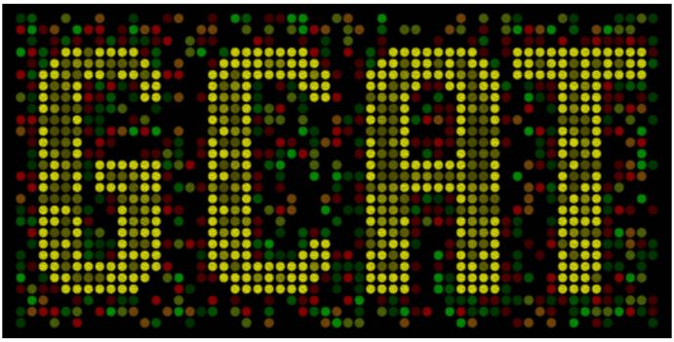


Synthetic Biology Workshop
March 26, 2011
A. Malcolm Campbell
Biology
Todd T. Eckdahl
Biology
Laurie J. Heyer
Mathematics
Jeffrey L. Poet
Math, CS and Physics

Slide 2
What is synthetic biology?
Is it different from molecular biology?

Slide 3
Synthetic Biology
Use of engineering principles and mathematical modeling to the design and construction of biological parts, devices, and systems with applications in energy, medicine, and technology.

Slide 4
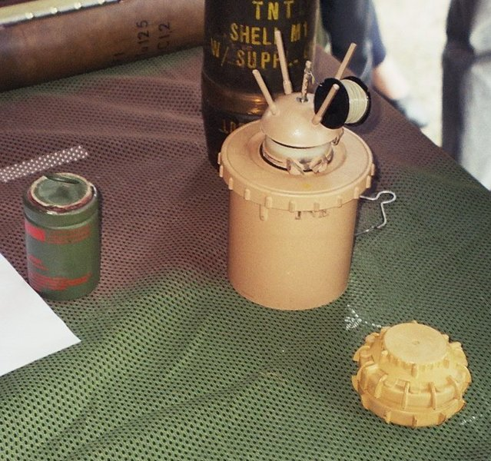

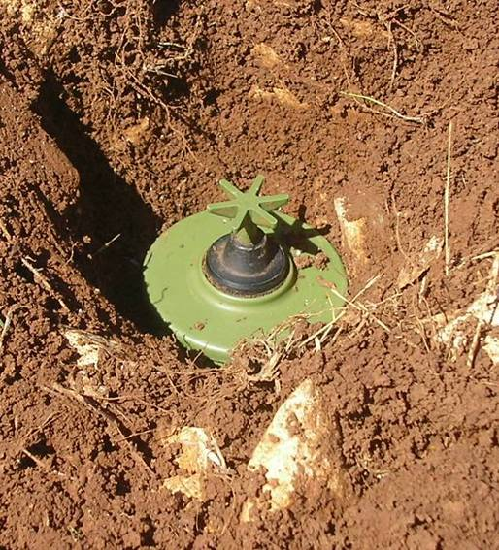
Land Mine Detection
Notes:
About 20,000 people injured or killed each year.

Slide 5
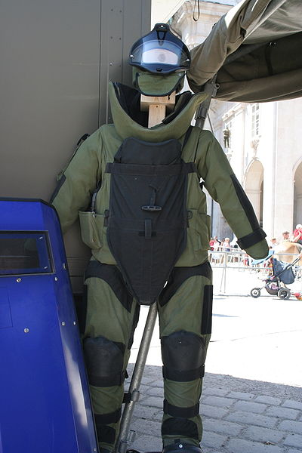
Land Mine Detection

Slide 6
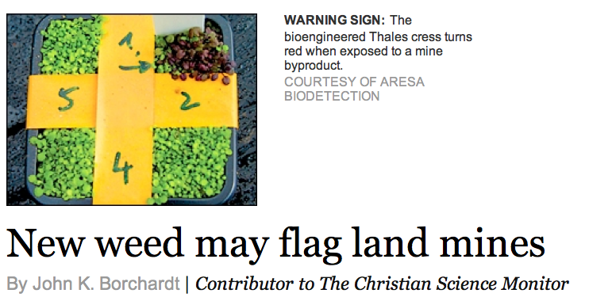
Synthetic Biology
Land Mine Detection
Notes:
About 20,000 people injured or killed each year.

Slide 7
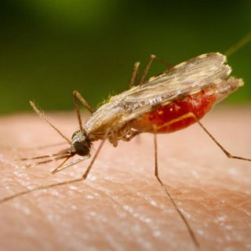
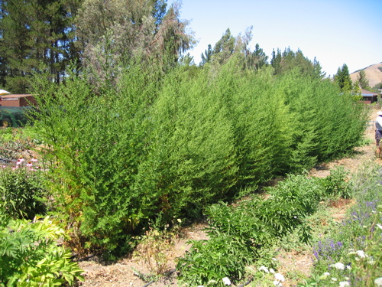
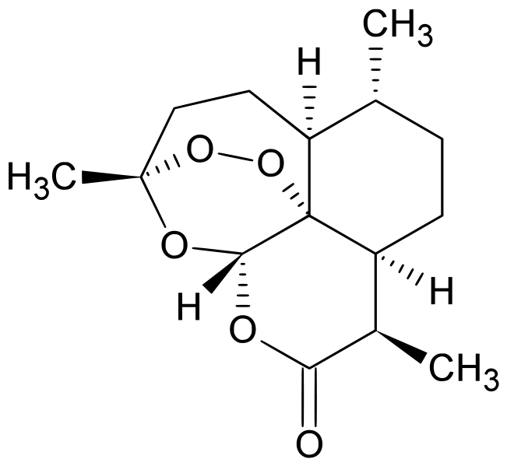
Production of Medicines
$1 per pill
Notes:
1 million people die each year from malaria, most of them children under the age of 5.

Slide 8
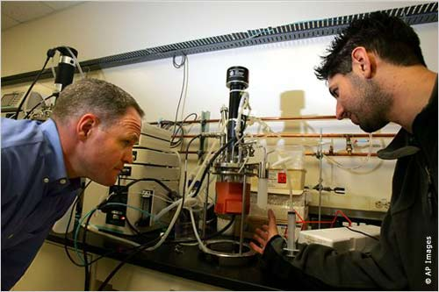
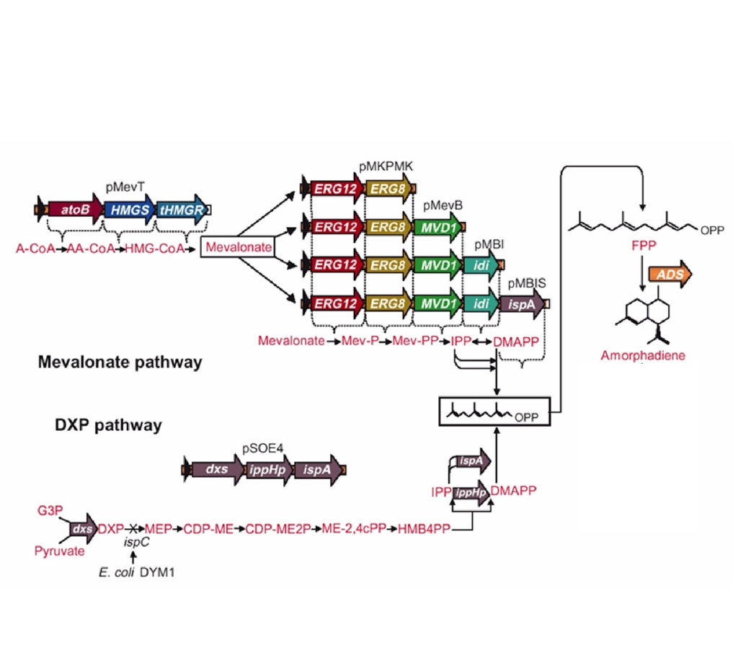
Production of Medicines
10¢ per pill

Slide 9
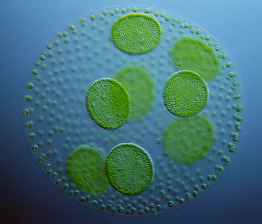
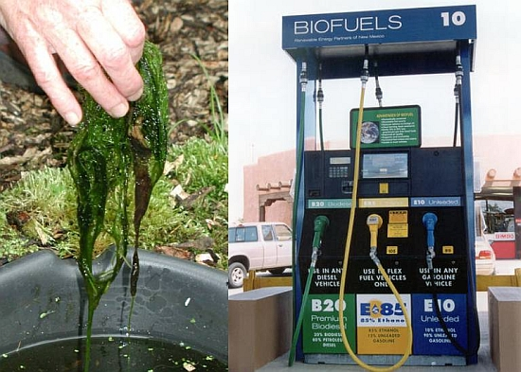
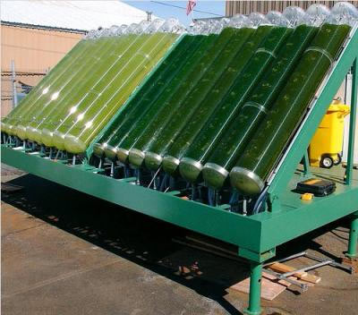
Biofuels from Algae
CO -neutral
2
1,000,000 gallons in 2008

Slide 10

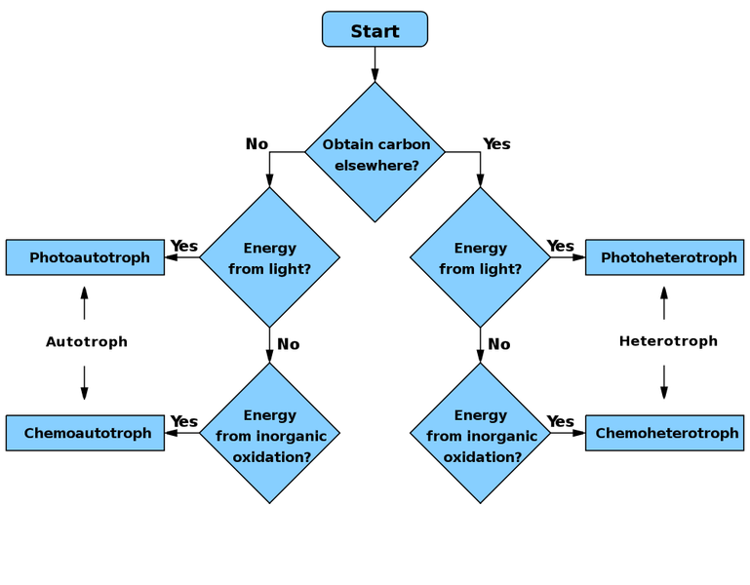
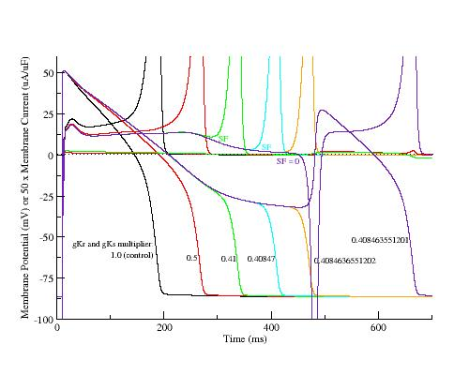
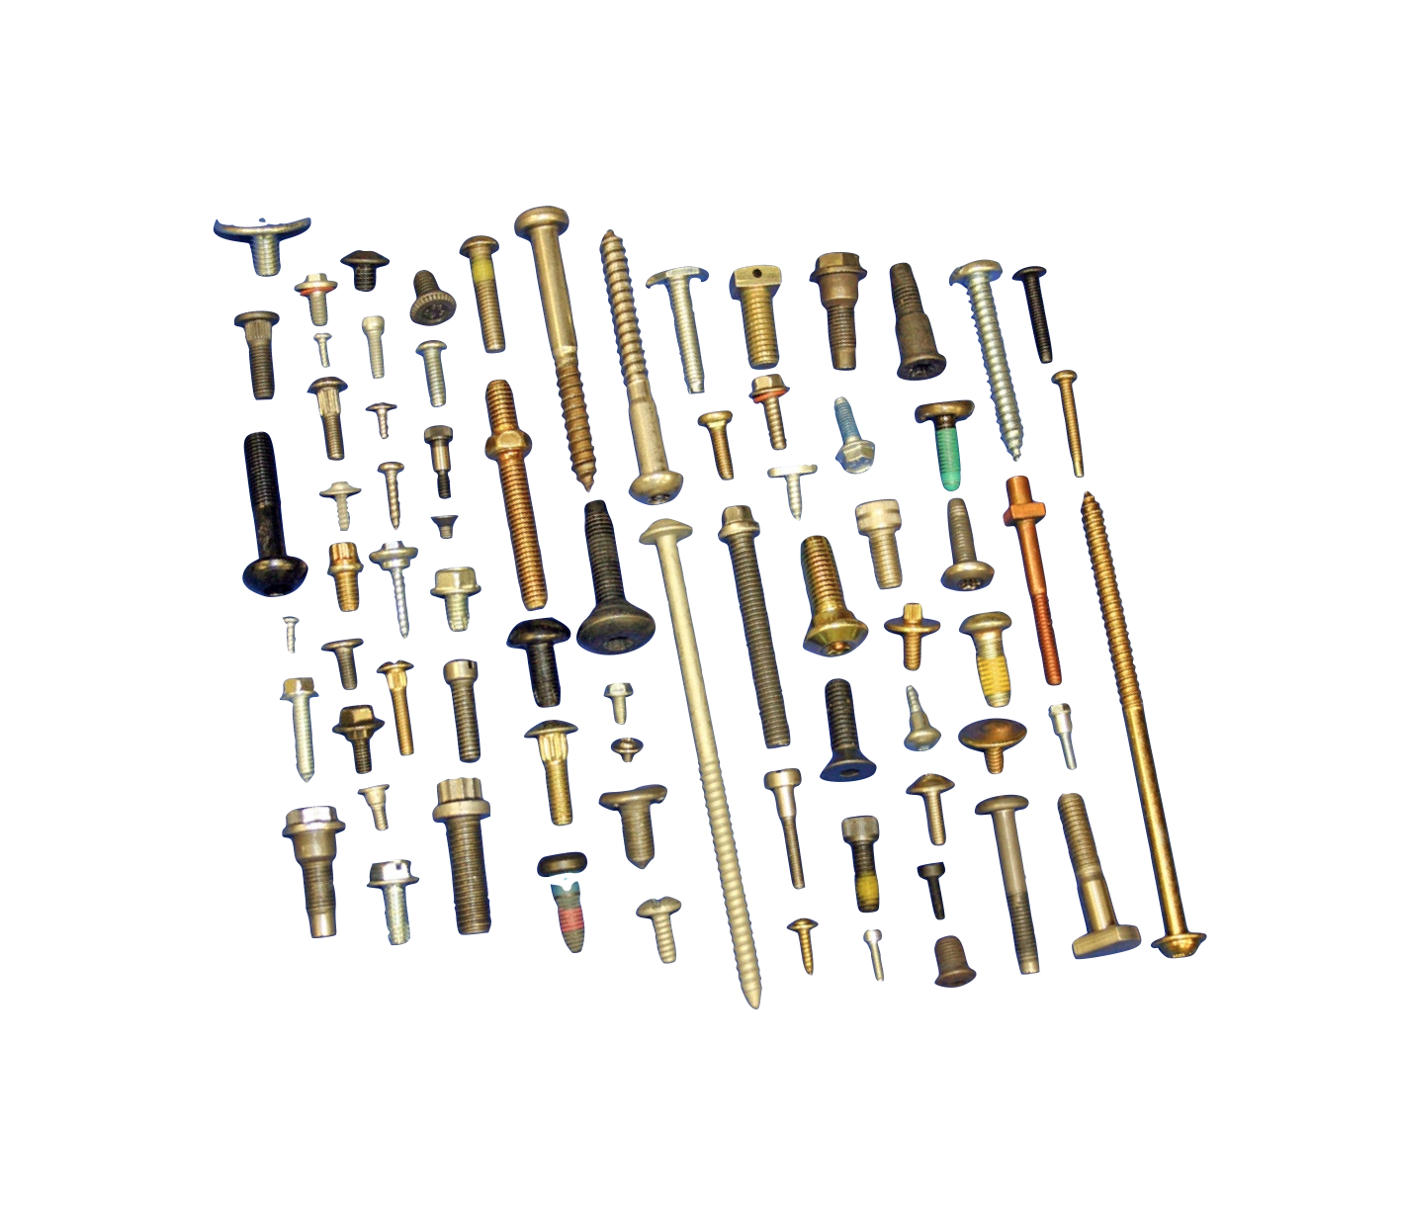
How is Synthetic Biology Different?
Standardization
Modularity
Abstraction
Modeling

Slide 11
How is synthetic biology well-suited for undergraduate interdisciplinary research?

Slide 12
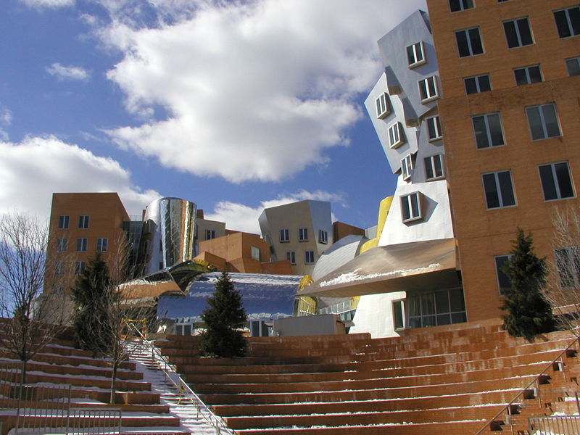
The iGEM Jamboree at MIT

Slide 13
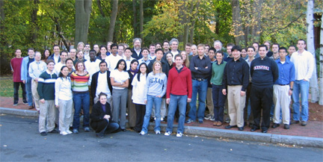

iGEM 2004
5 teams

Slide 14
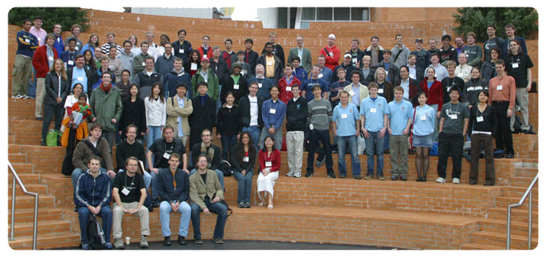
iGEM 2005
13 teams
Princeton Oklahoma ETH Zurich MIT Caltech Toronto Cambridge
Texas Penn State Berkeley Davidson Harvard UCSF

Slide 15
iGEM 2005
13 teams
Princeton Oklahoma ETH Zurich MIT Caltech Toronto Cambridge
Texas Penn State Berkeley Davidson Harvard UCSF

Slide 16
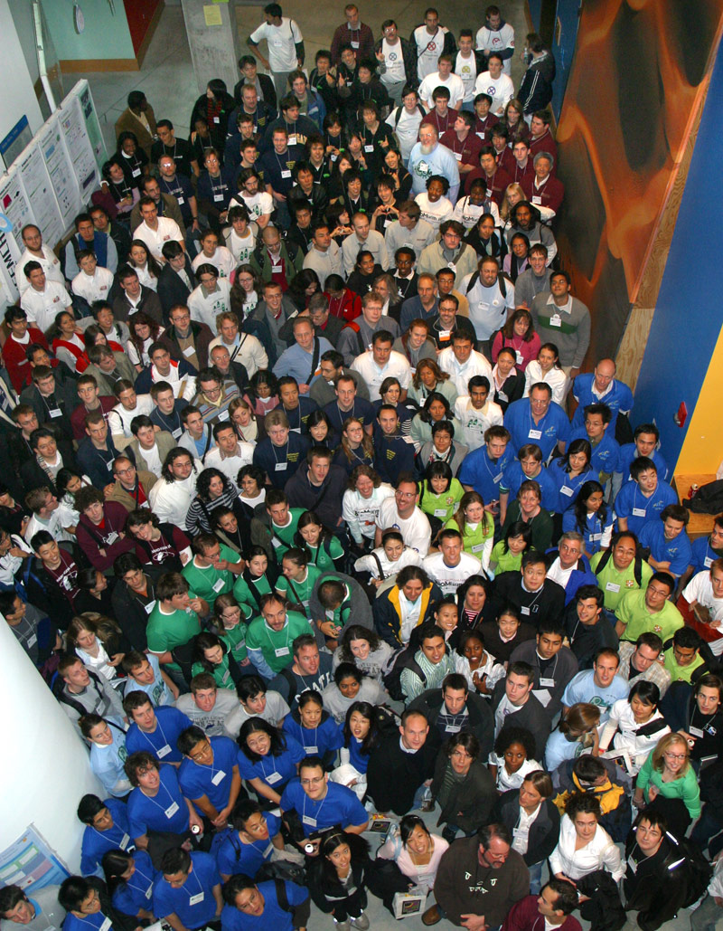
iGEM 2006
32 teams

Slide 17
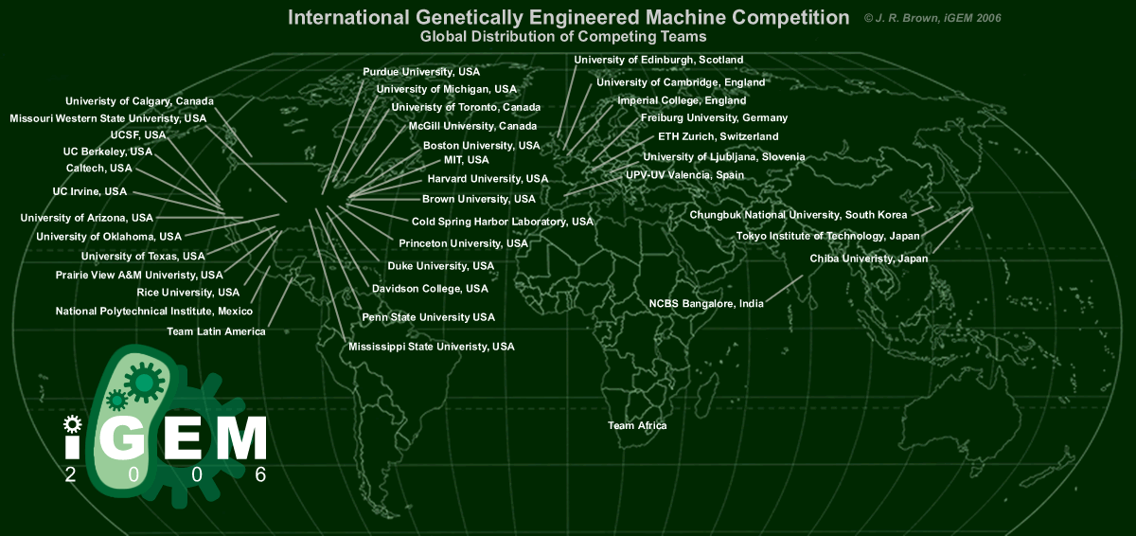
Putting the “i” in iGEM

Slide 18
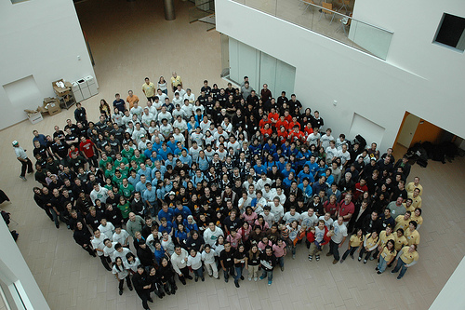
2007
54 teams

Slide 19
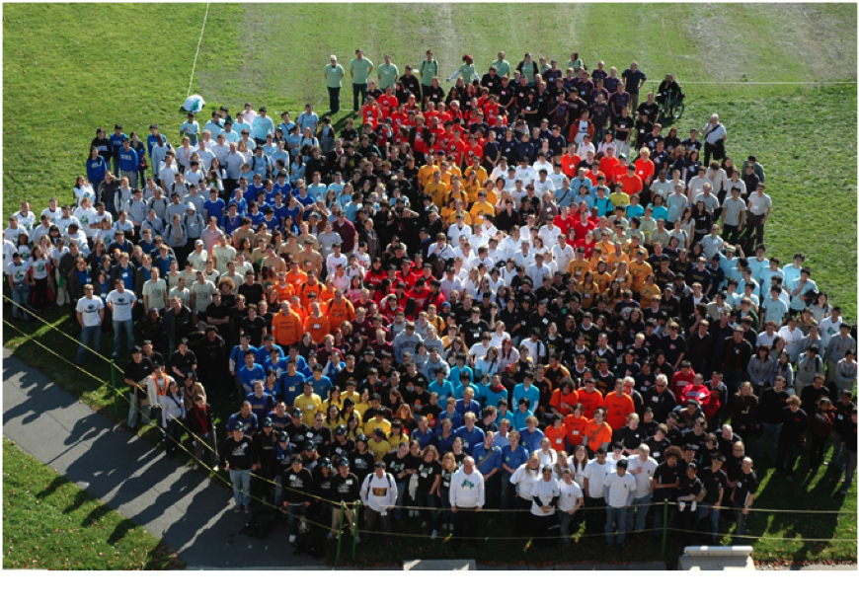
2008
84 teams

Slide 20
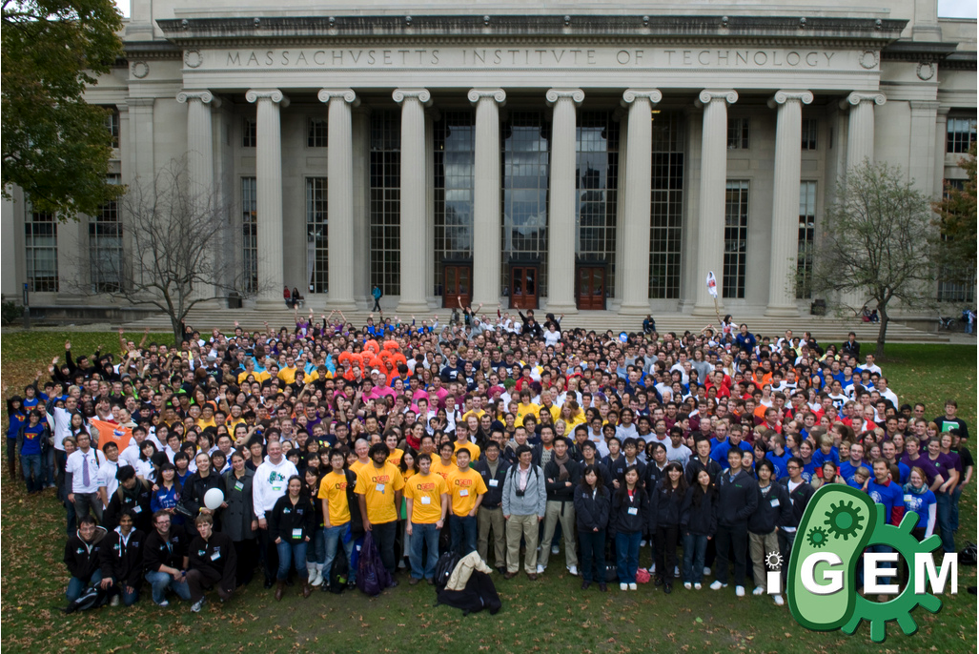
2009
112 teams

Slide 21
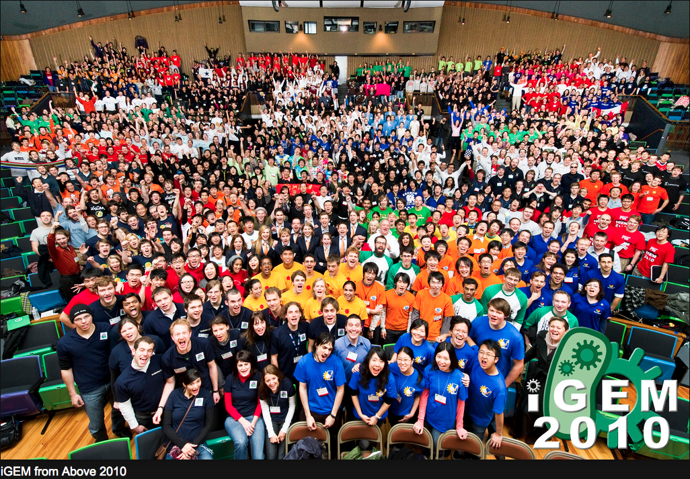
2010
128 teams

Slide 22
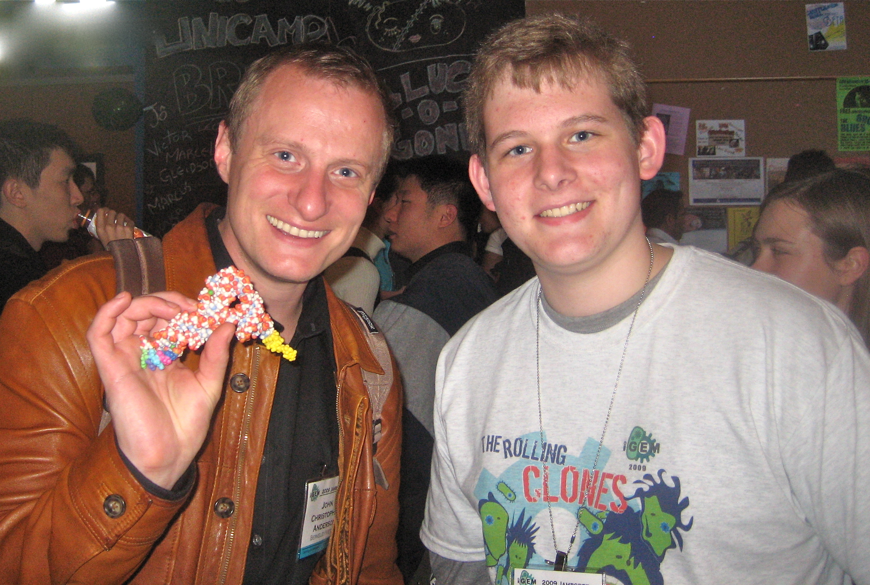
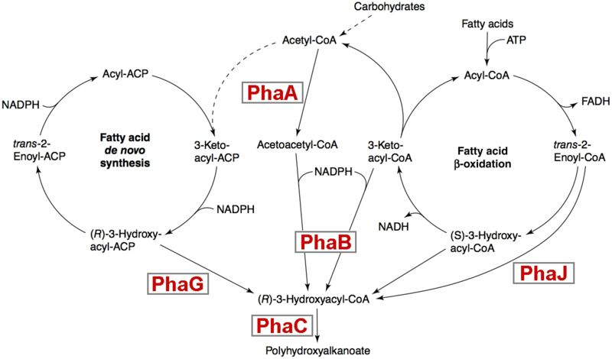
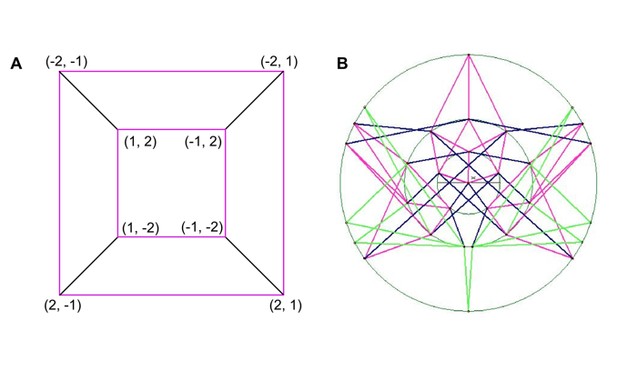
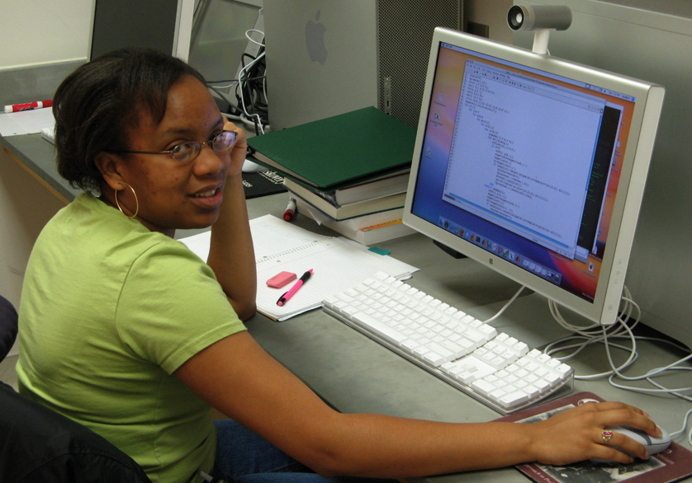
Biology
Chemistry
Mathematics
Computer Science

Slide 23

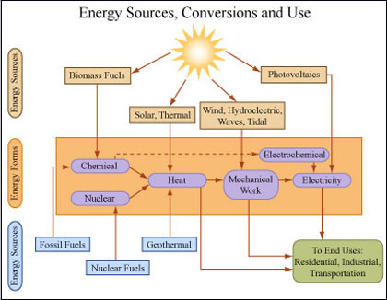

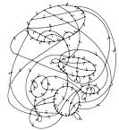
How is synthetic biology well-suited for interdisciplinary research?
Creativity
Flexibility
Adaptability
If you have a common interest,
you can find a synthetic biology way to approach it!
Environment Energy Medicine Technology

