Slide 1


Synthetic Biology
at
Davidson College
Building Bacterial Computers

Slide 2
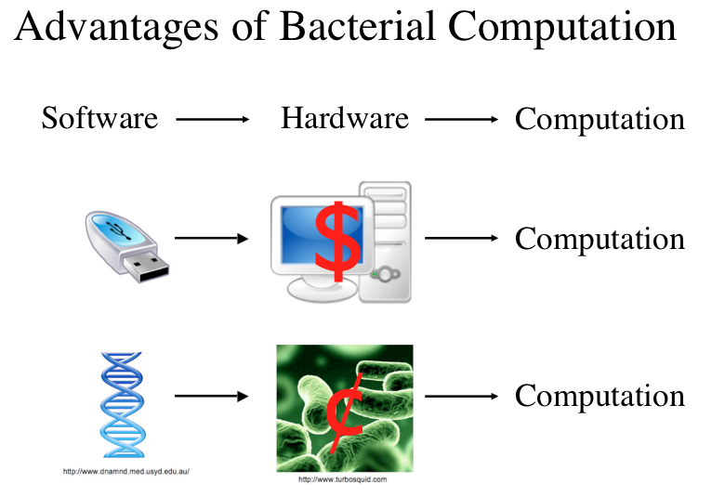

Slide 3
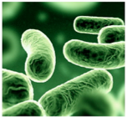
Advantages of Biological Computers
go anywhere - arctic, thermal vents, inside organisms
no electricity
self-replicating
no immune rejection

Slide 4
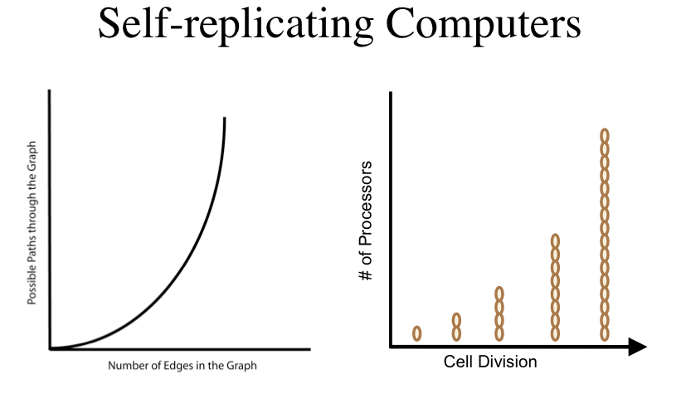

Slide 5
Two Recent Research Projects

Slide 7
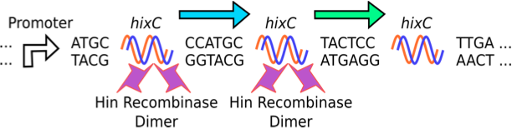
Flipping DNA with Hin/hixC

Slide 8
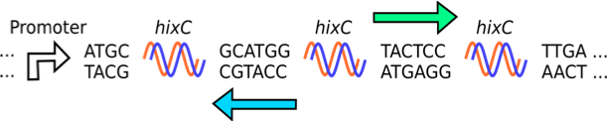
Flipping DNA with Hin/hixC

Slide 9
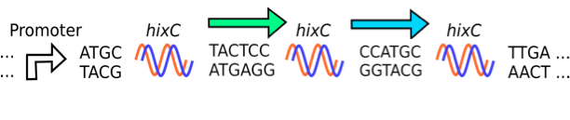
Flipping DNA with Hin/hixC

Slide 10
Hamiltonian Path Problem
1
4
3
2
5

Slide 11
Hamiltonian Path Solution
1
4
3
2
5

Slide 12
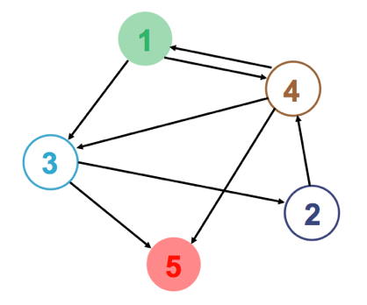
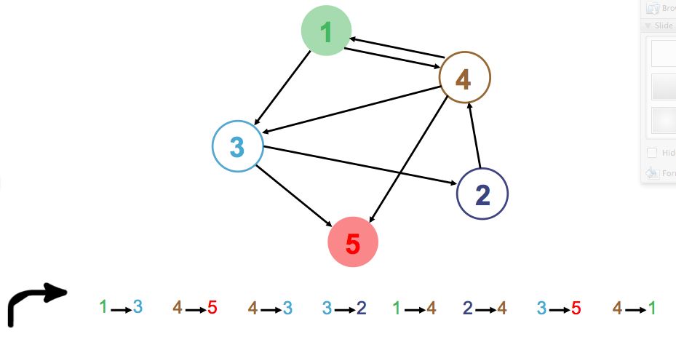
Engineering Biological HPP

Slide 13
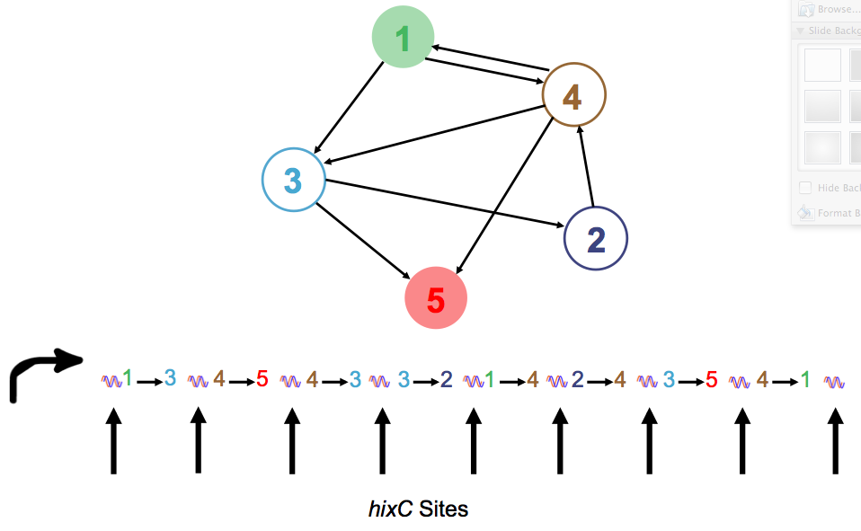
Engineering Biological HPP

Slide 14
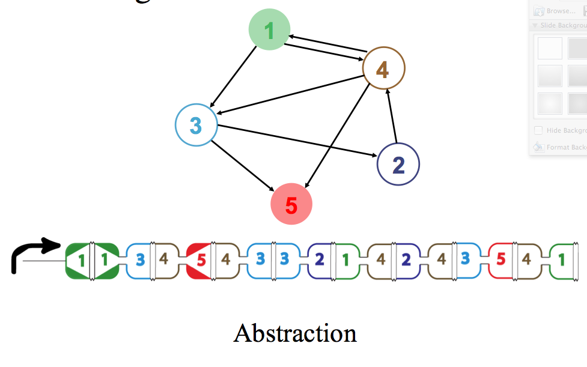
Engineering Biological HPP

Slide 15
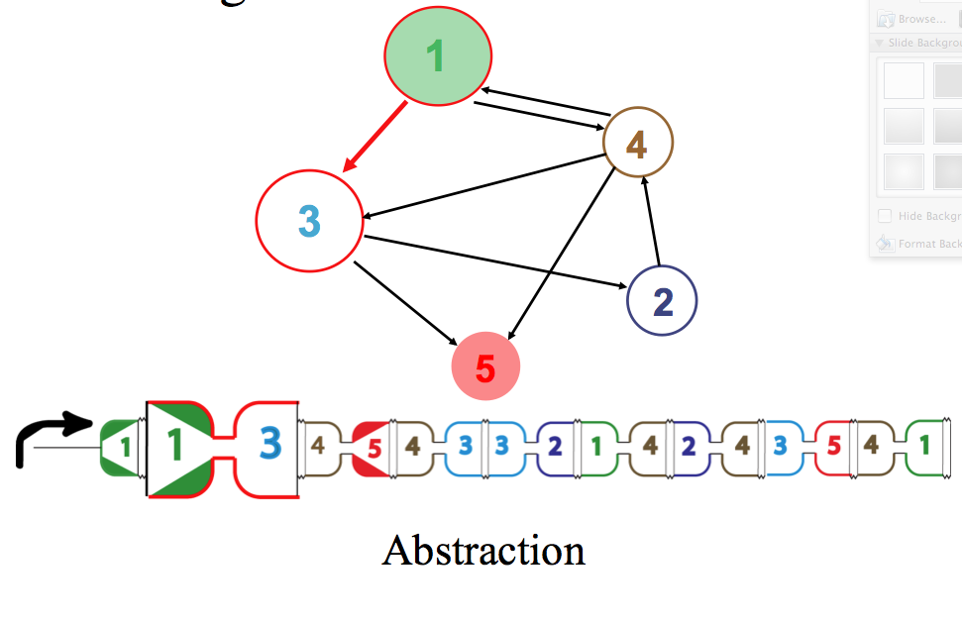
Engineering Biological HPP

Slide 16
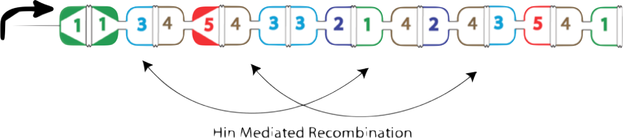
Engineering Biological HPP
Hin-mediated recombination

Slide 17
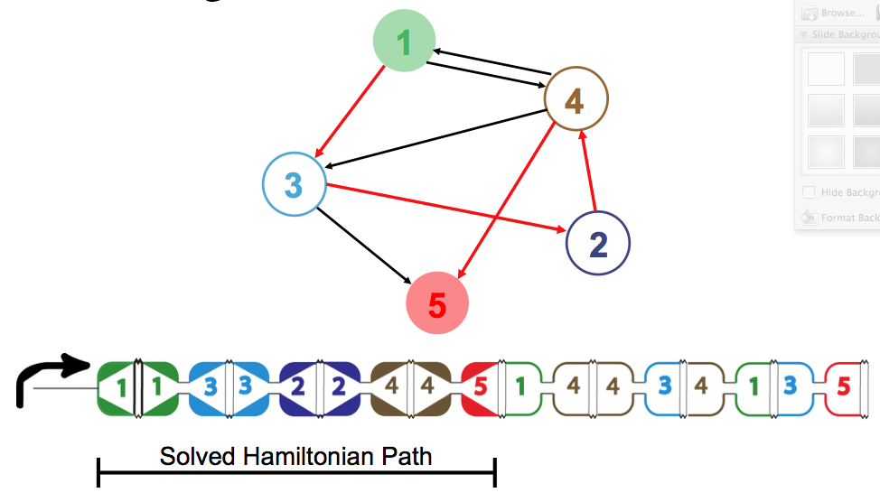
Engineering Biological HPP

Slide 18
Predicting Outcomes of Bacterial Computing

Slide 19
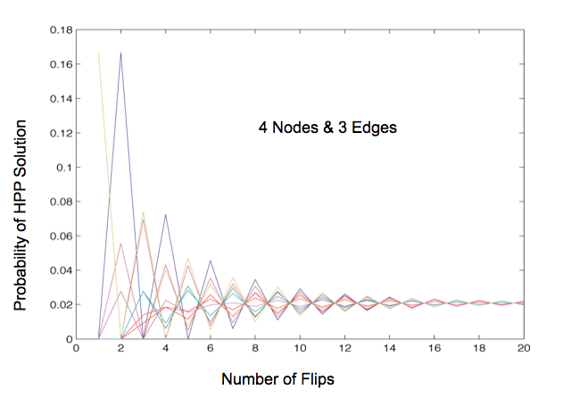
Does Starting Place Matter?

Slide 20
Does Starting Place Matter?
Equilibrium

Slide 21
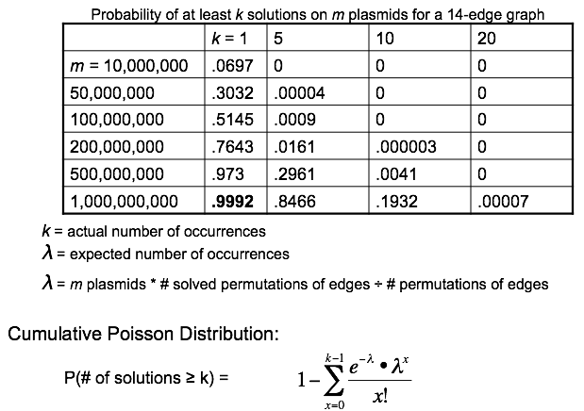
How Many Plasmids Do We Need?

Slide 22

Split Genes to Encode Problem

Slide 23
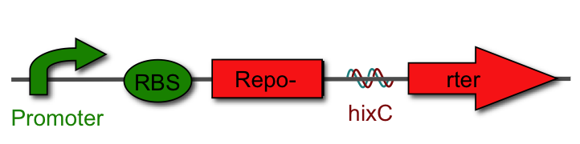
Split Genes to Encode Problem
gcat.davidson.edu/GcatWiki/index.php/Davidson_Missouri_W/Davidson_Protocols

Slide 24
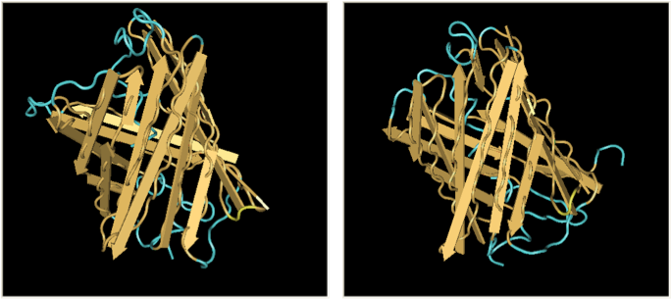
Split Reporter Genes
Green Fluorescent Protein
Red Fluorescent Protein

Slide 25
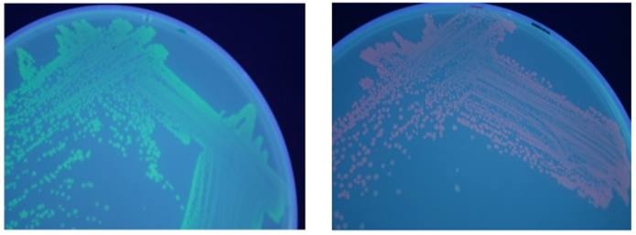
Split Reporter Genes
GFP Split by hixC
RFP Split by hixC

Slide 26
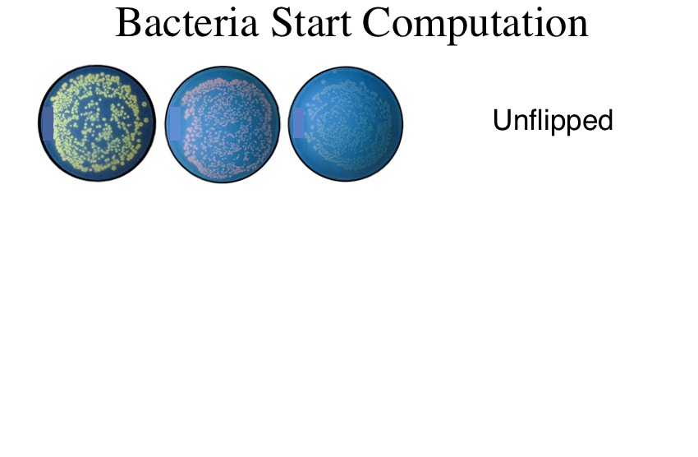

Slide 27
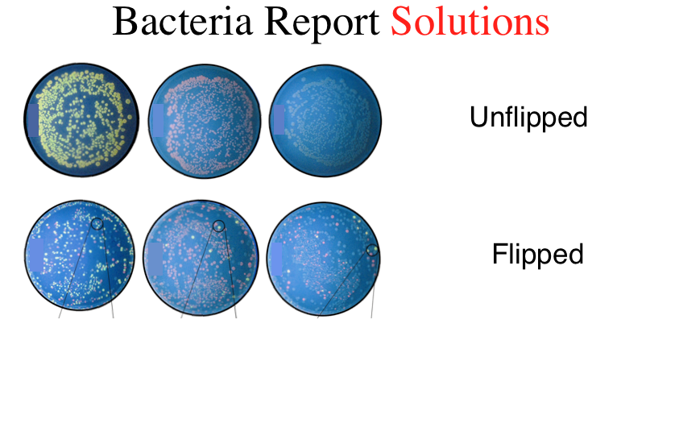

Slide 28
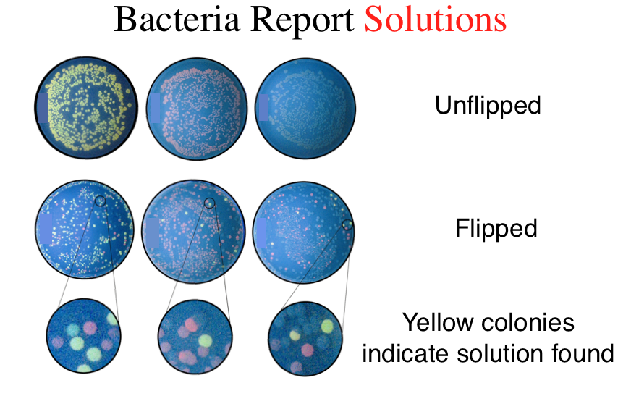

Slide 29

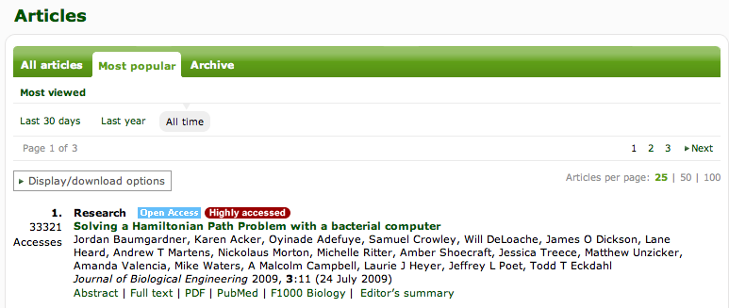
Paper Published 7/09
Paper of the year, 2009
15 undergraduate coauthors
Notes:
Having the number 2 paper of all time for the journal is nice, but having the number 1 paper is better.

Slide 30
Can we solve the SATisfiability problem?

Slide 31
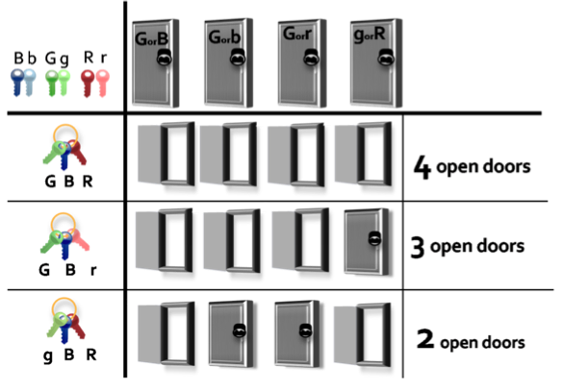
Define the SATisfiability Problem

Slide 32
Define the SATisfiability Problem

Slide 33
Define the SATisfiability Problem

Slide 34
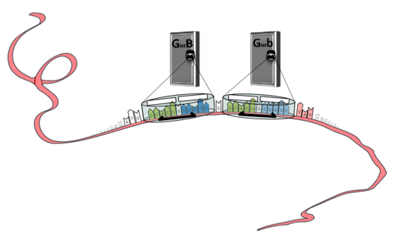
Converting Math to Biology

Slide 35
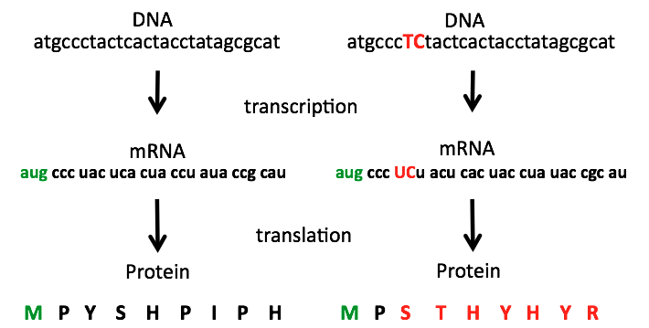
Central Dogma

Slide 36
Frameshift Mutation

Slide 37
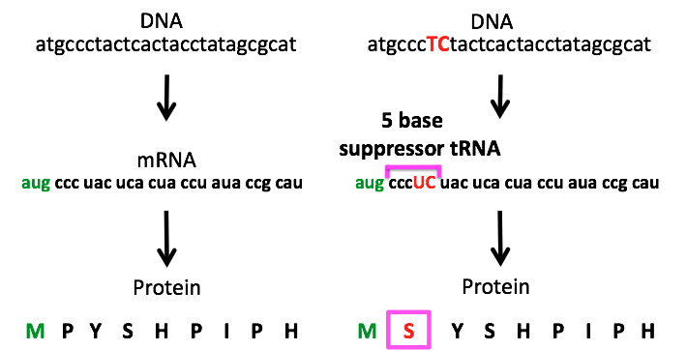
Frameshift Suppression

Slide 38
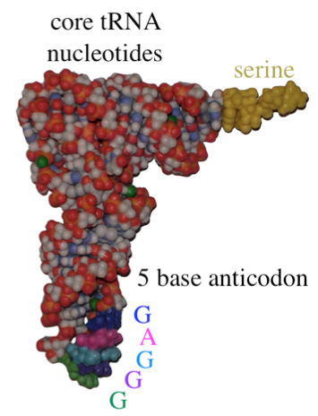
Suppressor tRNA

Slide 39
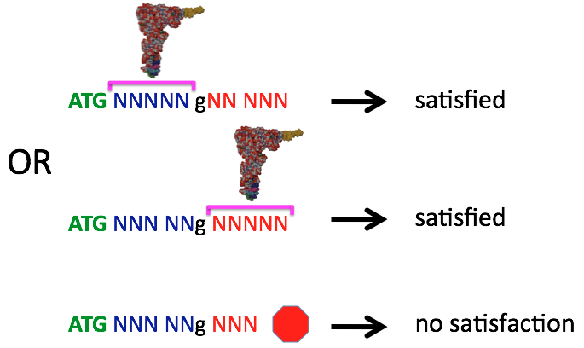
Coding 2-SAT Clause

Slide 40
Coding 2-SAT Clause

Slide 41
Coding 2-SAT Clause

Slide 42
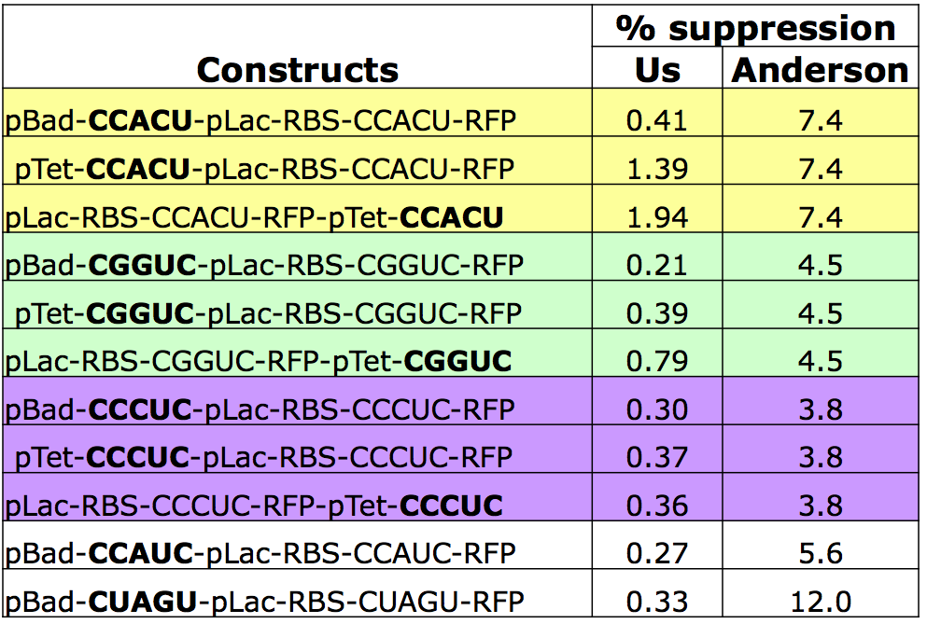
Outcomes of v 1.0

Slide 43
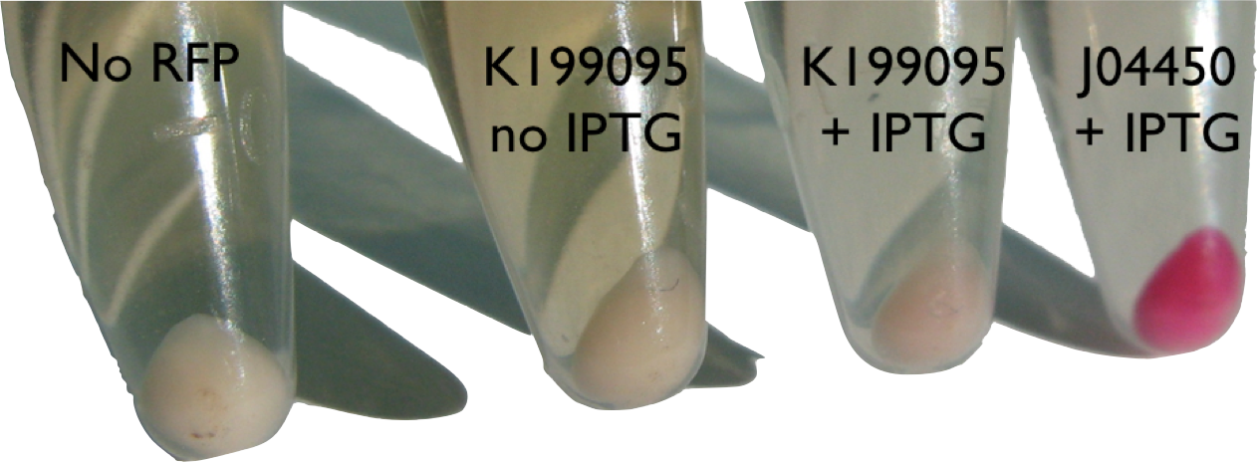
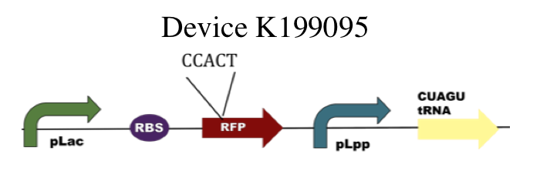
Outcomes of v 1.0

Slide 44
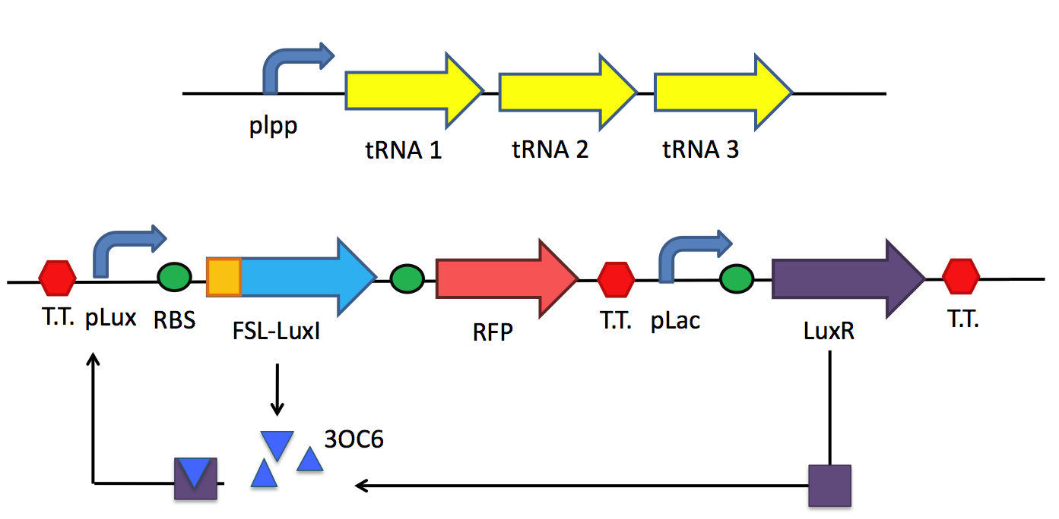
Redesign System v2.0
positive feedback loop

Slide 45
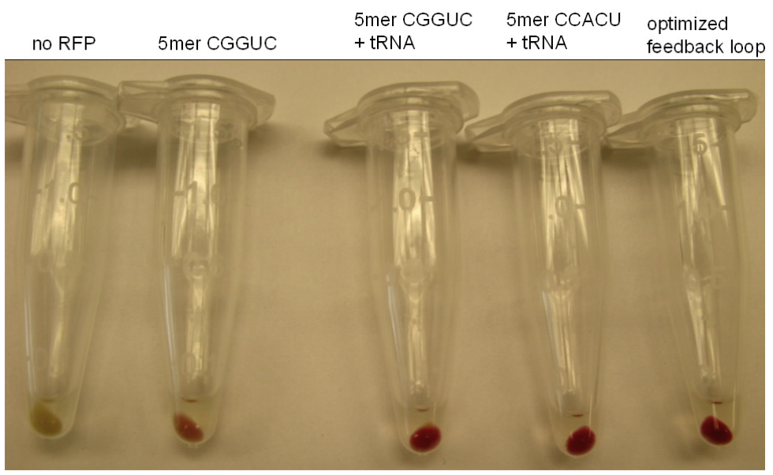
Outcomes of v 2.0
frame
shift
“leak”
+tRNA
CGGUC
+tRNA
CCACU
- control
+ control

Slide 46
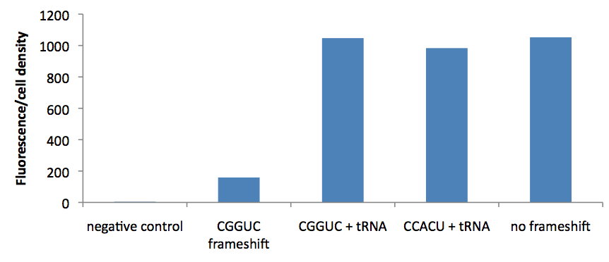
Outcomes of v 2.0
frame
shift
“leak”
+tRNA
CGGUC
+tRNA
CCACU
+ control

Slide 47
Why build bacterial computers?

Slide 48
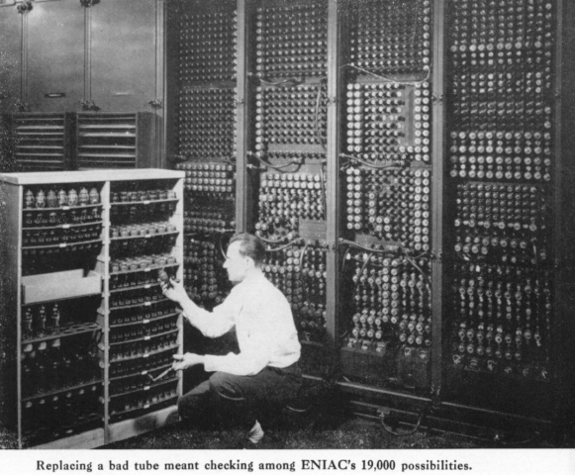
Evolution of Computers
1943

Slide 49
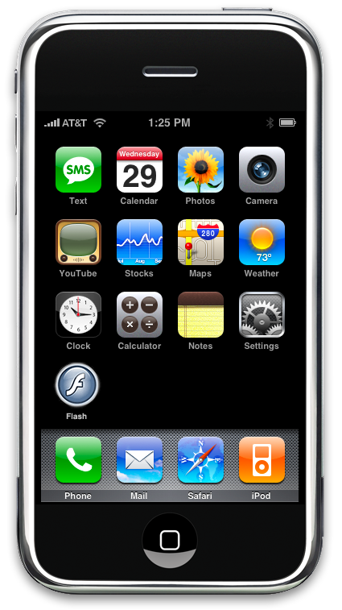
Evolution of Computers
iPhone in 2011
Notes:
67 years difference

Slide 50
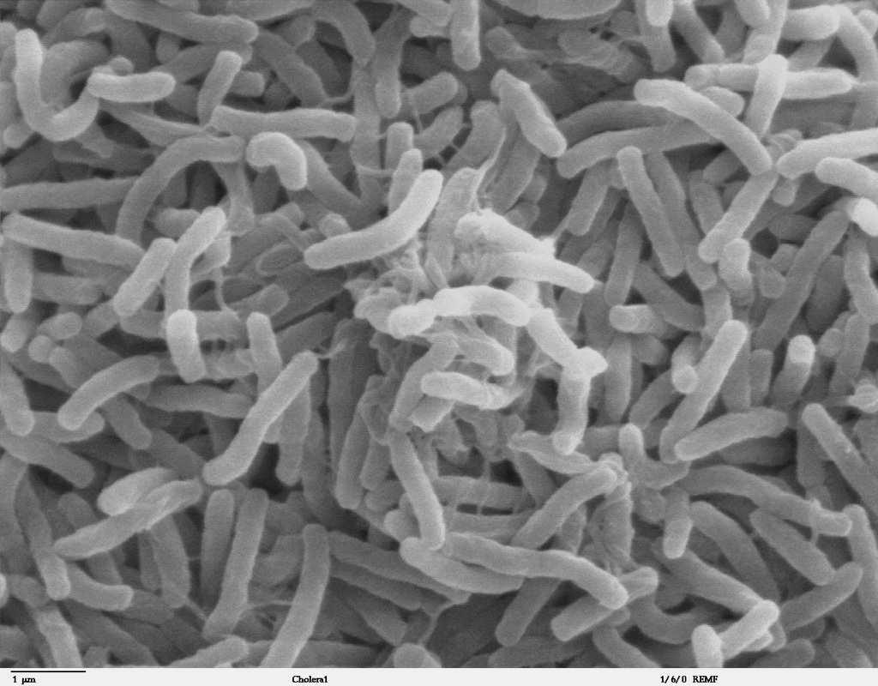
Evolution of Bacterial Computers
E. coli in 2011
?
Living Hardware in 2021
Notes:
10 years difference

