Slide 1
Nhx1
Aligning Orthologs and Identifying Alleles
Alexis Valauri-Orton and Puneet Lakhmani
Notes:
Lexi

Slide 2
Why Nhx1? What does it do?
Makes blueberries blue (Yamaguchi et al., 2001)
Controls vacuolar pH
Anthocyanin expression is pH dependent
Pigmented anthocyanins cause berry color
Elevated expression of Nhx1 causes bluing in flowers
Lack of Nhx1 prevents bluing
Vital to Salt Tolerance (Darley et al., 2000)
Key to Berry Ripening (Hanana et al., 2007)
→ water uptake to the berry
→ increases in berry size

Slide 3
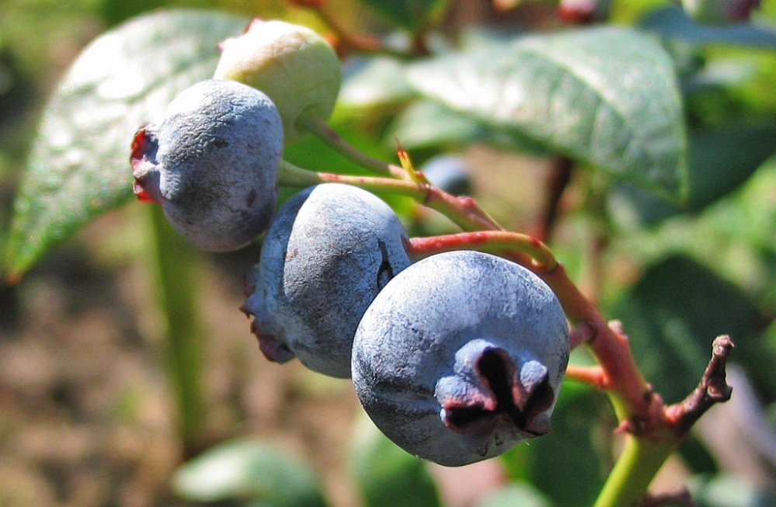
What can we learn from Nhx1 in blueberry?
Determine how blueberries facilitate production of healthful anthocyanins
Better understand ripening cycle
A shift in the ripening cycle could make for blueberry wine
http://upload.wikimedia.org/wikipedia/commons/b/b9/Vaccinium_corymbosum_Beeren.jpg

Slide 4
Nucleotide Errors → Frameshifts
Latter half of hit inconsistent with other species in NCBI database
This hit picks up where the above hit “leaves off.”
Aligns with other species in NCBI database
These hits are in two different reading frames
+3
+1
Notes:
Lexi – note on tBlastN

Slide 5
Nucleotide Errors → Frameshifts
+3
+1
N in sequence indicates potential error
Ignoring nucleotides N and A eliminates frameshift
We found the CaM binding domain within these two fragments
If we had not corrected this frameshift error, we would not have found this binding domain
Notes:
Lexi

Slide 6
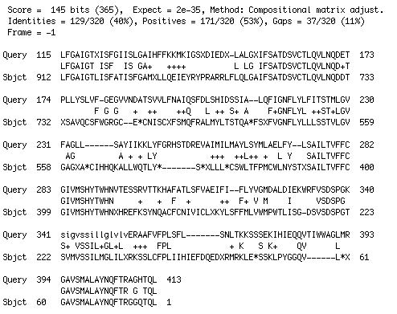
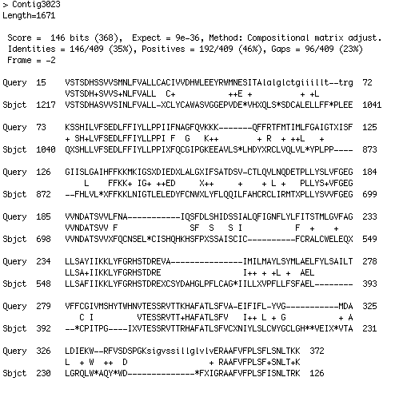
EST Data Unreliable
Hits discontinuous, fragmented
Aligned regions shift from frame to frame
Notes:
Lexi

Slide 7
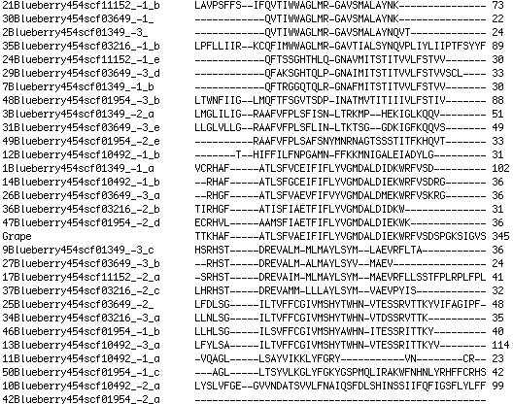
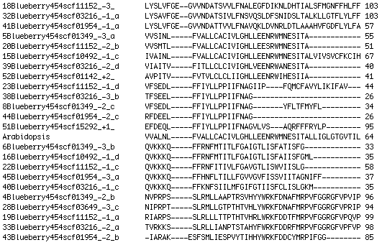
Identifying Families
Initial Clustal W Hit:
Too many sequences
Fragments align poorly with Grape and Arabidopsis, but alignment patterns emerge
We identified 12 families of hits
Hits within each family align closely
Notes:
Puneet

Slide 8
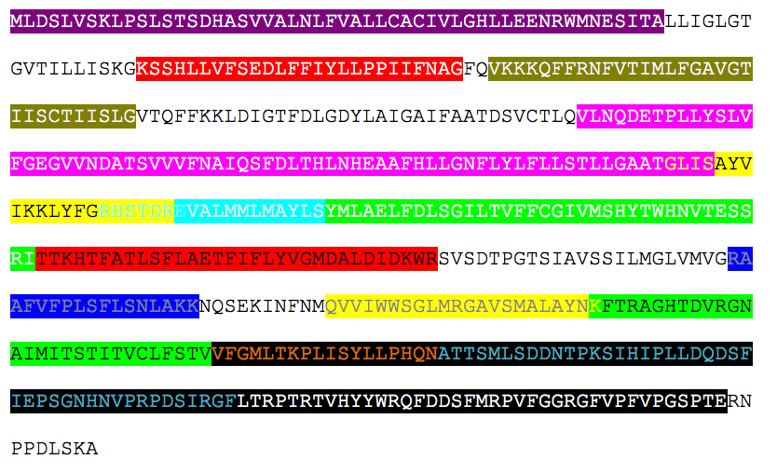
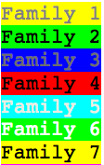
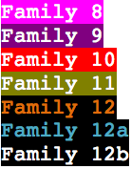
All Families Displayed on Arabidopsis NHX1
Notes:
Puneet

Slide 9
Family 1
4 alleles/paralogs/repeats
Equivalent of exon 11 in Arabidopsis
Notes:
Lexi

Slide 10
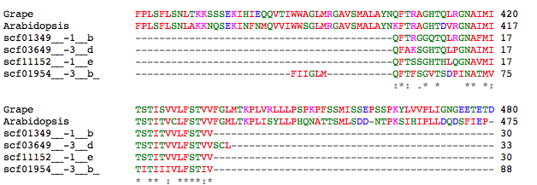
Family 2
4 alleles/paralogs/repeats
Equivalent of exon 12 in Arabidopsis
Notes:
Lexi

Slide 11
Family 3
3 alleles/paralogs/repeats
Equivalent of the latter half of exon 10 in Arabidopsis
Notes:
Lexi

Slide 12
Family 4
5 alleles/paralogs/repeats
Equivalent to the first half of exon 10 in Arabidopsis
Notes:
Lexi

Slide 13
Family 5
4 alleles/paralogs/repeats
Equivalent of exon 8 in Arabidopsis
Notes:
Lexi

Slide 14
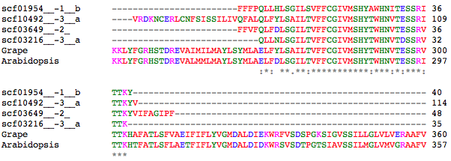
Family 6
4 alleles/paralogs/repeats
Equivalent of exon 9 in Arabidopsis
Notes:
Lexi

Slide 15
Family 7
2 alleles/paralogs/repeats – imperfect alignment
Equivalent of end of exon 7, beginning of exon 8 in Arabidopsis
Notes:
Puneet

Slide 16
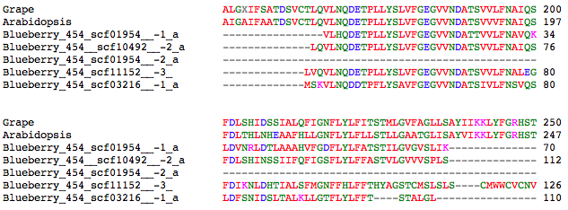
Family 8
4 alleles/paralogs/repeats
Equivalent of exon 6 in Arabidopsis
Notes:
Puneet

Slide 17
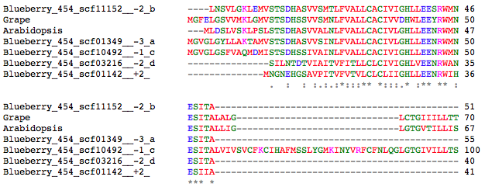
Family 9
5 alleles/paralogs/repeats
Equivalent of exon 1 in Arabidopsis
Notes:
Puneet

Slide 18
Family 10
Equivalent of latter half of exon 2 in Arabidopsis
5 alleles/paralogs/repeats
Notes:
Puneet

Slide 19
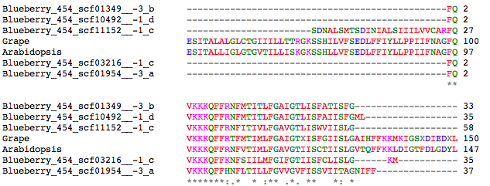
Family 11
5 alleles/paralogs/repeats
Equivalent of exon 3 in Arabidopsis
Notes:
Puneet

Slide 20
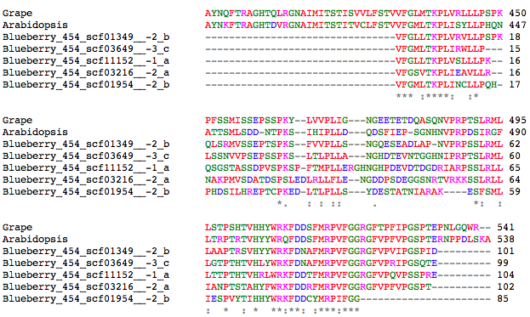
Family 12
5 alleles/paralogs/repeats – some poor alignment in center
Equivalent of exon 13 in Arabidopsis
Notes:
Puneet

Slide 21
Scaffolds Represented in Families
Scaffold | Hits Across All Families | Nucleotides in Scaffold
01142 | 1 | 43,106
10492 | 5 | 9,573
03216 | 5 | 26,189
11152 | 5 | 8,889
01349 | 6 | 40,310
03649 | 6 | 24,321
01954 | 7 | 33,985
Notes:
Puneet

Slide 22
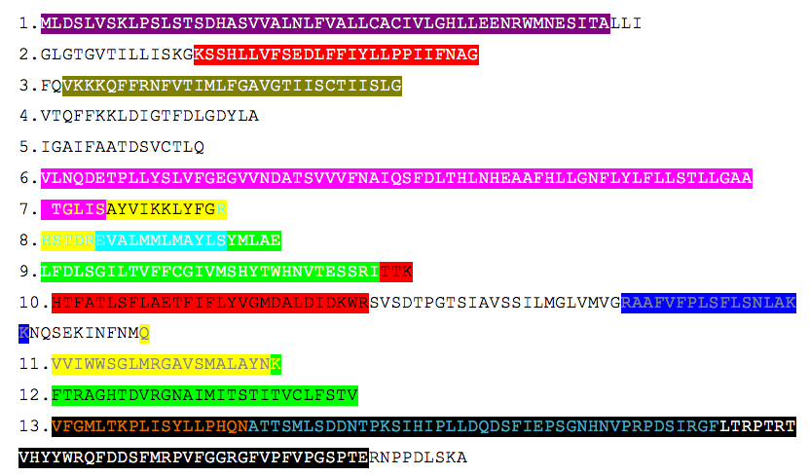
All Families Displayed on Arabidopsis NHX1

Slide 23
How many paralogs/alleles?
Difficult for us to determine now from our fragmented data
Allele numbers in other species give us some idea:
Arabidopsis: only one Nhx1 listed in genome browser
Grape: six putative Nhx1 genes listed in genome browser
We anticipate a number close to that of grapes
Many fruits experience whole genome duplication
Our data suggested variation/multiple copies of blueberry Nhx1

Slide 24
Further Steps
Wet lab work to extract entire gene
PCR amplification using our data?
Find the promoter
Myb binds to the Nhx1 promoter
Identify regulatory binding sites
Properties of the blueberry may be explained by binding sites on Nhx1 that are more or less sensitive than those in other species
Conduct more in-depth comparison of blueberry Nhx1 sequence and related orthologs

Slide 25
Acknowledgements
Dr. Allan Brown and NC State University
The David H. Murdock Research Institute
Dr. Malcolm Campbell and Davidson College

Slide 26
References
Darley, C.P., van Wuytswinkel, O.C., van der Woude, K., Mager, W.H., and de Boer, A.H. (2000). Arabidopsis thaliana and Sac- charomyces cerevisiae NHX1 genes encode amiloride sensitive electroneutral Na/H exchangers. Biochem. J. 351, 241–249.
Hanana M, Cagnac O, Yamaguchi T, Hamdi S, Ghorbel A, Blumwald E (2007) A grape berry (Vitis vinifera L.) cation/proton antiporter is associated with berry ripening. Plant Cell Physiol 48:804–811
Yamaguchi, T. e. a. (2001). Genes encoding the vacuolar Na+/H+ exchanger and flower coloration. Plant Cell Physiology, 42(5), 451--461.
Grape genome browser: http://www.genoscope.cns.fr/externe/GenomeBrowser/Vitis/
Arabidopsis genome browser: http://atensembl.arabidopsis.info/index.html

