Slide 1
Characterization of Resveratrol Binding Sites in ATP Synthase Through Molecular Analysis of Candidate Subunits
Lauren Ivey
Laura McCoy

Slide 2
Resveratrol
Polyphenol found in most plants at varying quantities
Grapes, blueberries, tomatoes, corn
Known to have with cardio-beneficial, anti-inflammatory, and anti-cancer effects
Protects against cardiovascular disease and neurological disorders

Slide 4
Resveratrol interacts with gamma, alpha, beta
Hydrophobic pocket between beta and gamma subunit
Prevents hydrolysis and synthesis

Slide 5
Hypothesis
Resveratrol binding in plants would NOT be beneficial
Changes in ATP synthase amino acid sequences in Grape/Blueberry that do not allow for resveratrol to bind
Alpha, beta, gamma

Slide 6
PDB Ligand Explorer
Resveratrol bound to ATP Synthase animation

Slide 7
Methods
KEGG
search for grape subunit amino acid sequences
tBLASTn
grape sequence against blueberry genome
taken from 454
Used paper and Ligand Explorer to locate resveratrol binding sites in bovine
NCBI
search for human and bovine subunit amino acid sequences
ClustalW
Compare human and bovine to grape and blueberry

Slide 8
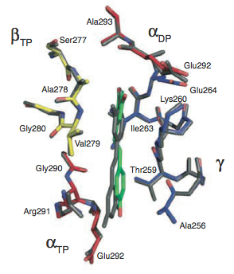
Alpha subunit
Notes:
Mention inconsistency in amino acid number from paper

Slide 9
Beta subunit

Slide 10
Gamma subunit

Slide 11
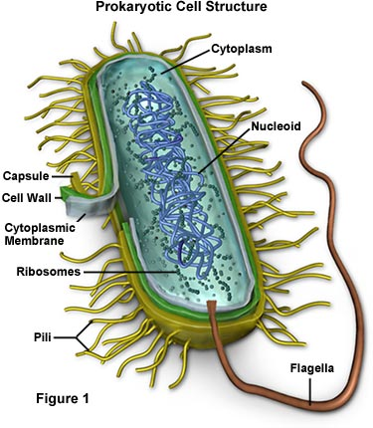
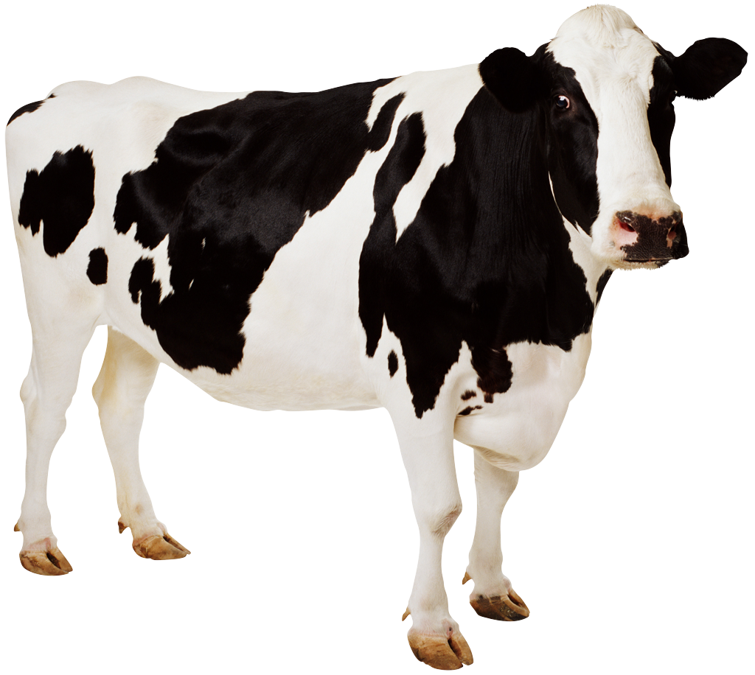
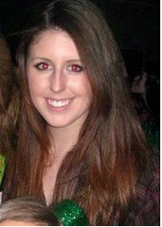
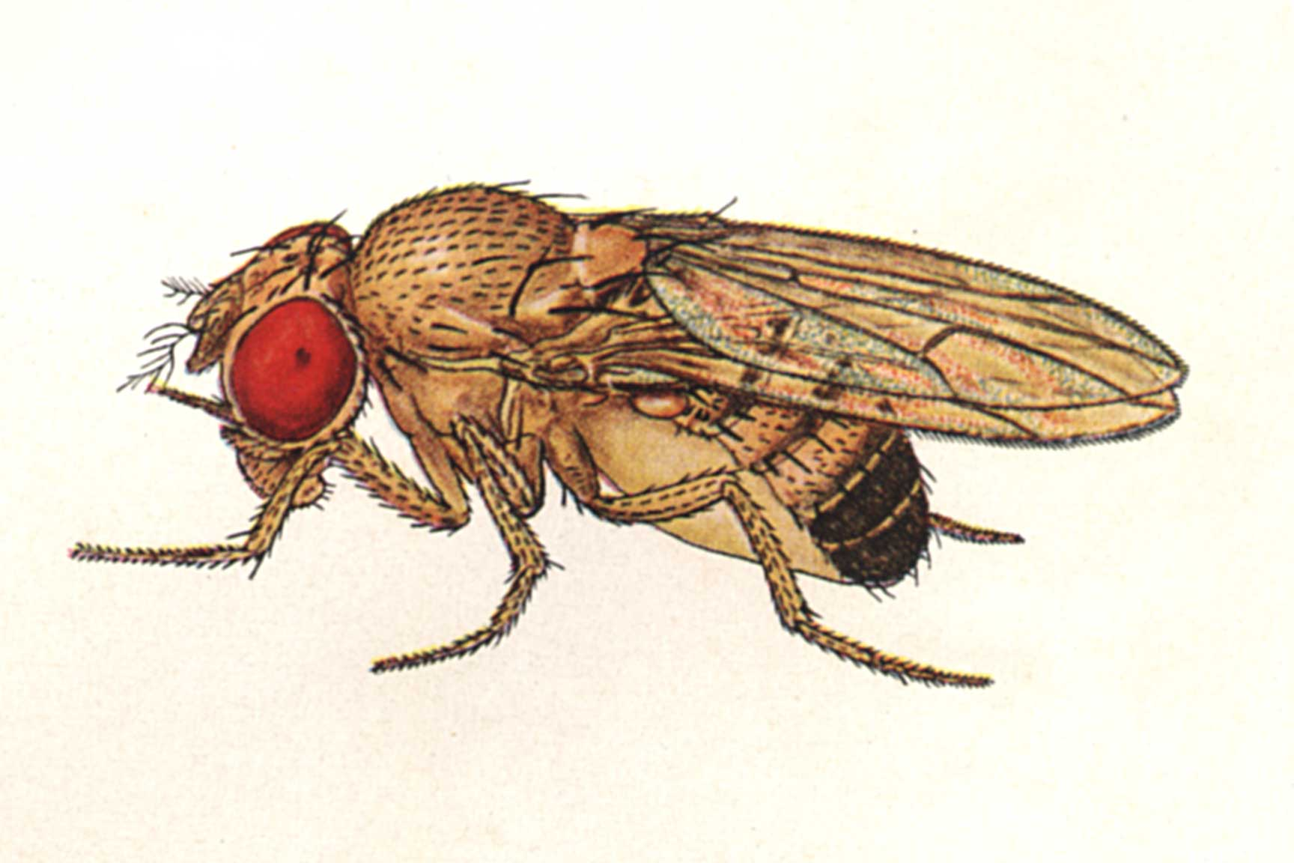
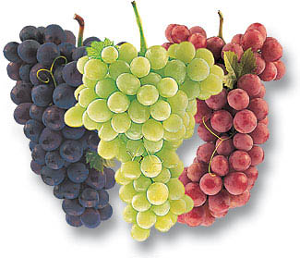
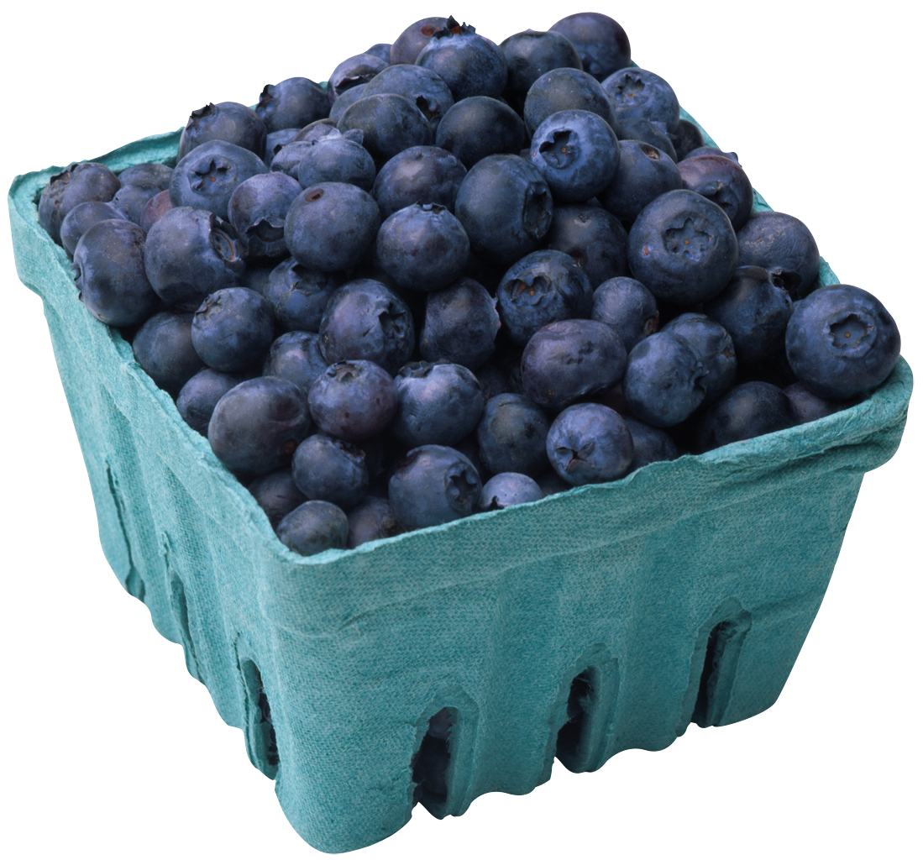
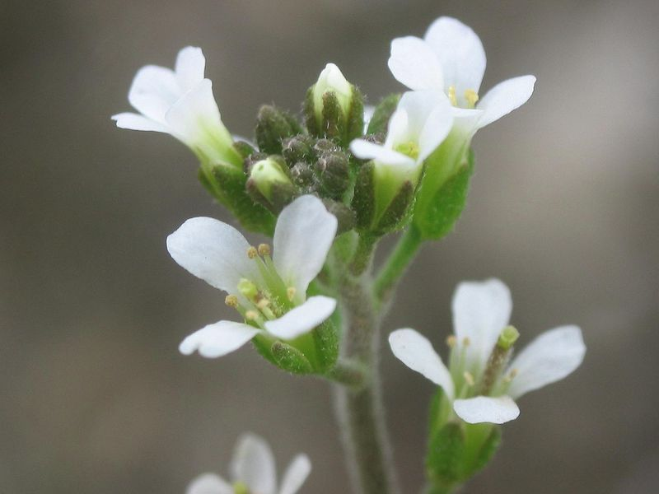
Phylogenetic Tree based on amino acid sequences of gamma subunit
http://insects.eugenes.org/species/about/species-gallery/Drosophila_melanogaster/; http://dbscience3.wikispaces.com/Braden; http://www.allantiaging.com/antioxidants-and-what-they-can-do-for-your-skin/; http://mips.helmholtz-muenchen.de/plant/genomes.jsp

Slide 12
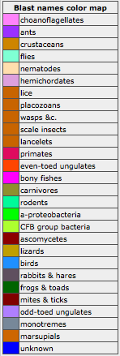
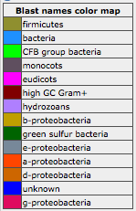
bovine
Bovine: AVITKELIE
Blueberry: AAITTELTE
grape

Slide 13
Amino Acid Divergence
bovine
blueberry

Slide 14
Further Investigation
What organelle do the amino acid sequences taken from blueberry originate from?
One subunit we have predicted is chloroplastic, but other programs need to be constructed to predict accurately
Mouse model?
Knockout specific binding site on gamma and see if resveratrol fails to bind in tissue

Slide 15
Conclusion
Blueberries produce polyphenol resveratrol
Resveratrol does not bind to and does not inhibit blueberry ATP synthase.
Resveratrol binds to bovine ATP synthase and inhibits ATP synthase activity.
Two amino acid disparities between blueberry and bovine in the resveratrol binding site on subunit gamma result in bovine ATP synthase sensitivity to inhibition by resveratrol, while blueberry remains unaffected.

Slide 16
References
Gledhill, J.R., Montgomery, M.G., Leslie, A.G., and Walker, J.E. 2007. Mechanism of Inhibition of Bovine F₁-ATPase by Resveratrol and Related Polyphenols. Proceedings of the National Academy of Sciences of the United States of America. 104: 13632-13637
Altschul, Stephen F., Thomas L. Madden, Alejandro A. Schaffer, Jinghui Zhang, Zheng Zhang, Webb Miller, and David J. Lipman (1997), "Gapped BLAST and PSI-BLAST: a new generation of protein database search programs", Nucleic Acids Res. 25:3389-3402.
Kanehisa, M. and Goto, S.; KEGG: Kyoto Encyclopedia of Genes and Genomes. Nucleic Acids Res. 28, 27-30 (2000).
Larkin M.A., Blackshields G., Brown N.P., Chenna R., McGettigan P.A., McWilliam H., Valentin F., Wallace I.M., Wilm A., Lopez R., Thompson J.D., Gibson T.J. and Higgins D.G. (2007) ClustalW and ClustalX version 2. Bioinformatics 23(21): 2947-2948.

Slide 17
Acknowledgments
Allan Brown
NC State University
David H. Murdock Research Institute

