Slide 1
AP Biology Redesign
Integrating Concepts in Biology
interpreted by
A. Malcolm Campbell, Laurie Heyer & Chris Paradise

Slide 2
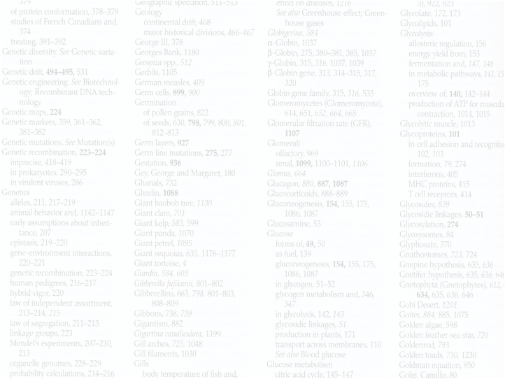
What’s Wrong with Biology Education Now?
Vocabulary is emphasized
Experimental approaches are minimized
Math is scarce
Memorization is rewarded
Critical thinking is discouraged
Information is irrelevant to students

Slide 3
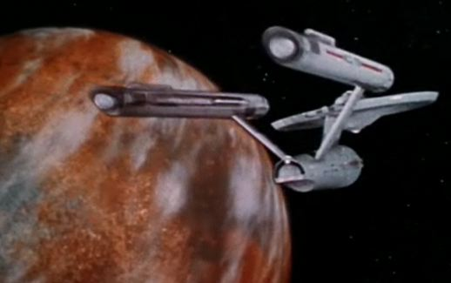

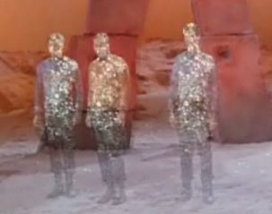
The Star Fleet Academy Myth
Our students can learn more each year.

Slide 4
If we currently cover all the important stuff….
…how can we add more content?

Slide 5
Too much content for the containers
Notes:
When you cram too much information into students, the outcome is unnatural and unpleasant to look at.

Slide 6


Slide 7
To fix biology education:
Reduce the volume of information
Facilitate construction of students’ knowledge
Connect new information with previous understanding
Use math repeatedly to illuminate biology
Analyze real experimental data
Reward thinking and creativity
Discuss ethical, legal and social implications

Slide 8
Present information and data…

Slide 10

Artificial Divide within Biology
Small Biology
Big Biology

Slide 11
Five Levels of Organization
Molecular
Cellular
Organismal
Population
Ecological System

Slide 12
Five Big Ideas of Biology
Information
Homeostasis
Evolution
Biology
Emergent
Properties
Cells

Slide 13
Five by Five Matrix of Biology
Cellular
Organismal
Information
Molecular
Population
Cellular
Organismal
Cellular
Organismal
Ecological System
Homeostasis
Evolution
Molecular
Population
Molecular
Population
Biology
Ecological System
Ecological System
Cellular
Organismal
Cellular
Organismal
Emergent
Properties
Cells
Molecular
Population
Molecular
Population
Ecological System
Ecological System

Slide 14
Five by Five Matrix of Biology
Cellular
Organismal
Information
Molecular
Population
Cellular
Organismal
Cellular
Organismal
Homeostasis
Evolution
Ecological System
Molecular
Population
Molecular
Population
Biology
Ecological System
Ecological System
Cellular
Organismal
Cellular
Organismal
Emergent
Properties
Cells
Molecular
Population
Molecular
Population
Ecological System
Ecological System

Slide 15
Five by Five Matrix of Biology
Cellular
Organismal
Information
Molecular
Population
Cellular
Organismal
Cellular
Organismal
Homeostasis
Evolution
Ecological System
Molecular
Population
Molecular
Population
Biology
Ecological System
Ecological System
Cellular
Organismal
Cellular
Organismal
Emergent
Properties
Cells
Molecular
Population
Molecular
Population
Ecological System
Ecological System

Slide 16
Five by Five Matrix of Biology
Cellular
Organismal
Information
Molecular
Population
Cellular
Organismal
Cellular
Organismal
Homeostasis
Evolution
Ecological System
Molecular
Population
Molecular
Population
Biology
Ecological System
Ecological System
Cellular
Organismal
Cellular
Organismal
Emergent
Properties
Cells
Molecular
Population
Molecular
Population
Ecological System
Ecological System

Slide 17
Five by Five Matrix of Biology
Cellular
Organismal
Information
Molecular
Population
Cellular
Organismal
Cellular
Organismal
Homeostasis
Evolution
Ecological System
Molecular
Population
Molecular
Population
Biology
Ecological System
Ecological System
Cellular
Organismal
Cellular
Organismal
Emergent
Properties
Cells
Molecular
Population
Molecular
Population
Ecological System
Ecological System

Slide 18
Five by Five Matrix of Biology
Cellular
Organismal
Information
Molecular
Population
Cellular
Organismal
Cellular
Organismal
Ecological System
Homeostasis
Evolution
Molecular
Population
Molecular
Population
Biology
Ecological System
Ecological System
Cellular
Organismal
Cellular
Organismal
Emergent
Properties
Cells
Molecular
Population
Molecular
Population
Ecological System
Ecological System

Slide 19
Five by Five Matrix of Biology
Cellular
Organismal
Information
Molecular
Population
Cellular
Organismal
Cellular
Organismal
Ecological System
Homeostasis
Evolution
Molecular
Population
Molecular
Population
Biology
Ecological System
Ecological System
Cellular
Organismal
Cellular
Organismal
Emergent
Properties
Cells
Molecular
Population
Molecular
Population
Ecological System
Ecological System

Slide 20
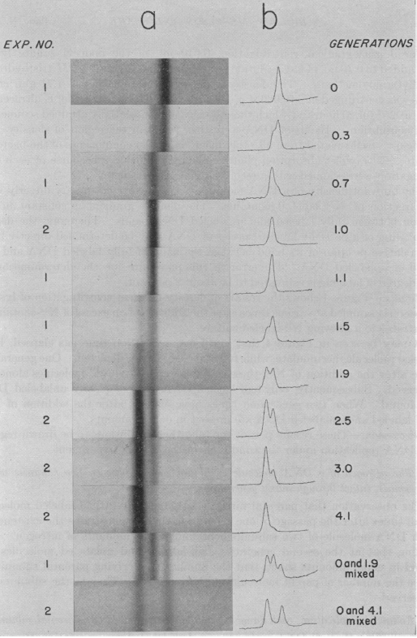
BioMath Explorations
Bio-Math Exploration 1.2
How much DNA
is in each band?

Slide 22
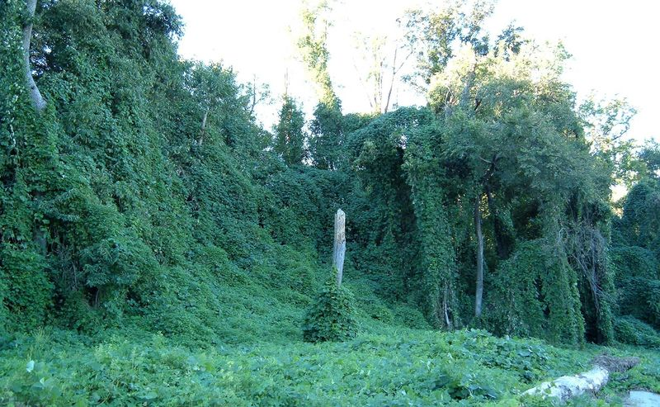
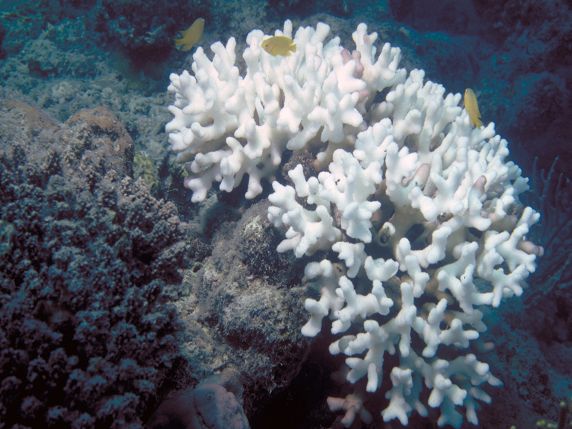

Ethical, Legal and Social Implications
Are religion and evolution compatible?
Is science possible if you are uncertain about what is true?
Does basic biology have any impact on the real world?
Who owns your DNA?

Slide 23
Did my students learn less content?

Slide 24
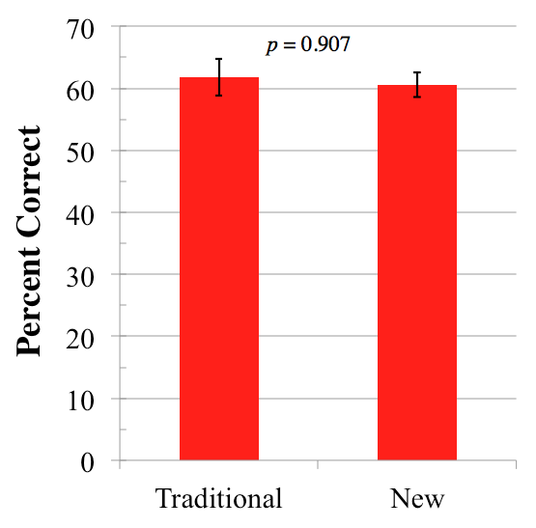
Student Content Questions
p = 0.74
+/- SEM
Notes:
t-test

Slide 25
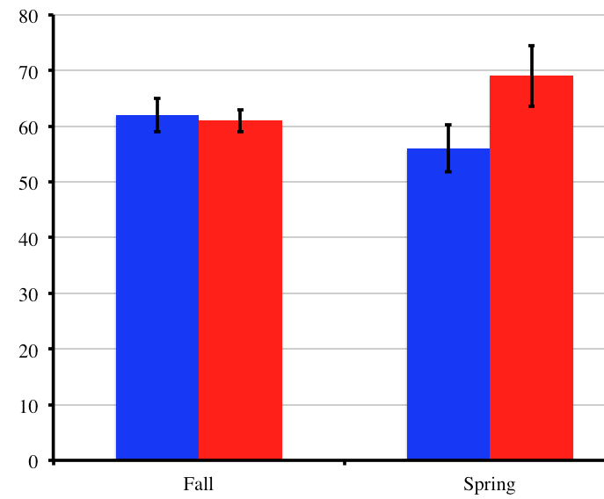
Student Content Assessment (+1 semester)
new
traditional
p = 0.74
p = 0.06
percent correct (4 questions)
83% response rate (new)
63% response rate (traditional)
+/- SEM
Fall
Spring
Notes:
t-test

Slide 26
Can my students analyze data better?

Slide 27
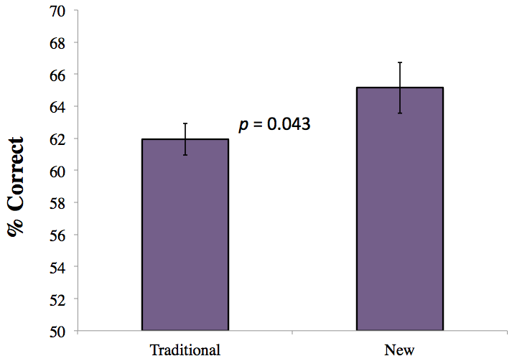
Student Skills Questions

Slide 28
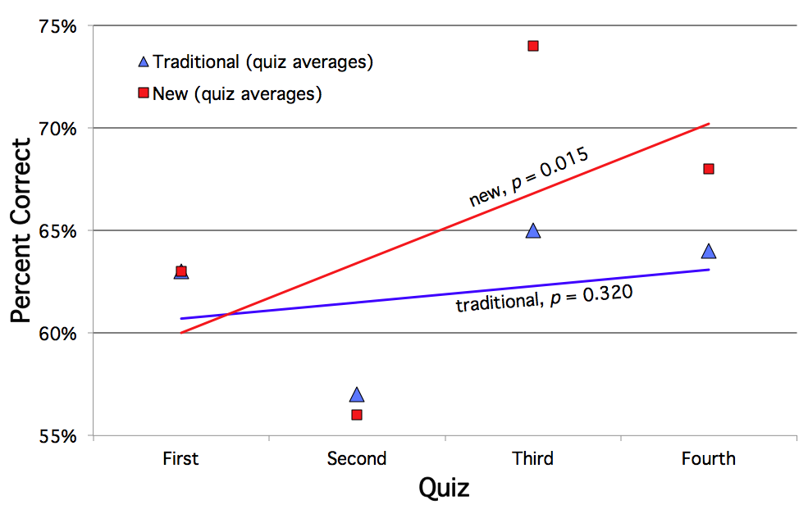
Student Skills Assessment
Notes:
two-way ANOVA, significant effect of teaching approach on skills quiz performance (P = 0.0464)
Malcolm’s students did significantly better than the other students on quiz 3 (P < 0.01) and on quiz 4 (P < 0.05)
a one-tailed P-value of 0.043

Slide 29
Did my students realize their gains?

Slide 30
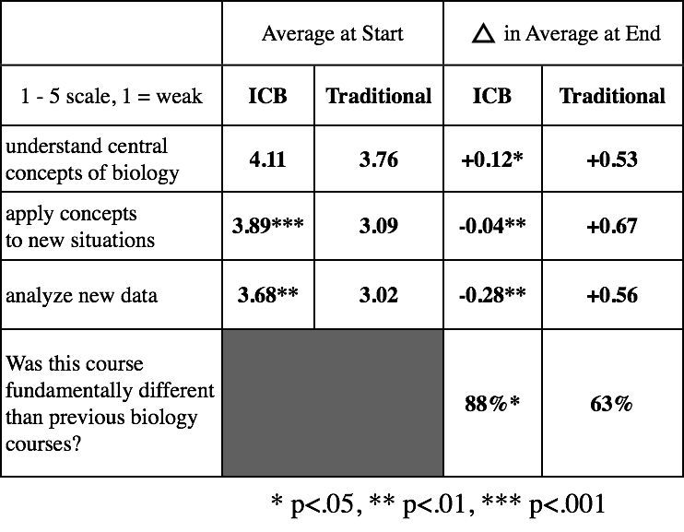
Student Self-Assessment

Slide 31
Student Self-Assessment

Slide 32
Student Self-Assessment

Slide 33
Student Self-Assessment

Slide 34
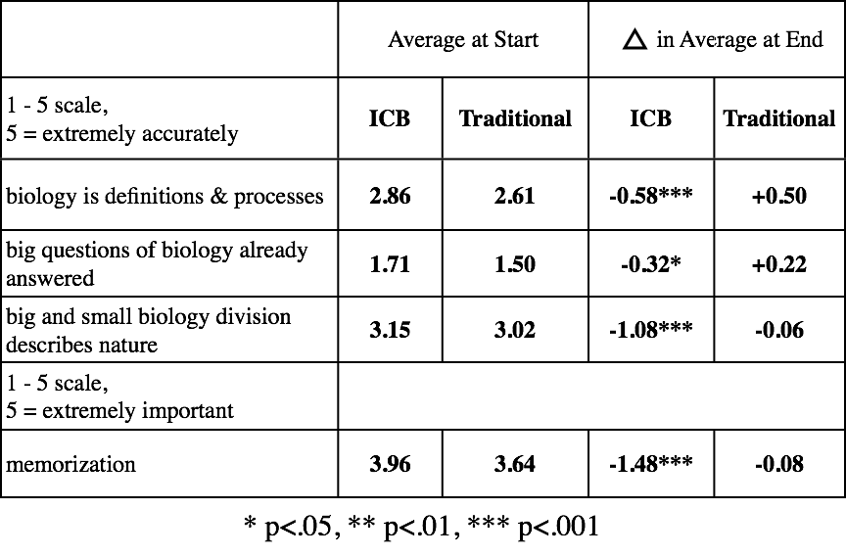
Student Opinions

Slide 35
Student Opinions

Slide 36
Student Opinions

Slide 37
Student Opinions (+1 semester)
-0.46***
+0.45
-0.33^
0.00
-0.75**
-0.10
-1.27***
+0.23
^p = 0.06

Slide 38
What did my students think about
this approach to intro bio?

Slide 39
“The method of learning, placing emphasis on the interpretation of data, has helped me not only in this class, but also in others.”
anonymous student course evaluation, Dec. 2010

Slide 40
“I found it much more beneficial using this approach compared to straight memorization. It allowed me to gain interpretation skills I was lacking before.”
anonymous student course evaluation, Dec. 2010

Slide 41
“The data-driven approach is brilliant. It alleviates the issues that I’ve always had of asking, ‘How do we know that? What’s the supporting data?’ ”
anonymous student course evaluation, Dec. 2010

Slide 42
“Emphasis on big picture and understanding how to pull information from real data was an easier and more beneficial format than memorization of facts (which used to be a struggle for me).”
anonymous student course evaluation, Dec. 2010

Slide 43
What did my students think after
second semester of intro bio?

Slide 44
Open Responses: 2nd semester was
different from 1st semester...
12/15 “New” students said second
semester more memorization
2/17 “traditional” students said
second semester more memorization.

Slide 45
How well did the New course prepare you for second semester?
It was a very difficult class, but it taught me how to think on a whole new level.

Slide 46
How well did the New course prepare you for second semester?
It taught me skills that will be very helpful in the future…. I think it highlights a greater problem in Bio112. Memorization and insane detail focus seems less beneficial than concepts.

Slide 47
How well did the New course prepare you for second semester?
My class truly opened my eyes to biology. Before then, I always felt that biology was mainly about memorization. But, after my class, I understand that biology deals primarily with application. Furthermore, my class pushed me to understand biological concepts and processes rather than memorizing lists which led to a more enriching learning experience.

Slide 48
How well did the New course prepare you for second semester?
I found that the concept of "building my own knowledge" helped me, so this semester I've found ways to learn some of the important concepts by fitting the material into that model (eg. analyzing examples rather than memorizing them to better understand the concepts being shown by those examples). It helped me realize that even without a strong background in biology, I can still do well and learn a lot.

Slide 49
How did I test student learning?

Slide 50
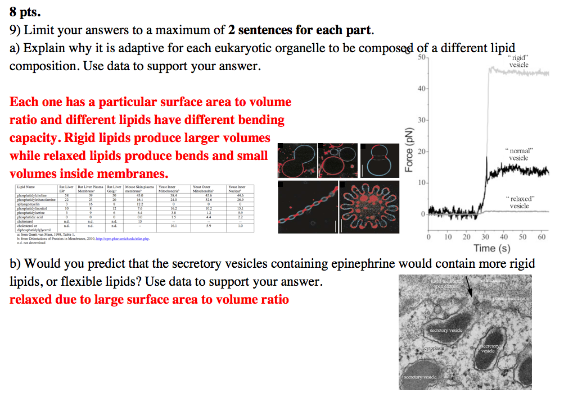
Four Exams Per Semester

Slide 51
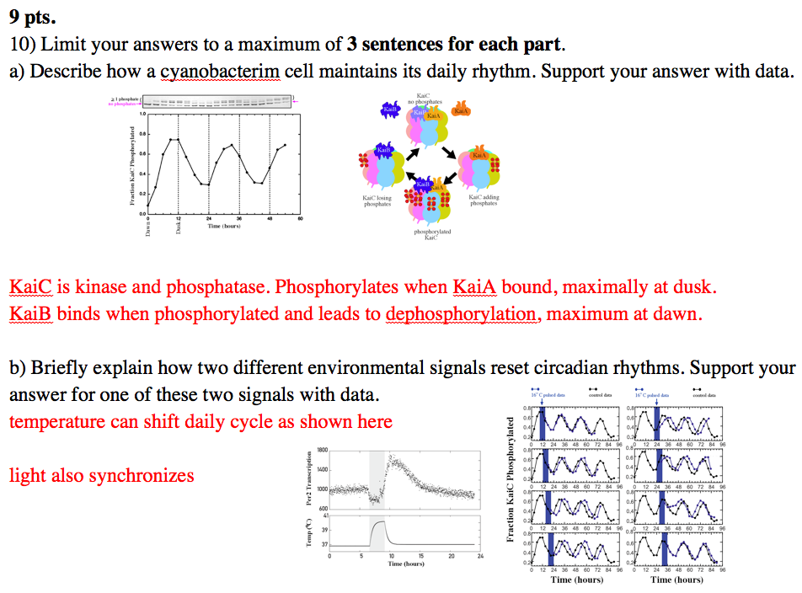
Four Exams Per Semester

Slide 52
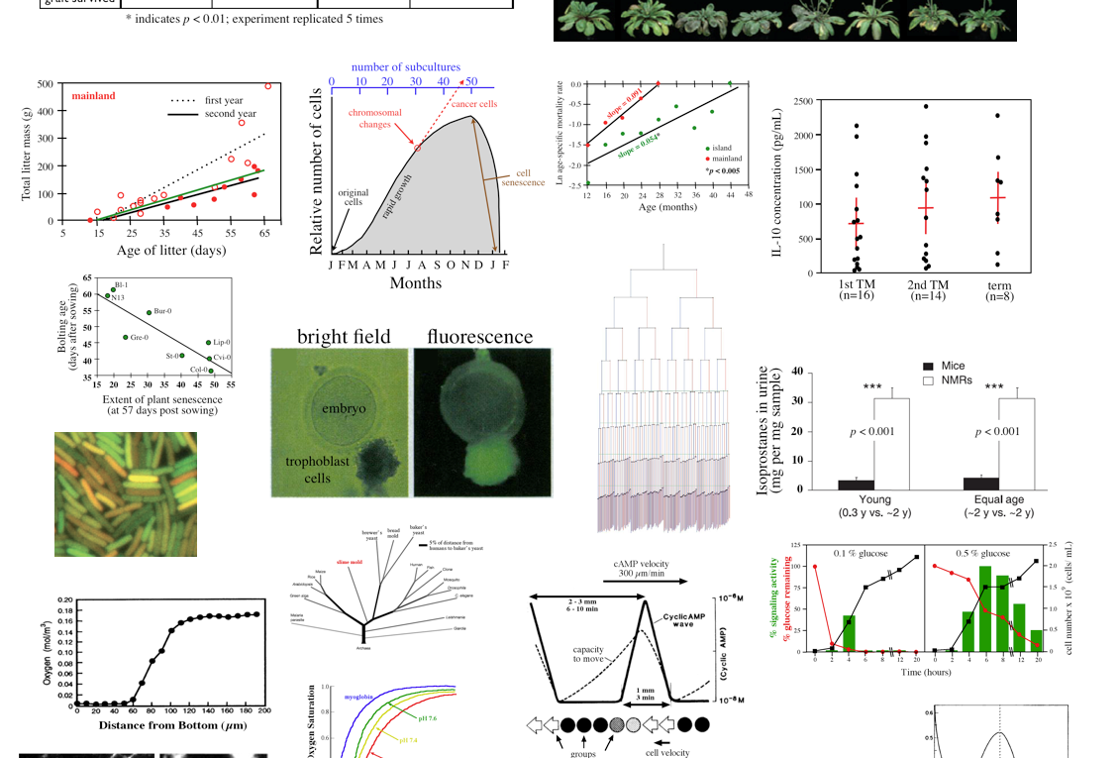
Data Gallery For Answers

Slide 53
Did the students feel they were learning something exciting?

Slide 54
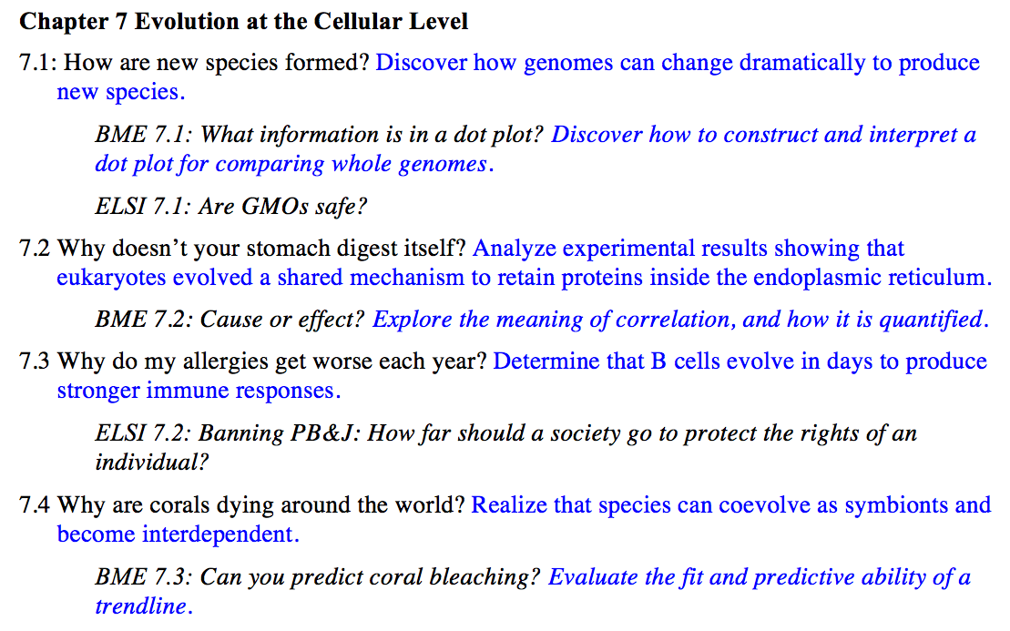
Table of Contents

Slide 55
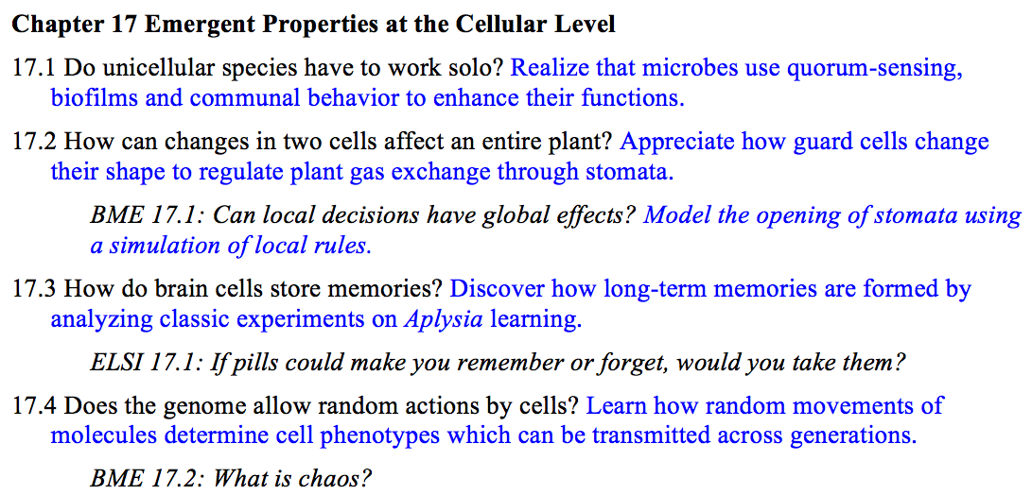
Table of Contents

Slide 56
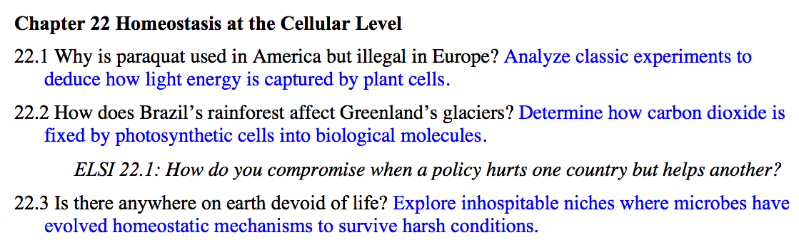
Table of Contents

Slide 58
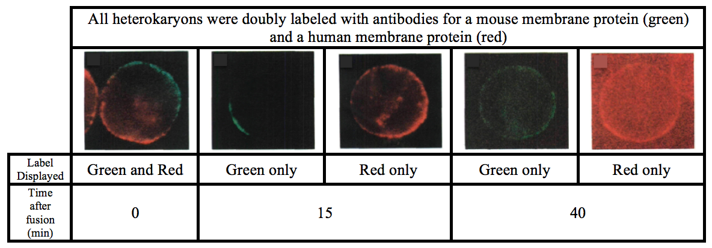
Student Skills Assessment #1

Slide 59
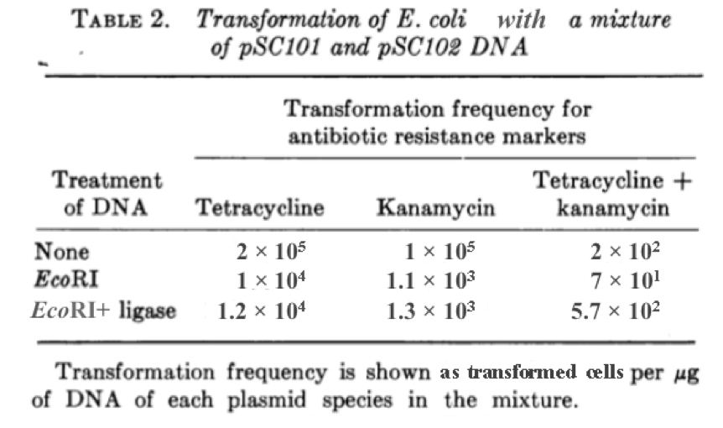
Student Skills Assessment #2

Slide 60
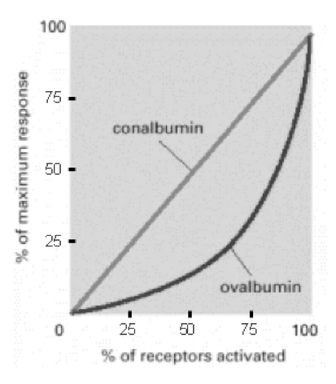
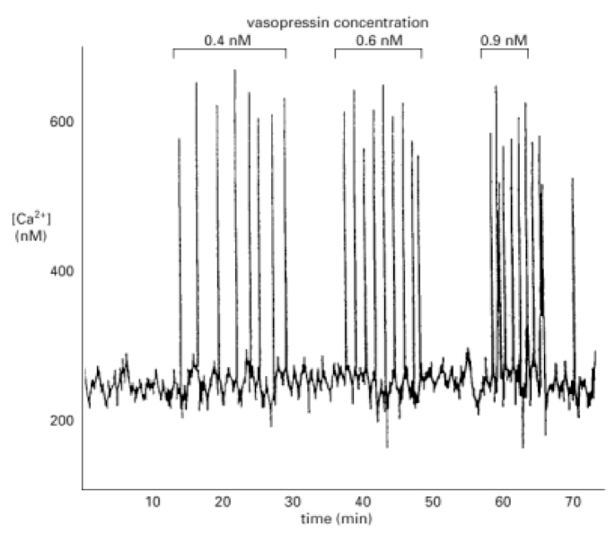
Student Skills Assessment #3

Slide 61
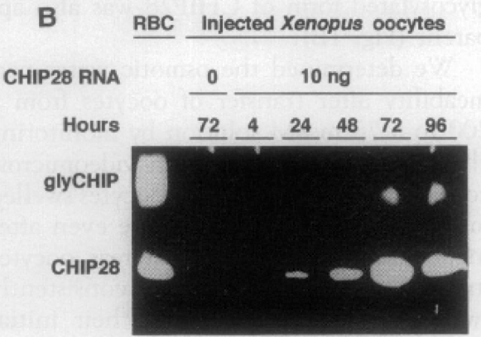
Student Skills Assessment #4

Slide 62
“The emphasis on the actual graphs, tables, and data was most helpful. Material was not just concepts to be learned for the test that had to be memorized but concepts related to experiments and real life that had to be applied.”
anonymous student course evaluation, Dec. 2010

Slide 63
“I found the new style of textbook to be very helpful along with non-memorization based teaching. Because I didn’t just spend time learning random facts, and instead learned how to interpret data, I feel like I took away a lot more from this class than I initially expected from intro bio.”
anonymous student course evaluation, Dec. 2010

