Slide 1

GCAT Pep Rally
A. Malcolm Campbell
Biology Department and GCAT
June 27, 2014

Slide 2
Outline of Presentation
Why go to college?
What is the value of an education?
How do you define an education?
How do people learn? What is the best way to study?
Should you do research in college?
Will you maximize your potential?

Slide 3

Why go to college?
http://www.creditnet.com/blog/miscellaneous/how-to-manage-student-loans

Slide 4
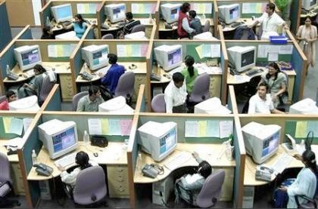
Are you training for one job?
“Number of Jobs Held, Labor Market Activity, and Earnings Growth among the Youngest Baby Boomers: Results from a Longitudinal Survey”
http://www.officefurniturepics.com/tag/used-office-cubicles/

Slide 5
Are you training for one job?
Bureau of Labor Statistics, 2008
born in the years 1957 to 1964
jobs from age 18 to age 42
average of 10.8 jobs
more jobs ages 18 - 24 than 36 - 42
23% held at least 15 jobs
14% held zero to four jobs
“Number of Jobs Held, Labor Market Activity, and Earnings Growth among the Youngest Baby Boomers: Results from a Longitudinal Survey”

Slide 6

List jobs that
pay you to
memorize
information
that you
don’t use….
http://confessionsofahighbrow.com/tag/standardized-tests/

Slide 7

Who thinks
they can
remember
more factoids
than a
computer?
http://yourwallpaper.com/abstract/circuitboard01-1024.phtml

Slide 8
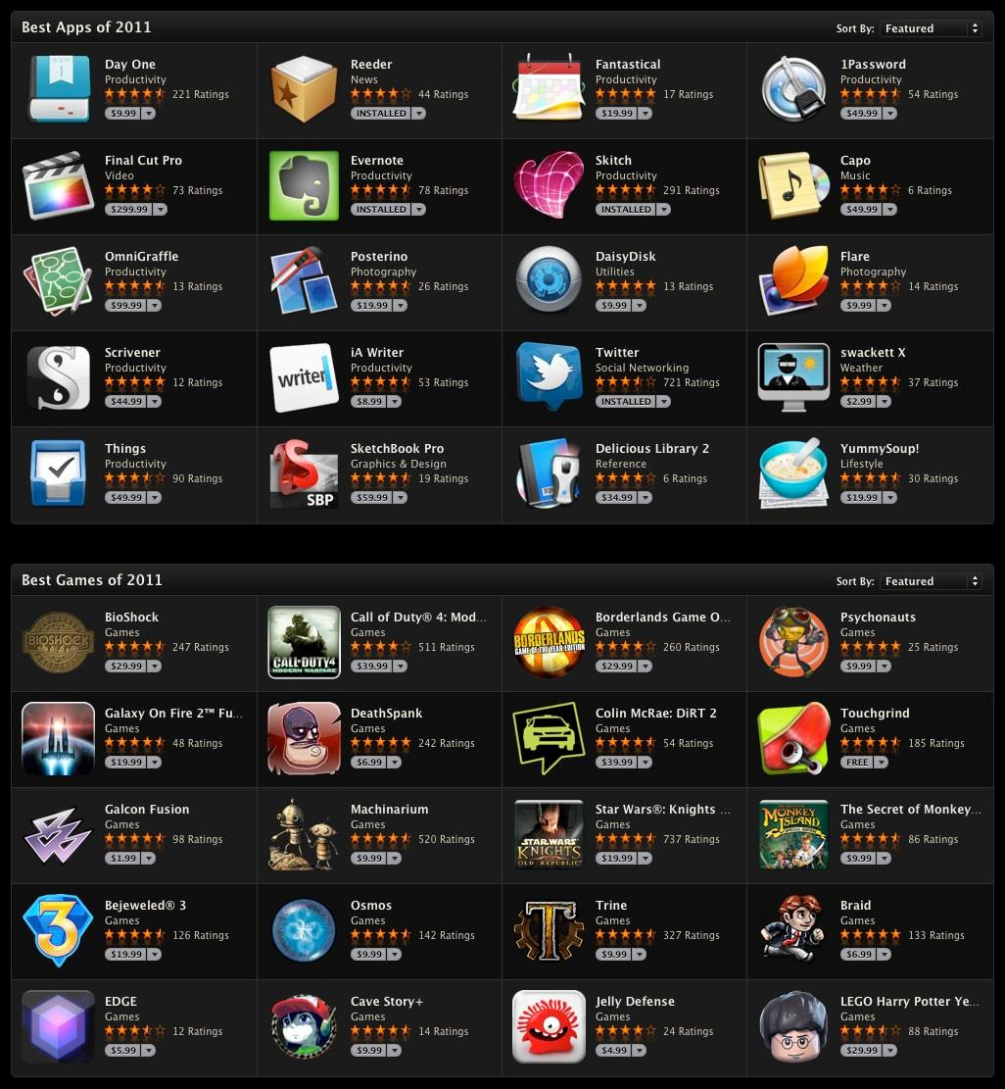
Why try to compete with computers by memorizing?
http://9to5mac.com/2011/12/08/apple-makes-its-2001-picks-on-the-app-store/

Slide 9

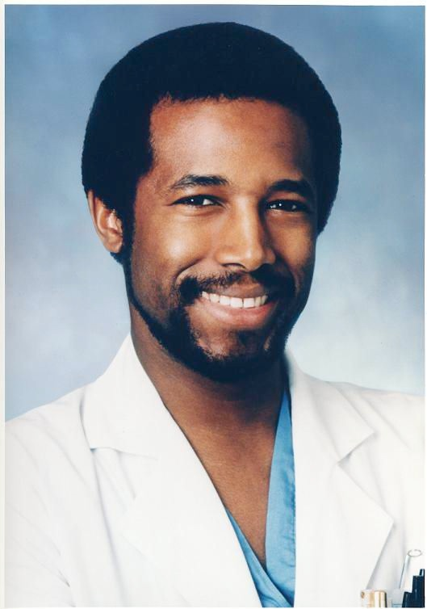
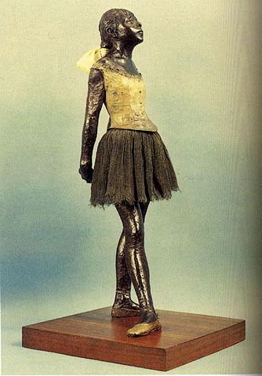

In college, you should
enhance your skills that
computers cannot perform.
Rihanna
Dr. Ben Carson
Edgar Degas
JK Rowling

Slide 10

No one gives you an education.
If you want one, you have to take it.
John Taylor Gotto
http://nccueagles.yuku.com/topic/6441#.T1o5-pjufqE

Slide 11
Who is John Taylor Gotto?
(prize for first correct answer)

Slide 12
Why is it that you can look up this,
but if you hit a word in your reading,
you ask the teacher what it means?

Slide 13
Take Charge of Your
Own Learning

Slide 14
What is the value of an education?
http://www.creditnet.com/blog/miscellaneous/how-to-manage-student-loans

Slide 15
Percent Americans > 25 with Bachelor’s Degree
30.4 % overall
14.1% Hispanics
19.9% African Americans
34.0% Caucasians
http://www.nytimes.com/2012/02/24/education/census-finds-bachelors-degrees-at-record-level.html

Slide 16
Average Annual Earnings Workers > 18
      advanced degree $74,602
bachelors degrees $51,206
high school diploma $27,915
no high school diploma $18,734.
http://usgovinfo.about.com/od/censusandstatistics/a/collegepays.htm

Slide 17
How do you define education?
http://www.creditnet.com/blog/miscellaneous/how-to-manage-student-loans

Slide 18
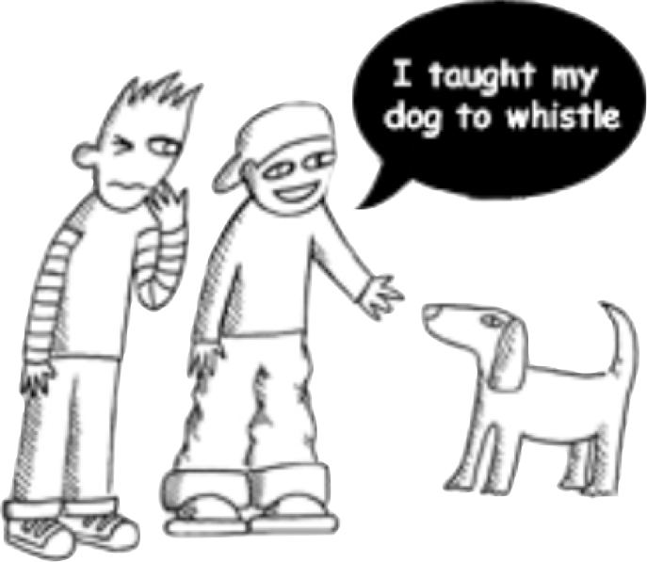
Teaching vs Learning
Guess what, I taught my dog to whistle!
http://thegoodpeople.se/blog/?p=208

Slide 19
Teaching vs Learning
Really?!

Slide 20
Teaching vs Learning
Whistle! C’mon boy, whistle!

Slide 21
Teaching vs Learning
?????????????

Slide 22
Teaching vs Learning
I thought you said you taught your dog to whistle.

Slide 23
Teaching vs Learning
I did, but I didn’t say that he learned to whistle.

Slide 24
Education is the only industry where
customers never complain when they
get less product for their money.

Slide 25
Our Current Challenge:
Introductory Biology
Integrating Concepts in Biology
by
A. Malcolm Campbell, Laurie J. Heyer
and Christopher J. Paradise

Slide 26
What is wrong with business as usual?
http://www.ibiology.org/ibioeducation/taking-courses/ibiology-scientific-teaching-series.html

Slide 27
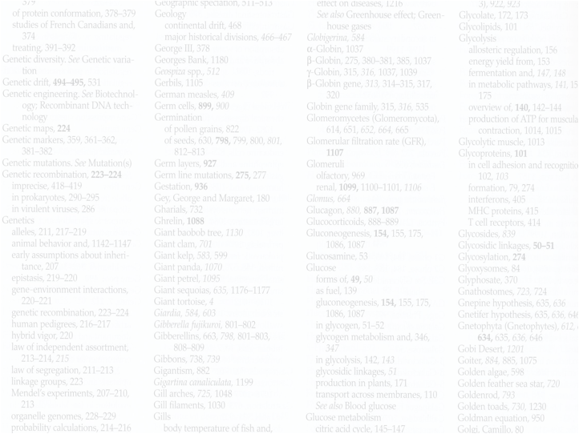
What’s Wrong with Biology Education Now?
Vocabulary is emphasized
Experimental approaches are minimized
Math is absent
Memorization is rewarded
Critical thinking is discouraged
Information is irrelevant to students

Slide 28
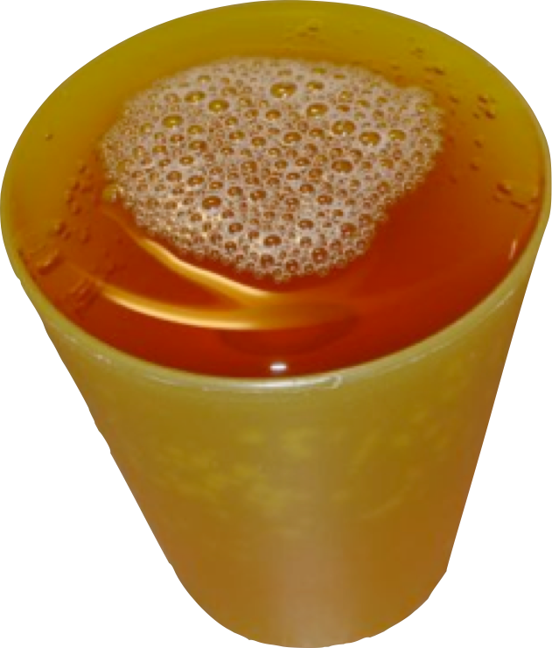
If we currently cover all the important stuff….
…how can we add more content?

Slide 29
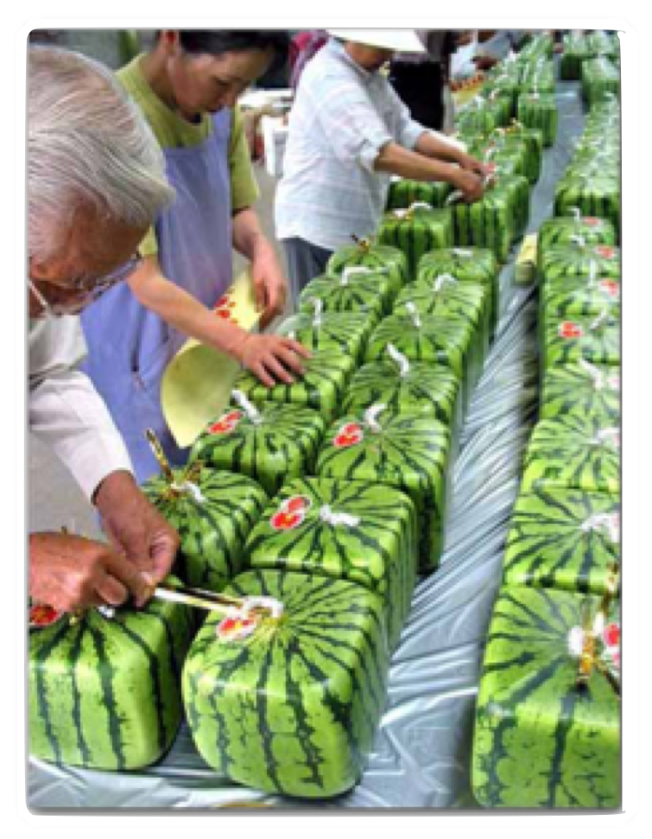
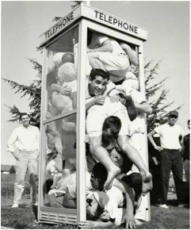
Too much content for the containers
Notes:
When you cram too much information into students, the outcome is unnatural and unpleasant to look at.

Slide 30
Too much content for the containers
Notes:
When you cram too much information into students, the outcome is unnatural and unpleasant to look at.

Slide 31
"Never mistake activity for achievement."
John Wooden

Slide 32
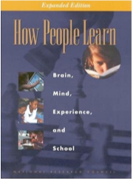



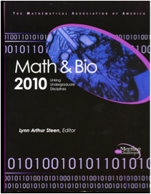

Start with the literature…

Slide 33
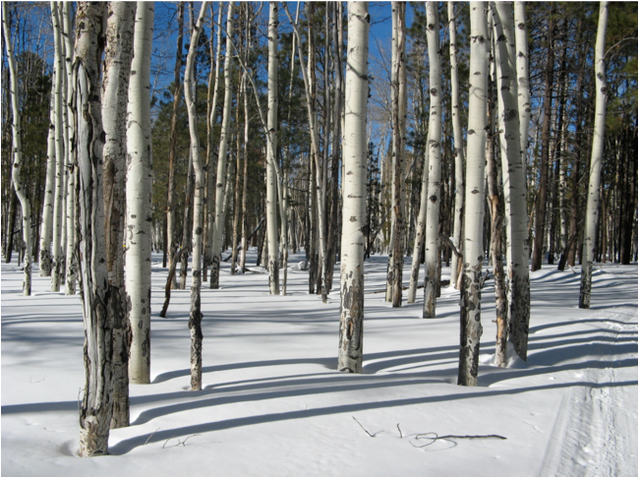
Present information and data…

Slide 34

… in the context of the big picture.

Slide 35

Artificial Divide within Biology
Small Biology
Big Biology

Slide 36
Five Levels of Organization
Molecular
Cellular
Organismal
Population
Ecological System

Slide 37
Five Big Ideas of Biology
Information
Homeostasis
Evolution
Biology
Emergent
Properties
Cells

Slide 38
Five by Five Matrix of Biology
Cellular
Organismal
Information
Molecular
Population
Cellular
Organismal
Cellular
Organismal
Ecological System
Homeostasis
Evolution
Molecular
Population
Molecular
Population
Biology
Ecological System
Ecological System
Cellular
Organismal
Cellular
Organismal
Emergent
Properties
Cells
Molecular
Population
Molecular
Population
Ecological System
Ecological System

Slide 39
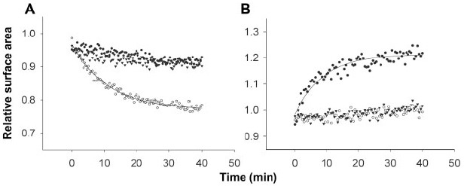
BioMath Explorations
BioMath Exploration 6.3
How can you fit
exponential curves to data?

Slide 40
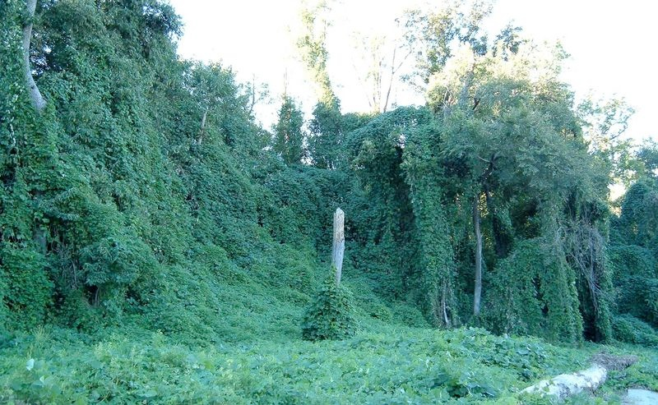
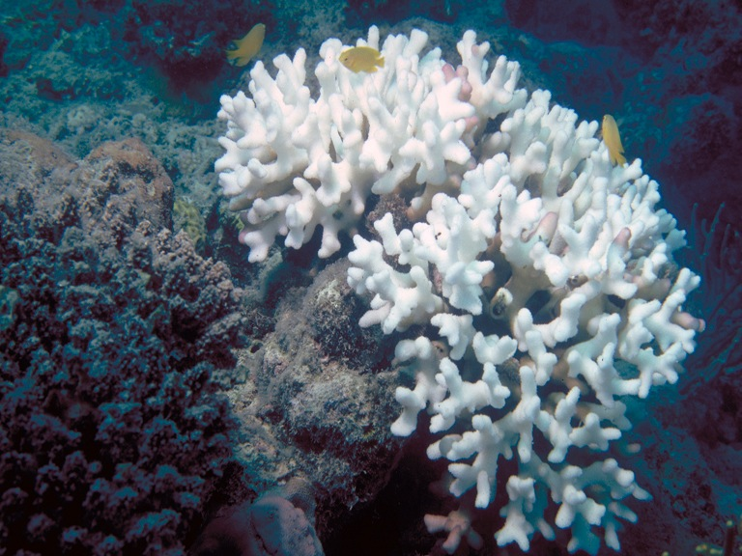

Ethical, Legal and Social Implications
Are religion and evolution compatible?
Is science possible if you are uncertain about what is true?
Does basic biology have any impact on the real world?
Who owns your DNA?

Slide 41
Did my students learn less content?

Slide 42
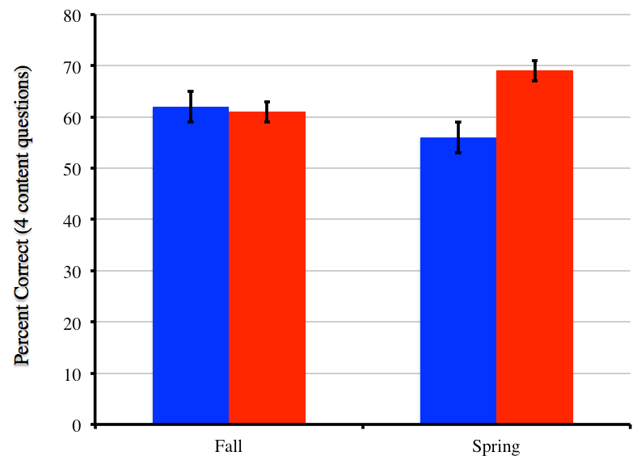
Student Content Assessment
new
83% response rate (new)
63% response rate (traditional)
traditional
percent correct
p = 0.97
p = 0.06
+/- SEM
Fall 2010
Spring

Slide 43
Student Content Assessment
new
83% response rate (new)
63% response rate (traditional)
traditional
percent correct
p = 0.97
p = 0.06
+/- SEM
Fall 2010
Spring 2011

Slide 44
Can my students analyze data better?

Slide 45
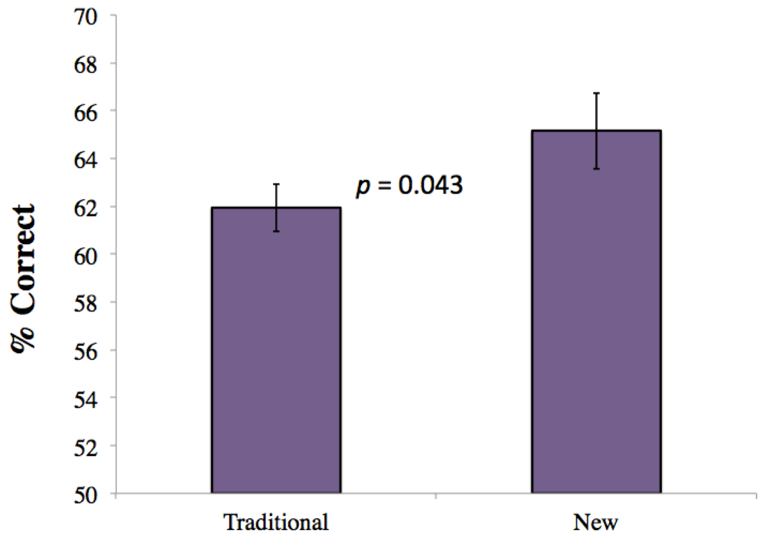
Student Skills Assessment

Slide 46
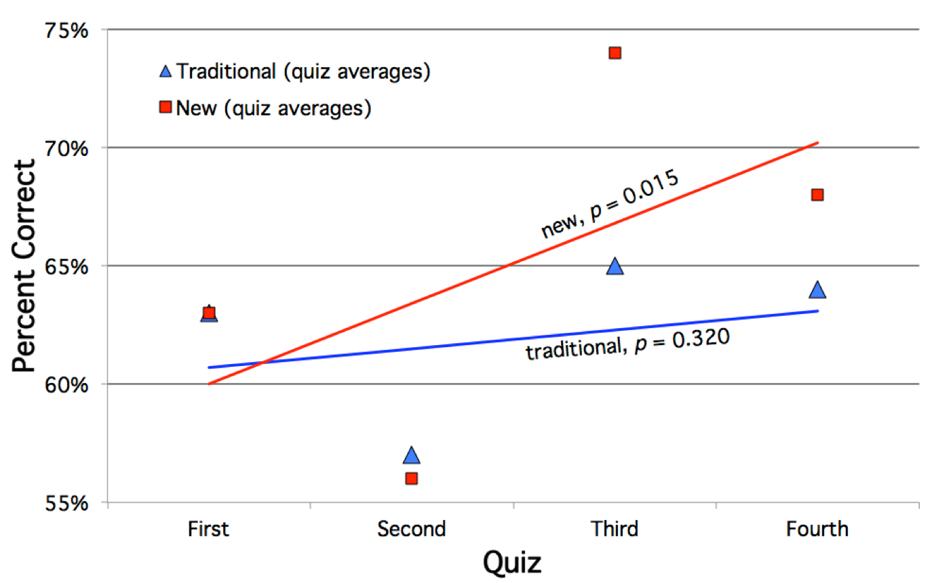
Student Skills Assessment

Slide 47
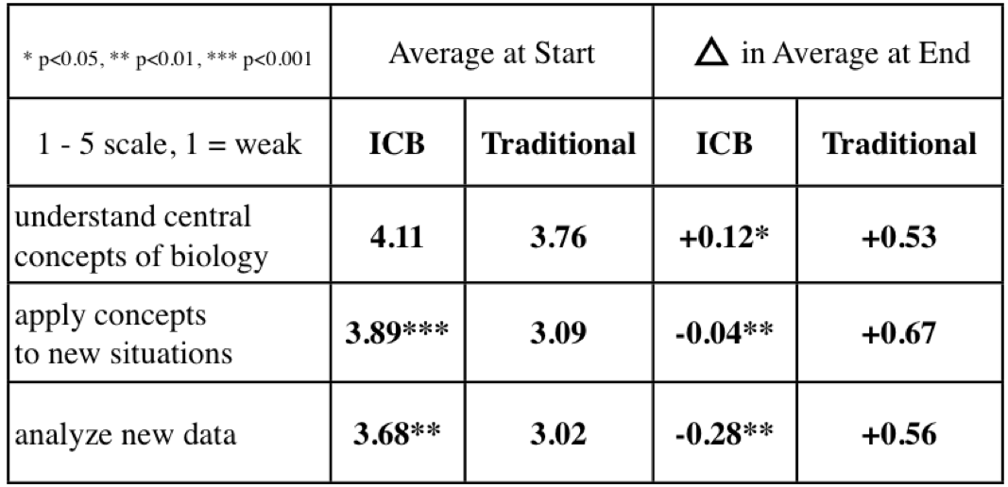
Are ICB students overconfident?
yes?

Slide 48
Are ICB students overconfident?
less so

Slide 49
Student Skills Assessment

Slide 50
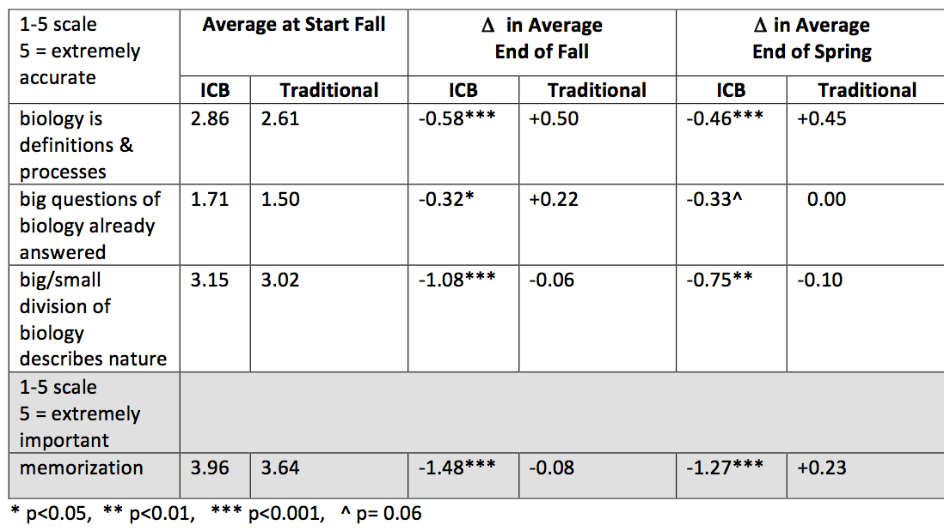
Do ICB students see biology differently?
no

Slide 51
Do ICB students see biology differently?
yes!
yes!
yes!
yes!

Slide 52
Do ICB students see biology differently?
yes!
yes?
yes!
yes!

Slide 53
To whom much has been
given, much is expected.

Slide 54
How do people learn?
http://www.creditnet.com/blog/miscellaneous/how-to-manage-student-loans

Slide 55
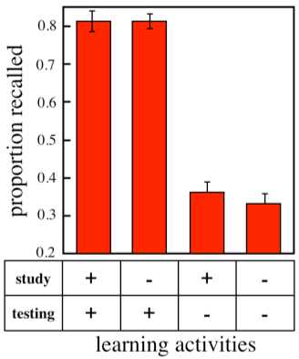
What is the most effective way to study?

Slide 56
What’s the best way to study?
http://www.creditnet.com/blog/miscellaneous/how-to-manage-student-loans

Slide 57
The Outline Method for Learning

Slide 58
The Outline Method for Learning
start with 1 blank piece of paper

Slide 59
The Outline Method for Learning
Why I love Biology
1. it is fun
I understand me
I know my dog better
2. I can get any job I want
I can do research
I can work in a zoo
I can become a superhero
3. In movies, knowledge is key
Bourne Legacy - blue pill
Hunger Games - find water
Harry Potter - spells win
make an outline
of the chapter

Slide 60
The Outline Method for Learning
turn the paper over
Why I love Biology
1. it is fun
I understand me
I know my dog better
2. I can get any job I want
I can do research
I can work in a zoo
I can become a superhero
3. In movies, knowledge is key
Bourne Legacy - blue pill
Hunger Games - find water
Harry Potter - spells win

Slide 61
The Outline Method for Learning
get a clean sheet of paper
Why I love Biology
1. it is fun
I understand me
I know my dog better
2. I can get any job I want
I can do research
I can work in a zoo
I can become a superhero
3. In movies, knowledge is key
Bourne Legacy - blue pill
Hunger Games - find water
Harry Potter - spells win

Slide 62
The Outline Method for Learning
try to recreate the outline
Why I love Biology
1. it is fun
I understand me
I know my dog better
2. I can get any job I want
I can do research
I can work in a zoo
I can become a superhero
3. In movies, knowledge is key
Bourne Legacy - blue pill
Hunger Games - find water
Harry Potter - spells win
Why I love Biology
1. it is fun
I understand me
I know my dog better
2. I can get any job I want
I can do research
I can work in a zoo
I can become a superhero
3. In movies, knowledge is key
Bourne Legacy - blue pill
Hunger Games - find water
Harry Potter - spells win

Slide 63
The Outline Method for Learning
this is what you DO know
Why I love Biology
1. it is fun
I understand me
I know my dog better
2. I can get any job I want
I can do research
I can work in a zoo
I can become a superhero
3. In movies, knowledge is key
Bourne Legacy - blue pill
Hunger Games - find water
Harry Potter - spells win
Why I love Biology
1. it is fun
I understand me
I know my dog better
2. I can get any job I want
I can do research
I can work in a zoo
I can become a superhero
3. In movies, knowledge is key
Bourne Legacy - blue pill
Hunger Games - find water
Harry Potter - spells win

Slide 64
The Outline Method for Learning
this is what you don’t know
Why I love Biology
1. it is fun
I understand me
I know my dog better
2. I can get any job I want
I can do research
I can work in a zoo
I can become a superhero
3. In movies, knowledge is key
Bourne Legacy - blue pill
Hunger Games - find water
Harry Potter - spells win
Why I love Biology
1. it is fun
I understand me
I know my dog better
2. I can get any job I want
I can do research
I can work in a zoo
I can become a superhero
3. In movies, knowledge is key
Bourne Legacy - blue pill
Hunger Games - find water
Harry Potter - spells win

Slide 65
The Outline Method for Learning
flip back over
look up the missing info
Why I love Biology
1. it is fun
I understand me
I know my dog better
2. I can get any job I want
I can do research
I can work in a zoo
I can become a superhero
3. In movies, knowledge is key
Bourne Legacy - blue pill
Hunger Games - find water
Harry Potter - spells win
Why I love Biology
1. it is fun
I understand me
I know my dog better
2. I can get any job I want
I can do research
I can work in a zoo
I can become a superhero
3. In movies, knowledge is key
Bourne Legacy - blue pill
Hunger Games - find water
Harry Potter - spells win
Why I love Biology
1. it is fun
I understand me
I know my dog better
2. I can get any job I want
I can do research
I can work in a zoo
I can become a superhero
3. In movies, knowledge is key
Bourne Legacy - blue pill
Hunger Games - find water
Harry Potter - spells win

Slide 66
The Outline Method for Learning
fill in these parts
Why I love Biology
1. it is fun
I understand me
I know my dog better
2. I can get any job I want
I can do research
I can work in a zoo
I can become a superhero
3. In movies, knowledge is key
Bourne Legacy - blue pill
Hunger Games - find water
Harry Potter - spells win
Why I love Biology
1. it is fun
I understand me
I know my dog better
2. I can get any job I want
I can do research
I can work in a zoo
I can become a superhero
3. In movies, knowledge is key
Bourne Legacy - blue pill
Hunger Games - find water
Harry Potter - spells win
Why I love Biology
1. it is fun
I understand me
I know my dog better
2. I can get any job I want
I can do research
I can work in a zoo
I can become a superhero
3. In movies, knowledge is key
Bourne Legacy - blue pill
Hunger Games - find water
Harry Potter - spells win

Slide 67
The Outline Method for Learning
make sure you understand
Why I love Biology
1. it is fun
I understand me
I know my dog better
2. I can get any job I want
I can do research
I can work in a zoo
I can become a superhero
3. In movies, knowledge is key
Bourne Legacy - blue pill
Hunger Games - find water
Harry Potter - spells win
Why I love Biology
1. it is fun
I understand me
I know my dog better
2. I can get any job I want
I can do research
I can work in a zoo
I can become a superhero
3. In movies, knowledge is key
Bourne Legacy - blue pill
Hunger Games - find water
Harry Potter - spells win
Why I love Biology
1. it is fun
I understand me
I know my dog better
2. I can get any job I want
I can do research
I can work in a zoo
I can become a superhero
3. In movies, knowledge is key
Bourne Legacy - blue pill
Hunger Games - find water
Harry Potter - spells win

Slide 68
The Outline Method for Learning
turn the paper over
try again to reproduce outline
Why I love Biology
1. it is fun
I understand me
I know my dog better
2. I can get any job I want
I can do research
I can work in a zoo
I can become a superhero
3. In movies, knowledge is key
Bourne Legacy - blue pill
Hunger Games - find water
Harry Potter - spells win
Why I love Biology
1. it is fun
I understand me
I know my dog better
2. I can get any job I want
I can do research
I can work in a zoo
I can become a superhero
3. In movies, knowledge is key
Bourne Legacy - blue pill
Hunger Games - find water
Harry Potter - spells win

Slide 69
Should you do research in college?
http://www.creditnet.com/blog/miscellaneous/how-to-manage-student-loans

Slide 70
Skills Most Sought After by Employers
Communications Skills
Analytical/Research Skills
Computer Literacy
Flexibility
Interpersonal Abilities
Leadership Skills
Multicultural Sensitivity
Organizational Skills
Problem-Solving/Creativity
Teamwork
http://www.quintcareers.com/job_skills_values.html

Slide 71
Skills Improved During Research
Communications Skills
Analytical/Research Skills
Computer Literacy
Flexibility
Interpersonal Abilities
Leadership Skills
Multicultural Sensitivity
Organizational Skills
Problem-Solving/Creativity
Teamwork
http://www.quintcareers.com/job_skills_values.html

Slide 72
Personal Values Employers Seek in Employees
Honesty/Integrity
Adaptability
Dedication/Tenacity
Dependability
Loyalty
Positive Attitude
Professionalism
Self-Confidence
Self-Motivated
Willingness to Learn
http://www.quintcareers.com/job_skills_values.html

Slide 73
Personal Values Improved by Research
Honesty/Integrity
Adaptability
Dedication/Tenacity
Dependability
Loyalty
Positive Attitude
Professionalism
Self-Confidence
Self-Motivated
Willingness to Learn
http://www.quintcareers.com/job_skills_values.html

Slide 74
Will you maximize your potential?
http://www.creditnet.com/blog/miscellaneous/how-to-manage-student-loans

Slide 75

Your College Education Put Into Focus
Notes:
2007 movie

Slide 76

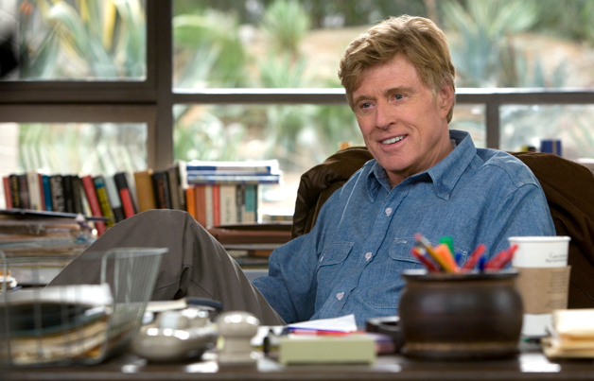
Your College Education Put Into Focus
Would you rather settle for a blue collar B
or try for an A and risk failure?

Slide 77
Thomas J. Watson, founder of IBM
“Would you like me to give you a formula for success? It's quite simple, really. Double your rate of failure. You are thinking of failure as the enemy of success. But it isn’t at all. You can be discouraged by failure or you can learn from it, so go ahead and make mistakes. Make all you can. Because remember that’s where you will find success.”
Thomas J. Watson

Slide 78
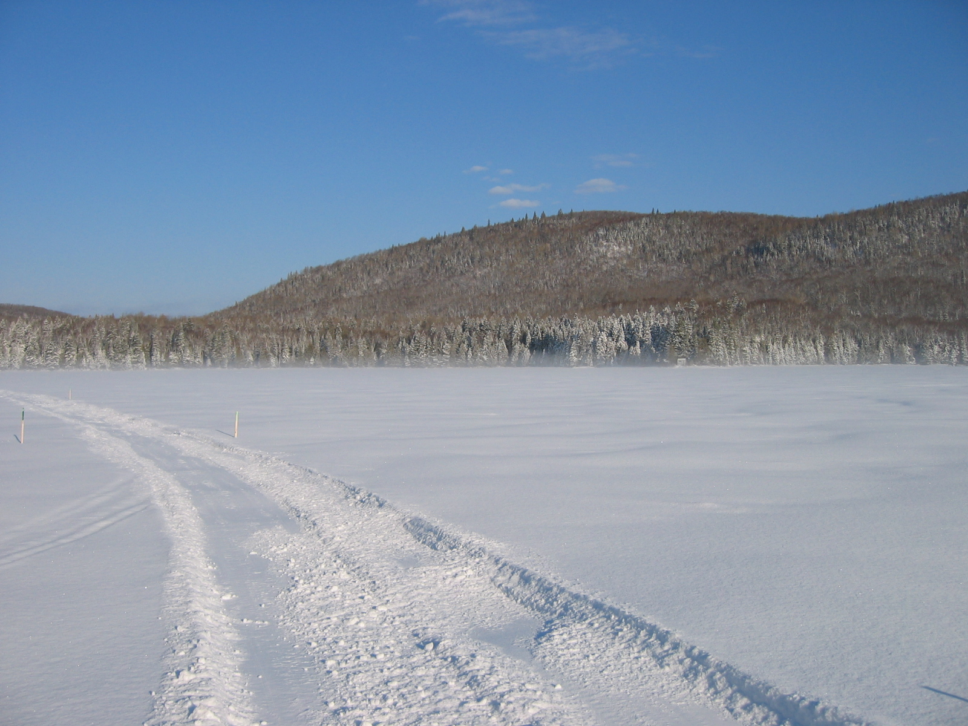
The scenery only changes for the lead dog.

Slide 79
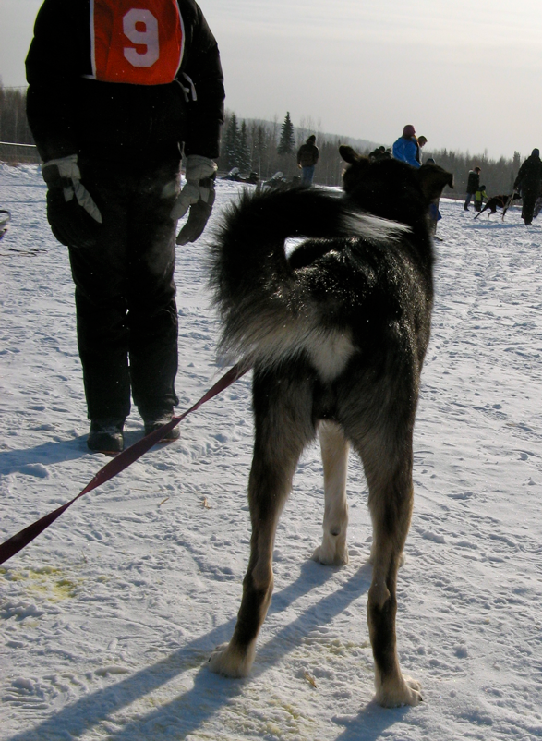
The scenery only changes for the lead dog.

Slide 80
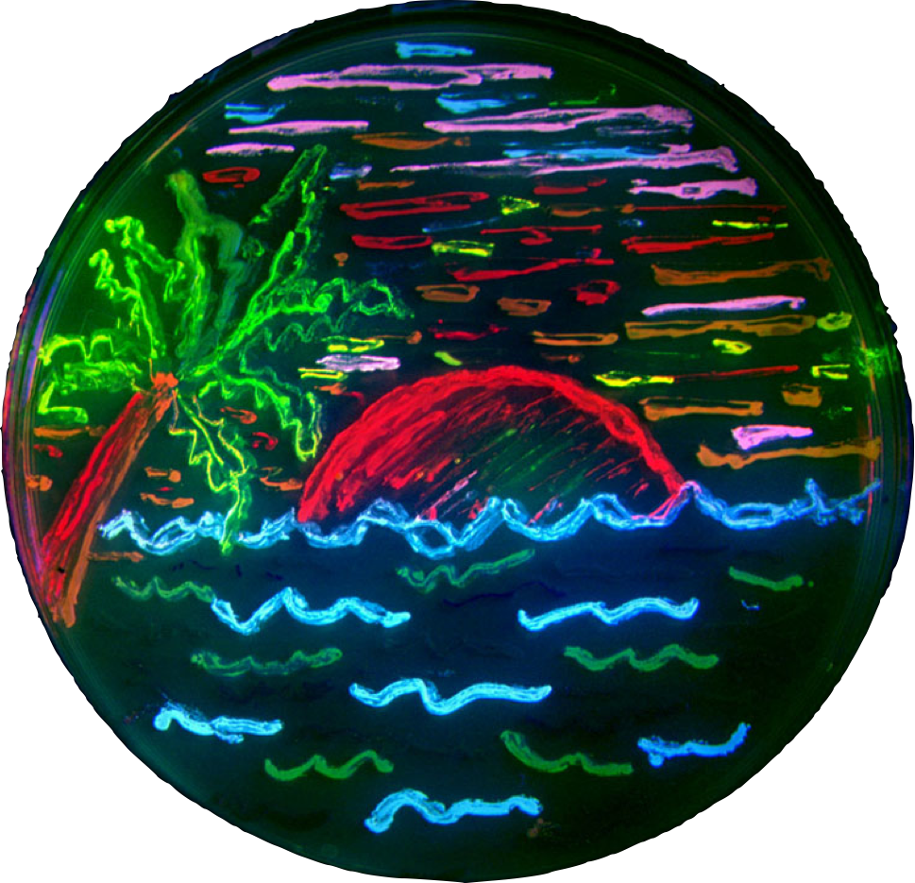
The End

