Slide 1
Synthetic Biology at Saint Mary’s College
1. Previous experience
2. Application in courses
a. Vidya – Genetics lab course
b. Valerie – Special Topics in Chemistry lecture course
3. Research

Slide 2
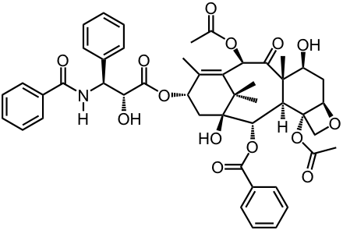
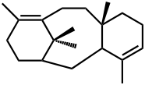
3. Research
a. Engineered biosynthesis of biologically active natural products
(or precursors)
i. Taxol
Challenge – work already in progress!
ex. Biotechnol. Bioeng. 2006, 93, (2) 212-224.
ii. Other targets?!
Challenge – finding biosynthetic pathways

Slide 3
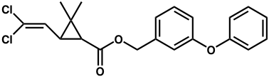
3. Research
b. Pollutant detectors
i. Pyrethroids: very low concentrations are toxic
Can synthetic biology provide lower detection methods?
challenge – Na⁺ channel disruptor
ii. Endocrine disruptors (herbicides, pesticides, additives)
bisphenols; chlordanes; PCBs; etc.

Slide 4
Endocrine disruptors strategy (maybe):
Lipid
Soluble
Drug
Hormone
Responsive
gene
HRE
HREP
GFP
Applications:
Detection of certain endocrine disruptors
Detection limits?
2. Screening to identify compounds as endocrine disruptors

