Slide 1
Week 9
miniprep to isolate plasmid DNA

Slide 2
overnight cultures

Slide 3
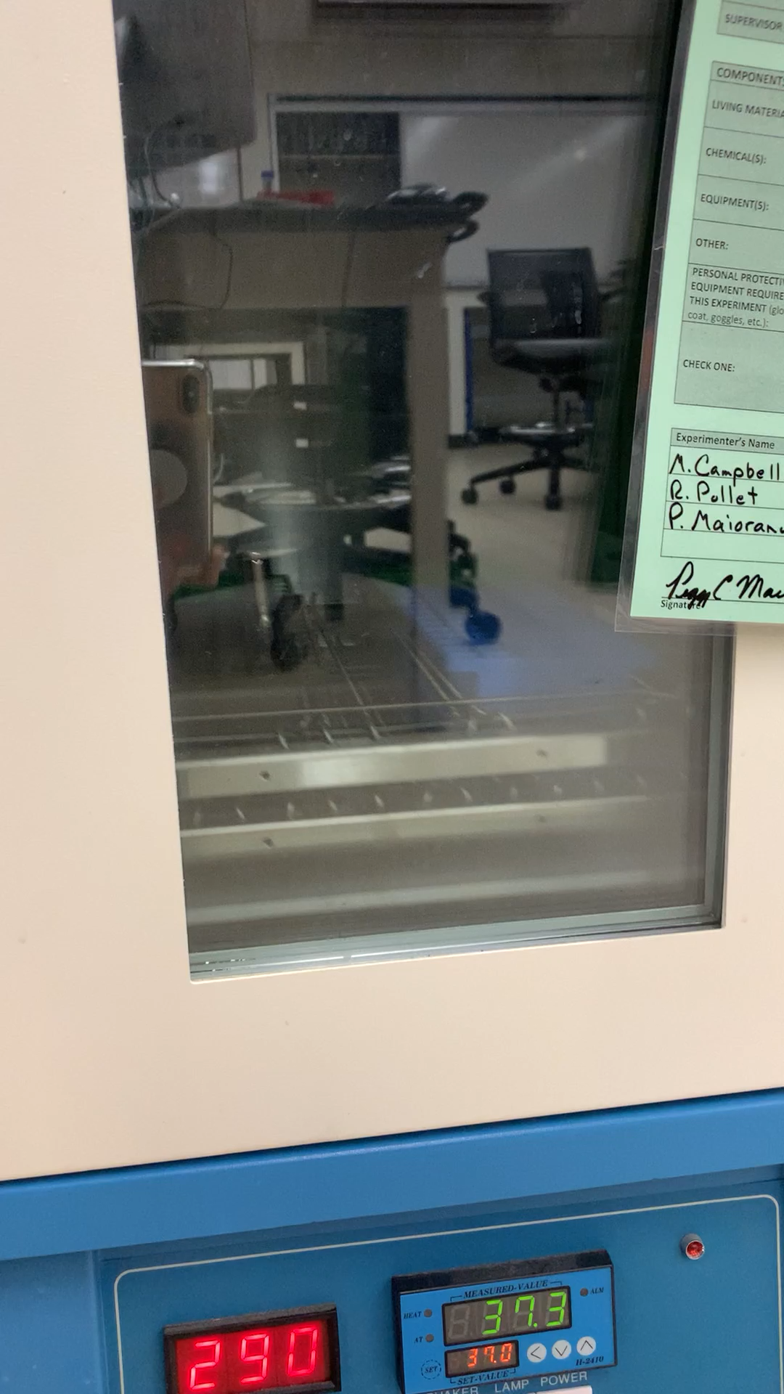
37º C incubator, shaking 281 rpm

Slide 4
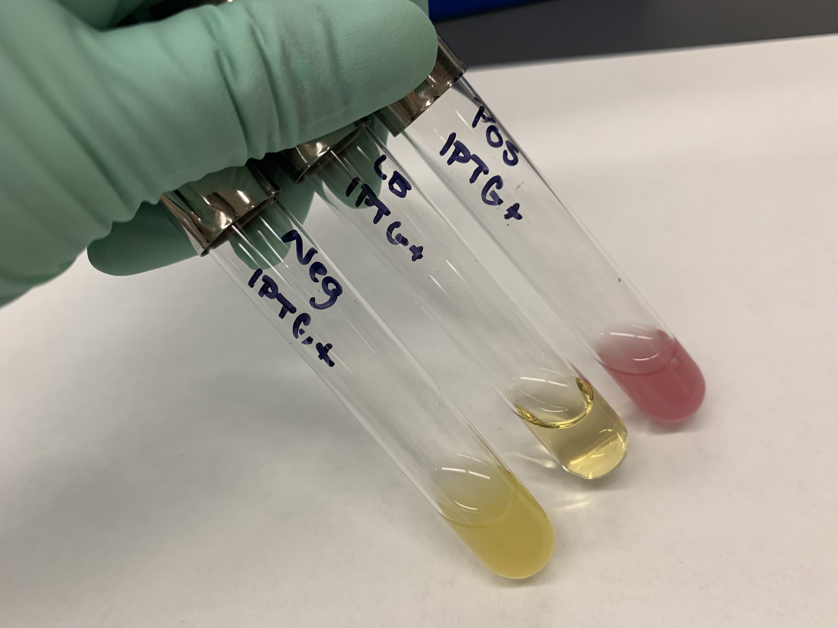
control tubes

Slide 5
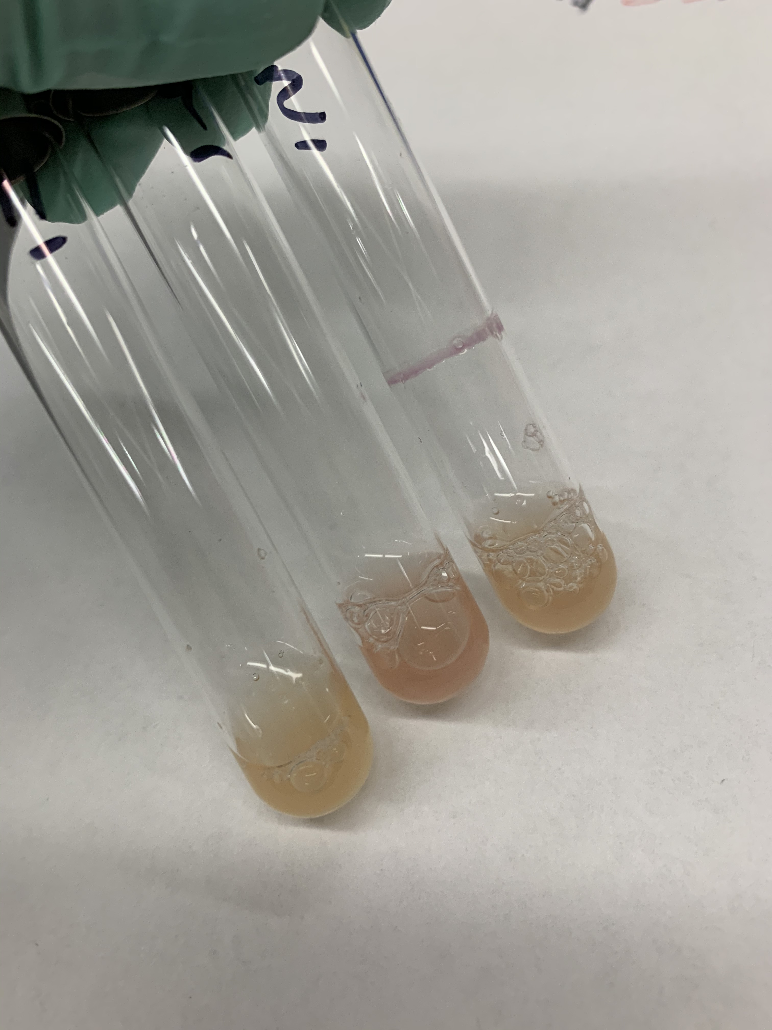
lac X1 – X3

Slide 6
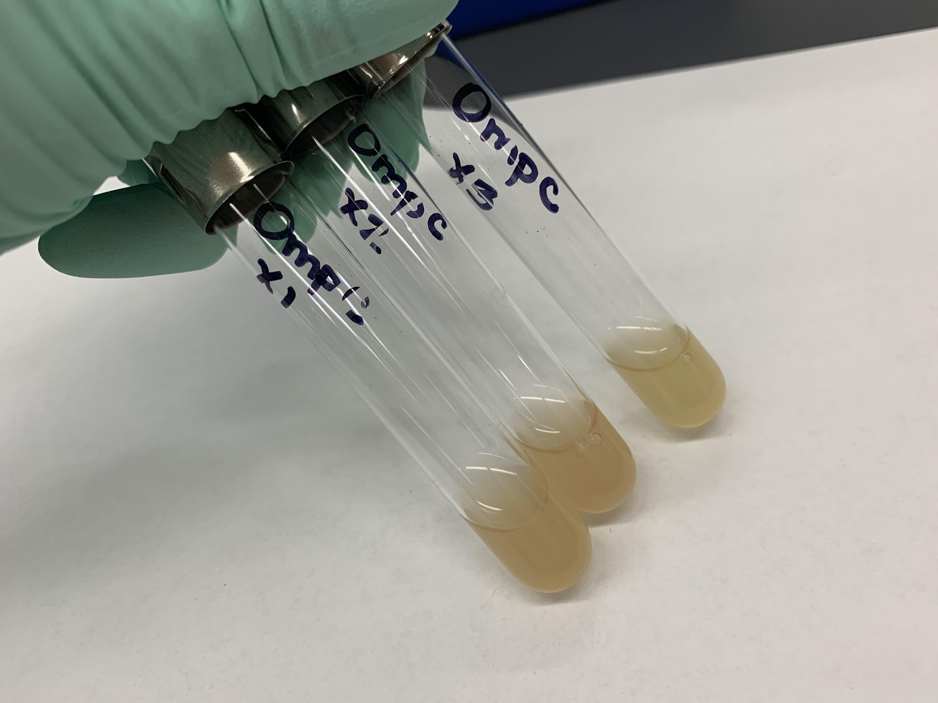
ompC X1 – X3

Slide 7
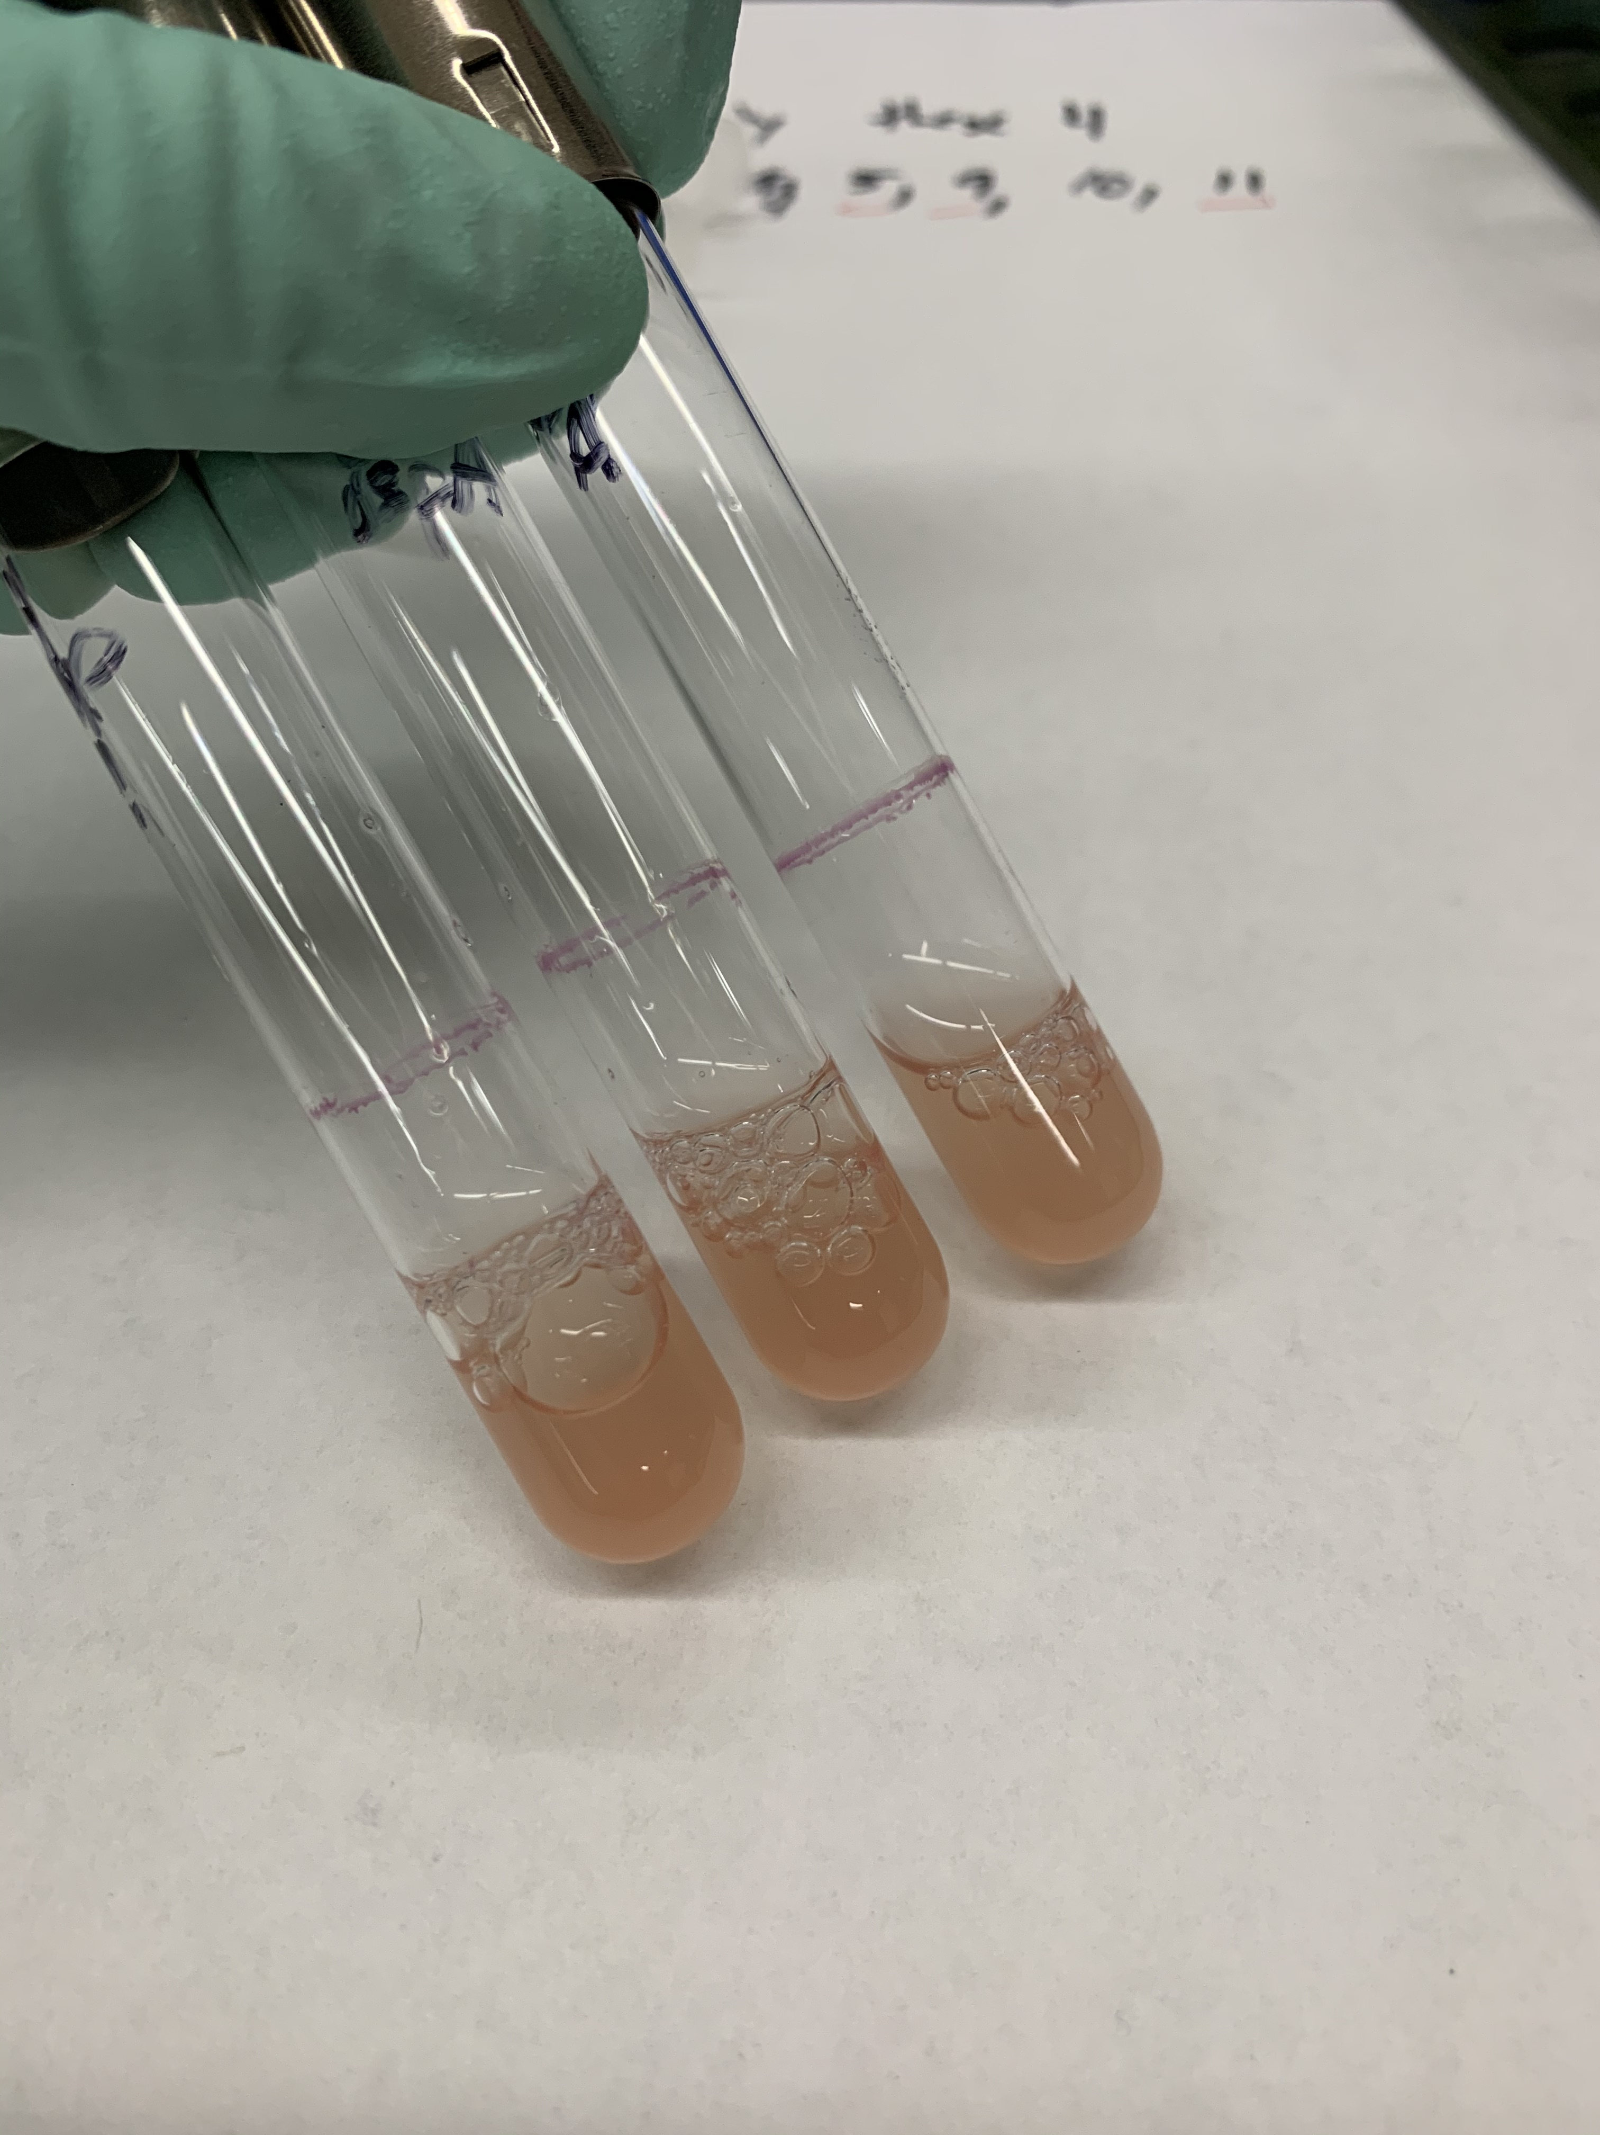
ospA X1 – X3

Slide 8
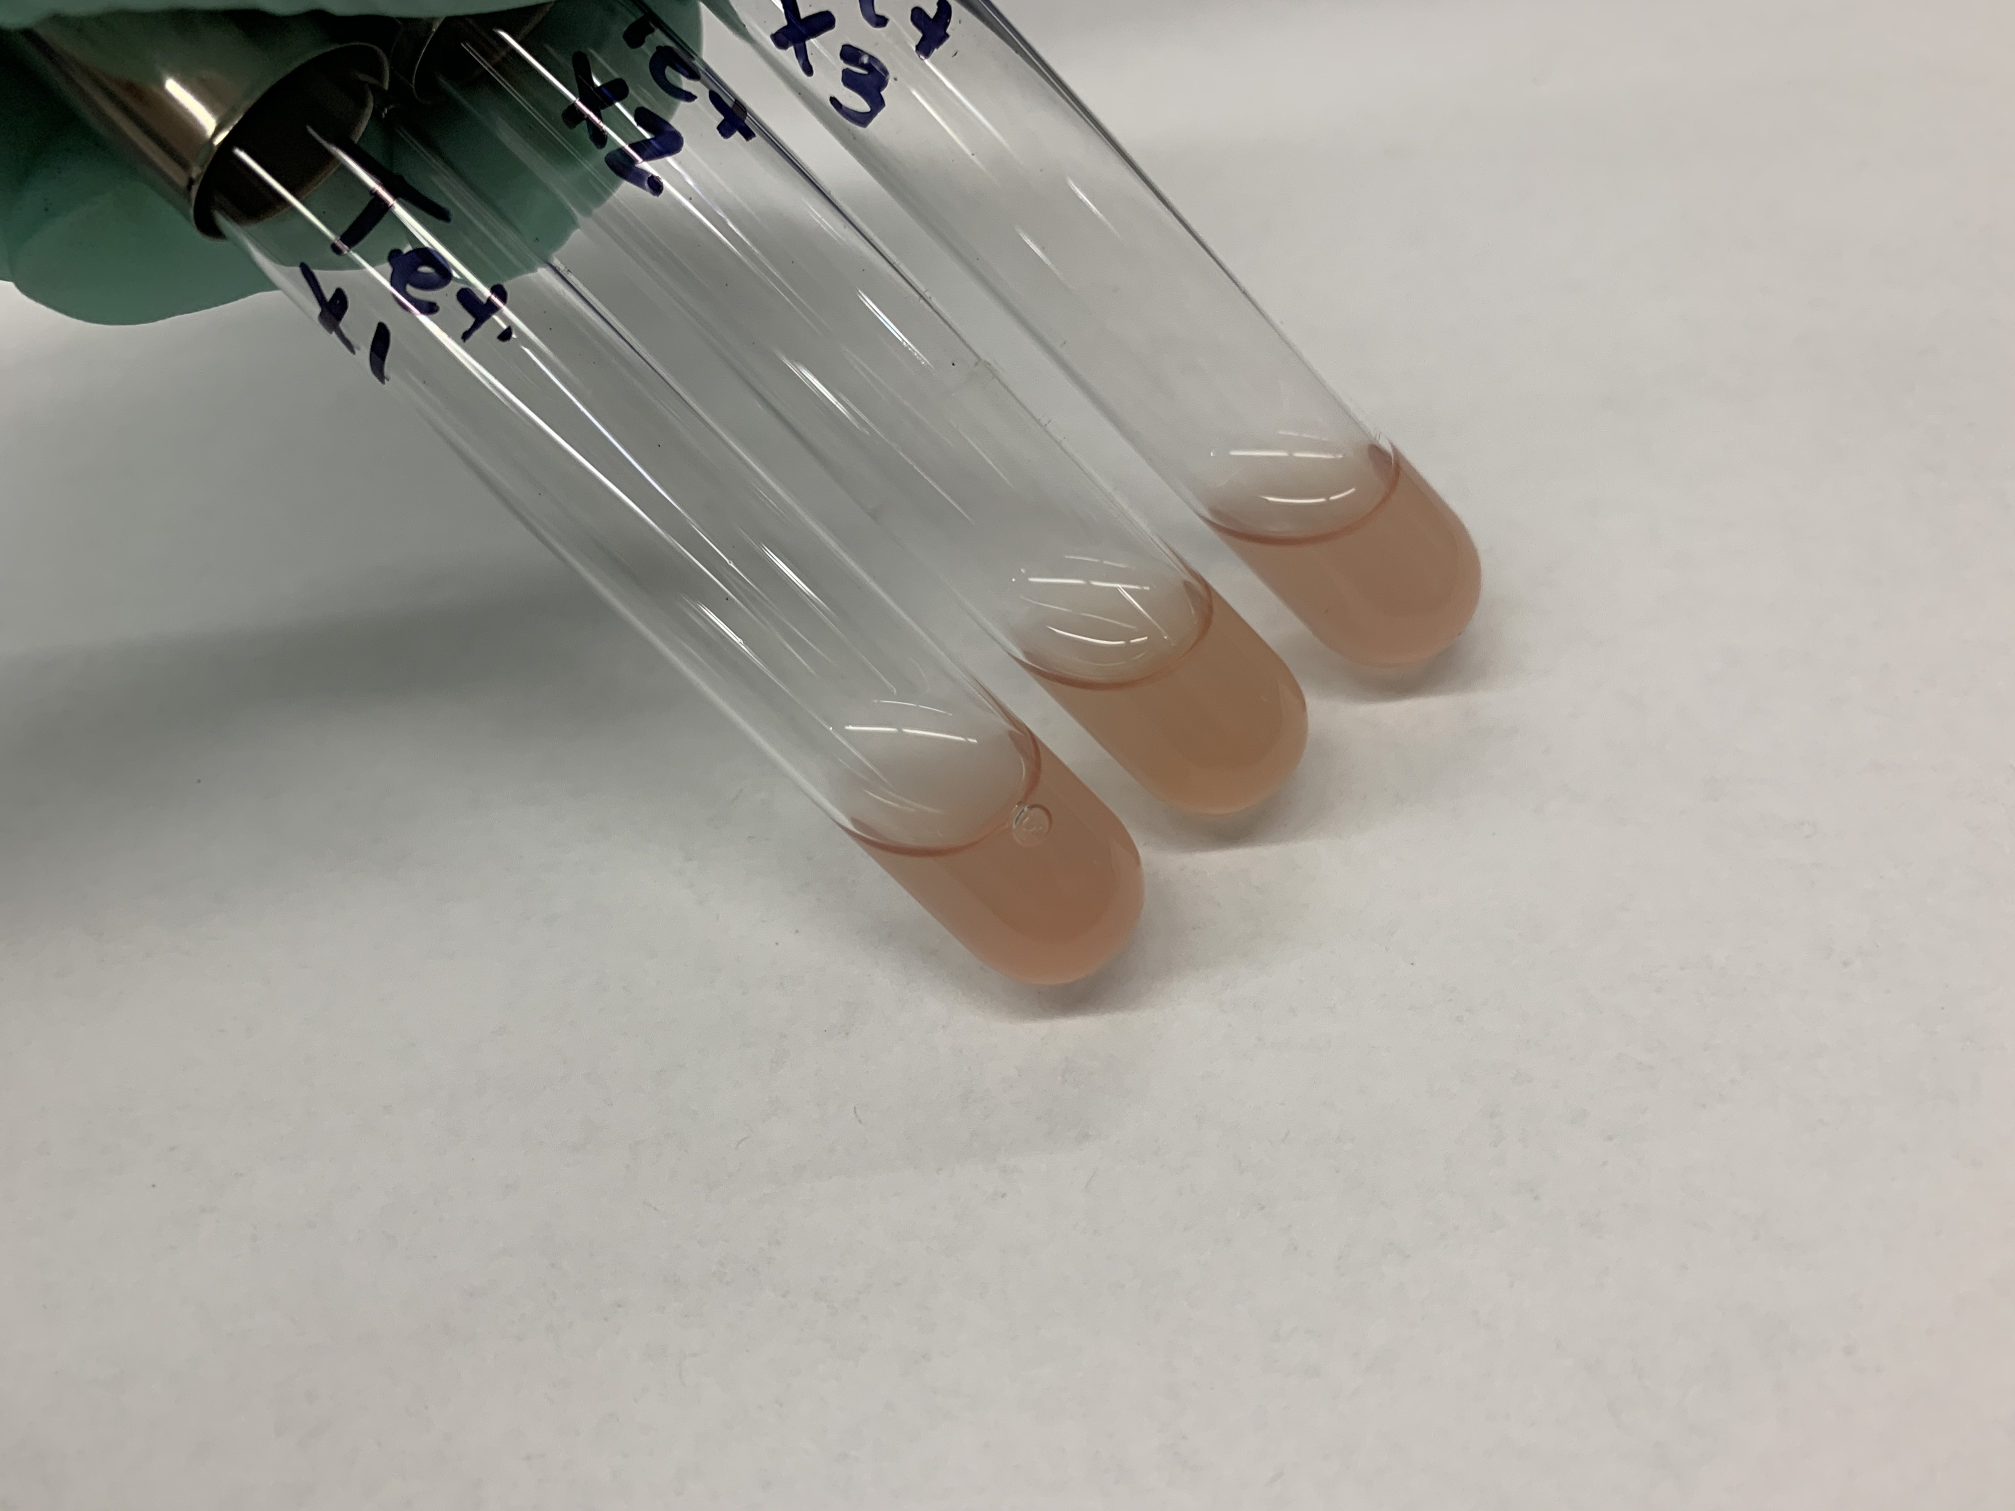
tet X1 – X3

Slide 9
Synergy plate reader
96-well plates: RFP, GFP, absorbance 600

Slide 10
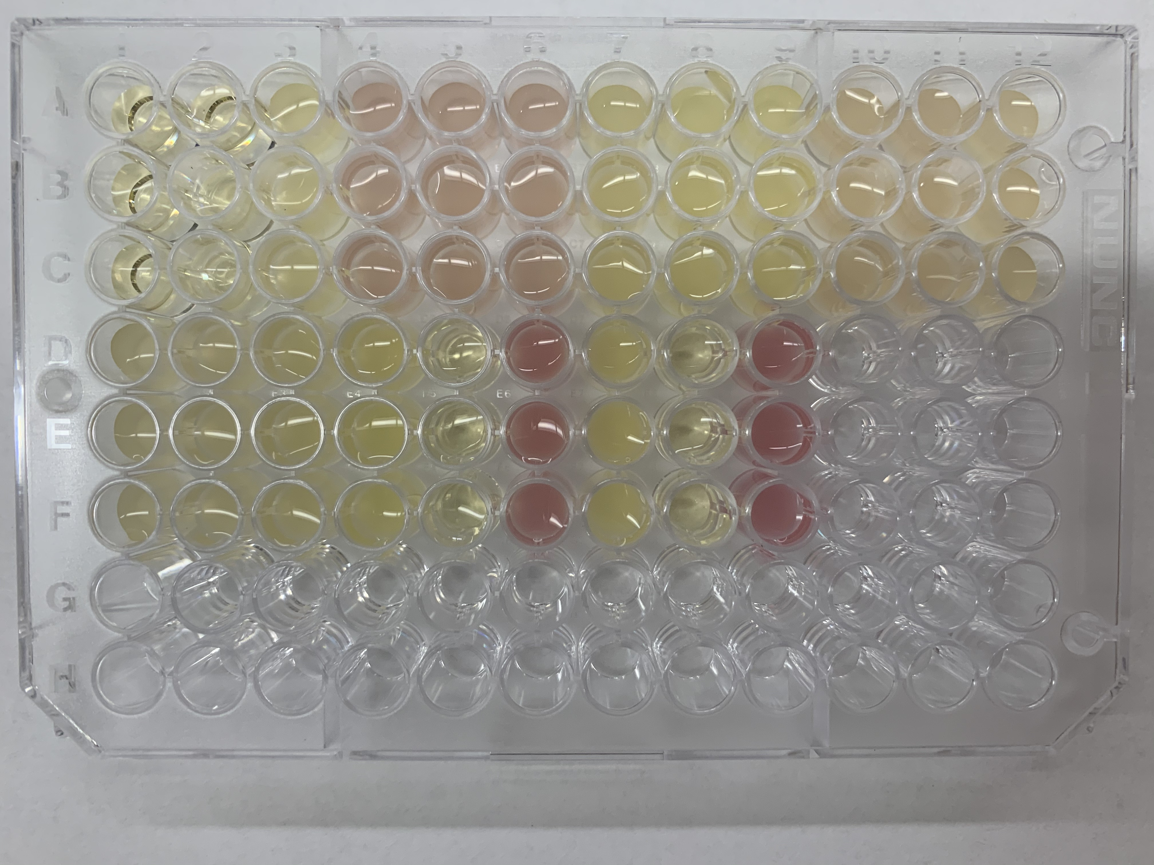
one of the plates with triplicates (200 µL each)

Slide 11
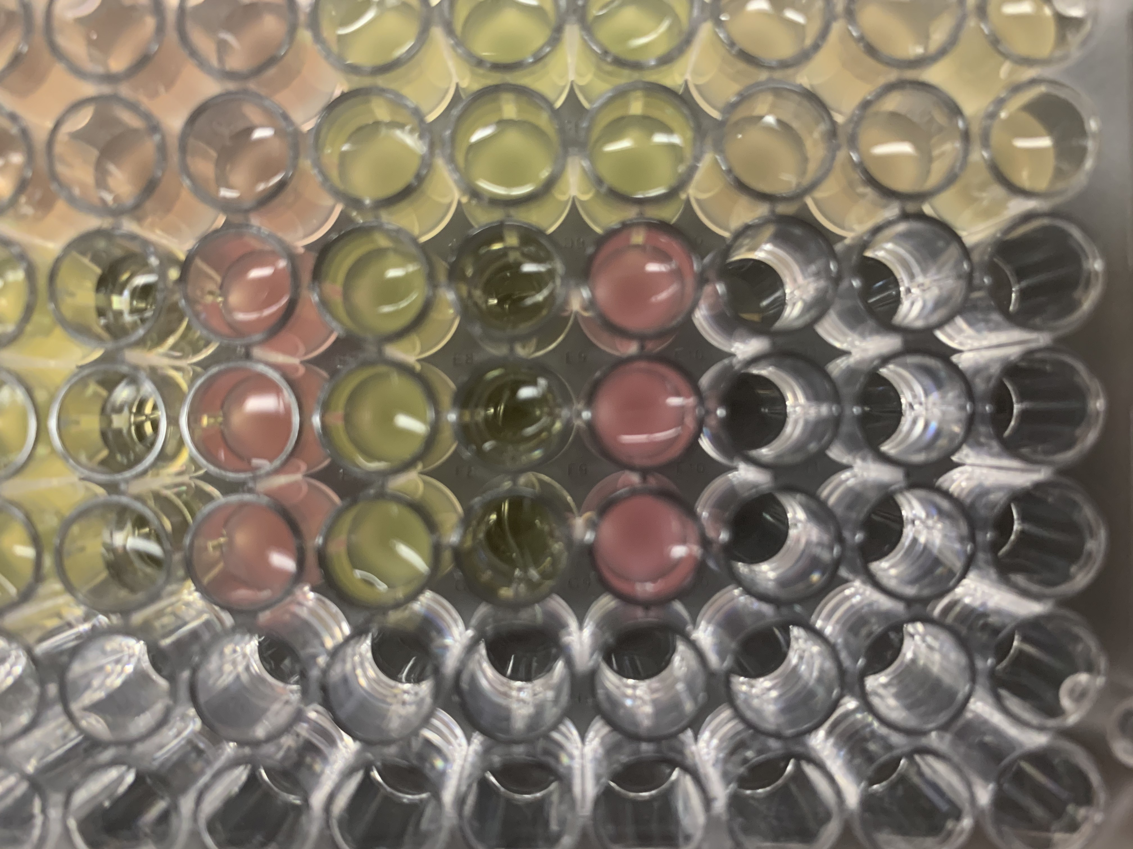
closeup of some wells

Slide 12
Minipreps

Slide 13
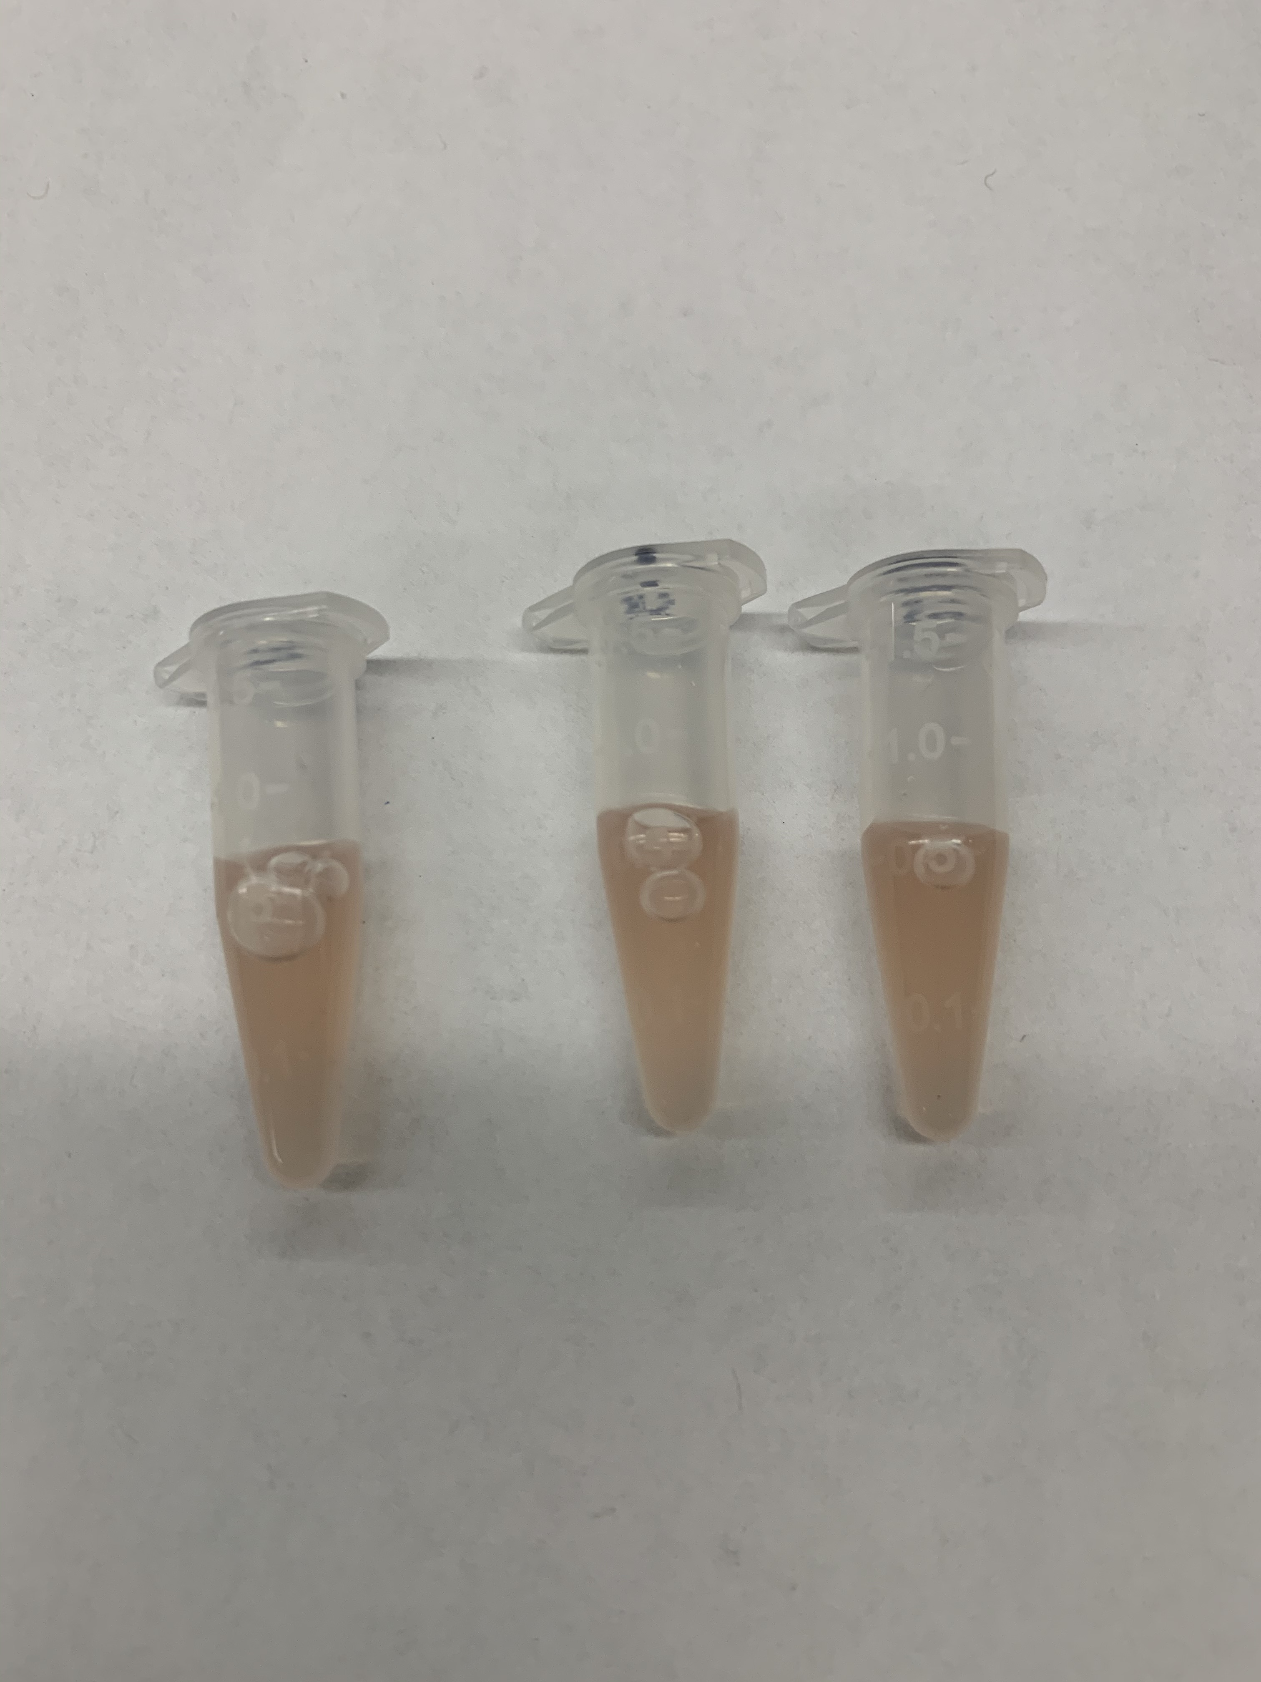
600 µL of culture
X1
X2
X3

Slide 14
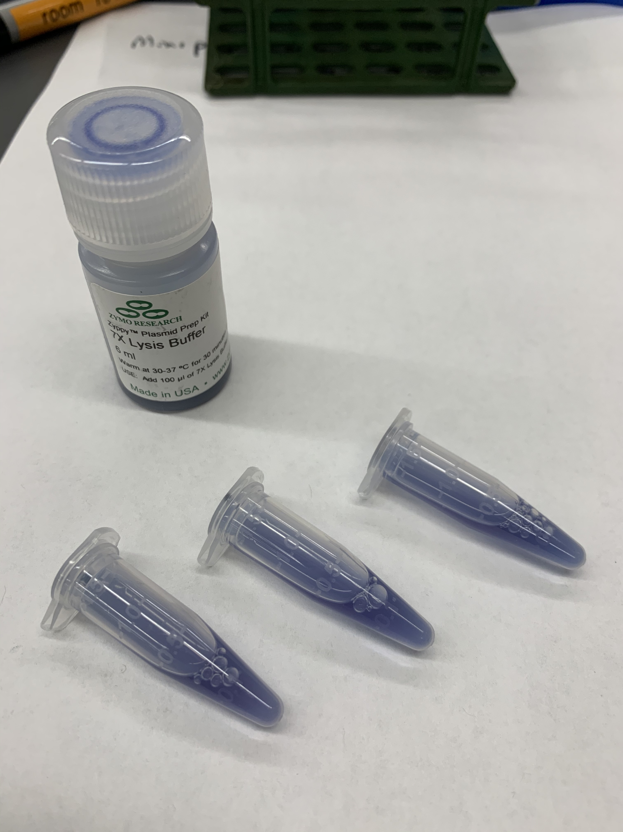
100 µL lysis buffer

Slide 15
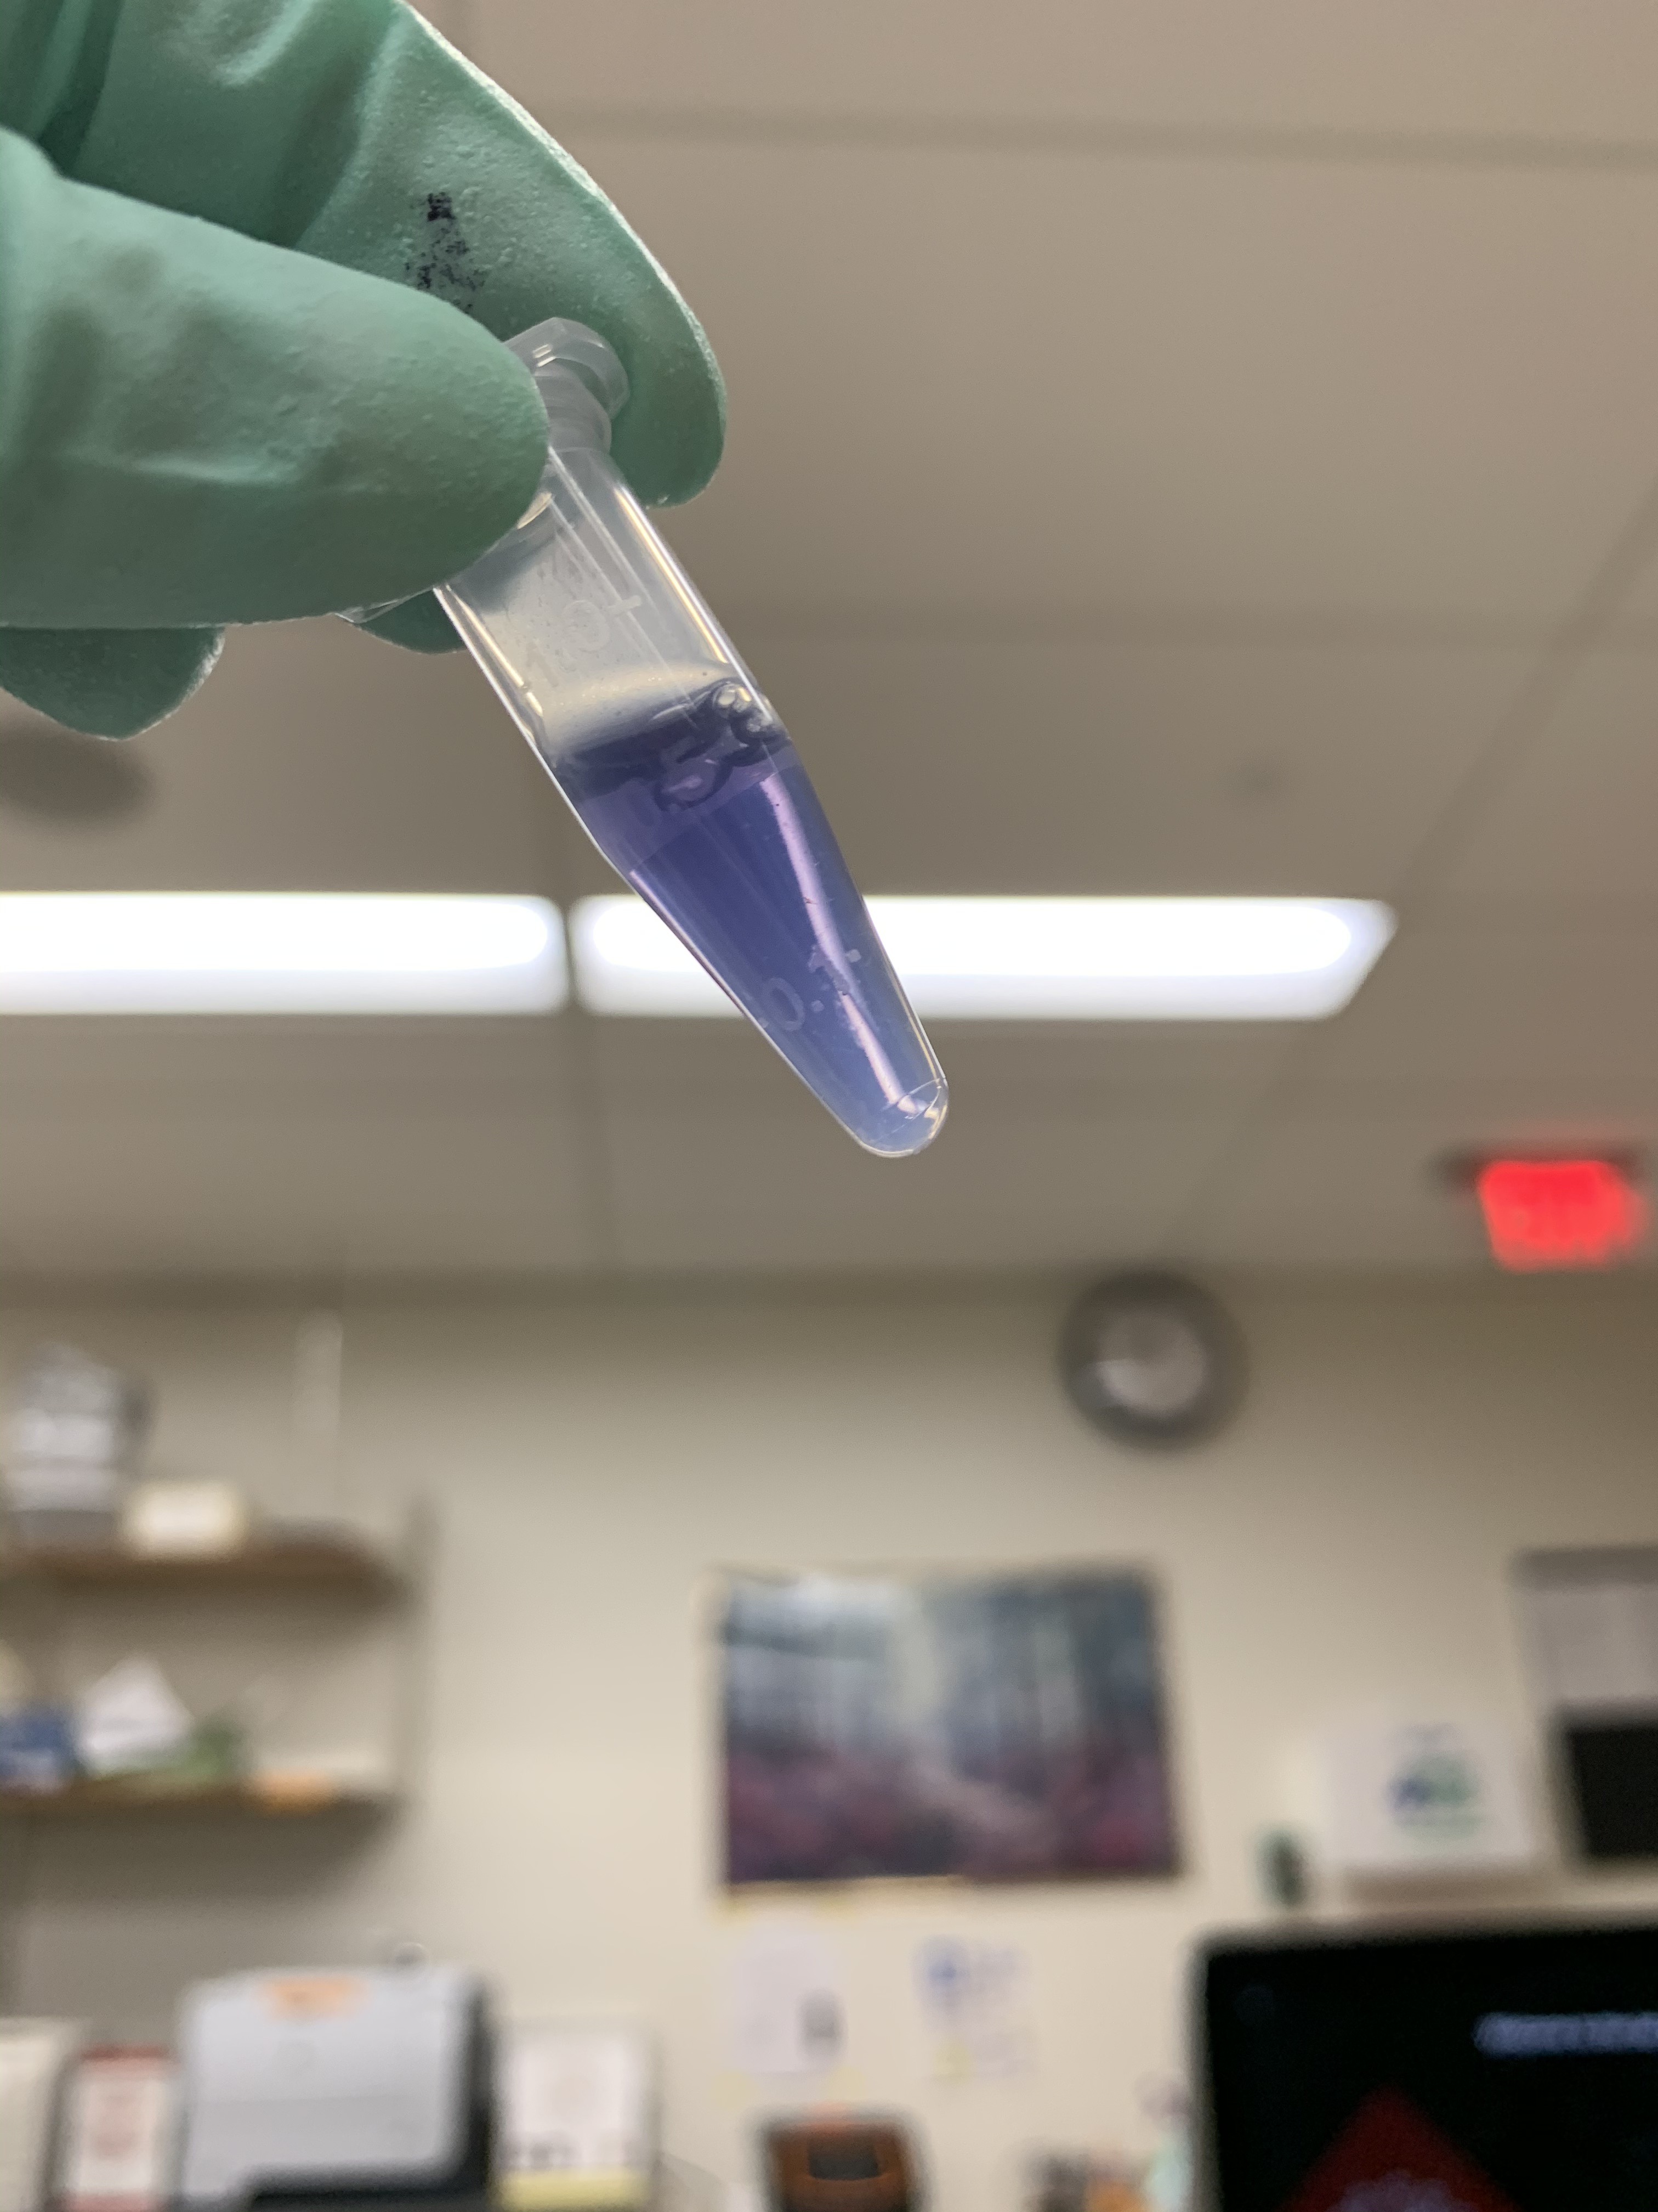
mix until clear (and blue)

Slide 16
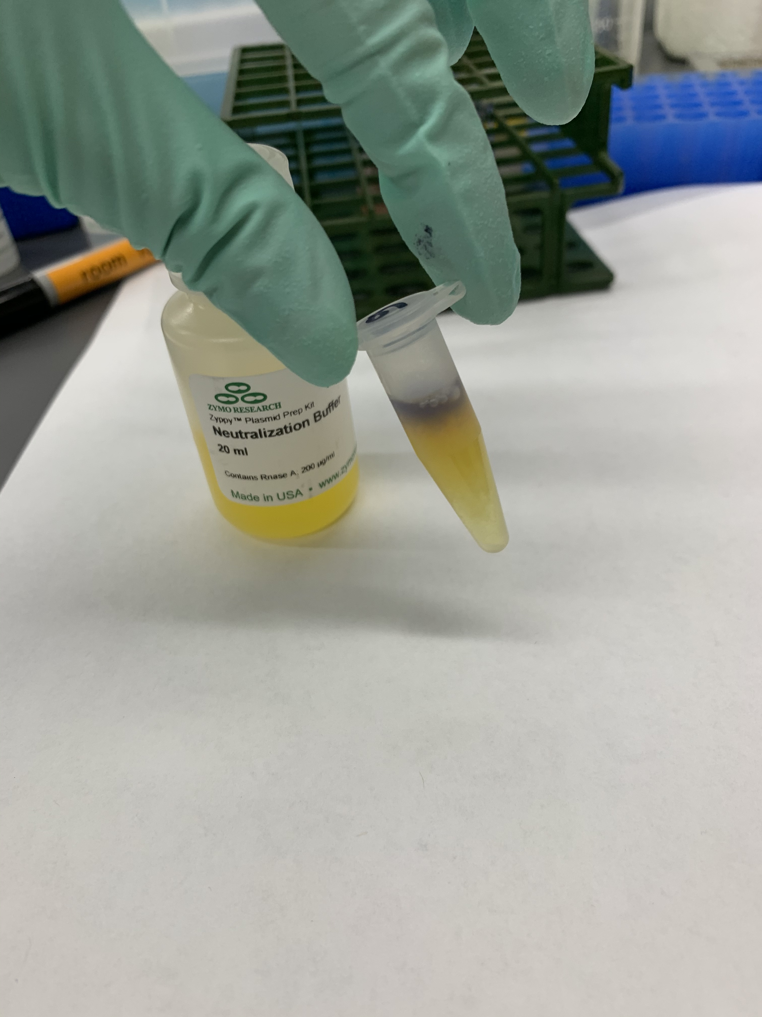
350 µL neutralization buffer

Slide 17
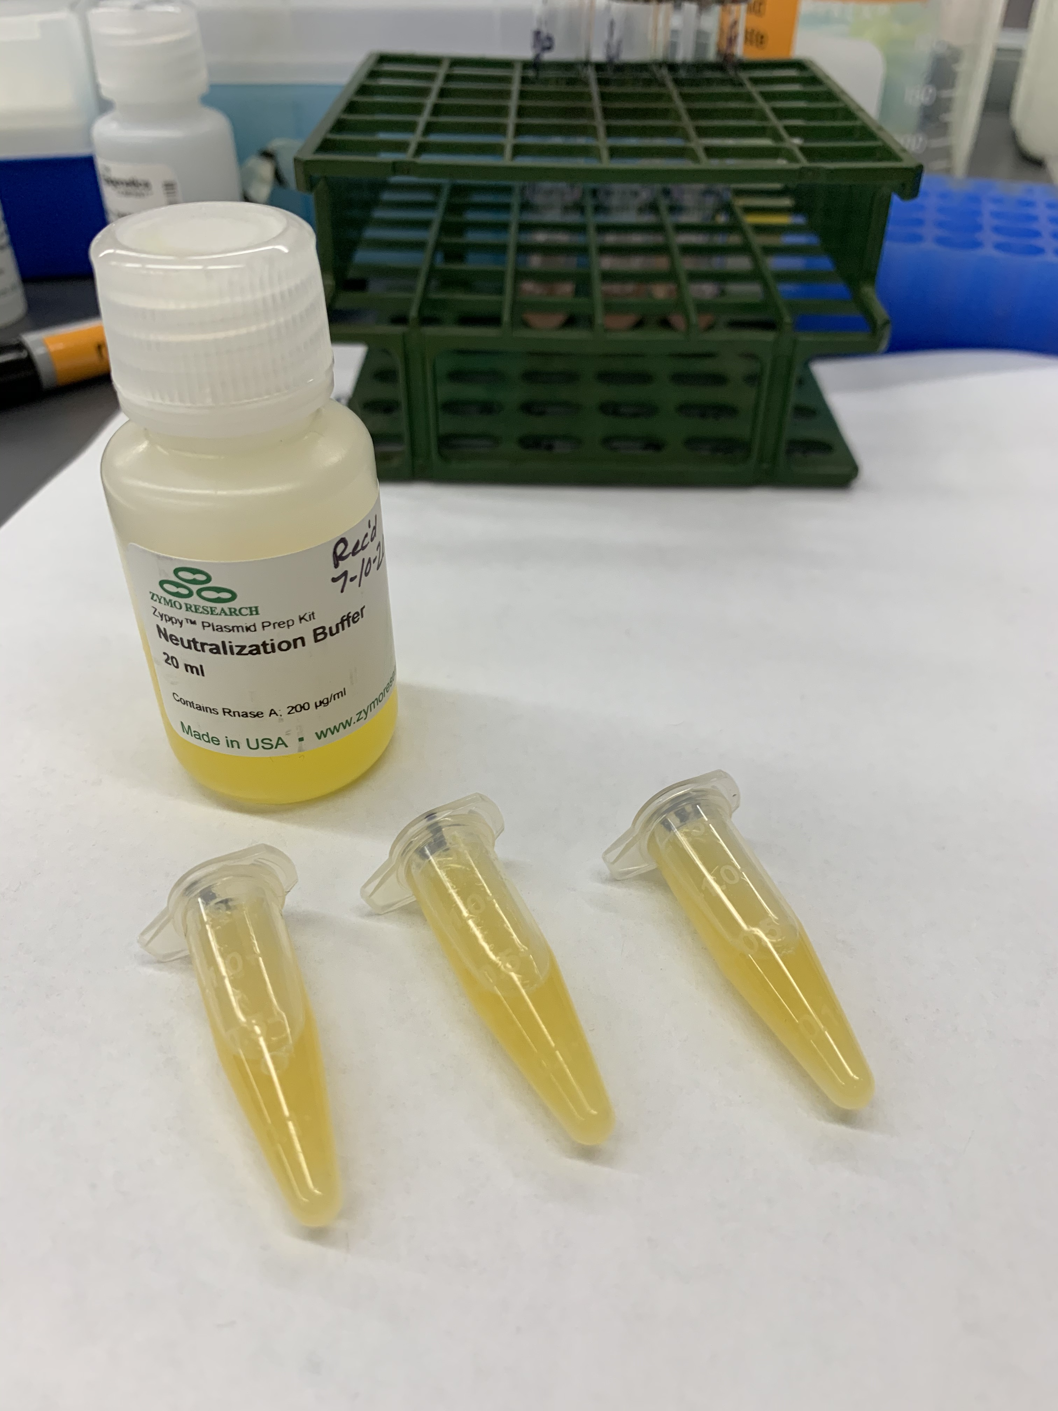
mix until uniformly yellow

Slide 18
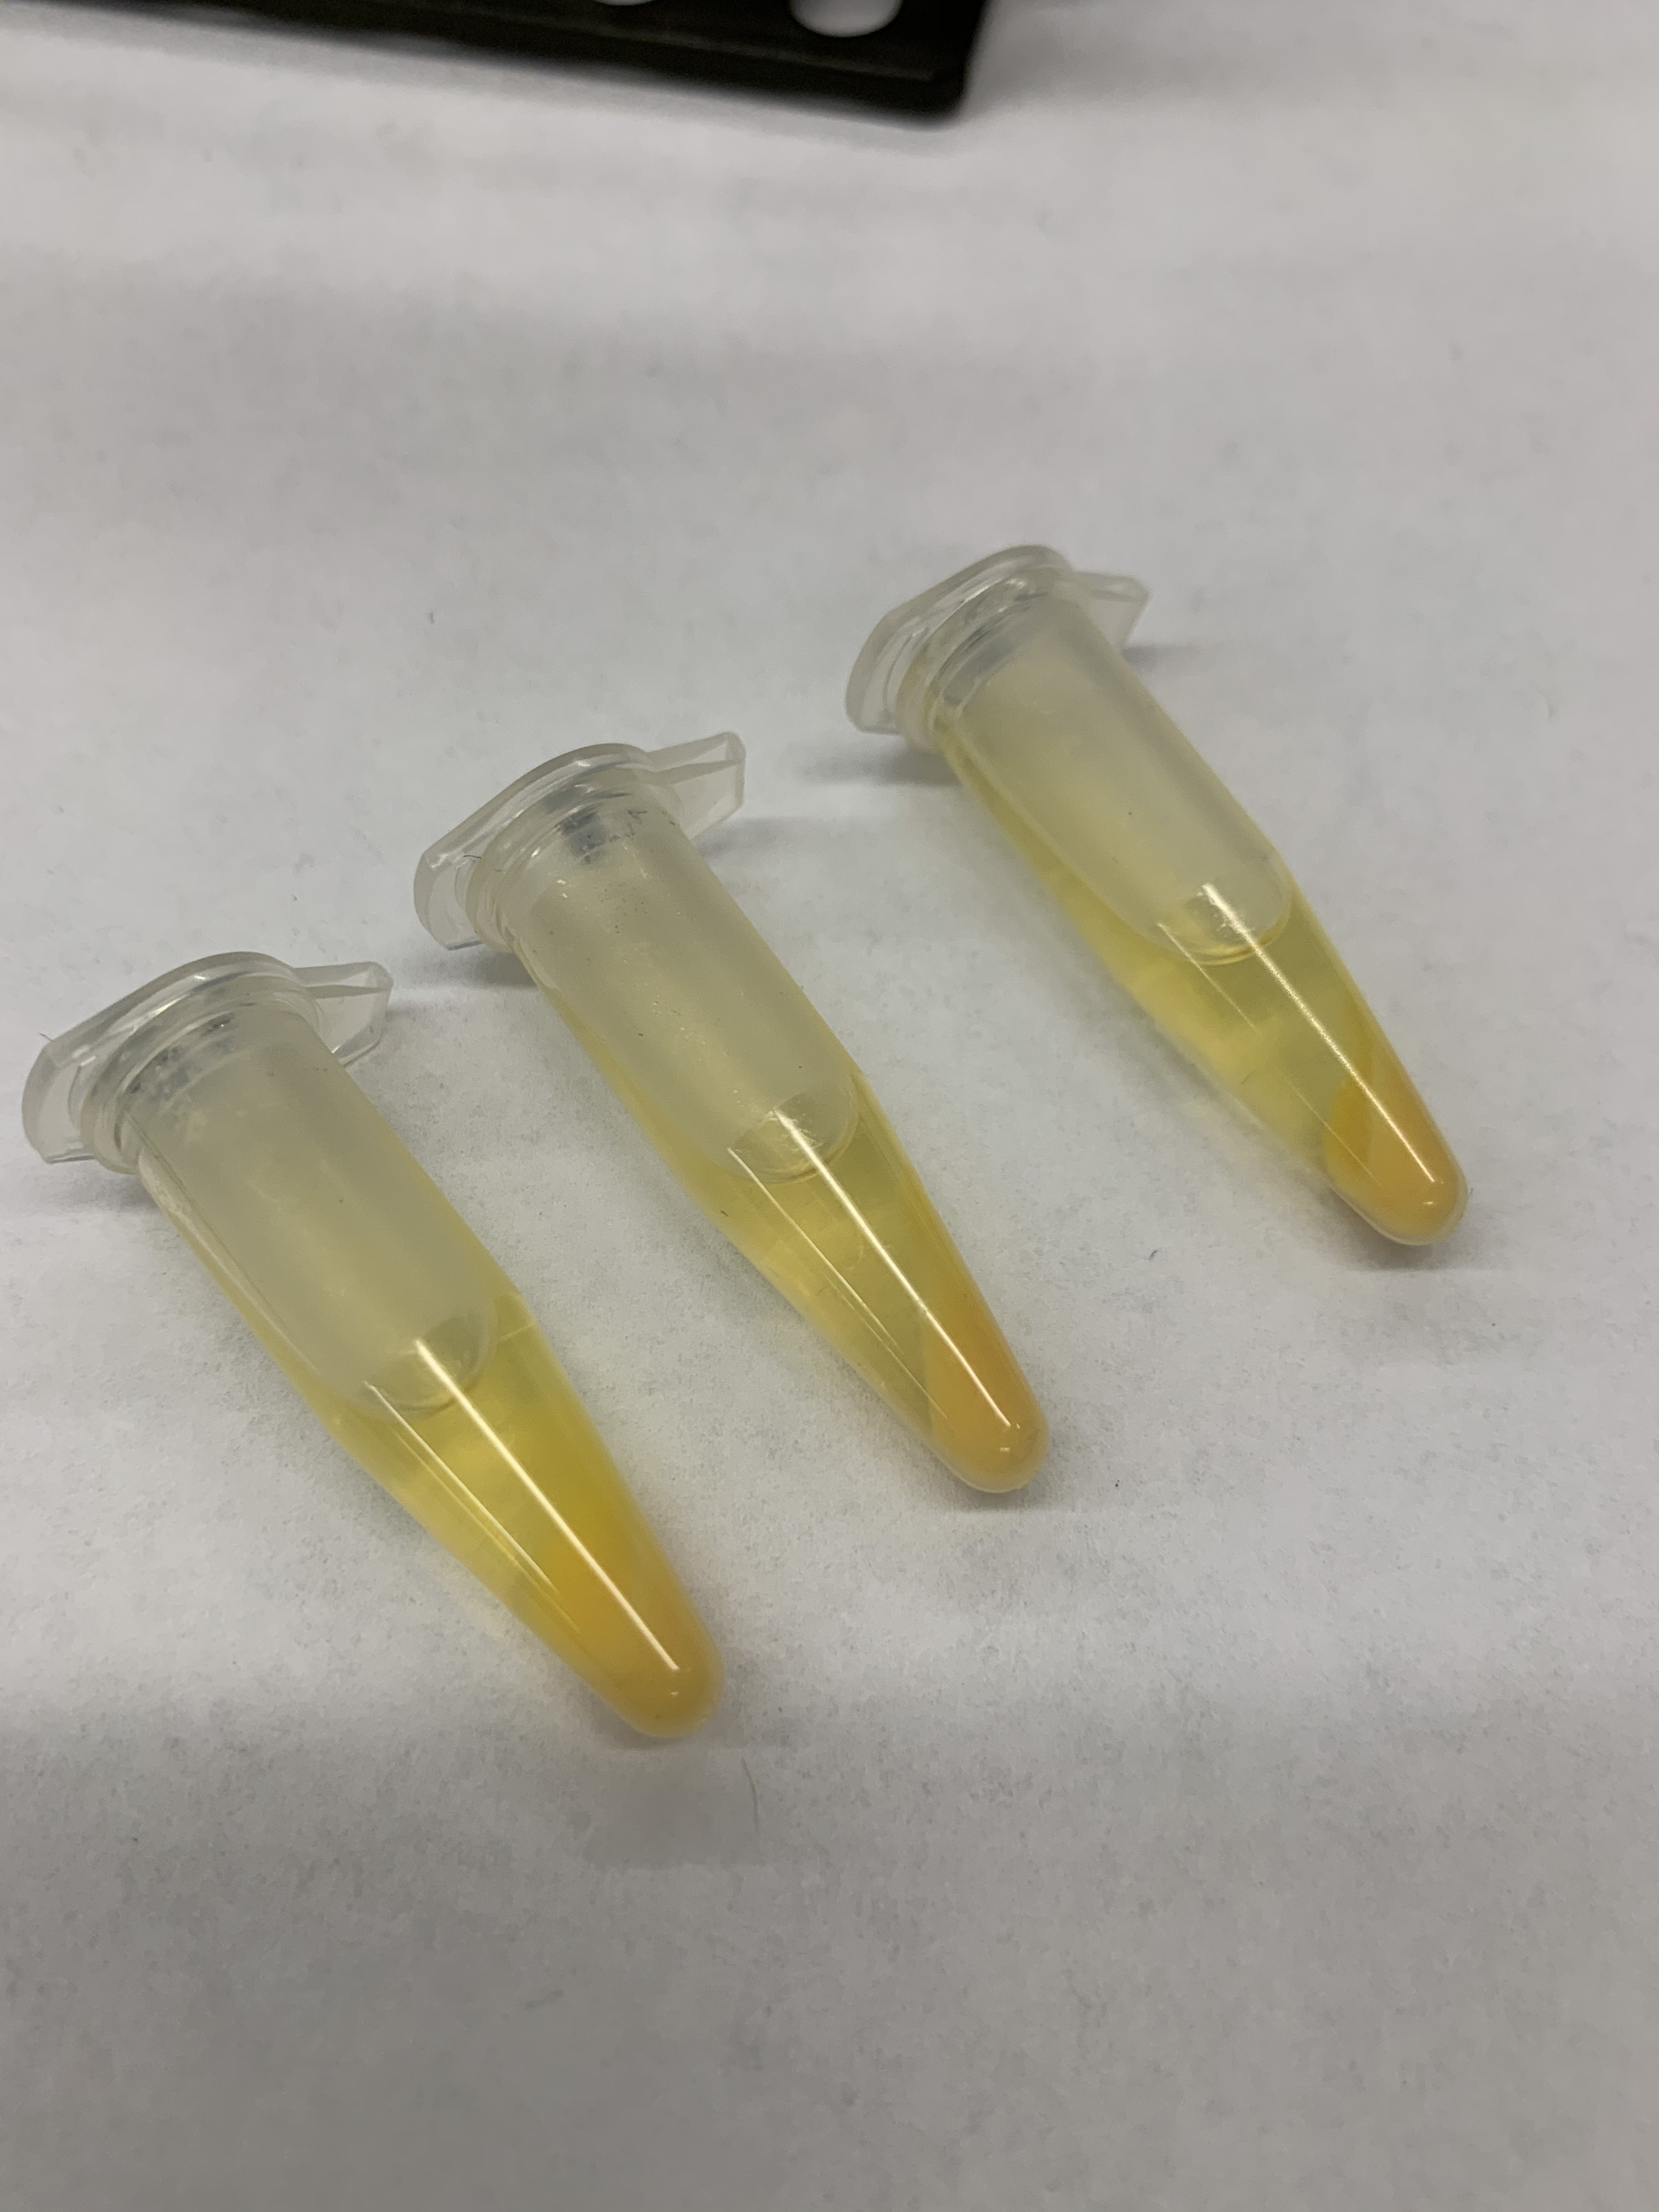
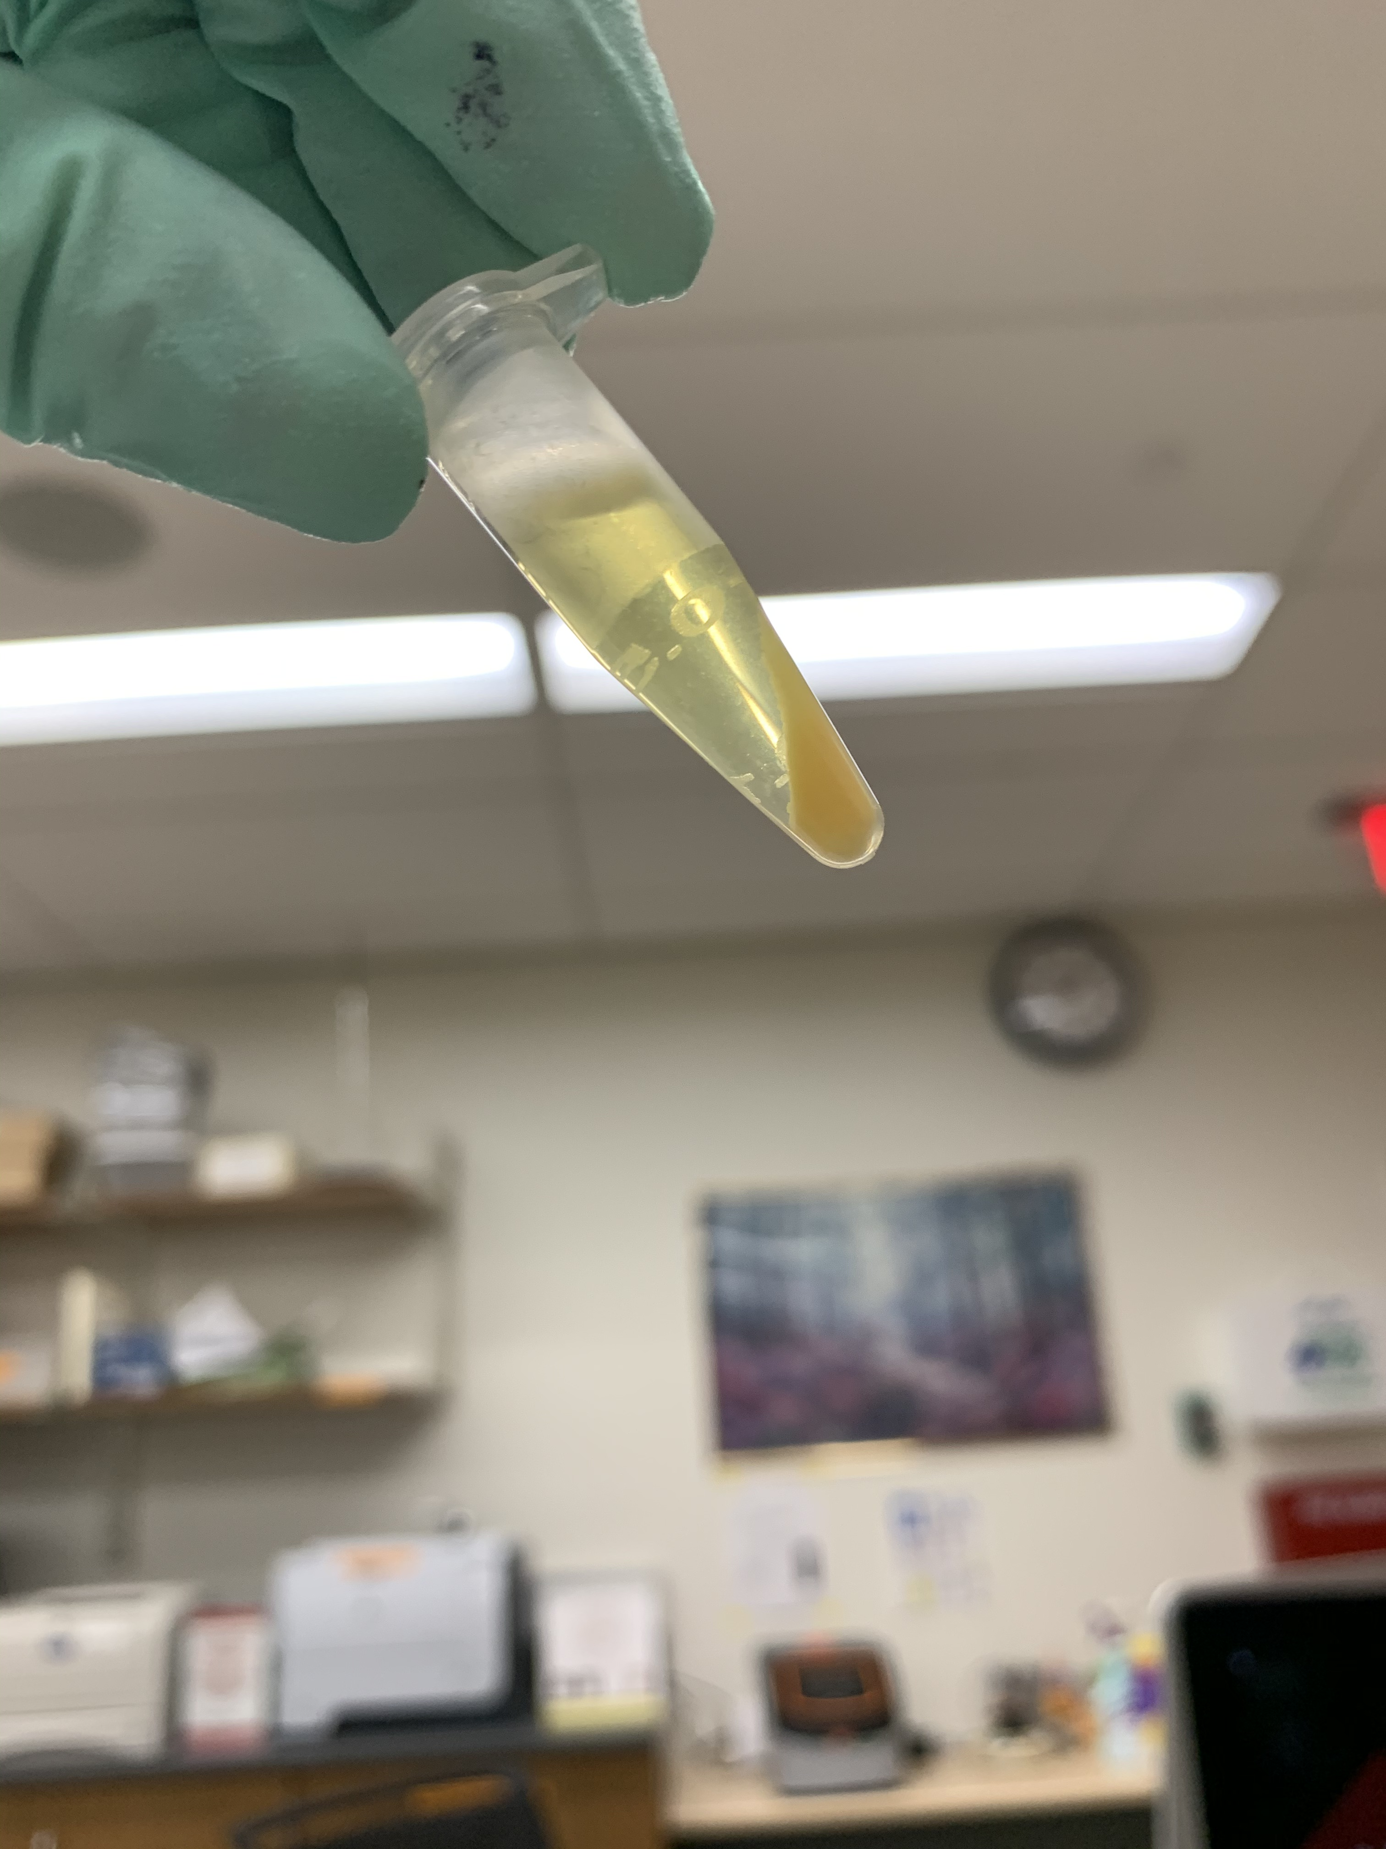
centrifuge to pellet cell wall, proteins & lipids

Slide 19
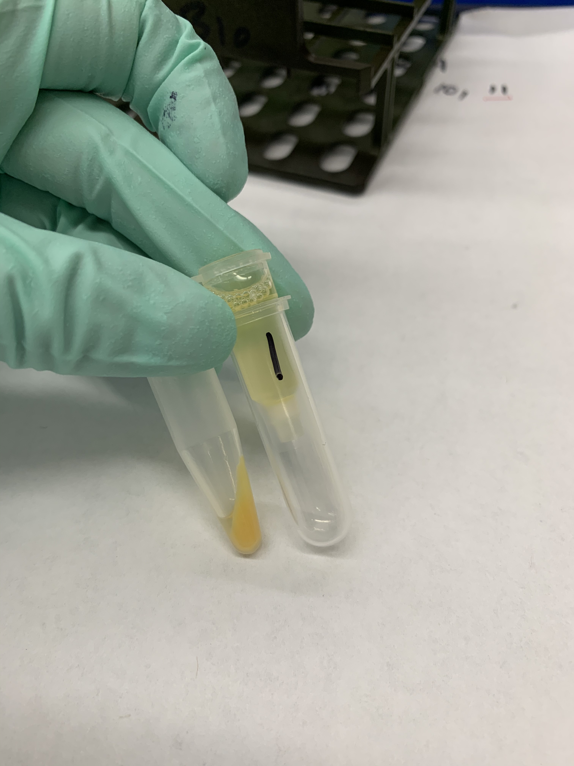
transfer supernatant to spin column

Slide 20
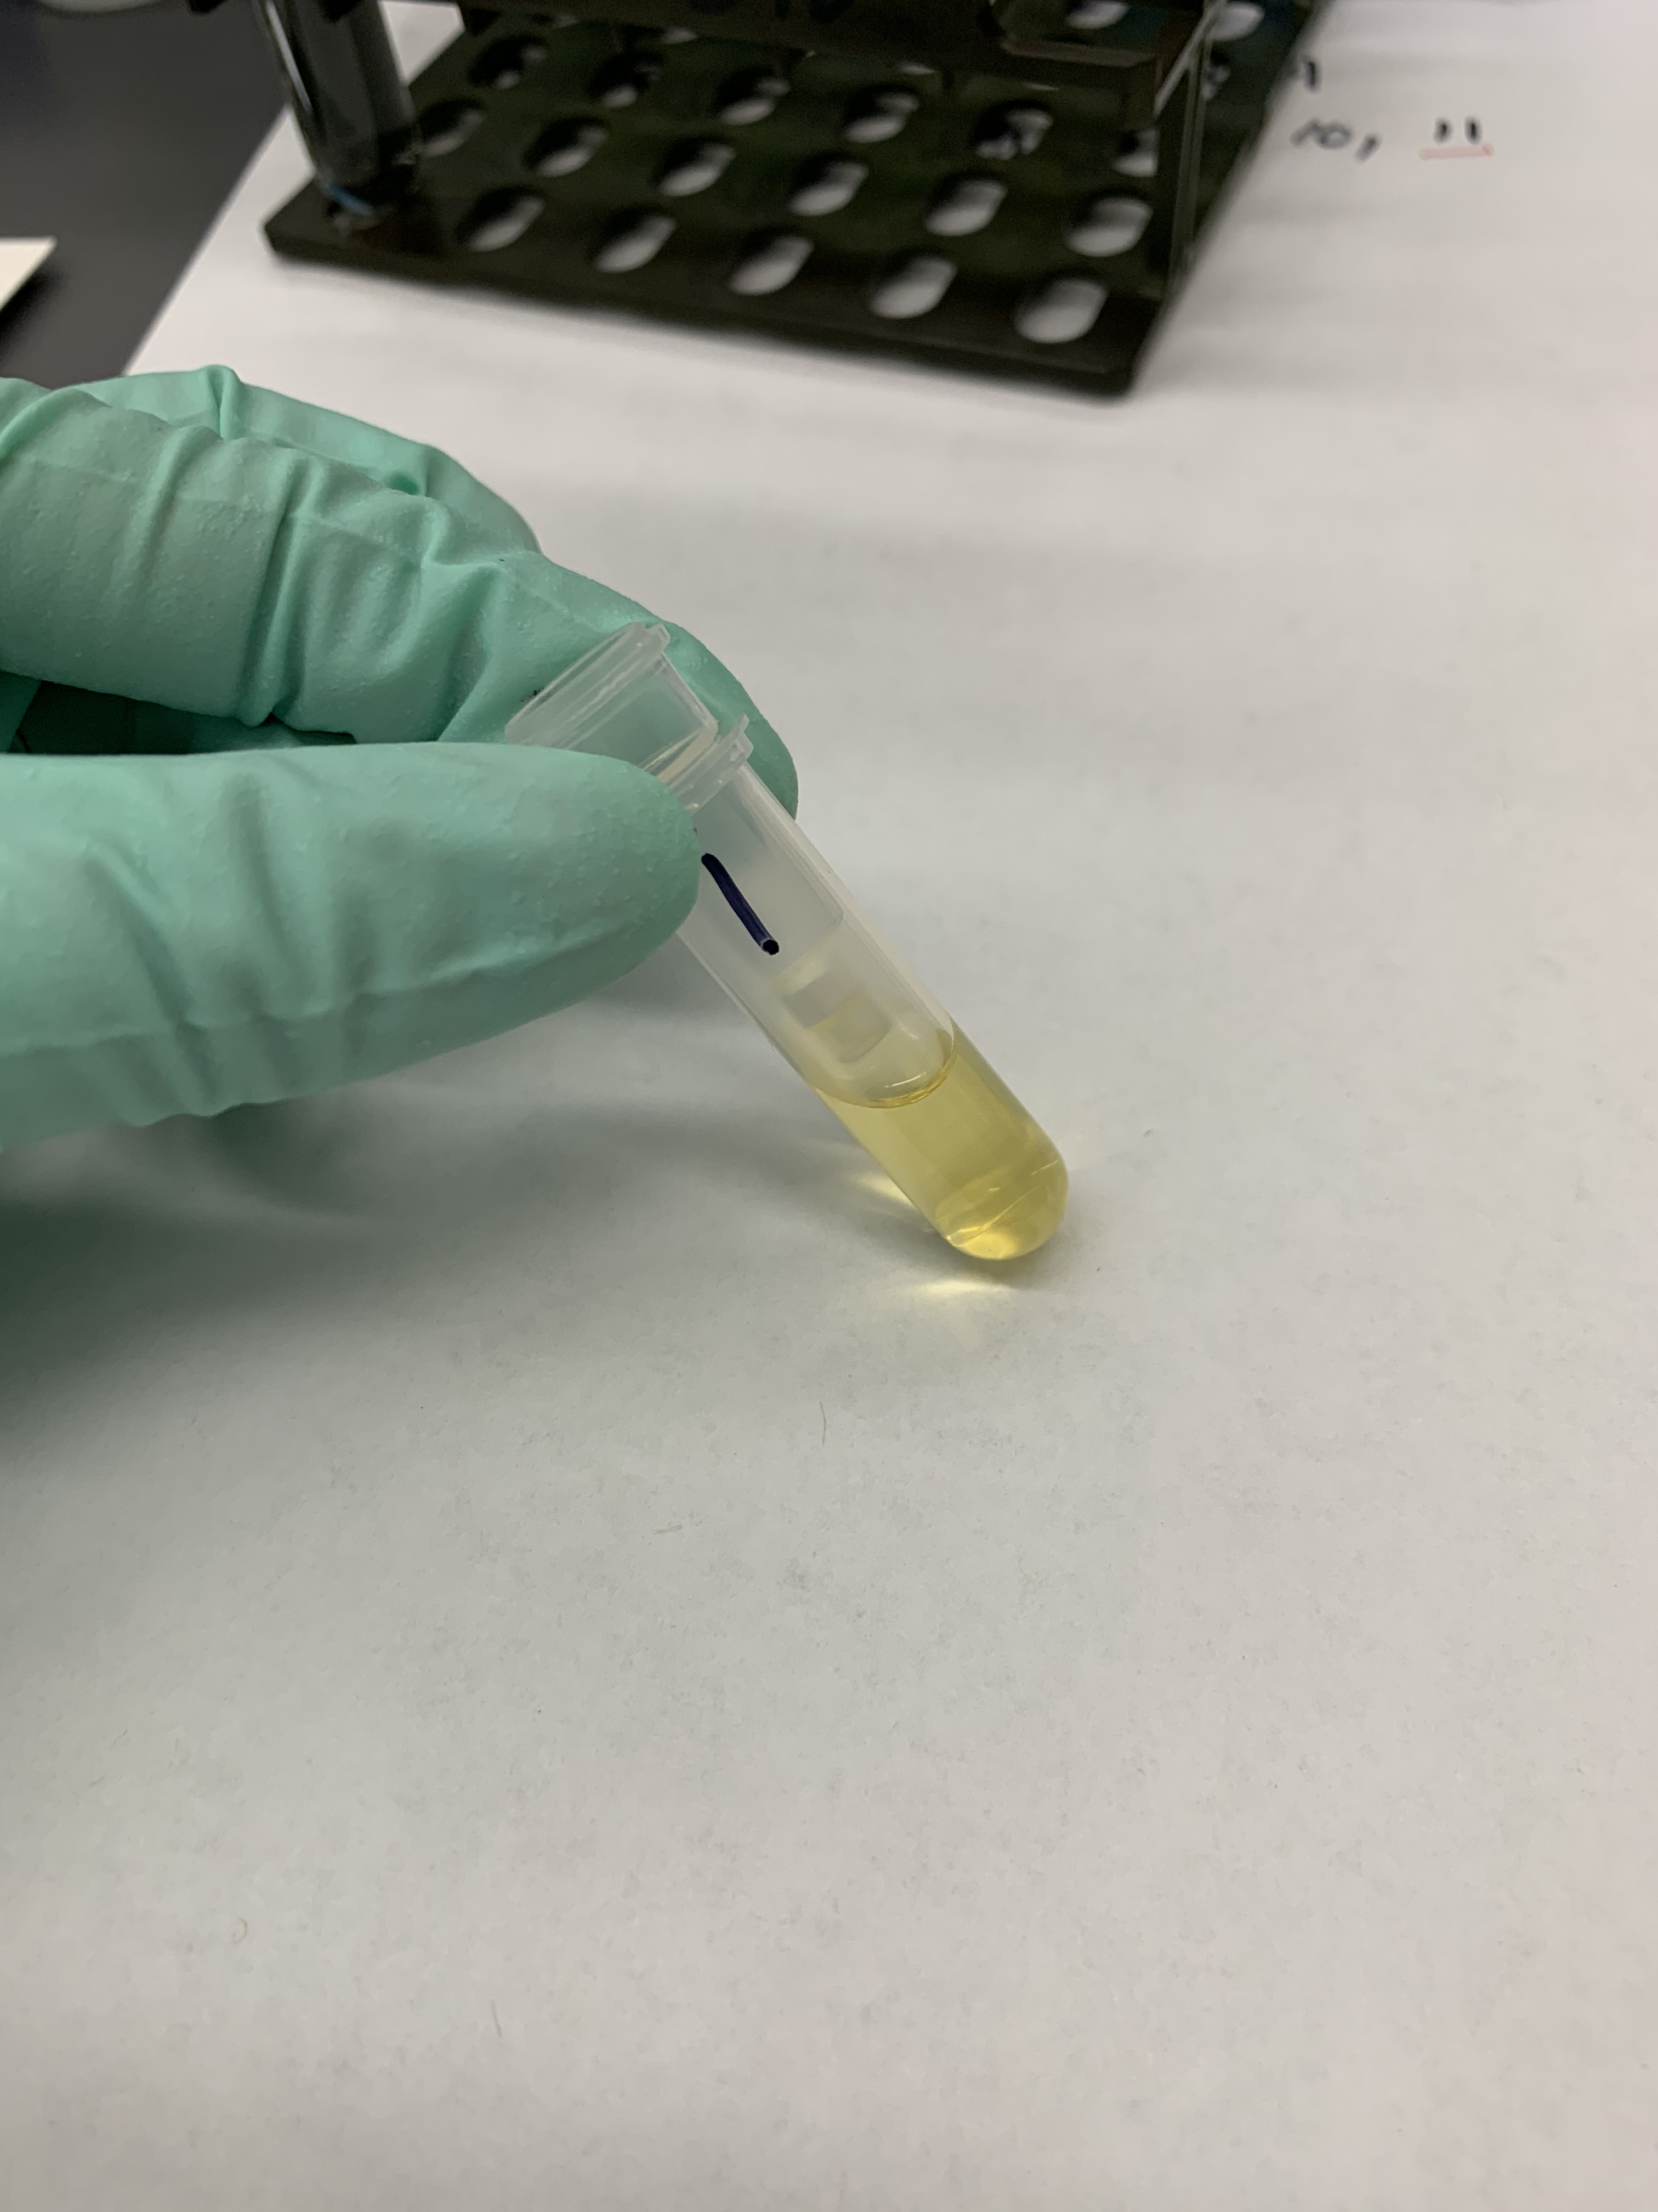
centrifuge: where is plasmid now?
Notes:
Plasmid is bound to positively charged resin in the column.

Slide 21
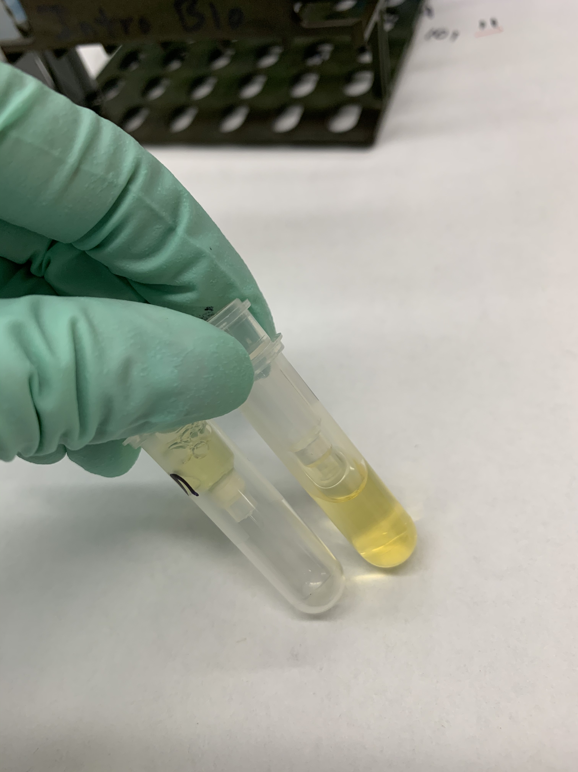
discard flow-through (from right tube) add 200 µL wash buffer (left tube)

Slide 22
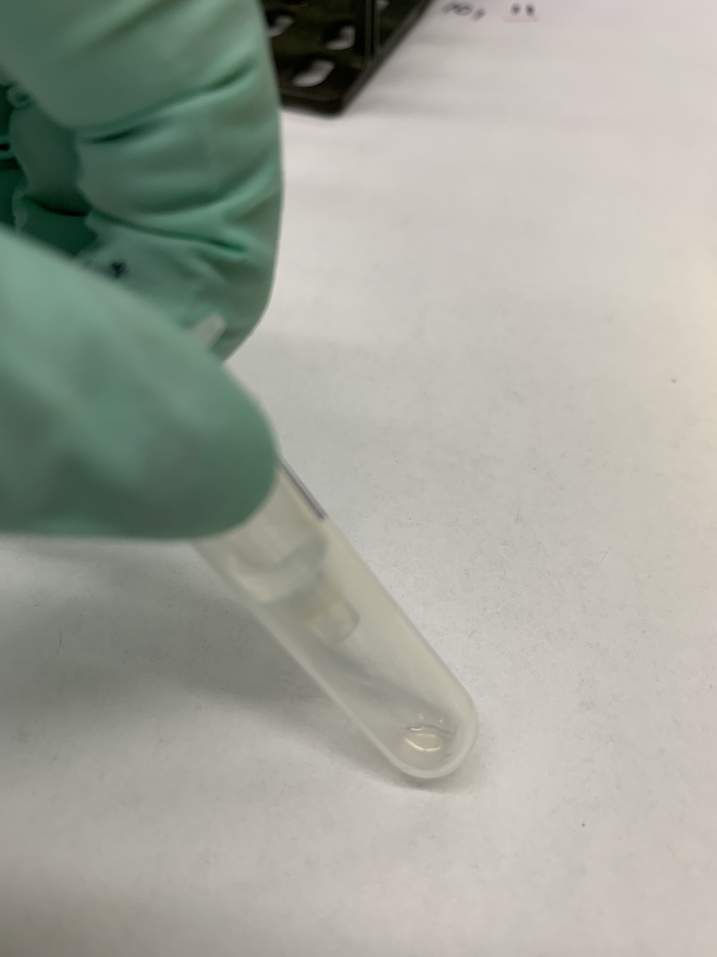
200 µL wash solution 1

Slide 23
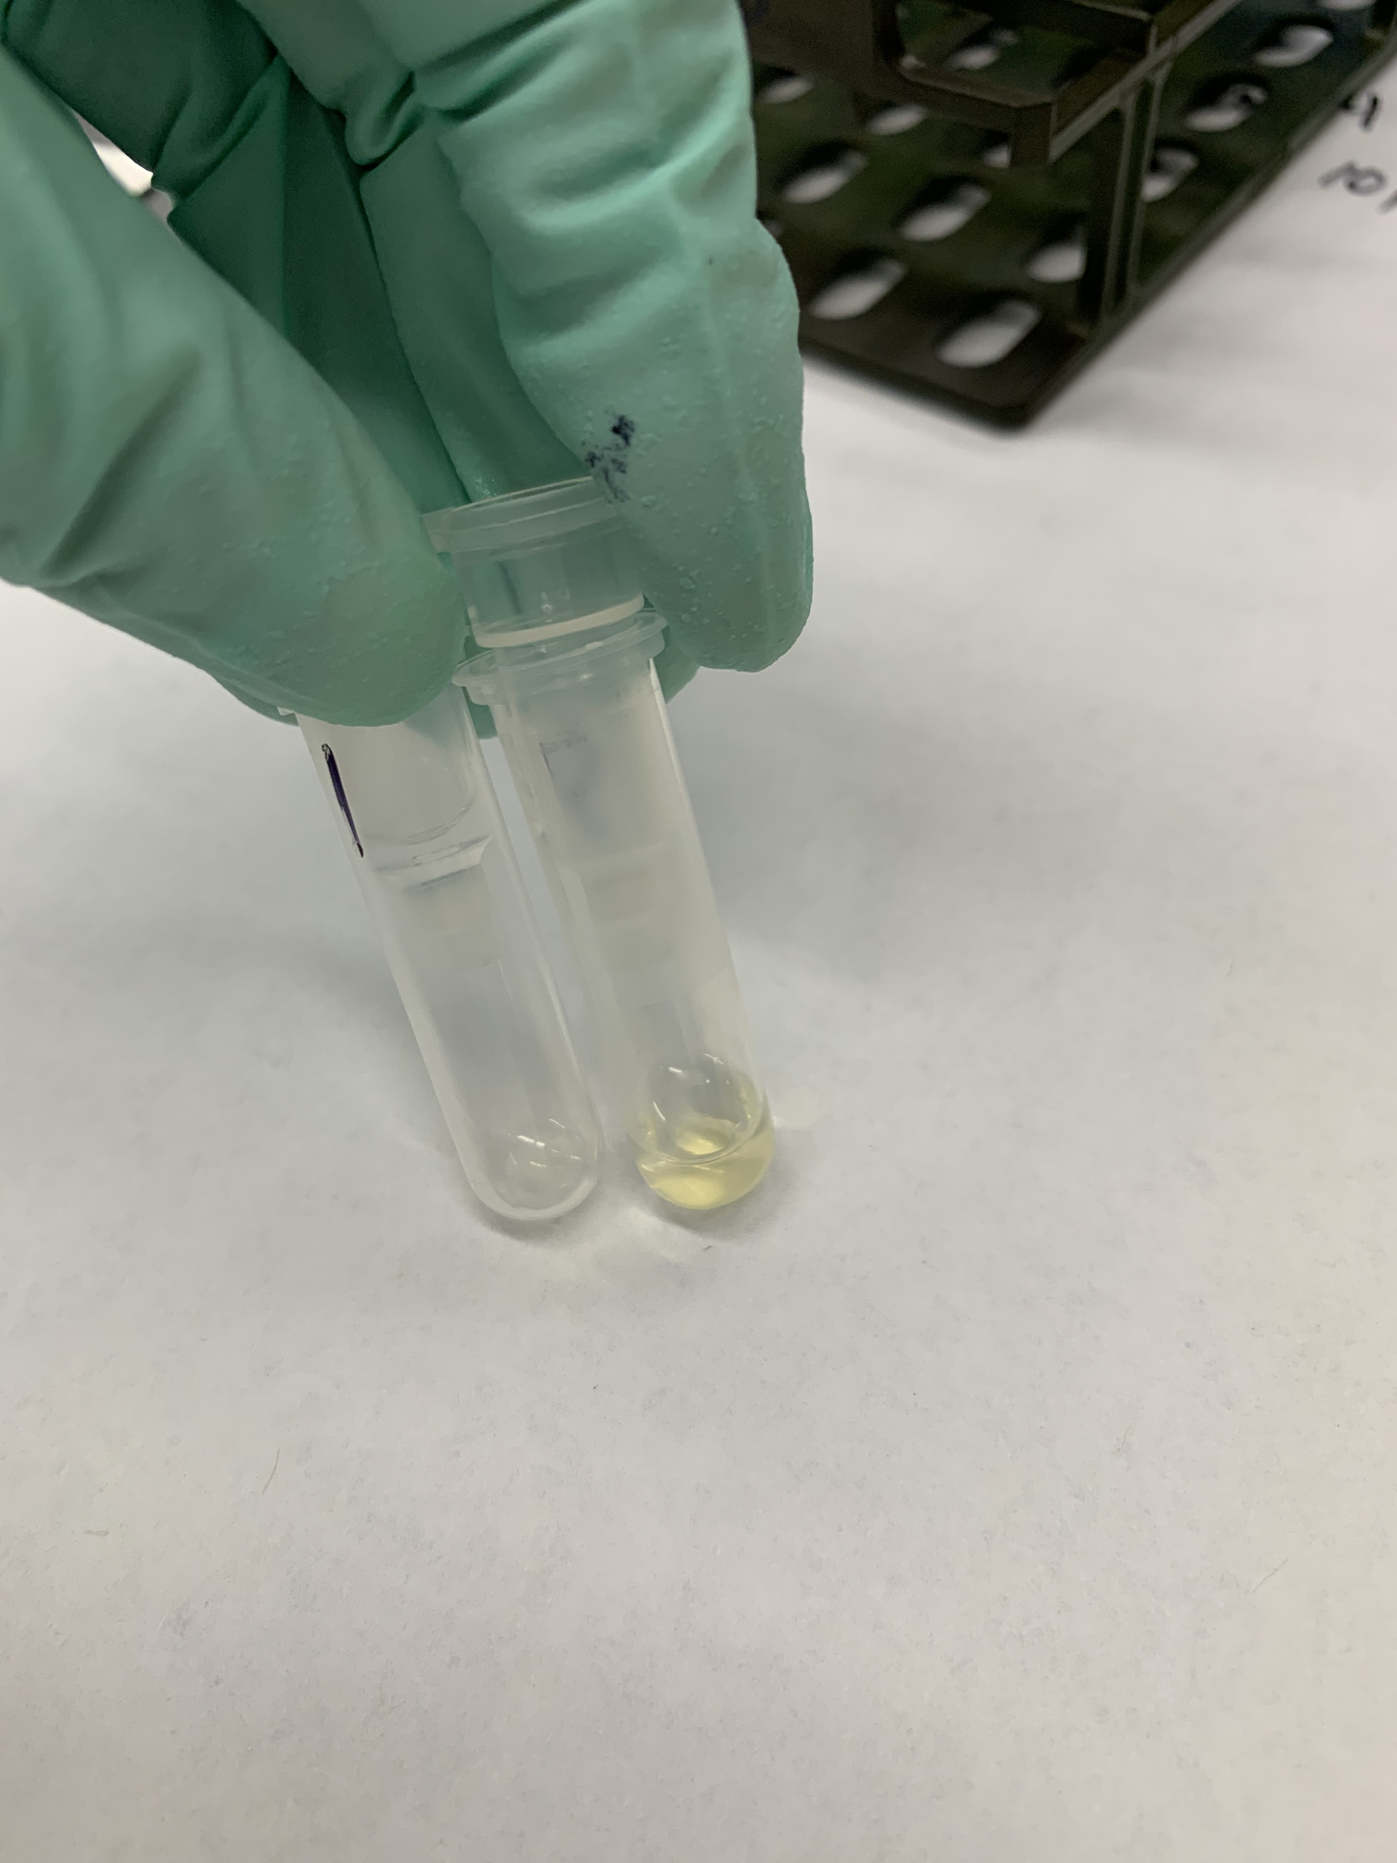
centrifuge, discard flow-through

Slide 24
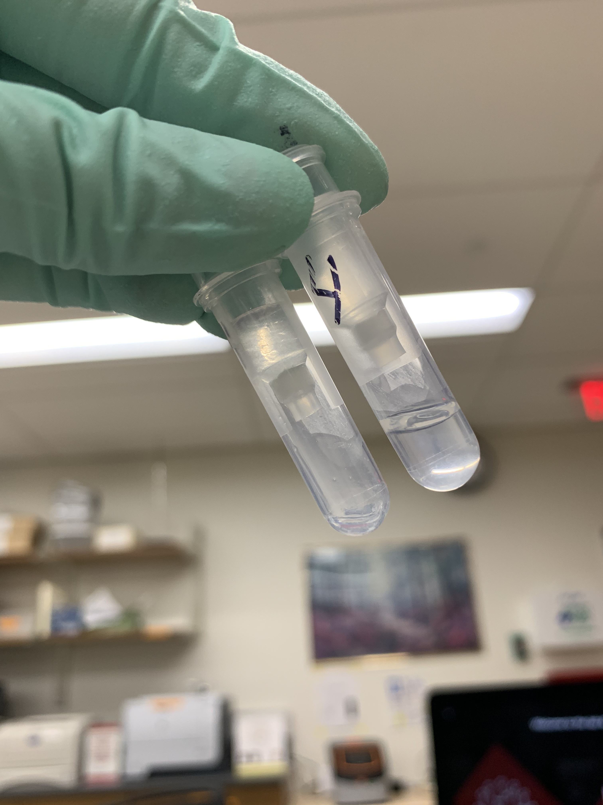
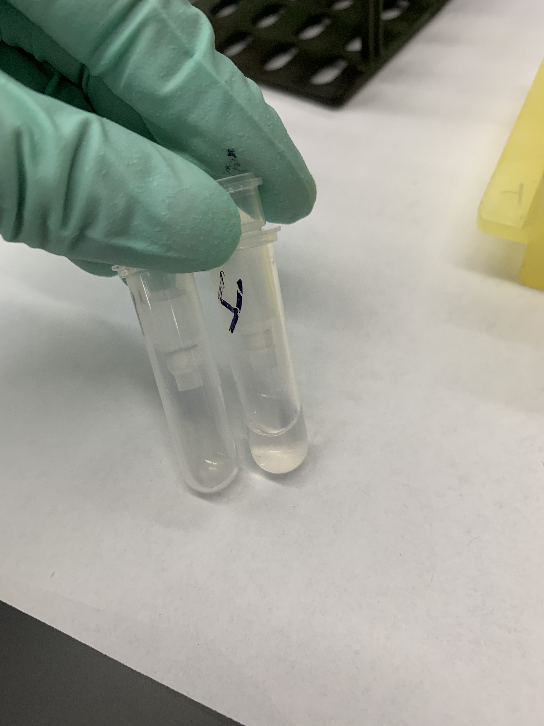
400 µL wash buffer 2 (left) centrifuge through (right)

Slide 25
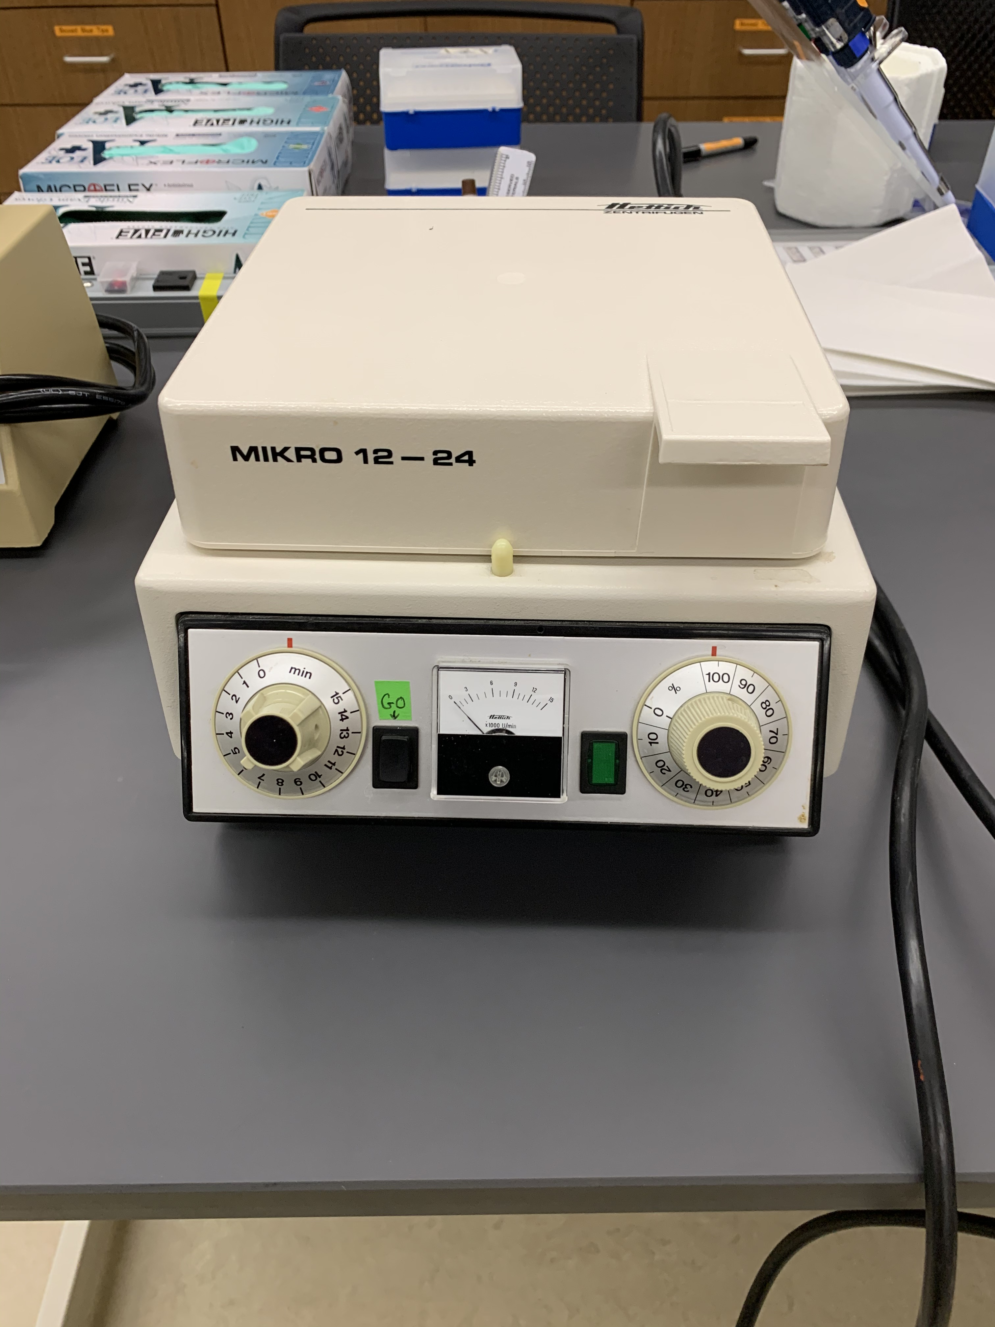
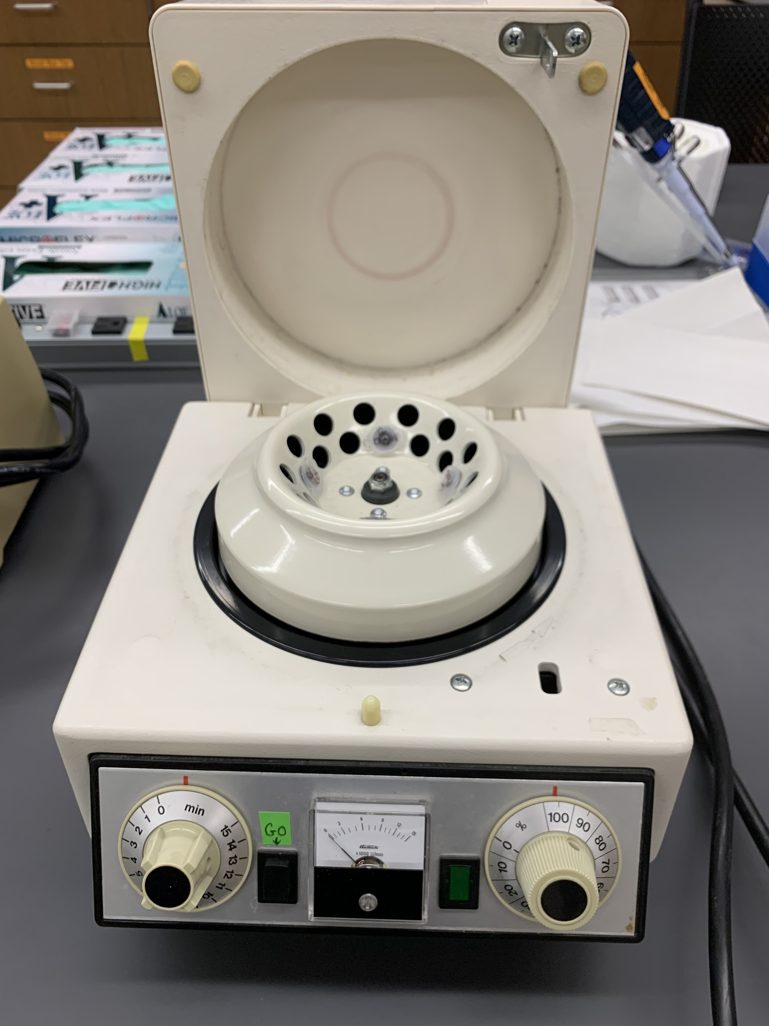
microcentrifuge

Slide 26
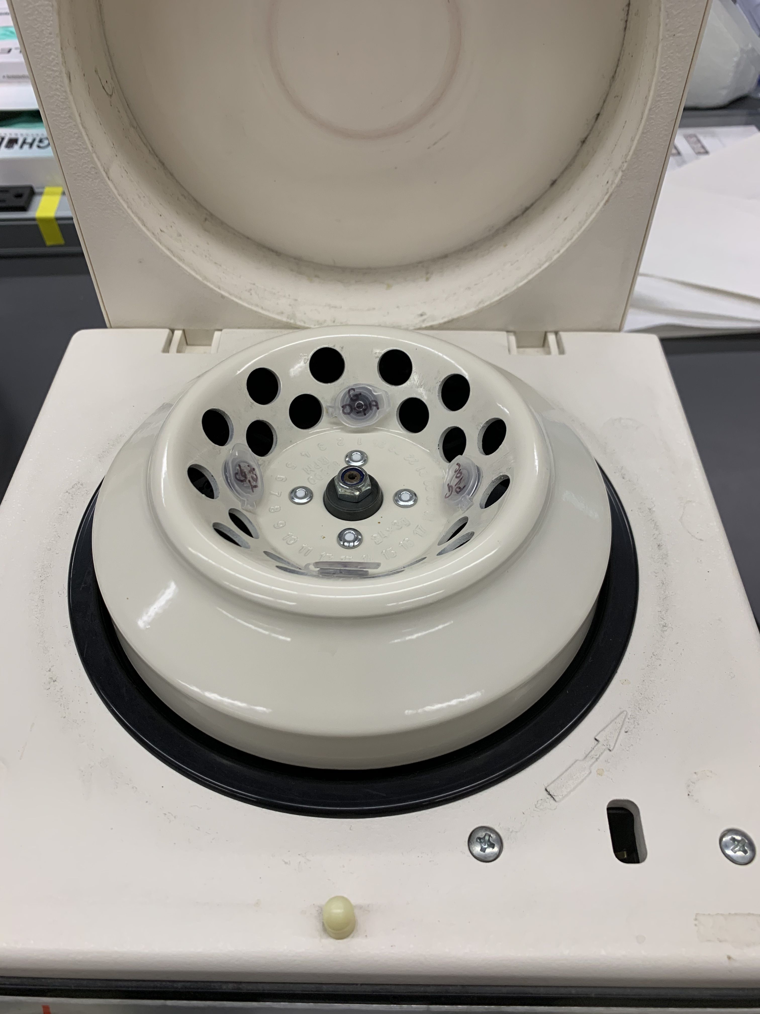
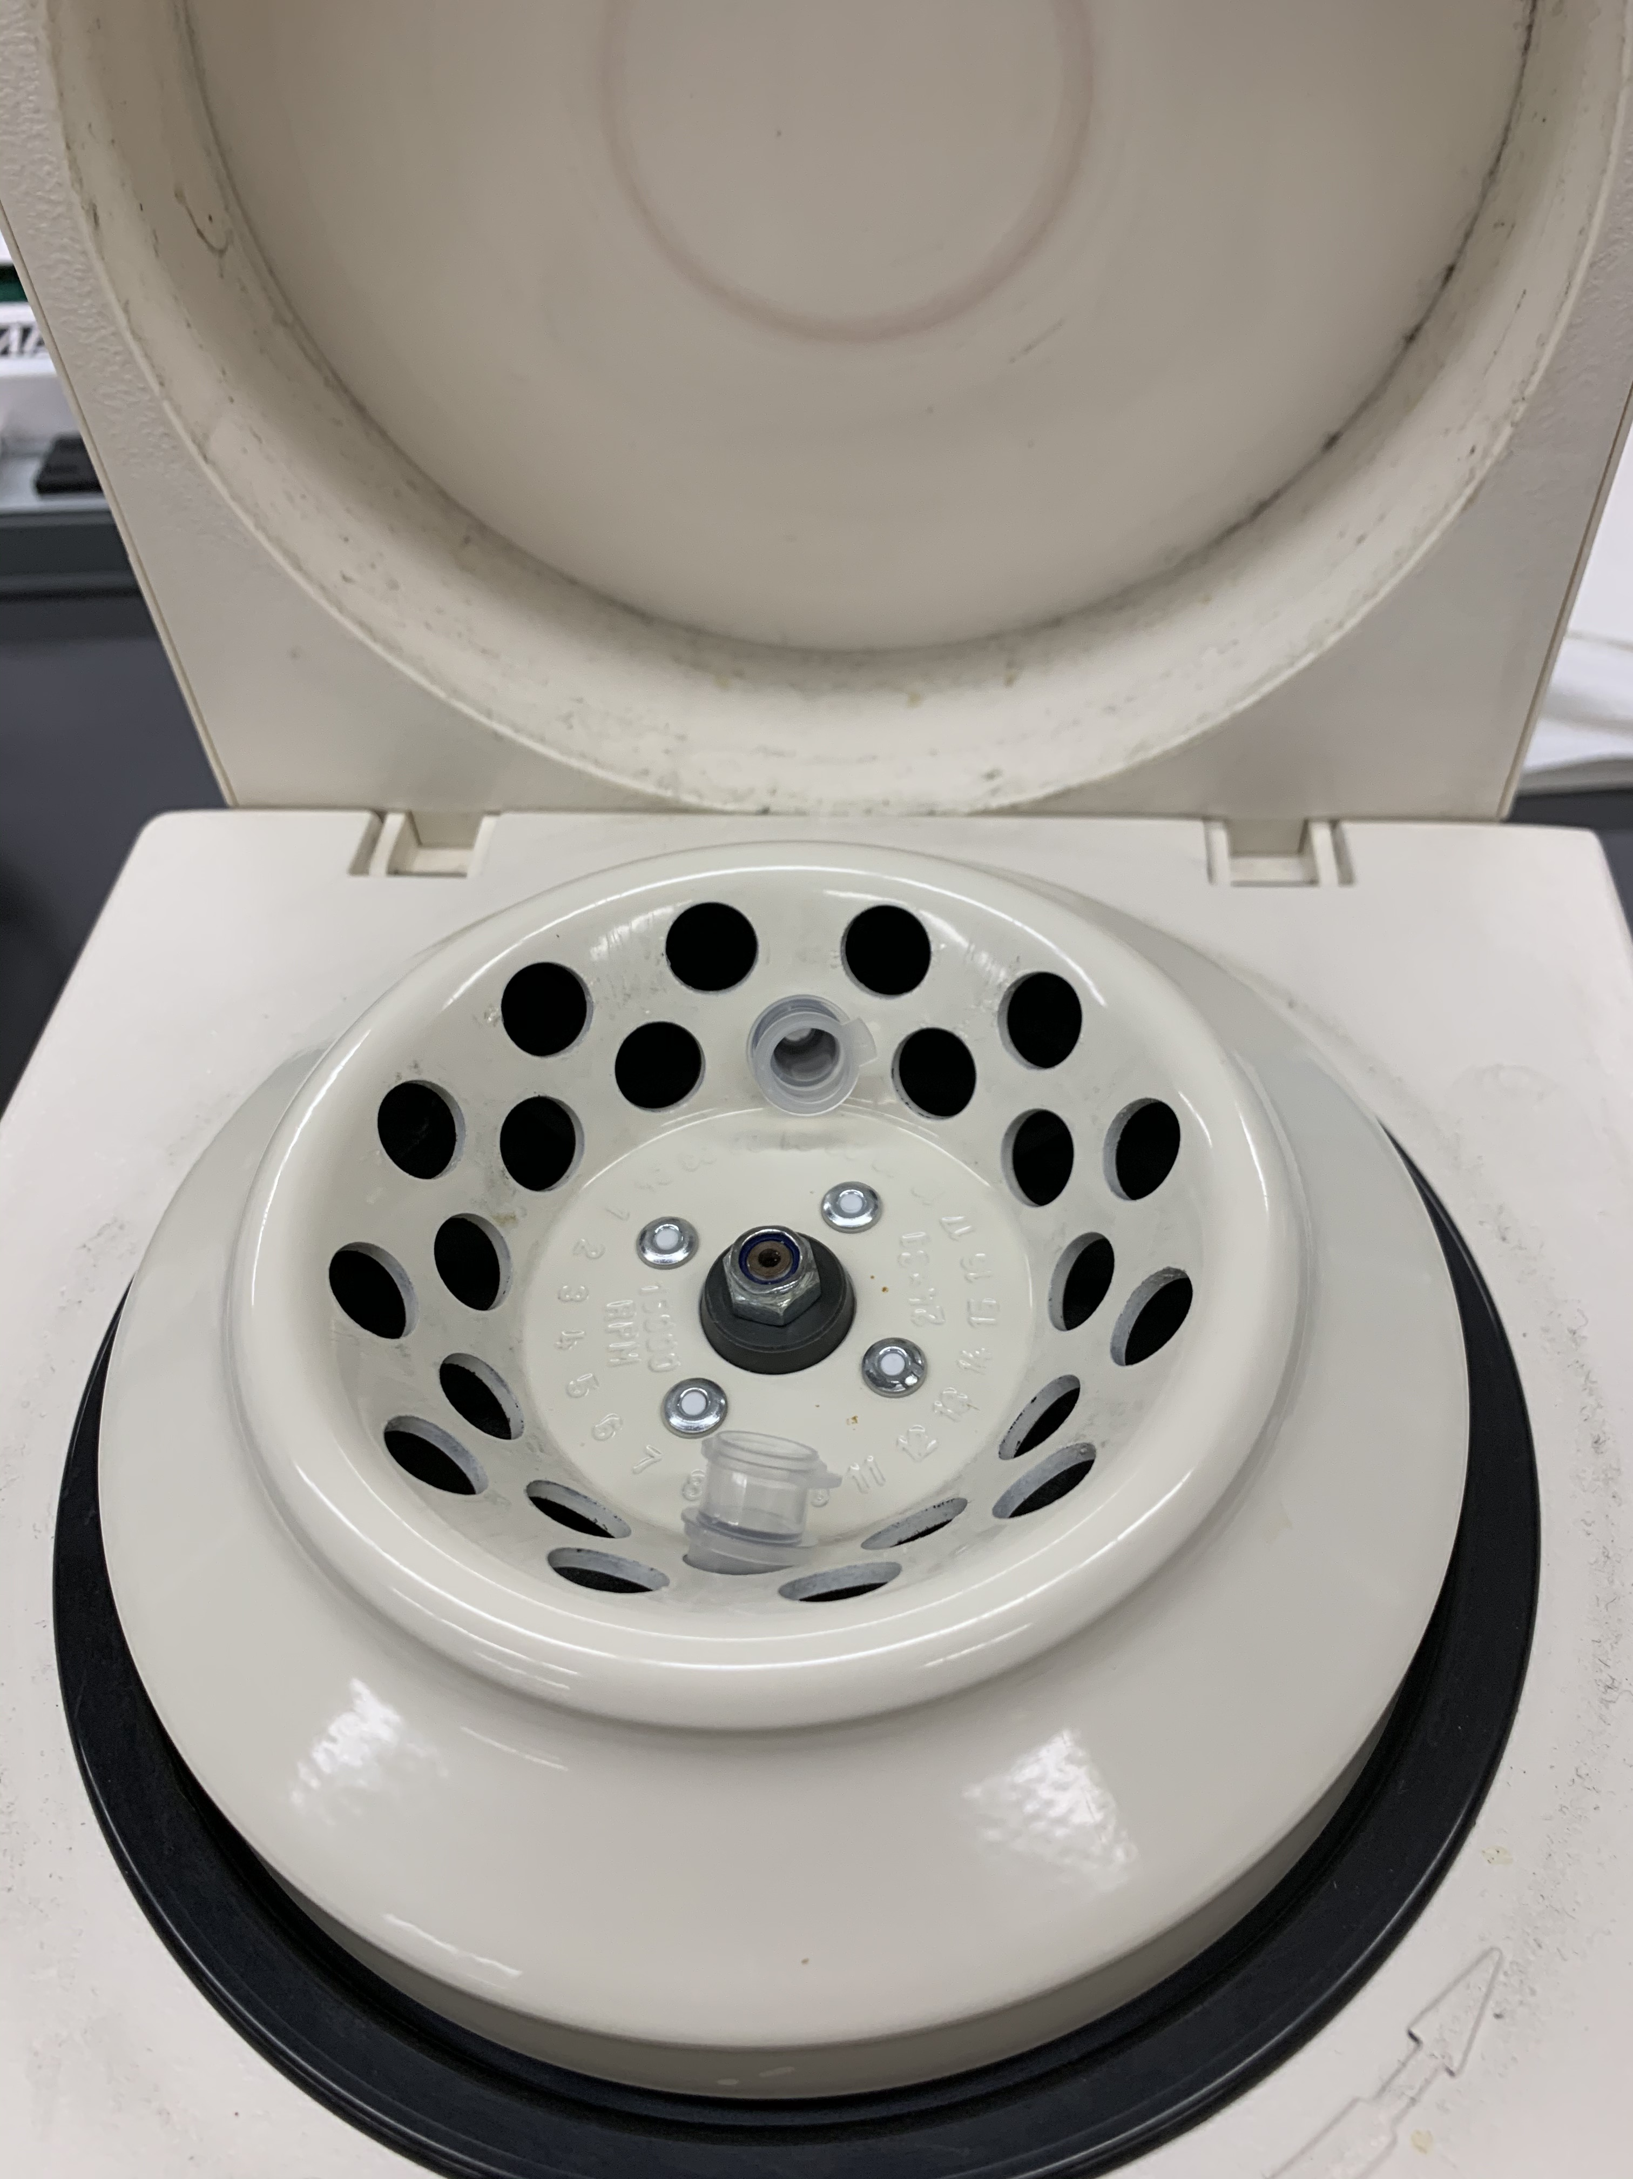
always balance tubes

