Slide 1
Myb Transcription Factors
Dylan Coughtrey
Laboratory Methods in Genomics
Spring 2011

Slide 2
What is Myb?
Acronym taken from myeloblastosis
  First recognized as an oncogene in avian myeloblastosis virus
Currently being studied to further identify genetic factors in cancer patients

Slide 3
What does it do?
Myb transcription factors regulate gene expresion by binding directly to DNA
  Localizes to recently replicated DNA in mitotically cycling and endocycling cells
Absence of Myb has been shown to cause increases in:
  Mitotic arrest
  Abnormal chromosome number
  Faulty spindle formation

Slide 4
What does it do?
Myb factors regulate production of anthocyanins
  Pigments change with pH (give the fruit its blue color)
  Potentially great health benefits, positive effects against:
    Cancer
    Aging and neurological diseases
    Inflammation
    Diabetes
    Bacterial infection

Slide 5
Protein Structure
Myb proteins are defined by the Myb Domain
  Sequence of approximately 50 amino acids
  Can be repeated up to three times
  Repeat domains are imperfect, but highly conserved
The Myb Domain allow the protein to bind to DNA and regulate transcription
Myb Size Range: ~1000-2500 bp
198 Mybs in Arabidopsis, 183 in rice, and 279 in grapevine

Slide 6
First Attempt
Blasted for known Myb nucleotide sequences from Vitis vinifera (grape) and Arabidopsis thaliana
  Found nothing
  Knew that there had to be Myb factors in blueberry
Analysis of the grape MYB R2R3 subfamily reveals expanded wine quality-related clades and conserved gene structure organization across Vitis and Arabidopsis genomes
  José Tomás Matus, Felipe Aquea, and Patricio Arce-Johnson

Slide 7
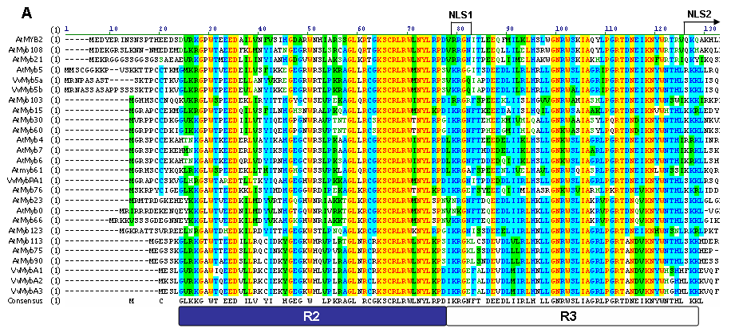

Slide 9
M-GLKKG-WT-EED-ILV-YI-HGEG-W-
LPKRAGL-RCGKSCRLRWLNYLRPDIK
RGNFT-DEEDLIIRLM-LLGNRWSLIAG
RLPGRTDNEIKNYWNTHL-KKL

Slide 10
M-GLKKG-WT-EED-ILV-YI-HGEG-W-
LPKRAGL-RCGKSCRLRWLNYLRPDIK
RGNFT-DEEDLIIRLM-LLGNRWSLIAG
RLPGRTDNEIKNYWNTHL-KKL

Slide 11
Finally Found!
BLASTed consensus sequence using tblastn
  Searches for amino acid sequences in genomic DNA
182 in bb_latest_assembly
85 in Illumina
25 in BB_EST_ALL_updated
25 in BB_EST_cleaned
  Some hits were larger than others
  e-values lower than 0.001

Slide 12

Determining the REAL Mybs
BLASTed each EST scaffold with a Myb hit against Illumina and bb_latest_assembly databases
Compared EST hits to Myb hits in Illumina and bb_latest_assembly
*Items highlighted yellow are bb_latest hits, those in orange are EST hits

Slide 13
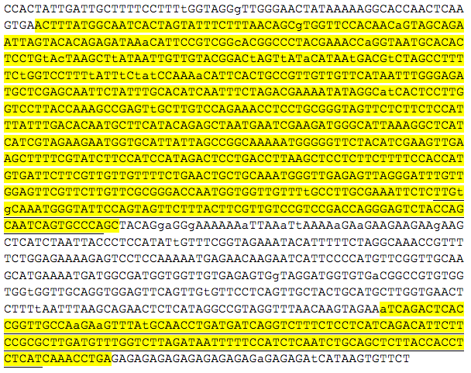

Slide 14

Determining the REAL Mybs

Slide 15
Determining the REAL Mybs

Slide 16
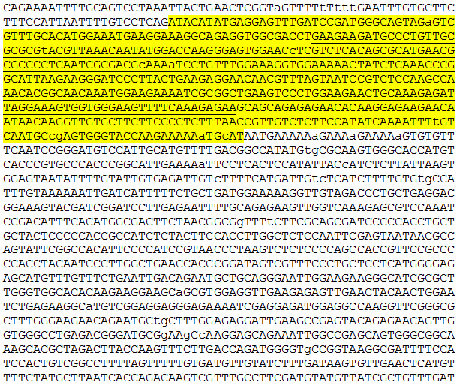

Slide 17
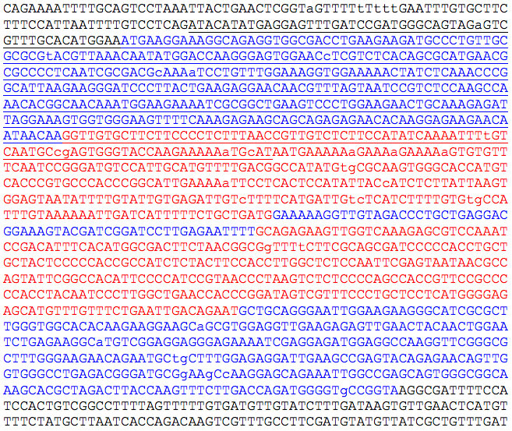
Exons
Introns

Slide 18
Further Steps
Phylogenic analysis based on Myb differences
  Comparisons to closely related species
Continue to analyze each consensus hit
Examine exon/intron structures in other plants
  Determine patterns that could be applied to blueberry

Slide 19
Acknowledgements
Dr. Allan Brown
NC State University
David H. Murdock Research Institute
Dr. Malcolm Campbell and Davidson College

