Slide 1
Cluster Analysis, an Overview
Laurie Heyer

Slide 2
Why Cluster?
Data reduction
  Analyze representative data points, not the whole dataset
Hypothesis generation
  Gain understanding of patterns in data, so they may be tested statistically
Hypothesis testing
  e.g. “Big companies invest abroad”
Prediction based on groups
  Cluster cancer patients, predict outcome for new patient

Slide 3
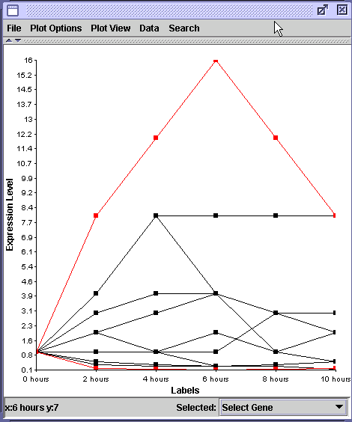
Gene Expression Data
One highlighted gene is induced 16 fold
One highlighted gene is repressed 16 fold
But induction looks much more dramatic

Slide 4
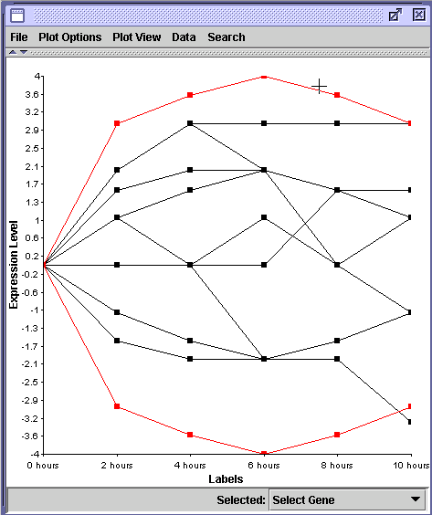
Log Transformation
Calculate log₂ of each ratio
Ratio of 16 becomes value of 4
Ratio of .0833 (1/16) becomes value of –4
Induction and repression look equal, but opposite sign

Slide 5
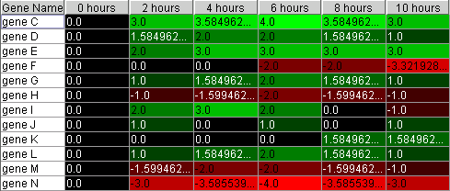
Intensity Plots

Slide 6
Comparing Gene Expression Profiles, or Guilt by Association

Slide 7
Proximity Measures
Correlation
Euclidean distance
Inner product x^{T}y
Hamming distance
L₁ distance
Dissimilarities may or may not be metrics
  Triangle inequality d(x,z) <= d(x,y) + d(y,z)
  Loosely referred to as distance

Slide 8
Linkage Methods
How far is this object:
From this group of objects?

Slide 9
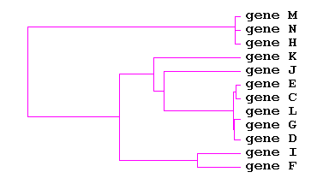
Hierarchical Clustering
Join two most similar genes
Join next two most similar “objects” (genes or clusters of genes)
Repeat until all genes have been joined

Slide 10
Cutting the Tree
MNH
K
J
ECLGD
I
F

Slide 11
Cutting the Tree
MNH
KJECLGD
IF
MATLAB Command: cluster

Slide 12
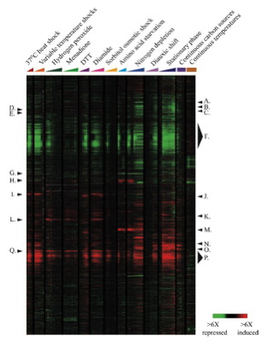

Slide 13
K-means Clustering
Specify how many clusters to form
Randomly assign each gene to one of k different clusters
Average expression of all genes in each cluster to create k pseudo genes
Rearrange genes by assigning each one to the cluster represented by the pseudo gene to which it is most similar
Repeat until convergence

Slide 14
Supervised Clustering
Find genes in expression file whose patterns are highly similar (“close”) to desired gene or pattern
Add closest gene first
Then add gene that is closest to all genes already in cluster
Repeat, as long as added gene is within specified distance of genes already in cluster
Distance from one gene to a set of genes defined to be maximum (or minimum, or average) of all distances to individual members of the set (complete, single, and average linkage, respectively)

Slide 15
Quality Clustering: QT Clust
  1. Each gene builds a supervised cluster
2. Gene with “best” list, and genes in its list, becomes next cluster
3. Remove these genes from consideration, and repeat
4. Stop when all genes are clustered, or largest cluster is smaller than user specified threshold

Slide 16
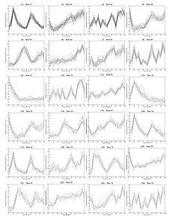
QT Clustering Example

