Slide 1
GGA Method
with pClone Red
by
A. Malcolm Campbell and Todd Eckdahl

Slide 2
Eco RI
AATTC
G
G
CTTAA
palindrome
type II

Slide 3
Eco RI
AATTC
G
G
CTTAA
palindrome
type II

Slide 4
Eco RI
AATTC
G
G
CTTAA
type II

Slide 5
Eco RI
G
CTTAA
AATTC
G
type II

Slide 6
Bsa I
GAGACC
CTCTGG
not a
palindrome
type IIs

Slide 7
Bsa I
1234nGAGACC
nCTCTGG
----
type IIs

Slide 8
Bsa I
----
1234nGAGACC
nCTCTGG
type IIs

Slide 9
Bsa I
GGTCTCn
CCAGAGn1234
----
type IIs

Slide 10
Bsa I
GGTCTCn
CCAGAGn1234
----
type IIs

Slide 11
Bsa I
1234nGAGACC
----nCTCTGG
cuts
left
GGTCTCn----
CCAGAGn1234
cuts
right

Slide 12
Part J119137
BsaI
cuts
left
BsaI
cuts
right

Slide 13
CGACtGAGACC GGTCTCa
aCTCTGG CCAGAGtCGCC
GCGG
GCTG
Bsa I
Bsa I

Slide 14
CGACtGAGACC GGTCTCa
aCTCTGG CCAGAGtCGCC
GCGG
GCTG

Slide 15
CGACtGAGACC GGTCTCa
aCTCTGG CCAGAGtCGCC
GCGG
GCTG

Slide 16
CGACtGAGACC GGTCTCa
aCTCTGG CCAGAGtCGCC
GCGG
GCTG
CGAC(promoter)
(promoter)CGCC

Slide 17
CGACtGAGACC GGTCTCa
aCTCTGG CCAGAGtCGCC
CGAC(promoter)
(promoter)CGCC
GCGG
GCTG

Slide 18
GGA Ligation Method
GFP
RBS
RBS
RFP
BsaI + Ligase
origin
antibiotic resistance
plasmid backbone

Slide 19
GGA Ligation Method
GFP
RBS
RBS
RFP
BsaI + Ligase
origin
antibiotic resistance
plasmid backbone

Slide 20
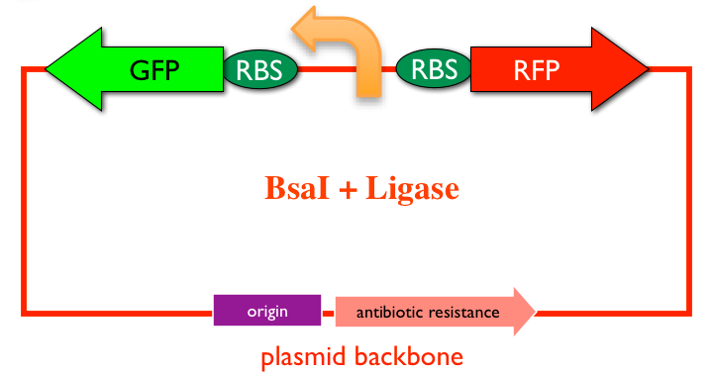
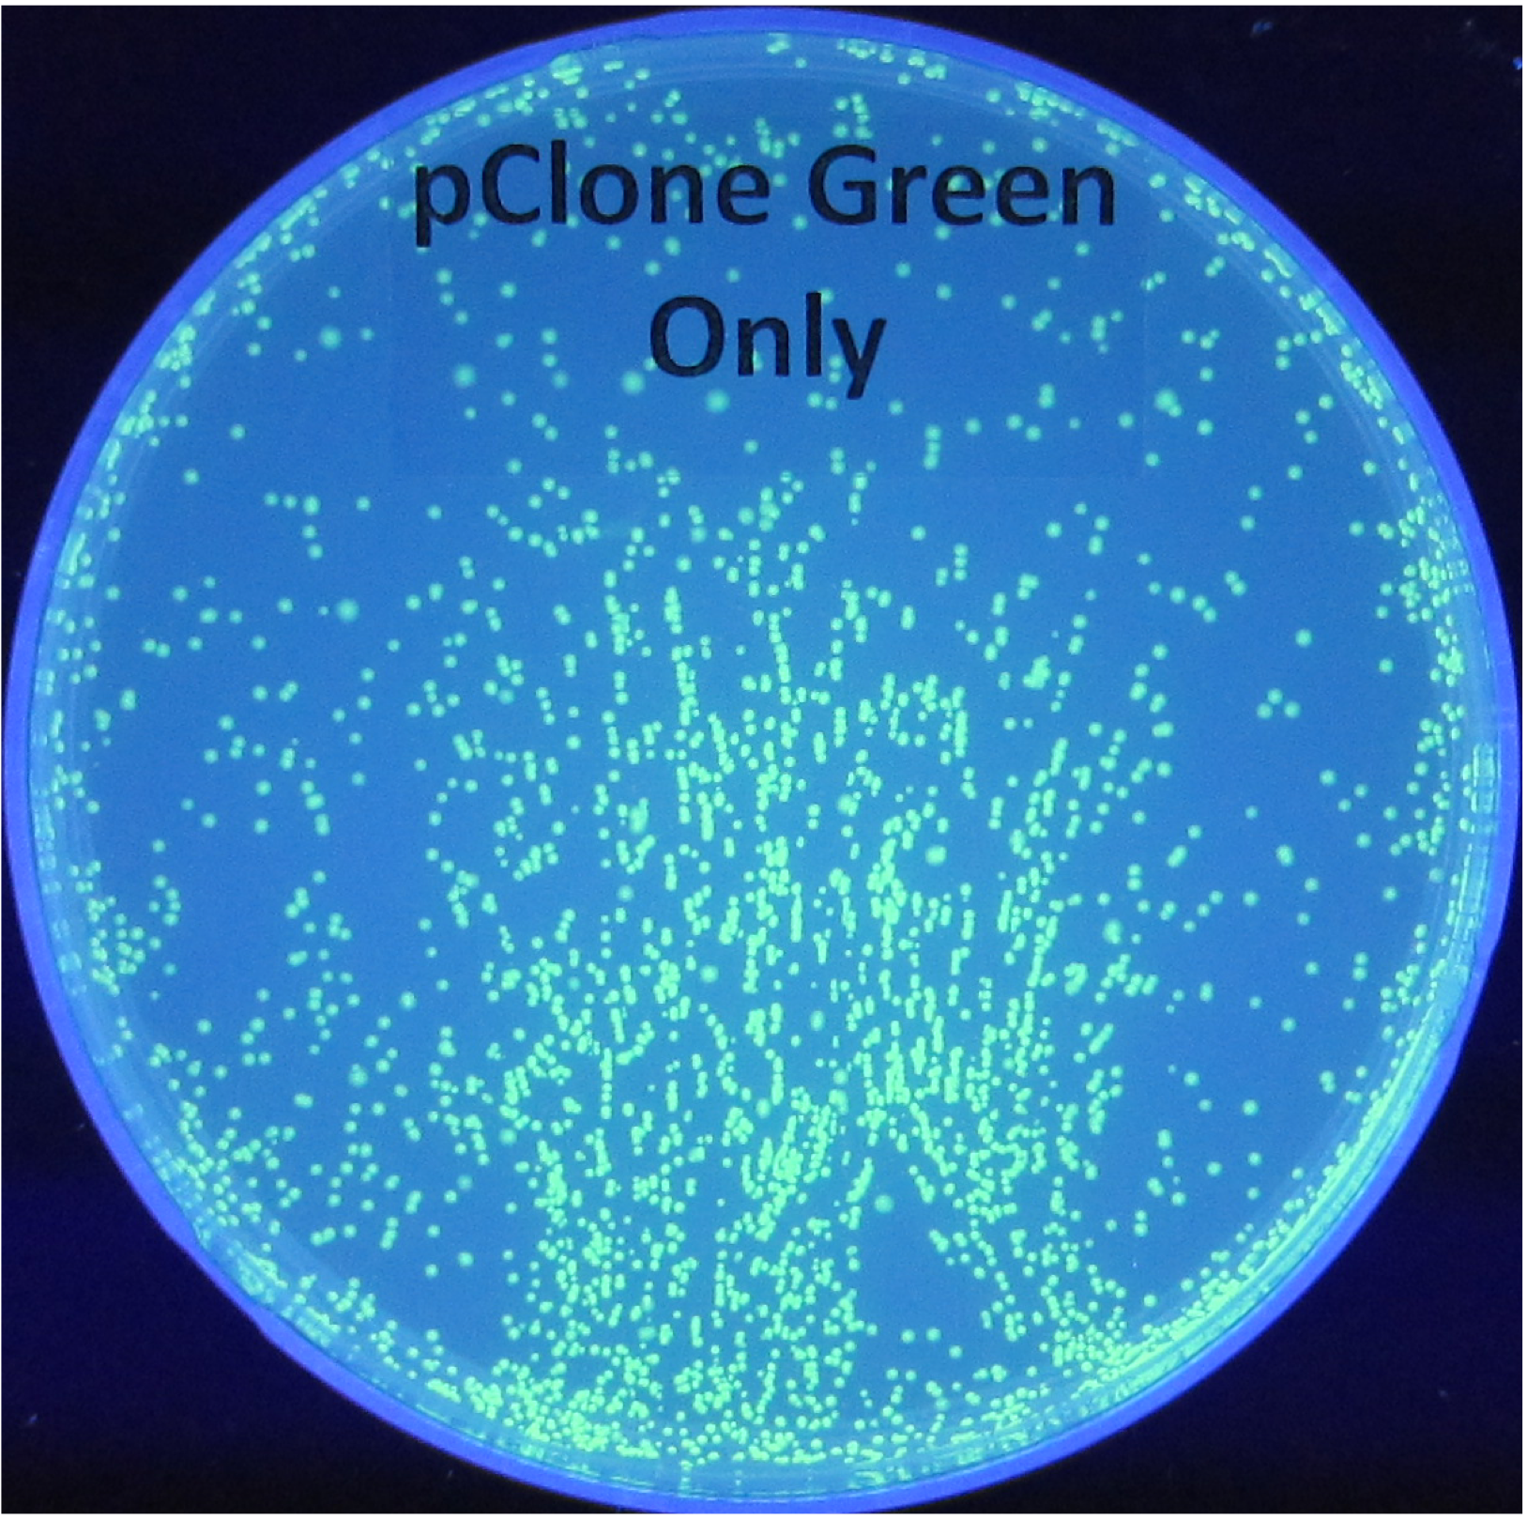
GGA Ligation Method
pClone Red

Slide 21
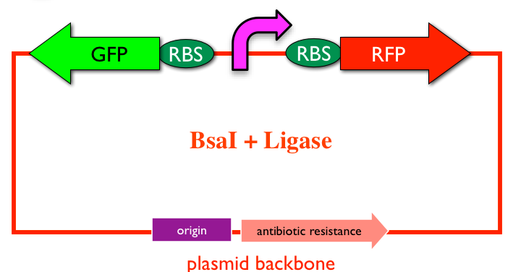
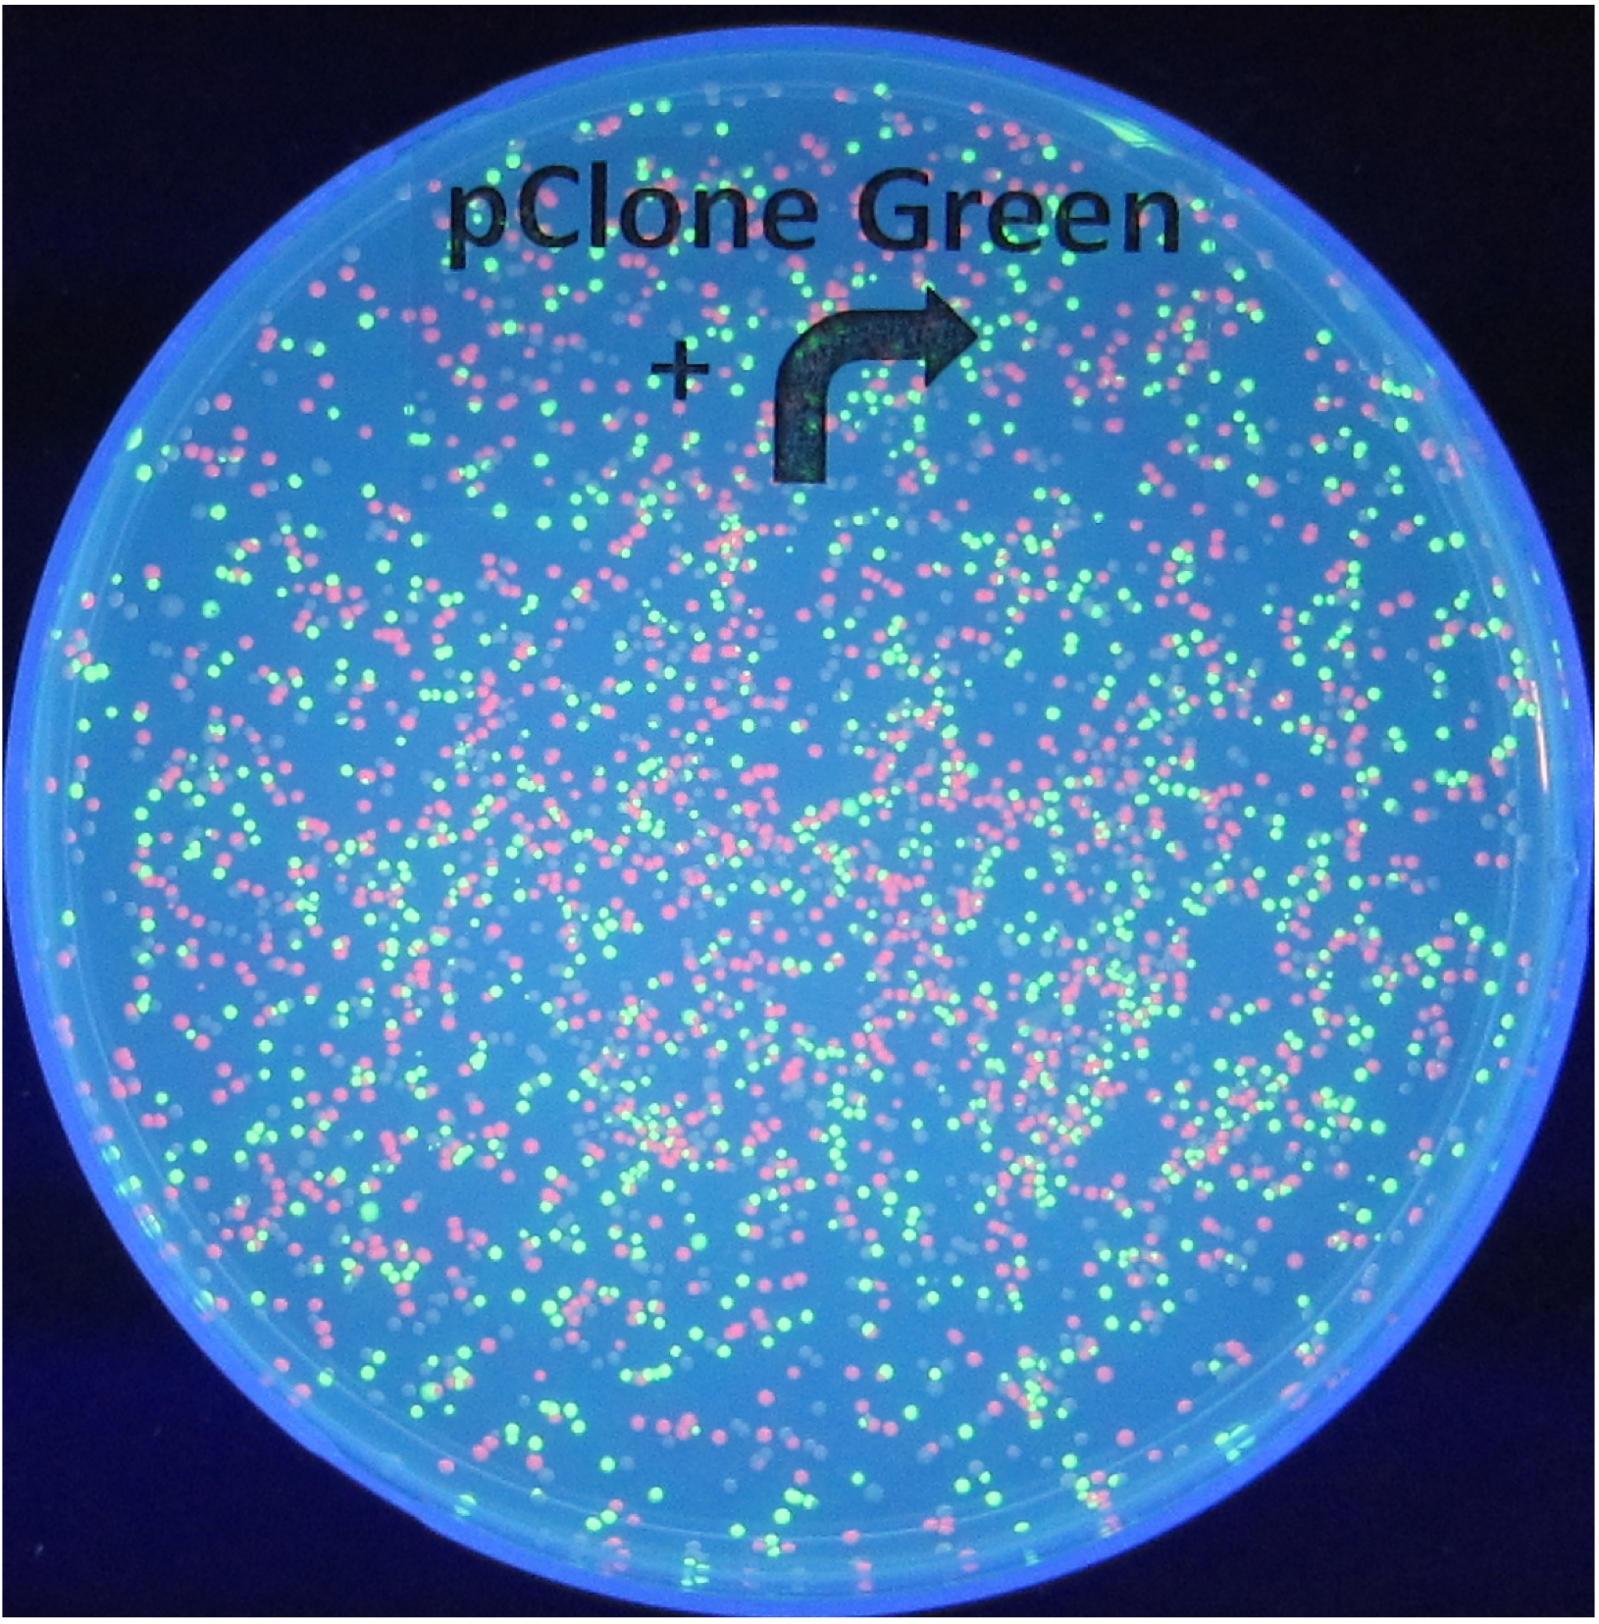
GGA Ligation Method
pClone Red

Slide 22
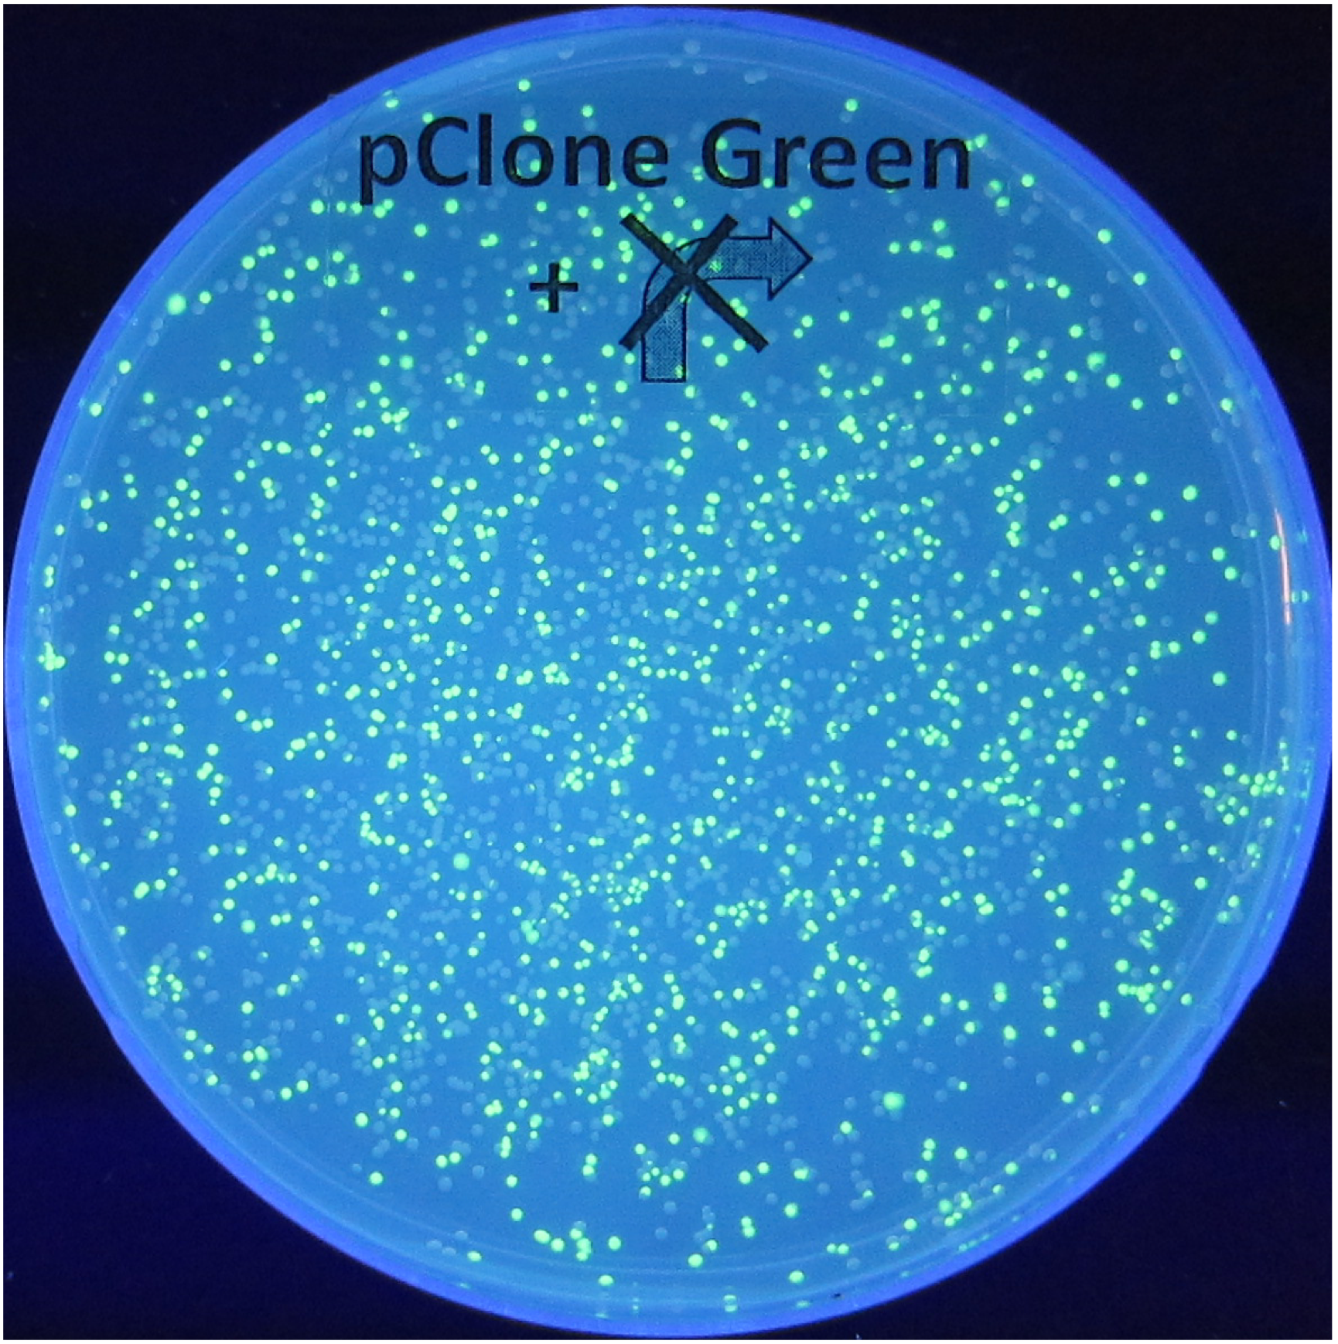
GGA Ligation Method
X
pClone Red

Slide 23
Your Research Project v1
?
pClone Red
pClone Red
functional?
broken?

Slide 24
Your Research Project v1
?
blue = entB
green = glp
red = hutP
yellow = pbp1b
pClone Red
pClone Red
functional?
broken?

