Slide 1
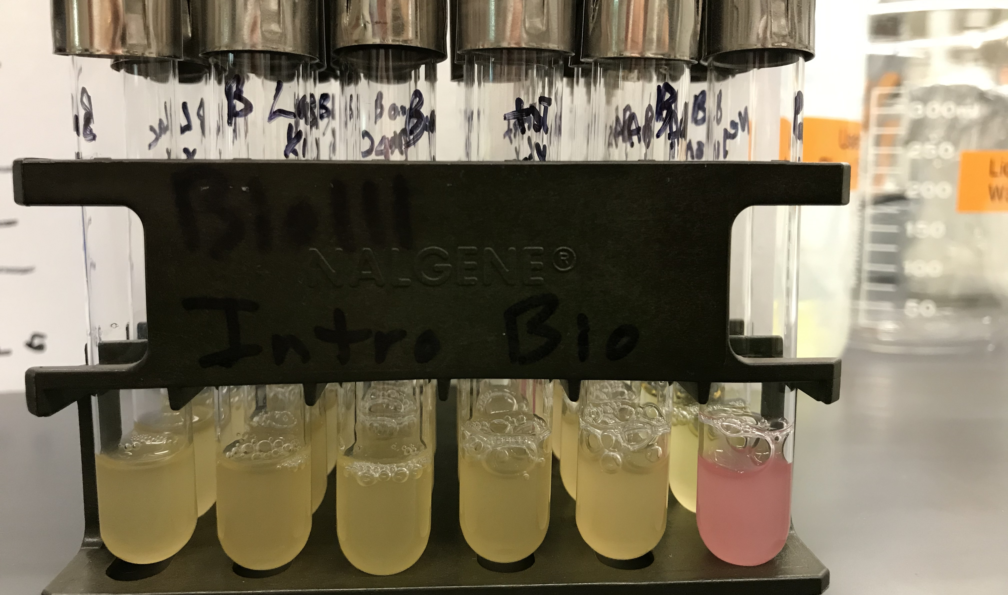
v1 tubes after overnight growth

Slide 2
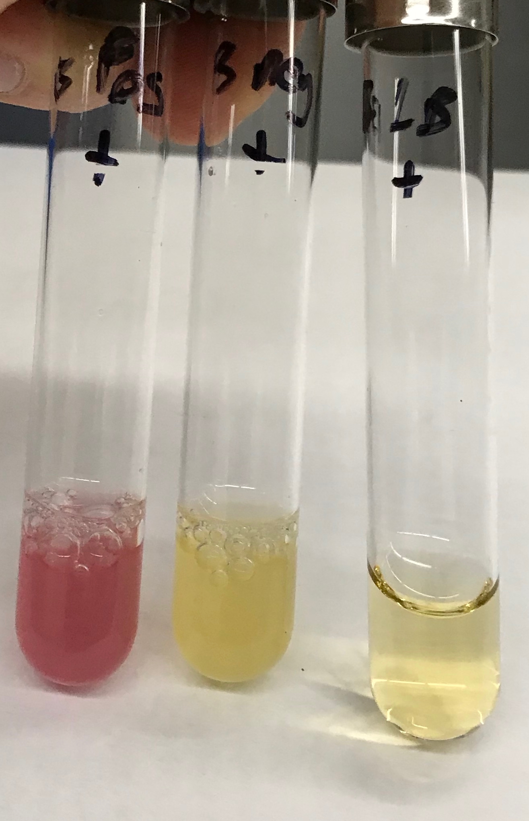
3 control tubes

Slide 3
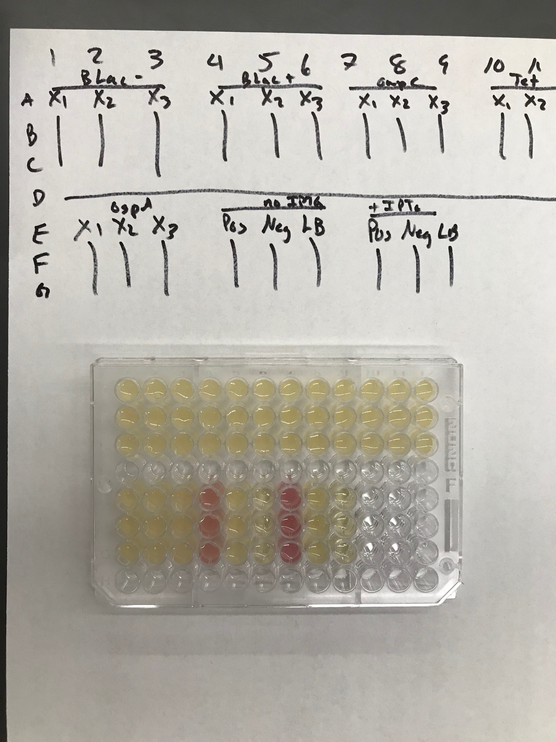
96-well plate, v1 samples
Look up IPTG. How is this used in molecular biology? It is called an analog for what molecule that we have studied?

