Slide 1
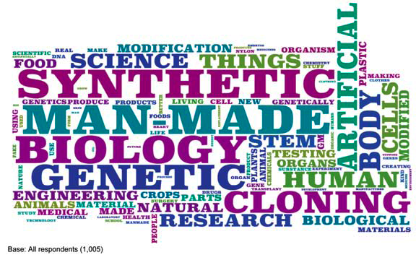
“What comes to mind when I say ‘synthetic biology’?”
Figure 4.2 from Royal Academy of Engineering report (June, 2009)

Slide 2

Context for Our Project
2 yrs ago: FY Bioinformatics course
We’re teaching a new Synthetic Biology ‘topics’ course this fall (!)
  Some students were in our FY course
  Many different ‘majors’ in the course
  8 juniors/seniors enrolled
  3 hrs once/week (plus outside time)
  14 week semester
  Project-based

Slide 3
Course Goals
After taking this course students will show gains in:
their ability to describe the history, theory, and application of synthetic biology approaches;
defining and using core principles of engineering (e.g. abstraction, modularity, standardization, and composition), molecular biology (e.g. control of gene expression, design of recombinant proteins, and creation of novel expression plasmids), and computation (e.g. logic devices and data structures) to identify and explain examples of synthetic biology in the current literature;
understanding and applying lab skills that are employed by synthetic biologist (e.g. REs, oligo design, DNA ligation, gel electrophoresis, bacterial transformation, etc.);
articulating and critiquing the social and ethical implications of synthetic biology.

Slide 4
Tentative Course Plan
Wk 1: Mol. Bio history and transition to Synthetic Bio, Motivation, Intro examples
Wk 2: Engineering principles, standardization, project management, abstraction
Wk 3, 4: Wet labs
  During downtime, students examine assigned iGEM projects
    Describe roles of team members
    Explain diagrams of project ‘schematic’
Notes:
removed reading assignments for Thursday

Slide 5
Wet-lab: Construct Devices for Comparison
Students will:
Gain hands-on experience with standard molecular biology methods
Consider and execute the assembly (and testing) of existing Biobrick parts
Expand their understanding of inducible promoter elements
pLac
pBAD
(U. B.C. variants?)
pgcvR
RBS
GFP
AND/
OR
+
+
+
LB
+
lactose
+
+
arabinose
+
+
+
LB
+lactose
+arabinose

Slide 6
Tentative Course Plan (cont’d)
Wk 5:
  Students present summary reports of the iGEM projects they examined;
  mini-lecture on LOGIC GATES;
  assigned reading about formation of logic gates with ‘bricks’ or other biological means

Slide 7
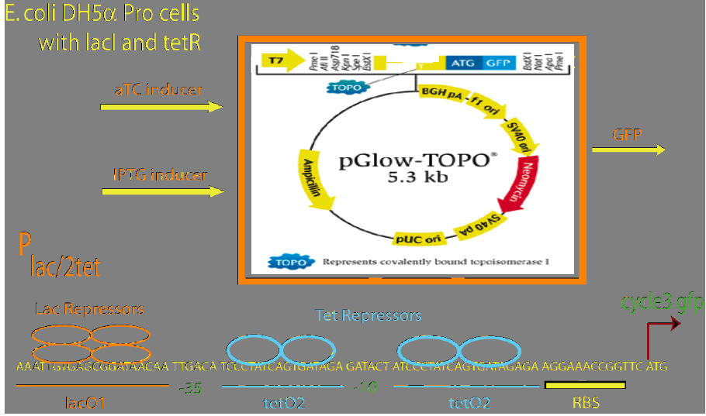
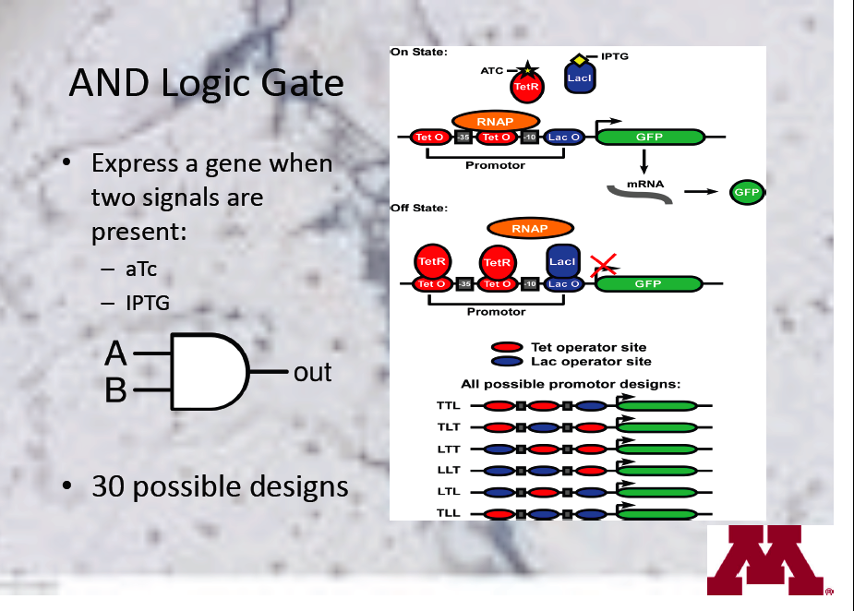
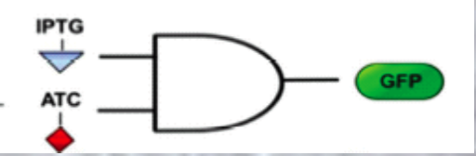
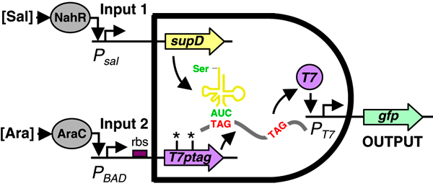
Example of AND gates
p | q | ^
T | T | T
T | F | F
F | T | F
F | F | F
• There are many examples of these types of gates in the registry/Wiki

Slide 8
Tentative Course Plan (cont’d)
Wk 6:
  Discussion of ethical and social implications
  brainstorm about possible end of course projects
    Constructing and/or testing a logic gate,
    plus other tasks (e.g. mathematical model, build data model of Registry, plan possible extensions/applications, etc.)
  Define the role of each team member
  Begin forming a Project Plan
Notes:
what role/responsibility would each team member like?

Slide 9
Tentative Course Plan (cont’d)
Wk 7: Present and discuss initial project plan
Wks 8 -12
  Plan and achieve milestones
  Regular progress reports
  Update wiki and online notebook
  Class time for team work, but also must organize outside time
Wk 13-14
  Prepare and present reports
    Products: report, poster, wiki

Slide 10
Number of Issues Still Need to Be Addressed
Assessment/grading
Scope of ethics discussion
More…

Slide 11
tRNA suppression
Bba_K117003

