Slide 1
Team Stritch: Metal-o-coli Removal of Heavy Metal from Contaminated Water
Susmita Acharya and Nighat Kokan
(Chemistry/Biology Collaboration)
Cardinal Stritch University
Milwaukee, Wisconsin

Slide 2
Project Goals/Ideas
Application Based
Understanding synthetic biology and its real world application
Our focus
Environmental problem and issues, specifically water contamination by heavy metals

Slide 3
Project Proposal
Two projects that really interested us after reviewing the 2009 iGEM website were
Team UQ-Australia: Mercury sequestration using multicomponent operon
Team Virginia: Arsenic sequestration for ground water decontamination
Team Stritch: Removal of heavy metals from contaminated water specifically mercury and arsenic

Slide 4
Implementation Strategy
As independent student research projects in collaboration with biology and chemistry faculty
Students have 4 plus credits for independent research study
One credit
literature review, bioethical issues, and research proposal
Three credits
Working on synthetic biology projects
Writing their research paper
Poster and oral presentation at the Institution level and at regional conferences

Slide 5
Metal Resistance Systems in Bacteria
Resistance genes on plasmids or chromosome
For example in mercury resistance
The system consists of
A metal transporter
A metal binding protein
Metal responsive promoter
Reduction mechanism, Hg (II)→ Hg (0)

Slide 6
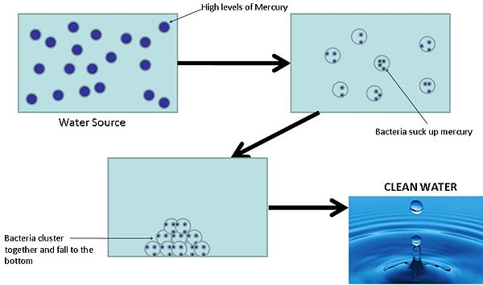
Project Design
Overview

Slide 7
Project Design
Plasmid 1
Allows Hg (II) transportation into cell
Metallothionien protein aids intracellular accumulation
MerR is a transcriptional regulator
MerA reductase (missing) no efflux of Hg (0)

Slide 8
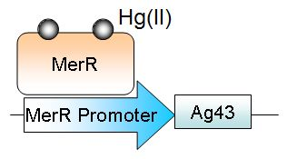
Project Design
Plasmid 2
MerR promoter linked to Ag43
Ag43, a native protein to E.coli (E. coli K12) is removed from genome and reinserted on a plasmid which can be controlled by Hg (II)
When Ecoli cells express Ag 43 they clump
Measure using Spectrophotometer

Slide 9
BioBricks Parts
BBa_I76101 (did not work )
BBa_I728456 MerRT: Mercury inducible promoter +RBS
BBa_J63010 vector
Ag43 isolated from plasmid pKKJ143
MerT and MerP from plasmid pSUTp
BBa_K205004 (MerT)
BBa_I728654 (mercury Induced RFP reporter)

Slide 10
Long Term Goals
Expand present project to other heavy metal sequestration
To offer synthetic biology as a 2-3 credit project based interdisciplinary course
Design and construct BioBricks
Characterize DNA-based devices
Contribute to registry

Slide 11
Acknowledgements
Our Thanks to
Malcolm Campbell
Laurie Heyer, Todd Eckdahl, and Jeff Poet
Davidson College

