Slide 1
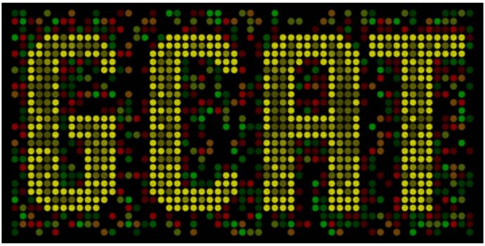



Synthetic Biology Workshop
July 8-10, 2010
A. Malcolm Campbell
Biology
Todd T. Eckdahl
Biology
Laurie J. Heyer
Mathematics
Jeffrey L. Poet
Math, CS and Physics

Slide 2















Introductions

Slide 3
What is synthetic biology?
Is it different from molecular biology?

Slide 4

Depends on how you look at it….

Slide 5
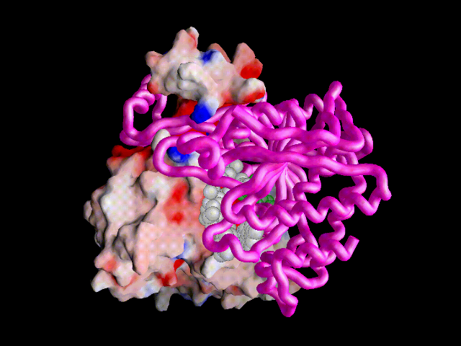
Why host a workshop on synthetic biology?

Slide 6
Why host a workshop on synthetic biology?
Being a teacher is like being an enzyme….
Lower the activation energy
Not consumed in the reaction
Increase the affinity for learning
Induce cooperativity (Hill coefficient > 1)
Positive feedback loop

Slide 7
Why host a workshop on synthetic biology?
Being a teacher is like being an enzyme….
Lower the activation energy
Not consumed in the reaction
Increase the affinity for learning
Induce cooperativity (Hill coefficient > 1)
Positive feedback loop

Slide 8
Facilitate learning for your students and become a
-alyst

Slide 9
Synthetic Biology
Application of engineering principles and mathematical modeling to the design and construction of biological parts, devices, and systems with applications in energy, medicine, and technology.

Slide 10
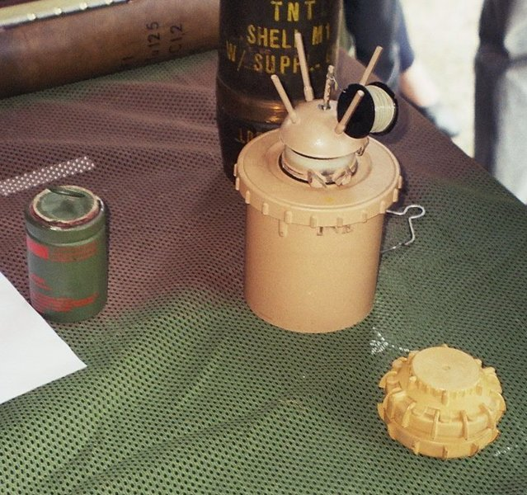

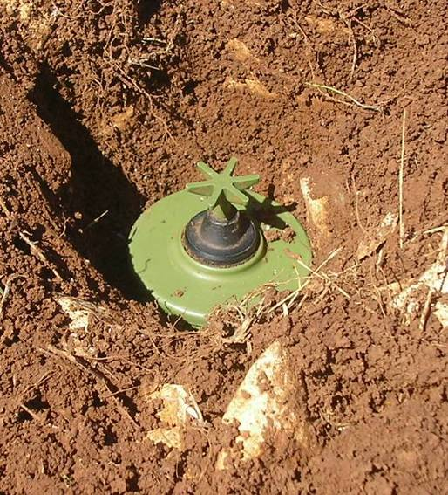
Land Mine Detection
Notes:
About 20,000 people injured or killed each year.

Slide 11
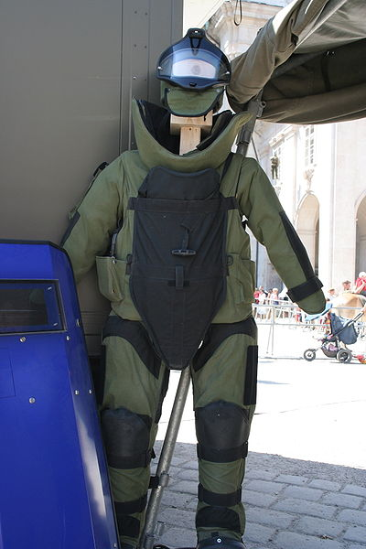
Land Mine Detection
Notes:
About 20,000 people injured or killed each year.

Slide 12
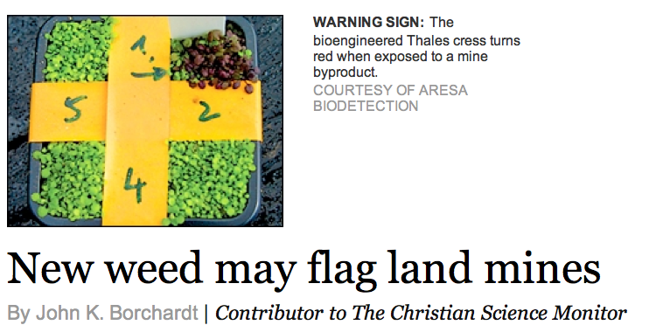
Synthetic Biology
Land Mine Detection
Notes:
About 20,000 people injured or killed each year.

Slide 13
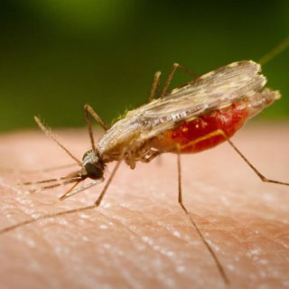
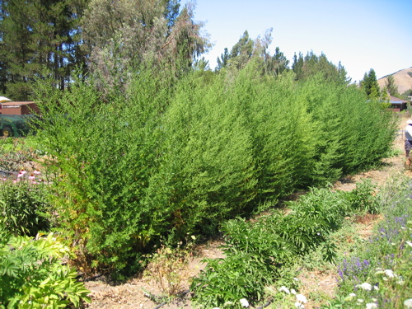
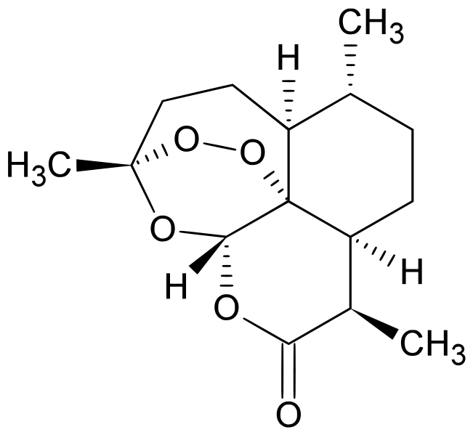
Production of Medicines
$1 per pill
Notes:
1 million people die each year from malaria, most of them children under the age of 5.

Slide 14
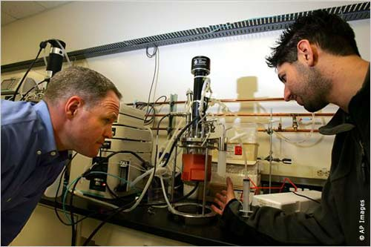
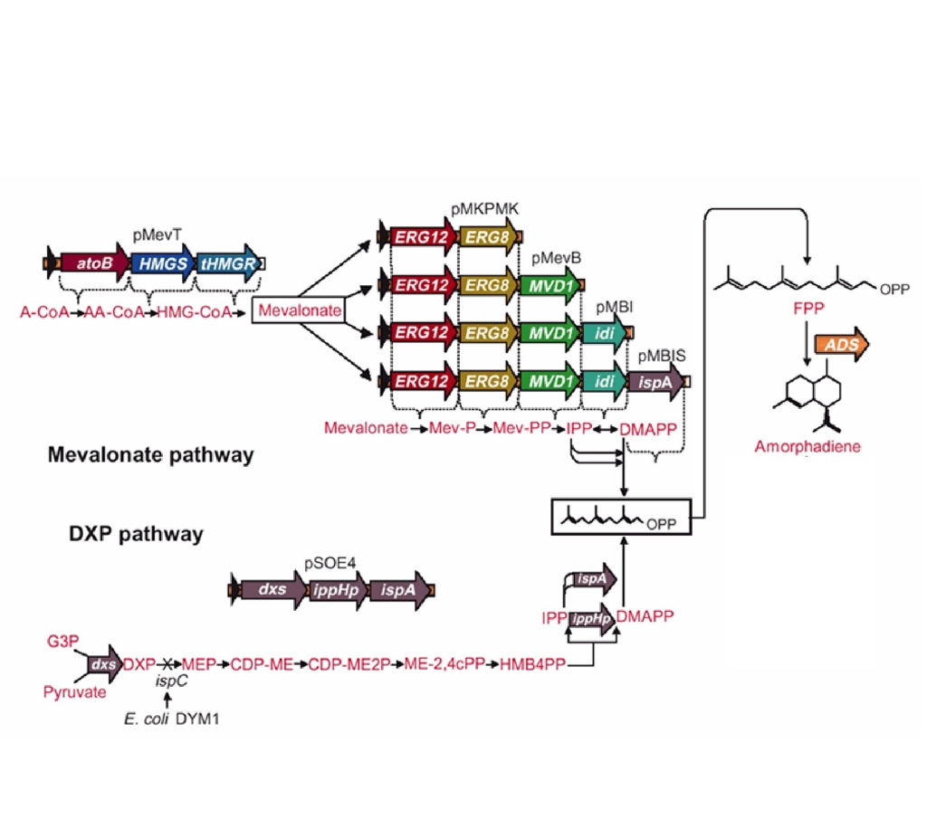
Production of Medicines
10¢ per pill
Notes:
1 million people die each year from malaria, most of them children under the age of 5.
Jay Keasling at UC Berkeley

Slide 15
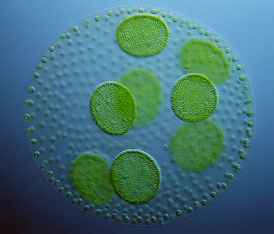
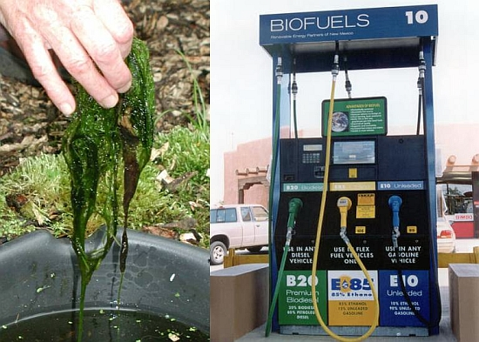
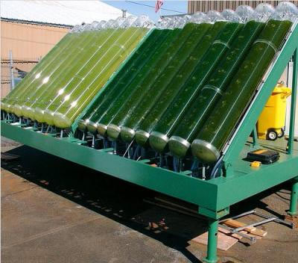
Biofuels from Algae
CO -neutral
2
1,000,000 gallons in 2008

Slide 16
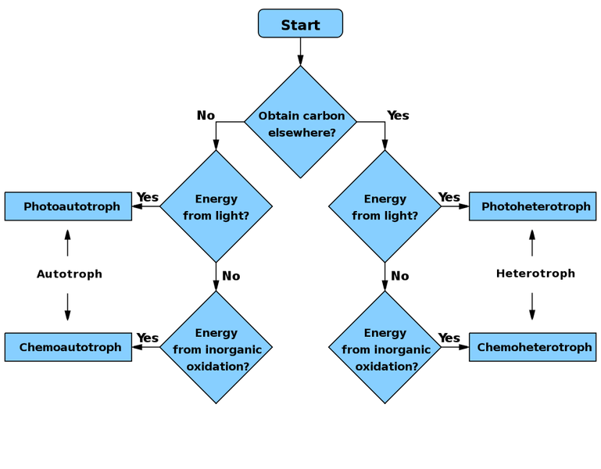
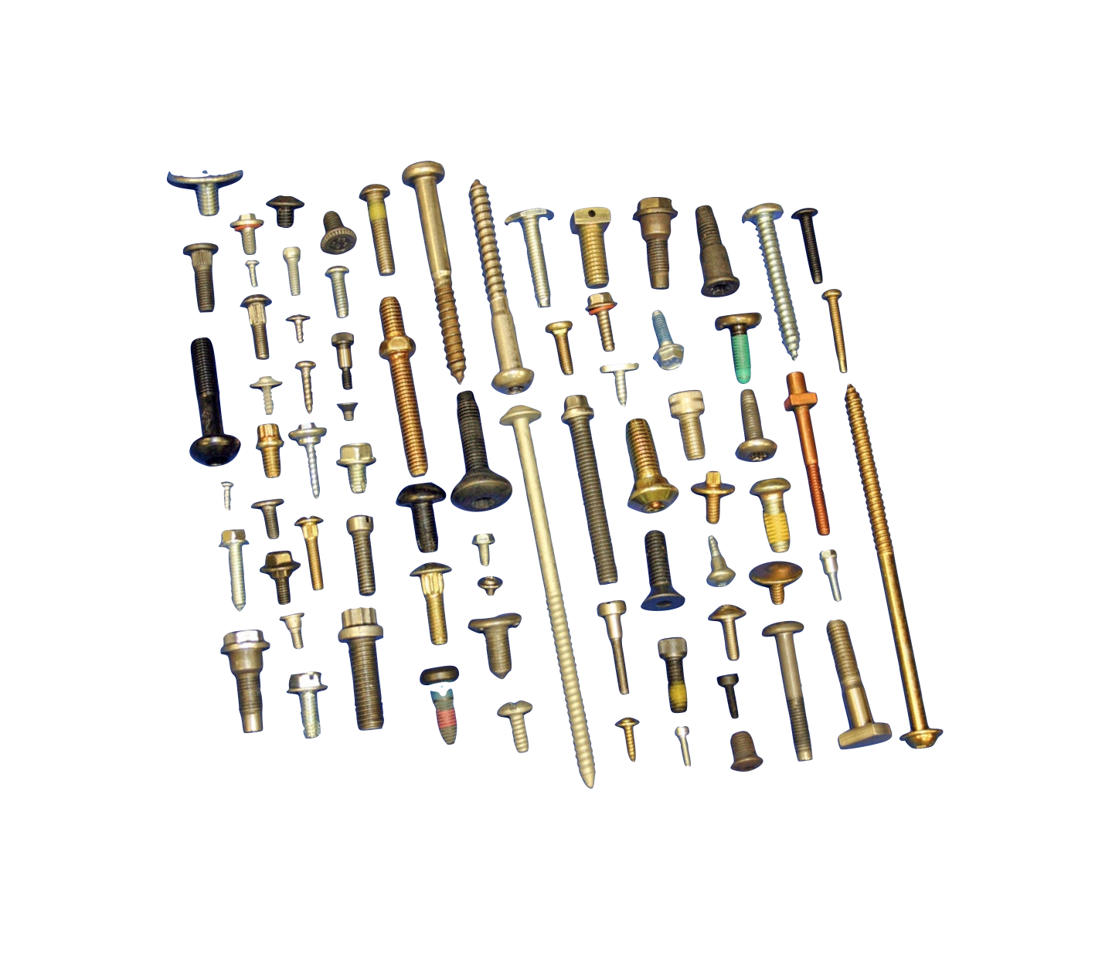

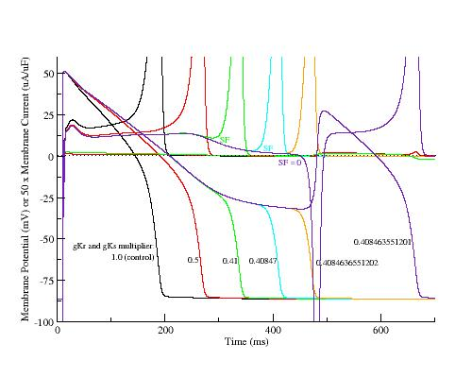
How is Synthetic Biology Different?
Standardization
Modularity
Abstraction
Modeling

Slide 17
How is synthetic biology well-suited for undergraduate interdisciplinary research?

Slide 18
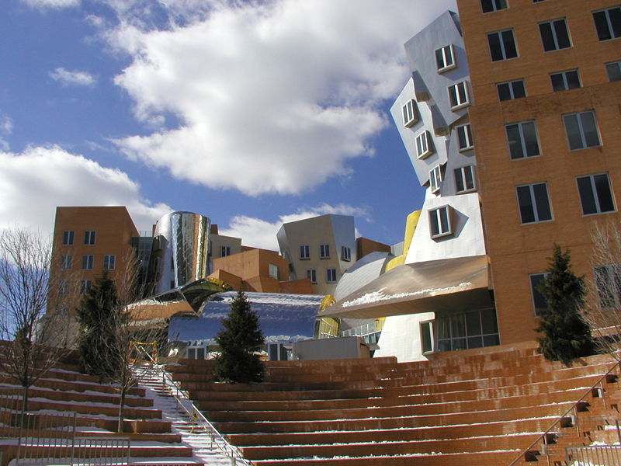
The iGEM Jamboree at MIT

Slide 19
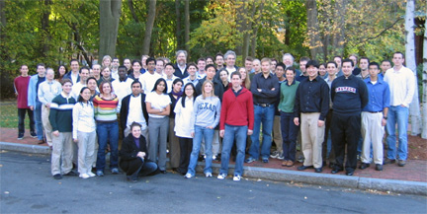

iGEM 2004
5 teams

Slide 20
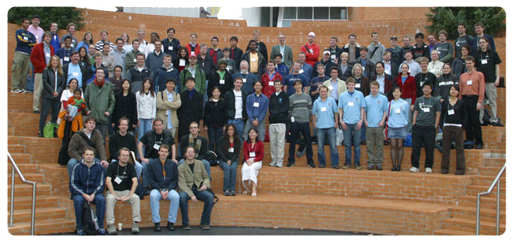
iGEM 2005
13 teams
Princeton Oklahoma ETH Zurich MIT Caltech Toronto Cambridge Texas Penn State Berkeley Davidson Harvard UCSF

Slide 21
iGEM 2005
13 teams
Princeton Oklahoma ETH Zurich MIT Caltech Toronto Cambridge Texas Penn State Berkeley Davidson Harvard UCSF

Slide 22
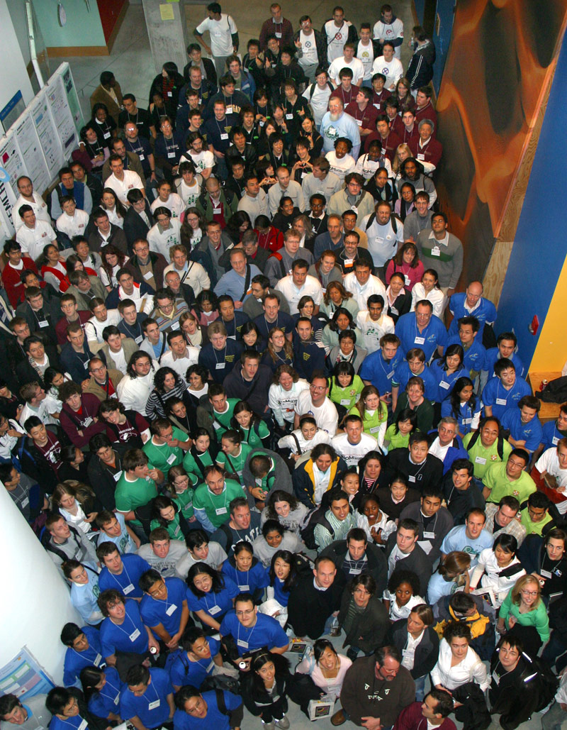
iGEM 2006
32 teams

Slide 23

Finding the “i” in iGEM

Slide 24
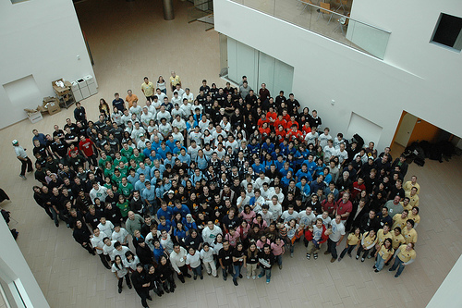
2007
54 teams

Slide 25
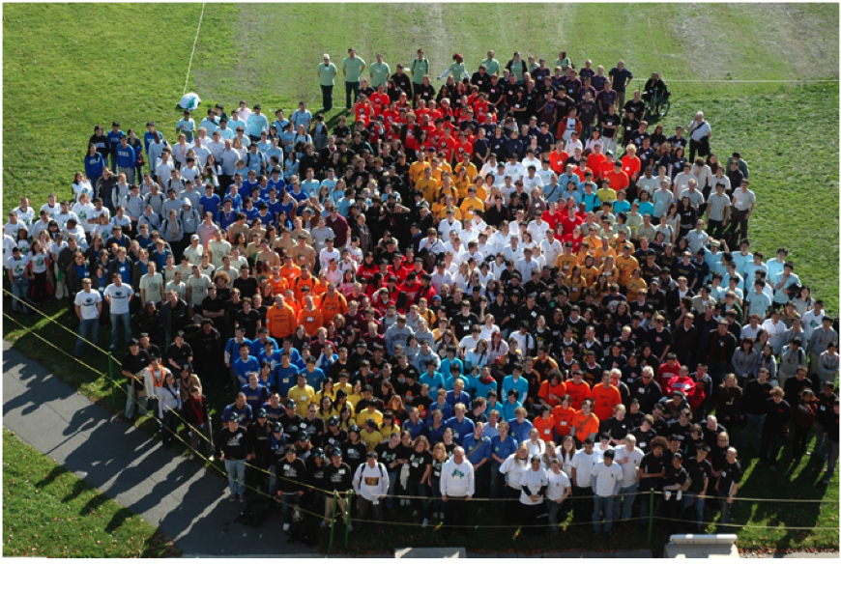
2008
84 teams

Slide 26
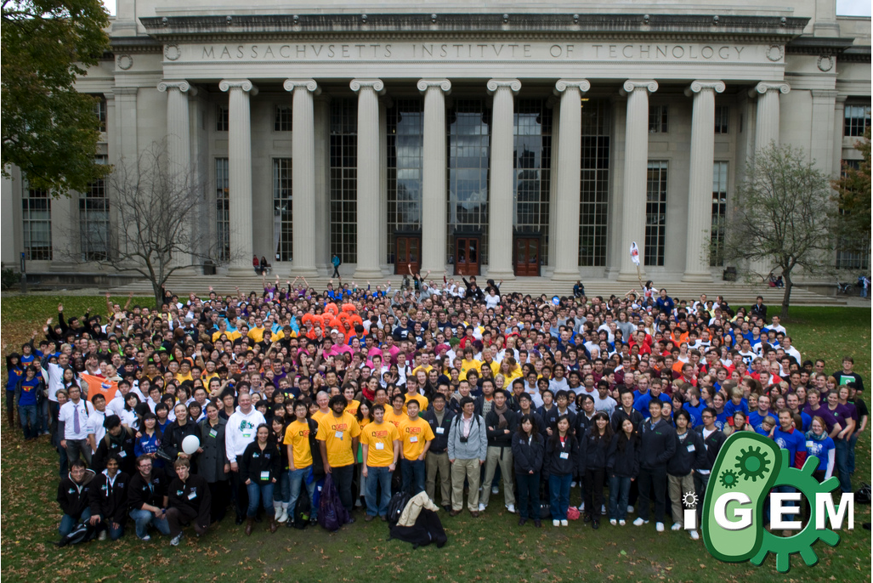
2009
112 teams

Slide 27
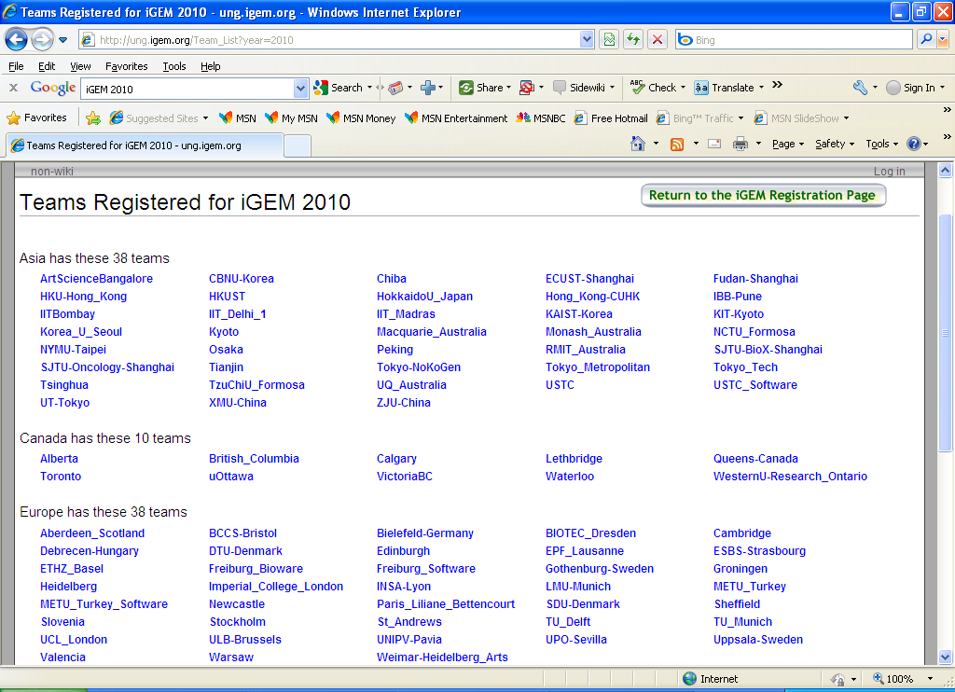

Slide 28
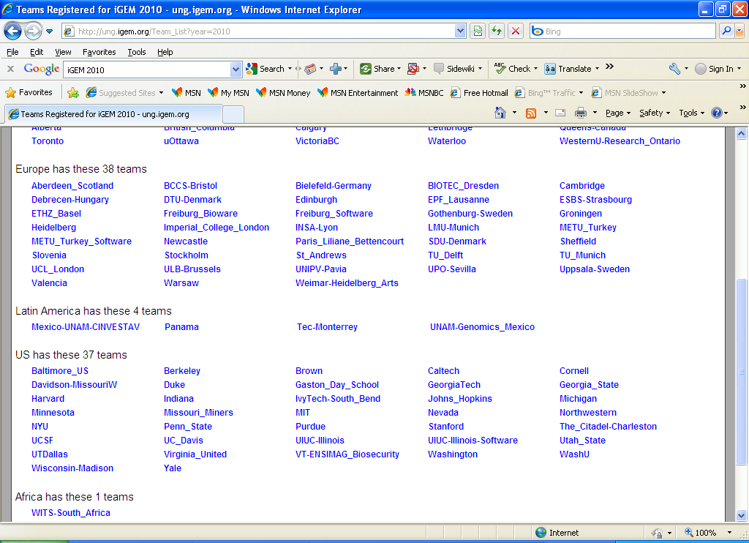

Slide 29
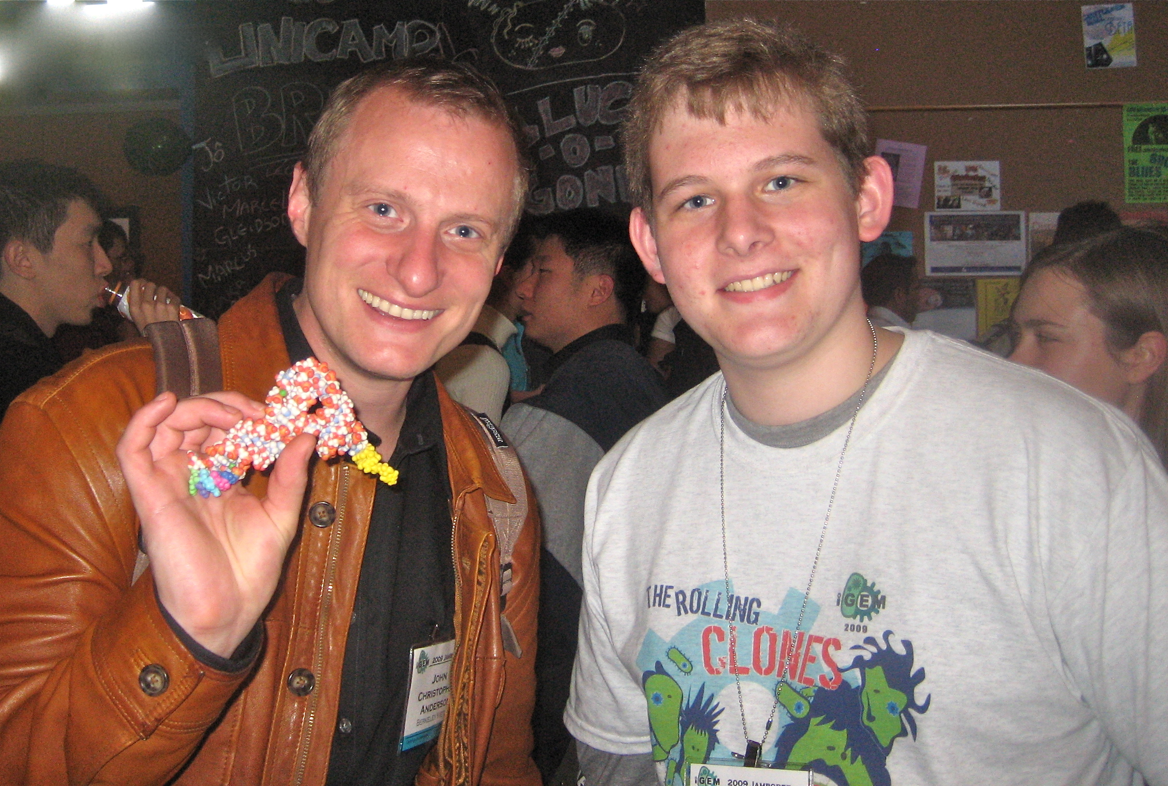
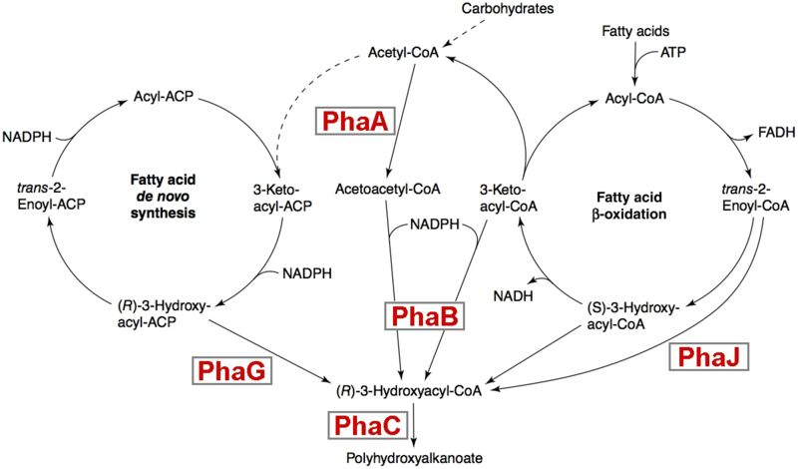
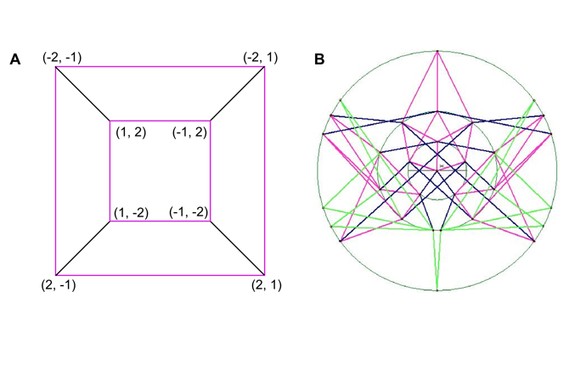
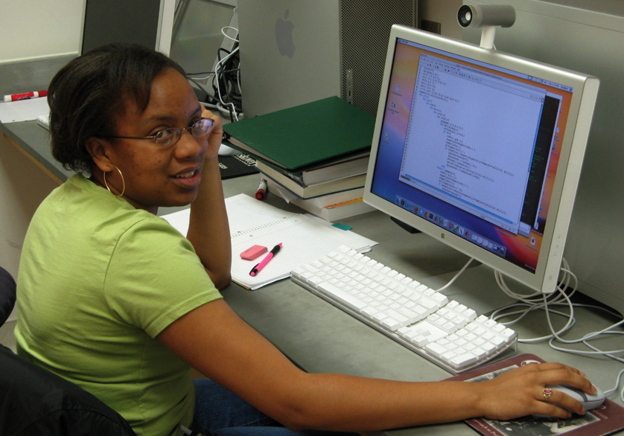
Biology
Chemistry
Mathematics
Computer Science

Slide 30

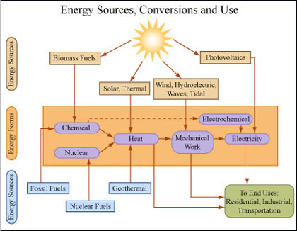
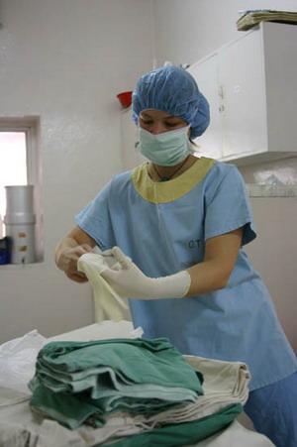
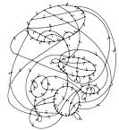
How is synthetic biology well-suited for interdisciplinary research?
Creativity
Flexibility
Adaptability
If you have a common interest,
you can find a synthetic biology way to approach it!
Environment Energy Medicine Technology

Slide 31
What are your goals for this workshop ?

Slide 32
Short-Term Workshop Goals
Everyone will learn as much as possible. We will all have fun, and the participants will begin a new phase in their teacher-scholar career.
Participants will learn some vocabulary and a new perspective that makes synthetic biology distinct from genetics and molecular biology.
Interdisciplinary teams will explore an area of common interest and investigate feasible projects for undergraduate research and possible course development.
Participants will develop a strategy to recruit and support undergraduates for research in synthetic biology.
Faculty from different departments will collaborate to find common ground, mutual understandings from different perspectives, and a shared vision of how to start a new research adventure.

Slide 33
Long-Term Workshop Goals
Participants will apply what they learn to develop an undergraduate research program in synthetic biology.
Participants will assemble multidisciplinary teams consisting of at least two faculty and two or more students from at least two different majors.
Faculty from outside biology will utilize the methods they learned to help design, construct, and test DNA-based devices as part of a synthetic biology research project.
Biology faculty will learn the language and tools of the trade from their partner’s discipline to a level of proficiency that they can help design, construct, and test a model of the device as part of a synthetic biology research project.

Slide 34
What makes a good synthetic biology project ?

